Slide 1
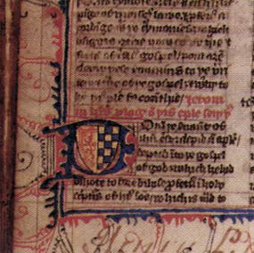
John Wycliffe and Jan Hus: Early Reformers

Slide 2
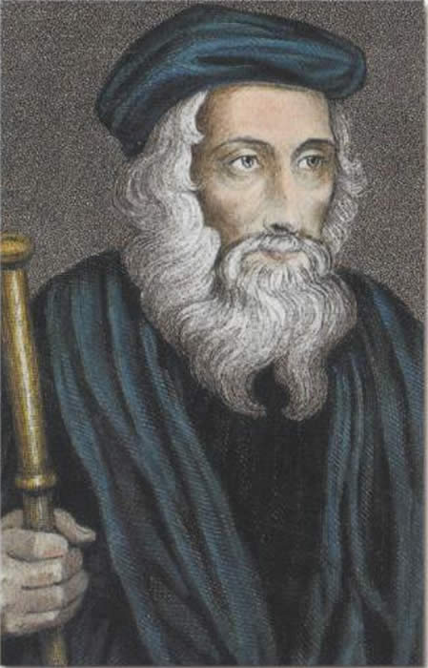
The Morningstar of the Reformation

Slide 3
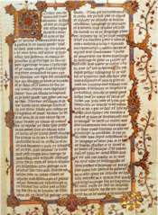
Wycliffe’s Bible
Wycliffe began to see the Bible as the one and only sure authority on orthodoxy.

Slide 4
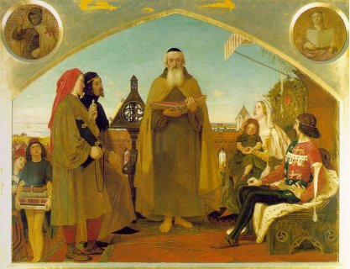
Reformation Pattern
First attack wealth and corruption, then attack Church authority, and finally attack the sacramental system.

Slide 5
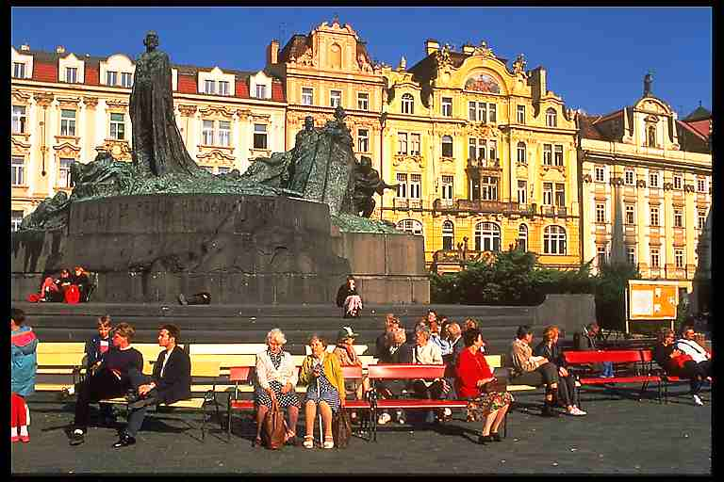
Jan Hus (1369-1415)
The date of his execution, July 6th, is a public holiday in the Czech Republic and his statue can be seen in Prague Old Town Square.

Slide 6
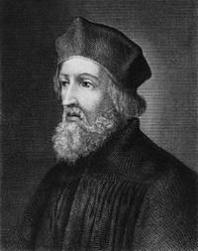
Excommunicated
In 1412 Hus was excommunicated not for heresy, but for insubordination.

Slide 7
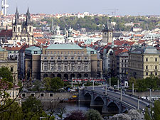
Prague University
With advanced religious experience now perceived as directly available to lay people as much as to clergy, the priest and bishop were no longer regarded as so necessary.

Slide 8
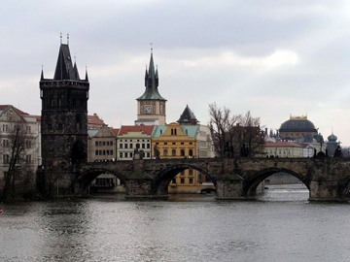
Summary
Much of what the original reformers wanted is now standard. But those in charge could not reform themselves at that time.

Slide 9
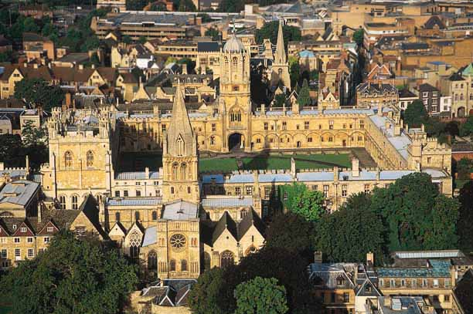
Humanism
The Humanists opened the door to individualism, which allowed people to think their own thoughts.

