Slide 1
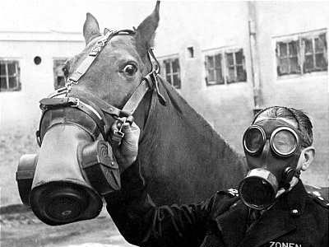
WWI

Slide 2
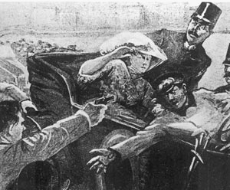
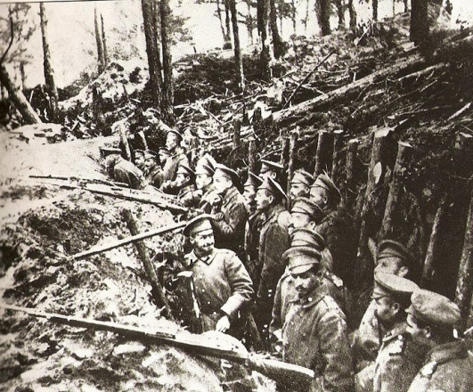
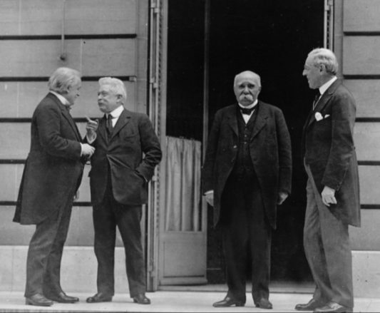
TABLE OF CONTENTS
PART I
PART III
PART III
Causes
Course
Consequences

Slide 3
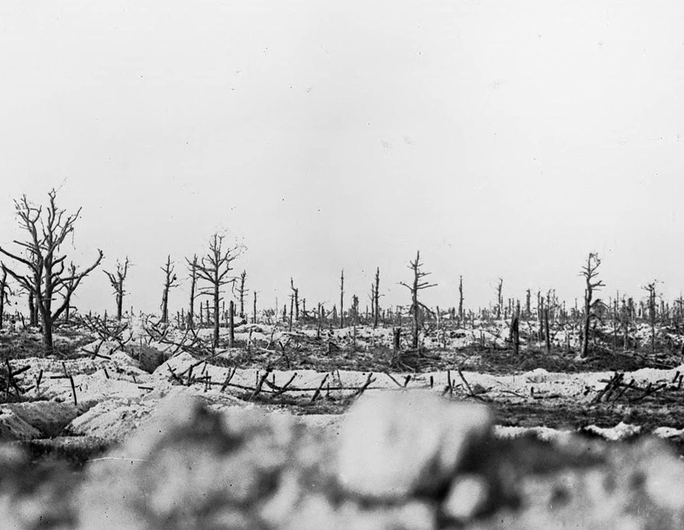
CAUSES OF WWI
Battlefield in the Marne between Souain and Perthes, 1915. (Bibliotheque nationale de France)

Slide 4
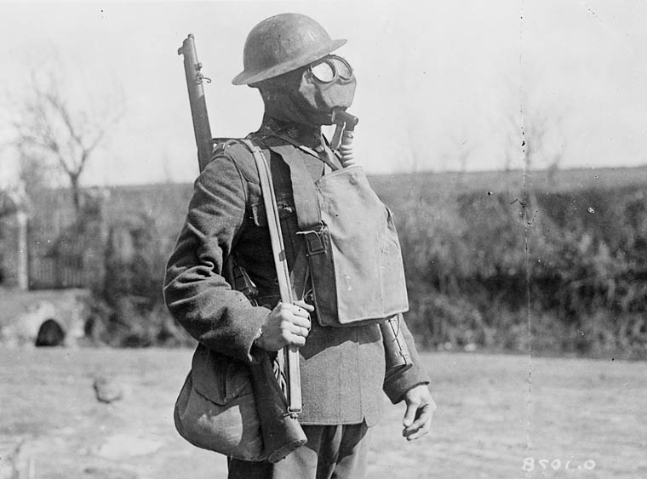
What started this mess?
Notes:
http://4acre.wordpress.com/2010/12/06/mustard-gas/

Slide 5
CAUSES of World War I
M
A
I
N
ILITARISM
LLIANCES
MPERIALISM
ATIONALISM

Slide 6
MILITARISM

Slide 7
Anglo-German ARMS Race

Slide 8
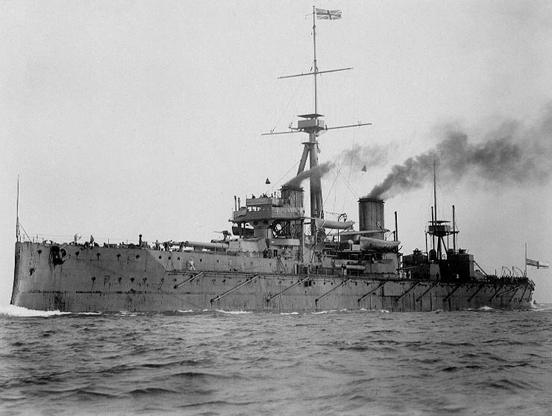
H.M.S. Dreadnought

Slide 9
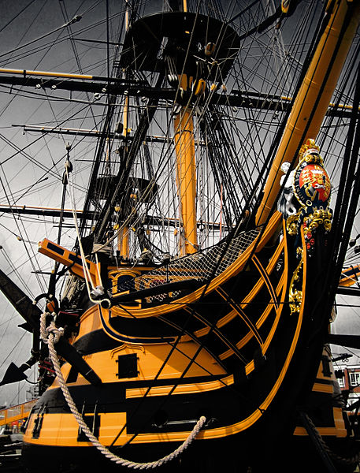
Royal Navy Ship Names
H.M.S. Arrogant
H.M.S. Gladiator
H.M.S. Unbeaten
H.M.S. Unbending
H.M.S. Unbroken
H.M.S. Undaunted
H.M.S. Valiant
H.M.S. Vampire
H.M.S. Vanquisher
H.M.S. Vehement
H.M.S. Vengeance
H.M.S. Victory
CLICK TO SEE MORE!
Credit: Jamie Campbell

Slide 10
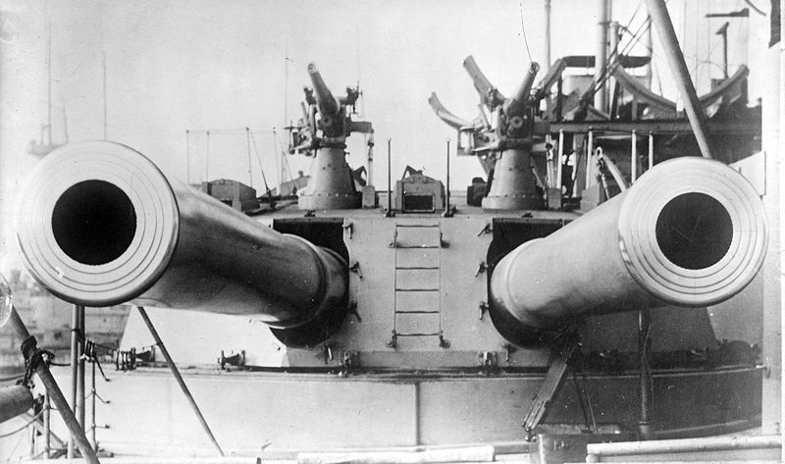
H.M.S. Dreadnought (1906)
12 in.

Slide 11
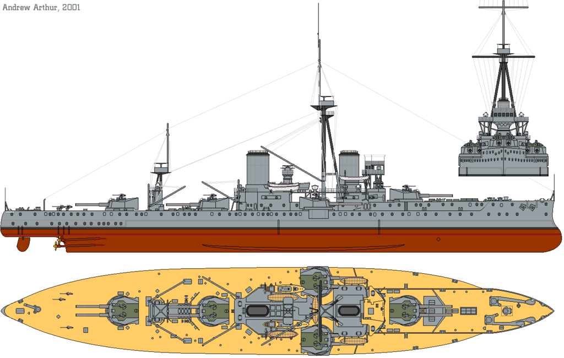
"HMS Dreadnought (1911) profile drawing" by Emoscopes

Slide 12
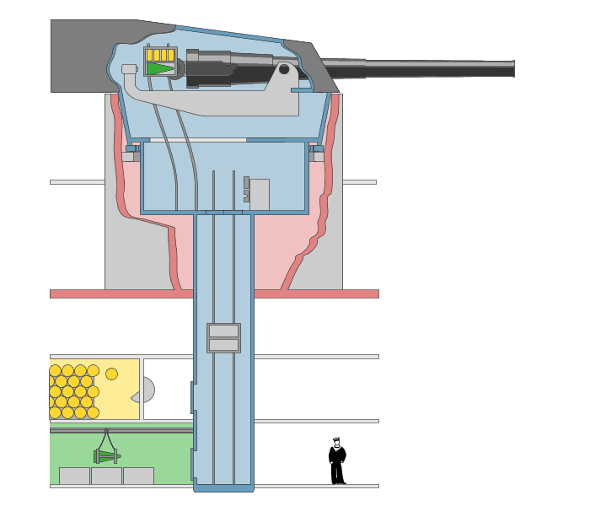
FULLY AUTOMATED
A Revolution in Weaponry
Art Credit: Emoscopes

Slide 13
Percentage Distribution of the World's Manufacturing Production
 | 1870 | 1913
USA | 23.3 | 35.8
Germany | 13.2 | 15.7
U.K. | 31.8 | 14.0
France | 10.3 | 6.4
Russia | 3.7 | 5.5
Italy | 2.4 | 2.7
Others | 15.3 | 19.9
Source: http://www.fordham.edu/halsall/mod/indrevtabs1.asp

Slide 14
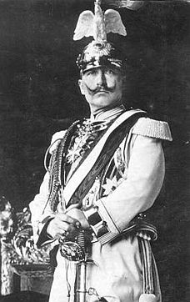
The Daily Telegraph Affair
LINK
Photo by @Doug88888
A PR move gone seriously wrong!
Wilhelm II “Kaiser Bill”

Slide 15
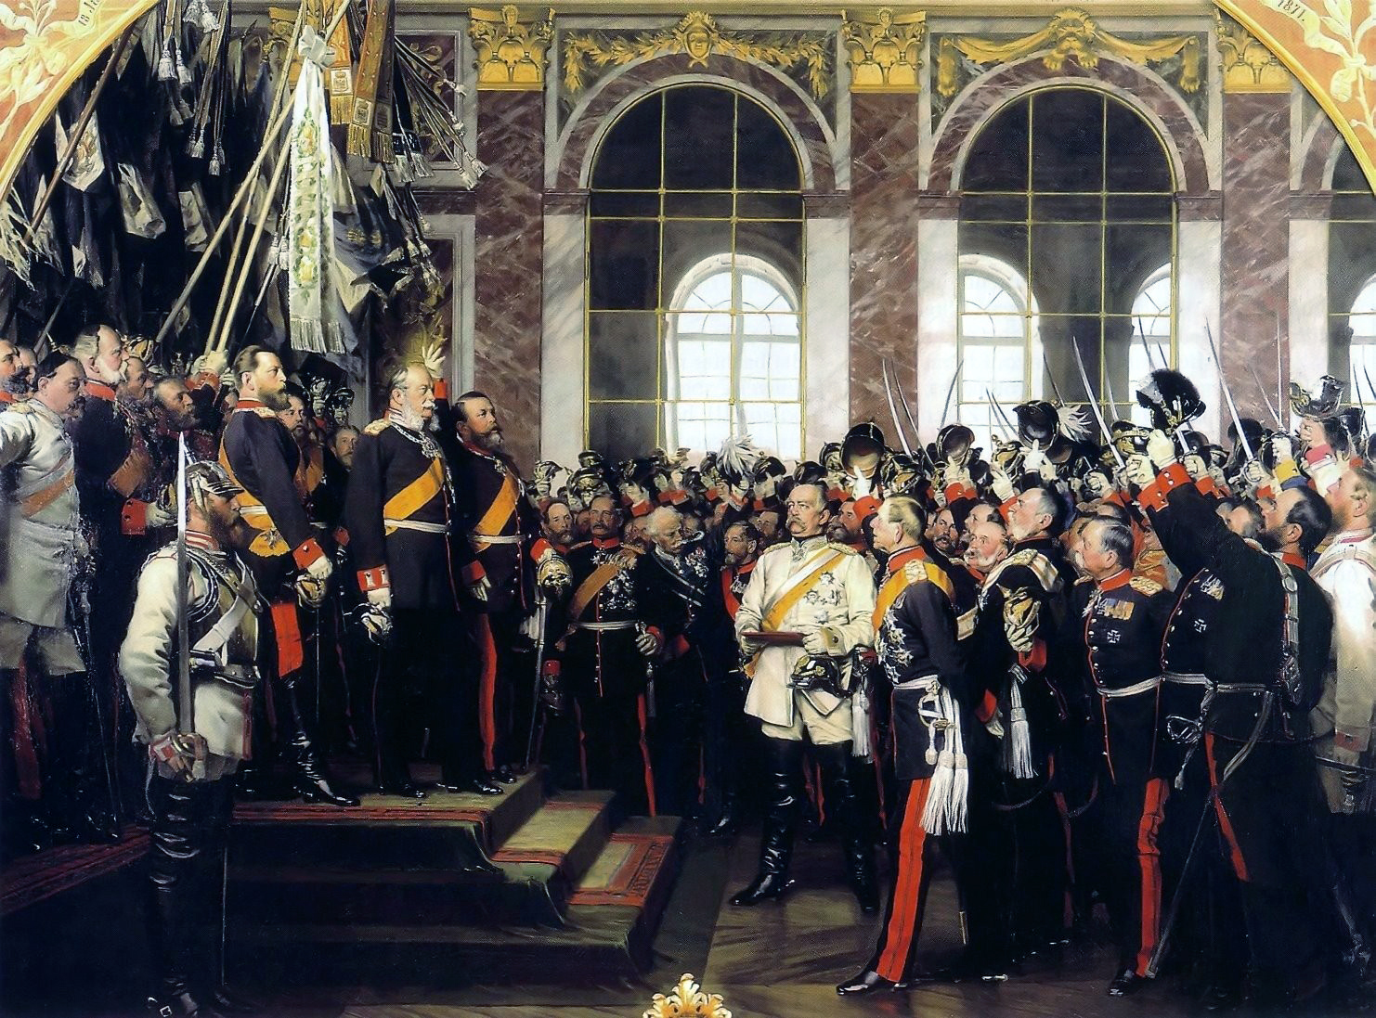
FRANCO-GERMAN TENSIONS

Slide 16
The ALLIANCE System

Slide 17
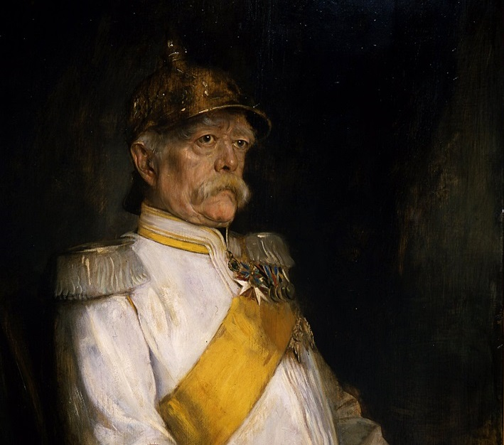
ARCHITECT

Slide 18
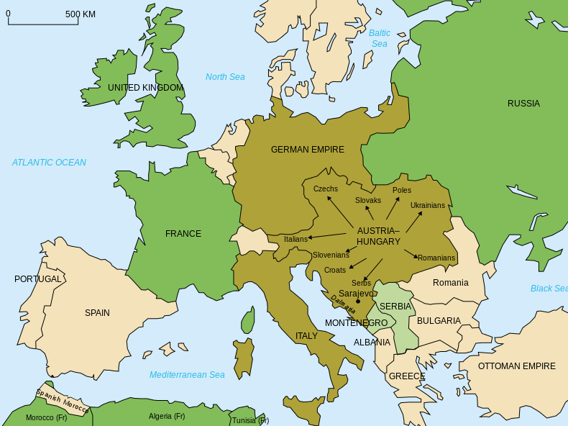
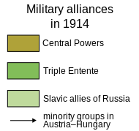
Alliances
Map Credit: historicair

Slide 19
Triple Entente
Britain France Russia
Central Powers
Germany Austria-Hungary Ottoman Empire Italy
Map Credit: historicair

Slide 20
Photo by Jayel Aheram

Slide 21
The objective was
NOT to go to war.
Photo by Jayel Aheram

Slide 22
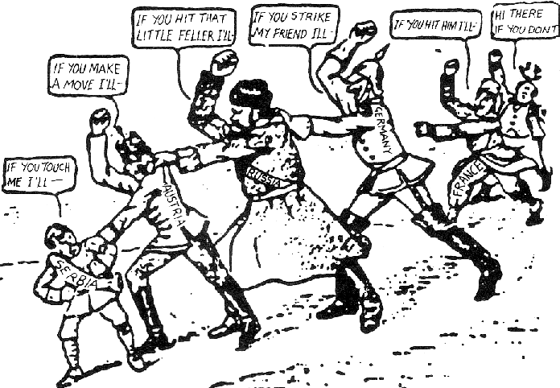
1914 American Cartoon

Slide 23
IT WORKS!!!

Slide 24
IT WORKS!!!
...until it doesn’t.

Slide 25
IMPERIALISM
National Rivalry Goes Global

Slide 26
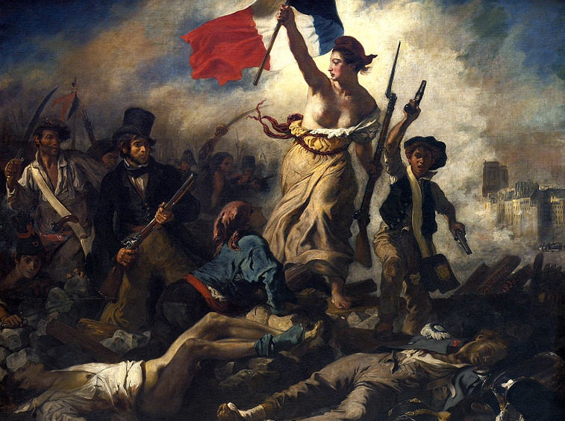
NATIONALISM
Liberty Leading the People (Eugène Delacroix, 1830)

Slide 27
Self-Determination on the Basis of Ethnicity
Liberty Leading the People (Eugène Delacroix, 1830)

Slide 28
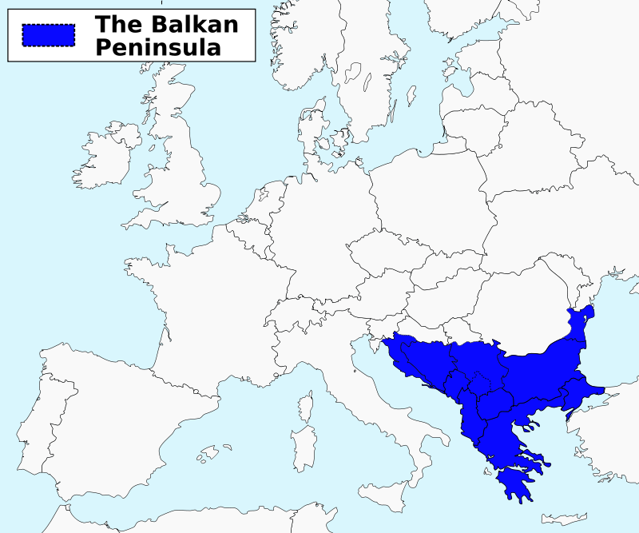
Map Credit: ArnoldPlaton

Slide 29
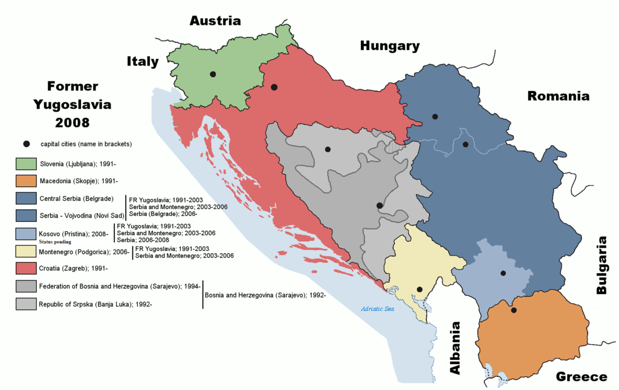
The “Former Yugoslavia”
Map Credit: Ijanderson977

Slide 30
It looks peaceful enough
Miss Snyder in Croatia
(Used With Permission)

Slide 31
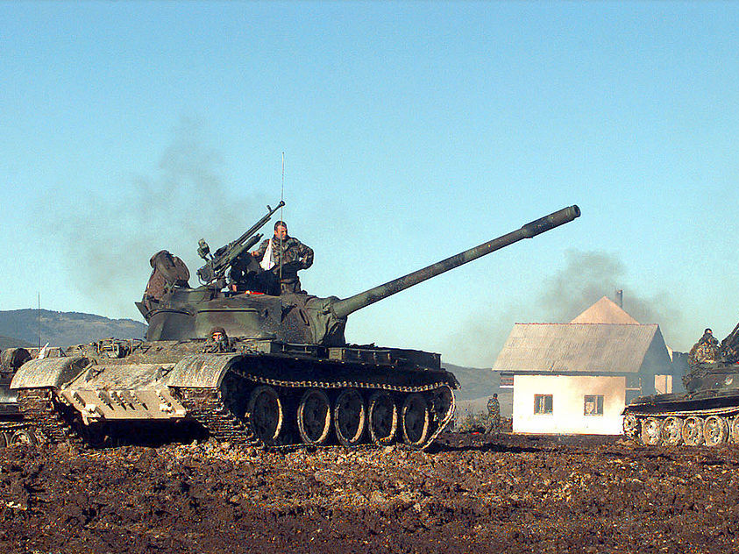
DON’T BE FOOLED

Slide 32
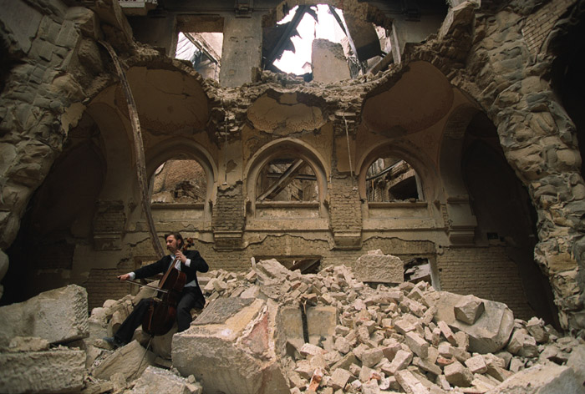
Vedran Smailović playing on top of the ruins of the National library (1992)
Photo Credit: Mikhail Evstafiev

Slide 33
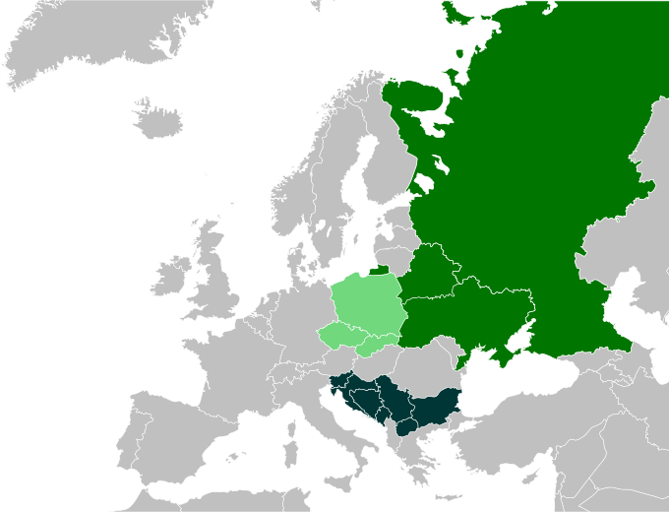
PAN-SLAVISM
Map Credit:
CrazyPhunk

Slide 34
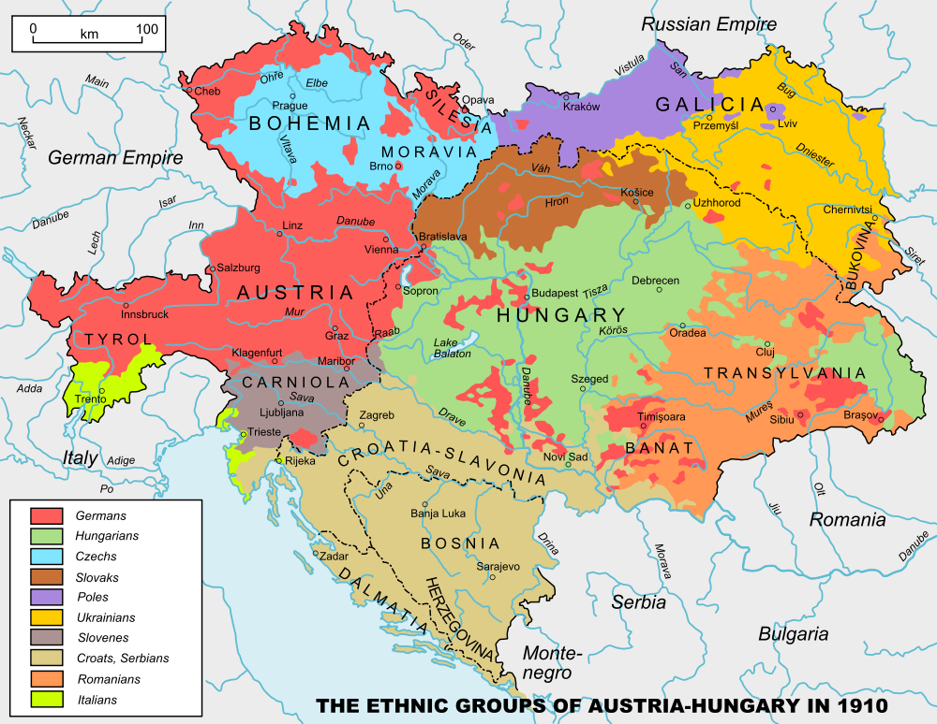

Slide 35
The Black Hand
Serbian Nationalists
Photo by FotoRita [Allstar maniac]

Slide 36
SLAVS

Slide 37
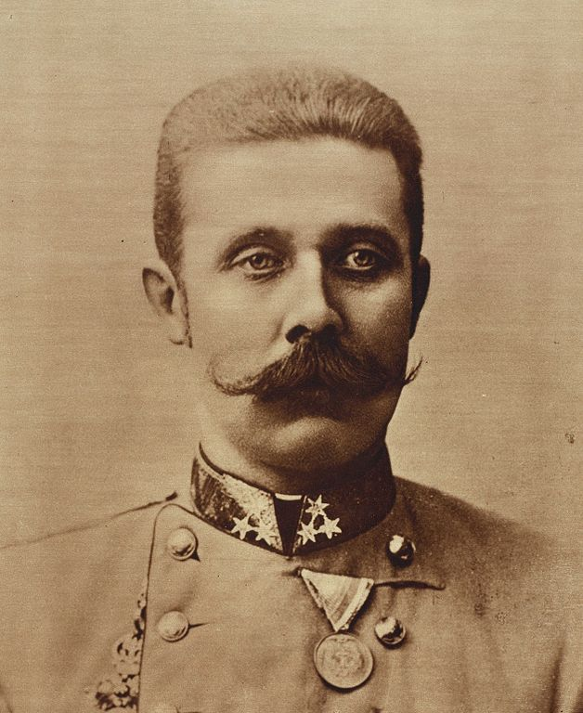
HEIR
Archduke Franz Ferdinand of Austria

Slide 38
ARCHDUKE

Slide 39
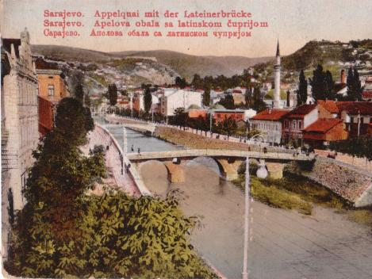
SARAJEVO
Picture Credit: Aloysius

Slide 40
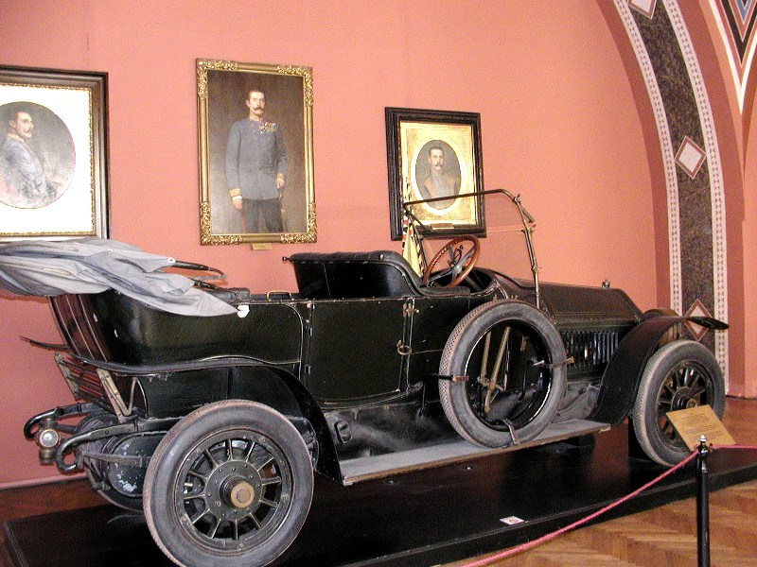
Photo by Alexf

Slide 41
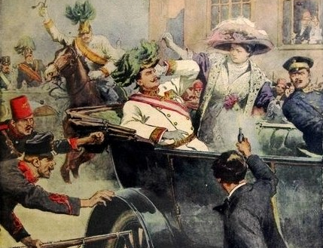

Slide 42
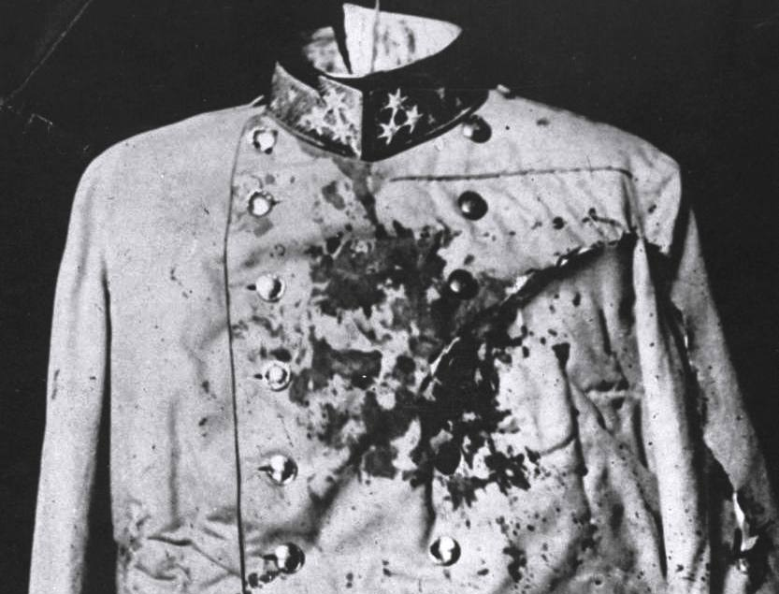

Slide 43
IGNITE
Photo by ☻☺

Slide 44
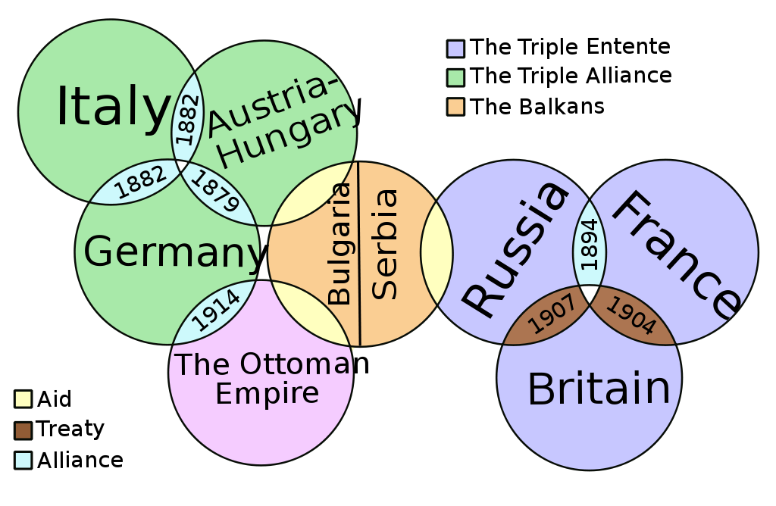
The Web of Alliances
Art Credit: It Is Me Here Xiaphias

Slide 45
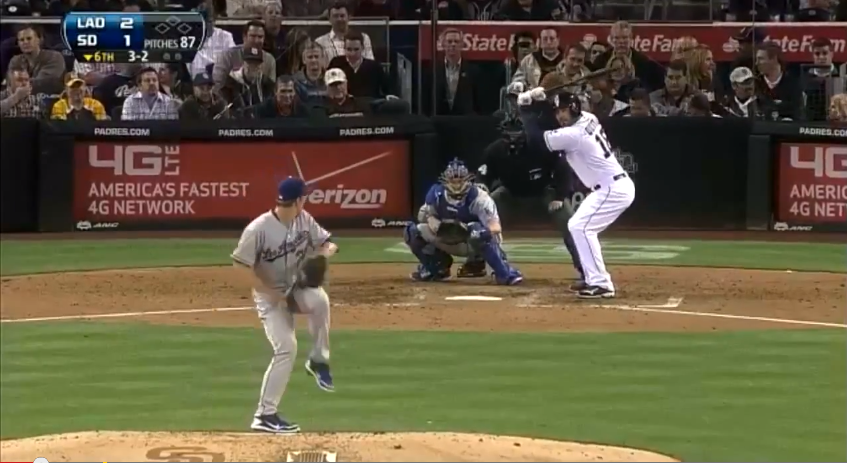
The Bench Clears…
http://www.youtube.com/watch?v=eZ3eA5ytOqg

Slide 46
Triple Entente
Britain France Russia
Central Powers
Germany Austria-Hungary Ottoman Empire Italy
Map Credit: historicair

Slide 47
Modern Warfare
The advent of World War I introduced several new military technologies that were used for the first time.

Slide 48
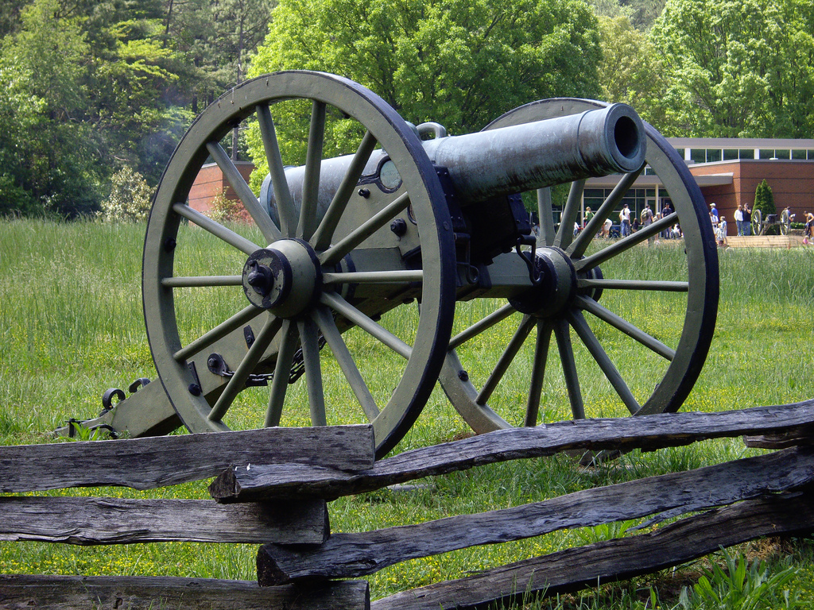
Civil War Cannon
Photo by terra2055

Slide 49
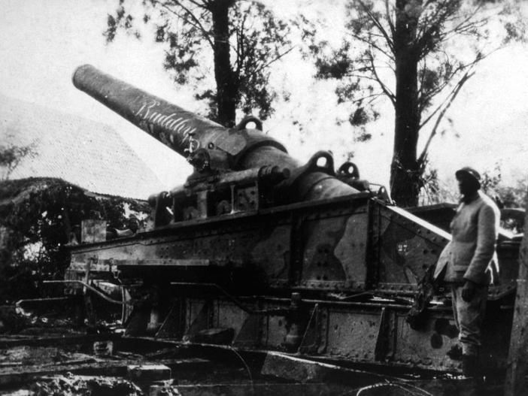
WWI Artillery Piece

Slide 50
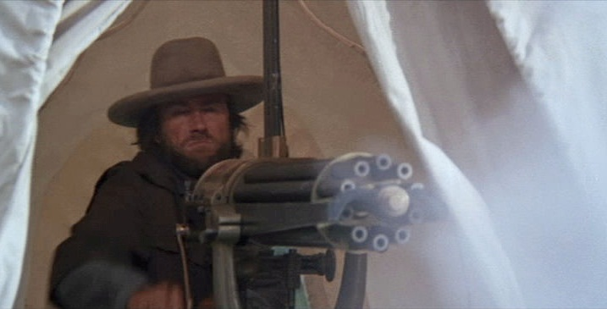
Civil War Gatling Gun
Screenshot from The Outlaw Josey Wales

Slide 51
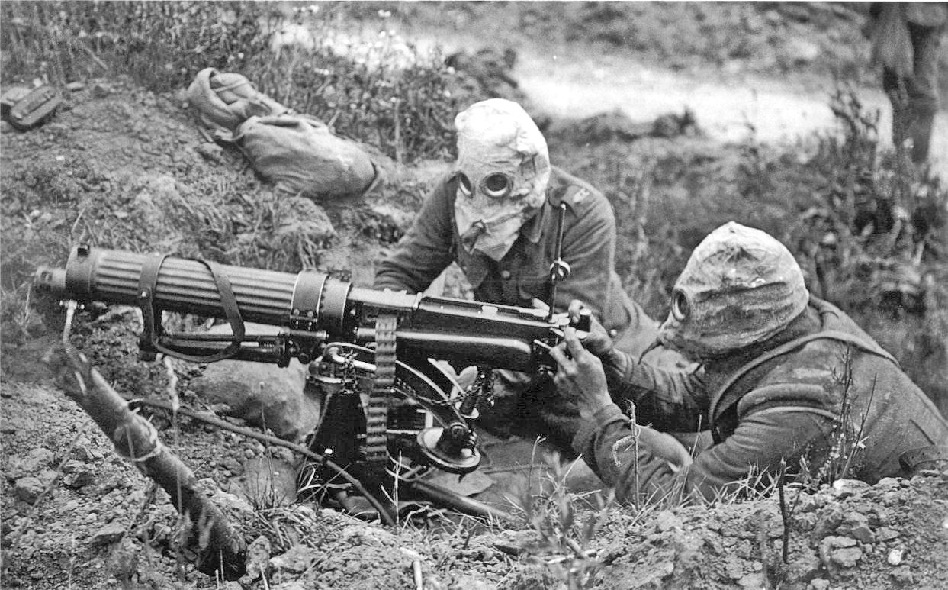
WWI Machine Gun

Slide 52
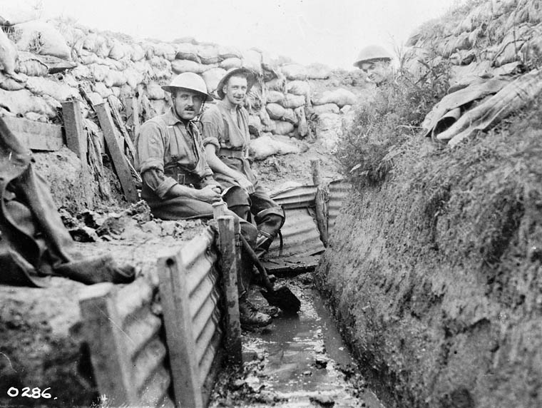
Trench Warfare

Slide 53
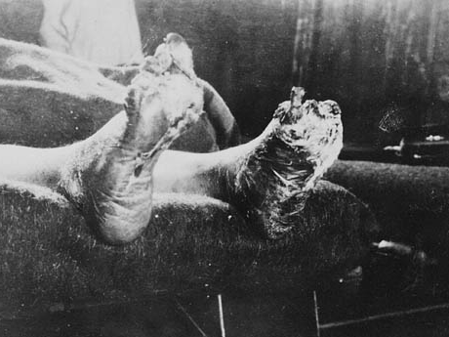
Trench Foot
Photo by BiblioArchives / LibraryArchives

Slide 54
STALEMATE

Slide 55
World War I was marked by prolonged battles that resulted in high casualties and little territorial gain.

Slide 56
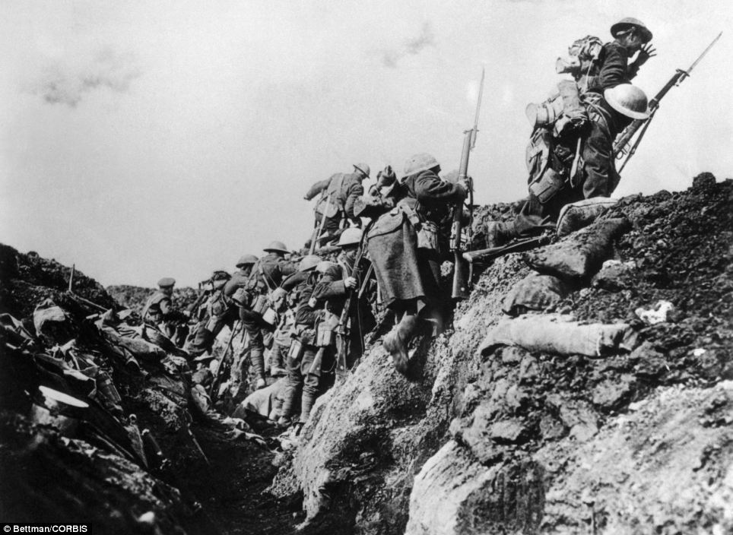
Over The Top

Slide 57
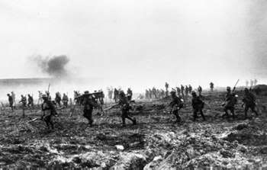
FUN!

Slide 58
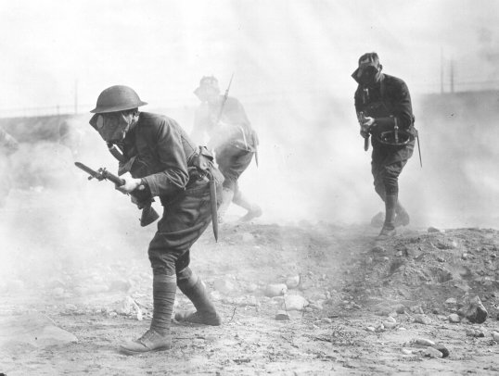
Mustard Gas

Slide 59
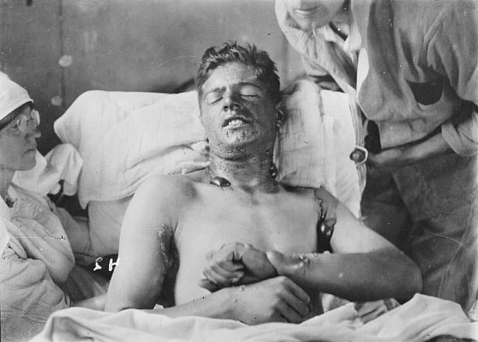
Should’ve worn my gas mask!

Slide 60
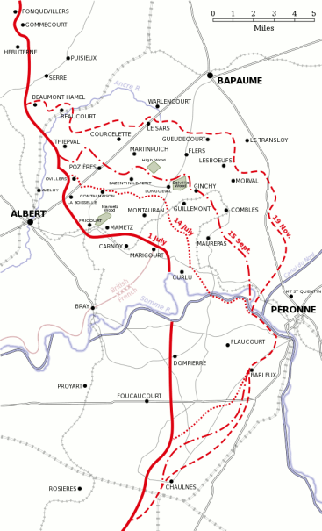
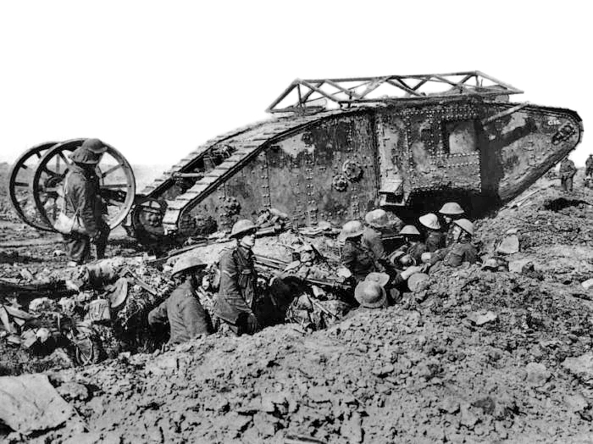
Battle of the Somme
July-November, 1916
Casualties (>1M)
Debut

Slide 61
The British Offensive
6
Miles

Slide 62
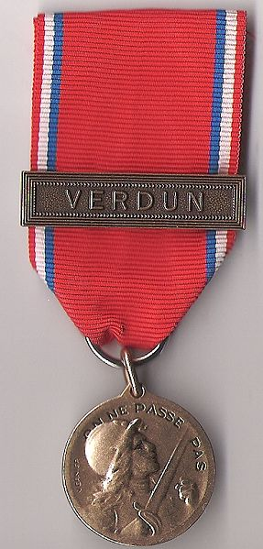
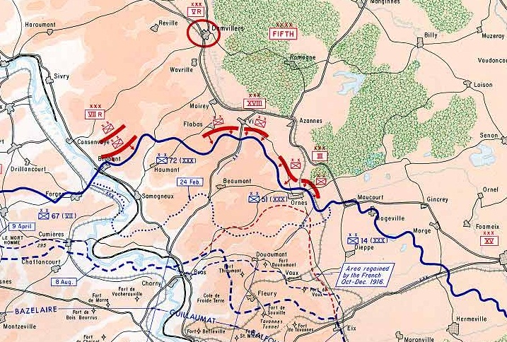
Battle of Verdun
February-December, 1916
The French repulse a German attack
> 700,000 Casualties

Slide 63
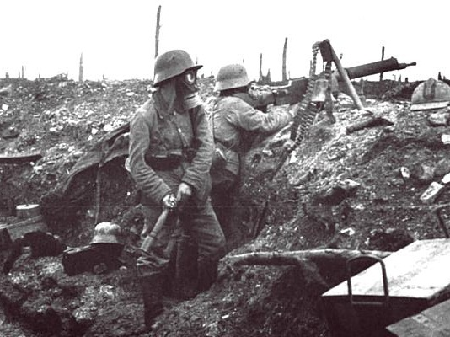
German Soldiers at Verdun

Slide 64
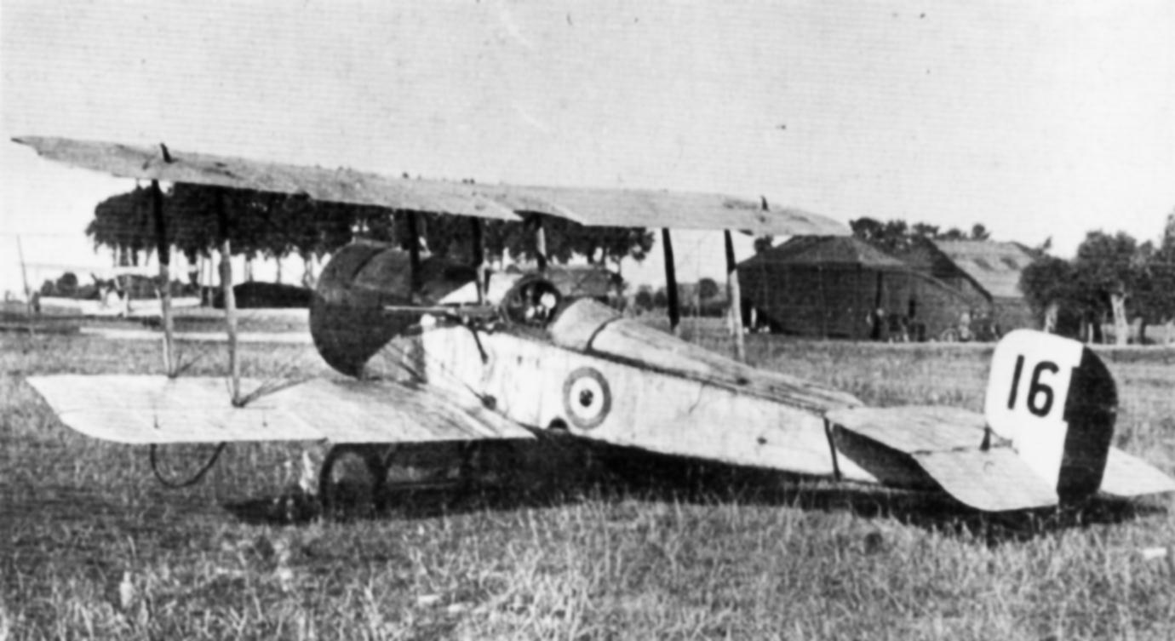
Aircraft in World War I

Slide 65
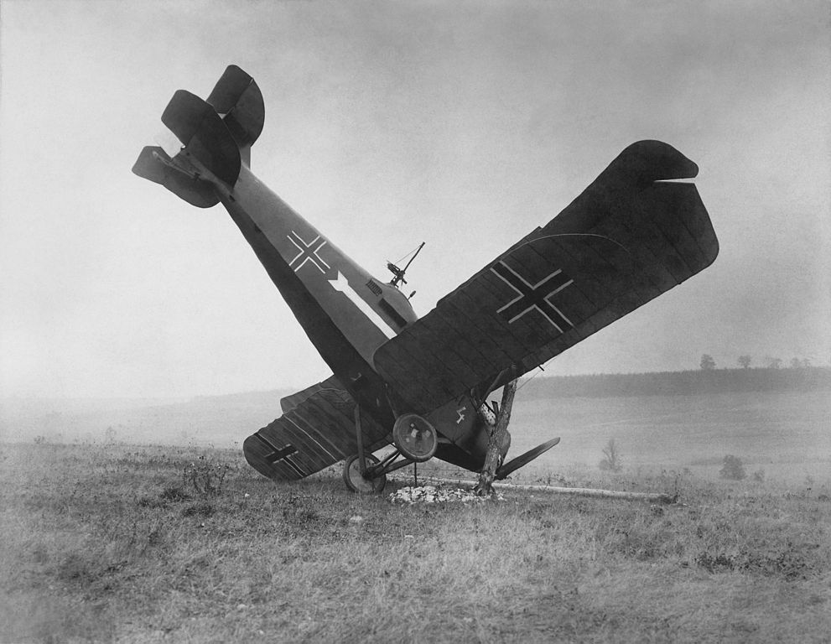
FAIL

Slide 66
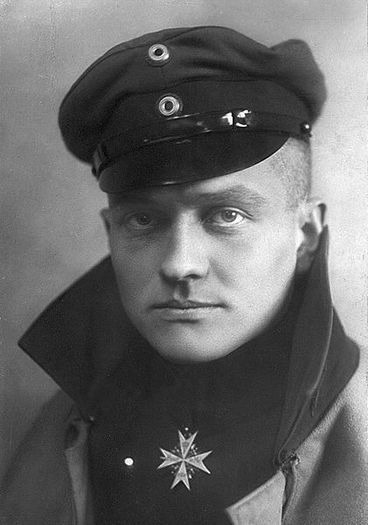
The Red Baron
80 Air Combat Victories
KIA 1918
Manfred Albrecht Freiherr von Richthofen

Slide 67
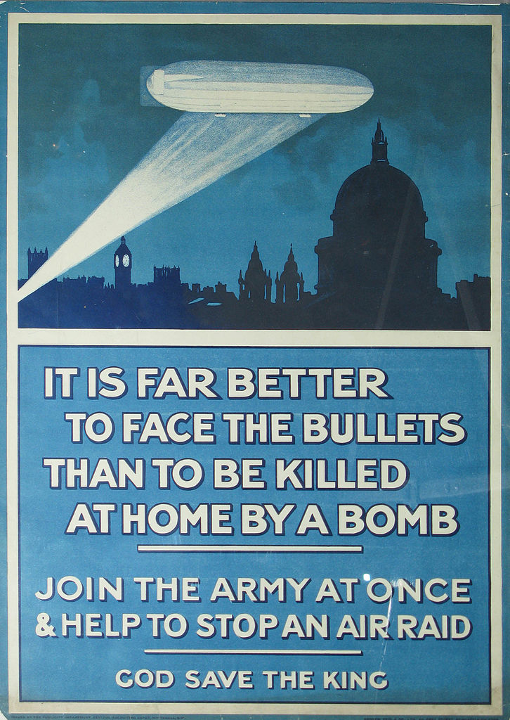
Zeppelin Raids
Germans used Zeppelins to bomb British cities.

Slide 69
German Gotha G.V Bomber

Slide 70
RESPONSES to Total War

Slide 71
“I am staring at a sunlit picture of Hell.”
-- Siegfried Sassoon (British Poet)

Slide 72
“Dulce et decorum est pro patria mori.” -- Horace

Slide 73
If you could hear, at every jolt, the blood Come gargling from the froth-corrupted lungs, Obscene as cancer, bitter as the cud Of vile, incurable sores on innocent tongues, My friend, you would not tell with such high zest To children ardent for some desperate glory, The old Lie; Dulce et Decorum est Pro patria mori.*
“Dulce et Decorum Est”
Wilfred Owen
1893-1918
*It is sweet and right to die for your country.

Slide 74
A German Soldier Writes Home
From German Students’ War Letters (Pine Street Books, 2002)

Slide 75
SHELLSHOCK
Psychological response to prolonged helplessness under artillery fire.
Further Reading
Shellshock vs. PTSD

Slide 76
The Thousand Yard Stare

Slide 77
The War at Home

Slide 78
Propaganda Campaigns
Both sides used war propaganda to motivate people to support the war effort.
CLICK HERE to see more posters.

Slide 79
Propaganda Campaigns
PURPOSES:
ENLIST
DEHUMANIZE the enemy
FINANCE the war
CONSERVE resources

Slide 80
Women and the War Effort
Women worked in munitions factories while men were at the Front.

Slide 83
Suffrage
The Legacy
1918 Germany
Austria
1919 Belgium
1920 Czechoslovakia
United States
1928 United Kingdom
Emmeline Pankhurst, a radical suffragette, is arrested in 1914

Slide 84
Russian Revolution
1917
Russian government pulls out of the war, then collapses.
Lenin and Stalin

Slide 85
Treaty of Brest-Litovsk
March, 1918
Russia cedes territory to Germany.

Slide 86
A German U-Boat

Slide 87
Sinking of the Lusitania
1915
Germany sparked an outrage by sinking a passenger ship (that was carrying armaments), killing British and American civilians.

Slide 88
Unrestricted Submarine Warfare
(1917)
A major factor leading to U.S. involvement in the war

Slide 89
The U.S. Enters the War
Fresh troops for the war-weary Entente Powers.

Slide 90
Armistice
11/11 (1918)
11:00 AM

Slide 91
The Treaty of Versailles
Photo by wallyg

Slide 93
Wilson’s Fourteen Points
PRINCIPLES:
Freedom of the Seas
Reduction of Arms
Open Treaty Negotiations
Self Determination of Peoples
League of Nations
14

Slide 94
PEACE Without Victory

Slide 95
Entente Military Deaths
More Info

Slide 96
Paris Peace Conference
“The Conference was an affair of three sides – the victors, the vanquished, and Wilson.”
-- Richard Hofstadter

Slide 97
“I was seated between Jesus Christ and Napoleon.”
David Lloyd George (British Prime Minister)

Slide 99
Article 231
The “War Guilt” Clause
Britain and France wanted Germany to claim responsibility for the war and pay reparations to the allies.

Slide 100
Wilson’s Fourteen Points
PRINCIPLES:
Freedom of the Seas
Reduction of Arms
Open Treaty Negotiations
Self Determination of Peoples
League of Nations
14

Slide 101
HOW
can the two ideas be reconciled???
14
231

Slide 103
EASY!!!
WHY NOT BOTH?
14
231

Slide 104
LINK TO MAPS

Slide 105
LINK TO MAPS

Slide 106
LINK TO MAPS

Slide 107
LINK TO MAPS

Slide 108
Proclamation of the German Empire
18 January 1871

Slide 109
Signing of the Treaty of Versailles
June 28, 1919
Five years to the day of the assassination of Archduke Franz Ferdinand
Look Familiar???

Slide 110
League Membership
1920- 1946
Map Credit: Maps & Lucy
The United States never joined the League. Wilson’s mission to intimately involve the U.S. in global affairs was a failure.

Slide 111
decolonization

Slide 112
League of Nations Mandates
Former colonies administered by Britain and France
Notes:
Map: Geoffrey Gaudreault, NPR; Source: A History of the Arab Peoples by Albert Hourani
http://www.npr.org/news/specials/mideast/the_west/mandates_map.html

Slide 113
League of Nations Mandates
Former colonies administered by Britain and France
Map: Geoffrey Gaudreault, NPR; Source: A History of the Arab Peoples by Albert Hourani
Notes:
Map: Geoffrey Gaudreault, NPR; Source: A History of the Arab Peoples by Albert Hourani
http://www.npr.org/news/specials/mideast/the_west/mandates_map.html

Slide 114
1919
I went to Versailles and all I got was this lousy peace prize.

