Slide 1
Women during the Renaissance
Notes:
If Renaissance is said to have “discovered” mankind in general, this meant, for the most part, men.
The Church still considered women to be the sinful daughters of Eve. Legally, women remained subordinate to men; they could own property and make their wills, but could not sell property without their husband’s permission.
Both rich and poor families continued to value boys over girls
Poor families more likely to abandon girls
Many families viewed girls as a liability because of the necessity of providing a dowry for marriage
Some patricians educated their girls as well as boys in humanities
Overall, the Renaissance did not bring about any significant loosening in restrictions placed on women, and women’s social and personal options may even have been reduced.
Less of a role in public life than in medieval Europe

Slide 2
Did Women Have a Renaissance?
Joan Kelly (historian): Did Women have a Renaissance? (1977)
1. Kelly asserts that middle class (bourgeois) women especially suffered a marked decline in their status along with that of noble women during the Italian Renaissance
2. Middle class women were exclusively relegated to the private sphere while men monopolized political and economic issues in the public sphere.
3. Sexual chastity was essential for both women of the nobility and the bourgeoisie; a double-standard existed as chastity was not expected of men
4. Medieval feudalism permitted homage to female vassals but in Renaissance Italy feudalism came to be replaced by powerful city-states. Thus, the political power of women in many cases vanished.
Noble women thus experienced a state of almost universal dependence on her family and husband

Slide 3
Wealthy Women
Querelles des Femmes (“The Problem of Women”) – new debate emerged over women’s nature and their proper role in society (starting with Pisan in the 14th century) the debate continued throughout history
Increased access to education
were to be “ornaments” to their husbands

Slide 4
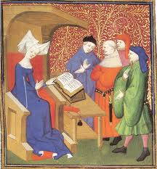
Christine de Pisan (1363?-1434?)
The City of Ladies (1405); The Book of Three Virtues
Chronicle of accomplishments of great women of history.
Renaissance woman’s survival manual.
Perhaps Europe’s first feminist
Extremely well-educated in France.
“Just as women’s bodies are softer than men’s, so their understanding is sharper.”

Slide 5
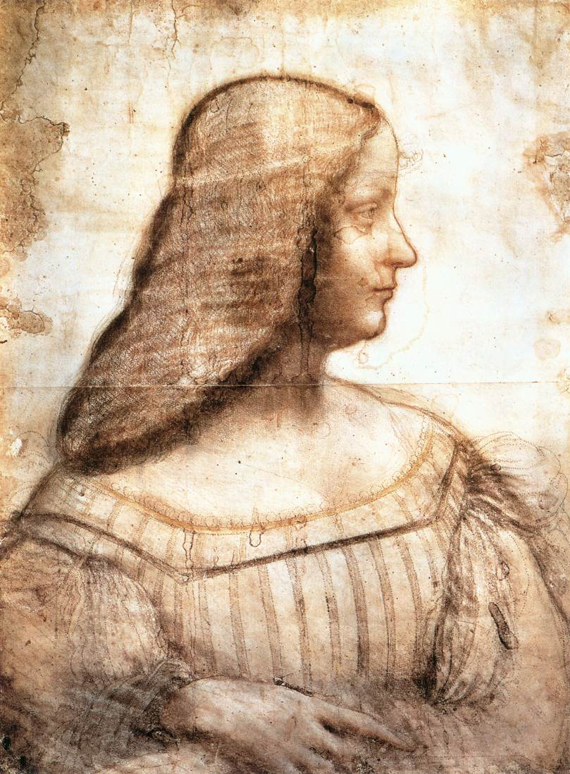
Isabella d’Este (1474-1539): “First Lady” of the Renaissance
Set an example for women to break away from their traditional roles as mere ornaments to their husbands
Ruled Mantua – comune in Lombardy, Italy - after her husband died
She and her siblings were well educated
Big patron of the arts
Founded a school for young women
Wrote over 2000 letters that provide a window into politics and courtly life at that time.

Slide 6
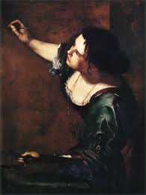
Artemesia Gentileschi (1593-1652) (considered a Baroque painter)
Perhaps the first female artist to gain recognition in the post-Renaissance era.
First woman to paint historical and religious scenes: e.g. her series of “Judith” paintings
Female artists at this time were largely consigned to portrait painting & imitative poses

Slide 7
Marriage
Based on economic considerations, not love
Dowries extremely important in wealthy families
Virtue was a marketable commodity
Women secluded from birth until marriage
Taught by women or priests
Kept under very close supervision
Women seen as property that could raise the social stature of a family, seal alliances (either princely or mercantile)

Slide 8
Marriage
Average age for women:
< 20 (for men it was mid-late 20s)
12 was common, 15 was late, and 17 was a catastrophe
Class issues: rich tend to marry earlier than middle classes, and poor tend to marry earlier too
In Italy, the age gap between husbands and wives was much larger than in Northern Europe
Increase in infanticide and abandonment among the poor

Slide 9
Marriage
Marriage demanded the biggest celebration that could be afforded
Using canals of Venice for a parade
Buildings adorned with rare tapestries
Bonfires
Fireworks
Balls and banquets were arranged
The couple was serenaded by hired musicians
Painters immortalized the couple
Poets wrote sonnets and odes in their honor
Playwrights wrote plays showing the couple as Greek heroes
Publically put to bed for all to see – end of the contract was in the marriage bed

Slide 10
Divorce available in certain areas (still very limited) compared to Middle Ages where divorce was non-existent
Women were to make themselves pleasing to the man (Castiglione)-- only upper classes
Sexual double-standard: women were to remain chaste until marriage; men were permitted to “sow their wild oats.”
More prostitution than in Middle Ages
Rape not considered a serious crime

Slide 11
Most women toiled at home, on looms, or in the field along with their men
It was in Church, that they eased their sorrows
Most women knew little of the fine ideals of the time
Lives dedicated to husbands, children, and proper social behavior

Slide 12
Women were to be:
Prudent, pius, ignore vanities
But they did possess a modest elegance, unlike medieval women
Women could dress finer, eat better, wear jewelry and entertain
But it was unusual for women to be very learned

