Slide 1
© Morgan AP Teaching
Period 1: 1450 CE -1648 CE
The Thirty Years War

Slide 2
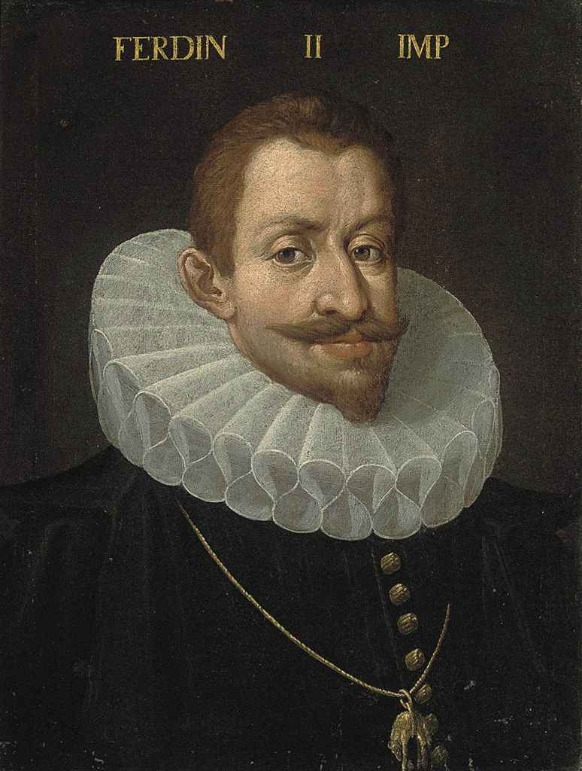
© Morgan AP Teaching
Thirty Years’ War (1618-1648)
The most destructive war until World War I, the Thirty Years’ War started out as a religious battle between Protestants and Catholics
The war started in 1618 when the holy Roman Emperor Ferdinand II tried to imposed religious uniformity within the Holy Roman Empire (HRE)
A direct violation of the Peace of Augsburg, the Protestant princes united against the emperor, while also receiving aid from England
However, the united power of Spain, Austria, Italy (all Hapsburg), and Poland pushed the princes to the brink of defeat
The only thing that saved the Protestants from swift defeat was the entry of a surprisingly strong and centralized Sweden that prolonged the conflict to expand their territorial holdings in Northern Europe at the expense of the HRE
The King of Sweden, Gustavus Adolphus, was a brilliant military mind and used the combined force and support of different types of military units– a practice and tactic that caught Catholic forces off guard (later replicated by all)

Slide 3
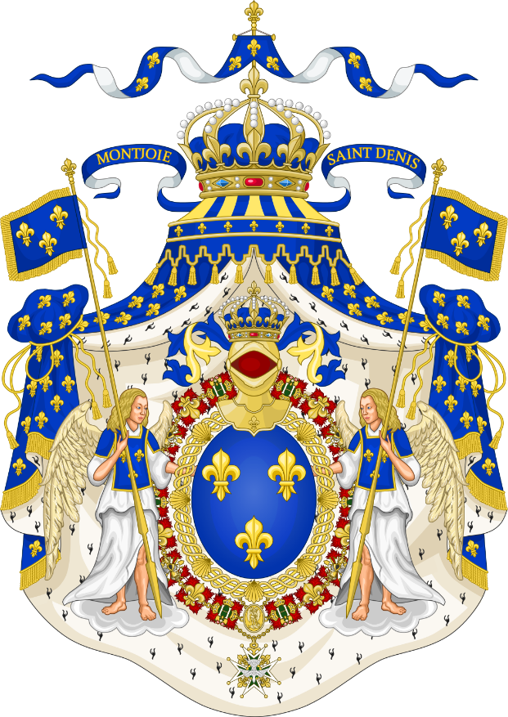
© Morgan AP Teaching
Religious War?
While the war started as an internal HRE dispute between Catholics and Protestants in 1618, the war ended with almost all European nations involved
Aid for the Protestants grew, as the Dutch, English, and Russians joined and/or sent aid, as well as the Hungarians for Catholics
However, after the death of Gustavus Adolphus, a stalemate ensured until the Protestants received some very unexpected help in this religious conflict
Instead of aiding the Catholic side and religious cause, France (Catholic) actually joined the conflict on the side of the Protestants
Their goal was not religious, but rather focused on gaining political power and strength by helping to defeat Hapsburg Spain and the HRE—its main competitors
This became an emergent theme of the Early Modern Era as powerful states began to exploit religious conflicts for political gain, as seen in the cases of both Sweden and France entering the conflict to gain political power and territory

Slide 4
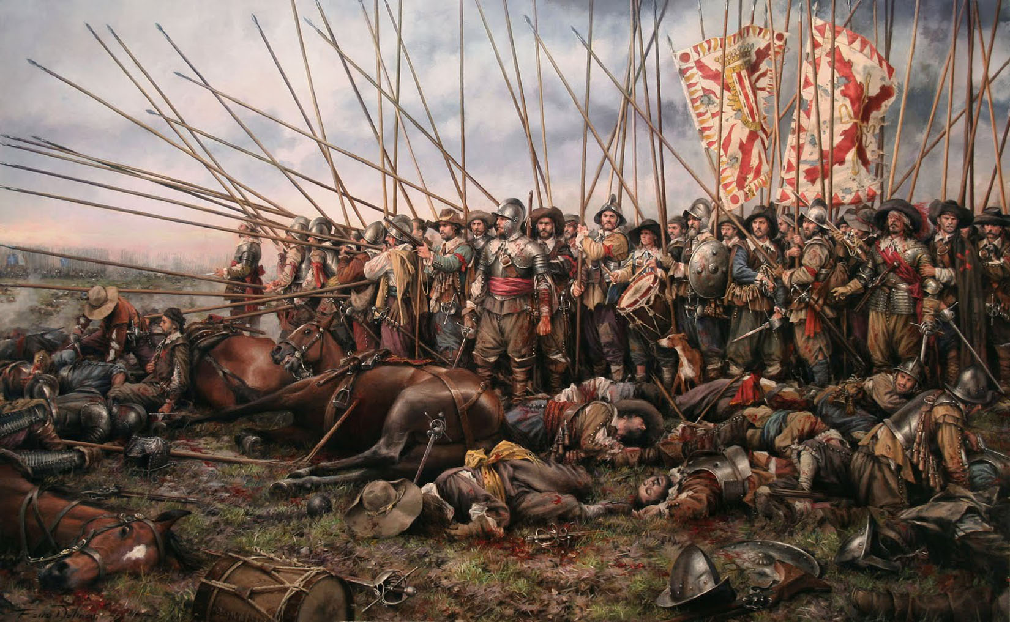

Slide 5
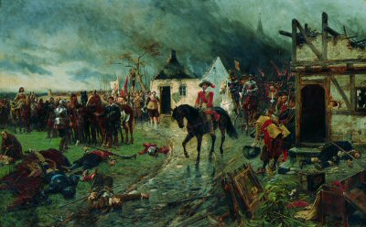

Slide 6
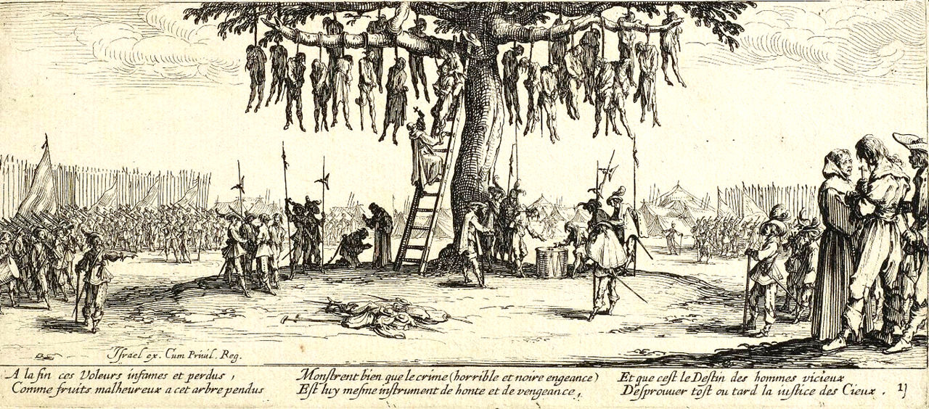

Slide 7
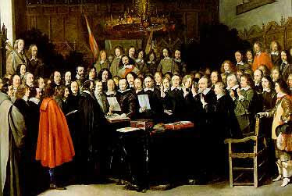
© Morgan AP Teaching
Peace of Westphalia (1648)
While the war see-sawed for thirty years, the entrance of the
centralized states of Sweden & France on the Protestant side
were too much for the Catholics
In 1648, ambassadors from all participating nations were sent
to Westphalia, Germany to negotiate the surrender of the
Catholic side as Spain had gone bankrupt
Sweden and France gained the most, taking land from the Catholic portions of the Holy Roman Empire & Spain
The Netherlands were also granted independence from Spain in 1648
Additionally, German princes of the Holy Roman Empire could now choose ANY religion and were free of control of the Holy Roman Emperor

Slide 8
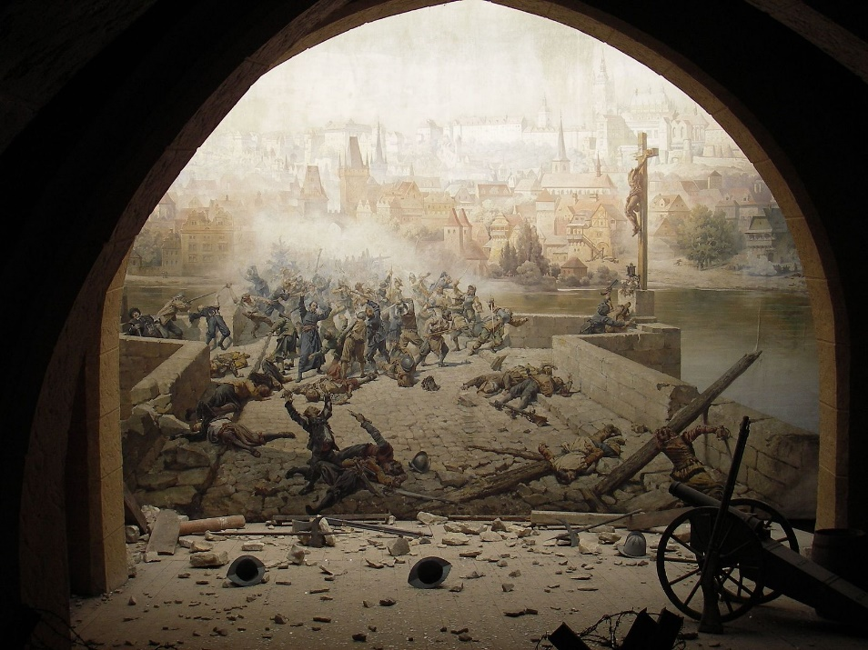
© Morgan AP Teaching
Impacts of the War
The most significant impact was this was the last religious war in Europe
as conflicts now focused on a new concept: the balance of power
From 1648 onward, nations joined conflicts in order to prevent one state
from becoming too strong/dominant in Europe, as Spain had been during
the Early Modern Era
2. Peace talks now involved members from ALL parties of the conflict
The conflict showed once-and-for-all that large, centralized states (Fr/Swed) with national taxes and armies
were far superior to non-centralized states
Spain and the Holy Roman Empire would no longer be relevant powers in Europe, and what power they had
left would be focused primarily at the Ottoman threat in Eastern and Southern Europe, such as during the
Siege of Vienna in 1683 and continuous fighting in Hungary and the Balkans
5. Over 1/3 of all German people in the HRE died in the wake of the destructive conflict

