Slide 1
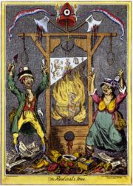
The Radical Phase
1793-1794
“The Terror”

Slide 2
The “Second” French Revolution
The National Convention:
Girondin Rule: 1792-1793
Mountain Rule: 1793-1794 [“Reign of Terror”]
Thermidorian Reaction: 1794-1795
The Directory → 1795-1799

Slide 3
Attitudes & actions of monarchy & court
Fear of Counter-Revolution
Religious divisions
The Causes of Instability in France 1792 - 1795
Economic Crises
Political divisions
War

Slide 4
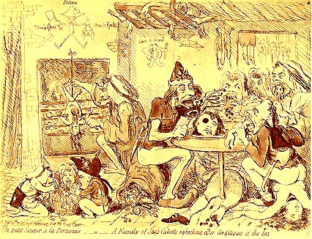
The Sans-Culottes
Depicted as Savages by a British Cartoonist.

Slide 5
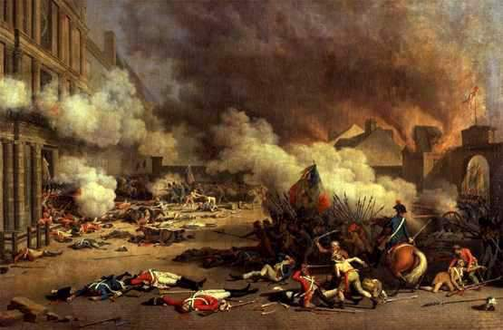
The Storming of the Tuilieres: August 9-10, 1792
This was triggered in part by the publication in Paris of the August 3 Brunswick Manifesto, which confirmed popular suspicions concerning the king’s treason.

Slide 6
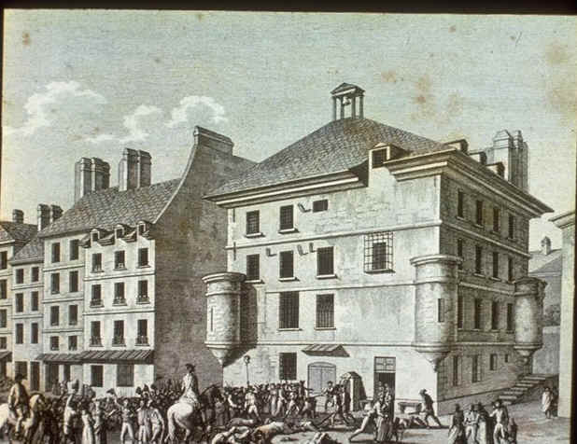
The September Massacres, 1792 (The dark side of the Revolution!)
Rumors that the anti-revolutionary political prisoners were plotting to break out & attack from the rear the armies defending France, while the Prussians attacked from the front.
Buveurs de sang [“drinkers of blood.”]→ over 2000 killed
It discredited the Revolution among its remaining sympathizers abroad.

Slide 7
The National Convention (September, 1792)
Its first act was the formal abolition of the monarchy on September 22, 1792.
The Year I of the French Republic.
The Decree of Fraternity
it offered French assistance to any subject peoples who wished to overthrow their governments.
When France sneezes, all of Europe catches cold!

Slide 8
The Politics of the National Convention (1792-1795)
The Mountain
Girondists
Power base in Paris.
Main support from the sans-culottes.
Would adopt extreme measures to achieve their goals.
Saw Paris as the center of the Revolution.
More centralized [in Paris] approach to government.
Power base in the provinces.
Feared the influence of the sans-culottes.
Feared the dominance of Paris in national politics.
Supported more national government centralization [federalism].

Slide 9
The Political Spectrum
TODAY:
1790s:
The Plain (swing votes)
Montagnards (“The Mountain”)
Girondists
Monarchíen (Royalists)
Jacobins

Slide 10
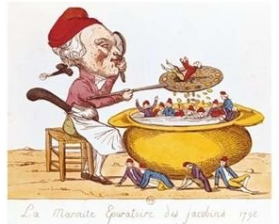
The “Purifying” Pot of the Jacobin

Slide 11
Louis XVI as a Pig
For the Mountain the king was a traitor.
The Girondins felt that the Revolution had gone far enough and didn’t want to execute the king [maybe exile him].

Slide 12
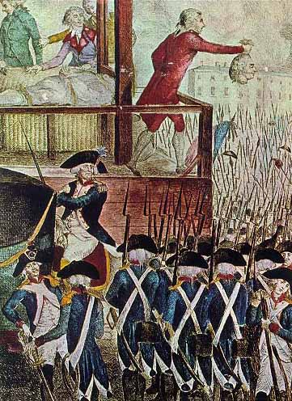
Louis XVI’s Head (January 21, 1793)
The trial of the king was hastened by the discovery in a secret cupboard in the Tuilieres of a cache of documents.
They proved conclusively Louis’ knowledge and encouragement of foreign intervention.
The National Convention voted 387 to 334 to execute the monarchs.

Slide 13
The Death of “Citizen” Louis Capet
Matter for reflection for the crowned jugglers.
So impure blood doesn’t soil our land!

Slide 14
“Revolutionary Razor”

Slide 15
The Guillotine: An “Enlightenment Tool”?
Oh, thou charming guillotine, You shorten kings and queens; By your influence divine, We have re-conquered our rights. Come to aid of the Country And let your superb instrument Become forever permanent To destroy the impious sect. Sharpen your razor for Pitt and his agents Fill your divine sack with heads of tyrants.

Slide 16
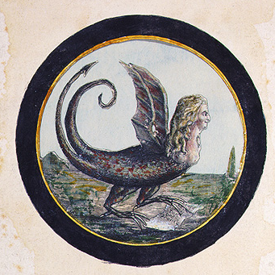
Marie Antoinette as a Serpent
The “Widow Capet”

Slide 17
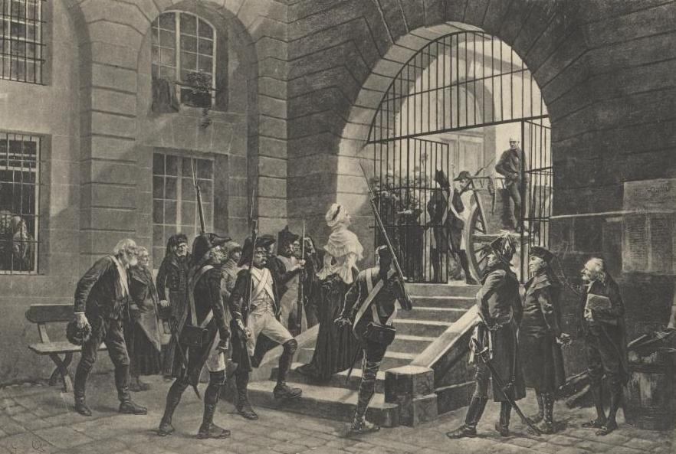
Marie Antoinette on the Way to the Guillotine

Slide 18
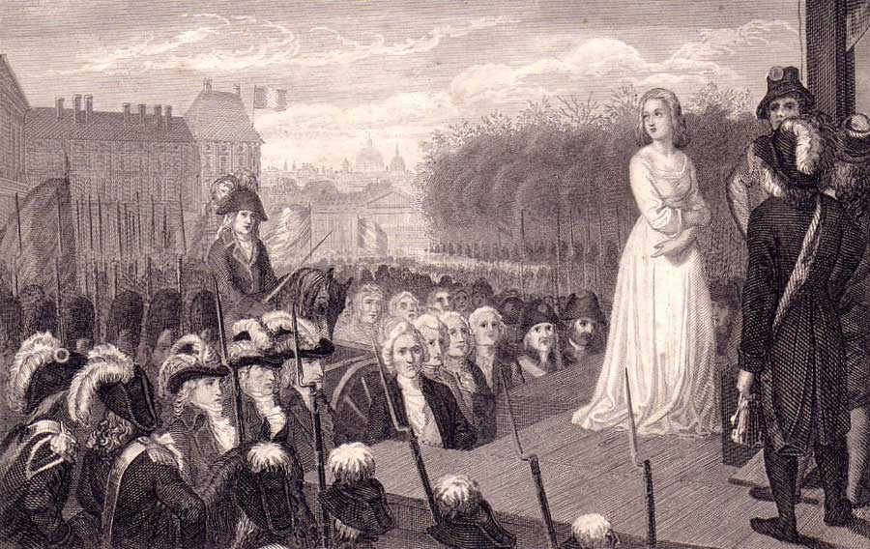
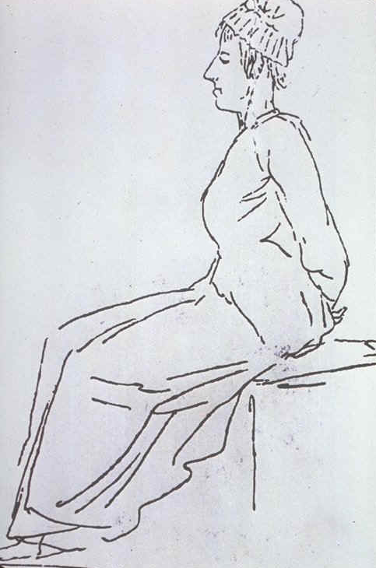
Marie Antoinette Died in October, 1793

Slide 19
Attempts to Control the Growing Crisis
Revolutionary Tribunal in Paris → try suspected counter-revolutionaries.
Representatives-on-Mission
sent to the provinces & to the army.
had wide powers to oversee conscription.
B. Watch Committees [comité de surveillance]
keep an eye on foreigners & suspects.
C. Sanctioned the trial & execution of rebels and émigrés, should they ever return to France.

Slide 20
Attempts to Control the Growing Crisis
The printing of more assignats to pay for the war.
Committee of Public Safety [CPS]
to oversee and speed up the work of the government during this crisis.
Committee of General Security [CGS]
responsible for the pursuit of counter-revolutionaries, the treatment of suspects, & other internal security matters.

Slide 21
Committee for Public Safety
Revolutionary Tribunals.
300,000 arrested.
16,000 – 50,000 executed.

Slide 22
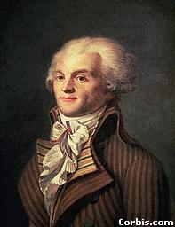
Maximillian Robespierre (1758 – 1794)

Slide 23
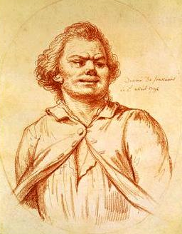
Georges Jacques Danton (1759 – 1794)

Slide 24
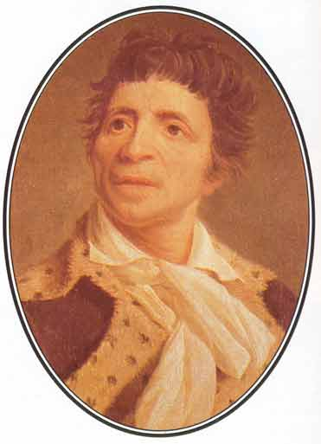
Jean-Paul Marat (1744 – 1793)

Slide 25
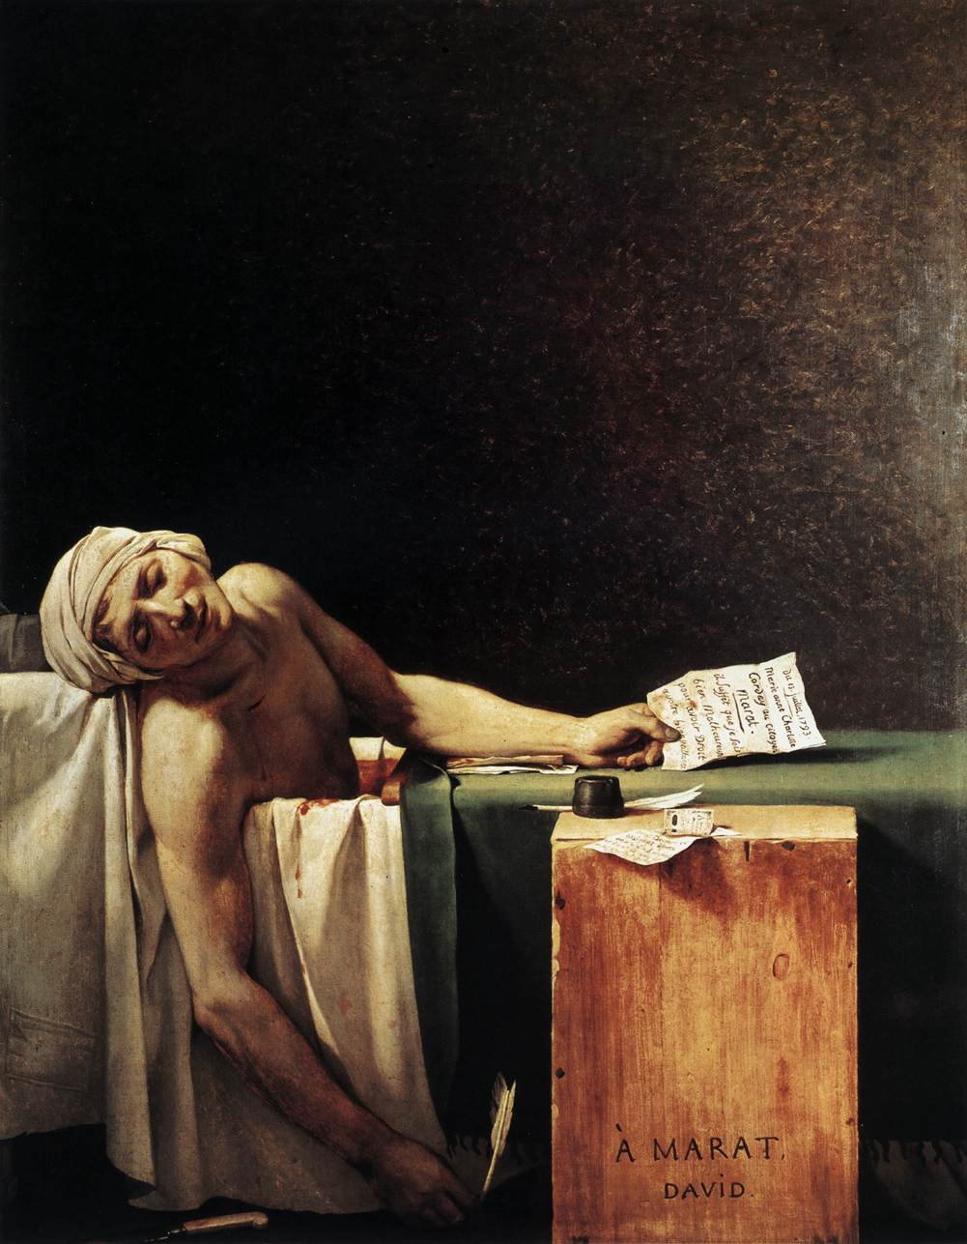
“The Death of Marat” by Jacques Louis David, 1793

Slide 26
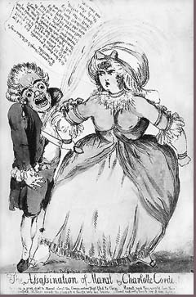
The Assassination of Marat by Charlotte Corday, 1793

Slide 27
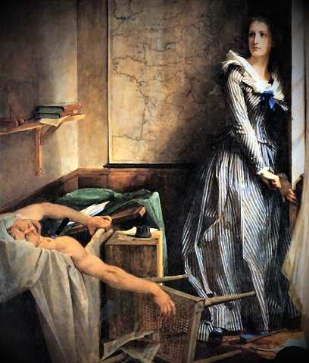
The Assassination of Marat by Charlotte Corday
Paul Jacques Aimee Baudry [A Romantic View]

Slide 28
The Levee en Masse: An Entire Nation at Arms! – 1.2 million Soldiers
An army based on merit, not birth

Slide 29
Legislation Passed by the National Convention
Law of General Maximum
September 5, 1793.
Limited prices of grain & other essentials to 1/3 above the 1790 prices & wages to ½ of 1790 figures.
Prices would be strictly enforced.
Hoarders rooted out and punished.
Food supplies would be secured by the army!
Law of Suspects
September 17, 1793.
This law was so widely drawn that almost anyone not expressing enthusiastic support for the republic could be placed under arrest!

Slide 30
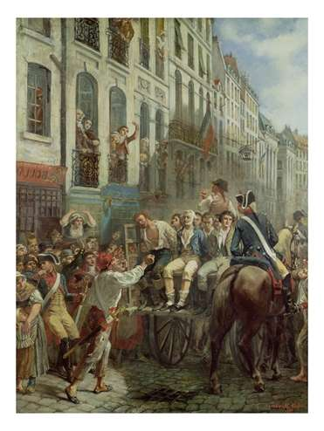
The Reign of Terror
Terror is nothing other than justice, prompt, severe, inflexible. -- Robespierre
Let terror be the order of the day!

Slide 31
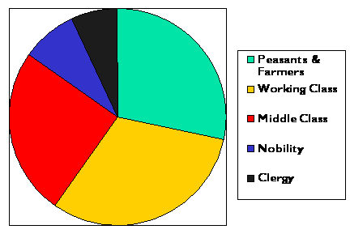
Different Social Classes Executed
7%
8%
28%
25%
31%

Slide 32
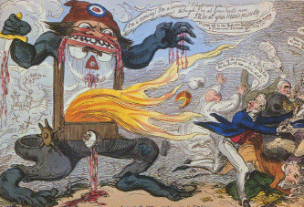
The “Monster” Guillotine

Slide 33
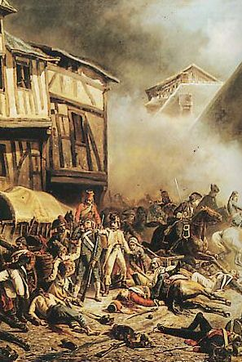
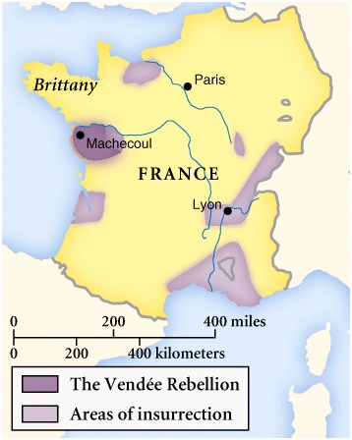
War of Resistance to the Revolution: The Vendee Revolt, 1793

Slide 34
Vendee Revolt, 1793
Vendee Symbol: For God & the King!
Drowning the Traitors!

Slide 35
Why was there a Revolt in the Vendee?
The need for 300,000 French troops for the war effort.
Rural peasantry still highly taxed.
Resentment of the Civil Constitution the Clergy.
Peasants had failed to benefit from the sale of church lands.
Local government officials National Guardsmen Jurying priests
TARGETS:

Slide 36
Political Propaganda

Slide 37
The Contrast: “French Liberty / British Slavery”

Slide 38
Religious Terror: De-Christianization (1793-1794)
The Catholic Church was linked with real or potential counter-revolution.
Religion was associated with the Ancien Régime and superstitious practices.
Very popular among the sans-culottes.
Therefore, religion had no place in a rational, secular republic

Slide 39
The De-Christianization Program
The adoption of a new Republican Calendar:
abolished Sundays & religious holidays.
months named after seasonal features.
7-day weeks replaced by 10-day decades.
the yearly calendar was dated from the creation of the Republic [Sept. 22, 1792]
The Convention symbolically divorced the state from the Church!!

Slide 40
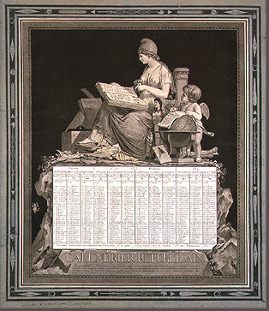
A Republican Calendar

Slide 41
Vendemaire | (Vintage) | 22 September-21 October
Brumaire | (Fog) | 22 October-20 November
Frimaire | (Frost) | 21 November-20 December
Nivose | (Snow) | 21 December-19 January
Pluviose | (Rain) | 20 January-18 February
Ventose | (Wind) | 19 February-20 March
Germinal | (Budding) | 21 March-19 April
Floreal | (Flowers) | 20 April-19 May
Prairial | (Meadows) | 20 May-18 June
Messidor | (Harvest) | 19 June-18 July
Thermidor | (Heat) | 19 July-17 August
Fructidor | (Fruit) | 18 August-21 September
A New Republican Calendar Year
I | 1792 – 1793
II | 1793 – 1794
III | 1794 – 1795
IV | 1795 – 1796
V | 1796 – 1797
VI | 1797 – 1798
VII | 1798 – 1799
VIII | 1799 – 1800
IX | 1800 – 1801
X | 1801 – 1802
XI | 1802 – 1803
XII | 1803 – 1804
XIII | 1804 – 1805
XIV | 1805
The Gregorian System returned in 1806.

Slide 42
Revolutionary Calendar
Vendemaire (Vintage) 22 September-21 October
Brumaire (Fog) 22 October-20 November
Frimaire (Frost) 21 November-20 December
Nivose (Snow) 21 December-19 January
Pluviose (Rain) 20 January-18 February
Ventose (Wind) 19 February-20 March
Germinal (Budding) 21 March-19 April
Floreal (Flowers) 20 April-19 May
Prairial (Meadows) 20 May-18 June
Messidor (Harvest) 19 June-18 July
Thermidor (Heat) 19 July-17 August
Fructidor (Fruit) 18 August-21 September

Slide 43
The De-Christianization Program
The public exercise of religion was banned.
The Paris Commune supported the:
destruction of religious & royal statues.
ban on clerical dress.
encouragement of the clergy to give up their vocations.
The Cathedral of Notre Dame in Paris was turned into the “Temple of Reason.”
The deportation of priests

Slide 44
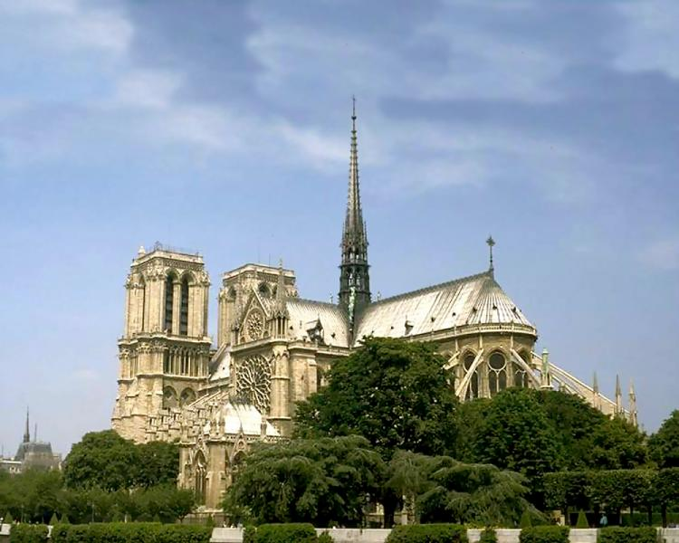
The “Temple of Reason”
Come, holy Liberty, inhabit this temple, Become the goddess of the French people.

Slide 45
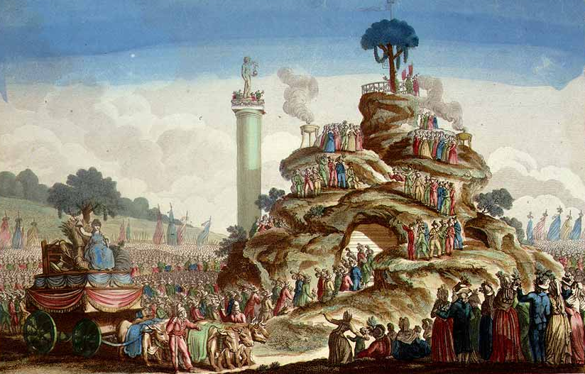
The Festival of Supreme Being
A new secular holiday

Slide 46
Backlash to the De-Christianization Program
It alienated most of the population (especially in the rural areas).
Robespierre never supported it.
he persuaded the Convention to reaffirm the principle of religious toleration.
Decree on the “Liberty of Cults” was passed
December 6, 1793.
BUT, it had little practical effect

Slide 47
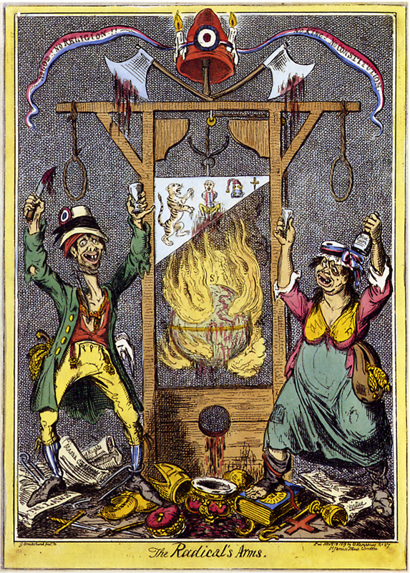
The Radical’s Arms:
No God! No Religion! No King! No Constitution!

Slide 48
The Terror Intensified: March to July, 1794
Jacques Hébert & the Hérbetists
Danton & the “Indulgents”
Executed in March, 1794
Executed in April, 1794
Law of 22 Prairial [June 10, 1794].
Trials were now limited to deciding only on liberty OR death, with defendants having no rights.
Were you an “enemy of the people?” (the law was so broadly written that almost anyone could fall within its definition!)

Slide 49
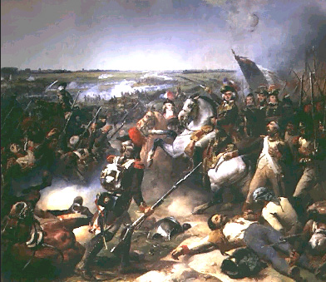
French Victory at Fleurus
June 26, 1794.
France defeated Austria.

Slide 50
The “Thermidorean Reaction,” 1794
July 26 → Robespierre gives a speech illustrating new plots & conspiracies.
he alienated members of the CPS & CGS.
many felt threatened by his implications.
July 27 → the Convention arrests Robespierre.
July 28 → Robespierre is tried & guillotined

Slide 51
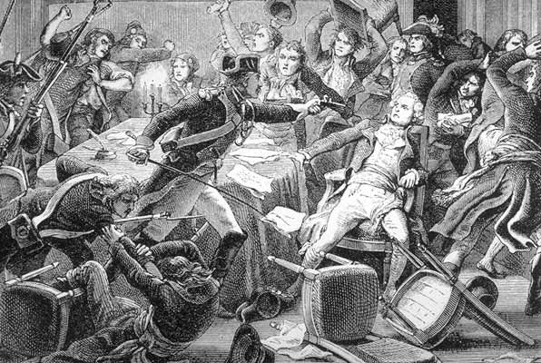
The Arrest of Robespierre

Slide 52
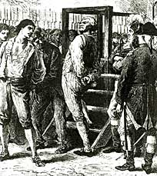
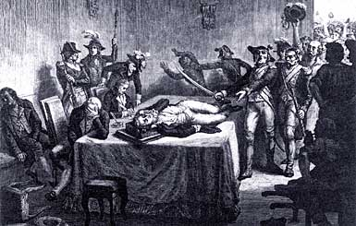
The Revolution Consumes Its Own Children
Robespierre Lies Wounded Before the Revolutionary Tribunal that will order him to be guillotined, 1794.
Danton Awaits Execution, 1793

Slide 53
The “Cultural Revolution”Brought About by the Convention
It was premised upon Enlightenment principles of rationality.
The metric system of weights and measures
Was defined by the French Academy of Sciences in 1791 and enforced in 1793.
It replaced weights and measures that had their origins in the Middle Ages.
The abolition of slavery within France in 1791 and throughout the French colonies in 1794.
The Convention legalized divorce and enacted shared inheritance laws [even for illegitimate offspring] in an attempt to eradicate inequalities.

