Slide 1
© Morgan AP Teaching
Period 1: 1450 CE -1648 CE
The Protestant
Reformation

Slide 2
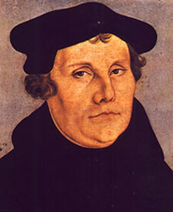
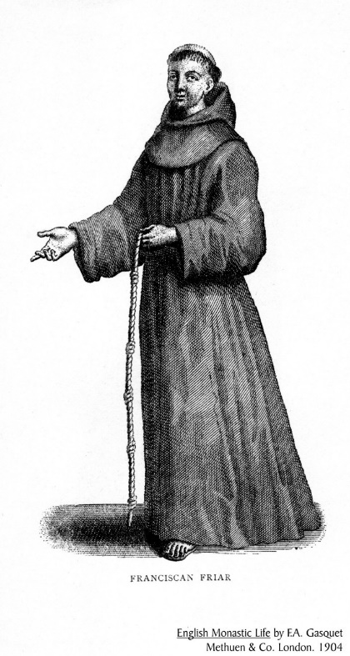
© Morgan AP Teaching
Martin Luther
Like Erasmus and Moore, a monk named Martin Luther began reading classical Christian texts—i.e., St. Augustine and the Bible
Martin Luther was shocked and disturbed to find none of the rituals, traditions, or authority of the Church was mentioned in either
After thoroughly reading scripture, Luther came the conclusion that only one thing was required to go to heaven: faith in Jesus alone
To Luther, the Bible justified none of the rituals, traditions, deeds, or powers of the pope/Church, and wrote fiercely against both
On October 31st, 1517, he nailed his 95 Theses (all the of the problems he had with the Church) to the doors of the Wittenberg Castle Church

Slide 3
© Morgan AP Teaching
Individual Interpretation
Luther’s 95 Theses, and following movements across Europe against the Church,
is considered the start of the Protestant Reformation
While Luther simply wanted reform, his ideas would prove too divisive in the
Catholic Church, and those who agreed would Luther would be deemed heretics
The basis of Luther’s ideas were simple: that all people should have and read
the Bible, and interpret from it what they believe God wants
So to spread his ideas and his message, Luther depended heavily on the printing
press and other church leaders to read and carry the message on
While only a few people at this time were literate, the spread of the Bible and Luther’s readings were often read and shared with entire towns, ultimately making him far more successful than his failed predecessors John Wycliffe in England and Jan Hus in Bohemia decades earlier
It also contributed to the development of common vernacular language and grammar which, eventually, helped develop national identities in the Modern Era

Slide 4
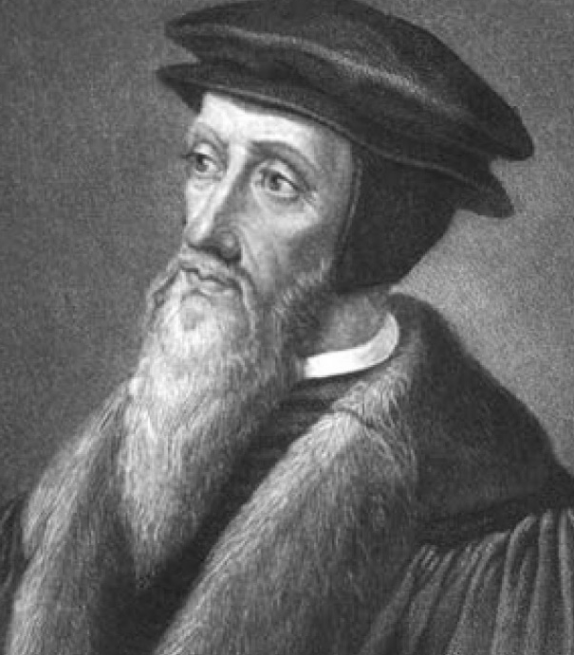
© Morgan AP Teaching
Calvinism
While Luther’s ideas developed into Lutheranism in the German and Scandinavian areas, The Netherlands, France, Switzerland, and Scotland followed another branch
Started by John Calvin and Ulrich Zwingli, Calvinists were very similar to Lutherans: they were against Church traditions, and supported salvation by faith alone
However, they disagreed on two primary things: predestination and communion
Calvinists believe everyone is predestined to go to heaven or hell, and can do nothing to change that fate
For communion, Calvinists believe the bread and wine represented Jesus’ body, while Lutherans believe it is the actual blood and body of Jesus

Slide 5
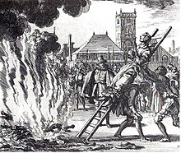
© Morgan AP Teaching
Different Interpretations
Luther expected those that read the Bible would agree with his
ideas, however, it soon became clear that others would often
disagree with his interpretations
Besides Calvin and Zwingli, other, more radical groups began
to read and interpret the Bible for themselves: the Anabaptists
Upon reading scripture for themselves, they believed that in order
to go to heaven, an adult must choose to be baptized (i.e., not kids)
Additionally, Anabaptists often violently defended their ideas when the Catholic or Protestant state rulers attempted to control their beliefs
As a result, both Catholic and Protestant leaders considered them ‘radical’ and often killed, tortured, imprisoned and chased Anabaptists out of their towns

Slide 6
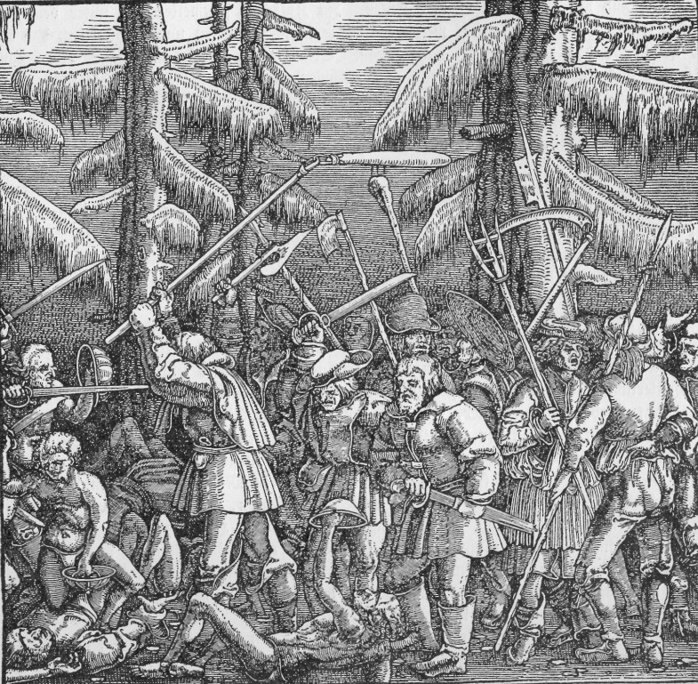
© Morgan AP Teaching
Peasant Revolts (1524-1526)
Aside from violence against the Anabaptists, a much larger and more
violent movement would begin as a result of people reading the
Bible: German Peasant Revolts
The Bible is filled with passages about being kind, helping the needy,
not being greedy, and about rulers being kind and benevolent
Peasants, however, under the feudal system were not treated this way:
they were overtaxed, overworked, and their rulers lived luxurious lives
To the peasants, Christians should be a harmonious Christian society, whose rulers rule kindly, don’t overtax or overwork, and provide aid
As a result, in 1524, hundreds of towns rose up against their lords and rulers, killing and murdering thousands on a rampage that took over two years to control
While the issues themselves were not religious, it was Luther’s ideas about Christianity and their interpretations of the Bible that were the direct cause of the revolt
Note: While this particular set of revolts was set off due to interpretations of scripture, many peasant rebellions would
emerge during the Early Modern Era as nobles increasingly attempted to extract heavier tax duties from peasants

Slide 7
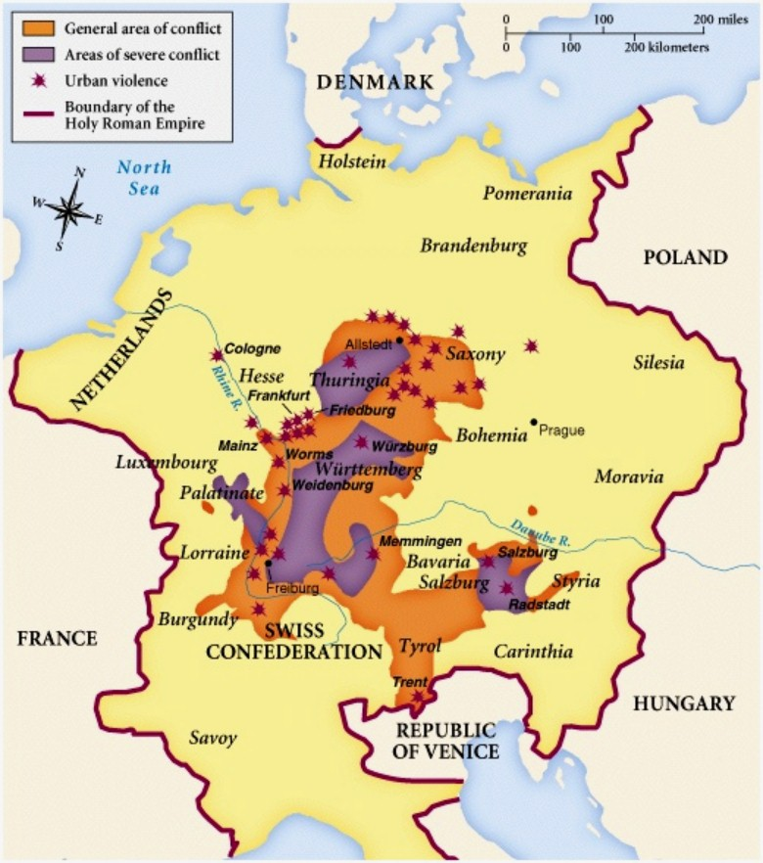
Peasant Revolts (1524-1526)

