Slide 1
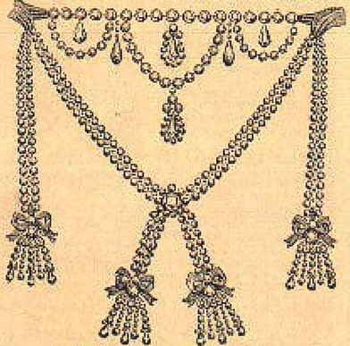
The Necklace Scandal
1,600,000 livres [$100 million today]
Cardinal Louis René Édouard de Rohan
The Countess de LaMotte

Slide 2
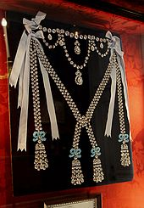

Slide 3
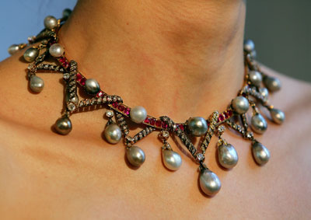
A necklace that Marie Antoinette did own is auctioned at Christie's London on Dec. 12, 2007, as part of the Magnificent Jewelry Sale. The bauble, which is comprised of pearls, diamonds and rubies, was valued between £350,000-400,000.

