Slide 1
Period 3: 1815 CE – 1914 CE
The Industrial Revolution

Slide 2
British Textiles
China and India had for centuries dominated manufacturing
all through the 19th century
It wasn’t until the 18th century that any other region would
begin to challenge them, starting in Great Britain
Europeans had long been producing textiles, like those of China
and India, with the putting out system—but Chinese and India
production were far superior
Britain, and other Europeans, would not surpass China and India until they began to mechanize production—meaning, replacing human workers with machines
In 1760, British inventors did just that with the spinning jenny and the water frame—they took slow, ineffective human textile production and mechanized it

Slide 3
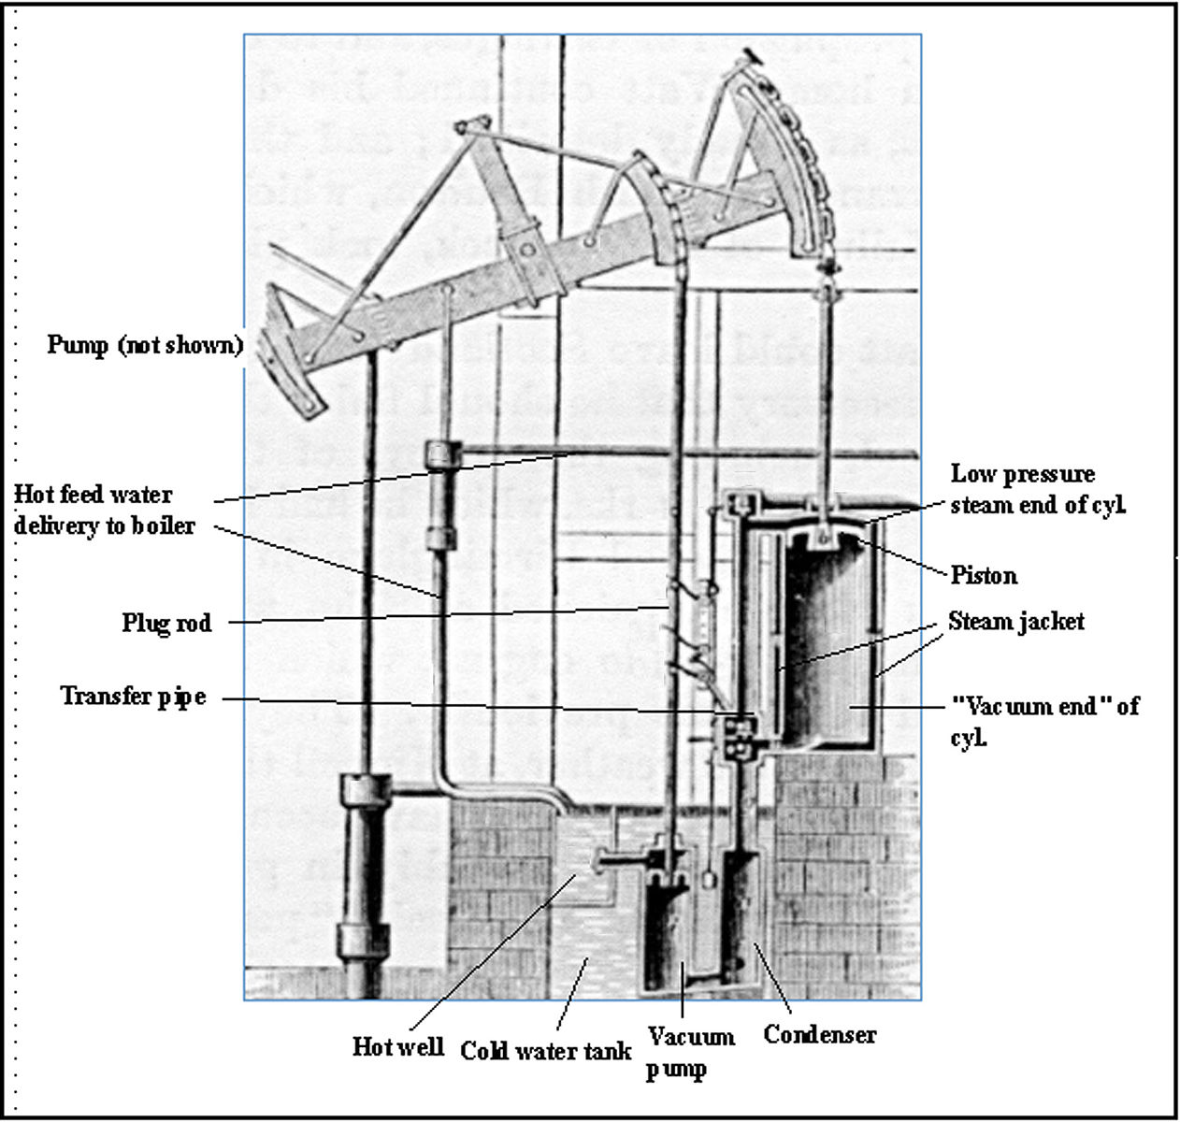
Great Britain
Textile production is actually what accelerated industrial revolution, as these machines required greater and greater sources of power
While many were initially powered by water and wind mill, production was limited to windy areas and fast-flowing rivers
James Watts steam engine (1775) changed that, but allowing the use of coal, something that was abundant in Great Britain, as a source of power
As steam entered and cooled, it created a vacuum that drove a piston, thus creating mechanized force that be used in many different ways
This also provided a high-power source for larger, iron machinery and manufactured products, optimal for Britain which had large iron and coal deposits

Slide 4
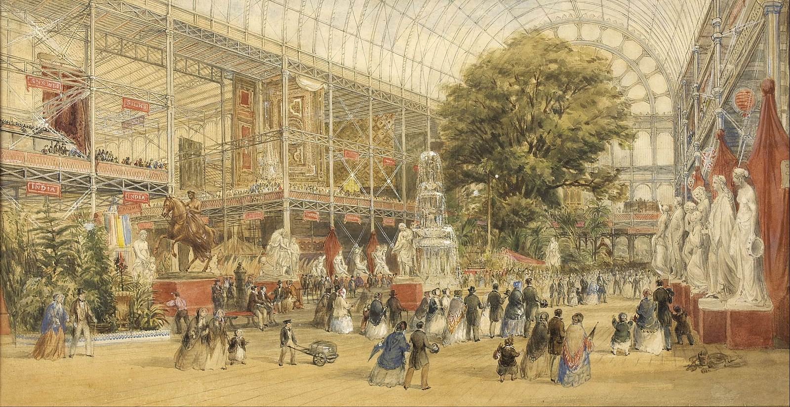
Culture of Invention
As Britain (and the Netherlands) showcased a Parliamentary
government that included the urban gentry, most limitations,
such as guilds and tariffs were removed
This allowed people and labor to move freely, working or
investing on whatever they were good at or passionate about
Additionally, governments began to provide monetary incentives, rewards, and awards to inventors such as the Nobel Prize, as well as patents to protect inventor profits/rights
As a result, the available resources and supportive gov. of Britain allowed it to lead the way in industrialization, and it VASTLY increased manufacturing
This was most evident at the Crystal Palace Exhibition in 1851, where British inventions and manufacturing goods FAR outnumbered all other countries at the fair

Slide 5
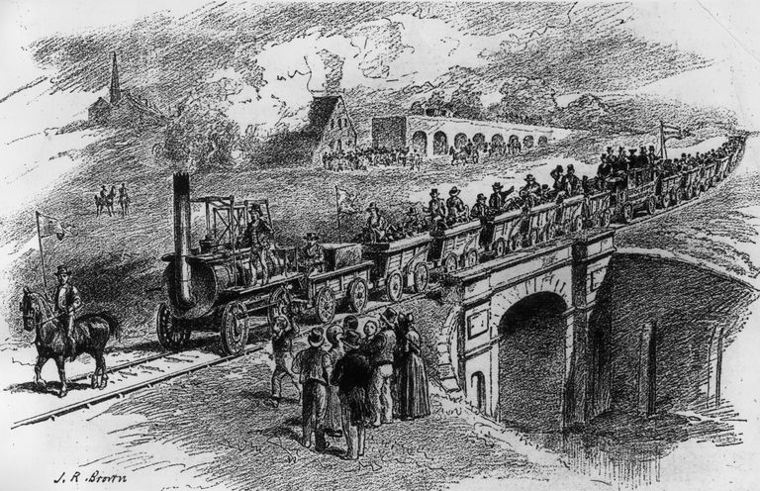
Railroads
Advances in steel production and the steam engine revolutionized
transportation with the invention and cheap spread of the railroad
Railroads made transportation costs lower, and boosted economic
efficiency, as well as reduced travel time for cargo and passengers
This revolutionized society and travel, and additionally required
governments to standardize time—something that previously varied from region to region
Railroads were incredibly efficient, but also required a large amount of labor and capital (money) to lay, which also required a complex and stable banking system
The Bank of England provided a massive advantage for British railroads, as Britain, and later Germany, would lay far more track than the rest of Europe

Slide 6
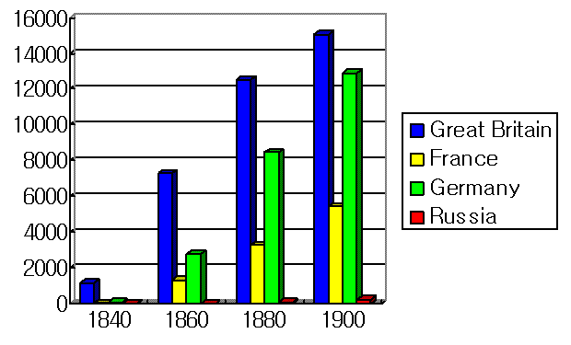
Kilometers of Railroad Track

Slide 7
Railroad Expansion in Britain

Slide 8
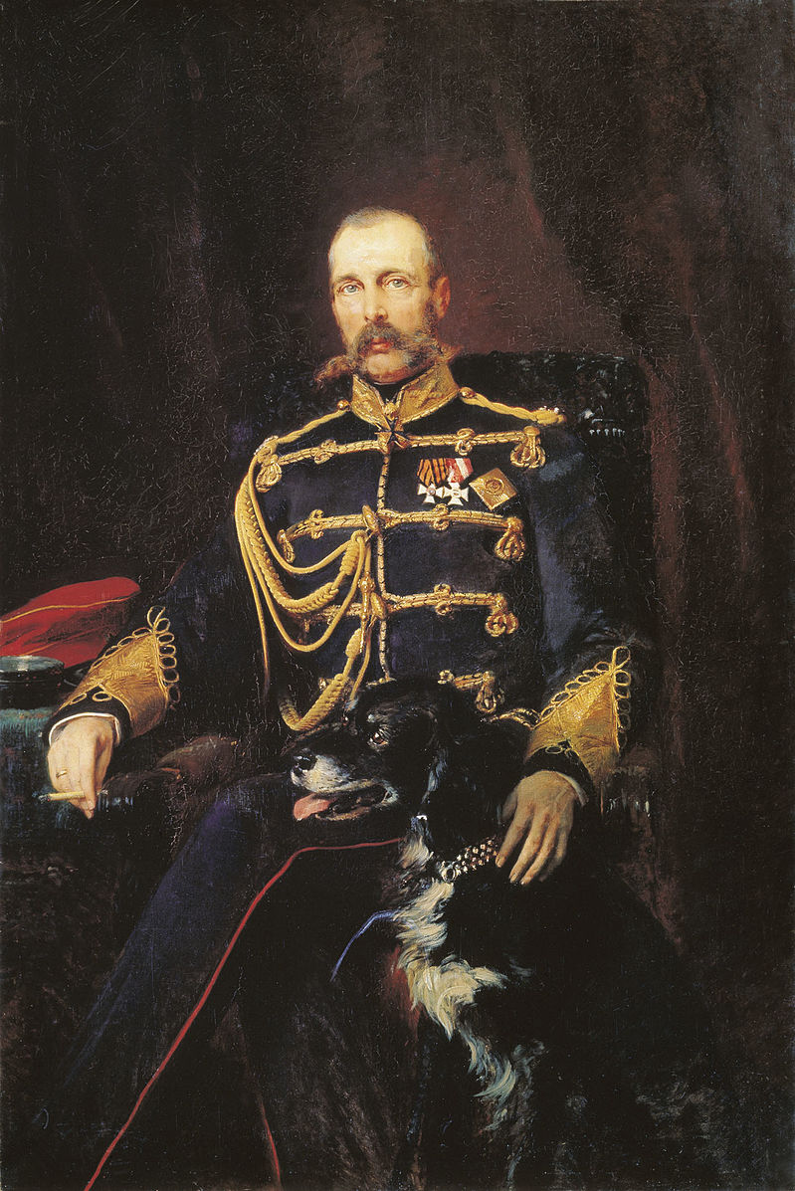
Continental Industrialization
Industrialization on the continent was far slower—slowed by government less friendly to the urban gentry (i.e., a lack of rep. assemblies), as well as many conflicts
The French Rev., Revs of 1830 and 1848 also made continental countries too unstable to foster industrialization, and agriculture remained the focus of economies
In Eastern Europe, serfdom was still the dominant economic force, remaining even in Russia until tsar Alexander II emancipated the serfs in 1861 in an attempt to catch up to the West socially, and, unintentionally, to provide a source of industrial wage labor
Additionally, areas like France and Eastern Europe lacked high-quality iron and coal deposits, something Britain, Belgium, and Germany had in high amounts
France and Eastern Europe also lacked the advanced and consistent banking system that allowed for the expansion of railroads, resulting in slow railroad expansion

Slide 9
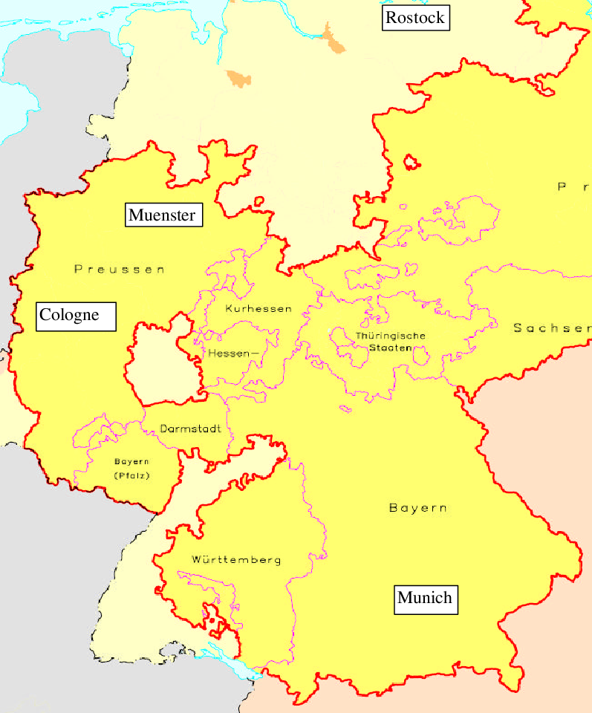
Germany and France
Germany, like Britain, had a ready source of coal and iron to launch itself into the industrial revolution, as well as an established banking system
It’s biggest advantage was the Zollverein (1834)—a free trade union in the German area among all German states before Germany’s union in 1871
This allowed the German states to trade, loan, and industrialize freely with each other, and railroad track and factories to develop easily, as they had in Britain
While France lacked the resources and banking system to match Britain and Germany, it did make attempts to reform, industrialize, and lay railroad
In 1860, it formed the Anglo-French free-trade agreement to boost its trade and economy, as well as attempting to finance railway expansion in the mid-19th
France would never expand its railways like those of the British and Germans, settling for a large amount of canal transportation instead

