Slide 1
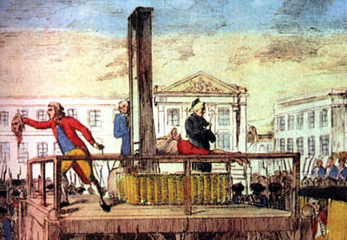
It is not so good to be king anymore…

Slide 2
It was the best of times, it was the worst of times, it was the age of wisdom, it was the age of foolishness, it was the epoch of belief, it was the epoch of incredulity…
-- Charles Dickens A Tale of Two Cities

Slide 3
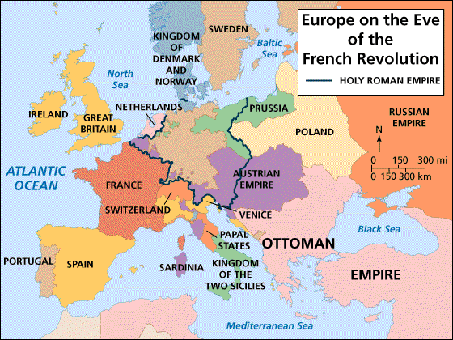
Europe on the Eve of the French Revolution

Slide 4
Causes of the French Revolution
Debt
Weak King
Social Structure
The Enlightenment and American Revolution
Hunger
Notes:
4

Slide 5
Debt
Louis XIV- Wars and Versailles
American Revolution
Royal spending- Louis XVI and Marie Antoinette
Notes:
5

Slide 6
The French Urban Poor

Slide 7
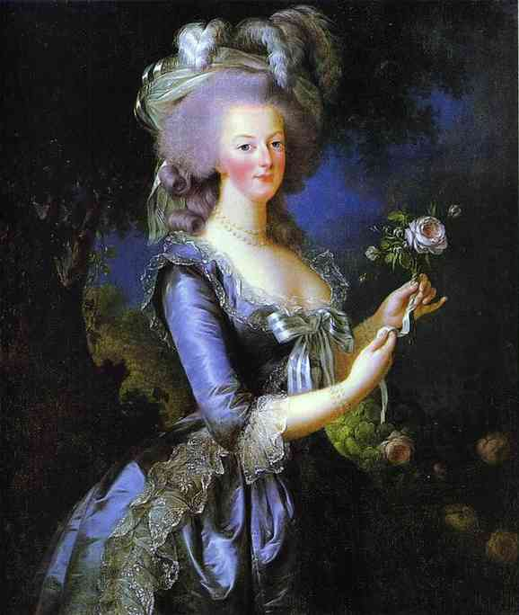
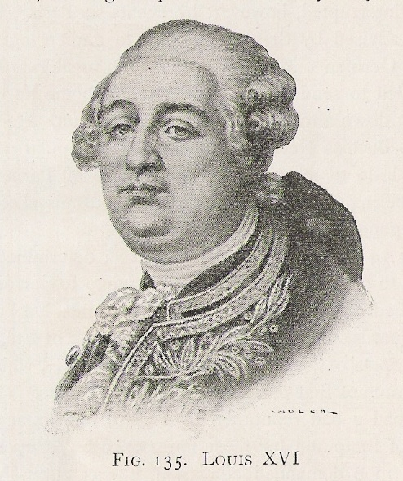
The French Monarchy: 1774 - 1793
Marie Antoinette & Louis XVI

Slide 8
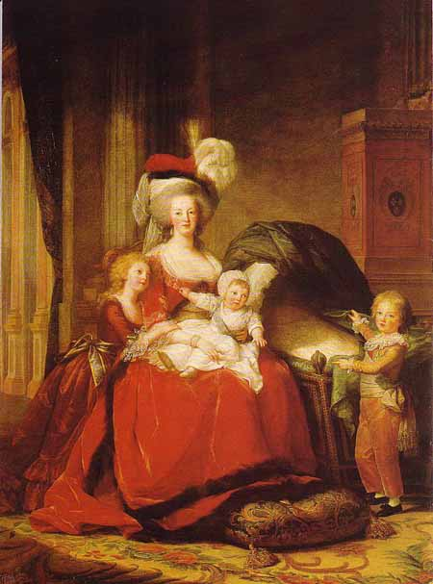
Marie Antoinette and the Royal Children

Slide 9
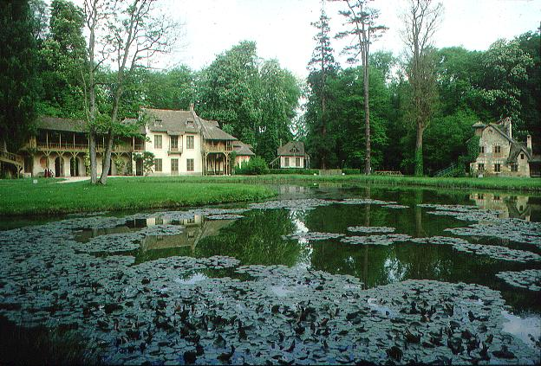
Marie Antoinette’s “Peasant Cottage”

Slide 10
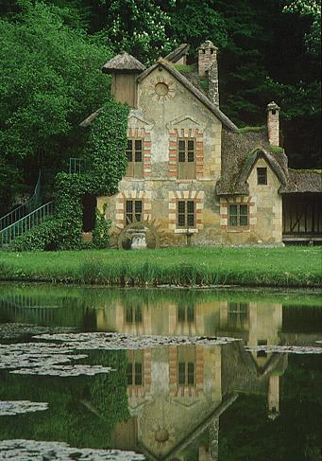
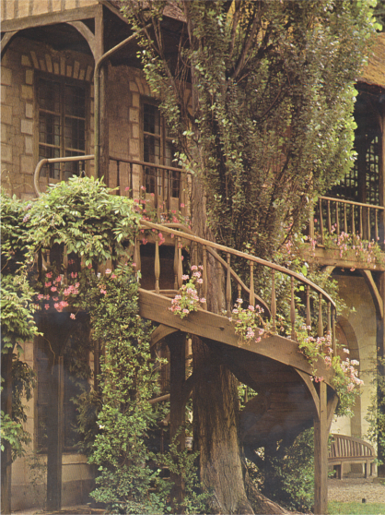
Marie Antoinette’s “Peasant Cottage”

Slide 11
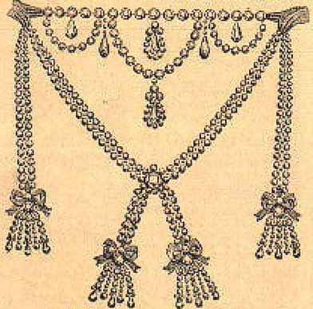
The Necklace Scandal
1,600,000 livres [$100 million today]
Cardinal Louis René Édouard de Rohan
The Countess de LaMotte

Slide 12
Enlightenment and Revolution
The Philosophes were mainly French or living in France
Locke, Montesquieu, Voltaire, Rousseau
American Revolution- Liberty, Brotherhood, Equality
Notes:
12

Slide 13
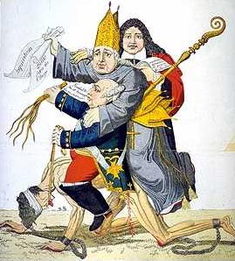

Slide 14
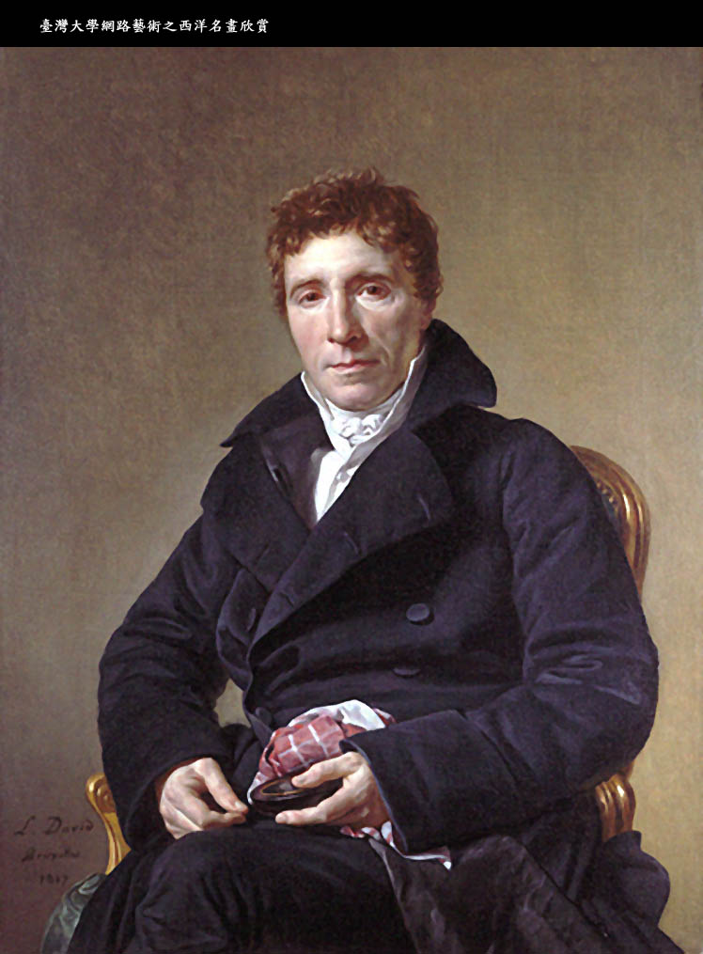
Emmanuel Joseph Sieyes
1st What is the Third Estate? Everything!
2nd What has it been heretofore in the political order? Nothing!
3rd What does it demand? To become something therein!
Abbé Sieyès 1748-1836

Slide 15
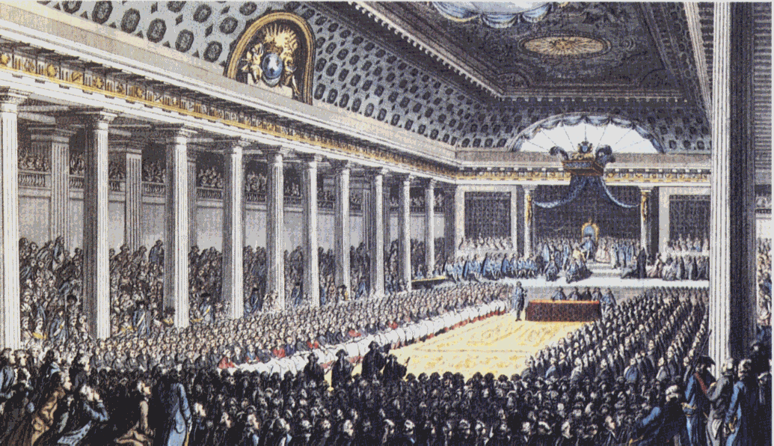
Convening the Estates General May, 1789

Slide 16
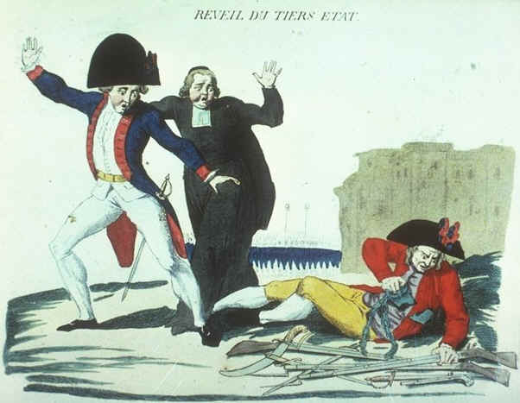
“The Third Estate Awakens”
The commoners finally presented their credentials not as delegates of the Third Estate, but as “representatives of the nation.”
They proclaimed themselves the “National Assembly” of France.

Slide 17
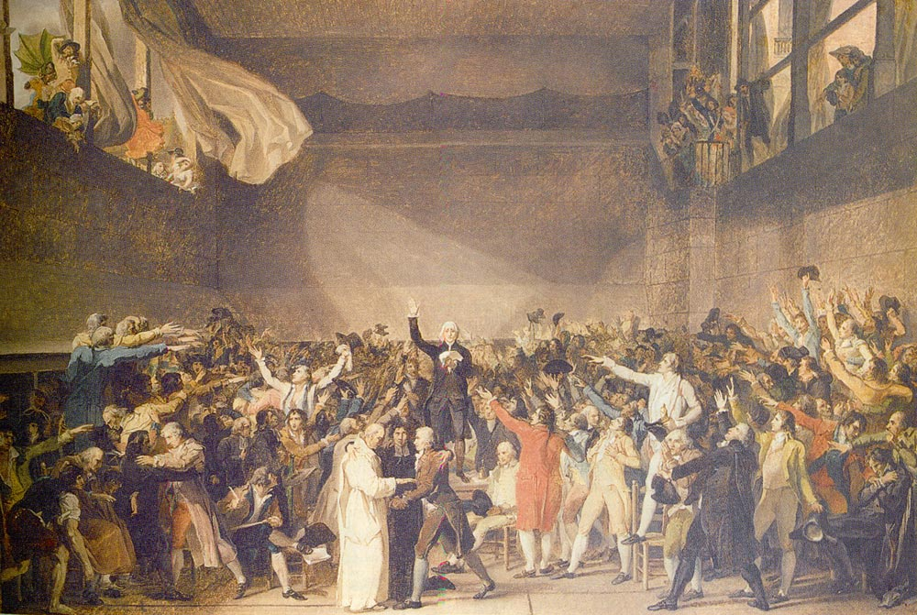
“The Tennis Court Oath” by Jacques Louis David
June 20, 1789

Slide 18
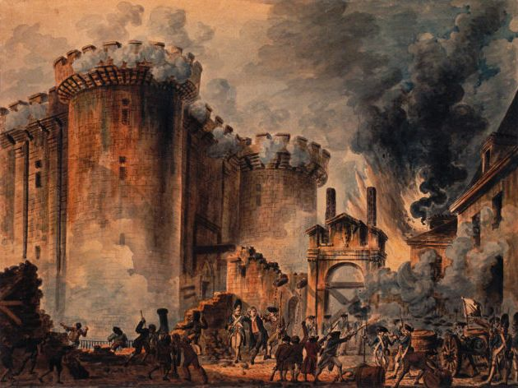
Storming the Bastille, July 14, 1789
A rumor that the king was planning a military coup against the National Assembly.
18 died.
73 wounded.
7 guards killed.
It held 7 prisoners [5 ordinary criminals & 2 madmen].

Slide 19
Notes:
19

Slide 20
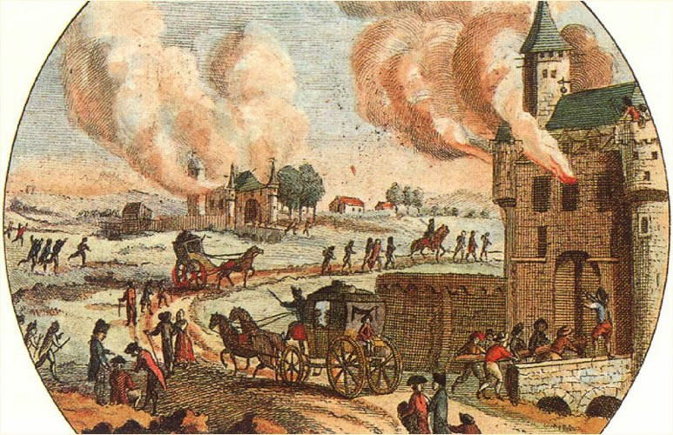
The Great Fear: Peasant Revolt (July 20, 1789)

Slide 21
Night Session of August 4, 1789
Before the night was over:
The feudal regime in France had been abolished.
All Frenchmen were, at least in principle, subject to the same laws and the same taxes and eligible for the same offices.
Equality

Slide 22
National Constituent Assembly 1789 - 1791
Liberté!
Egalité!
Fraternité!
August Decrees August 4-11, 1789
(A renunciation of aristocratic privileges!)

Slide 23
BUT . . . . .
Feudal dues were not renounced outright [this had been too strong a threat to the principle of private property!]
Peasants would compensate their landlords through a series of direct payments for obligations from which they had supposedly been freed.
Therefore, the National Assembly made revolutionary gestures, but remained essentially moderate.
Their Goal
Safeguard the right of private property!!

Slide 24
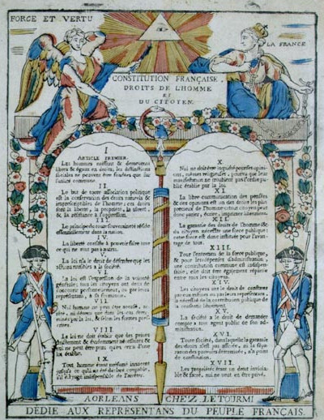
The Declaration of the Rights of Man and of the Citizen
August 26, 1789
Liberty!
Property!
Resistance to oppression!
Thomas Jefferson was in Paris at this time.

Slide 25
Olympe de Gouges (1745-1793)
Women played a vital role in the Revolution.
But, The Declaration of the Rights of Man did NOT extend the rights and protections of citizenship to women.
Declaration of the Rights of Woman and of the Citizen (1791)

Slide 26
The Tricolor (1789)
The WHITE of the Bourbons + the RED & BLUE of Paris.
Citizen!

Slide 27
The “Liberty Cap”: Bonne Rouge

Slide 28
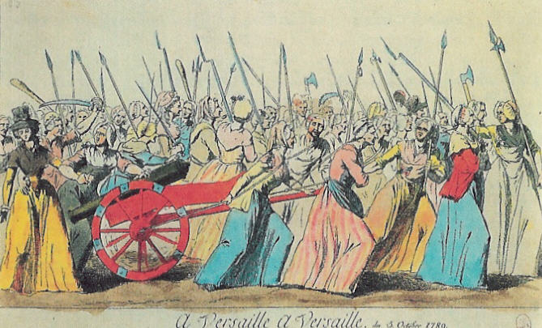
March of the Women, October 5-6, 1789
We want the baker, the baker’s wife and the baker’s boy!

Slide 29
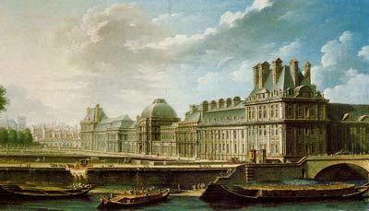
The “October Days” (1789)
The king was thought to be surrounded by evil advisors at Versailles so he was forced to move to Paris and reside at the Tuileries Palace.

Slide 30
The Church
And the Revolution
Notes:
30

Slide 31
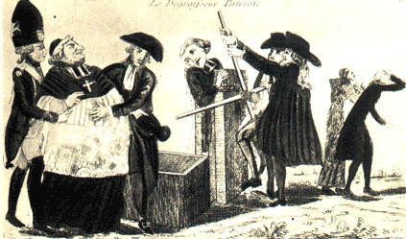
How to Finance the New Govt.? 1. Confiscate Church Lands (1790)
One of the most controversial decisions of the entire revolutionary period.

Slide 32
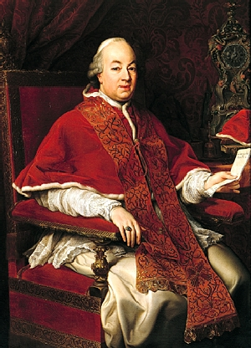
The Civil Constitution of the Clergy
Government run Churches.
The church was reorganized:
Parish priests → elected by the district assemblies.
Bishops → named by the department assemblies.
Pope Pius VI [1775-1799]

Slide 33
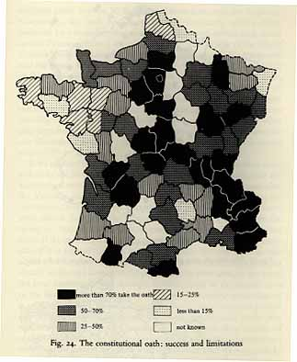
July 12, 1790
Jurying vs. Non-Jurying [refractory] Clergy
The oath of allegiance permanently divided the Catholic population

Slide 34
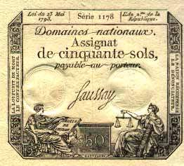
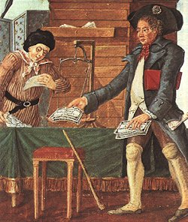
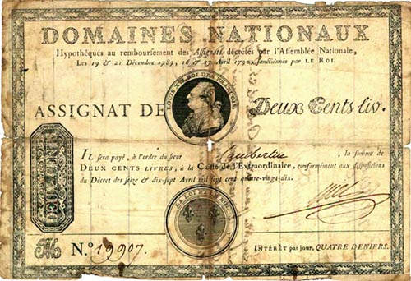
2. Print Assignats
Issued by the National Constituent Assembly.
Interest-bearing notes which had the church lands as security.

Slide 35
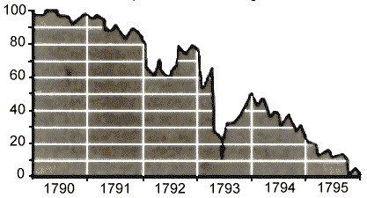
Depreciation of the Assignat
Whoever acquired them were entitled to certain privileges in the purchase of church land.
The state would retire the notes as the land was sold.
They began circulating as paper currency.
Government printed more → INFLATION [they lost 99% of their value ultimately].
Therefore, future governments paid off their creditors with cheap money.

Slide 36
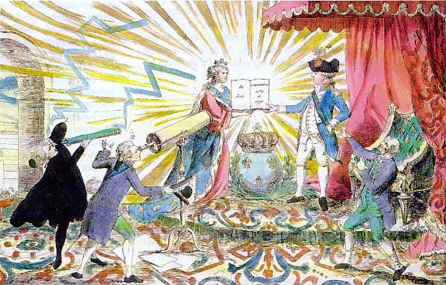
Louis XVI “Accepts” the Constitution & the National Assembly. 1791

Slide 37
The French Constitution of 1791:
A Bourgeois Government
The king got the “suspensive” veto [which prevented the passage of laws for 4 years].
He could not pass laws.
His ministers were responsible for their own actions.
A permanent, elected, single chamber National Assembly.
Had the power to grant taxation.
An independent judiciary.

Slide 38
The French Constitution of 1791:
A Bourgeois Government
“Active” Citizen [who pays taxes amounting to 3 days labor] could vote vs. “Passive” Citizen.
1/3 of adult males were denied the franchise.
Domestic servants were also excluded.
A newly elected LEGISLATIVE ASSEMBLY.
GOAL → Make sure that the country was not turned over to the mob!

Slide 39
Legislative Assembly
Jacobins
Radicals- Sans Culottes- The Mountain- the Left
Moderate
Conservatives- Girondists - Right
Notes:
39

Slide 40
The Political Spectrum
TODAY:
1790s:
The Plain (swing votes)
Montagnards (“The Mountain”)
Girondists
Monarchíen (Royalists)
Jacobins

Slide 41
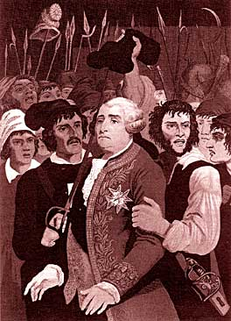
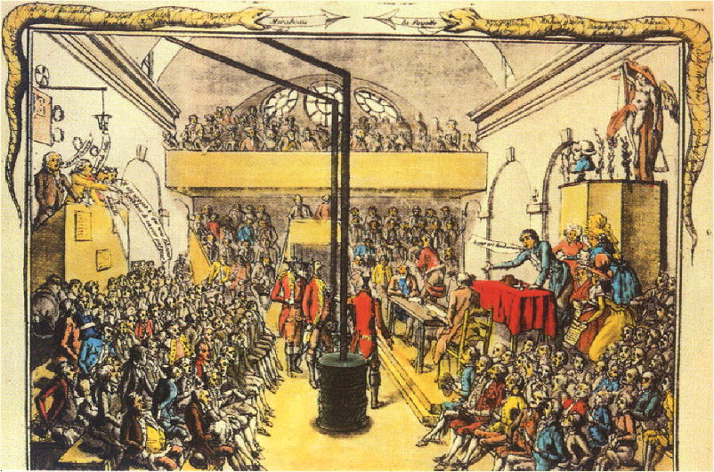
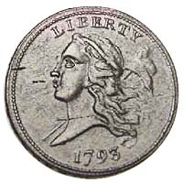
The Jacobins
Jacobin Meeting House
They held their meetings in the library of a former Jacobin monastery in Paris.
Started as a debating society.
Membership mostly middle class.
Created a vast network of clubs.

Slide 42
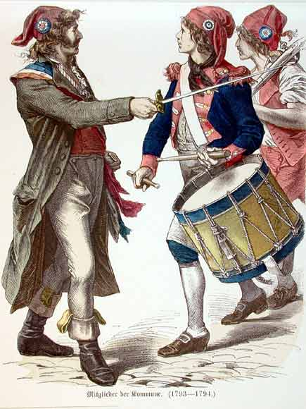
The Sans-Culottes: The Parisian Working Class
Small shopkeepers.
Tradesmen.
Artisans.
They shared many of the ideals of their middle class representatives in government!

Slide 43
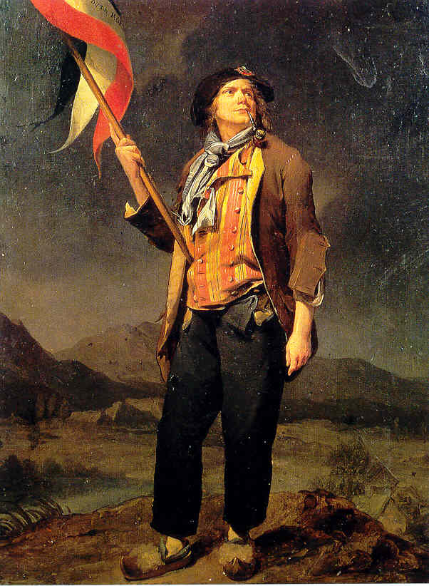
Sans Culottes

Slide 44
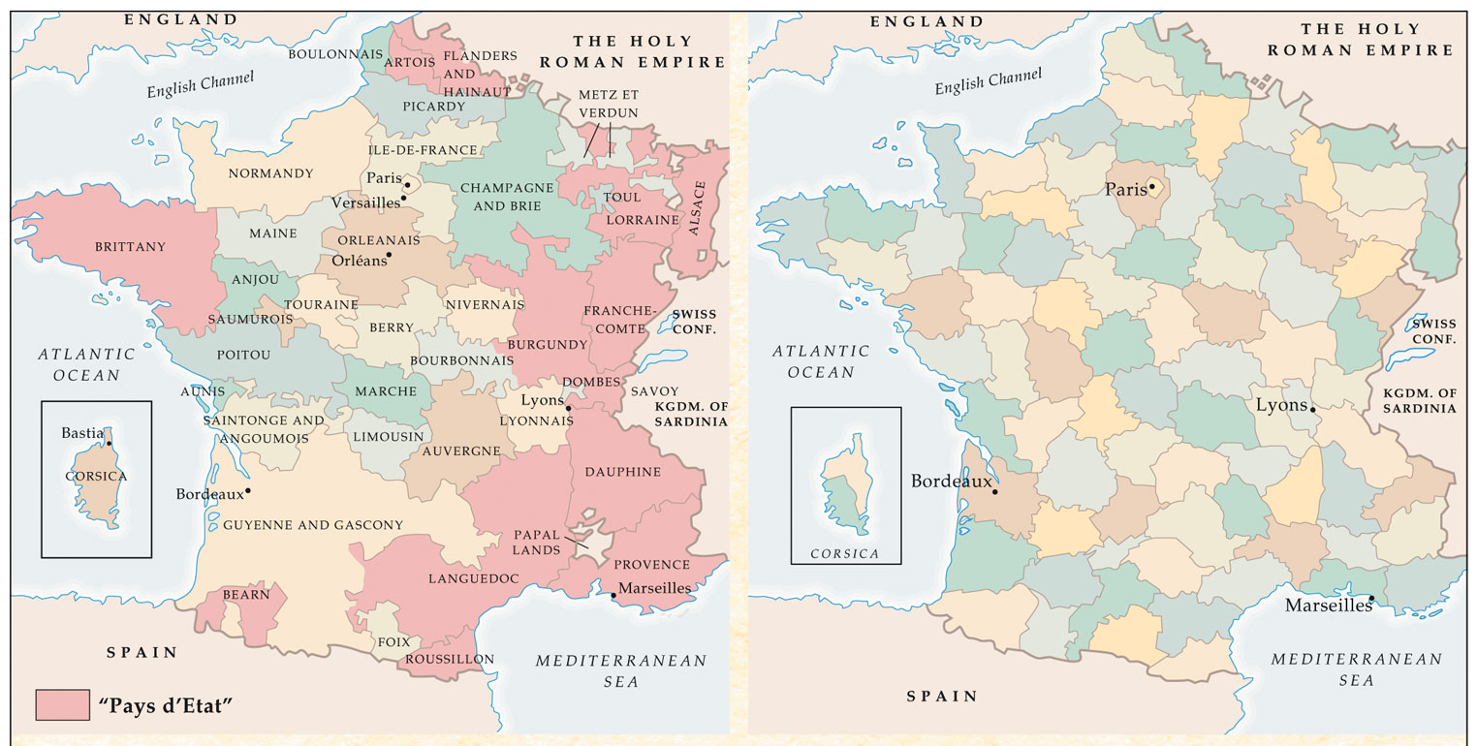
83 Revolutionary Departments
February 26, 1790

Slide 45
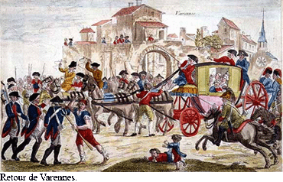
The Royal Family Attempts to Flee
June, 1791
Helped by the Swedish Count Hans Axel von Fusen [Marie Antoinette’s lover].
Headed toward the Luxembourg border.
The King was recognized at Varennes, near the border

Slide 46
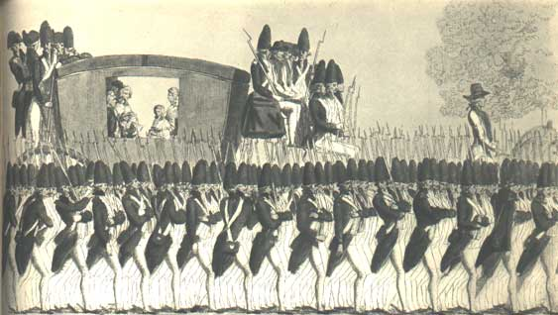

Slide 47
Foreign Involvement
Declaration of Pillnitz
Europe’s Attitude

Slide 48
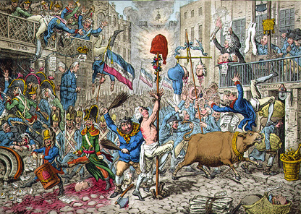
Sir Edmund Burke (1790): Reflections on the Revolution in France
The conservative response to the French Revolution

Slide 49
The First Coalition & The Brunswick Manifesto (August 3, 1792)
Duke of Brunswick→ if the Royal Family is harmed, Paris will be leveled!!
1792-1797
FRANCE
AUSTRIA PRUSSIA BRITAIN SPAIN PIEDMONT
This military crisis undermined the new Legislative Assembly.

Slide 50
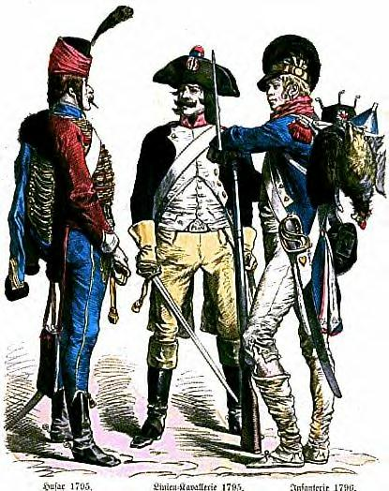
French Soldiers
The French armies were ill-prepared for the conflict.
½ of the officer corps had emigrated.
Many men disserted.
New recruits were enthusiastic, but ill-trained.
French troops often broke ranks and fled in disorder.

Slide 51
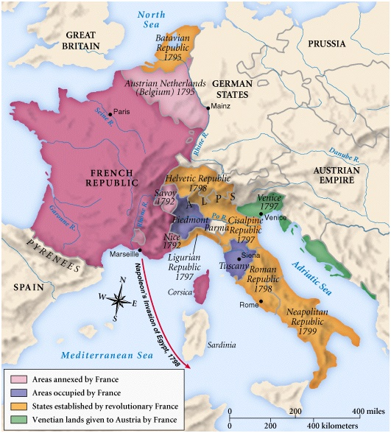
French Expansion: 1791-1799

