Slide 1
The Cold War
1947-1970

Slide 2
Cold War was a C.O.N.F.L.I.C.T. between the U.S.A. & U.S.S.R.
Containment (Truman Doctrine)
Ongoing problems in Berlin
NATO vs. Warsaw Pact
Fighting (Korea and Vietnam War)
Loss of China & Cuba to communism
Iron Curtain
Cuban Missile Crisis
Theory of deterrence (avoid nuclear war)

Slide 3
17.1 Superpowers Face Off
Main Idea
The opposing economic & political philosophies of the U.S. and the Soviet Union led to global competition.
Why it Matters Now
The conflicts between the U.S. and the Soviet Union played a major role in reshaping the modern world.

Slide 4
END OF WWII ISSUES
Loss of life
50 million (15 mil. Soldiers)
Homeless
Holocaust survivors
Japanese in U.S.
War torn countries
Loss of property – 2 trillion
Factories
Transportation systems
Devastated cities
WHO’S RESPONSIBLE?
HOW DOES IT GET FIXED WITH DIFFERENT, OPPOSING BELIEFS?

Slide 5
“COLD WAR”
Cold war
state of intense economic, political, military, and ideological rivalry between nations
No actual fighting
Attempts to block one another’s goals
Two major players
United States
Soviet Union

Slide 6
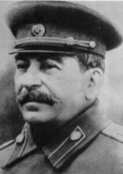
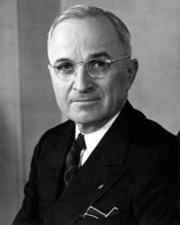
VS.
Communism
collective ownership
No private property
No political choice
No god
Totalitarian gov
complete control over citizens
Worldwide revolution against capitalism
American system
Private property
Elections & free assembly
Freedom of religion
Limited gov
Spread “democracy” & capitalism
means of production are privately owned
Guided by supply & demand

Slide 7
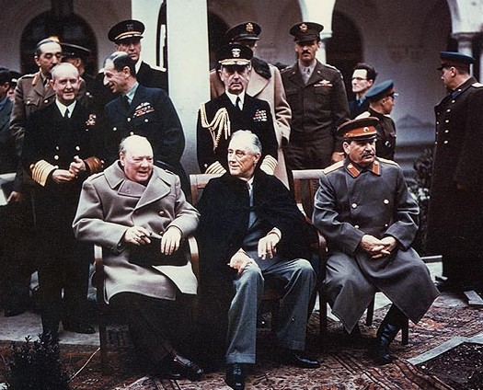
Yalta Conference (Feb. 1945)
Plans for the end of WWII
Stalin, FDR, & Churchill
Germany would be divided into 4 parts
USSR to enter war against Japan
create United Nations
USSR will allow elections in Poland & E. Europe

Slide 8
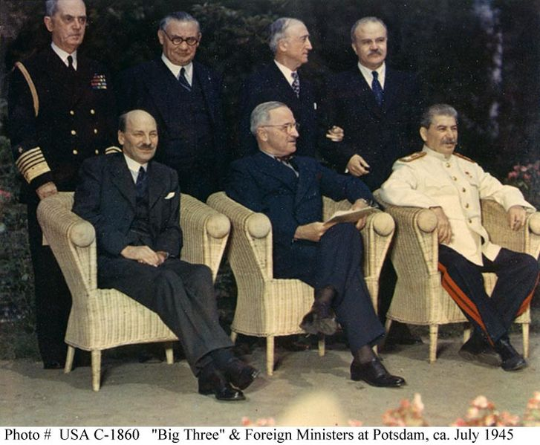
Potsdam (July 1945)
How to deal with Germany & Japan
Truman, Stalin, & Churchill
Disagreement over Stalin canceling elections
Germany would be demilitarized
Division of Germany into 4 zones
Occupied by U.S., Britain, France, and Soviet Union
Berlin (capital) also split
& occupied

Slide 9
UNITED NATIONS
1st met April 1945
By June 1946: agreed on a charter
General assembly: all UN member states
UN council: 5 permanent members:
U.S., U.K., France, Soviet Union & China
have power to veto
Elected members are elected by the general assembly for 2 year terms, with five replaced every year
UN security council unable to exercise its primary responsibility
disagreement among the permanent members

Slide 10
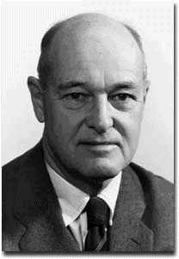
CONTAINMENT
Feb. 1946: Containment
Proposed by George Kennan (American diplomat in Moscow)
Created alliances and supported weaker countries
effort to block Soviet influence
“It is clear that the united states cannot expect in the foreseeable future to enjoy political intimacy with the soviet regime. It must continue to regard the soviet union as a rival, not a partner, in the political arena.”

Slide 11
TRUMAN DOCTRINE
1946-1947: Both Greece and Turkey faced communist revolts (civil war)
Asked the U.S. for aid to defend themselves from communist takeovers
President Truman asked congress for aid
$400 million
US troops/advisors
.
“The seeds of totalitarian regimes are nurtured by misery and want. They spread and grow in the evil soil of poverty and strife. They reach their full growth when the hope of a people for a better life has died. We must keep that hope alive.
The free peoples of the world look to us for support in maintaining their freedoms. If we falter in our leadership, we may endanger the peace of the world -- and we shall surely endanger the welfare of our own nation. Great responsibilities have been placed upon us by the swift movement of events.”
Notes:
$400 MILLION WOULD BE OVER $3.2 BILLION IN 2002 DOLLARS.

Slide 12
The “Iron Curtain”
March 1946: Churchill gives speech
Should be a US/UK agreement to resist and deter disturbances to world peace
Stalin wants "not war but the fruits of war”
If Allies stay strong and united they can counter any Soviet threat
Stalin considered speech “a call to war”
http://vimeo.com/38521555
From Stettin in the Balkans, to Trieste in the Adriatic, an iron curtain has descended across the Continent. Behind that line lies the ancient capitals of Central and Eastern Europe. -- Sir Winston Churchill, 1946

Slide 13
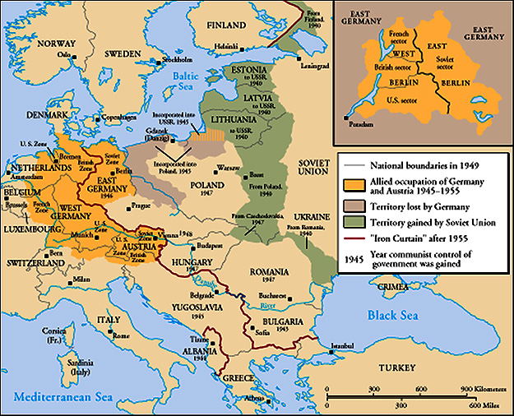

Slide 14
Marshall Plan (1948)
1948: Soviets seized control of Czechoslovakia
Made it a USSR puppet state
Result: U.S. approves Marshall Plan
“European Recovery Program”
Secretary of State, George Marshall
US should provide aid to all European nations that need it
$12.5 billion of US aid to Western Europe extended to Eastern Europe & USSR, [but this was rejected].
http://www.dailymotion.com/video/xd50l9_the-marshall-plan_news

Slide 16
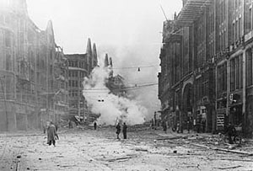
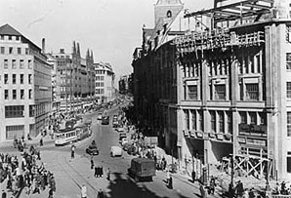
GERMAN CITY OF HAMBURG, 1947
MARSHALL PLAN
Modernization of industrial equipment
Creation of sound currencies and national
budgets
Expansion of trade and increase in exports
Increased economic cooperation
Increase in production
agriculture & energy
Improvement in transport systems
1952, AFTER THE MARSHALL PLAN

Slide 17
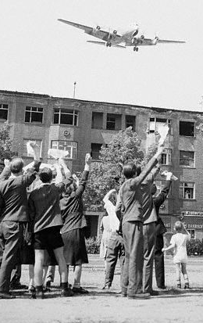
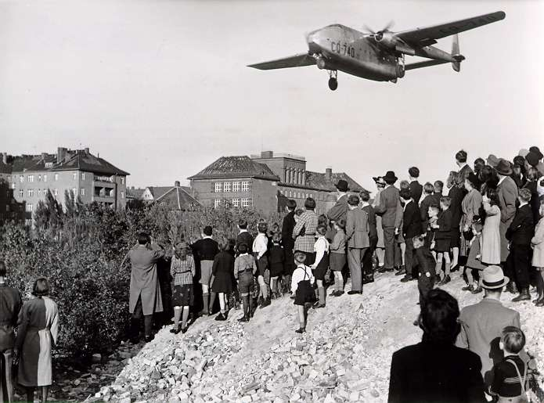
Berlin Blockade & Airlift (1948-49)

Slide 18
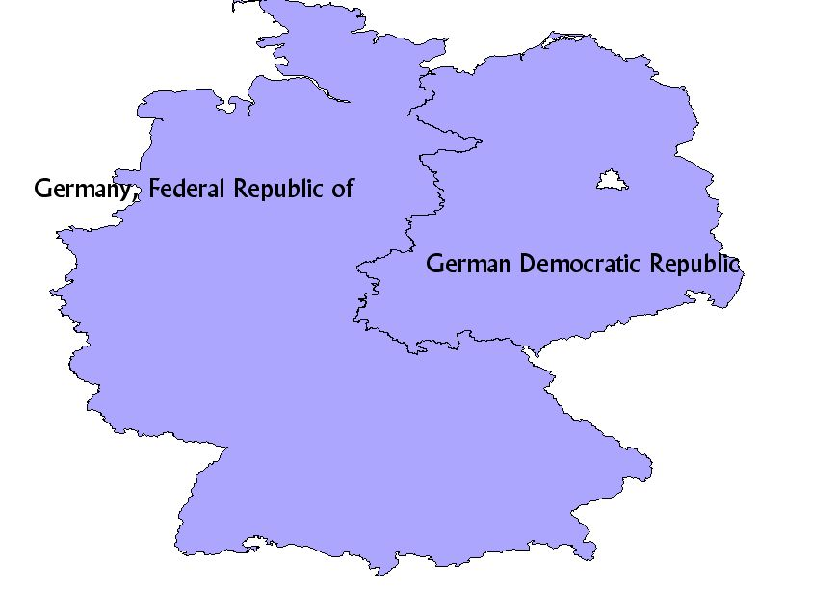
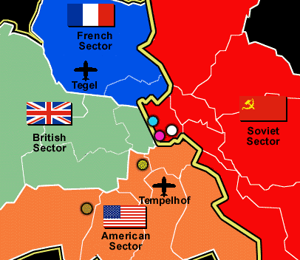
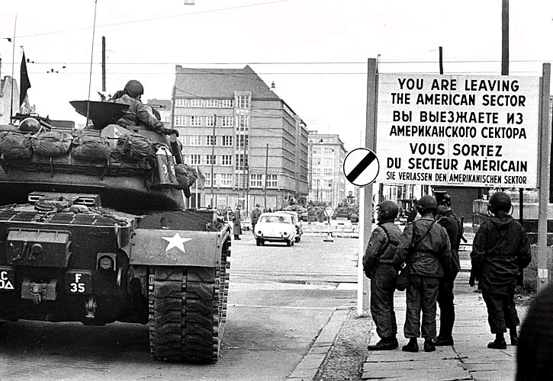
1949: Germany & its capital Berlin were divided into 4 zones
Soviet
French
British
American
Allies united in the West
Soviets in the East

Slide 19
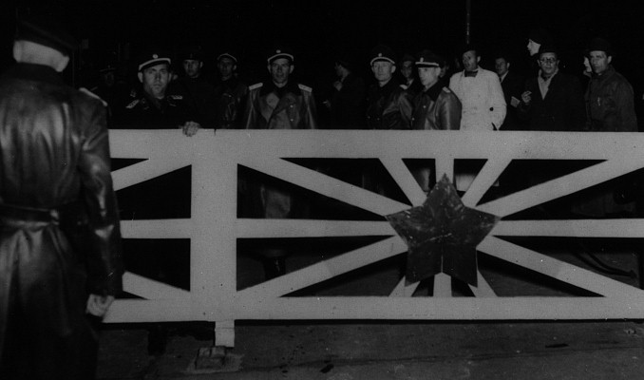
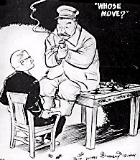
June 23, 1948: USSR imposed blockade
Blocked railway, road, & canal traffic leading to West Berlin from the allied German zone
No supplies of any type were allowed to enter West Berlin
Stalin wanted to starve the city into submission.
Why?:
Stalin wanted to control all Berlin
The London program of 1948
called for separate West Germany & currency reform

Slide 20
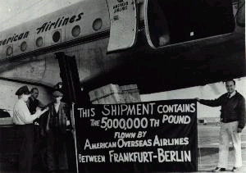
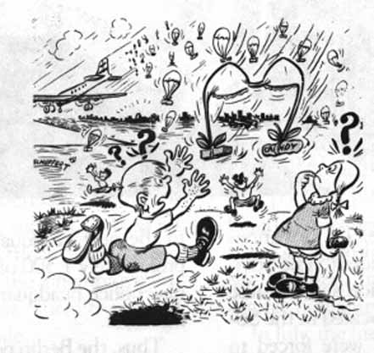
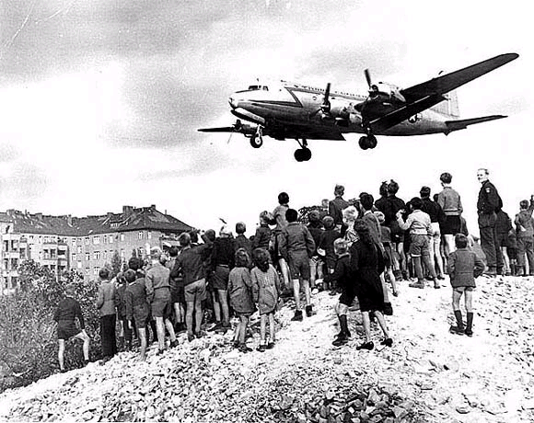
BERLIN AIRLIFT (June 1948 - May 1949)
Operation Vittles (Berlin Airlift)
President Truman decided to hold on to West Berlin
An airlift would keep the city supplied with goods
Used small parachutes to dropped candy to Berlin children

Slide 21
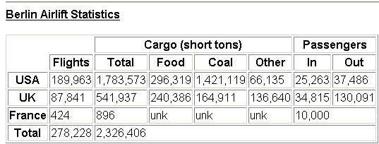

Slide 22
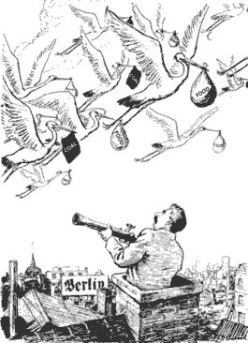
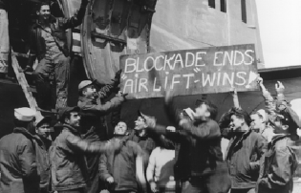
President Truman made it clear that if one cargo plane was shot down it would mean war between the us and USSR
May of 1949: Russians ended the blockade

Slide 23
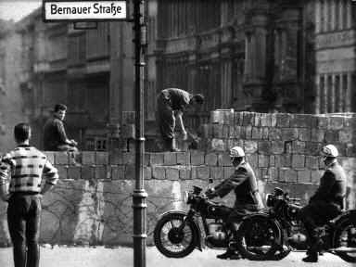
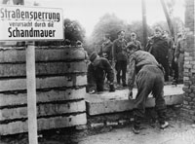
Berlin Wall
1961: Soviets build a wall around East Berlin to keep people from leaving to go to West

Slide 24
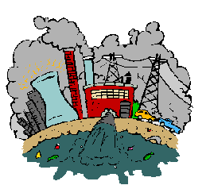
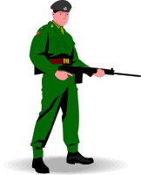
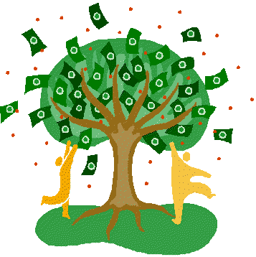
Life in West Berlin
1961
Life in East Berlin
BERLIN WALL
Democratic Elections
Poverty
Capitalism
Good Trade Relations
Harsh Regulations
Industry
Freedom of Movement
Communism
GDR
Quick Recovery from WWII
Under Soviet Control
Limited Choice
Prosperous
1989
Limited Trade
Choice
Totalitarianism

