Slide 1
© Morgan AP Teaching
Period 1: 1450 CE -1648 CE
The Catholic Counter
Reformation

Slide 2
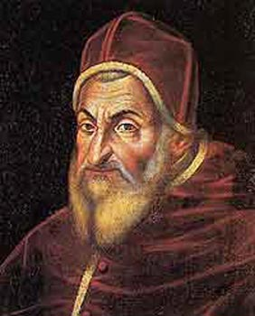
© Morgan AP Teaching
Impact of the Reformation
The Reformation in the 16th century absolutely devastated the political and financial power of the Church, as well as its influence
Many princes and kings joined the Reformation movement to take Church land, and avoid Church taxes
By number, almost half of all Catholics in Europe turned to some form of Protestantism, mostly in German areas
As a result, the Catholic Church leadership decided to consider the view of the Protestants, and contemplate reforms

Slide 3
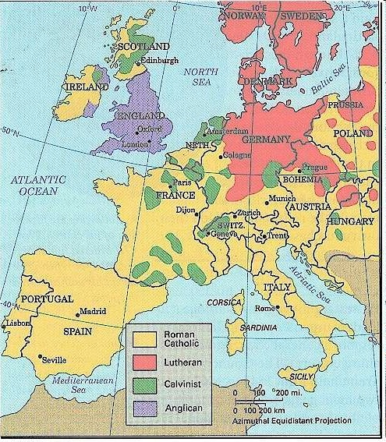

Slide 4
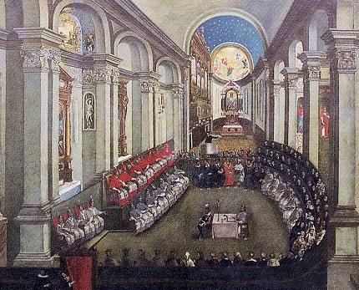
© Morgan AP Teaching
Counter Reformation
At The Council of Trent (1545-1563) Catholic leaders discussed all of the issues brought fourth by the Protestants and talked about changes
However, during the meeting, they essentially decided to deny all Protestant claims and maintained their exact same system
Rather than deciding to make some adjustments, Catholics doubled-down on their opposition to Protestants
The Council accomplished nothing more than reaffirming their practices, and forever destroying a united, Christian Europe

Slide 5
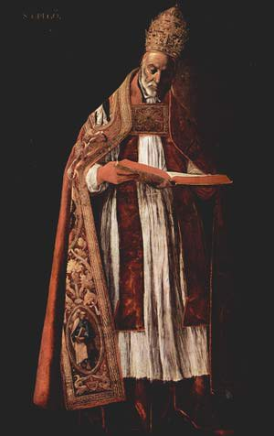
© Morgan AP Teaching
Different Reforms
Rather than changing their beliefs, the Catholics instead sought to reinvigorate the people that remained faithful to Catholicism
Like humanists and Christian humanists, they encouraged priests, monks, and bishops to look to older Christian writings for inspiration
Catholics hoped to spark a renewed sense of belonging to the Church, and encouraged a close, personal relationship with God
They were clear to establish, however, scripture was NOT the form of authority—rules, regulations, and changes were still the Church’s to make

Slide 6
© Morgan AP Teaching
Revival
The catholic Church highly promoted any writings that spoke highly of Catholicism, a relationship with God, or their traditions and rituals
Two figures that embodied this were the works of St. Teresa of Avila,
as well as Ignatius Loyola’s book entitled the Spiritual Exercises
Teresa of Avila was a nun who wrote about dedicating your body and soul to the Catholic faith, and promoted strong, close connection with God
In the Spiritual Exercises, Ignatius Loyola laid out a step-by-step plan about how to be closer to God by maintaining Catholic traditions and rituals
Lastly, the Catholic Church founded the Society of Jesus (Jesuits) dedicated to education, reconverting Protestants, and converting new members in the New World

Slide 7
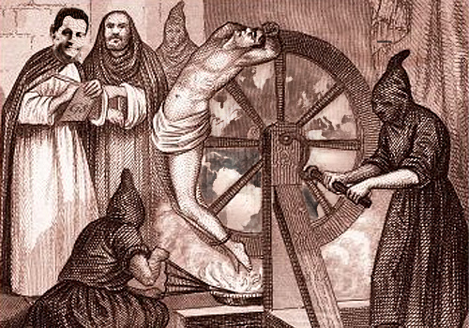
© Morgan AP Teaching
Opposition to Protestants
Lastly, the Counter Reformation cemented a divide with
Protestants with no hopes of making changes or reuniting Europe
Catholic leaders were encouraged (and most did) to make
laws explicitly forbidding and punishing Protestantism
The Catholic Church created the Index of Prohibited Books, banning
anything deemed heretical (Protestant or scientific in most cases)
Additionally, the Catholic Church promoted and expanded the Inquisition, which traveled around Europe seeking out ‘heretics’ (Jews, scientists, and Protestants)
The Inquisition used torture and brutal methods of killing, murdering thousands of Europeans in Spain, Italy, France, the HRE, and the Netherlands

