Slide 1
The Atlantic Slave Trade

Slide 2
Terms and Names
Atlantic Slave Trade
Triangular trade
Middle Passage

Slide 3
Setting the Stage
Sugar plantations and tobacco farms required a large supply of workers to make them profitable for their owners. Since most of the Native Americans that were used for labor had died, they turned to Africa for a new source of labor.

Slide 4
The Evolution of African Slavery
Slavery in Africa, as in other parts of the world, had existed for ages
Slavery is thought to be as old as civilization itself
New agricultural techniques created a need for more labor, and prisoners of war were put to use

Slide 5
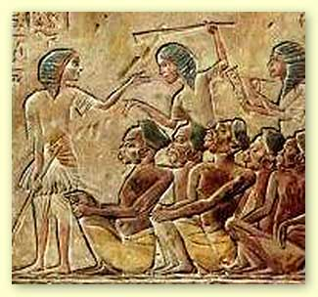

Slide 6
Evolution of African Slavery
African rulers justified the sale of slaves through their Muslim beliefs.
Between the years 650 and 1600, black and white Muslims transported 4.8 million African to Muslim lands in SW Asia.
In African and Muslim societies, slaves had rights and the opportunity for social mobility.
Slavery in African and Muslim societies was NOT hereditary.

Slide 7
The Desire for Africans
The Portuguese were the first Europeans to Explore Africa.
They were more interested in trading for gold than for slaves.
The colonization of the Americas changed the focus of trade.

Slide 8
The Desire for Africans
There were several advantages in using Africans:
They had been exposed to European diseases
They had experience in farming
They had little knowledge of the land and there were no familiar tribes

Slide 9
The Desire for Africans
This trade for slaves became the Atlantic Slave Trade
Between 1500 and 1600, about 300,000 slaves were taken to the Americas.
During the next 100 years, the number jumped to 1.5 million, and by 1870 the number was about 9.5 million.

Slide 10
Spain and Portugal lead the way
During the 1600’s, Brazil dominated the sugar market – and as it grew, so did the need for slaves.
During the late 17th century, nearly 40% of the slaves from Africa were taken to Brazil.
Brazil, by the end of the slave trade, had 10 times the amount of slaves than in North America.

Slide 11
Slavery Spreads
England then dominated the slave trade from the 1690 until 1807.
By 1830, there were nearly 2 million African slaves in North America.
African merchants, with the help of local rulers, captured fellow Africans to be enslaved.
They delivered them to the Europeans in exchange for gold, guns and other goods.

Slide 12
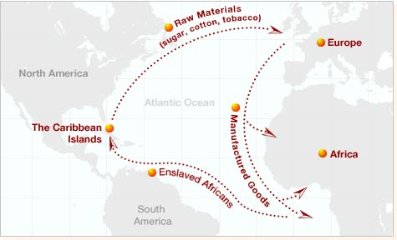

Slide 13
Forced Journey
The trade routes formed a Triangle, becoming known as the triangular trade.
Manufactured goods from Europe to Africa
Slaves from Africa to the Americas
Rum, and other goods from the Americas to Europe

Slide 14
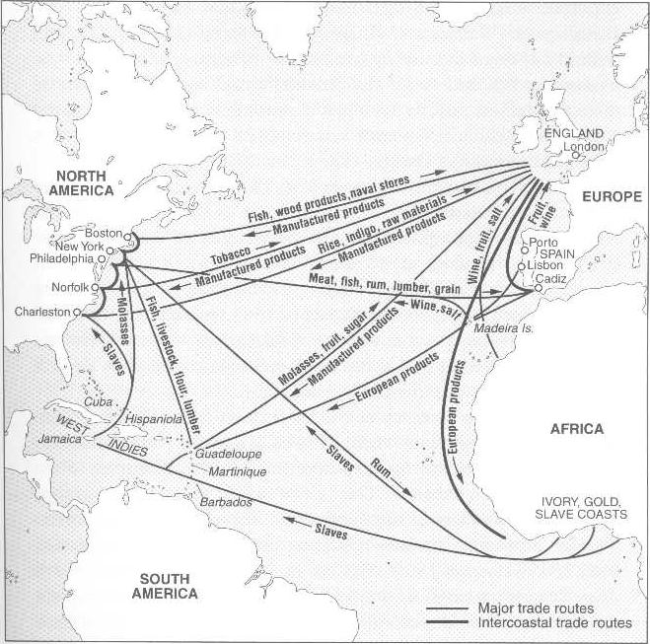

Slide 15
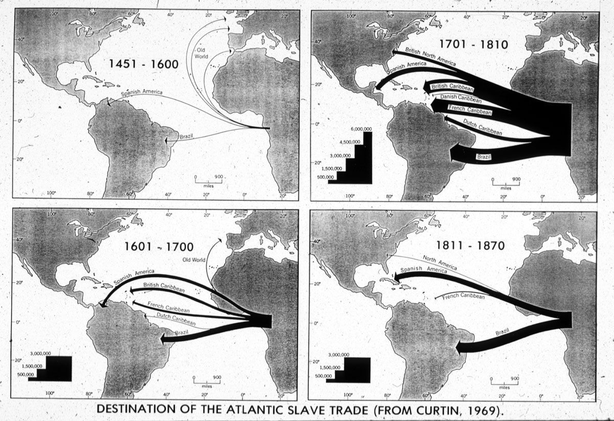

Slide 16
Forced Journey
The voyage across the Atlantic was dehumanizing, and deadly
Nearly 1/3 died between capture and sailing
Another 1/3 died in the crossing

Slide 17
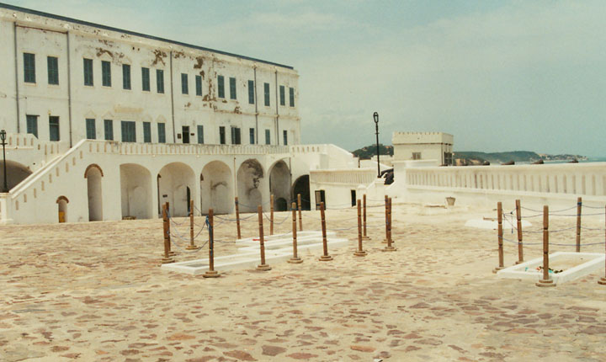

Slide 18
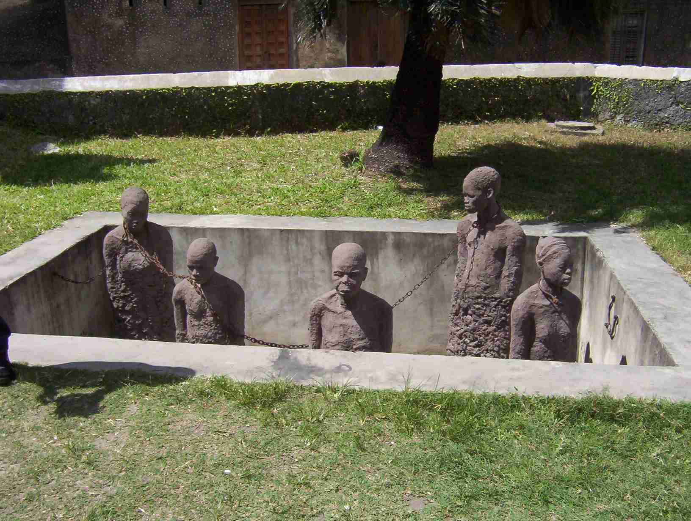

Slide 19
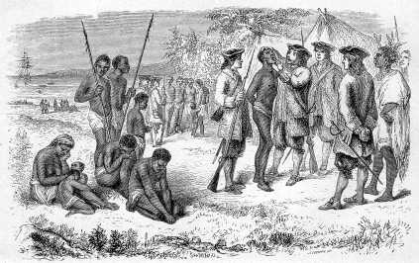

Slide 20
Forced Journey
Many Africans jumped overboard to their deaths rather than be enslaved.
Diseases ravaged the “passengers”
Cruel treatment ravaged more

Slide 21
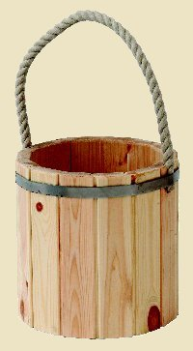
Forced Journey
The second part of the journey, from Africa to the Americas was known as the Middle Passage.
Formula – 2 slaves per tonne
Loose Pack and Tight Pack

Slide 22
The Slavers
Small and narrow ships
Two slaves per ship tonnage formula
Most captains are “tight packers”
ignored formula in the name of profits

Slide 23
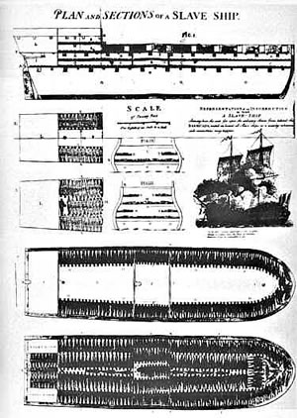

Slide 24
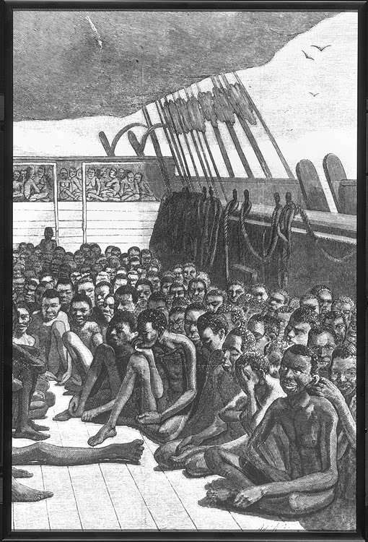

Slide 25
The Slavers (cont.)
Crowded, unsanitary conditions
Slaves ride on planks 66” x 15”
only 20”– 25” of headroom
Males chained together in pairs
Kept apart from women and children
High mortality rates
1/3 perish between capture and embarkation

Slide 26
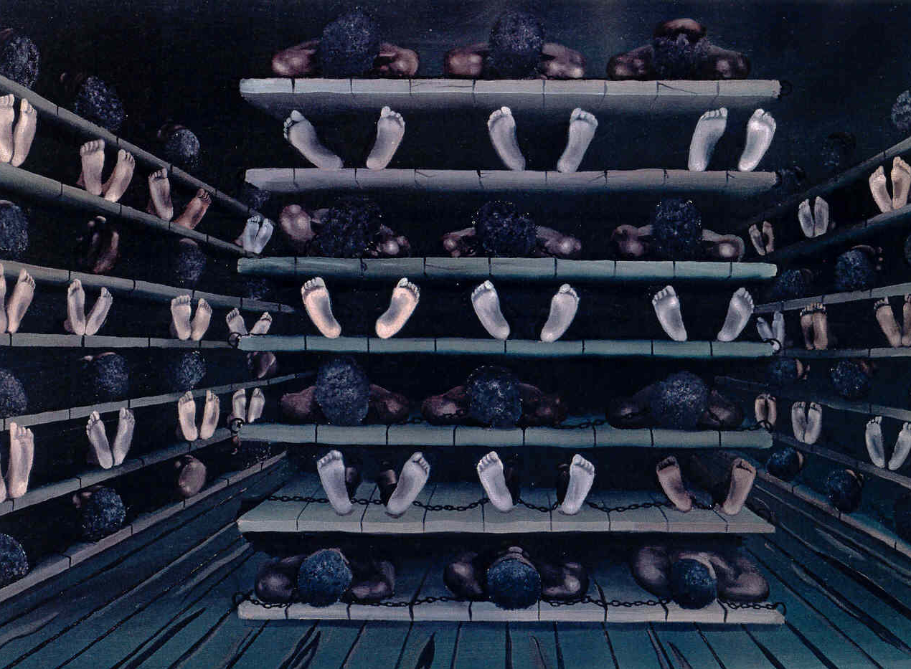

Slide 27
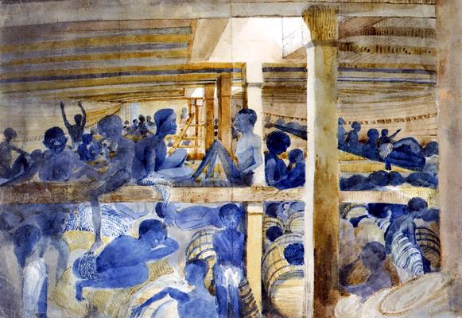

Slide 28
Provisions for the Middle Passage
Slaves fed twice per day
Poor and insufficient diet
Vegetable pulps, stews, and fruits
Denied meat or fish
Ten people eating from one bucket
Unwashed hands spread disease
Malnutrition ~ weakness ~ depression ~ death

Slide 29
The Crossing
Canary Islands to the Windward Islands
40 to 180 days to reach the Caribbean
Pirates attacked Spanish ships
Frightening experience

Slide 30
Growth of the Atlantic Slave Trade
Harsher in the Americas
Based on race
Most were males
Believed they were stronger laborers than females
Agricultural workers

Slide 31
Resistance and Revolt at Sea
Uprisings were common
Most rebellions before sailing
Some preferred death to bondage
Justification for harsh treatment by slavers

Slide 32
The End of the Journey
Survival
One-third died
men died at a greater rate than women
Adapt to new foods
Learn a new language
Creole dialect well enough to obey commands
Psychological ~ no longer suicidal
Africans retain culture despite the hardships and cruel treatment
Created bonds with shipmates that replaced blood kinship

Slide 33
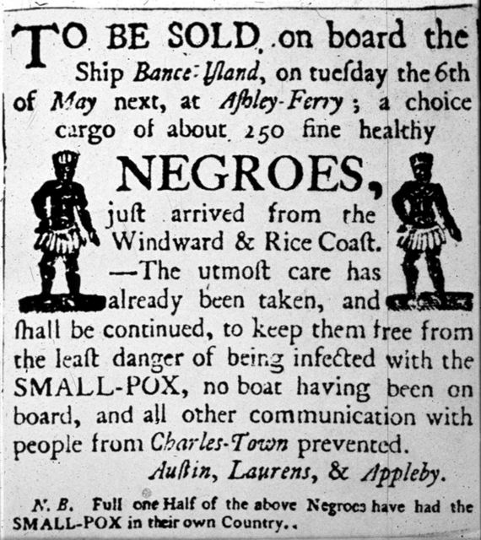

Slide 34
IX. The Ending of the Atlantic Slave Trade
Cruelties help end Atlantic slave trade
Great Britain bans Atlantic slave trade in 1807
Patrols African coast to enforce
United states congress outlaws slave trade in 1808
Guinea and western central African kingdoms oppose banning slave trade

Slide 35
Conclusion
Nine to eleven million Africans brought to the Americas during three centuries of trade
Millions more died
Most arrived between 1701 and 1810
Only 600,000 reached the British colonies of north America

Slide 36
Consequences of the Atlantic Slave Trade
In Africa, numerous cultures lost generations of their strongest members, both men and women.
The slave trade introduced guns to the African continent
African slaves contributed greatly to the cultural and economic development of the Americas.
Africans brought their culture to the Americas

