Slide 1
© Morgan AP Teaching
Period 1: 1450 CE -1648 CE
The Age of
Exploration

Slide 2
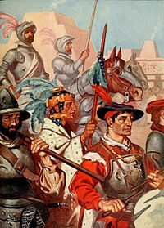
© Morgan AP Teaching
Spain and Portugal Begin
Searching for a route to join the lucrative Indian Ocean Trade Network, Europeans stumbled up the Americas in the late 1400s
While the Spanish and Portuguese were the first to initiate large-scale exploration, all Europeans were inspired to explore by the three Gs
The Portuguese focused more on setting up trade posts in Africa and South/East Asia
The Spanish focused more on conquering the Americas, Caribbean, & Pacific by forming colonies
Spain and its vast silver mining would make it the most powerful European state up until the end of the Thirty Years War

Slide 3
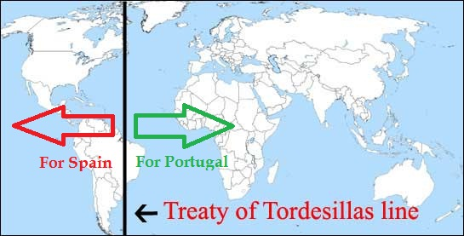

Slide 4
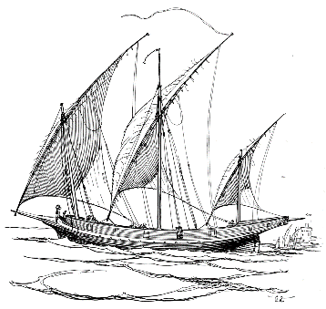
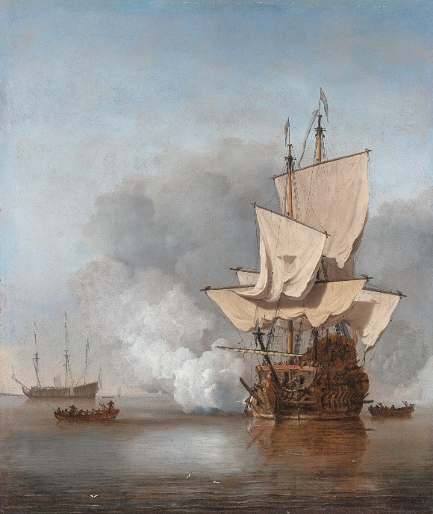
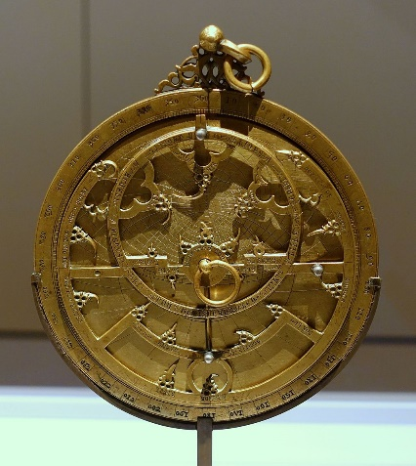
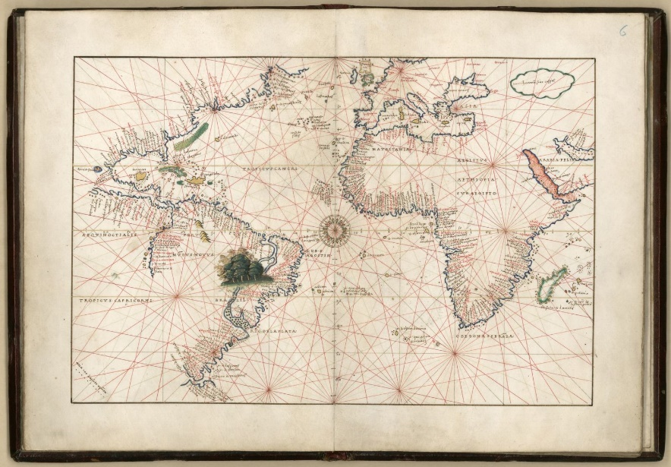
© Morgan AP Teaching
Travel Technology
Lateen sails, stern-post rudder, and the caravel
Understanding of wind patterns (trade winds and Westerlies)
Compass, astrolabe, and portolan maps for navigation
Royal patronage and joint-stock investment funded
Guns and cannons allowed for easy conquest

Slide 5
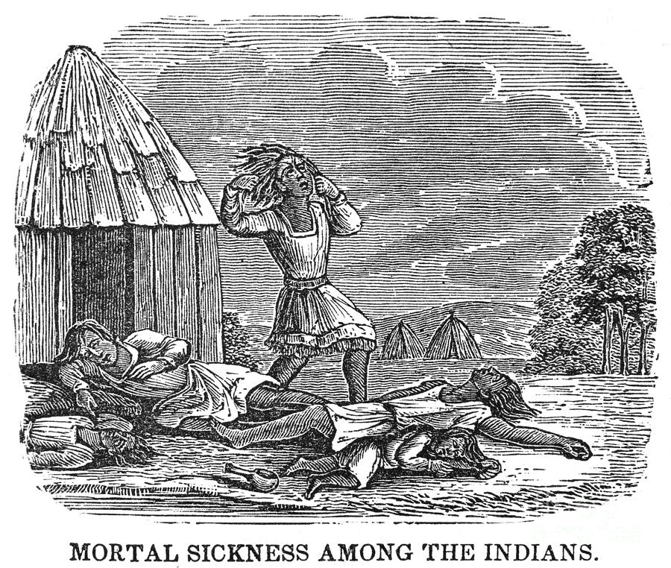
© Morgan AP Teaching
Columbian Exchange
To the New World: cattle, horses, pigs, smallpox, measles, rice, wheat
To the Old World: tomatoes, potatoes, corn, tobacco, turkey, syphilis
Impact on Old World:
Massive population growth due to calorie-dense foods
Vast amounts of wealth due to increased trade with foreign nations
The Atlantic States now had the economic power—not the Italian city-states
Impact on New World:
Massive population loss due to the spreading of Old World disease
Oppression due to plantations, mines, and slavery
Forced conversion to Christianity

Slide 6
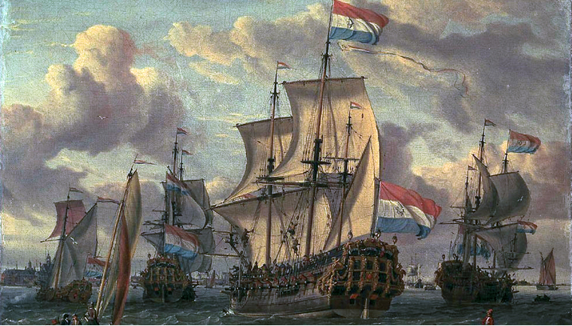
© Morgan AP Teaching
England, France, and the Netherlands
Entering the exploration scene late, the other Atlantic states
attempted to grab themselves some lucrative colonies as well
All three started colonies in North America, the Caribbean, the Dutch
established a colony in Indonesia, and the French and British in India
These five dominated world trade for the next two centuries, fighting
in Europe, and competing for colonies and resources throughout the world
In fact, the Dutch and English particularly developed a whole new set of economic tactics with which to compete with other Europeans: mercantilism
The goal of mercantilism being to increase exports, decrease imports, as well as disrupt the trade of other competing countries with privateering and pirating

Slide 7
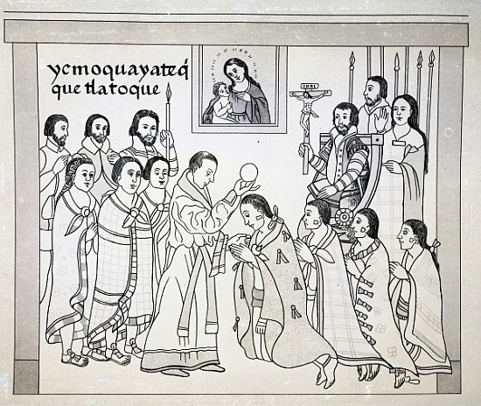
© Morgan AP Teaching
Treatment of Natives
One of the primary motivations for the Catholic explorers was missionary
work: to convert, in some cases by force, Native Americans to Catholicism
While some missionaries were kind, and converting people
with their kind treatment, help, and attitudes, many were quite violent
Natives working for colonial rulers were often required to practice
Christianity, and forced to hide their beliefs through syncretism
Additionally, most Spanish and Portuguese rulers viewed the Natives as barbaric and inferior, and required civilizing and enlightenment from Christianity
Some Europeans, however, opposed Native treatment and the encomiendas System, such as Bartolome de las Casas, arguing such treatment is un-Christian

Slide 8
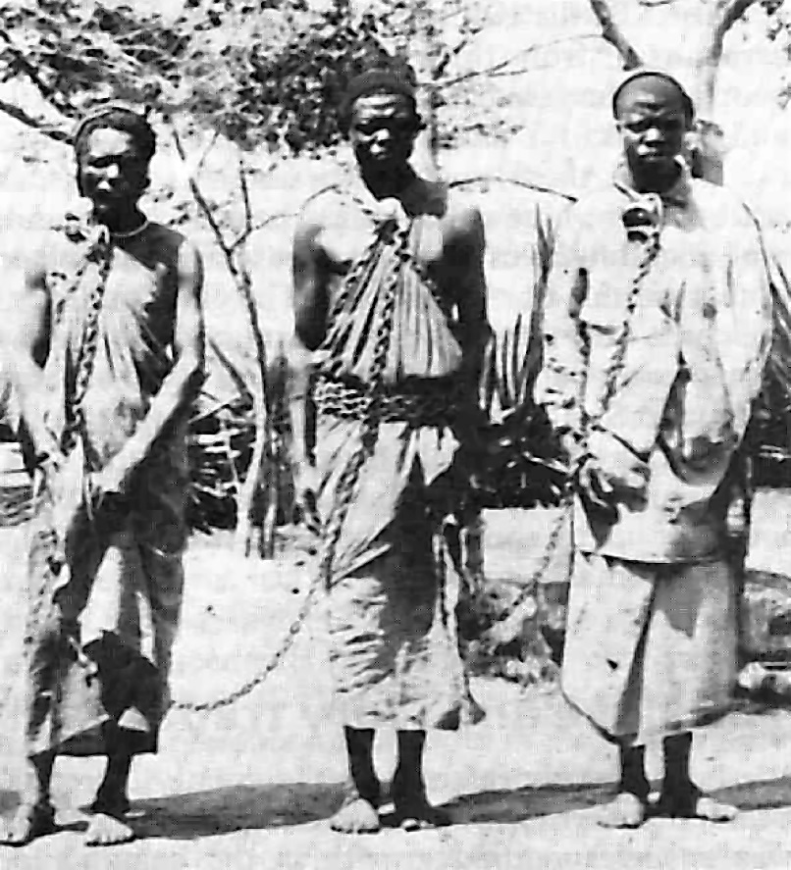
© Morgan AP Teaching
Consequences
Exploration not only harmed Native Americans forced to work under the encomienda system on mines and plantations (haciendas), but Africans as well
In need of cheap and/or free labor, the Atlantic Slave Trade began, in which Europeans bought or captured West Africans for work
African slaves were forced to endure the grueling Middle Passage Trip from Africa as a part of the Triangular Trade System
Under this system, goods from the New World came to Europe, Were either sold or used for light manufactured production
The profits or goods were then sold to West Africa and Asia allowing more slaves to be purchased for the haciendas

