Slide 1
© Morgan AP Teaching
Period 1: 1450 CE -1648 CE
State Control
of Religion

Slide 2
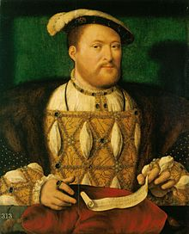
© Morgan AP Teaching
Henry VIII of England
One of the best examples of monarchs reforming religion to greater control their country and its morals/religion is Henry VIII of England
In 1534 Henry VIII, King of England, joined the Protestant movement, and started his own church: The Church of England
Henry’s ambitions to form a unique Protestant Church were not like Luther or Calvin who opposed Catholic views—it was so he could get a divorce
As such, Henry did not care about the theological issues and differences Luther and Calvin had with Catholicism
So while the Anglican Church (Church of England) is considered Protestant, it operated very similarly to the Catholic Church, with the king at the head—not the pope

Slide 3
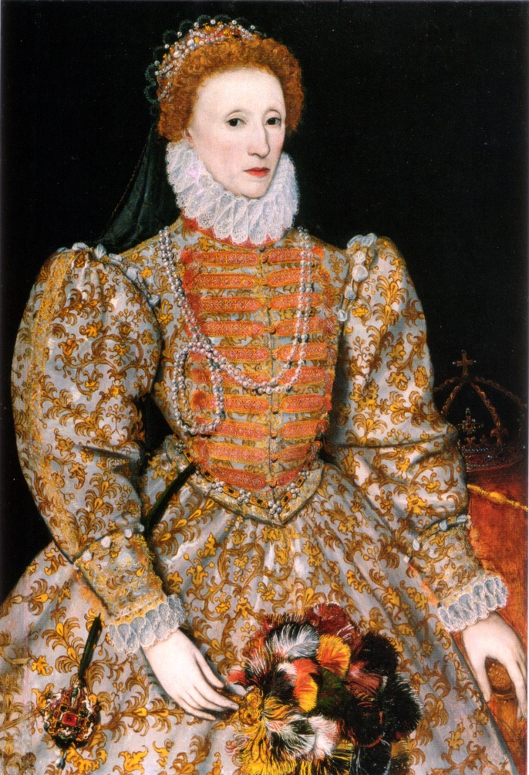
© Morgan AP Teaching
Elizabeth I of England
Another example of a monarch bringing about religious reforms to greater control their state was Elizabeth I of England- Henry VIII’s daughter
After Henry VIII, Queen Mary I of England returned England to a Catholic nation, and attempted to imprison and execute many of the new Anglicans
However, after her short reign and imprisonment, Henry’s daughter, Elizabeth I took over and re-established the new Church of England
Her two important and controlling reforms were:
The Act of Supremacy – made Elizabeth I the head of the Church of England
The Act of Uniformity – required all England attend church on Sunday at an Anglican Church with the Book of Common Prayer

Slide 4
© Morgan AP Teaching
The Puritans
Like the Huguenots in France and the Calvinists in the Netherlands, a group in England called the Puritans also used religious conflict to challenge their monarch
The Puritans were a radical group of Protestants in England that felt the Church of England was far too similar to the Roman Catholic Church
It had very similar traditions and structure, and the Puritans felt very strongly that the Anglican Church needed to be more like its Lutheran and Calvinist counterparts
Since they were so critical of the Anglican Church, they were often persecuted by the government, with harsh laws and unfair treatment against their group
The did, however, resist and continue their faith, eventually leaving England due to extensive persecution and violence for the Netherlands and Americas (pilgrims)

Slide 5
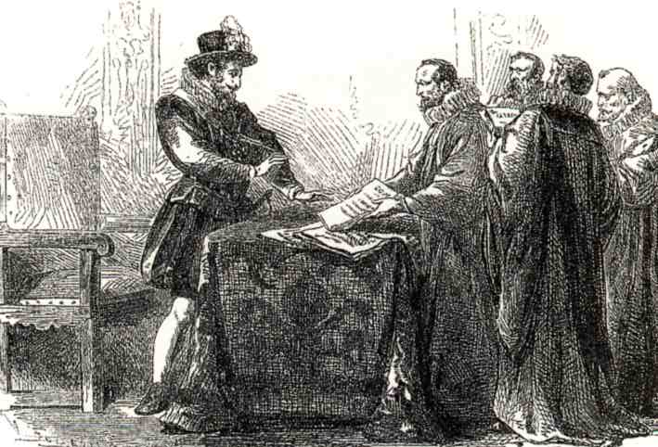
© Morgan AP Teaching
Religious Pluralism
While many states attempted to control religion, and many
groups like the Puritans, Calvinists, and Anabaptists resisted,
some areas took a different approach
Once the Spanish were defeated in the Netherlands in 1648,
the Dutch parliament voted for religious pluralism (freedom)
in the new nation
Rather than worry about enforcing Calvinism or Catholicism, the Dutch
simply allowed general religious freedom to maintain peace and unity
Likewise, earlier in France, Henry of Navarre had already allowed religious
pluralism in the Kingdom of France with the Edict of Nantes
Both of these were early European examples of religious pluralism to maintain peace

