Slide 1
Chapter 8 The Atlantic System and Africa, 1500 - 1800
AP EURO

Slide 2
Plantations in the West Indies
Colonization Before 1650
Spanish introduced sugar cane to the West Indies.
Tobacco production became popular because of chartered companies and the availability of indentured servants.
Dutch planters were expelled from Brazil by the Portuguese and brought the Brazilian system of sugar plantations to the West Indies.

Slide 3
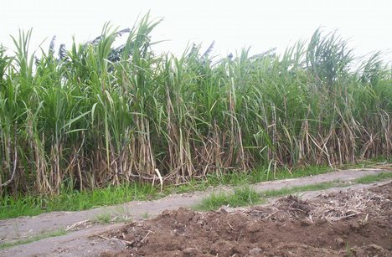
Spanish settlers introduced sugar cane cultivation into the
West Indies, but it fell into neglect as attention
shifted to colonizing the American mainland.

Slide 4
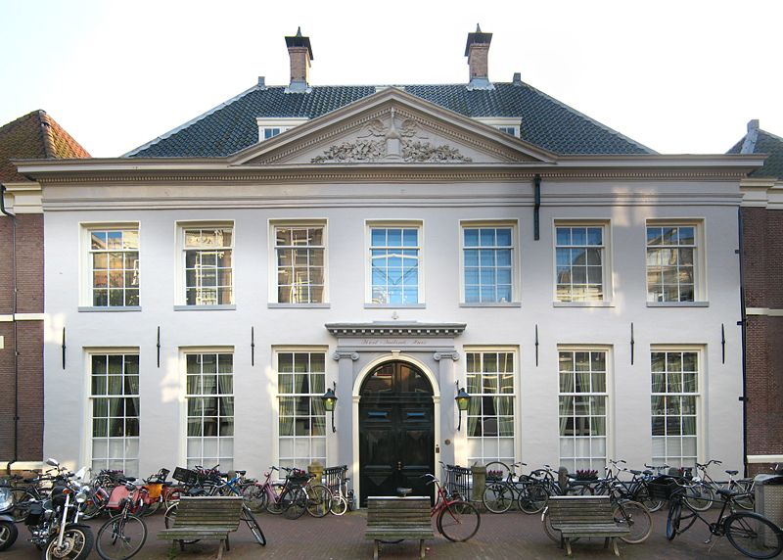
In order to promote national claims without government expense, charted companies gave groups of private investors, like The Dutch West India Company, monopolies over trade in West Indies colonies in exchange for payment.

Slide 5
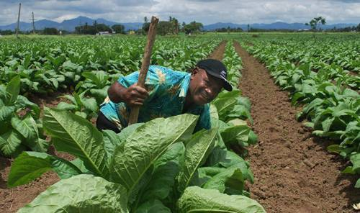
In the West Indies, English colonies prospered first, largely by growing tobacco for export. By 1614 tobacco was reportedly being sold in seven thousand shops in and around London.

Slide 6
Sugar and Slaves
The switch from a tobacco economy to a sugar economy caused a sharp and significant increase in the volume of the Atlantic Slave Trade.
There were three reasons for the shift from indentured servitude to slavery:
A decline in number of Europeans willing to be indentured.
Life expectancy of the slave was longer.
A rise in sugar prices enabled planters to invest in slaves.

Slide 7
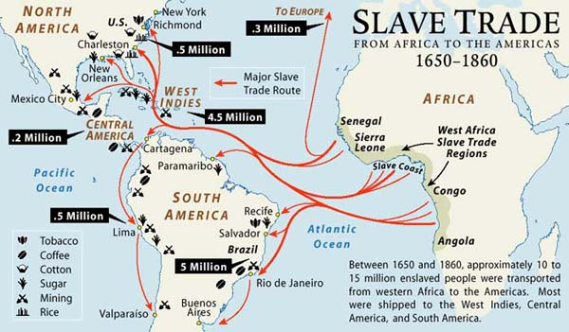
During the first half of the 17th century about 10,000 slaves a year arrived from Africa. The expansion of sugar plantations
in the West Indies in the second half of the 17th century
cause the slave trade to average 20,000 slaves per year.

Slide 8
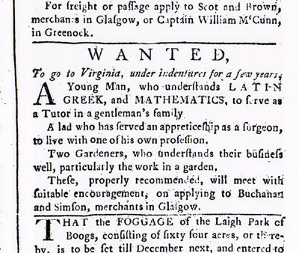
The decline of Europeans willing to be indentured, longer periods of servitude for slaves, and a rise in plantation
owners’ wealth made owning African slaves more attractive
and a better investment than indentured servants.

Slide 9
Plantation Life in the 18th century
Technology and Environment
Machinery (rollers, copper kettles) that processed sugar into crystals, molasses, and rum was very expensive.
Sugar production caused soil exhaustion and deforestation.
European colonization led to the introduction of European and African plants and animals that crowded out indigenous species.
The Arawak and Carib people were pushed to extinction.

Slide 10
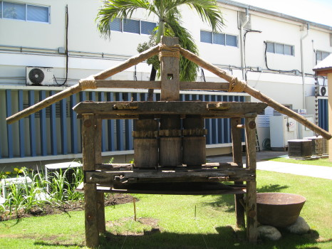
A sugar plantation was a complex investment because it had to be a factory as well as a farm. Freshly cut cane needed to be crushed within a few hours to extract the sugary sap.

Slide 11
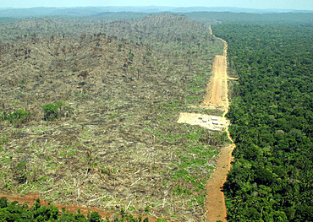
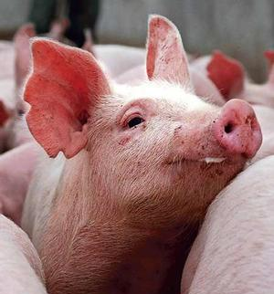
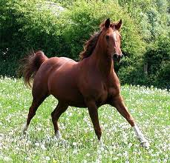
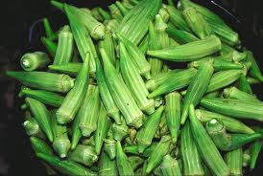
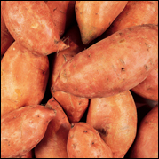
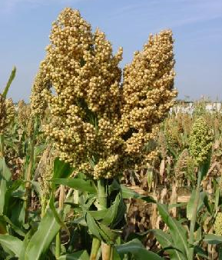
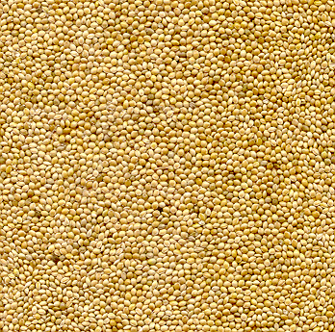
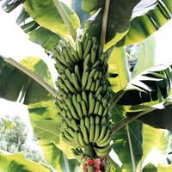
Combined with soil exhaustion and deforestation, the ecological balance of the West Indies was altered by the introduction of cattle, pigs, horses, bananas, okra, yams, millet and sorghum.

Slide 12
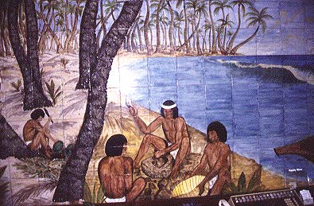
The Arawak (Taino) peoples of the large islands were
wiped out by disease and abuse within fifty years of
Columbus’s first voyage.

Slide 13
Slaves Lives
Society consisted of wealthy land owning plantocracy and slaves.
Plantations had to extract as much labor as possible from its slaves.
Slaves were both rewarded and punished for their work or lack of. Slaves cultivated their own crops on Sundays and had very little rest or relaxation, no education, and little family life.
Disease, harsh working conditions, and dangerous mill machinery all contributed slaves short life expectancy.
Occasional rebellions and frequently ran away. (Tacky in Jamaica)
Planters sought to prevent rebellions by curtailing African cultural traditions, religions, and languages.

Slide 14
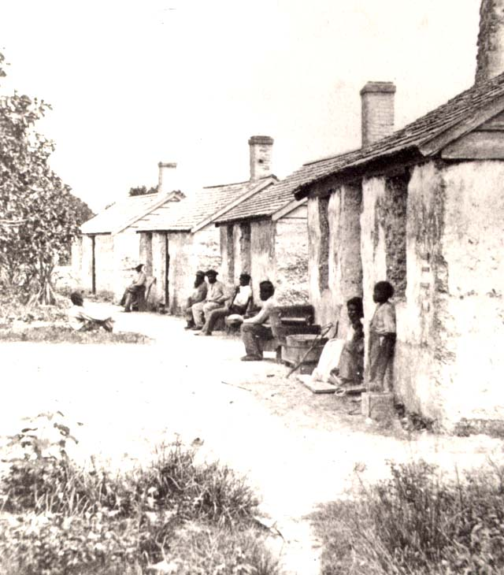
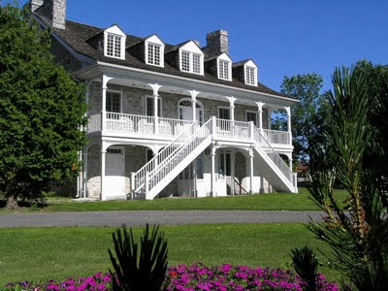
A plantocracy consisted of a small number of very rich men
who owned most of the slaves and most of the land.

Slide 15
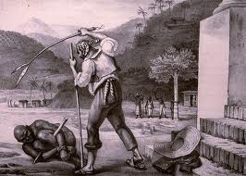
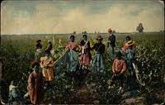
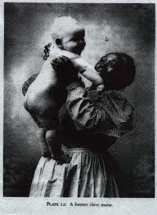
A privileged male slave, a “Driver”, ensured that the gang work was completed. The “great gang” comprised the strongest slaves, the second gang comprised less fit slaves, and the “grass gang” was comprised of children and the elderly.

Slide 16
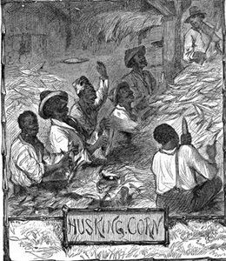
With 18 hour days, there was little time for recreation and relaxation, so slaves might sing in the fields to distract themselves from the fatigue and the monotony of the work.

Slide 17
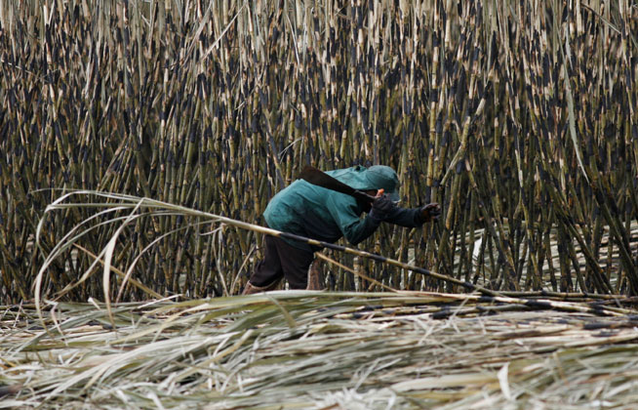
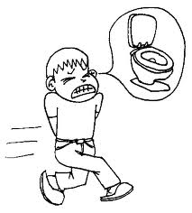
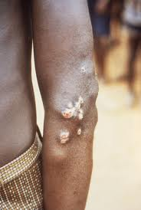
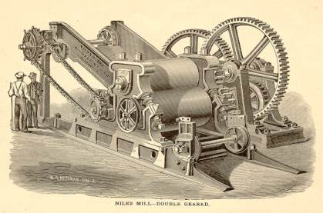
Dysentery
Harsh working conditions
Yaws
Dangerous mill machinery
During a period of seasoning, 1/3 of imported slaves died
from unfamiliar diseases. If they initially survived, the
harsh working conditions, poor nutrition and dangerous
mill machinery contributed to a life expectancy of 23
for males and 25.5 for females.

Slide 18
Free Whites and Free Blacks
In Saint Dominique, there were three groups of free people; wealthy whites, less well off whites, and free blacks.
Only a very wealthy man could afford the capital to invest in the land, machinery, and slaves needed to establish a sugar plantation. (Used wealth to establish political power).
Slave owners who fathered children by female slaves often gave both mother and child freedom (Manumission).
The largest group of freed slaves in the French, Spanish, and Portuguese colonies came from self purchase.
Runaway slaves known as maroons were also free.

Slide 19
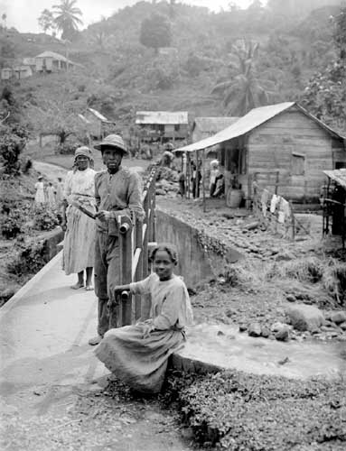
In the Caribbean runaways were known as maroons and were especially numerous in the mountainous interiors of Jamaica.

Slide 20
Creating the Atlantic Economy
Capitalism and Mercantilism
Capitalism and mercantilism established the framework within which government protected private enterprise.
Early mechanisms of capitalism were banks, joint stock companies, stock exchanges, and insurance.
Mercantilism was a number of state policies that promoted private investment in overseas trade and accumulation of capital in the form of precious metals.
The instruments of mercantilism included chartered companies and the use of military force to pursue commercial dominance.
The French and English eliminated the Dutch in a series of war and then used high tariffs to prevent foreigners from gaining access to trade with their colonies.

Slide 21
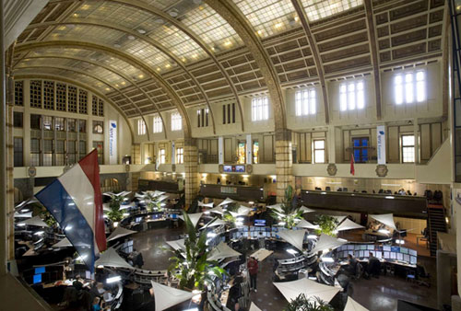
Dutch banks
Amsterdam Exchange
The essence of early modern capitalism was the expansion of credit and the development of large financial institutions – banks, stock exchanges, and chartered trading companies.

Slide 22
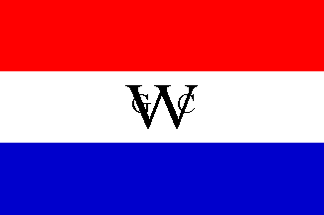
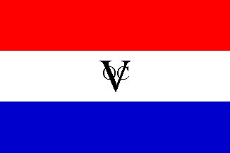
Dutch West India Company
Dutch East India Company
Mercantilism is defined by government policies, like the English Navigation Acts, that promote overseas trade between a country and its colonies to accumulate precious metals by requiring colonies to trade only with the mother country.

Slide 23
The Atlantic Circuit
The Atlantic Circuit was a network of trade routes going from Europe, to Africa, from Africa to the plantation colonies of the Americas and then from colonies to Europe.
The Slave Trade was a highly specialized business in which chartered companies and then private traders who purchased them for sale, packed them into specially designed ships, and then delivered them for sale.
Disease, maltreatment, suicide, and psychological depression all contributed to the average death rate of 1 out of 6 slaves on the Middle Passage.

Slide 24
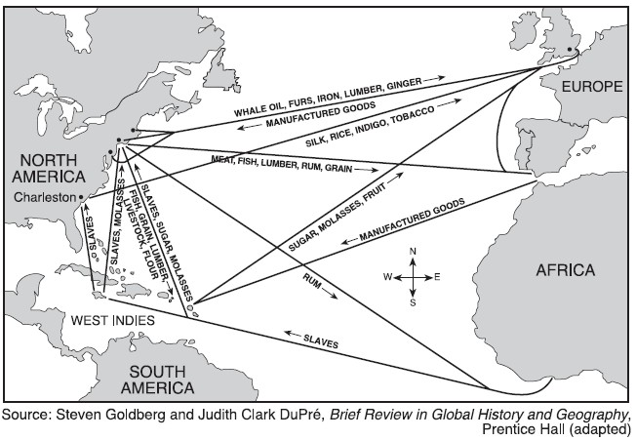
The heart of The Atlantic Circuit was a clockwise
network of sea routes that used prevailing winds
and currents to propel their ships.

Slide 25
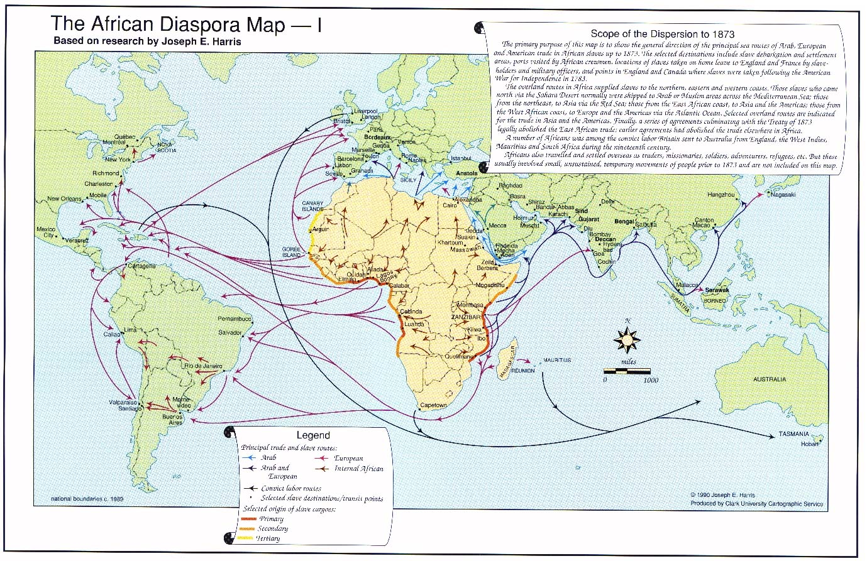
The increased demand for sugar led to an increase in the flow of slaves from Africa to the New World via the Middle Passage.

Slide 26
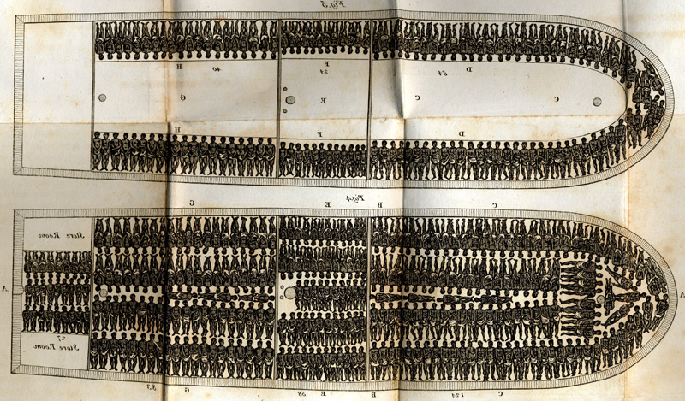
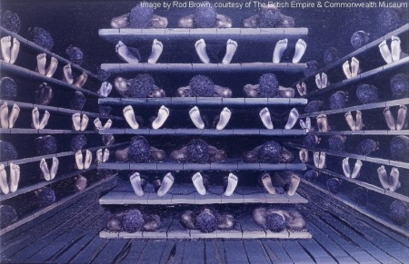
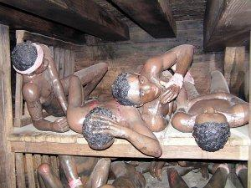
For the 6 to 10 week voyage, slaves were transported in
modified ships that had additional platforms on which the
human cargo was packed as tightly as possible.

Slide 27
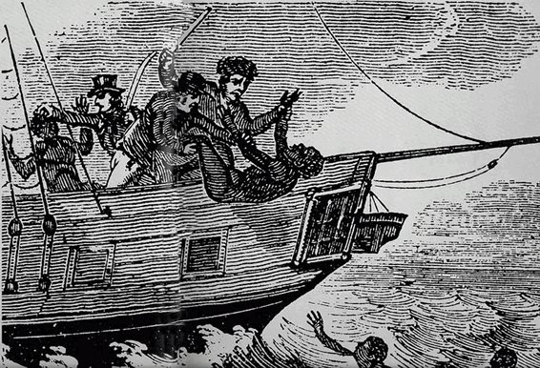
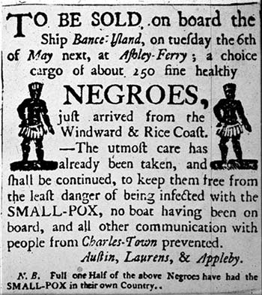
Aboard slave ships there was a 11% - 12% mortality rate for slaves and crew. Some deaths resulted from jumping overboard, depression, dysentery, smallpox and malaria.

Slide 28
Comparative Perspectives
Economic and Cultural Comparisons
European powers colonized the Caribbean islands, which were transformed under capitalism.
The British switched from indentured servitude to slavery very quickly in the Caribbean because of their capitalistic ventures.
France was also able to profit quickly through state monopolies and state-sanctioned companies.
The Dutch were more successful at transporting slaves and sugar technology than colonization.

Slide 29
Spain’s introduction of slaves and sugar to the Caribbean did not translate into the most success among European powers, except for their island of Cuba.
All West Indian plantation societies were affected by the introduction of European and African plants and people and participation in a world market.
Though Africa’s participation in the Atlantic trade system was as important as sugar production in the West Indies, Africans maintained control of their own religion.

