Slide 1
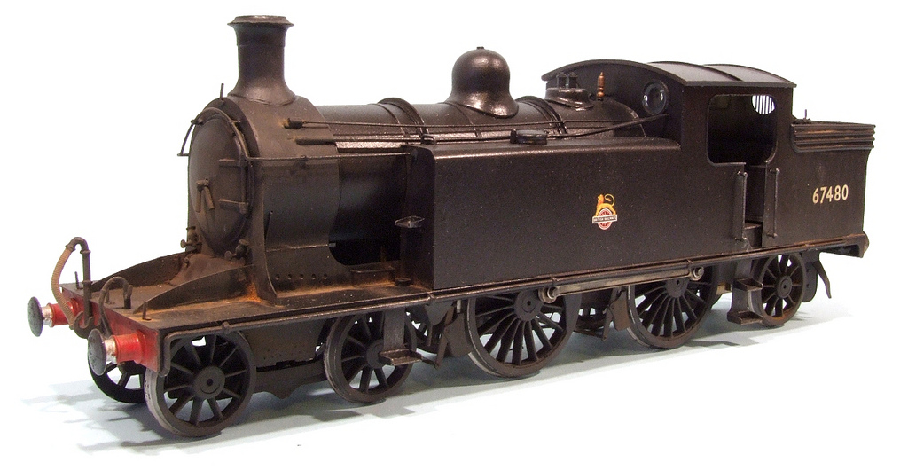
The Second
Industrial Revolution
Photo by Phil Parker

Slide 2
Essential Question
What was the Second Industrial Revolution and what differentiated it from the First Industrial Revolution?

Slide 3
 | 1st Ind. Rev. | 2nd Ind. Rev.
Time Frame
Methods of Production
Mass Production
Power Sources
New Engines
Inventions
Standard of Living for working class
c. 1760-1830
c. 1850-1914
Hand → Machine
Increased Automation
Textiles
Steel (Bessemer Process)
Water, Coal, & Steam*
Petroleum & Electricity
Steam Engine*
Internal Combustion
Spinning Jenny
Water Frame
Spinning Mule
Cotton Gin
Automobiles
Chemicals
Railroads
Telegraph, Telephone, Radio
AWFUL
Still Bad, but improving
(Sewers, Sanitation, etc.)
Expansion of Middle Class
* Note that these technologies continued to be used during the 2nd IR but new sources of power were introduced, in addition.

Slide 4
WORLD EXPOSITIONS
1851-Present

Slide 5
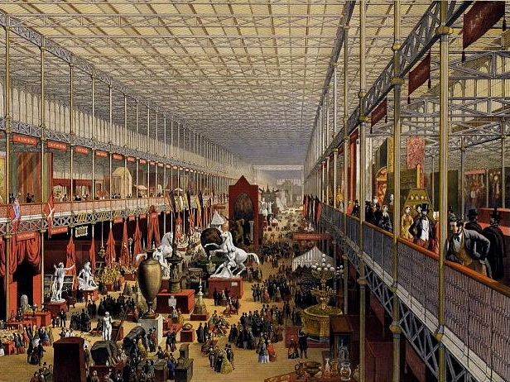
Crystal Palace Exhibition (1851)

Slide 6
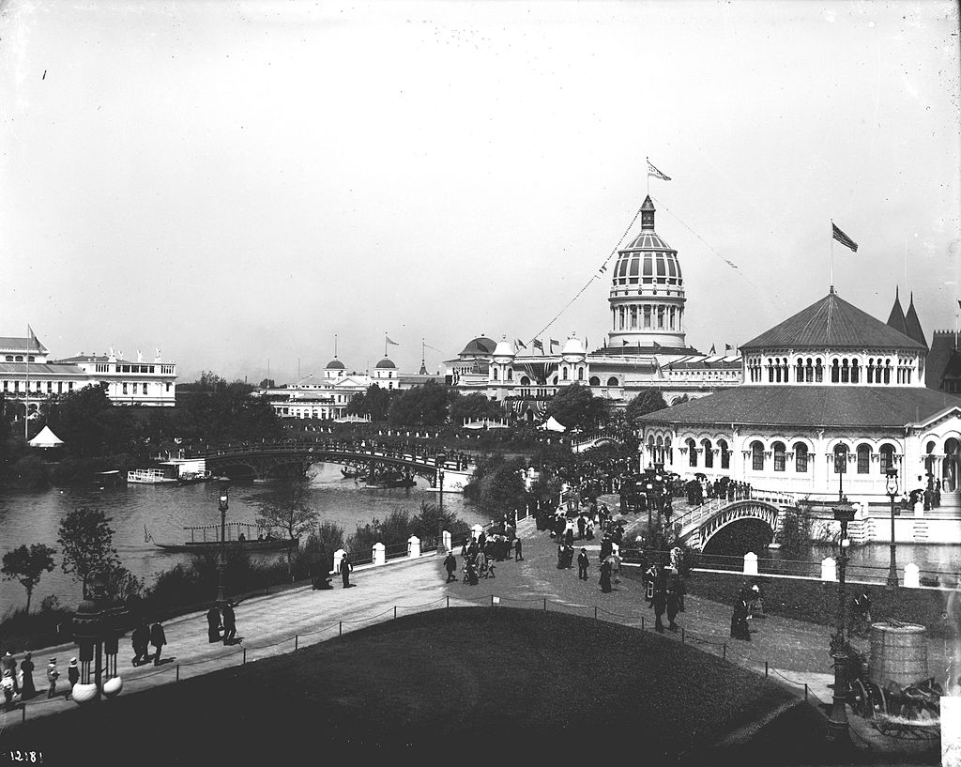
Columbian Exposition (1893)

Slide 7
MILITARY TECHNOLOGIES
Comparing the First and Second Industrial Revolutions

Slide 8
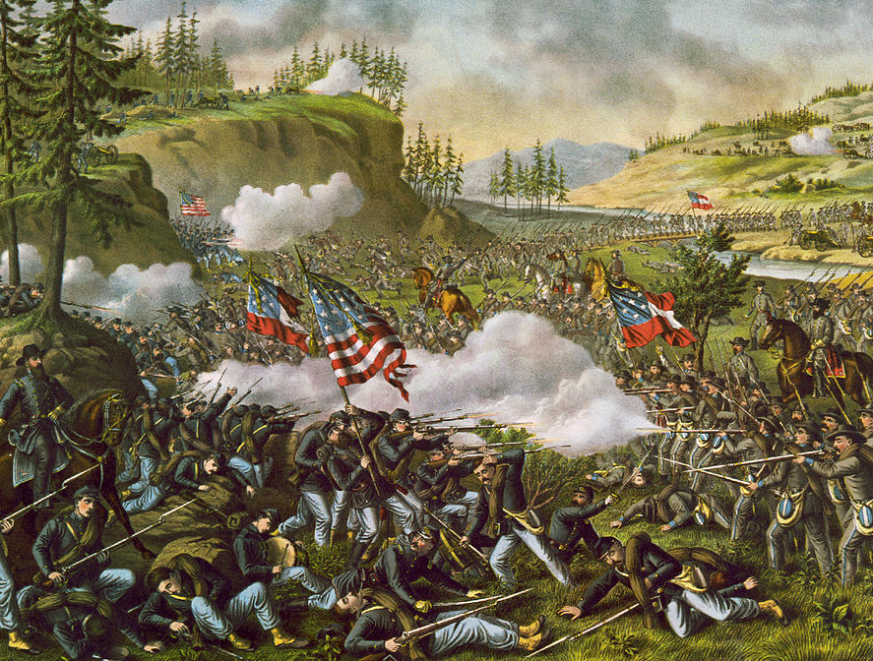

Slide 9
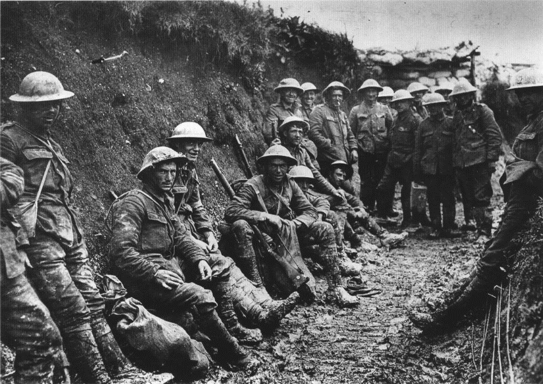

Slide 10
Spencer
Repeating
Rifle
(American Civil War)
Photo by Thomas Quine

Slide 11
Machine Gun (WWI)
Photo by
Rain0975

Slide 12
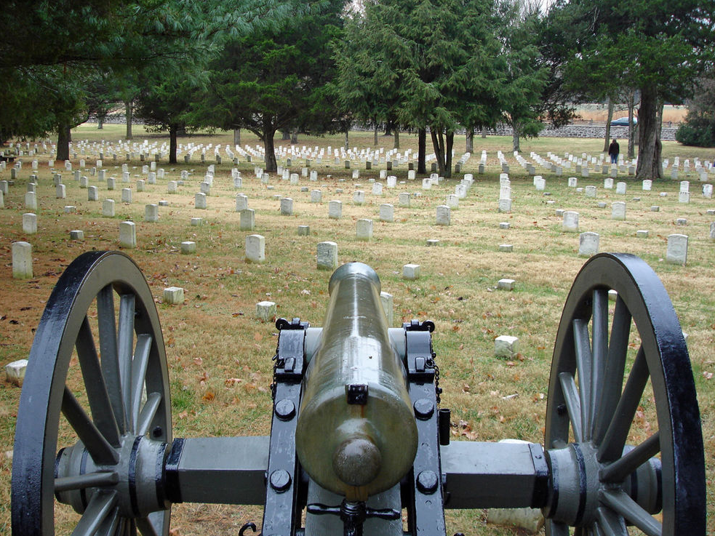
CIVIL WAR CANNON

Slide 13
WWI Artillery Piece

Slide 14
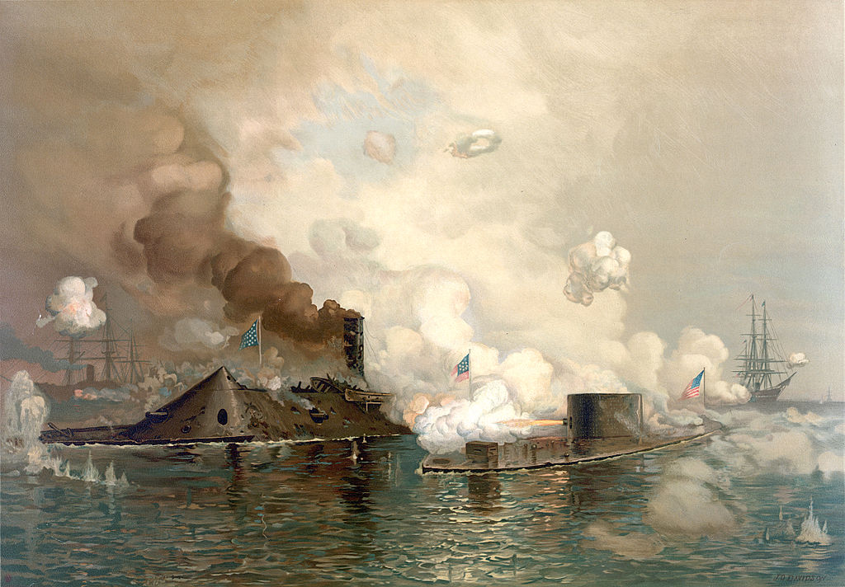
IRONCLADS

Slide 15
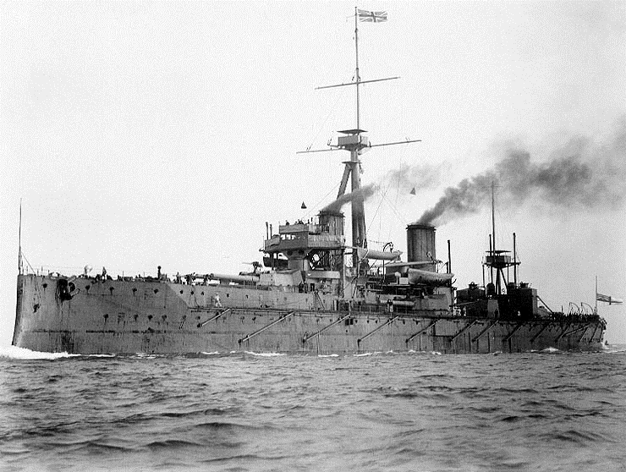
DREADNOUGHT

Slide 16
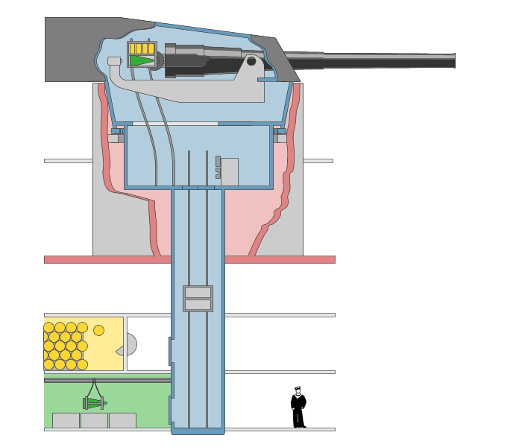
FULLY AUTOMATED
A Revolution in Weaponry
Art Credit: Emoscopes

Slide 17
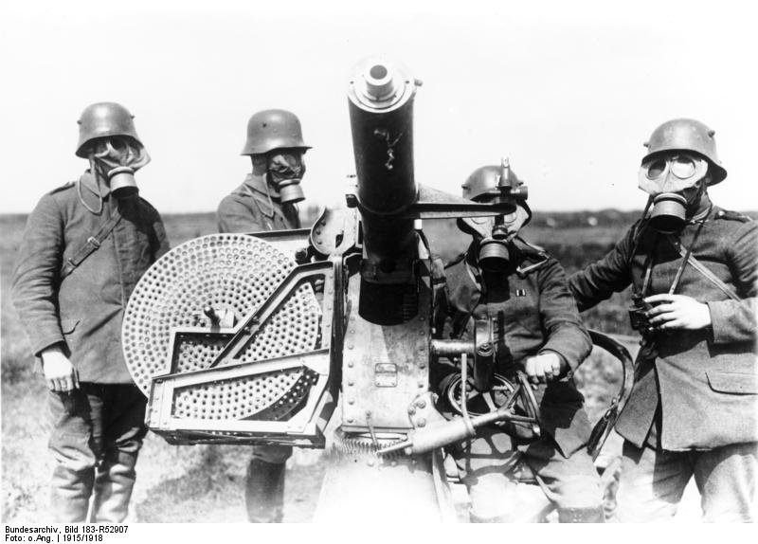
German Federal Archives

Slide 18
RAILROADS
Photo by Kool Cats Photography

