Slide 1
The Russian Revolution
Outline 9.2

Slide 2
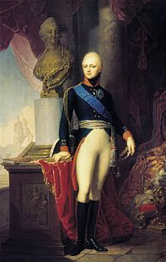
Tsar Alexander I
Reign: 1801 – 1825
Considered an Enlightened Despot
Became conservative after a plot to kidnap him and a conspiracy among his officers
Proposed the Holy Alliance which was designed to stop liberalism

Slide 3



Holy Alliance
coalition created by the monarchist great powers of Russia, Austria and Prussia.
after the ultimate defeat of Napoleon
formed to instill the divine right of kings and Christian values in European political life (that’s why it’s “holy”)

Slide 4
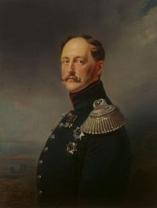
Nicholas I
Reign 1825 – 1855
Known as one of the most reactionary monarchs
Supported divine right
Viewed himself as an autocrat (all power and wealth is with the tsar)

Slide 5
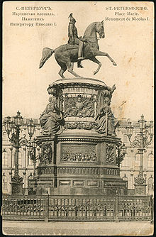
Monument to Nicholas I

Slide 6
Nicholas I
He believed that suppressing liberalism was crucial to maintaining order
Under Nicholas I, Russia became a police state
Russia became heavily censored with limited education and no representative assemblies

Slide 7
Intellectuals during Nicholas I Reign
Slavophiles
Westernizers
Believed that the culture of the Russian village was superior
Opposed autocracy but supported the tsar
Thought the mir (village) was the basis for future socialism
Wanted to industrialize
Wanted constitutionalism
Wanted to end serfdom
Revolution is the key to change

Slide 8
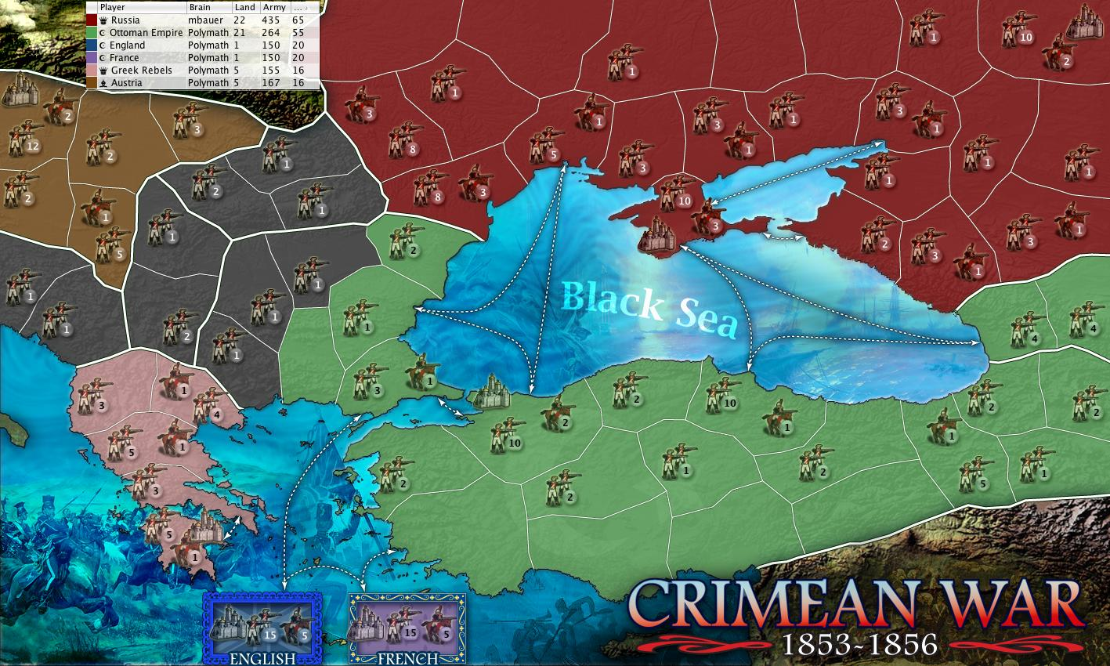
Crimean War
1853 – 1856 Russia defeated

Slide 9
Crimean War
Defeat forced Russia to modernize or continue to be vulnerable
In order to modernize, the serfs would have to be freed
Nobility resisted efforts to modernize

Slide 10

Alexander II
Reign 1855 - 1881
Most liberal ruler in Russian history prior to the 20th century
Still very autocratic
Believed serfdom had stunted Russian modernization

Slide 11
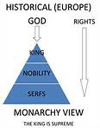

Serfdom
Serfs were an unlimited source of labor for the nobles and so the nobles had no desire to change or improve

Slide 12

Emancipation Act
1861
Abolished serfdom
Peasants could
  Own property
  Buy land
  Marry freely
  Vote

Slide 13
Alexander II
In 1864, Alexander established Zemstvos
  Local or village assemblies
  Provided a measure of self-government
  Gave peasants a voice but still controlled by the nobles
  Successful in solving problems of education, medical needs, and transportion
  Largely abolished in 1917

Slide 14
Other Reforms by Alexander II
Improved the judicial system
Reduced terms of military service
Eased brutal corporal punishment
Relaxed censorship
Liberalized education
Stimulated industrialization by building railroads

Slide 15
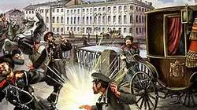
Alexander II
Became more conservative late in his reign
Assassinated in 1881 by The People’s Will members who bombed his carriage

Slide 16

Alexander III
Reign 1881 – 1894
Most reactionary czar of the 19th century
Wanted to rule by “Autocracy, Orthodoxy, and Russification” (loyalty to and rule by the tsar, protection of the Russian Orthodox Church, and nationalism)

Slide 17
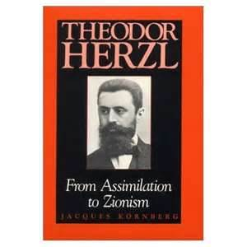
Alexander III
Wanted to reverse the liberal policies of his father (Alexander II)
Encouraged anti-Semitism (part of the protection of the Russian Orthodox Church)
Theodor Herzl: advocated a Jewish homeland in the Holy Land as a way to escape persecution in Europe

Slide 18
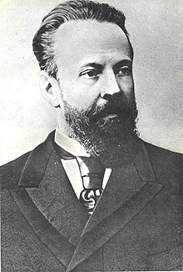
Alexander III
Attempted to improve industrialization
Count S. Y. Witte (right) worked to increase industrialization and aggressively sought western capital to build factories
Russia’s economic problems were still severe by 1900 and were made worse by the Russo-Japanese War

Slide 19
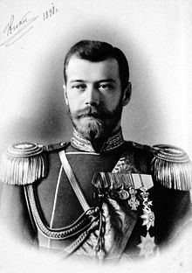
Nicholas II
Reign 1894 – 1917
Came to power after his father, Alex III, died from kidney problems
During his reign, Russia went from a great power to collapse
Also known as Bloody Nicholas because of the violence during his rule

Slide 20
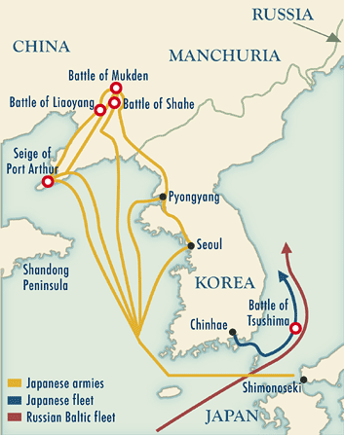
Russo-Japanese War (1904 – 1905)
Russia was trying to expand into Asia
Defeated by the Japanese, including the destruction of the Russian fleet
After, the Russians turned away from acquiring territory in Asia and focused on expanding control of the Balkans

Slide 21
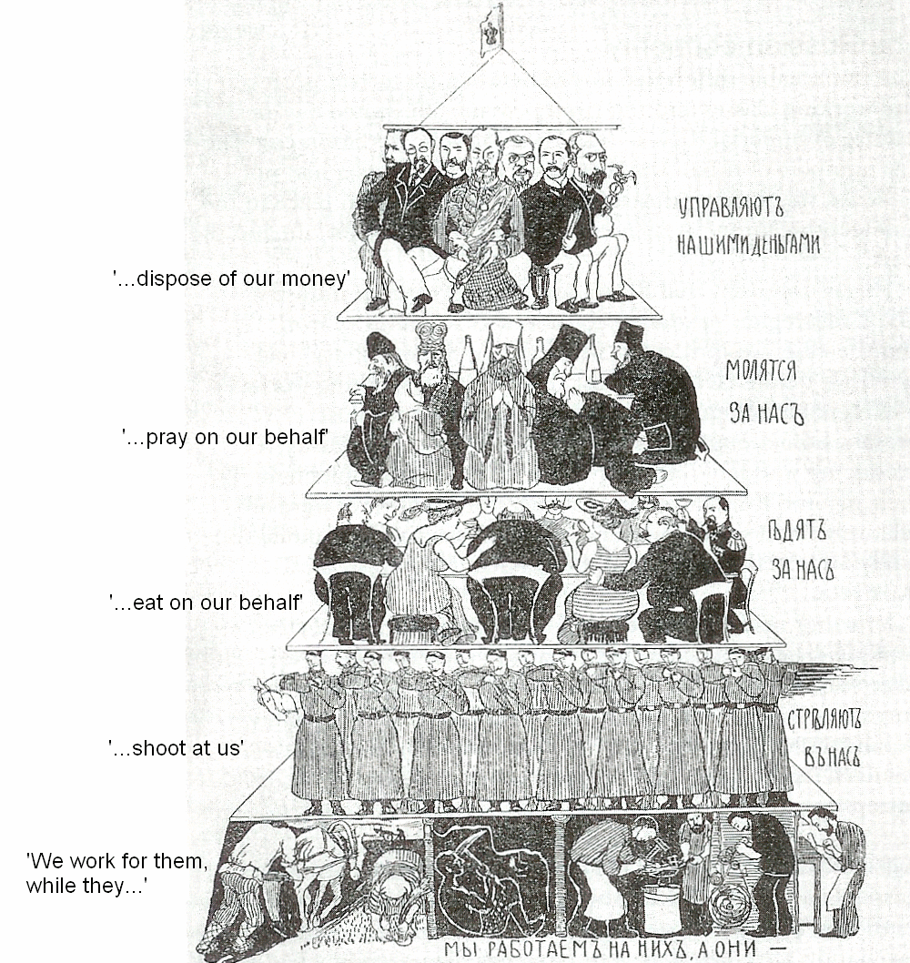
Causes of the
Russian Revolution of 1905
Russian social hierarchy created inequities and abuse of the lower classes
These strains led to growing call for reforms

Slide 22
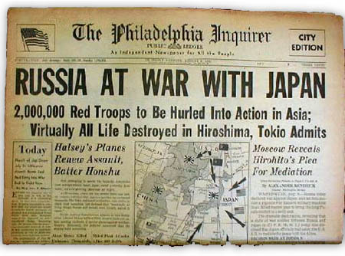
Causes of the
Russian Revolution of 1905
Russo-Japanese War: Russia’s poor showing became a major cause of the 1905 Revolution

Slide 23
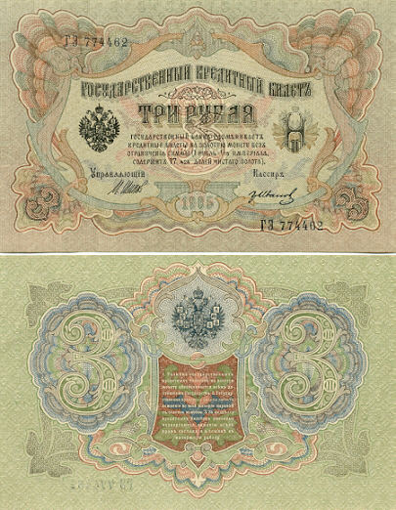
Causes of the
Russian Revolution of 1905
Weak economy
Expansion of liberalism
Emerging middle class

Slide 24
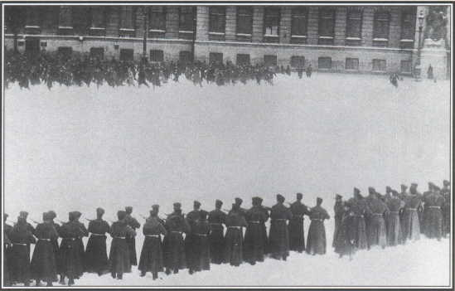
Bloody Sunday, Jan. 22, 1905
200,000 workers and peasants marched on the tsar’s winter palace to ask for reforms
The Army killed 300 in cold blood

Slide 25
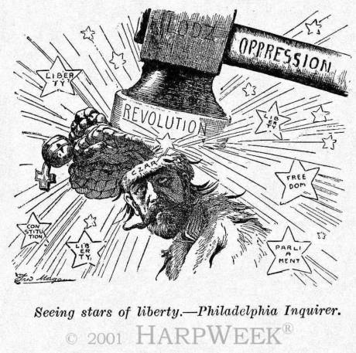
October Manifesto of 1905
Created the Duma: national assembly that advised the tsar
Representatives elected by universal male suffrage
Granted freedom of speech, assembly, and press
Tsar retained absolute veto
Dissolved by Nicholas twice in 1906

Slide 26
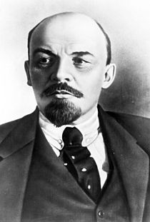
Rise of Socialism in Russia
1898 Social Democratic Worker’s Party formed
Led by Vladamir Lenin →
He was heir to Marx in socialist thoughts
Leader of the Bolsheviks (future Communists)

Slide 27

Lenin’s Philosophy
Three basic ideas:
  Capitalism could be destroyed only by violent revolution
  Socialist revolution possible in some countries, such as backward Russia
  Needed a highly disciplined workers’ party which would be controlled by elite intellectuals and full-time revolutionaries

Slide 28
The February Revolution of 1917
Overthrow of Nicholas II
Caused by economic problems and the Russo-Japanese War defeat
Most important cause: the tremendous human and economic suffering during WWI
  Had caused large numbers of deaths and food shortages
  The tsar was an ineffective leader

Slide 29
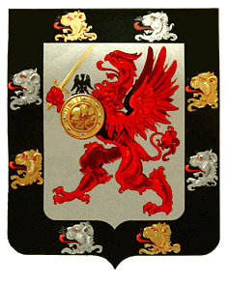
End of the Romanov Dynasty
Nicholas II abdicated his throne on March 2, 1917
He and his family were executed in July 1918
Nicholas and his immediate family were recognized as saints by the Russian Orthodox Church

Slide 30
October Revolution of 1917
After the February Revolution, a Provisional Government was established
The Provisional government implemented liberal reforms but rejected outright social revolution
Russia continued to be plagued by anarchy
In April 1917, Lenin rejected the provisional government and called for a socialist revolution

Slide 31

October Revolution of 1917
On October 25, 1917, Leon Trotsky, leader of the Petrograd Soviet (Red Army), led the Soviet overthrow of the provisional government
The Bolsheviks (Communists) took control of the government even though they were a minority
The October Revolution led to a communist dictatorship

Slide 32

Soviet Union under Lenin
Gave land to peasants
Gave direct control of factories to local workers
Took Russia out of WWI to stop the suffering
Moved the government to Moscow
His actions led to the Russian Civil War

Slide 33
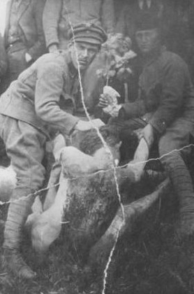
Russian Civil War 1918 - 1920
Reds (Bolsheviks) vs. Whites (old Army officers and others)
Both sides brutal
Bolsheviks mobilized the home front via “War Communism”
  Earliest form of socialism in the Soviet Union
  Total war concept
  Nationalized all land
  Ended private trade
  Cheka (secret police)
Victim of Secret Police

Slide 34
Effects of the Russian Revolution
In 1921, the Reds won
The Union of Soviet Socialist Republics was created in 1922
15 million dead, economy ruined
Creation of the world’s first communist society: one of the monumental events of the 20th century

