Slide 1
ROMANTICISM
Radicalism In Art-
Reaction Against the Enlightenment

Slide 2
A revolt against classicism and the Enlightenment, which taught that the ancient Greeks and Romans had discovered eternally valid aesthetic rules and that playwrights and painters should continue to follow them with no deviation or creativity
Characterized by a belief in emotional exuberance, unrestrained imagination, and spontaneity in both art and personal life

Slide 3
Now, after saying that, there is a big problem with Romanticism: It is nearly impossible to concisely define what it was.
When we talk about Romanticism as a movement we are not talking of “romance” in the sense of hearts and flowers or infatuation.
Instead, we use “romance” in the sense of glorification: romantic visual and literary artists glorified things!
These things though were not physical; they were huge, complex concepts like liberty and hope, and heroism, and despair

Slide 4
Traced its emphasis of individual genius, deep emotion, and the joys of nature to thinkers like Rousseau especially
This movement encompassed poetry, music, painting, history, and literature.
In Germany early romantics called themselves Sturm und Drang (“Storm and Stress”)
Romantic artists of the early 19th century lived lives of great emotional intensity

Slide 5
Suicide, duels to the death, madness, and strange illnesses were not uncommon among leading romantics.
Romantic artists typically led Bohemian lives, rejecting materialism, and sought to escape to lofty spiritual heights through their art.
They believed the full development of one’s unique human potential to be the supreme purpose in life.

Slide 6
They were enchanted by nature.
1) For some it was awesome and
tempestuous.
2) For others, they saw nature as a source
of spiritual inspiration.
Most romantics saw the growth of modern
industry as an ugly, brutal attack on their
beloved nature and on the human personality. Today they would be environmentatists and support the Green Movement.

Slide 7
Romanticism and Literature
British Romantics led the way in literature:
William Wordsworth’s and Samuel Coleridge’s poetry, whose poetry used ordinary speech as opposed to flowery language, the Scotsman, Walter Scott’s Ivanhoe, and of course, Mary Shelley, who wrote Frankenstein

Slide 8
In Germany there were a number of great romantic writers; the greatest being:
Johann Wolfgang von Goethe who wrote the greatest novel in German literature, Faust, the story of a man who made vow to serve the devil if he would grant his desires
Jacob and Wilhelm Grimm- collected most of the famous German fairy tales into a famous collection.

Slide 9
Among French romantic writers there were:
1) Alexander Dumas- The Three Musketeers
2) Victor Hugo- Who besides Les Miserables, also
wrote the classic, The Hunchback of Notre Dame
3) Amandine Aurore Lucie Dupon, who
used the pen name of George Sand,
and defied the conventions of the time
to explore her own personal fulfillment,
not only in topics written, but in many
affairs with both men and women.

Slide 10
ROMANTICISM
And
ART

Slide 11
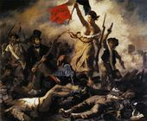
Romanticism and Current Events
Eugene Delacroix-
1) Greatest romantic painter in France
2) Master of dramatic, colorful scenes that stirred
the emotions
3) July Revolution
of 1830
Liberty Leading Her People

Slide 12
Theodore Gericault’s Raft of the Medusa was based on the 1816 Naval frigate, the Medusa

Slide 13
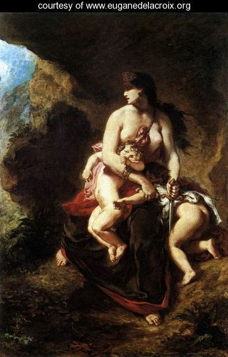
“Medea About to Murder Her Children”

Slide 14
Philip James de Loutherbourg’s An Avalanche in the Alps

Slide 15
Loutherbourg’s The Great Fire of London

Slide 16
Andreas Achenbach’s Sunset After a Storm on the Coast of Sicily

Slide 17
Francis Danby’s The Deluge

Slide 18
And, for me, the greatest of the romantic painters was the German, Caspar David
Friedrich
1) His paintings often focus on dark,
silhouetted figures silently
contemplating an eerie landscape.
2) Friedrich came to believe that humans
were only an insignificant part of an
all-embracing higher unity

Slide 19
Caspar David Friedrich’s “Sea of Ice”

Slide 20
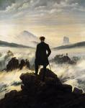
Friedrich’s Traveler Looking Over a Sea of Fog

Slide 21
Friedrich’s Cloister Cemetery in the Snow

Slide 22
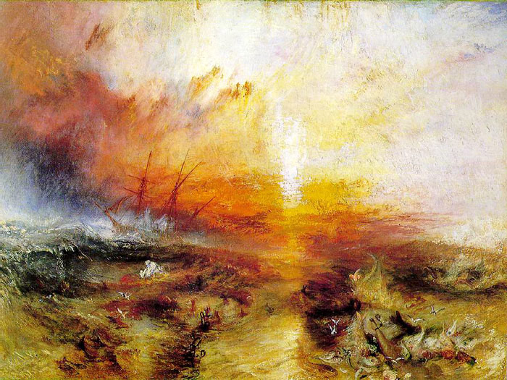
Joseph M. W. Turner
1) One of England’s greatest romantic painters
2) Depicts nature’s power and terror- “The Slave Ship”

Slide 23
Revival of Past Styles
Neo-Gothic Architectural Style
Medieval ruins were a favorite theme for art and poetry.

Slide 24
John Constable’s Salisbury Cathedral

Slide 25
Constable’s Hadleigh Castle

Slide 26
Romanticism and the Supernatural
Ghosts, fairies, demons, etc. are a part of Romantic art and literature
Dreams and madness are a part of the era also.

Slide 27
Theodore Gericault’s Mad Woman

Slide 28
William Blake’s The Great Red Dragon and the Woman Clothed with The Sun

Slide 29
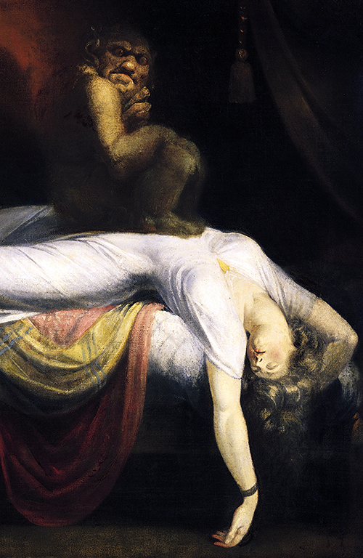
Henry Fuseli’s Nightmare

Slide 30
John Constable’s Stonehenge

Slide 31
Francis Goya’s Saturn Devouring His Son

Slide 32
Romanticism and Music
It was in music that romanticism realized most fully its goals of free expression and emotional intensity.
Romantic composers transformed the small classical orchestra, tripling its size by adding wind instruments, percussion, and more brass and strings.
This totally changed the role of music as performance, power, and prestige.
No longer was music to be for church, or for the aristocrat in his palace.

Slide 33
Music became, now, an end in itself, to allow the artist to express his inner self deeply and emotionally.
That “one-in-a-million” performer who could transport the listener to ecstasy
and hysteria became a cultural hero.
An example was Franz Liszt, the great pianist, who when he played, the audience would scream just as for rock stars today.

Slide 34
Of course the greatest of them all was
Ludwig van Beethoven.
Beethoven created his own rules for writing music, using contrasting themes and tones to produce dramatic and powerful music.
At the peak of his fame, he began to go deaf.
He considered suicide but eventually overcame his despair: “I will take fate by the
throat; it will not bend me completely to its will.”

