Slide 1
The
Rococo Style
(1715-1780s)

Slide 2
Background
Begun as a French style of interior decoration during the period that followed Louis XIV’s death.
Régence Style (1715-1723)
Versailles society was in a temporary eclipse.
French power and fashion centered around the court of the Regent, Philippe d’Orleáns at the Palais-Royal in Paris.

Slide 3
Background
Derived from the French word, rocaille, or “rock-work.”
The ‘softer side’ of the Baroque [or a reaction against it].
A backlash to the darkness of the Baroque → less formal & grandiose.
Eventually replaced by Neo-Classicism, the artistic style of the American and French Revolutions.

Slide 4
Artistic Style
Light, elaborate, decorative.
The Rococo palette, softer and paler [pastels] than the rich primary colors and dark tonalities of the Baroque style.
Ornate and fussy details.

Slide 5
Rococo
Artistic
Themes

Slide 6
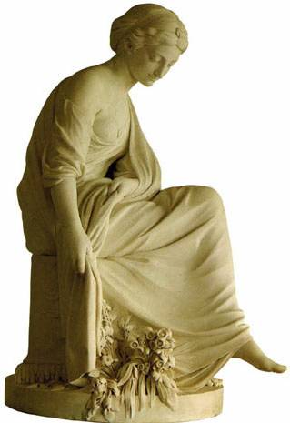
1. Fantasy & Wistful Nostalgia
An emphasis on ultra beauty and nature.
Classical gods and goddesses.
“Winter” by
Etienne-Maurice
Falconet, 1771

Slide 7
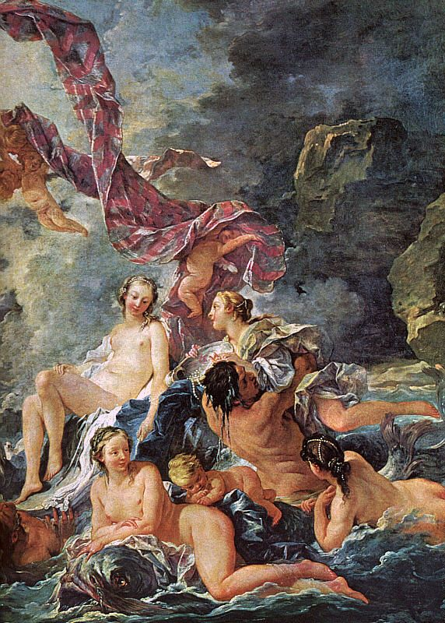
“The Triumph of Venus” François Boucher, 1740

Slide 8
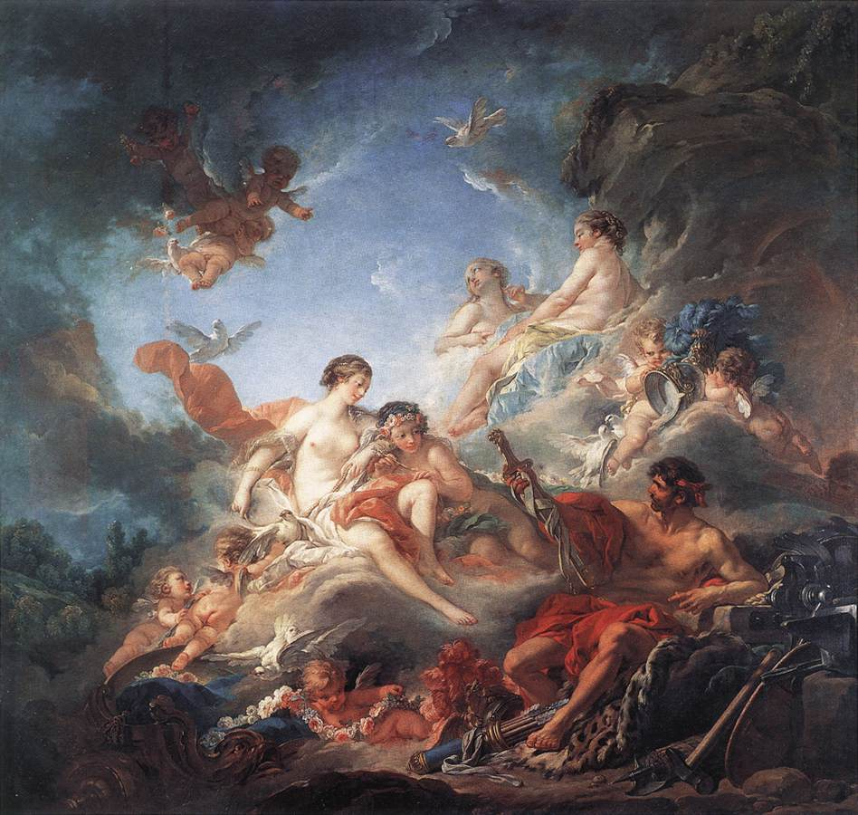
“Vulcan Presenting Venus with Arms for Aeneas” by Francois Boucher, 1757

Slide 9
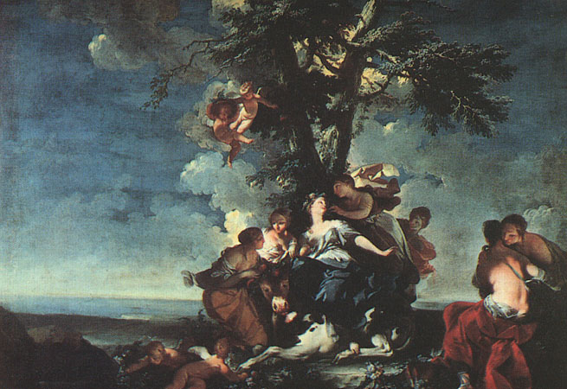
“The Rape of Europa” Giovanni Domenico Ferretti, 1720-40

Slide 10
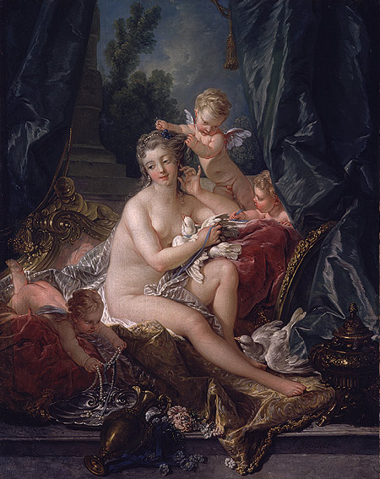
2. Love, Romance, & Eroticism
[about Boucher] His canvases often seem to consist of little beyond mounds of pink flesh…
“The Toilet of Venus” by François Boucher, 1751

Slide 11
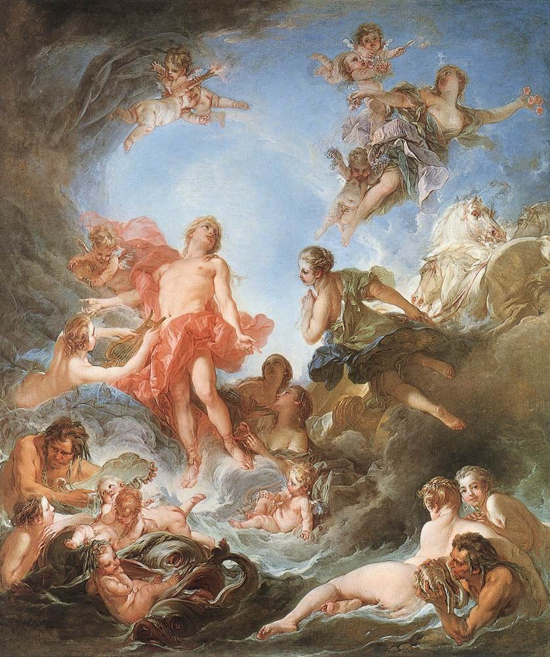
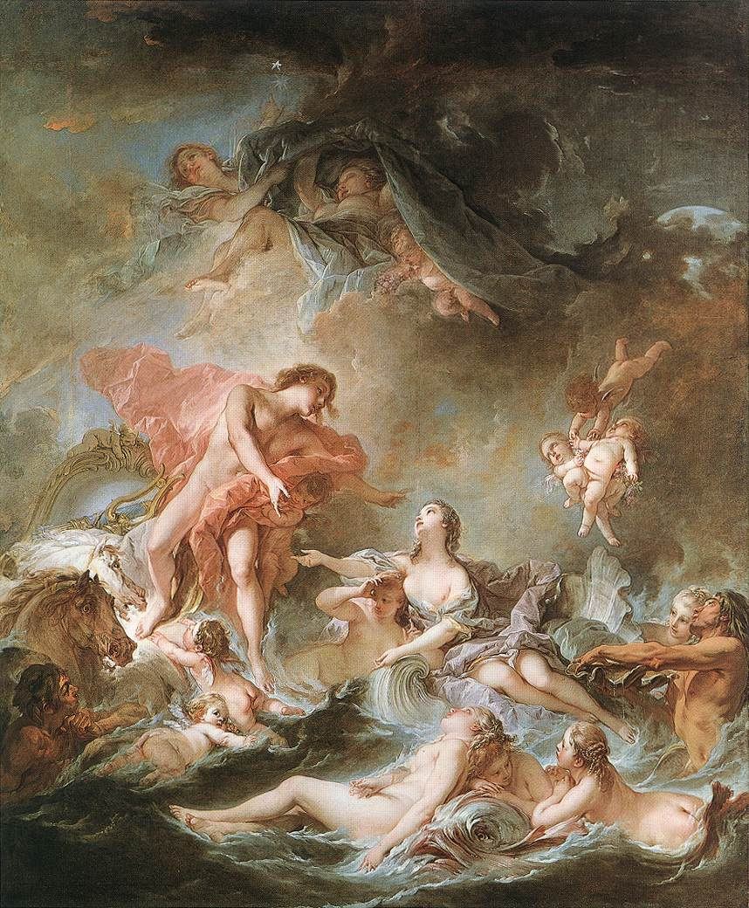
“The Rising of the Sun” & “The Setting of the Sun” François Boucher, 1752-1753

Slide 12
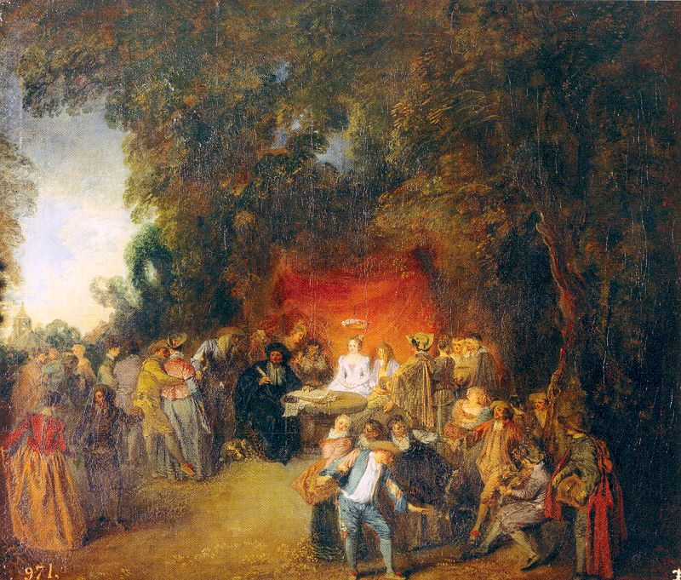
“The Marriage Contract” Jean-Antoine Watteau, 1713

Slide 13
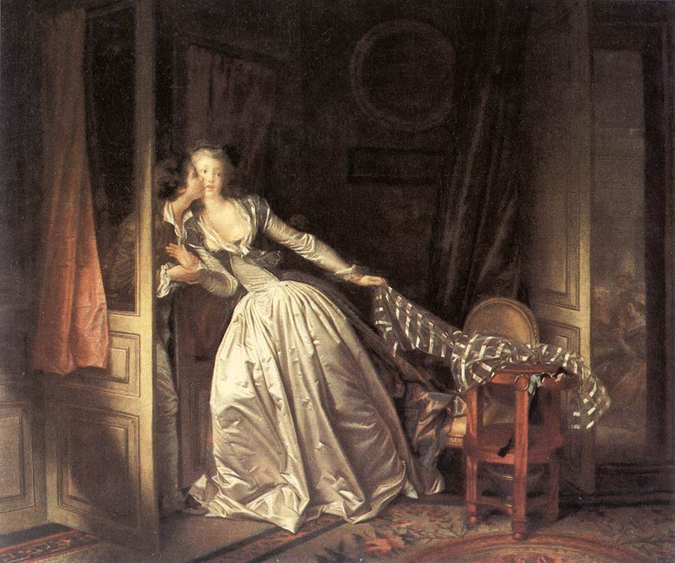
“The Stolen Kiss” Jean Honoré Fragonard, 1787-1788

Slide 14
3. Domestic & Family Life
Portrays the carefree life of the upper class.
The Galante style.
Informal, decorous intimacy of peoples’ manners.

Slide 15
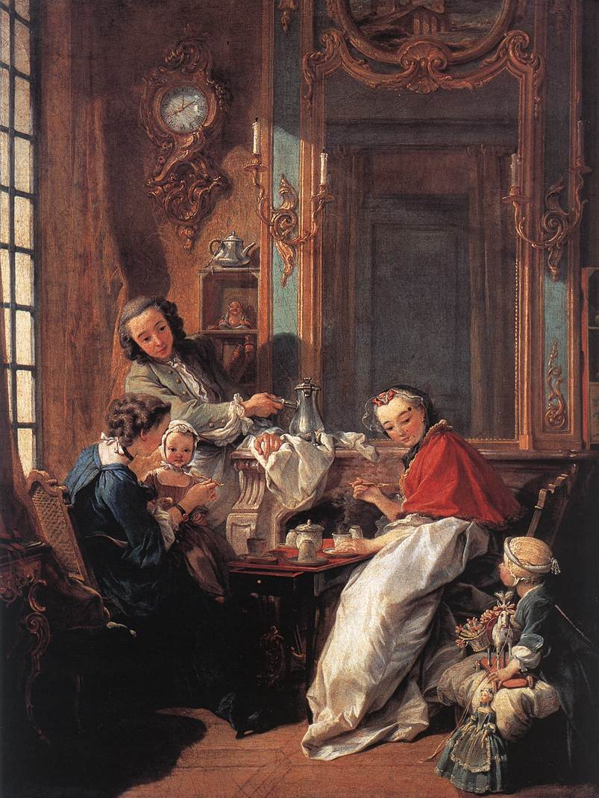
“The Afternoon Meal”
François Boucher
1739

Slide 16
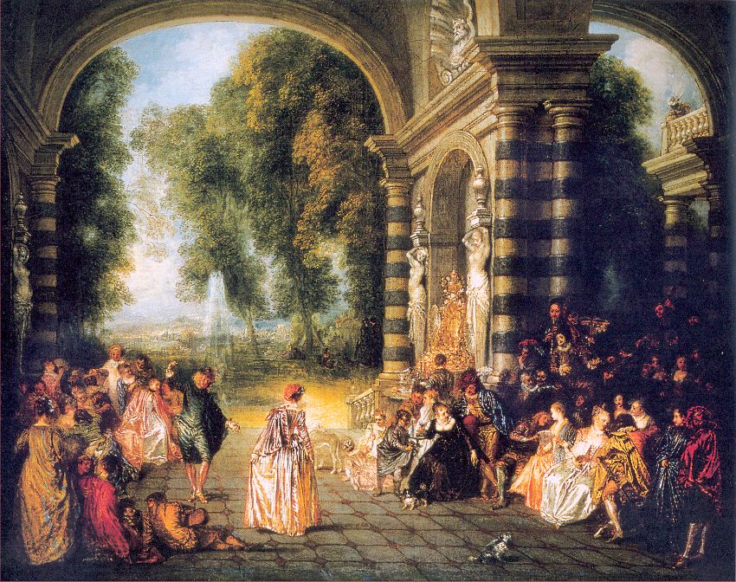
“The Pleasures of the Ball” Jean-Antoine Watteau, 1717

Slide 17
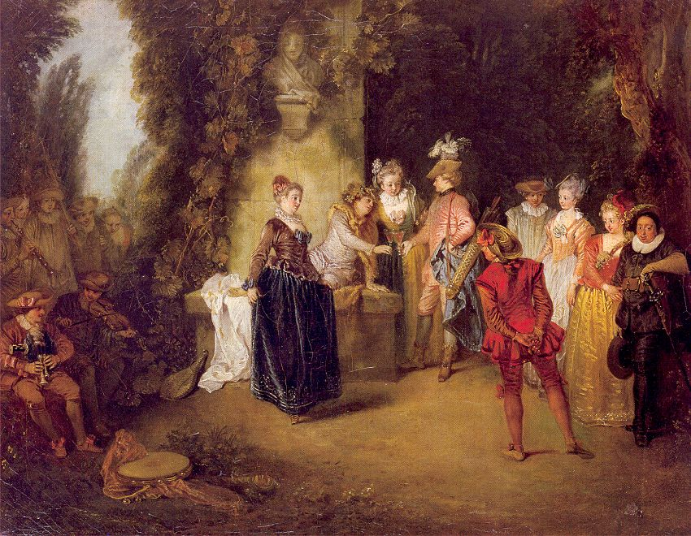
“The French Theater” Jean-Antoine Watteau, 1714

Slide 18
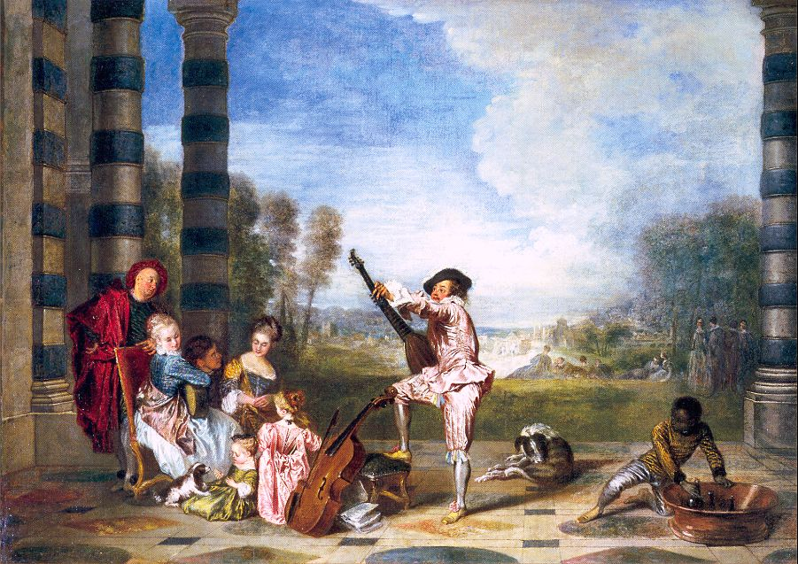
“The Delights of Life” Jean-Antoine Watteau, 1718

Slide 19
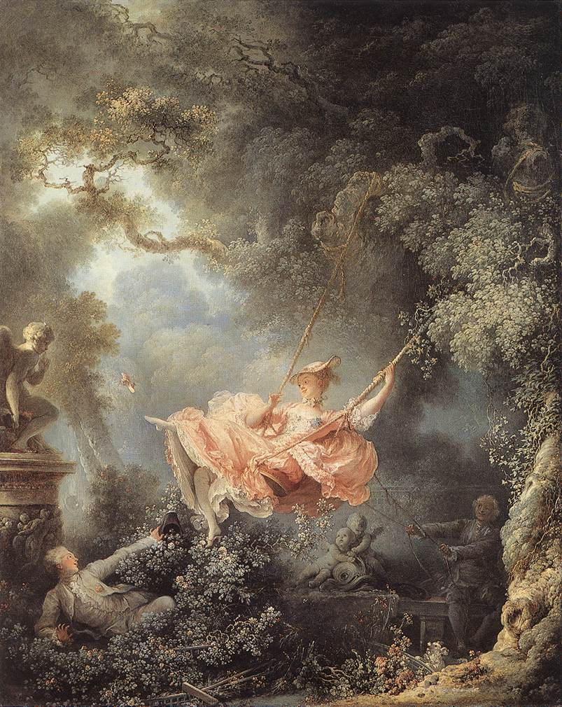
“The Swing”
Jean Honoré Fragonard
1767

Slide 20
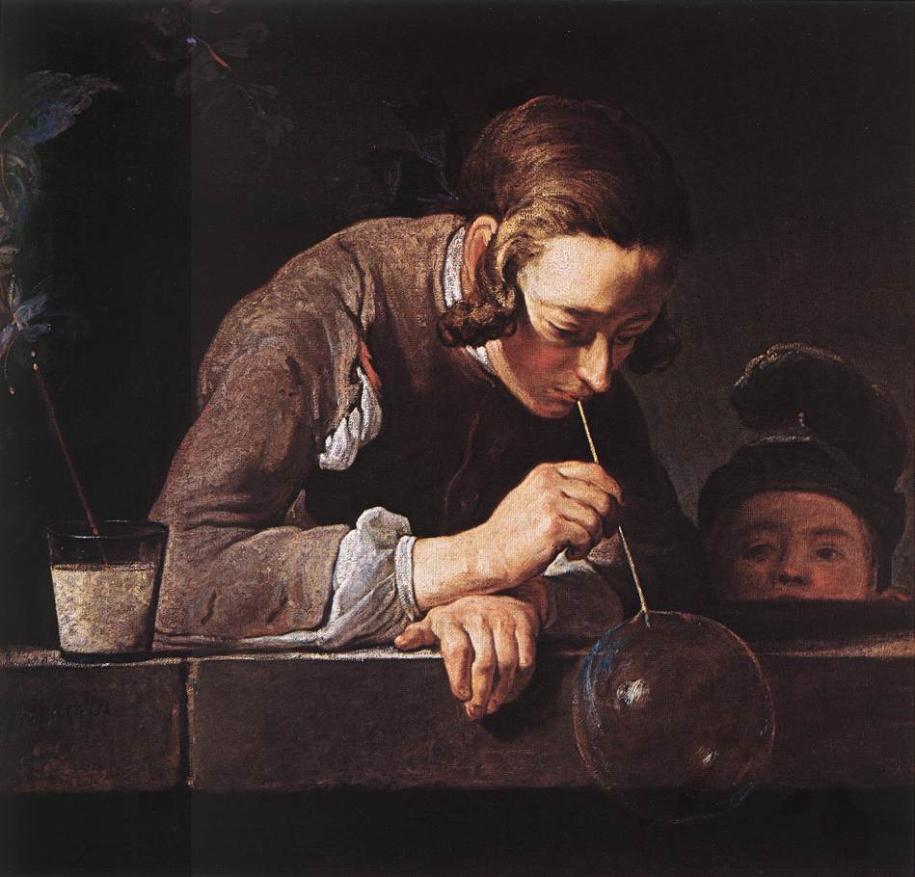
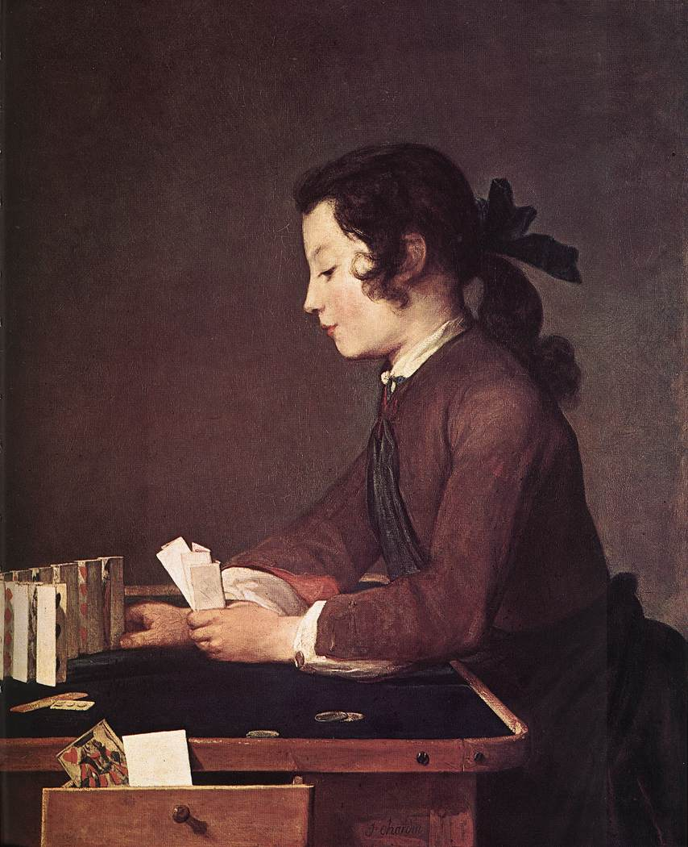
Jean Siméon Chardin
“The House of Cards” 1737
“The Soap Bubble” 1739

Slide 21
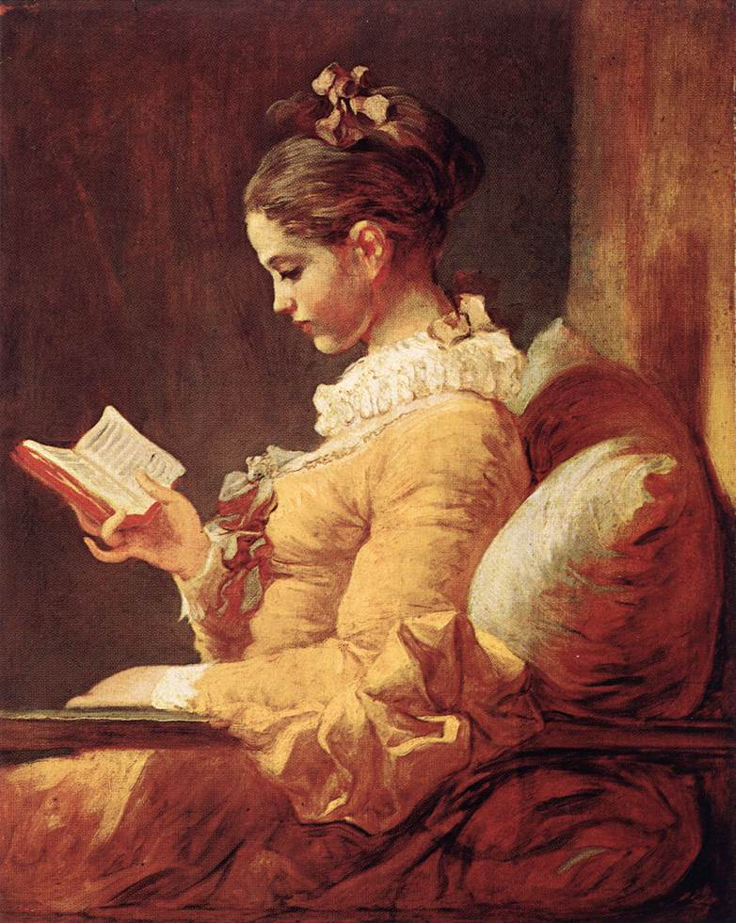
“A Young Girl Reading”
Jean
Honoré
Fragonard
1776

Slide 22
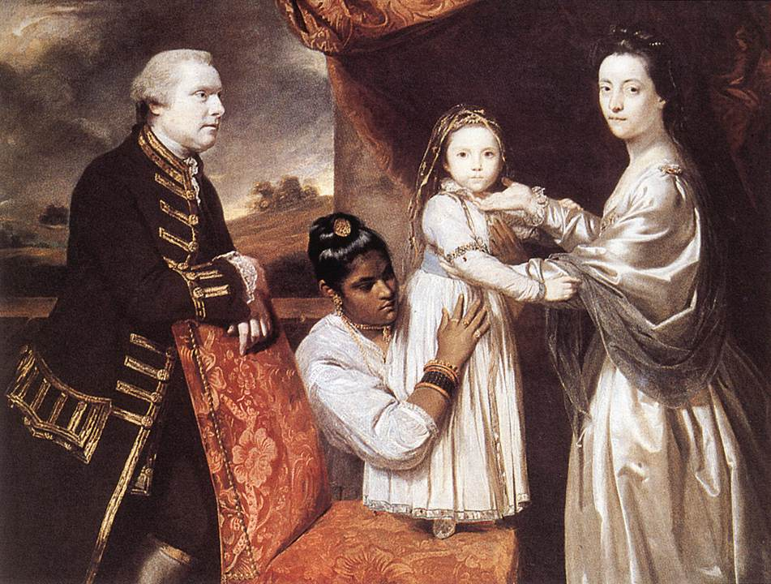
4. Love of the Exotic
Oriental decorative motifs & themes.
“Sir George Clive & His Children with an Indian Maid” by Sir Joshua Reynolds, 1765

Slide 23
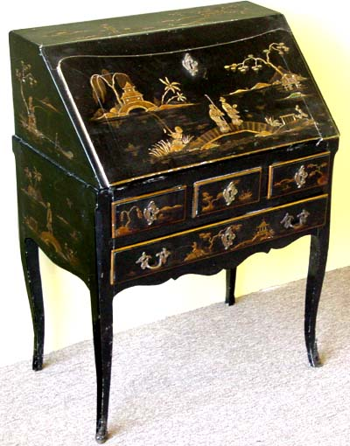
Chinoiserie
Louis XV-style lacquered secretary, late 18c.

Slide 24
The English
Rococo
Portraiturists

Slide 25
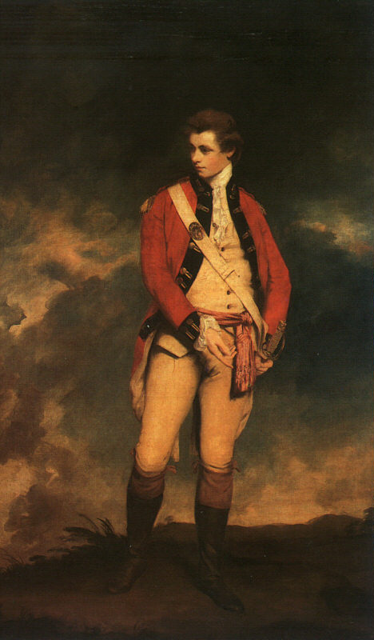
“Colonel
St. Leger”
Sir
Joshua
Reynolds
1778

Slide 26
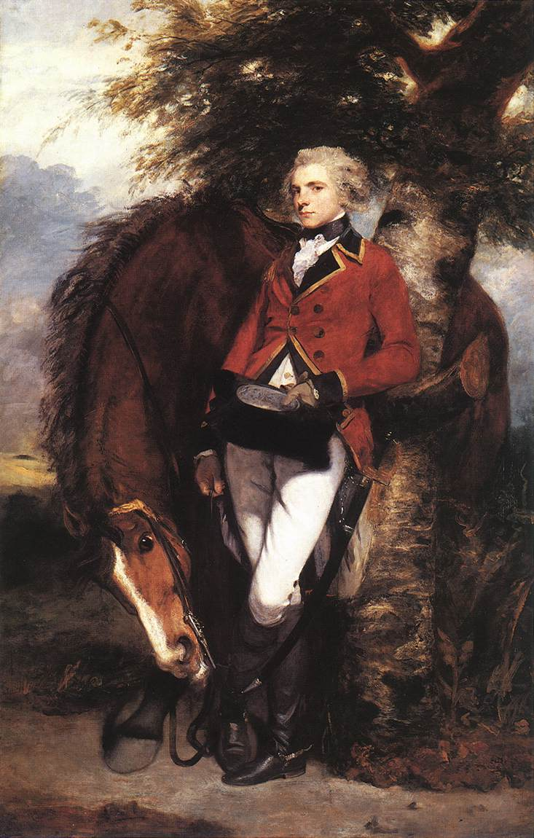
“Colonel
George Coussmaker, Grenadier Guards”
Sir
Joshua
Reynolds
1782

Slide 27
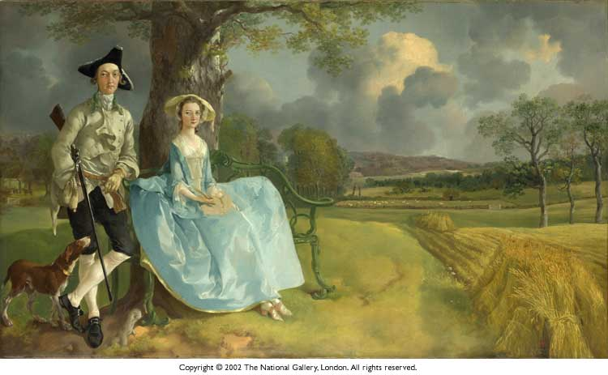
“Mr. & Mrs. Andrews” Thomas Gainsborough, 1750

Slide 28
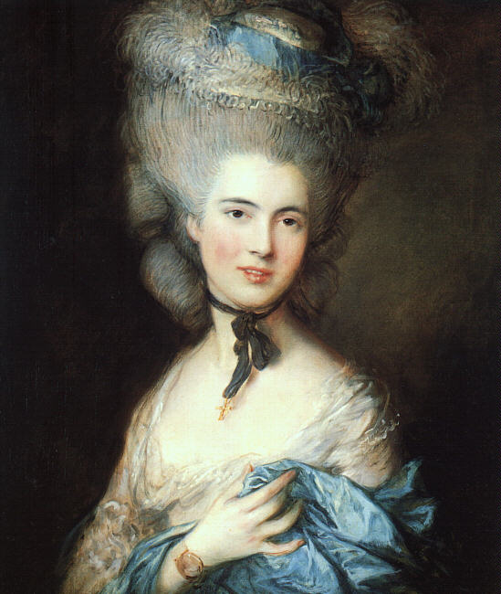
“Portrait of a Lady in Blue”
Thomas Gainsborough
1777-1779

Slide 29
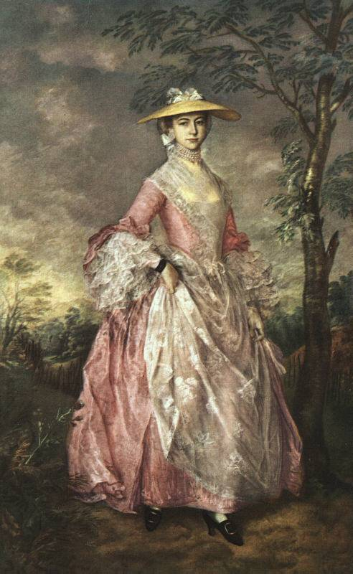
“Mary,
Countess Howe”
Thomas Gainsborough
Late 1760

Slide 30
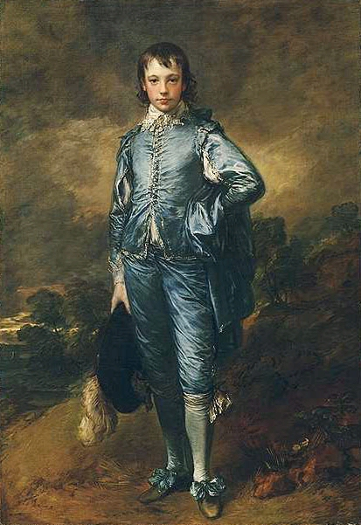
“The Blue Boy” Thomas Gainsborough 1770

Slide 31
Rococo
Architecture

Slide 32
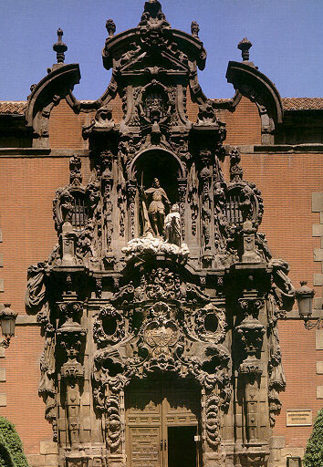
Portal of the Hospicio de San Fernando in Madrid, 1722

Slide 33
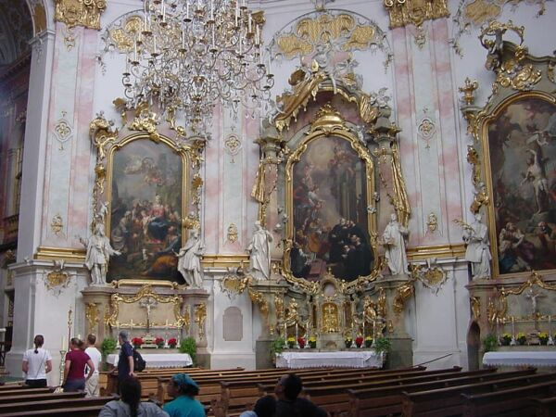
Abbey of Ettal (Interior) Oberammergau, 1750

Slide 34
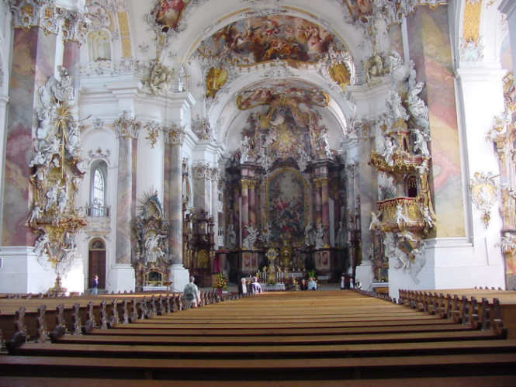
The Basilica at Ottobeueren, Bavaria

Slide 35
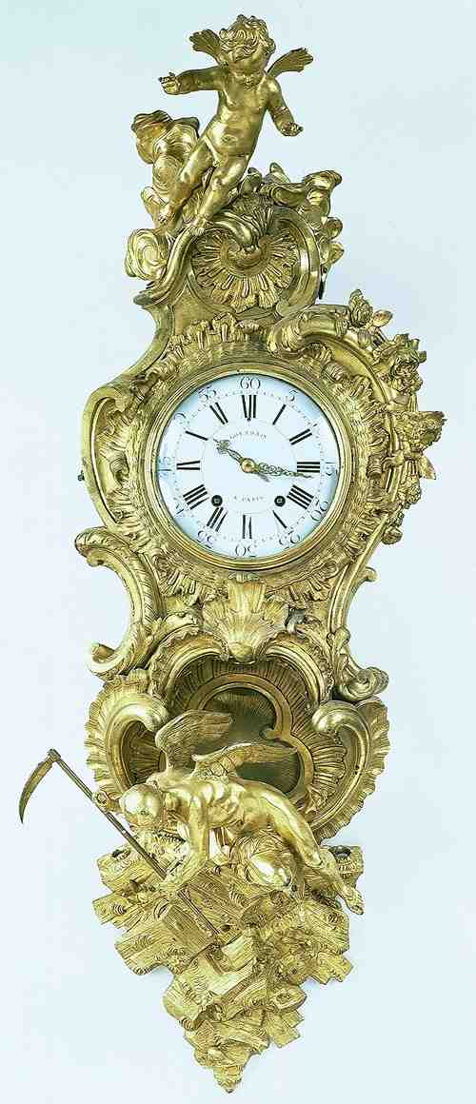
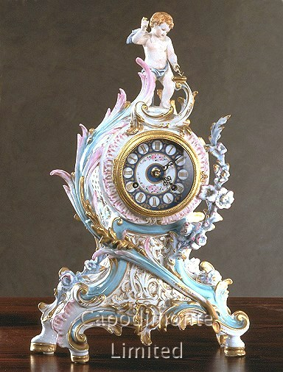
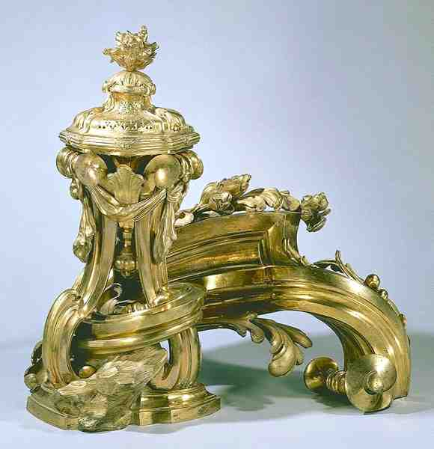
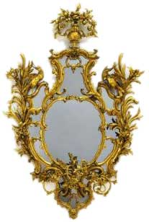
Rococo Furniture

Slide 36
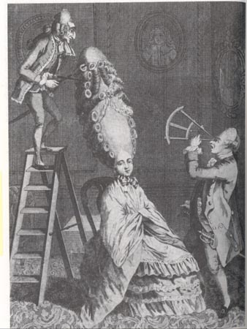
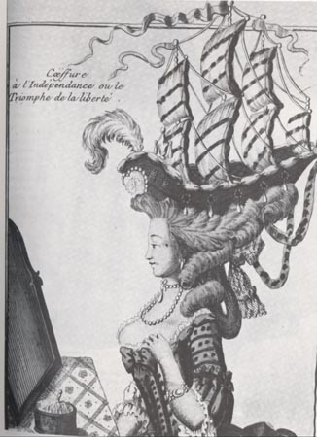
A Rococo Hairdo

Slide 37
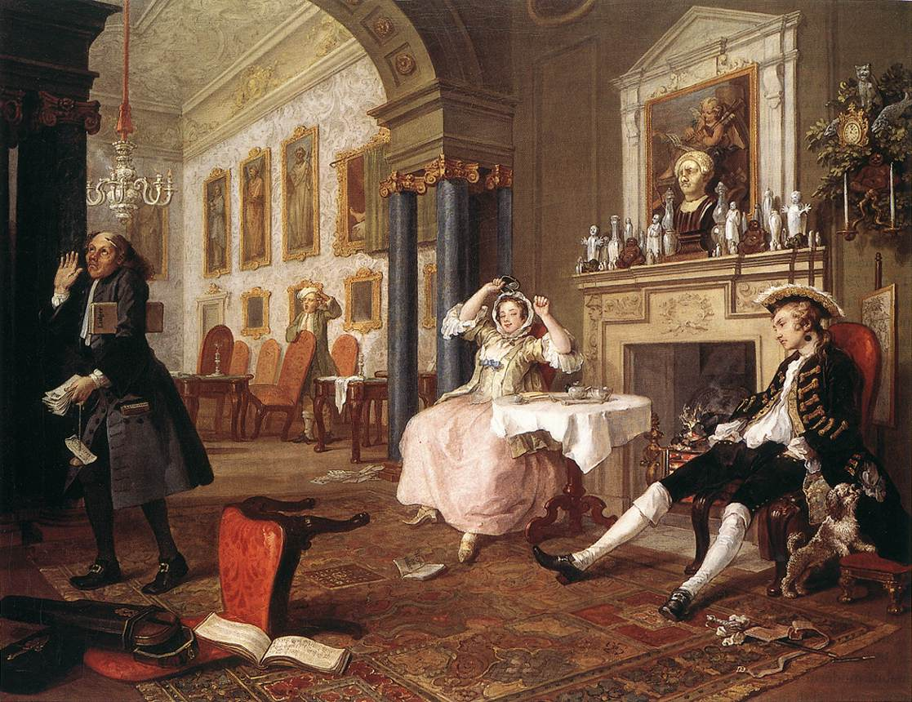
“Marriage a La Mode” William Hogarth, 1745
An anti-Rococo statement.

