Slide 1
The Revolutions Of 1848
“The Springtime of Peoples”
Third times a charm…?

Slide 2
The turning point at which history failed to turn.
--- George Macaulay Trevelyn [1937]

Slide 3
Historicism
The “Hegelian Dialectic”
History advances through conflict.
One phase of history creates its opposite [ex: absolutism to democracy].
Thesis
Antithesis
George Wilhelm Friedrich Hegel [1744-1803]
Synthesis

Slide 4
Pre-1848 Tensions: Long-Term
Industrialization
Economic challenges to rulers.
Rapid urbanization.
Challenges to the artisan class.
Population doubled in the 18^{c}
Food supply problems → Malthus
Ideological Challenges
Liberalism, nationalism, democracy, socialism.
Romanticism
Repressive Measures
Carlsbad Decrees [Prus.]
Six Acts [Eng.]
Secret police created in many European states.

Slide 5
Pre-1848 Tensions: Short-Term
Agricultural Crises
Poor cereal harvests
prices rose 60% in one year.
Potato blight → Ireland
Prices rose 135% for food in one year!
Financial Crises
Investment bubbles burst → railways, iron, coal.
Unemployment increased rapidly [esp. among the artisan class].
Working & middle classes are now joined in misery as are the urban and agricultural peasantry!

Slide 6
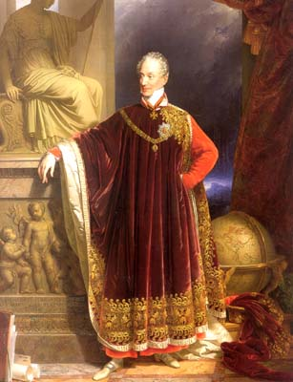
Prince Metternich
1815: We have redrawn Europe’s map for eternity.

Slide 7
Revolutions in 1848

Slide 8
No Coherent Organized Revolutions
Many different reasons for revolutionary activities.
Reactions to long- and short-term causes.
Competing ideologies in different countries.
Different revolutionary leaders, aims, and goals in different countries.
Some countries had no revolutions:
England.
Russia.

Slide 9
FRANCE: The Giant Sea Snake?

Slide 10
FRANCE

Slide 11
Louis Philippe, “The Pear,” 1848

Slide 12
Prince Louis: Not Too Steady!
Victor Hugo & Miguel de Girardin try to raise Prince Louis upon a shield.

Slide 13
The February Revolution
Working class & liberals unhappy with King Louis Philippe, esp. with his minister, Francois Guizot [who opposed electoral reform].
Reform Banquets used to protest against the King.
Paris Banquet banned.
Troops open fire on peaceful protestors.
Barricades erected; looting.
National Guard [politically disenfranchised] defects to the radicals.
King Louis Philippe loses control of Paris and abdicates on February 24.

Slide 14
Alphonse Lamartine
A poet & liberal, he believed in the “Rights of Man.”
To vote, to free speech, to property, & to a secular education.
Declared a new Provisional Government.
Conservatives & liberals are suspicious of republicanism
Reminiscent of the Reign of Terror.

Slide 15
Louis Blanc
A Social Democrat.
He believed in the “Right to Work.”
National Workshops.
Provide work for the unemployed.
Financial Crisis
Flight of capital.
Stock market crashes [55% decline].
New 45% increase of taxes on the peasants.

Slide 16
The Coalition Splits: Mar.-May
The conflicts between liberals & socialists over:
The timing of elections to the Constituent Assembly.
The costs of government social programs.
Did they violate laissez-faire?
The question of whether you could have liberty for all men and still have a system based on private property.
Growing social tensions between the working class & the bourgeois middle class regarding:
The nature of work.
The right to unionize.
Pay levels.

Slide 17
April Elections
Resulted in a conservative majority in the National Assembly.
They began debating the fate of social programs [like the National Workshops].
The conservative majority wanted the removal of radicals like Blanc from the government.
In early June, the National Workshops were shut down.
This heightened class tensions!

Slide 18
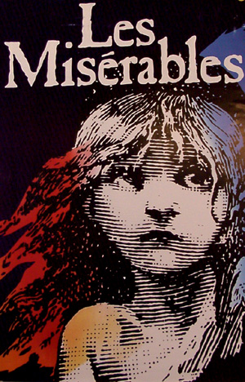
The “June Days”
Worker groups in Paris rose up in insurrection.
They said that the government had betrayed the revolution.
Workers wanted a redistribution of wealth.
Barricades in the streets.
Victor Hugo’s Les Miserables was based on this event.
A new liberal-conservative coalition formed to oppose this lower class radicalism.

Slide 19
Paris: To the Barricades Again!

Slide 20
The 2nd French Republic (1848-1852)
General Louis Cavaignac assumed dictatorial powers & crushed the revolt.
10,000 dead.
A victory for conservatives.
Nov., 1848 → a new constitution provided for:
An elected President.
A one-house legislature.
The Republic by Jean-Leon Gerome

Slide 21
President Louis Napoleon
The December election:
The “law and order” candidate, Louis Napoleon Bonaparte, defeated Cavaignac.
This was a big shift in middle class opinion to the right!
The New President:
Purged the govt. of all radical officials.
Replaced them with ultra-conservative and monarchists.
Disbanded the National Assembly and held new elections.
Represented himself as a “Man of the People.”
His government regularly used forced against dissenters.

Slide 22
1851 Coup d’Etat
President Louis Napoleon declared a hereditary 2nd French Empire.
A national plebiscite confirmed this.

Slide 23
The HAPSBURG EMPIRE

Slide 24
The Austrian Empire: 1830

Slide 25
Ferdinand I (1793-1875)
The nature of the Austrian Empire:
Very conservative monarchy [liberal institutions didn’t exist].
Culturally and racially heterogeneous.
Social reliance on serfdom dooms masses of people to a life without hope.
Corrupt and inefficient.
Competition with an increasingly powerful Prussia.
Therefore, the Empire was vulnerable to revolutionary challenges.

Slide 26
Austrian Students Form a Militia

Slide 27
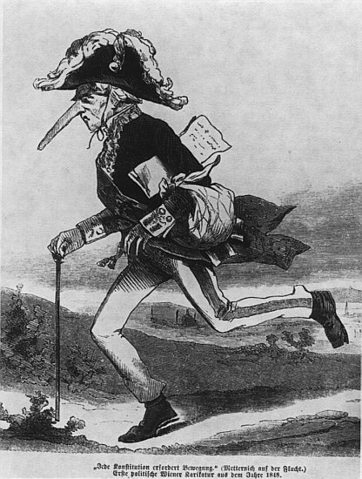
Vienna, 1848: The Liberal Revolution
The “February Revolution” in France triggered a rebellion for liberal reforms.
March 13 → rioting broke out in Vienna.
The Austrian Empire collapsed.
Metternich fled.
Constituent Assembly met.
Serfdom [robot] abolished.
The revolution began to wane.
The revolutionary government failed to govern effectively.

Slide 28
The New Austrian Emperor Franz Joseph I [r. 1848-1916]

Slide 29
The Hungarian Revolution

Slide 30
Lajos Kossuth (1802-1894)
Hungarian revolutionary leader.
March laws provided for Hungarian independence.
Austrians invade.
Hungarian armies drove within sight of Vienna!
Slavic minorities resisted Magyar invasion & the Hungarian army withdrew.
Austrian & Russian armies defeated the Hungarian army.
Hungary would have to wait until 1866 for autonomy.

Slide 31
Tsar Nicholas I (r. 1825-1855)
He raised an army of 400,000 in response to a request from Franz Joseph.
140,000 put down the Hungarian revolt.

Slide 32
Bohemia, 1848
Bohemia was split between Pan-Slavs & Pan-Germans.
Prague Conference:
Developed the idea of Austro-Slavism.
A constitution & autonomy within the Habsburg Empire.
The Austrian military ultimately attacked Prague, occupied Bohemia & crushed the rebellion.
The Prague Barricades

Slide 33
Revolution in Romania

Slide 34
Italy

Slide 35
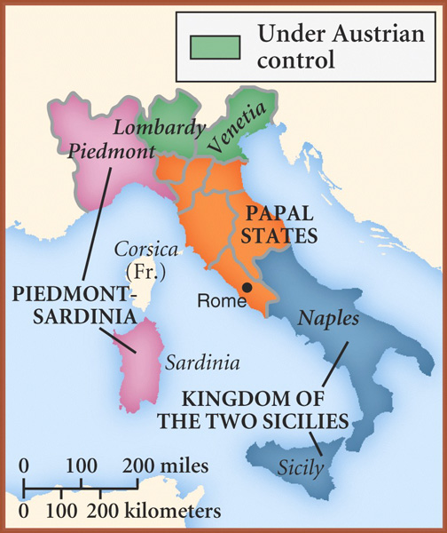
Upheaval in Italy, 1848
Italian nationalists and liberals sought to end foreign domination of Italy.
Milan, Lombardy & Venetia wanted to expel their Austrian rulers.
Bourbon rulers in Kingdom of Two Sicilies.
House of Savoy in Sardinia-Piedmont grant liberal constitutions.
Sardinia-Piedmont declared war on Austria.
Beginning in May, revolutions suppressed.

Slide 36
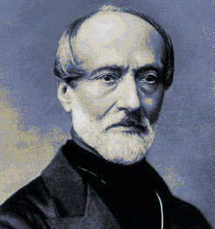
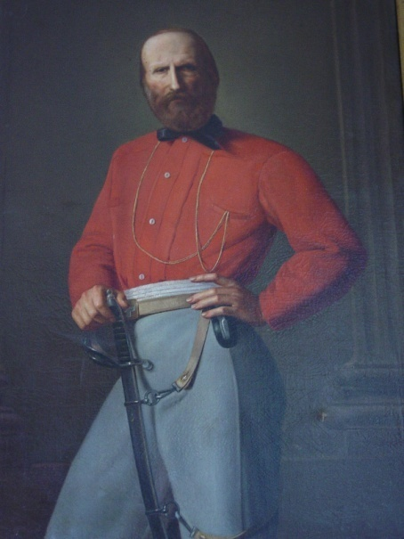
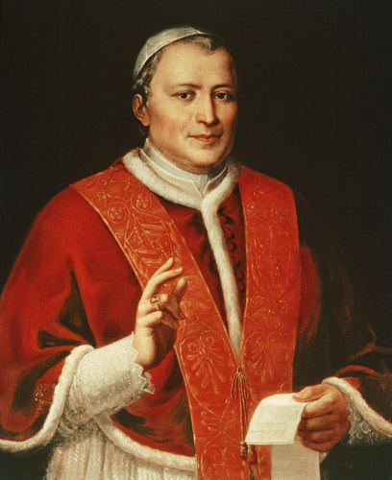
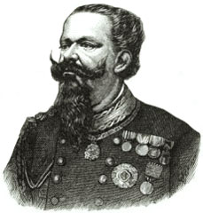
Italy, 1848
Giuseppe Mazzini established a Roman Republic in 1849 protected by Giuseppe Garibaldi.
Pope Pius IX forced to flee.
Austrian General Radetsky crushed Sardinia-Piedmont.
French troops take back the Papal States.
Victor Emmanuel II takes the throne in Sardinia-Piedmont.

Slide 37
Reasons for Failure in Italy
Rural people did not support the revolutions.
Revolutionaries focused mainly on urban middle classes.
The revolutionaries were not united.
Fear of radicals among moderates lead to the collapse of the revolutions.
Lack of leadership and administrative experience among the revolutionaries.

Slide 38
The German States

Slide 39
Germania - 1848

Slide 40
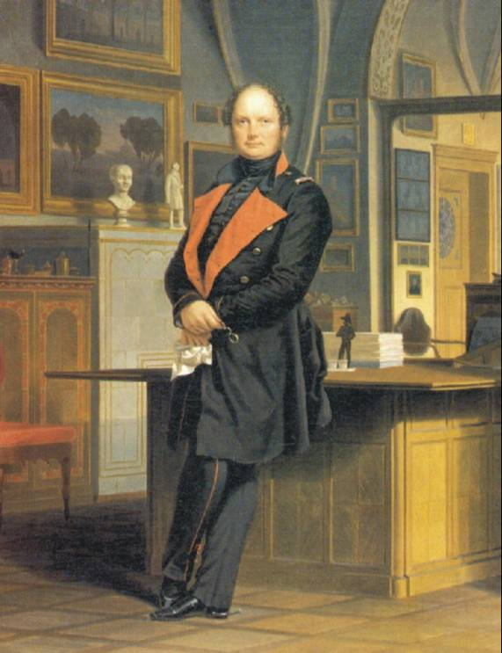
Frederick William IV of Prussia (1840-1861)
Mad as a hatter!
Anti-liberal, but an ‘Arthurian’ medieval romantic.
Agricultural romantic.
Relied on Junker support.
Prussia in the mid-19^{c}:
Efficient.
Good economy.
Strong military.

Slide 41
The Germans Follow the French
After the February French revolutions, there were many riots in minor German states.
Austria and Prussia expected to intervene to crush these revolts, BUT:
Vienna Revolution → led to the fall of Metternich.
Berlin riots
Prussian army efficiently suppressed the revolutionaries.
King Frederick William IV withdraws the troops and hand the Prussia liberals a big victory!
Other Princedoms collapse when Prussia’s nerve fails.

Slide 42
Funeral for Berlin Freedom Fighters

Slide 43
The Frankfurt Assembly
German liberals are overjoyed!
German National Assembly established in Frankfurt:
Universal suffrage.
Delegates mostly from the middle class.
Debate over the nature of the state → monarchy of Habsburgs or Hohenzollerns?
They chose the Austrian Habsburg Archduke John rather than the King of Prussia.
He was a well-known liberal sympathizer.
But they couldn’t guarantee the loyalty of the Prussian Army.

Slide 44
Frankfurt Assembly Meets

Slide 45
A Citizen Militia on Parade in Berlin

Slide 46
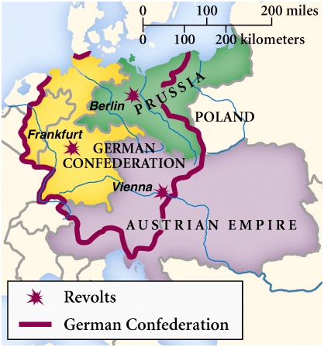
The “Three Germanies”

Slide 47
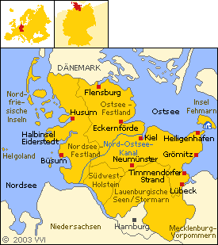
Prussian Resurgence
The Prussian army moved to crush the new Polish Grand Duchy.
The Prussian parliament disagreed with the Frankfurt Parliament.
The Prussian army invaded Schleswig-Holstein (at Frankfurt’s request).
Horrified international liberal opinion.
Britain & Russia threatened war with Prussia.
Prussia agreed to its own peace with Denmark.
The Prussian army abandoned the Frankfurt government.

Slide 48
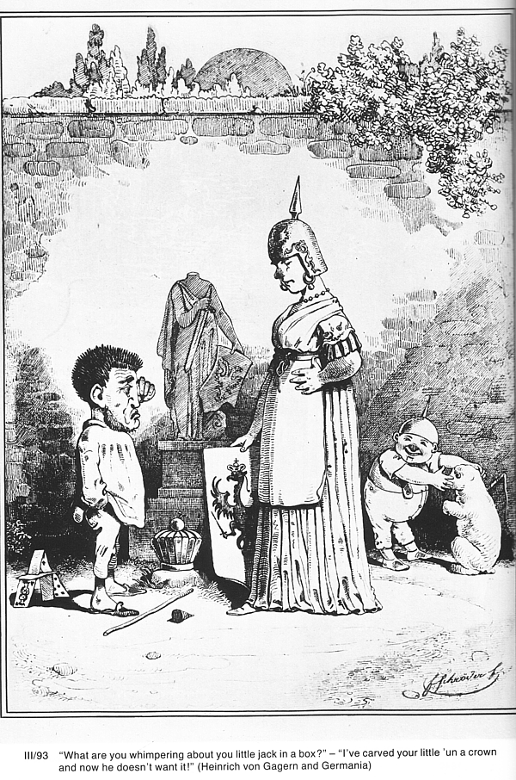
Austria & Prussia Reassert Control
Austria re-gained control of Vienna.
Frederick William deposed the Berlin parliament.
The Frankfurt Assembly offered the emperorship to Frederick William.
He declined.
Radicals took to the barricades again.
The Prussian army crushed all resistance.
April, 1849 → the Assembly collapsed.

Slide 49
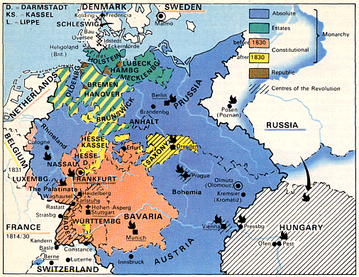
A New German Confederation
Frederick William IV of Prussia was still interested in ruling a united Germany.
1850 → the German Confederation was re-established at Olmutz.
But, Frederick was forced to accept Austrian leadership of Central Europe.

Slide 50
Liberalism Discredited in Germany
Little popular support.
The union of liberals and democrats didn’t last.
Rule of force was the only winner!
There was a massive exodus of liberal intelligentsia.
Militarism, hierarchy, and statism were triumphant!
Capitalists followed suit.

Slide 51
1848: Outside the Continent

Slide 52
Chartist Meeting, 1848
The Movement reached its height with the Kennington Common demonstration on April 10, 1848.
This could have been the prelude to revolution in Britain, but the meeting was peaceful.
The Chartist leaders did not follow up on the meeting, and the movement died.

Slide 53
Seneca Falls Convention, NY

Slide 54
THE AFTERMATH

Slide 55
Democrats Swept Out of Europe

Slide 56
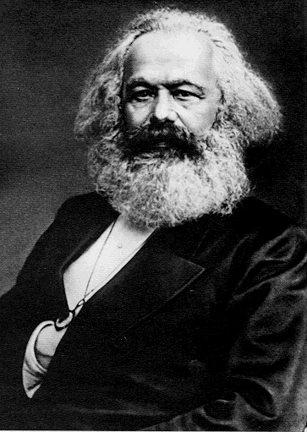
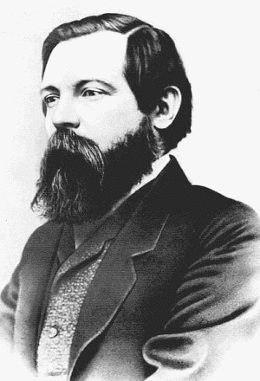
The Communist Manifesto
Karl Marx
Friedrich Engels

Slide 57
Why did the 1848 Revolutions Fail?
They failed to attract popular support from the working classes.
The middle classes led these revolutions, but as they turned radical, the middle class held back.
Nationalism divided more than united.
Where revolutions were successful, the Old Guard was left in place and they turned against the revolutionaries.
Some gains lasted [abolition of serfdom, etc.]
BUT, in the long term, most liberal gains would be solidified by the end of the 19^{c}:
The unification of Germany and Italy.
The collapse of the Hapsburg Empire at the end of World War I.

Slide 58
The Bottom Line
It looked like the Conservative forces had triumphed.
BUT…
Things had changed forever.
Economic/social problems continued to be constant challenges to the ruling order.
Conservatives would have to make concessions in order to stay in power.
Many of the limited Liberal achievements remained permanent.

