Slide 1
© Morgan AP Teaching
Period 1: 1450 CE -1648 CE
Renaissance Art
Notebook Page 3

Slide 2
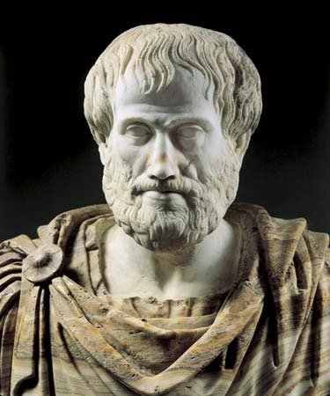
© Morgan AP Teaching
Impact of Humanism on Art
With humanism dominating literature and education, the concepts of the Renaissance also bled over into visual art
Visual art and literary art are where we can see the issues and ideas that dominate and define that time/generation
Two main features define Renaissance art, and separate it from Medieval Art:
Emphasis on the individual and regular people rather than God
Use of classical figures, architecture, and style
Like literature, visual art emphasized the idea that we are individual humans and worthy of being the subject of art—not just God
Additionally, art started including old, classical figures (Aristotle, Cicero, Plato, Socrates, etc.), and style of architecture (marble pillars and buildings)

Slide 3
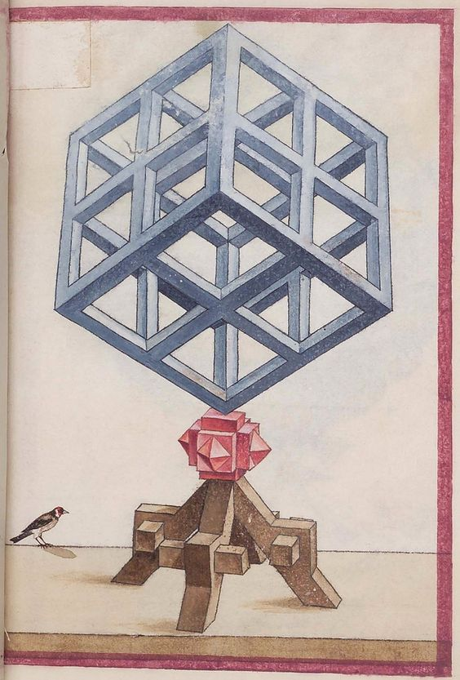
© Morgan AP Teaching
Renaissance Art
With this emphasis on regular people and individual life, a much larger amount of detail and effort were put into visual art
A new technique was developed called geometric perspective, which was an attempt by artists to make each painting or sculpture accurately
Painting and sculptures portrayed real, 3-D characters, with shading, shadows, and expressions as normal human bodies showcase
Raphael – School of Athens
Additionally, rather than simply painting Godly or heroic figures, art began to show regular people in regular situations (while not exclusive to the movement, themes of regular human life and religious themes were more indicative of the Northern Renaissance)
Leonardo da Vinci – The Mona Lisa
Rembrandt – Anatomy Lesson

Slide 4
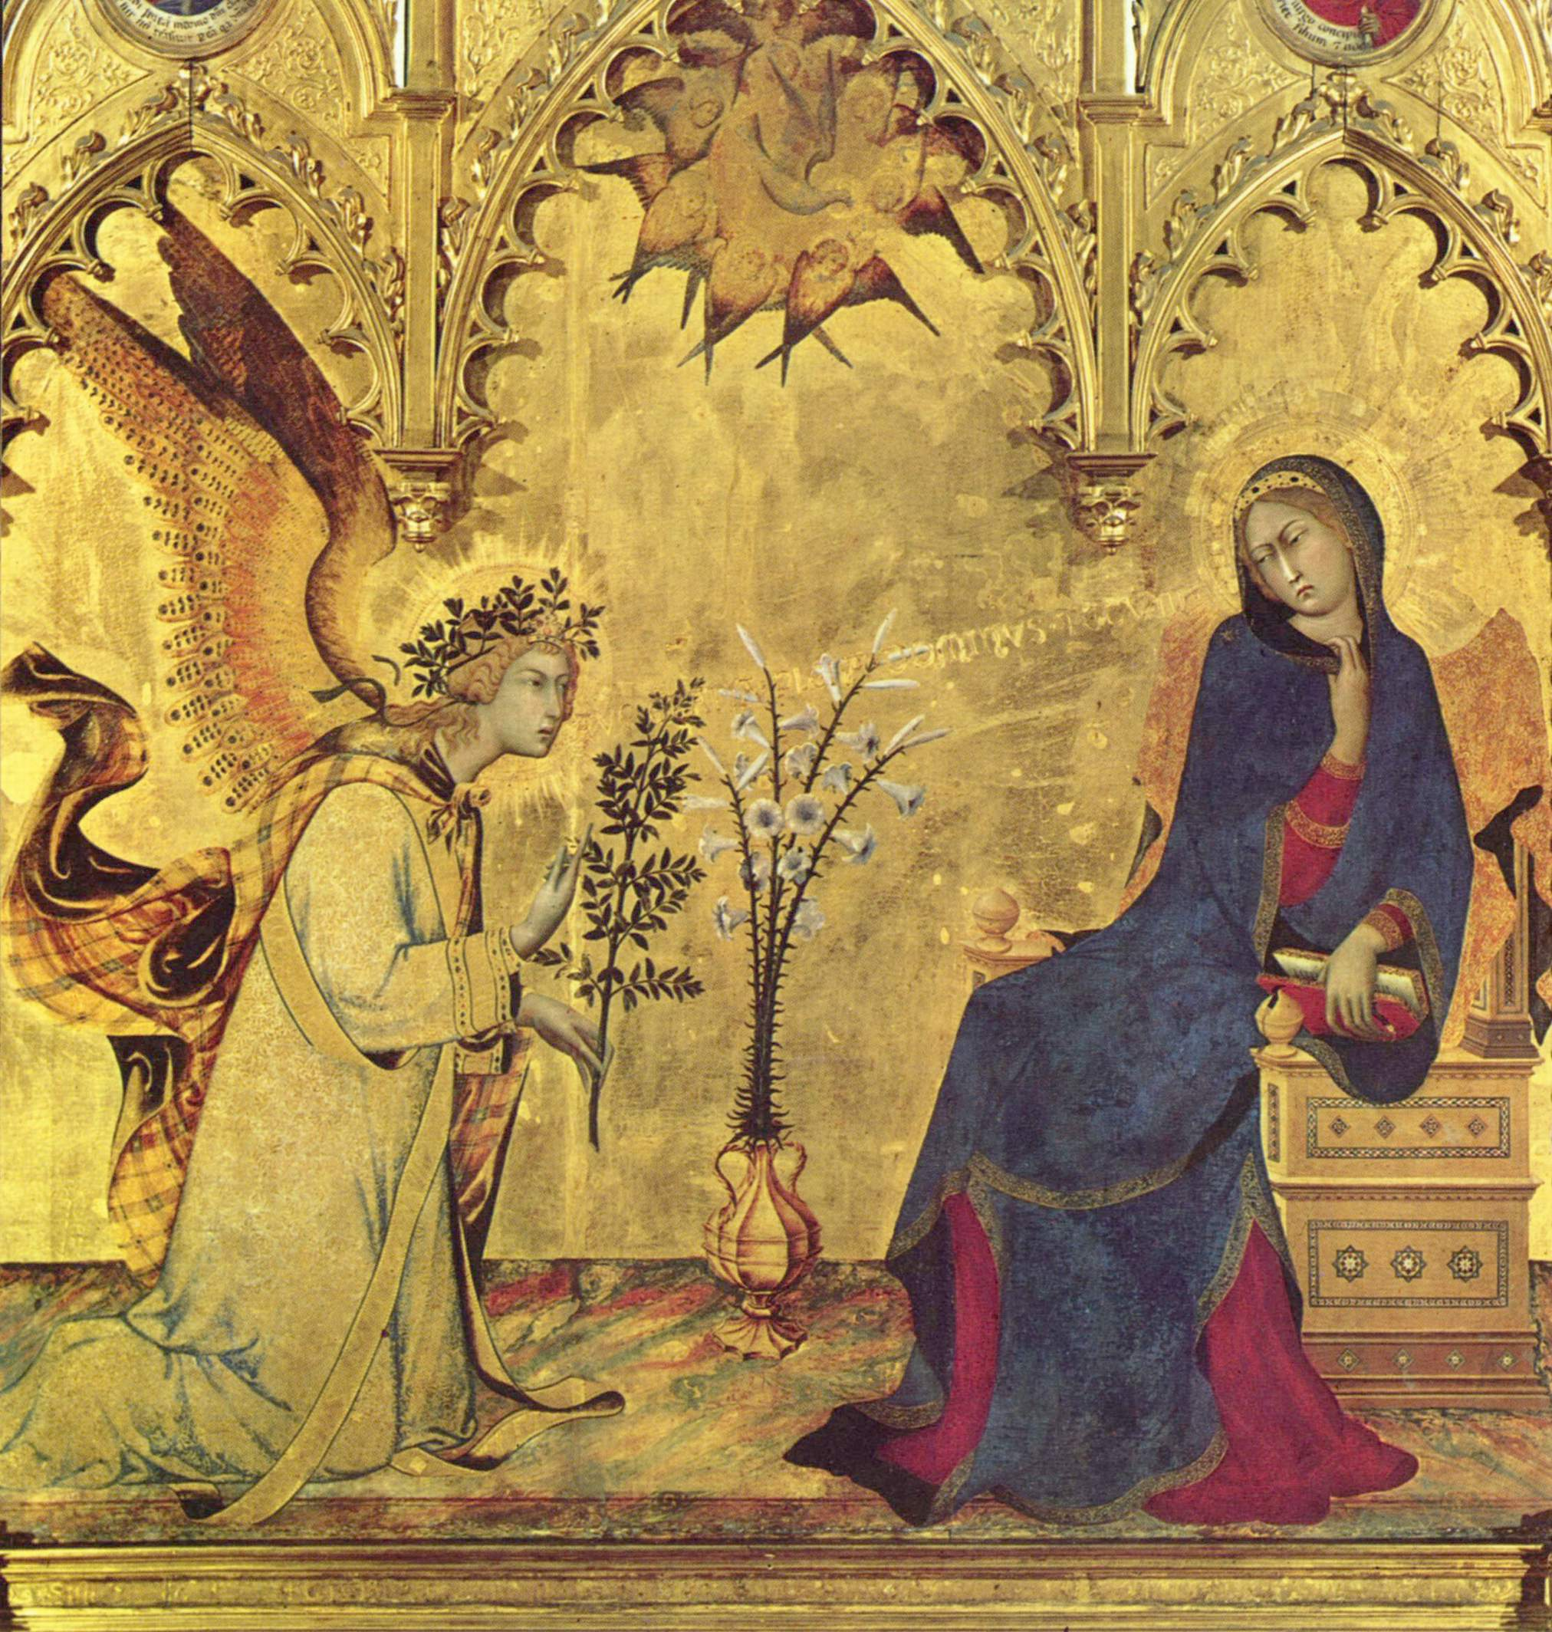
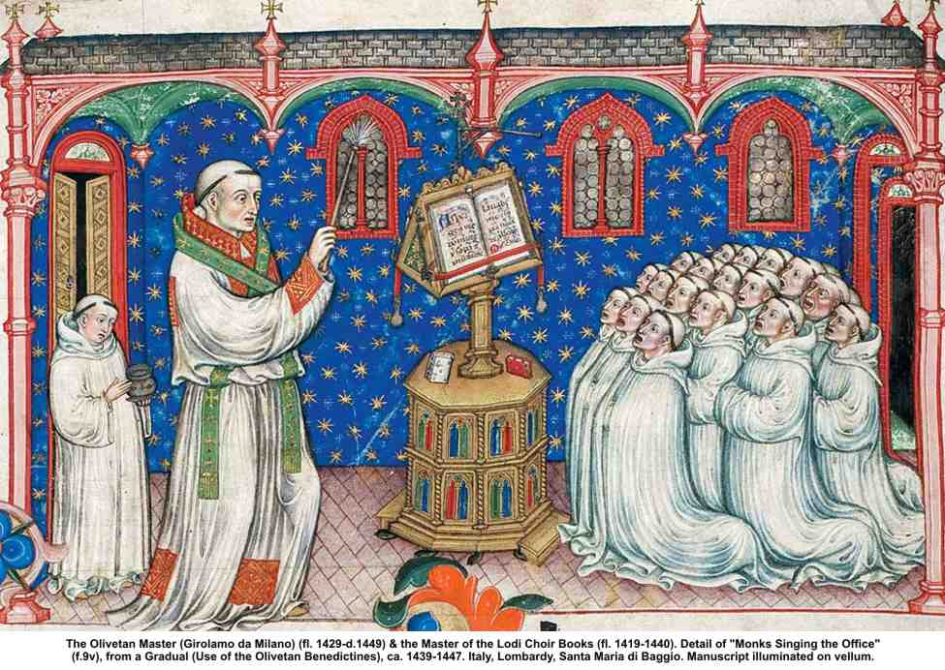
Medieval Art

Slide 5
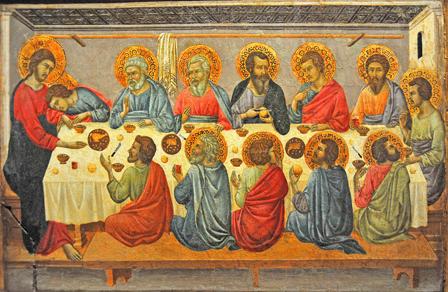
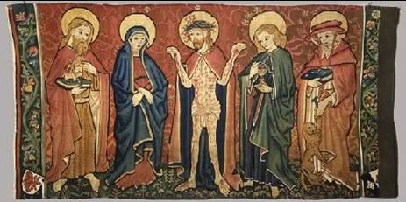
Medieval Art

Slide 6
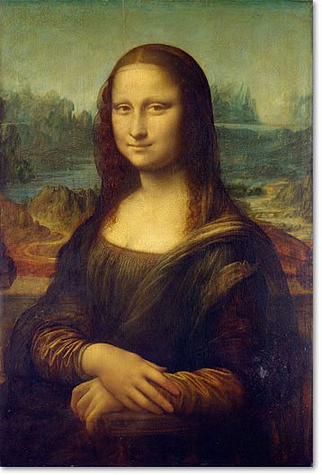
© Morgan AP Teaching
Renaissance Art
Mona Lisa – Leonardo da Vinci

Slide 7
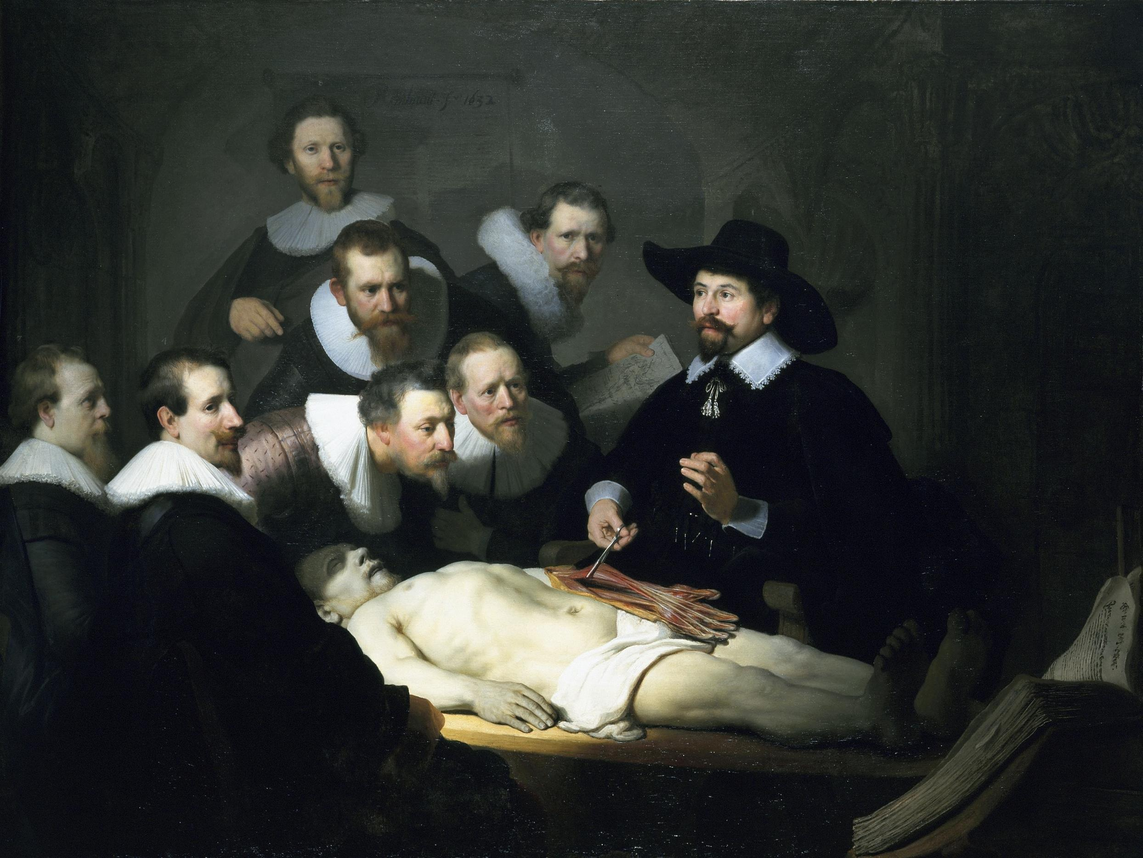
Anatomy Lesson - Rembrandt

Slide 8
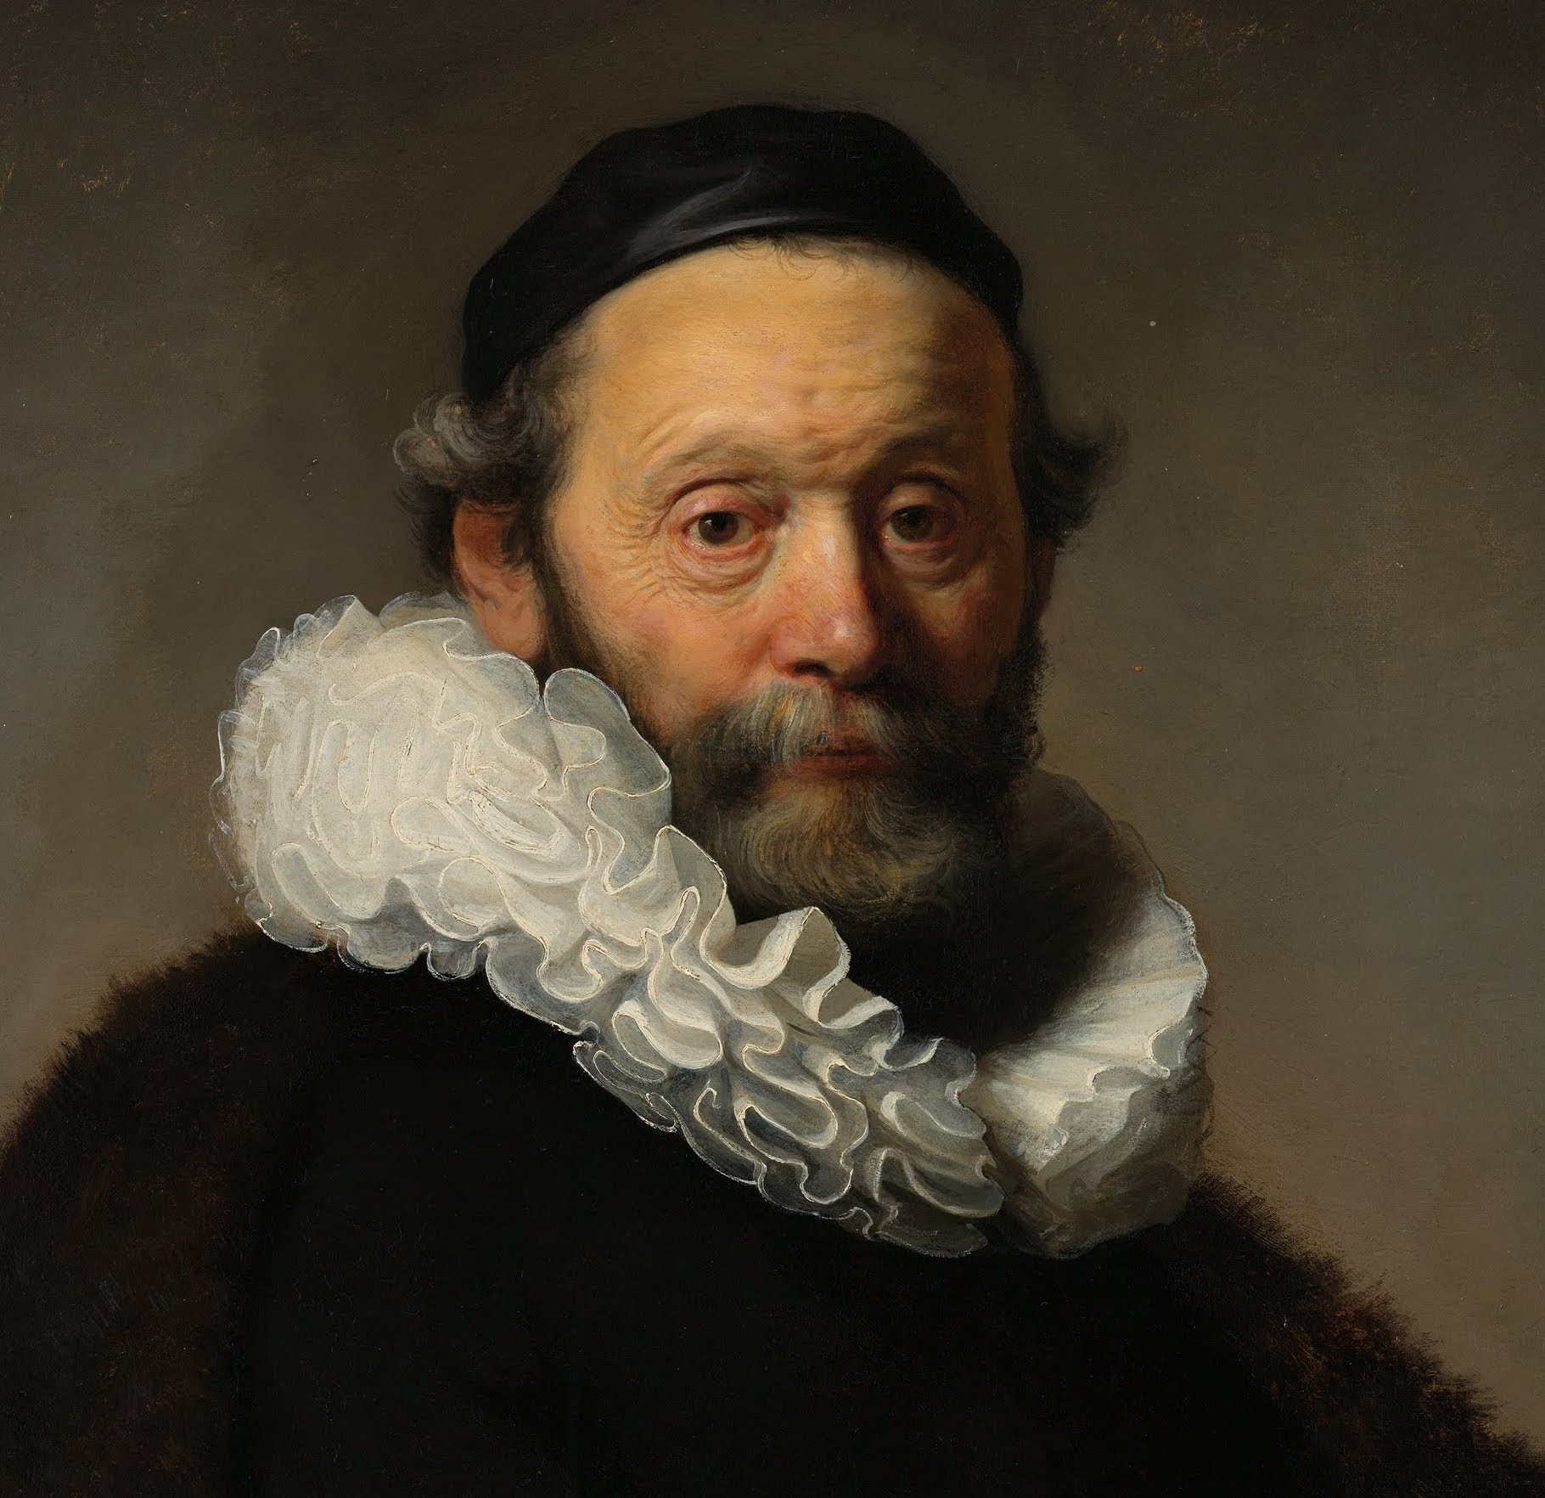
Self-portrait –
Rembrandt

Slide 9
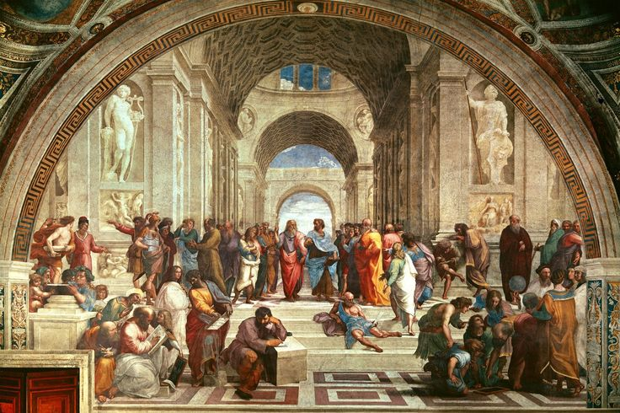
School of Athens - Raphael

Slide 10
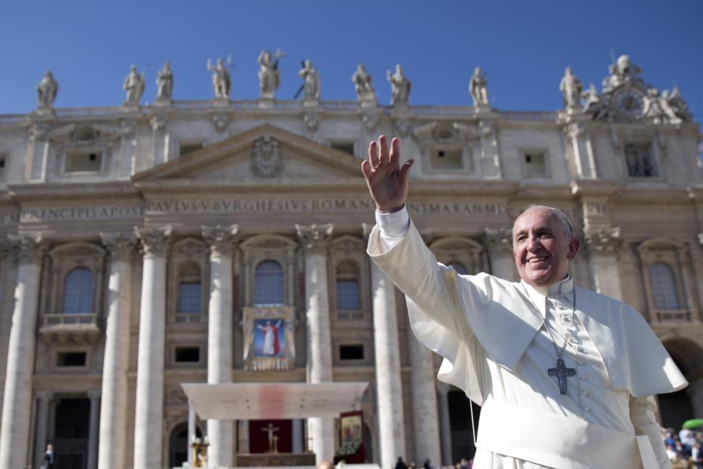
© Morgan AP Teaching
Patrons of Art
Renaissance art became so popular that it started a
new trend: hiring Renaissance artists to paint, sculpt,
or build your own stuff
Princes, merchants, and other patrons (people buying)
hired artists to paint themselves or their family in the
geometric, regular-person style
The Catholic Church itself also hired Renaissance artists to sculpt and design religious statues and buildings
Two of the most famous examples are:
Michael Angelo (sculptor and painter) – the Sistine Chapel
Filipo Brunelleschi’s architecture, such as the Cathedral in Florence

Slide 11
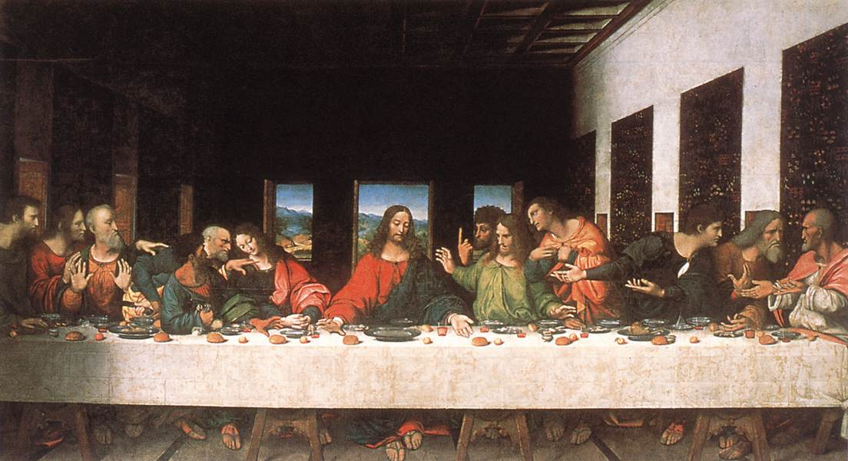
Last Supper – Leonardo da Vinci

Slide 12
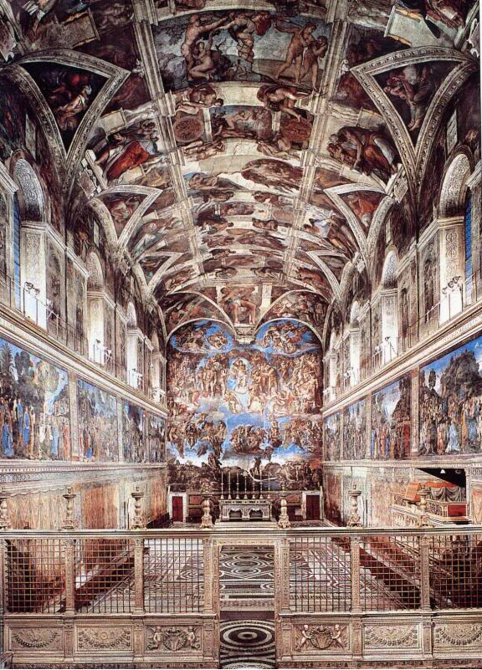
Sistine Chapel - Michelangelo

Slide 13
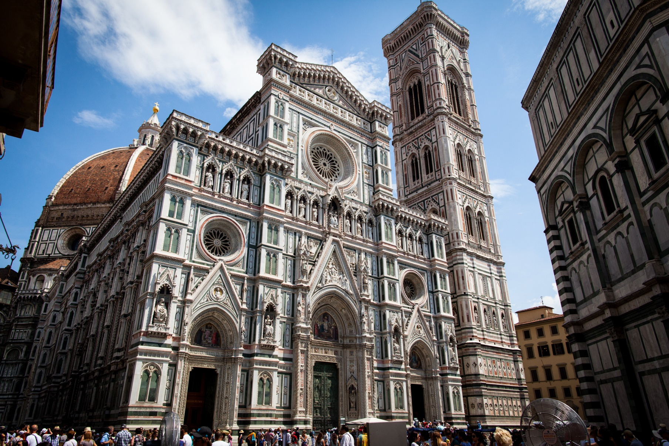
Florence Cathedral

