Slide 1
Period 1: 1450 CE -1648 CE
The Italian
Renaissance
© Morgan AP Teaching

Slide 2
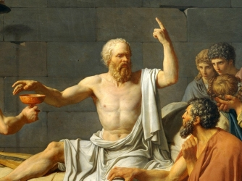
© Morgan AP Teaching
Return of the Classics
In the Middle Ages (the time between the fall of Rome and
the Renaissance), Europe had become insignificant in the world
Kings, nobles, and peasants were local, un-centralized, & lived
in service and fear of the Roman Catholic Church and the pope
Everything in the Middle Ages revolved around God and the
Church: education, celebrations, wars, medicine, laws, etc.
However, through the Abbasid Caliphate, the crusades,
and Mongols, they came across classical texts (old Greek and Roman)
Coming in through the Italian city-states, Europe in the 14th
century would start rediscovering and utilizing classical knowledge
Italy, specifically the city-states of Florence and Venice, became the center for the Italian Renaissance as Italy, at the time, was the center of commerce and the papacy—through which merchants and Crusaders returned with Ancient Christian and Greek texts

Slide 3
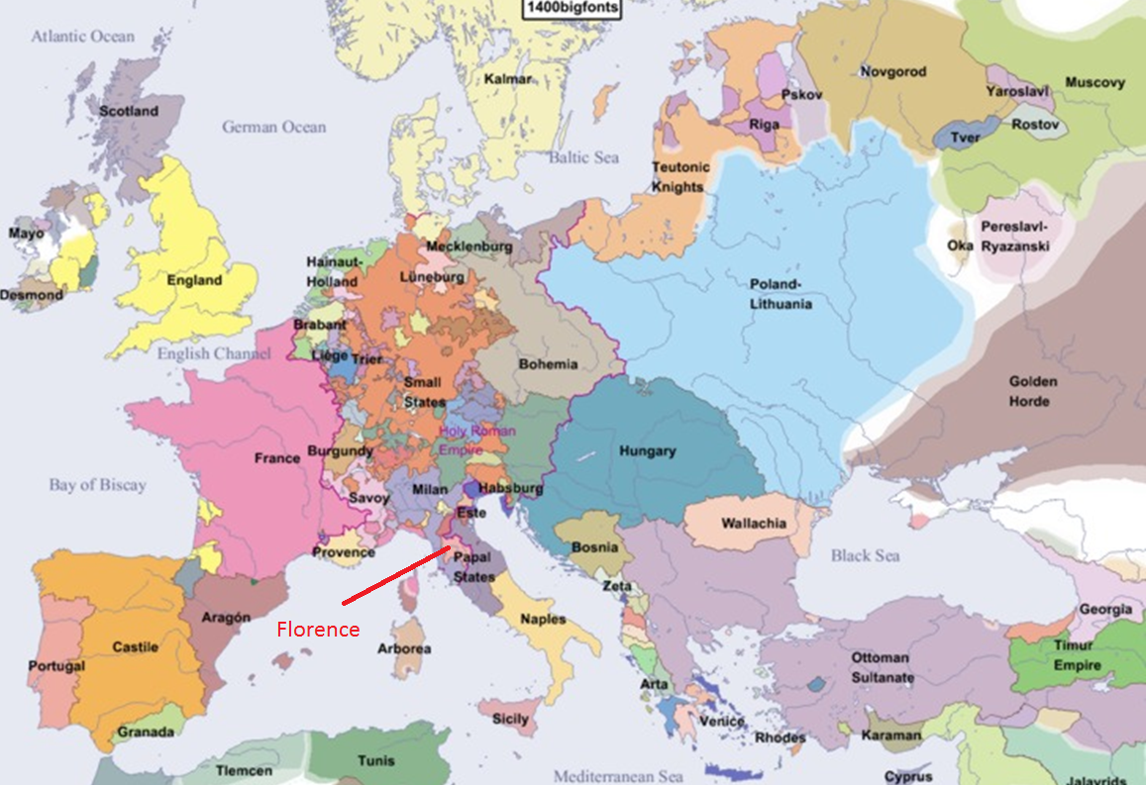

Slide 4
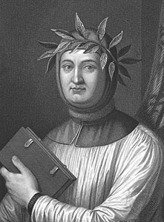
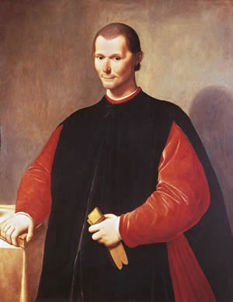
© Morgan AP Teaching
New Old Knowledge
There were three primary writers that profoundly emphasized models
of thought: Francesco Petrarch, Niccolo Machiavelli & Leonardo Bruni
One of the things that changed after rediscovering the classics was education
Education in the Middle Ages focused exclusively on professional
training (training for your job) and theology (religion)
One of the first Renaissance figures to challenge this was
Petrarch who was one of the first to read and study the classics
Classical writing and education was based on being well-rounded in art,
philosophy, science, and rhetoric (language)—not just professional based

Slide 5
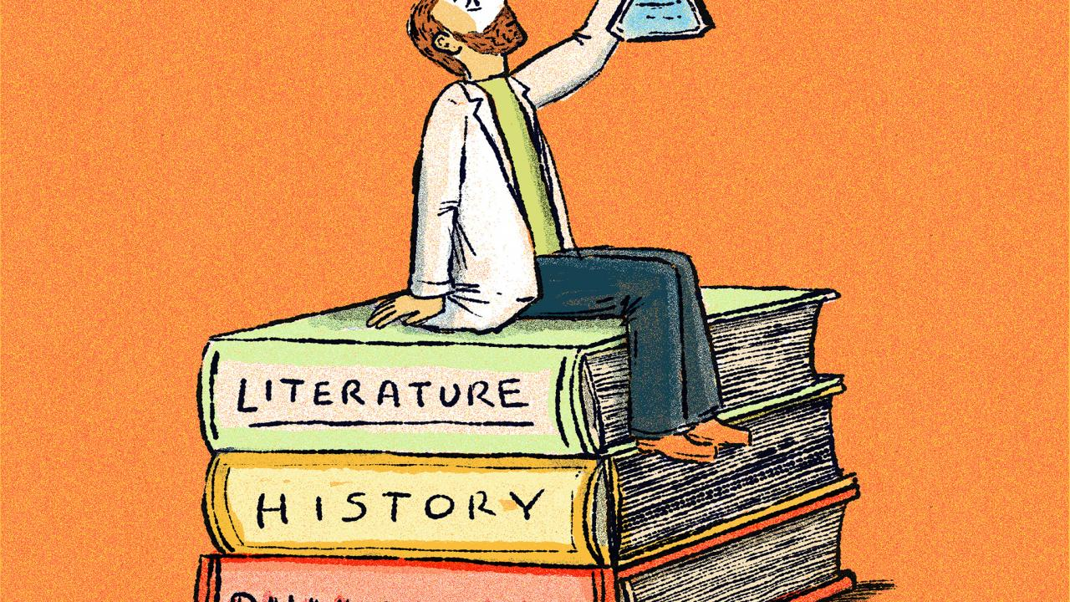
© Morgan AP Teaching
Humanism
Writers like Petrarch were profoundly influenced by these
classical texts and their emphasis on regular life—not religion
Since Greek and Roman writers predated Christianity, topics
and life were not determined by behaving or acting Christian
Classical writers and knowledge were far more focused on the life of
the individual, and developing a well-rounded set of knowledge and skills
This emphasis on being well rounded in multiple subjects is referred to as
humanism—the study of the humanities (art, philosophy, history, etc.)
Such changes in thought would, over the years, result in revival of European
culture and power; this era of ‘rebirth’ is known as the Renaissance

Slide 6
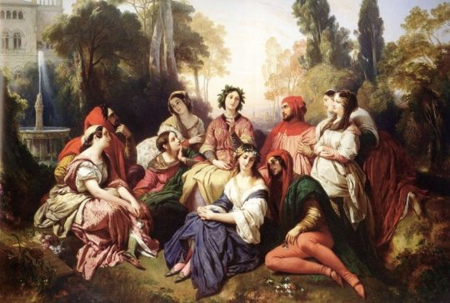
© Morgan AP Teaching
Humanist Literature
Renaissance humanism not only changed education, but its
impact was also seen in literature, art, and politics (governments)
Traditionally, all stories, songs, and poems were based
on God or some sort of invincible hero (also usually tied to God)
Petrarch dismissed the idea of perfect human heroes or Christian morality—
instead, he focused on the moral issues of the individual in his sonnets (poems)
He wrote of love, hate, admiration, and sadness,
painting a far more realistic and picture of what life is like
Giovanni Boccaccio also stuck to the individual, non-heroic theme in his
work The Decameron—a compilation of stories about several different people
In his stories, Boccaccio describes the moral dilemmas people have to deal
with as prostitutes, criminals, and regular people rather than being perfect or heroic

