Slide 1
© Morgan AP Teaching
Period 1: 1450 CE -1648 CE
Religious Conflicts

Slide 2
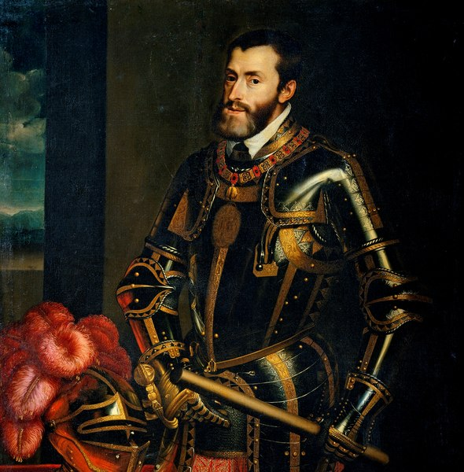
© Morgan AP Teaching
Wars of the Reformation – Charles V
From 1540-1648 there were a series of BRUTAL internal and international religious conflicts
It all started around the Council of Trent, when the Church sanctioned Catholic leaders banning and resisting Protestantism
In order to reunite Catholic Europe by force, Charles V – King of Spain and Holy Roman Emperor, took his armies into Protestant lands
His goal was to defeat the defiant Protestant
princes, and return them to Catholicism
Heavily motivated, Charles V would use all the resources of Spain to attempt to defeat all the Protestant princes, and restore Catholic unity to Europe in the 1540s

Slide 3
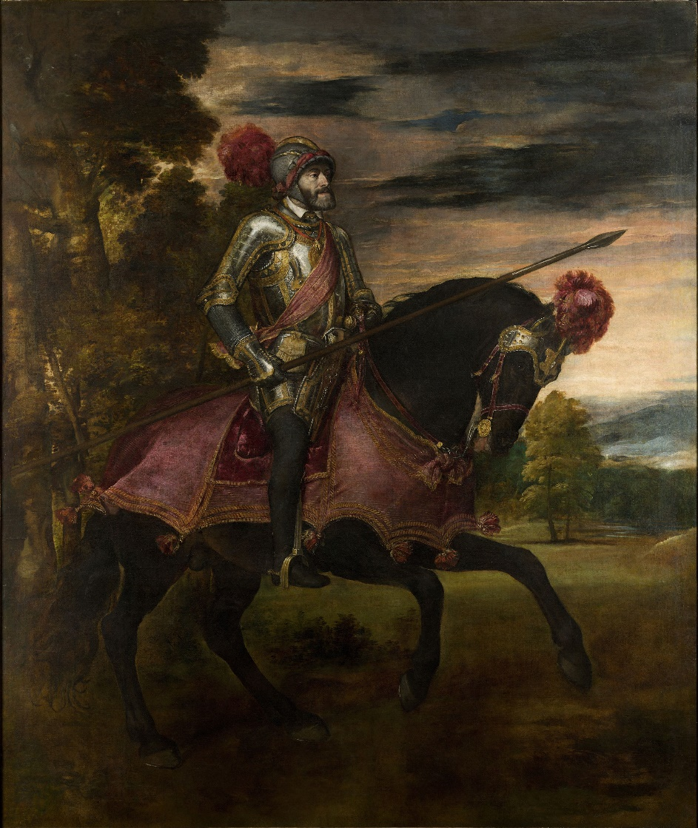
© Morgan AP Teaching
Charles V
As was always the problem with the Holy Roman Empire, many of the princes defied Charles V opting to be Protestant, and free of taxes and Catholic Church control in their land
While Charles V was fairly successful with the might of Spain and the Catholic parts of the Holy Roman Empire, he could never completely defeat the Protestants
The Protestant princes formed a large alliance called the Schmalkaldic League, and resisted Charles V for over a decade
Realizing he could not re-unify Europe, Charles V agreed to settle for peace at the Peace of Augsburg in 1555
The peace settlement was quite important as not only did it halt the fighting, it officially allowed princes to choose their own religion, and weakened the Holy Roman Empire further

Slide 4
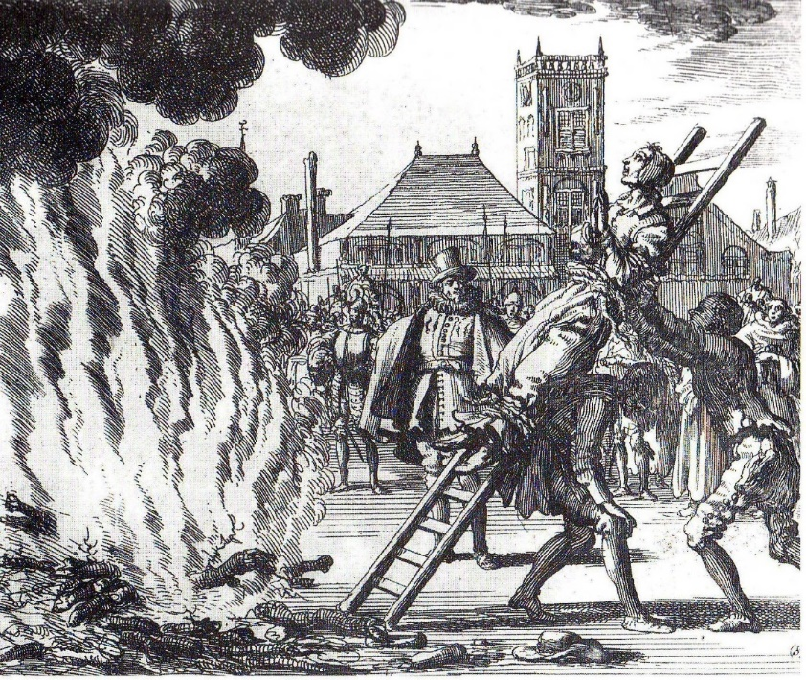
© Morgan AP Teaching
Dutch Revolts (1568-1648)
While Charles V was unable to defeat Protestants in the German
lands, he was able to fight them viciously in the Netherlands,
held by Spain in the 1500s
The Dutch were stoutly Calvinist, and in 1568 began the longest
and bloodiest revolt in European history: the Dutch Revolts that
lasted 80 years
While the Dutch were relatively small in number and power compared to Spain, 3 Spanish monarchs fought constantly to stomp out Dutch Protestants
Among these were Charles V and Philip II – Philip II being the one to officially outlaw all Protestantism and send the Inquisition to the Netherlands
Thousands of Dutch Protestants died in this 80-year revolt, but were victorious in the end when Spain ran out of money in the early 1600s

Slide 5
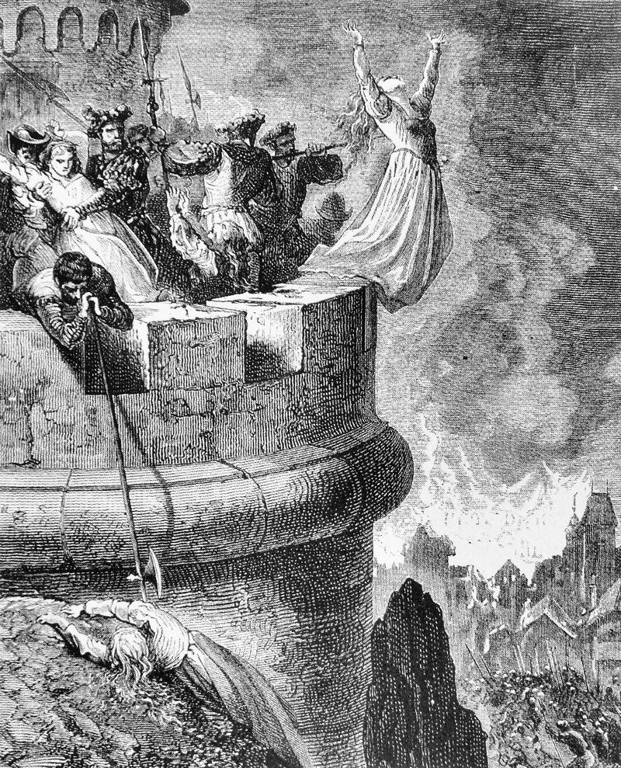
© Morgan AP Teaching
French Wars of Religion
In France, the Protestant-Catholic conflict was far more complicated and bloody
French Protestants (Calvinists) were called Huguenots, and rather than all live in similar areas, they were spread all throughout France
France was not a part of the Holy Roman Empire, but its king generally remained Catholic, which made being a Huguenot (French Protestant) difficult
From 1562-1598, Huguenot Princes fought and resisted the king of France, who had always remained a Catholic monarch with Catholic laws
These Huguenot and Catholic forces were able to keep fighting due to foreign aid, with England helping Protestants and Spain helping Catholics
While various nobles and princes had fought in France for decades, the wars escalated far more when Henry of Navarre, a Protestant, became king of Navarre

Slide 6
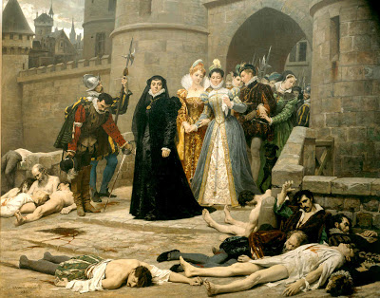
© Morgan AP Teaching
Henry of Navarre
In 1572, Henry married Margaret Medici, an Italian-born Catholic
girl from a very rich Catholic family
To support Henry, a Protestant, all of the most rich and powerful
Huguenot princes gathered in Paris for his wedding
Knowing this, Catholics (specifically Catherine Medici – the
mother) arranged to have all the Huguenot princes murdered
On August 24th, 1572, Catholics engaged in the St. Bartholomew’s Day Massacre, murdering thousands of Huguenots and their families before the wedding and throughout the kingdom
With the Huguenots weakened, the Massacre reduced the religious wars in France, as all of the rich and powerful Huguenot princes were now dead
Henry of Navarre, however, got the last laugh by becoming king and in 1598 enacted the Edict of Nantes, which officially made all Huguenots legal and safe in the Kingdom of France

