Slide 1
Philosophical Reactions to Industrialization

Slide 2
“Iron law of wages”
English economist David Ricardo developed idea
Believed that workers should only be paid enough to survive
If they make more, they will only have more children and therefore become poor again or die off from starvation

Slide 3
“Iron law of wages”
Workers should be satisfied with their wages because they are maintained at a natural level
Leads to the idea that poverty is caused by character flaws in an individual

Slide 4
Rise of Socialism
Critics of the Industrial Revolution began advocating for a more even distribution of the wealth and the benefits of industrialization
Many were labeled utopians because ideas were impractical and impossible to implement

Slide 5
Rise of Socialism
Robert Owen set up an utopian system in his factories, creating an ideal working community – workers worked less, children were taken care of while parents worked, productivity and profit increased
Robert Owen

Slide 6
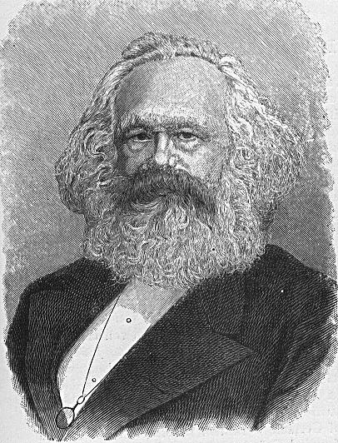
Communism and Capitalism
Karl Marx and Frederick Engels witness the horrors of industrialization
Together they write the Communist Manifesto, the following chart outlines the major differences between communism and capitalism
Karl Marx

Slide 7
Communism and Capitalism
 | Capitalism | Communism
Founders | Adam Smith | Karl Marx/Frederick Engels
Book | Wealth of Nations | The Communist Manifesto

Slide 8
Communism and Capitalism
 | Capitalism | Communism
View of gov’t | Government should not interfere with economy – laissez faire | Everything owned by government Government closely regulates economy (sets prices, etc.)

Slide 9
Communism and Capitalism
View on people | People become wealthy because they offer something – a product or service, that others want Everyone has the opportunity to succeed | People should cooperate to obtain success, eliminating competition Everyone should have an equal share of the available wealth/property

Slide 10
Communism and Capitalism
 | Capitalism | Communism
Social Conditions | Through hard work people can lift themselves out of poverty | Government ownership of the economy will end unemployment, poverty, hunger, and slave-like working conditions

Slide 11
Communism and Capitalism
 | Capitalism | Communism
Individual Freedom | People are free to choose their own careers Freedom of religion Freedom is more important than security | Government determines job placement Religion considered a burden Sacrifice freedom for security

Slide 12
Communism and Capitalism
Future of the World | Capitalism is the only efficient economic system | Capitalism is self-destructive Workers will eventually rise up in a violent revolution and take power The future of the world is communism

Slide 13
Legislation and Reform
Early attempts to regulate factories lacked any real enforcement
Unions were outlawed by the government because they would interfere with the natural order of the factories

Slide 14
Legislation and Reform
Initial legislation only limited child labor
Kids could only work twelve-hour days and it only affected the textile mills (excluded the mines, shipyards, match factories, etc.)

Slide 15
Legislation and Reform
Factory Acts of 1833, 1842, and 1847
  limited child labor
  prohibited children under ten in the mines
  set the maximum number of hours for women and children at ten

