Slide 1
Poland
An Industrial Society

Slide 2
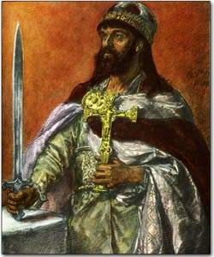
History, Border Changes and Influences
Poland is often identified as an official state with the adoption of Christianity by its first historical ruler of Poland Mieszko I in 966.
-Original territory was very similar to that
of today
---The commonwealth was dissolved
in the late 18th century by the powers of Austria,
Russia and Prussia ( German Kingdom
from 1701-1918)

Slide 3
The 1st Partition ( land seizure) occurred in August of 1772 when the Poles proved to be defenseless against the 3 simultaneously invading threats. (Russia, Prussia and Austria)
Poland resisted but was overwhelmed by invading forces
The Polish-Lithuanian Commonwealth lost roughly 30% of its territory and Prussia gained control of 80% of the Commonwealth's foreign trade
With foreign invasions and significant land lost, Poland has been influenced by many Eastern European nations primarily by those who have reshaped their borders over the previous centuries
2nd Partition
By 1790, Poland had grown weaker by its unnatural and unfair alliance with Prussia- Russia again invaded in 1792

Slide 4
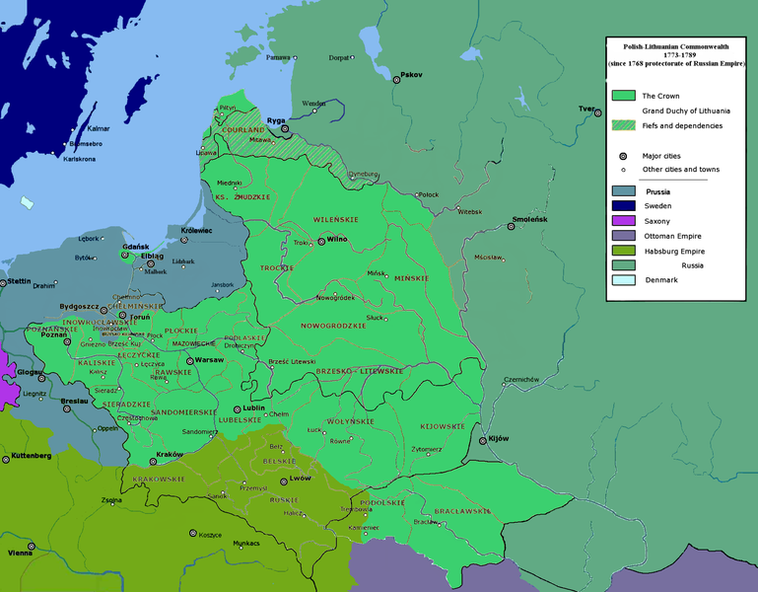
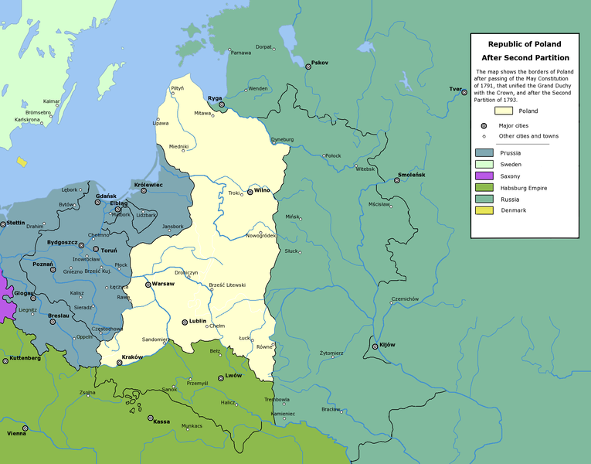
Russia and Prussia once again helped themselves to more land, so that only 1/3 of the population of 1772 remained.
Prussia eventually took Warsaw making it their capital of their new province.
Below is Poland after the 2nd Partition- previous land now in control of surrounding powers
1772
1792

Slide 5
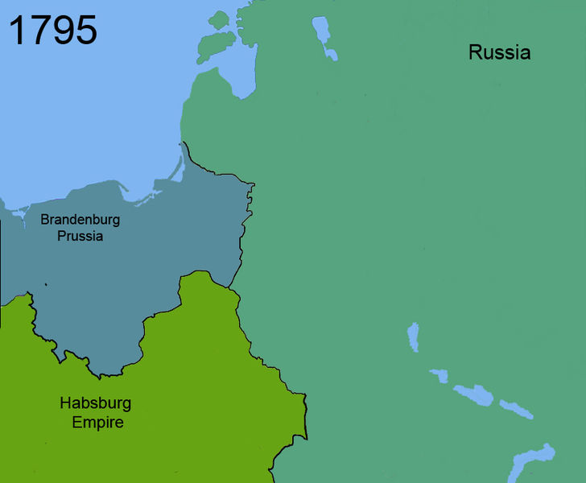
Border Changes/Influences Continued
3rd Partition
increasing unrest by the Poles from previous partition, so the three partitioning powers wanted to destroy any kind of independent Polish state
October 1795, the three powers divide up the rest of Poland
Poland has been influenced their surrounding countries mainly by the powers that have repeatedly reshaped their borders- Poland will not have autonomy until after WWI

Slide 6
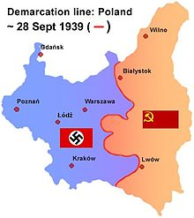
Border Changes 1900+
WWI
The Treaty of Versailles (1920) recreated the nation of Poland. From the defeated German Empire Poland reclaimed large amounts of territory
After the War
Tensions between neighboring countries rose as borders were often disputed often with Czechoslovakia, Lithuania, Ukraine and Russia which have all been influential
WWII
In 1939, Germany and the Soviet Union invade Poland and split it up once again

Slide 7
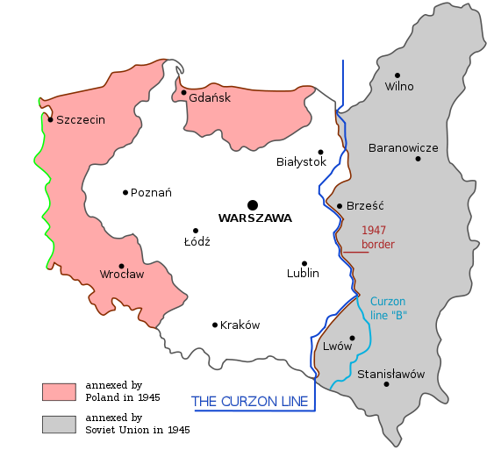
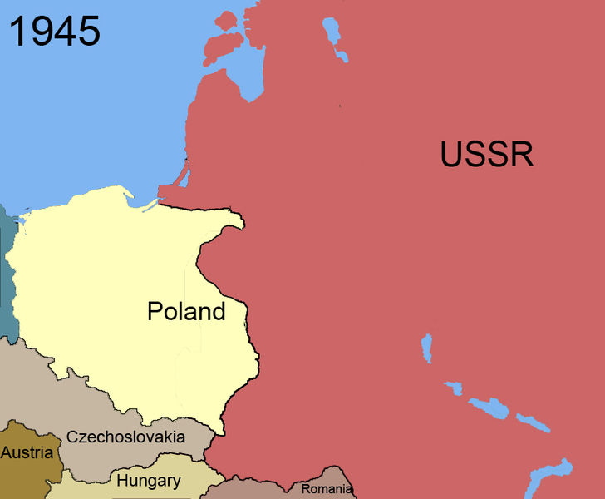
WWII Aftermath
Poland received former German territory consisting of the majority of East Prussia.
There have been minor tweaks to border changes but nothing major--In 1975, the border was slightly modified with Czechoslovakia for the ability to construct a dam ---
Its most current national state has been in tact since the end of World War II and is very similar to its original foundation in 966

Slide 8
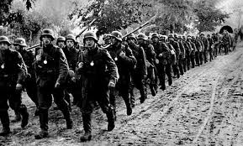
Economy
After WW II, heavy industrialization based on state socialism and Soviet influence: steel, ship-building, iron
Inefficient state enforced prices resulted in poor estimates of supply and demand
Prewar depression in 1930's negatively affected peasants- only 20% owned land and only 43% owned homes: became major source of labor pool after WWII
For these large scale industries, women were also heavily recruited into labor pool
However, severe labor shortages persisted due to inefficient state planning

Slide 9
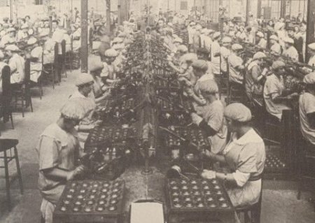
Economy
Between 1947 and 1958, the number of agricultural workers switching to industrial sector increased by 10% each year
By 1970, Poland became Eastern Europe's largest food producer and the world's fourth largest coal producer: most farms were privately owned, but prices were state mandated
The most productive industries, such as equipment manufacturing and food processing utilized Poland's natural resources, such as coal and copper
Polish economy isolated from the international economy: most of the trade with Eastern Europe and USSR

Slide 10
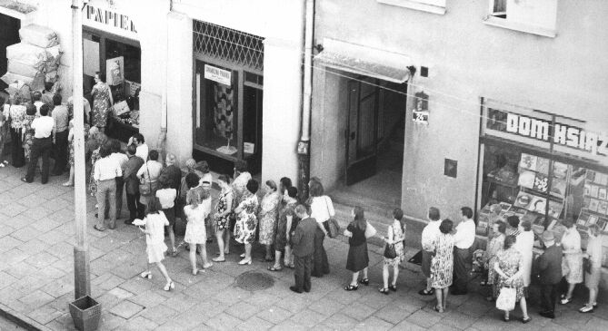
Economy
The weakening of the USSR, social and political strife in Poland, and deepening economic crisises eventually led to the collapse of the Polish economic rule in 1989
Negative growth, scarcity of goods, and double digit inflation in the 1980's due to decades of inefficient central planning

Slide 11
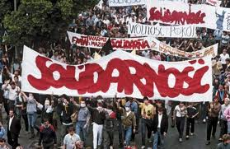
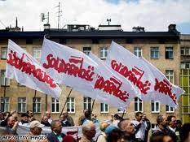
Poland's Economy Today
Mazowieki becomes leader in 1989
Inflation over 500%, basic goods not available, government could not afford to make payments to international creditors
Balcerowicz Plan passed in 1990, reduces state control over economy and decreases inflation: privatization of the economy
Command Economy-->Market Economy

Slide 12
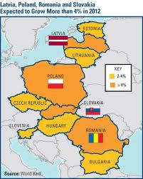
Poland's Economy Today
Poland joins EU in 2004 - market driven economy, most large industries not state owned, does not use euro
Only country in EU to mantain positive GDP in 2008-2009 economic downturn.
GDP per capita 2011: $18, 800
GDP by sector:
Agriculture: 3.4%
Industry: 33%
Services: 63.5% (2010 est.)
Imports:$167.4 billion and exports: $168 billion- mainly machinery and transportation equipment
Growth rate: 3.8%

Slide 13
Population
Population Size: 38,441,588
*8th largest population in Europe, 6th in EU
Crude Birth Rate: 10.01/1000
Crude Death Rate: 10.17/1000
*First time in six years Poland's CDR > CBR
Net Migration Rate: -0.47/1000 migrants
*More people leaving than coming in
Population Growth: -0.062%
Total Fertility Rate: 1.3 (avg. number of children a woman will have in her childbearing years)
*Well below replacement level fertility (2.1)

Slide 14
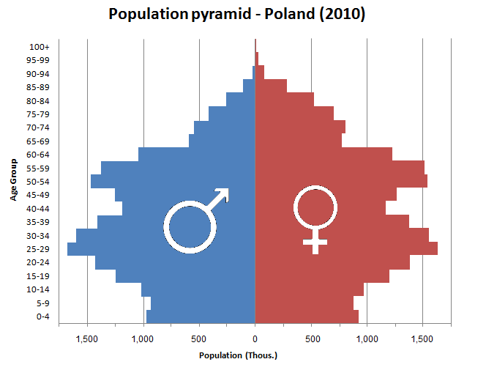

Slide 15
What does this all mean?
Poland's population is getting smaller and older
Why?
*Changing Female Social Role
-more women pursuing higher education
-more women pursuing careers
*Lower Religiosity Among Young Poles
-movement away from traditional ideas of marriage and family
*Contraception and Sex Ed.
-higher usage of contraception
-sexual education becoming more prominent
*Economy -Global economic downturn
-Cost of having children increasing

Slide 16
Why a Concern for Poland?
Severe Economic Threat!
- number of retirees on the rise
- number of work-force participants on the decline
- threat of pension crisis
Severe population decline difficult to overcome
- population momentum a strong force!
What's being done about it?
Government Efforts
- 2010 legislation; couples get 2000 zl. per newborn
- expansion of gov. funded day cares
- laws for greater workplace flexibility

Slide 17
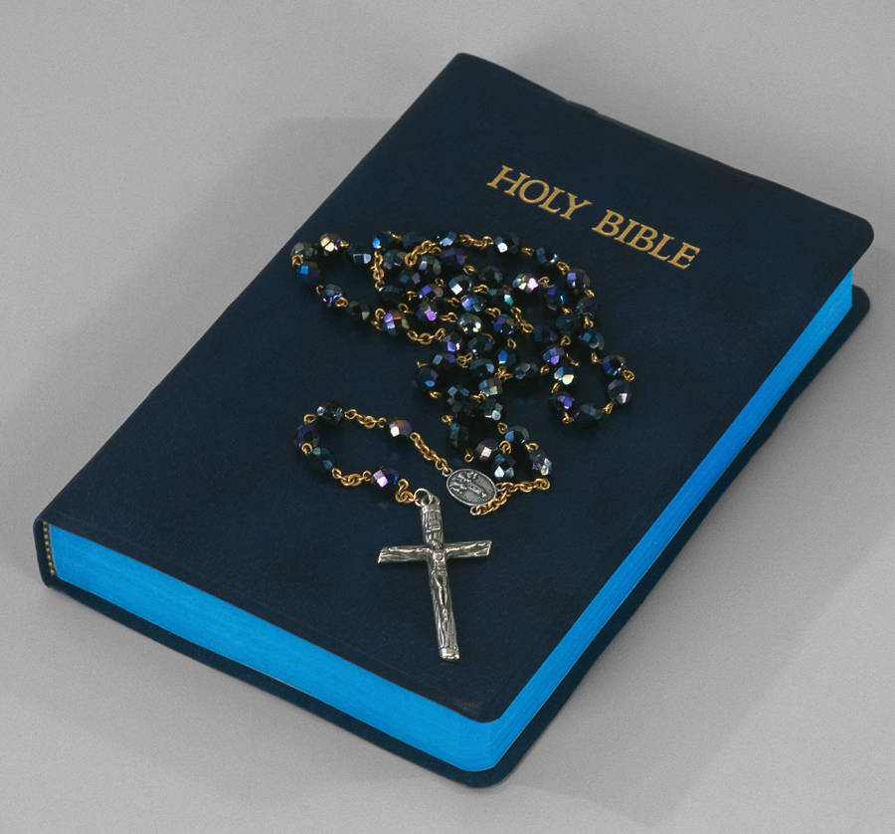
Ideology
Religion
- 95% of the Polish population belongs to the Catholic Church
Only 41% attend mass regularly
- Second largest official religions organization is the Polish Orthodox Church
555,000 members
Belorussian minority in Eastern Poland
- Third largest is Protestantism
- Other smaller groups include
Muslim Religious Union
Union of Jewish Religious Communities
Karaite Relgious Boards

Slide 18
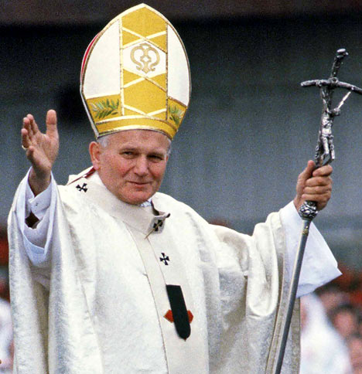
Ideology
- Emphasis on traditional Christian practices
-John Paul II
Polish Pope
1978
revolutionized Catholicism
- Following World War II, the Church goes from serving as a moral guide to holding a powerful position and influence in government
-Growing antichurch sentiment, especially
among younger generation
- One of the richest organizations in Poland
- Religion served as a saving agent
throughout history

Slide 19
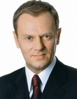
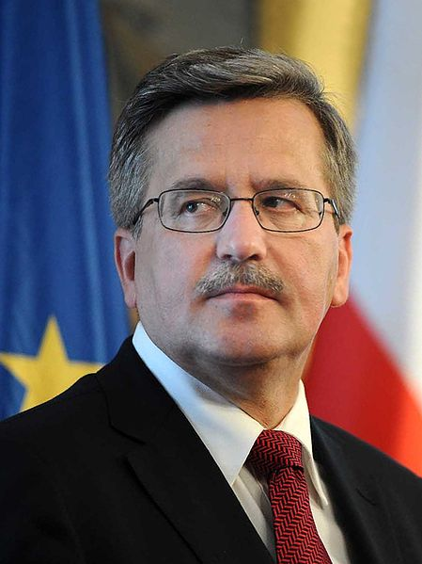
Polity and Conflict
Type of government: parliamentary representative democratic republic
Executive power is exercise by the Council of Ministers, led by the Prime Minister
Legislative power is given to two chambers of parliament, the lower house (Sejm) and the Senate
The President is the head of state
Two major political parties: Civic Platform (PO) and Law and Justice (PiS)
Polish Prime Minister
Donald Tusk
Polish President
Bronislaw Komorowski

Slide 20
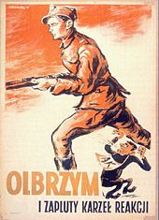
Polity and Conflict
Soviet Communist country from 1945 until 1989
Legal system is based on the Constitution of Poland, adopted in 1997
Governed by the code of Civil Law and based on the principle of civil rights
Constitution specifically casts off many Communist ideals to create a free market economic system
Corruption has been a problem in Poland for many years

Slide 21
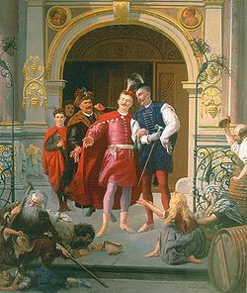
Social Classes
Lower Class-lower income jobs, unemployed. Often former employees of farms, women over 50 years of age, minorities, phsyically/mentally disabled.
Middle Class-white collar workers. Higher income professionals-forms nearly half of the working population
Upper Class-Often do not have to work for a living, supported by earned or inherited investments.
Szlachta-owners of landed property and had personal obligation to defend Poland so became kingdom's privileged social class.
Traditional elite move to private businesses to maintain rich, and modern elite are developing because of market based economy.

Slide 22
Economic Inequality
•Employment in rural locations does not have as many profitable labor opportunities.
•Inequality among rural and urban settings even for the highly skilled professionals.
•Wages tend to increase as the amount of workers decreases- strengthening inequality between classes. Income inequalities higher among urban middle classes than non-urban.
•Distribution of income/wealth is not equal.
•Large divisions between the rich(elite) and the poor(non-elite).

Slide 23
Health Care
Mandatory universal health insurance for all eligible people
Voluntary insurance within the mandatory system
Free access to financed health services for uninsured poor people.
Prohibition of treatment of private patients by public health care providers
Protection of access to dental health care services by insured poor people.
Poles are generally unhappy with their healthcare- one in three believes the system to be poor and very underfunded.

Slide 24
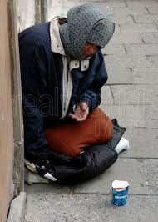
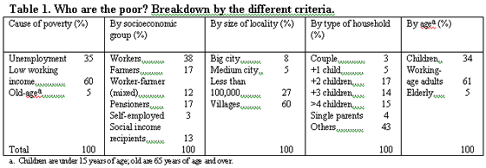
Poverty
•The unemployment rate remains high (9.4%)
•Nearly 1 in 7 people are at risk of poverty.
•20 percent of the population is considered poor. Number of impoverished is still rising.

Slide 25
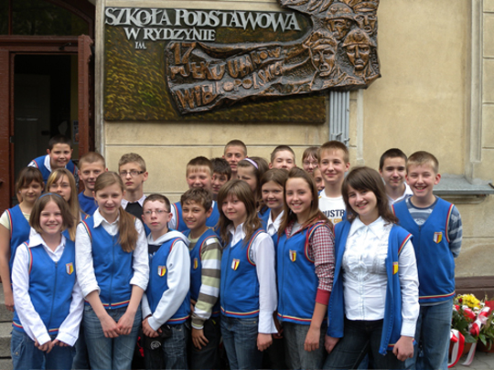
Education During Communism
Russification
Uniformity of education
available to all, but regimented
Expansion of vocational schools

Slide 26
Structure of Education System
Kindergarten (age 7)
Eight years of primary school (age 7-13)
Compulsory exam to determine lower, upper secondary school
Students must learn 2 foreign languages
English: ~66%
German: ~33%
39% students go to college
Higher than United States

Slide 27
Educational Systems
Before 1990, only state higher education systems
Higher Education Act (1990)
non-state higher education systems
129 state higher education systems
303 non-state higher education systems
Ranked 23rd best in the world
By Programme for International Student Assessment

Slide 28
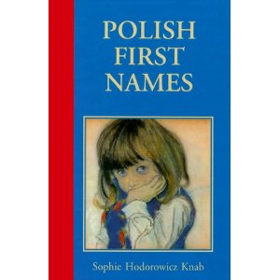
Kinship
Given names
governed by a list of names that include Christian names and Slavic names of pre-Christian origin
children are not named until their Baptism
Family names
in marriage, the woman usually adopts her husband's surname
can also choose keep her maiden name or add her husband's name to hers

Slide 29
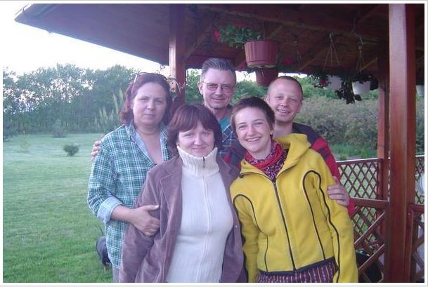
Kinship
Traditional model of a family is falling out of favor
More emphasis on material goods means more time spent working
Falling birth rate
Free time is rarely spent together as a family

Slide 30
During Industrialization and After
Traditionally, the woman's place﻿ was in the home.
By 1979, women were 43.4 %of the work force which increased in1996 to 46%.
Now, in cities, both men and women are employed outside the home.
WHY?
The socialist government's help.
100 males : 89 females
11.1 years of education for both sexes.

Slide 31
Employment, Restrictions, and Expectations
Male bias in employment and wages
women < 50 % of total workforce
more women are unemployed than men (55% = women)
Women earn about 66% of men’s wages (even after the same amount of education)
“The second shift“
managing an external job AND keeping a household together
Women are held responsible for this
Women employed outside the home averaged 6.5 hours on the job and 4.3 hours on housework
Women are subject to family violence at home and sexual harassment in the work place
With few exception, women are excluded from leadership in politics, business, the professions, and even Church positions

Slide 32
Causes for the Discrepancy
Women are still expected to maintain the household
Women in Poland are choosing careers in badly paid sectors of the economy
70% percent of the women worked in health, social security, finance, education, and retail sales
These jobs do not pay as well but allow women to work the “second shift”
Even in the better paid sectors of the economy, women are mostly accepted in administration and/or semiskilled working positions
Women often work in rural areas as opposed to urban areas
Women operate a significant percentage of farms
70% of female farmers are single (do not need to worry about “second shift” due to lack of children, children moving away, or dead husband; therefore can work all day on a farm and be employed)
The reorientation of Poland's economy from a socialist command model to a capitalistic market

Slide 33
Marriage and Family Life
Marriage (rooted in Catholicism):
Women married before age twenty after being courted by a male
Unmarried women over twenty were considered spinsters
Women needed parents blessing in order to marry (which also physically took place on wedding day along with the Czepek
women expect to marry, have children, and have only one spouse for a lifetime (polygyny is illegal)
Traditionally, most marriages were arranged to improve family fortunes with love disregarded
Difficult for women to get a divorce
strong patriarchal ideology :
husband regards himself as superior; wife is expected to respect husband is the head of the family
Man will not make important decisions without consulting his wife
There is more equality in upper class families
Reproductive rights:
Under socialist governments, sex education was minimal
Accessibility to contraceptive devices and abortions varied depending on city
1989: severe restrictions were imposed on women’s reproductive rights (especially on abortions)

Slide 34
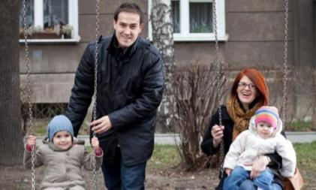
Marriage and Family Life cont.
Family:
Up until the last decade, common for multiple generations of a family to live in the same household
Previously, had numerous children
Industrialization and now: 2+2 model
Easier for women to have job outside of home and invest more in each child
Families live in flats with it being common to share rooms between family members

Slide 35
Questions
What percentage of women make up Poland's work force?
a. <15%
b. <30%
c. <50%
d. >50%
How many chambers does the Polish Parliament have?
a. Poland does not have a Parliament
b. one chamber, the Parliament
c. two chambers, the Sejm and the Senate
d. three chambers, the Sejm, the Senate, and the House
What is the significance of the Balcerowicz plan
a. reduced state control over the economy
b. increased state control over the economy

Slide 36
What percentage of Poland's population is Catholic?
a. 90%
b. 50%
c. 95%
d. 98%
Poland's population is becoming:
a. larger and younger
b. larger and older
c. smaller and younger
d. smaller and older

