Slide 1
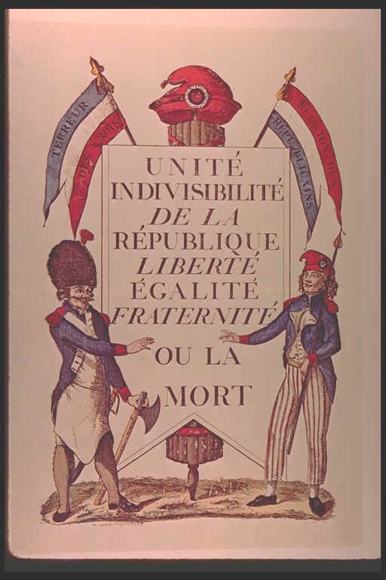
Political Cartoons/Causes of the French Revolution

Slide 2
French Revolution Political Cartoons
Anyone who is relatively well acquainted with the history of France will know that this medium was used as a means of mass communication to serve very effective purposes.
These cartoons are funny alright, but the motive behind them and the news that they brought was very contradictory to the medium of expression.
During those times a layman citizen could get the real picture of specific events by feasting his eyes upon the works of those cartoonists that sought to produce political cartoons at the time.
These cartoons were widely available in print shops and the garden of Palace-Royal which was a market place to sell them.
During the years of the revolution many people took to this means of communication from anonymous amateurs to artists of the highest rank like Jacques Louis.
In fact cartoons much more so than the literature of the time represents the real picture of France to the people.

Slide 3
French Revolution Political Cartoons
These political cartoons and caricatures were not just a means thereby which to inform the people with the real news; rather it was a means of instigating the spirit of rebellion in the hearts of men.
This was by far the meanest you could get with your opposition which is what led the Republicans and Royalists to battle it out on the canvas to shape the public’s opinion.

Slide 4
Role of Political Cartoons
The general aim behind the French Revolution cartoons was to anger the opposition by means of mockery.
The cartoonists had a no holds barred attitude when it came to expression and they would use the most humiliating and condescending jokes with the most demeaning visuals to express their disgust of the regime.
The political cartoons of that time are quite unlike those that you find today because back then it meant instigating a revolution and not mere opinion.
To a large extent these cartoons were successful in breaking down the dogmatic respect that the people had for the monarchy and clergy which resulted in paving the way for the revolution.
The whole revolutionary spirit was given a heroic philosophy which influenced the people to take action and be part of the movement.

Slide 5
Role of Political Cartoons
Europe was also enduring many great changes in the 19th Century.
The general shift from monarchy to republic caused turmoil and uncertainty which gave political cartoonists plenty of material.
France, for example, was going through both political and social unrest as it looked for its identity after the breakup up the monarchy in the French Revolution.
Cartoonist Honoré Daumier revealed the hypocrisy of the French aristocracy.
Daumier’s cartoons left no casualties, which was the way he liked it.
After being thrown into jail for drawing a cartoon with a rather plump King Louis Philippe called "Gargantua," Daumier returned to cartooning with even more drive and ideas on how to expose the governmental and societal troubles of his homeland. (Hoff 45)

Slide 6
French Revolution Cartoon Themes
Today the French revolution cartoons are celebrated and put up in museums and art galleries as they depict a unique and important event in history.
From the storming of the Bastille all the way through to Napoleon Bonaparte declaring himself the First Consul, these cartoons serve as a graphical representation of the history of the major events during the French revolution.
Although there is much good art that is to be appreciated from amongst the revolution cartoons, the major chunk of the collection serves better as an outline of history.
Although most of the cartoons and caricatures are political in nature, some artists have wandered off into depicting social trends at the time such as making fun of the weird hairstyle fashion amongst the women of that time.

Slide 7
Political Cartoons Addressing King Louis XVI And His Role In Causing The French Revolution

Slide 8
Louis balancing on a rope handing down sweets to the commoners to keep them satisfied

Slide 9
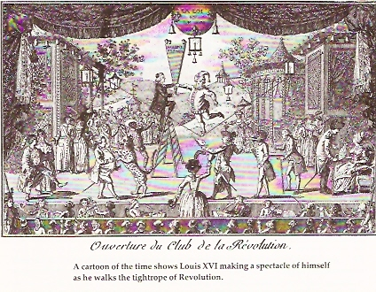

Slide 10
In the 18th century dietary habits had the ability to mark membership in a social group.
The bourgeoisie used the influence of culinary habits as another way of presenting an aristocratic image.
The private banquets of the bourgeoisie and their forays to restaurants served to boost their social status by exemplifying their wealth and "savoir faire."
The Royal Family:
Many republican pamphlets and publications focused on depicting the corruption and weakness within the Royal family through images of their eating habits.
In numerous anti-monarchial pamphlets the King was portrayed as suffering from a "moronic and short-sighted bulemia that made him no match for the honest, abstemious, and responsible Constitutional Assembly." (Spang, 123)

Slide 11
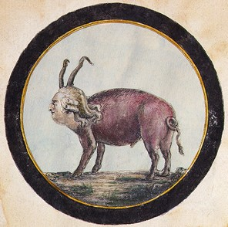
In particular, the night of Louis XVI's Flight to Varennes has historically been within the context of gastronomy On the June 21, 1791 Louis XVI, Marie Antoinette, the royal children and the royal entourage fled Paris.
In response to their flight, some revolutionary posted a "Lost Pig" notice in the Tuileries Garden. (Spang, 127)
However, in Varennes the entourage was stopped by the procureur, a grocer-candlemaker, Monsieur Sauce. Sauce was to become a key character in reports of the King's arrest.
Although accounts vary throughout 19th century retellings, almost all focus on the detail of Sauce's hospitality. One eyewitness account describes the King eating Sauce's cheese and toasting Sauce with his own Burgundy. The official version published by the Imprimerie Nationale reports that the King ate several meals before his captive return to Paris. (Spang, 125)
Political Cartoon Making Fun of Louis’s Weight

Slide 12
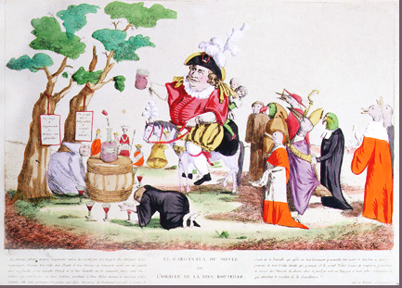
"Louis as a Drinker"
The arrest of the King prompted an outpouring of sentiment against Louis.
Like his grandfather, Louis XV, whose early reputation as "Louis the Well–Loved" faded by the end of his long reign, Louis XVI now became the focus for all sorts of discontents
. This image depicting Louis as incapable of governing himself, let alone France, reveals the depth of the scorn expressed.
"Louis as a Drinker"

Slide 13
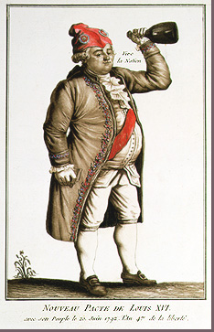
"Louis as a Drunkard"
This image of Louis, already altered by commoner attire and a Phrygian cap, added a raised bottle. This transformation could scarcely have been anticipated even a year or two into the Revolution.

Slide 14
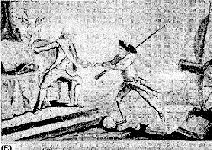
A cartoon called "The Great Step Accomplished" or the "Dawn of a Fine Day," which shows the Frenchman advancing over heads, Bastilles, etc., to join with the King and observe the law.

Slide 15
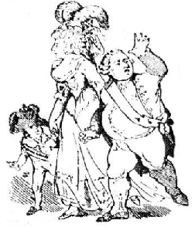
The royal family--or "the baker, the baker's wife, and the baker's boy," as they were called by the bread-hungry crowd.

Slide 16
Political Cartoons Targeting Marie Antoinette And Her Role In Causing The French Revolution

Slide 17
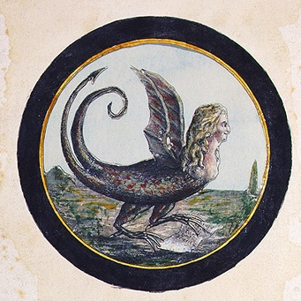
Marie Antoinette as a Serpent
The “Widow Capet”

Slide 18
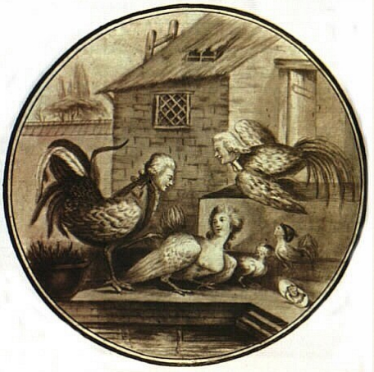

Slide 19
A pamphlet showing Marie Antoinette with another man.

Slide 20
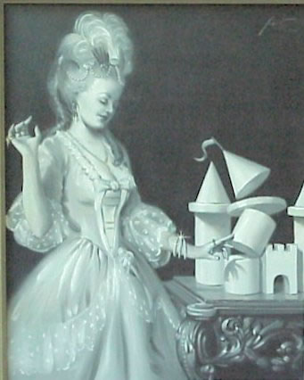

Slide 21
Political Cartoon On The Economic Causes Of The French Revolution

Slide 22
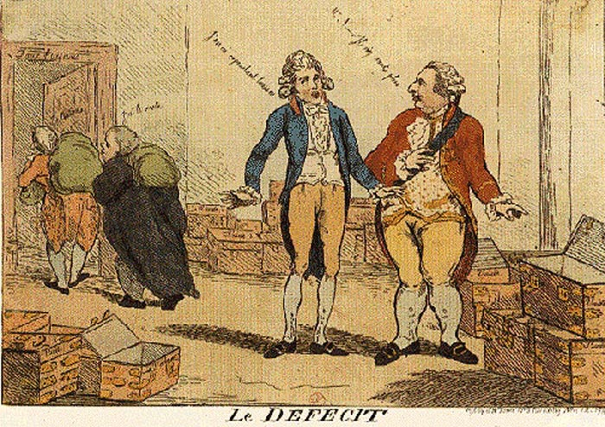
The financial minister, Necker, looks on and says "the money was there last time I looked." The nobles and clergy are sneaking out the door carrying sacks of money, saying "We have it."

Slide 23
Political Cartoon On Cultural Causes Of The French Revolution

Slide 24
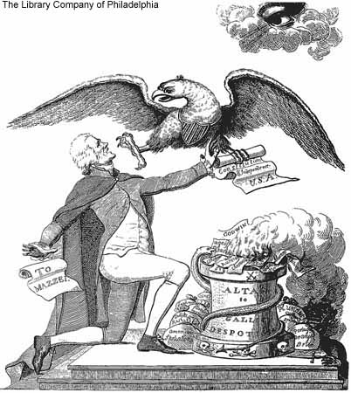

Slide 25
Political Cartoons On The Social Causes Of The French Revolution

Slide 26
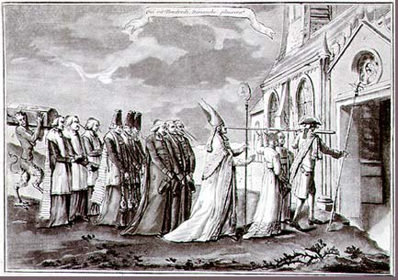
"Procession of Refractory Clergy"
Of particular interest in this caricature of refractory clergy here are the long noses, traditionally used to caricature Jews, that suggest the refractory clergy were not of the people. This image shows resistant clergy marching in their last procession. The satyr at the rear with a coffin seems to threaten their very lives.

Slide 27
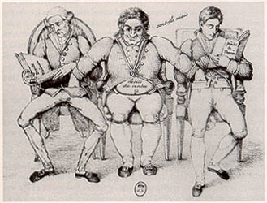
In this drawing by an unidentified artist, the aristocratic right reads about "Feudal Rights" and the Republican left studies "The Rights of Man" while the "Belly" steals from both.
This image demonstrates the common feeling of many French citizens who opposed restaurants because those who frequented these establishments were showing a deliberate display of wealth and a disregard for France's suffering lower classes.
Members of the sans-culottes despised restauranteurs due to the belief that they had "no greater enemy than these voracious creatures who daily gulp down our money...so that we may obtain the necessities of life." (Spang, 122)
This opinion was echoed by Mercier who felt that "aristocratic delicacies corrupted republican decency and contaminated honest citizens." (Spang, 142),
This concern carried over into the public's opinion that Louis XVI's "crime was both moral and economic." (Spang, 127)

Slide 28
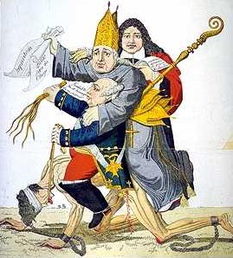
Conditions of a Revolution: The Old Regime
The people in
French society
were not
treated equally.
The system of feudalism in
France was
known as The
Old Regime. Citizens were
divided into
three classes
or estates.

Slide 29
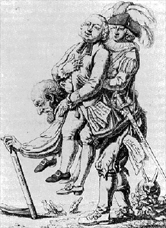
The Three Estates

Slide 30
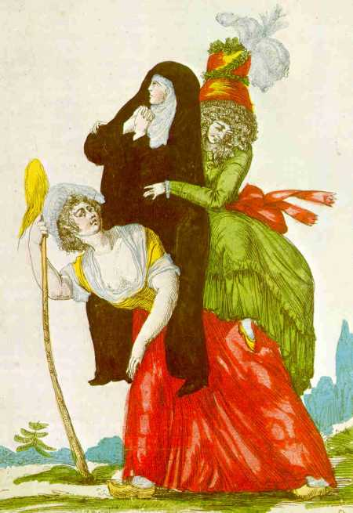

Slide 31
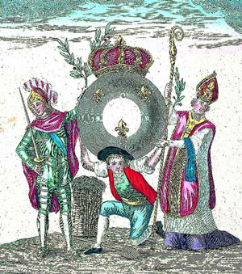

Slide 32
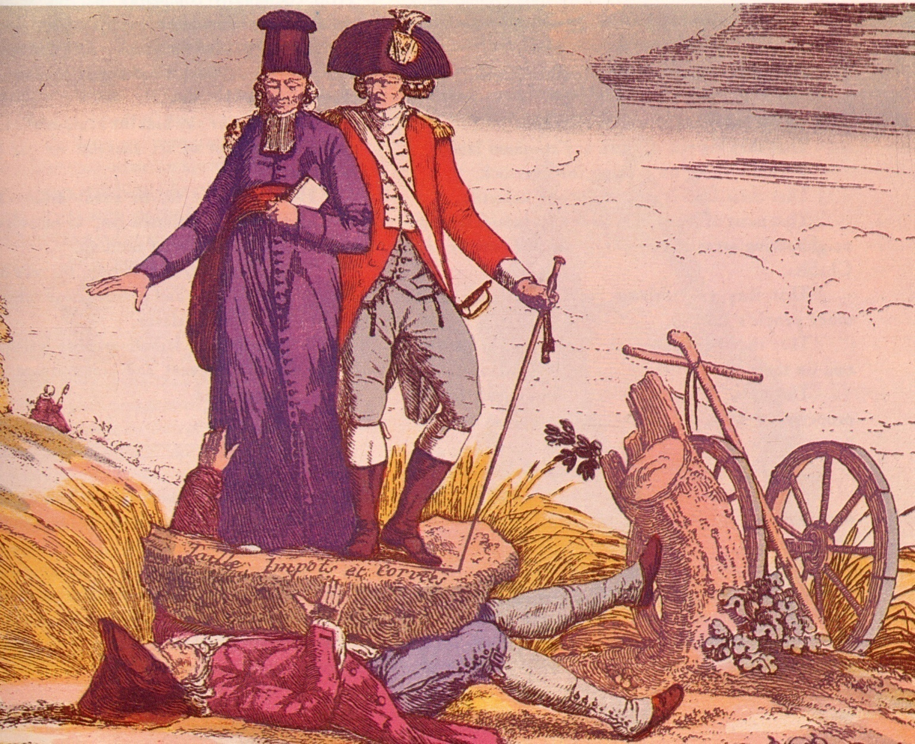

Slide 33
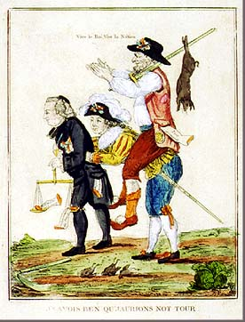
The tables were turned. The French Revolution had given the First and Second estates less power than the Third estate.
The peasant now rides on the backs of the clergy and nobility, instead of supporting them.
He carries the results of a hunt, which was forbidden in the Old Regime, and says vive le roi (the king) and vive la nation.

Slide 34
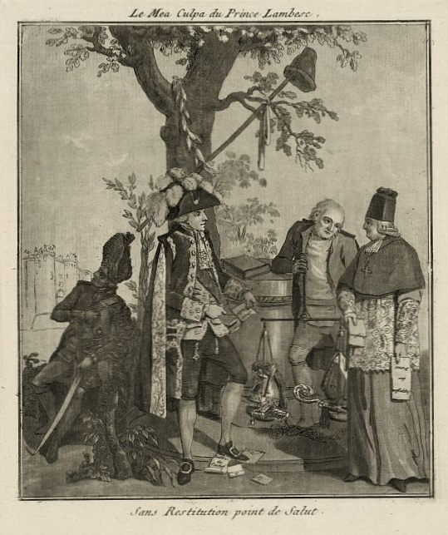

Slide 35
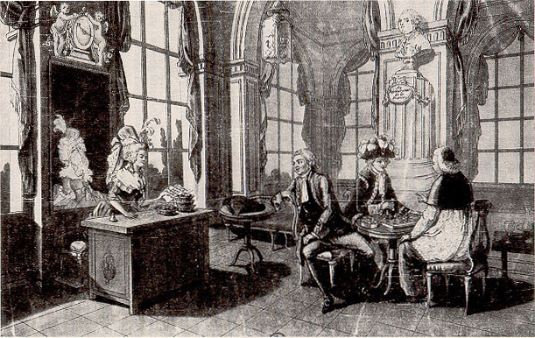
The caption to this painting states, "That's right...separate checks," says one representative of the Three Estates
In the eighteenth century some publications depicted the shifting of economic and social responsibility within the Estates General through restaurant scenes.
In the drawing above, a request for three separate checks shows the Upper Estates finally paying their share instead of letting the Third Estate carry the responsibility, as in the past. Popular belief rumored that a meal between the Three Estates would ease any disagreements

Slide 36
Political Cartoons On The Storming Of The Bastille

Slide 37
Effects of the Storming of the Bastille
On the next slide, we see a political cartoon, implying that after the Storming of the Bastille, the First and Second Estates will have to dance to the tune of the Third Estates, as the common people became more important in the Revolution.
The piper of the Third Estate is wearing a revolutionary cockade in his hat, with the colors of the new French Flag in it, the white the color of the Bourbon monarchy, and the red the color of the revolutionaries.

Slide 38
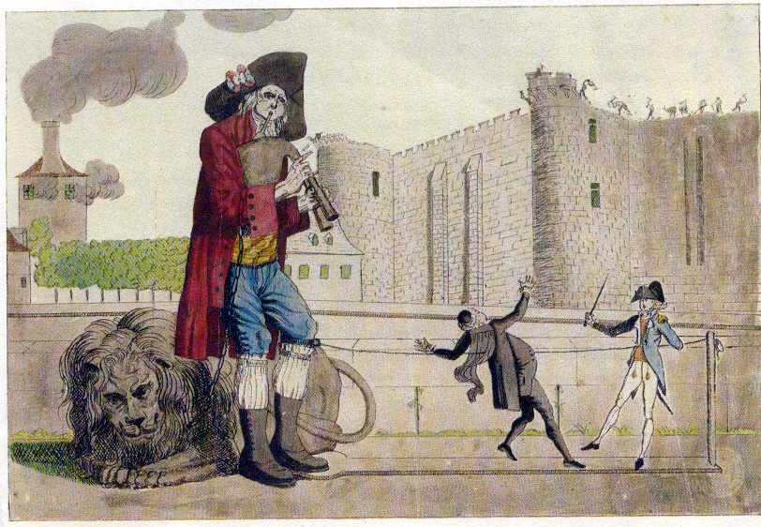

Slide 39
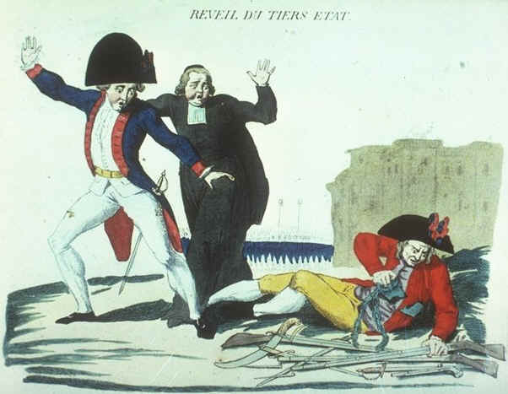

Slide 40
WARNING: THE FOLLOWING HISTORICAL POLITICAL CARTOONS ARE GRAPHIC IN TERMS OF SEXUAL CONDUCT!
DO NOT VIEW IF YOU OR YOUR PARENTS ARE NOT COMFORTABLE WITH YOU VIEWING IMAGES OF SEXUAL NATURE…IT IS DEFINITELY PG-13 AT LEAST!
If it is even called into question a little bit, please do not view.
Please read the historical background slides first to understand the historical context.
But is captures the true brutal nature of the caricatures against Marie Antoinette!

Slide 41
Attacks against Her Family The Royal Dildo and The Royal Orgy were two pamphlets that circulated during Antoinette's lifetime
. In one pamphlet, Louis XVI is accused of homosexuality and Marie Antoinette is accused of perverted and profuse masturbation.
In another pamphlet, Antoinette is accused of holding orgies and fornicating with her brother-in-law, Comte d'Artois.
A third pornographic pamphlet, (image at left) depicts Marie Antoinette leading Lafayette, the great French general and politician, as he rides a giant penis.
Although this image implies that the queen and the general were intimate, that was not so.
Lafayette attempted to be a moderate - positioning himself between the royals and the revolutionaries.
This won him few friends.
He was made the head of the National Guard in 1789 but eventually had to flee France.
Before departing, Marie Antoinette is believed to have said, "I can see that Monsieur de Lafayette wishes to save us, but who will save us from Monsieur de Lafayette?"
Clearly, there was no love lost (and nothing illicit) between Marie Antoinette and Lafayette. (For more information about pornography published during Marie Antoinette's lifetime, read The Wicked Queen by Chantal Thomas or Marie Antoinette: Writings on the Body of a Queen by Professor Dena Goodman )

Slide 42
The Root of All Evil The scurrilous pamphleteers accused Marie Antoinette of adultery, lesbianism, pedophile, and treason. In one pamphlet they even accused her of being the cause of all evil within French society.
They called her the root of all evil.
In a contemporary pamphlet entitled Vie de Marie-Antoinete d'Autriche, it is written:
"Since the Revolution, the monarchist club, whose body and soul is Antoinette, have been continually at it; all its members have drawn from the vagina of the Austrian Woman…That infectious cavern is the receptacle of all vices, where each comes and takes his required dose."

Slide 43
The Seeds of Hatred Pornography was a sharp tool in eighteenth century France. When wielded properly, it could be used to cut down larger than life figures, even kings and queens.
Pornography was used against Marie Antoinette before the Revolution to lower public opinion of her and to blame her for the country's ails.
It was a way to take the heat off of the more culpable individuals.
Once the Revolution was underway, pornography against the queen was churned out in staggering amounts.
It was used then to further smear her reputation, to maintain the low public sentiment about her, and to assure harsh punishment.

Slide 44
Aftermath Very little has been written about the emotional toll the pornographic pamphlets took on the queen or on her surviving child, Madame Royal.
Fortunately, Marie Antoinette, who was a sensitive person herself, did not live long enough to read all of the horrible things written about her.
Though, she was forced to suffer countless indignities.
During her trial, a particularly wretched pamphlet accused her of having sexual relations with her son.
Once can only imagine the pain that must have shot through her heart upon hearing such an accusation.
With as much dignity as anyone could have mustered, Marie Antoinette answered, "If I have not answered, it was because Nature refused to answer such a charge against a mother." She then turned to the assembled crowd and said, "I appeal to all of the mothers in this room."

Slide 45
Aftermath Continued:
Unfortunately, the mothers in the assemblage were unmoved.
Marie Antoinette was sent to the guillotine on 16 October 1793.
The blood was still fresh on the sawdust beneath the scaffold when a new round of pornographic pamphlets hit the streets of Paris.

Slide 46
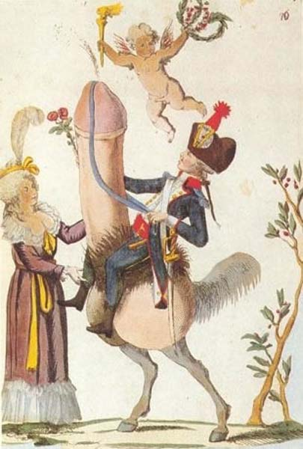
“The Royal Dildo” Political Cartoon---Marie Antoinette was the subject of countless cruel, and sometimes pornographic, pamphlets throughout her reign.
Pornography in eighteenth century France took the form of crude caricatures, colorful cartoons, and even sophisticated etchings and engravings.
Pornographic songs, plays and news-like stories were also popular.
Marie Antoinette was a favorite target of seditions libelers because, to them she represented an extravagant lifestyle, everything they hoped to attain but knew they would not.
To some pamphleteers, Marie Antoinette was the symbol, the very cause, of all that was wrong with their economy, society and government.
Pamphlets were used to accuse Marie Antoinette of all manners of debauchery, including adultery, lesbianism, and incest.

Slide 47
