Slide 1
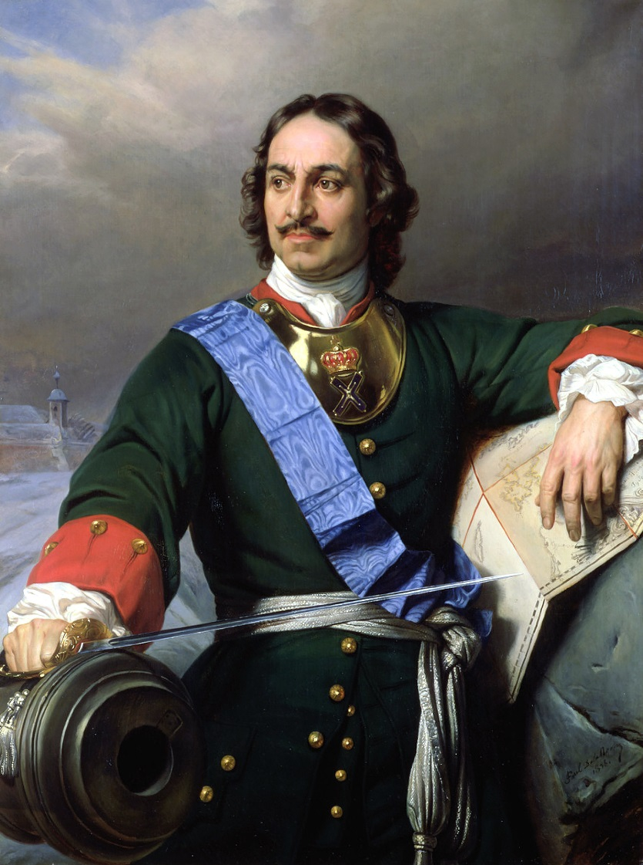
Peter the Great
Russia's Absolute Monarch

Slide 2
Peter the Great
Born in 1672
Began almost immediately to consolidate power and to increase his power
The Russian Church and the nobles, called Boyars, were two prime targets
Major goal was the westernization of Russia

Slide 3
Russia Before Peter the Great
Medley of peoples who spoke a Slavic language– Difficult to unify
In spite of geographic location, the Russians were focusing their attention to the east, and not on Europe to the west
Russians inhabited the land from the edge of the modern Baltic states to the pacific ocean
Russia lacked a warm-water or an ice-free port which hindered trade and communication with Europe

Slide 4
3 Reasons Russia Needed to be Westernized
Russia was Eastern Orthodox Christian, Not Roman Catholic
Influence was Greek (eastern), not Latin (western)
Different alphabet (Cyrillic)
Different culture, customs etc.
Eastern Church did not promote charity or education like the Western Church and had little time for humanity
Church was very superstitious & opposed learning as “a spiritual sin”
Without Church promotion of learning even basic arithmetic was hardly understood

Slide 5
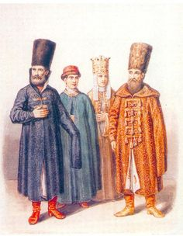
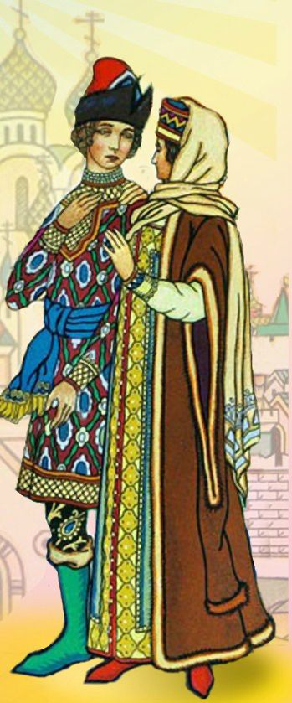
Mongol influence of about 250 years:
Women wore veils; men wore long flowing robes and beards
Customs were crude & brutality was prevalent– “Life was cheap”
Russia developed the idea of strong man rule which would last into the 20th century
Attention was focused to the east and Asia

Slide 6
Geography prevented effective trade and exchange of ideas with the rest of Europe
Russia was not ready or able to receive the Renaissance and missed out
The need for a warm-water port or ice-free port was becoming even greater as time went on

Slide 7
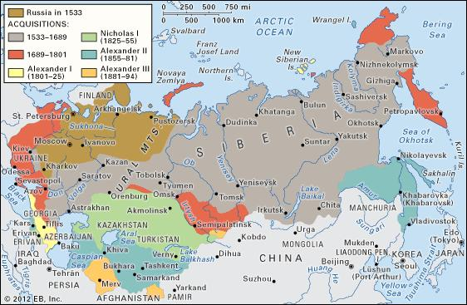

Slide 8
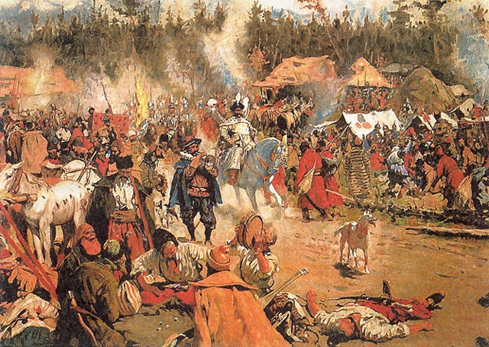
Westernization & Modernization
Peter needed to use European civilization to create a stronger Russian army that could stand up to the West as well as to obtain his “window on the West”
Needed to defend against the Poles, Turks, & Swedes
Needed access to Black Sea as well as access to the Baltic Sea

Slide 9
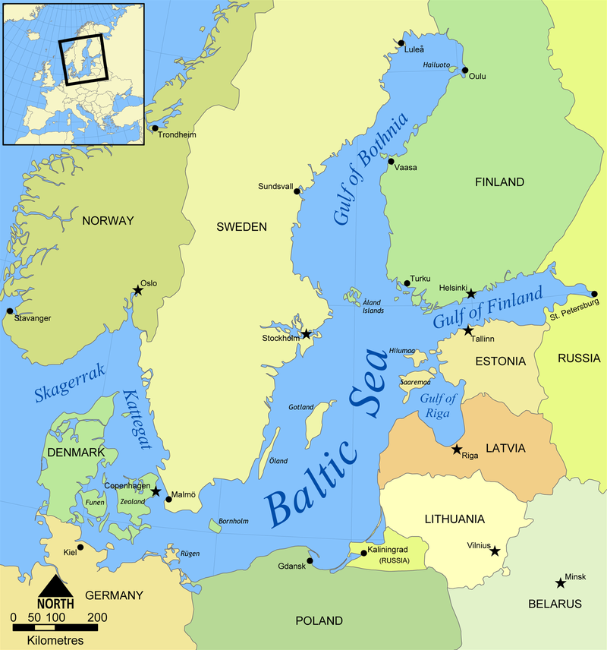

Slide 10
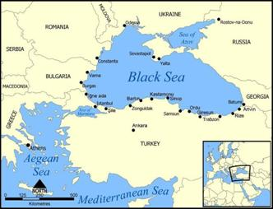

Slide 11
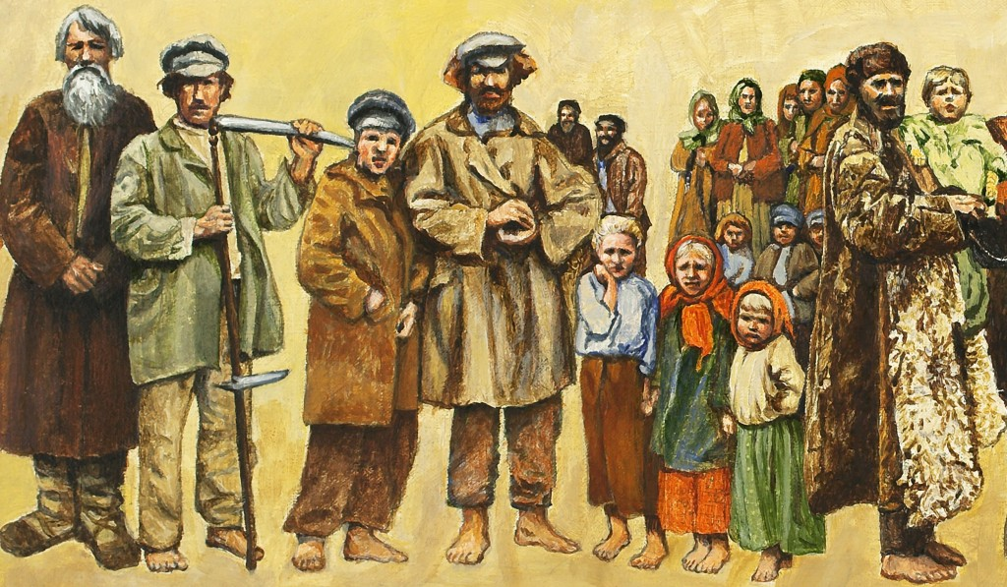
Unlike Western Europe, serfdom still existed in Russia and was very widespread
Serfs could be bought and sold like slaves
Serfs could even be killed without punishment for the killer!!
Without the free movement of people, the nation could not become more urbanized and then industrialized

Slide 12
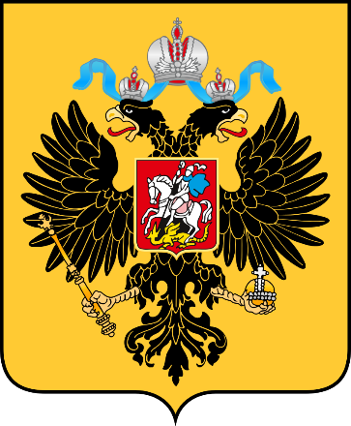
Peter’s Reforms
Peter had an inquisitive mind and began to study things like sailing with foreigners living in Moscow
In 1697 Peter began his year-long “Grand Embassy” to Western Europe to learn as much as he could so he could strengthen Russia and her army

Slide 13
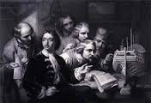
The Grand Embassy took Peter to Holland, Venice & England
He visited almost every factory, museum & printing press he could to find out how Russia could do the same things
Peter hired hundreds of technicians to work in Russia to help strengthen Russia

Slide 14
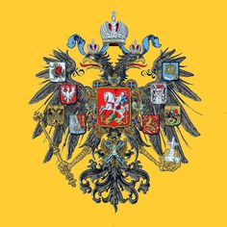
Peter made the following changes to Russia once he returned to Russia:
The Russian Church, which had opposed all learning and change came under Peter’s direct control
All non-serfs were required to serve the state in the government or in the military and nobility did not guarantee any high positions

Slide 15
Peter created a professional army that was drilled by European soldiers with European weapons
Taxes were raised to pay for the army and taxes were put on items such as beards, land, inns, mills, leather, coffins, meat & the right to marry
Encouraged industrialization and provided government money for companies to start making products the army needed

Slide 16
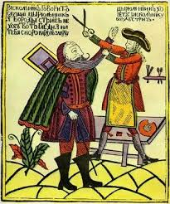
Eastern fashions were prohibited and men could not wear beards
A newspaper was created which helped to increase literacy and exchange ideas
Russians were sent abroad to study
A book of etiquette was published that encouraged Russians not to spit on the floor, scratch themselves or to wear hats indoors

Slide 17
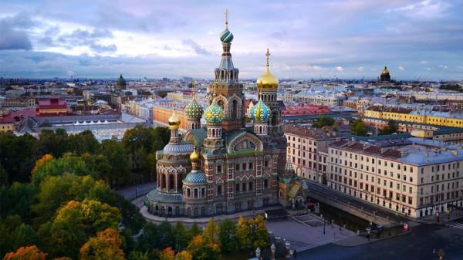
Peter built his new capital, St. Petersburg, on Swedish lands on the Baltic Sea and forced nobles to move there
His new capital provided the ice-free port that Russia had desired for so long

Slide 18
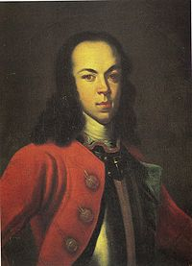
Results of Westernization
Peter’s own son and heir to the throne was tortured and executed for opposing Peter’s changes
The peasant stayed outside looking in while the nobility continued to enjoy a privileged life– this gap between classes would have dire consequences for Russia’s future

