Slide 1
The
Third
French
Republic:
The Paris Commune

Slide 2
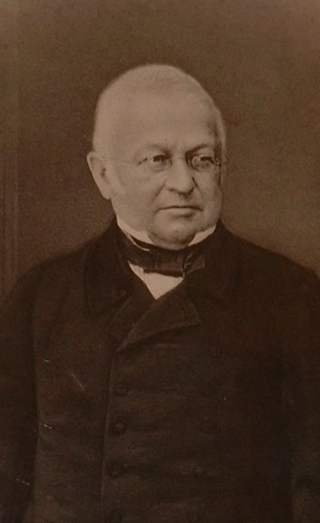
Third French Republic Declared
September, 1870 after
France’s defeat at the
Battle of Sedan.
Napoleon III abdicated
the throne.
New government headed
by Adolphe Thiers.
    This new government continued the fight against the Germans who laid siege to Paris.
    To defend Paris, a National Guard was raised numbering over 350,000.
France surrendered in February, 1871 after 40,000 Parisians died.

Slide 3
The Third French Republic
Thiers’ government was seen as:
  Too conservative.
  Too royalist.
  Too ready to accept a humiliating peace with Prussia.
Prussian troops marched into Paris in March, 1871.
The French government established itself at Versailles, NOT in Paris.
  Parisians were angered by this.
  They opposed the policies of this new government.
  It attempted to restore order in Paris.

Slide 4
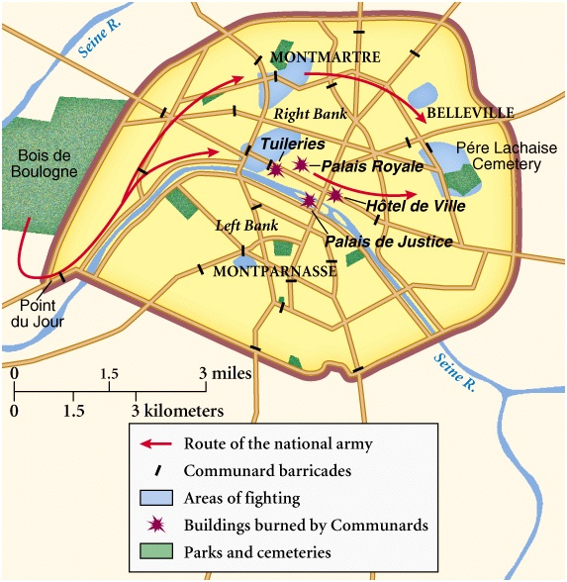
Paris in Revolt!...Again
The Paris Commune [Communards] was elected on March 28 and established itself at the Hôtel de Ville.

Slide 5
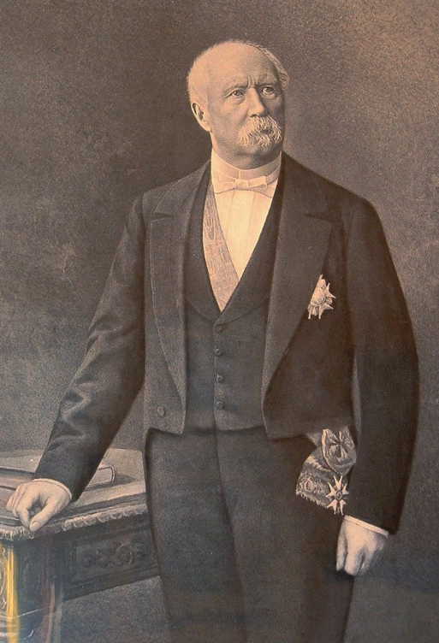
Civil War…Again
Troops from Versailles
Communards
The Commune was suppressed by government troops led by Marshal Patrice MacMahon during the last week of May, 1871.
Known as the “Bloody Week.”

Slide 6
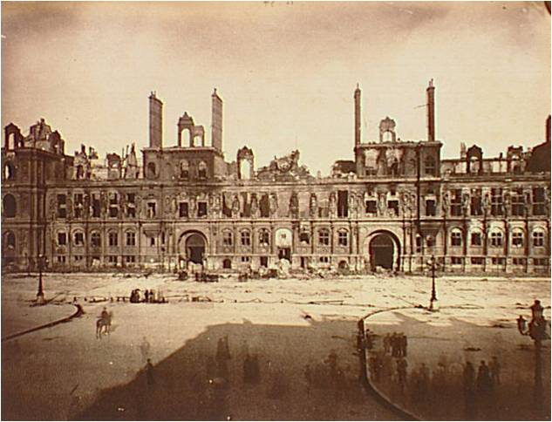
Paris City Hall Destroyed

Slide 7
Attempted Communard Reforms
Allowed trade unions & workers cooperatives to take over factories
not in use and start them up again.
Set up unemployment exchanges in
town halls.
Provide basic elementary education
for all → they were strongly against
church-controlled schools.
Attempted to set up girls schools.
Day nurseries near factories for working mothers.
Too little time to accomplish much

Slide 8
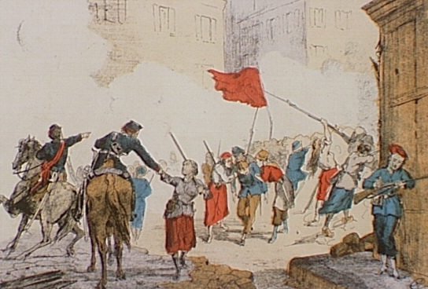
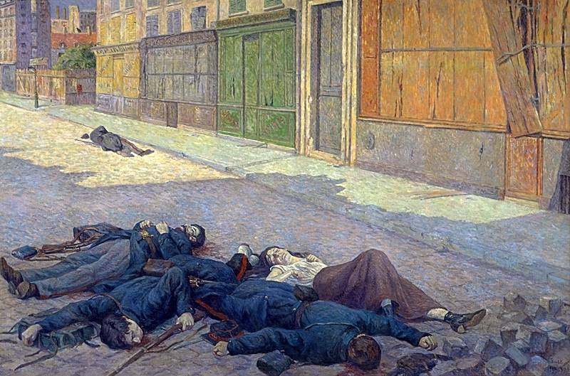
First Communist Revolution?
It served as an inspiration
to later revolutionaries like Lenin.
25,000 Communards killed.
35,000 were arrested.

Slide 9
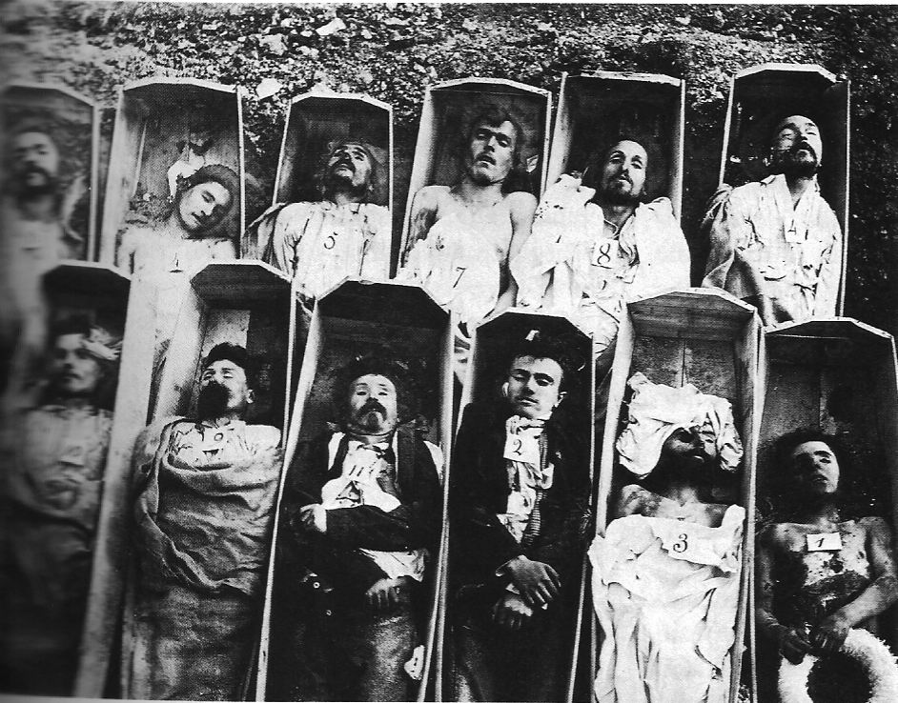
Communard Casualties

Slide 10
The
Third
French
Republic:
Government Structure

Slide 11
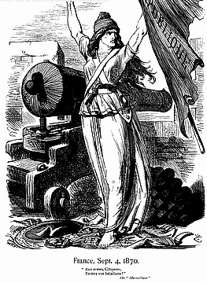
Declaring the
3rd French Republic

Slide 12
An Overview of the
3rd French Republic
Politically very unstable.
    Rivalry between monarchists and republicans.
    A number of scandals:
      The Boulanger Affair.
      The Panama Canal Scandal.
      The Dreyfus Affair [L’Affaire]
Because there were so many factions, all governments were coalitions.
Still, it survived longer than any other regime since 1789

Slide 13
The Constitution
The President:
  Head of state → little political power.
    Right to dissolve the Chamber of Deputies with the support of the Senate.
    Right to nominate the new head of government.
    Played an important role in foreign affairs.
The Senate:
  Elected by mayors & councillors in the counties throughout France.
  Nicknamed the “Chamber of Agriculture” because the countryside was over represented.

Slide 14
The Constitution
The Senate:
  Senators elected every nine years.
  Very conservative body → able to block progressive legislation.
The Chamber of Deputies:
  Chosen every four years.
  600 members elected by universal male suffrage.
  There was no organized party system.
  Major political groupings in the Chamber:
    Socialists → many were Marxists.
    Moderate Republicans → middle class.
    Radicals → anti-clerical.
    Monarchists → Catholics, Bonapartists, etc.

Slide 15
The
Third
French
Republic:
Scandals

Slide 16
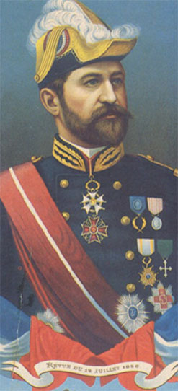
1. The Boulanger Affair
Bonapartism without a Bonaparte.
Most of the army was dominated by monarchists.
BUT, the Minister of War, General Georges Boulanger, was a republican.

Slide 17
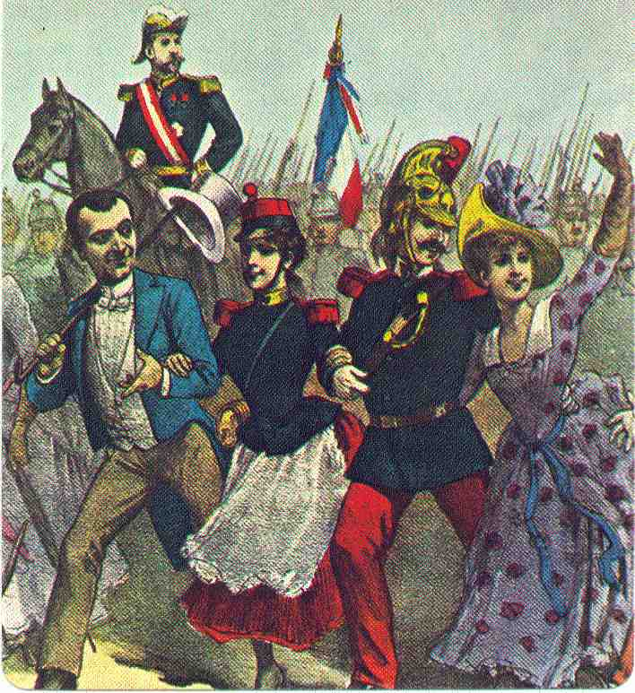
1. The Boulanger Affair
Very popular with the troops → the government was suspicious and removed him in 1887.

Slide 18
1. The Boulanger Affair
Now a national figure, he was the focal point of conservative opposition to the republican government.
  Was part of a plot to overthrow the Republic.
  Was summoned to trial, but he fled to Belgium where he committed suicide on the grave of his mistress.
Boulanger’s fall increased public confidence in the Republic.

Slide 19
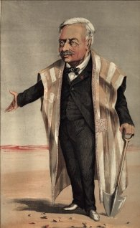
2. The Panama Canal Scandal : Ferdinand de Lesseps
President of the French Company that worked on the Panama Canal.
  Govt. officials took bribes from the company to withhold news from the public that it was in serious economic debt.
  One billion francs affecting 800,000 investors.

Slide 20
2. The Panama Canal Scandal : Ferdinand de Lesseps
All but one of the accused went unpunished due to lack of evidence.
Anti-Semitism:
  Two German Jews were also
  involved → they received the most press coverage.
Results:
  The scandal proved to the public that the Republic was corrupt.
  It created a climate of anti-Semitism that would increase in time.

Slide 21
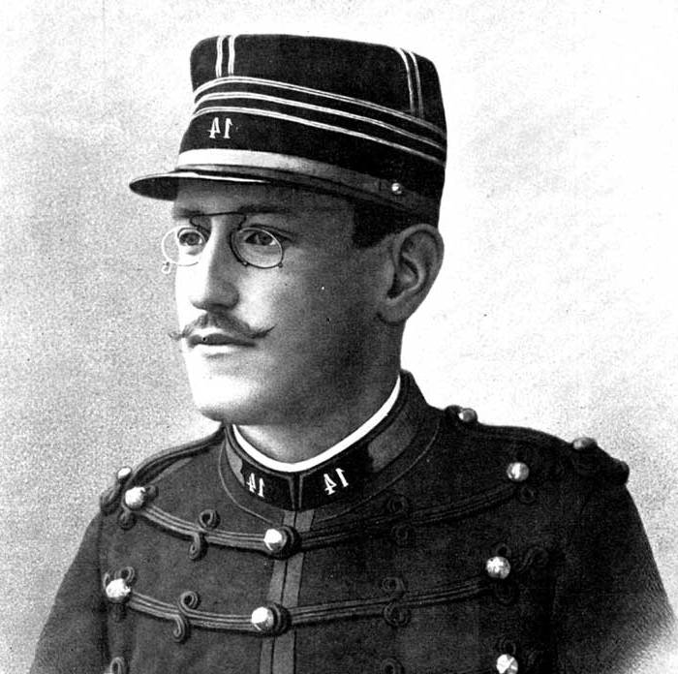
3. The Dreyfus Affair
In 1894 a list of French military documents [called a bordereau] were found in the waste basket of the German Embassy in Paris.
French counter-intelligence suspected Captain Alfred Dreyfus,
from a wealthy Alsatian
Jewish family → he was
one of the few Jews on
the General Staff.

Slide 22
3. The Dreyfus Affair
Dreyfus was tried, convicted of treason, and sent to Devil’s Island in French Guiana.
The real culprit was a Major Esterhazy, whose handwriting was the same as that on the bordereau.
  The government tried him and found him not guilty in two days.

Slide 23
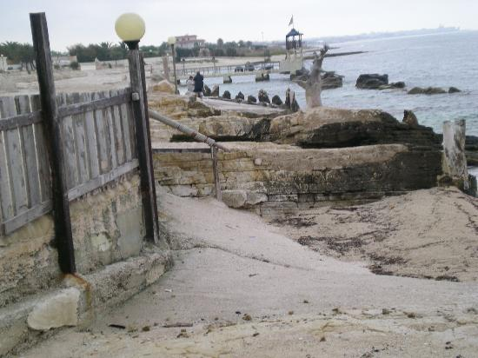
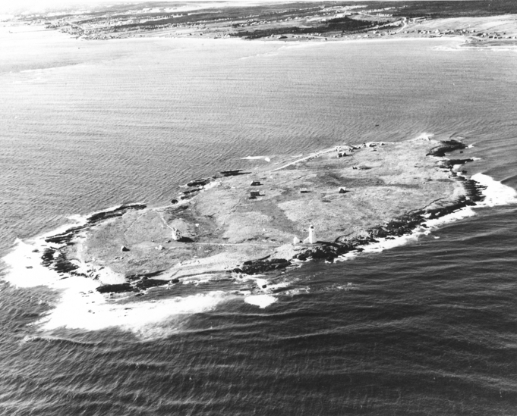
Devils Island

Slide 24
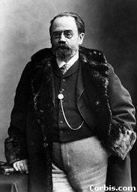
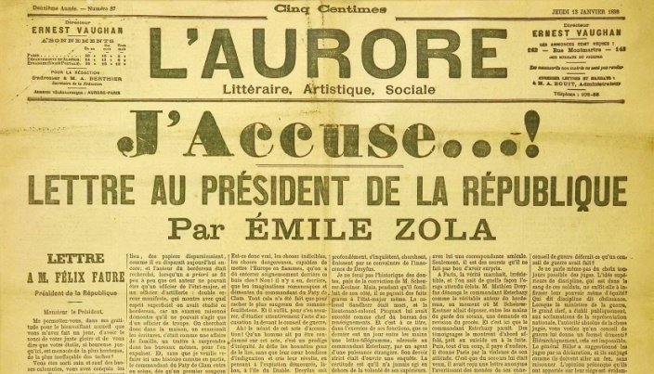
3. The Dreyfus Affair
A famous author, Emile Zola, published an open letter called J’Accuse!
  He accused the army of a mistrial and cover-up.
  The government prosecuted him for libel.
  Found him guilty → sentenced to a year in prison.

Slide 25
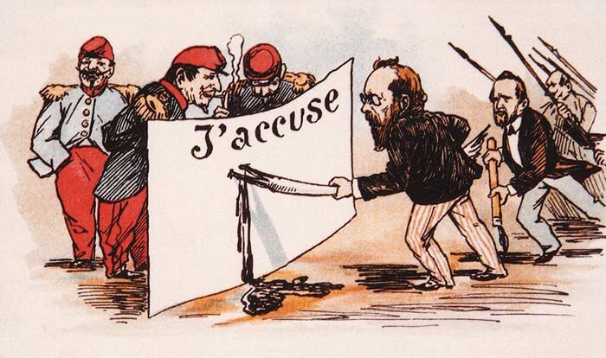
J’Accuse!

Slide 26
3. The Dreyfus Affair
Anti-Dreyfusards
Dreyfusards
Public opinion was divided → it reflected the divisions in Fr. society.
The Dreyfusards were anti-clericals, intellectuals, free masons, & socialists.
For Anti-Dreyfusards, the honor of the army was more important than Dreyfus’ guilt or innocence.
  Were army supporters, monarchists, & Catholics.

Slide 27
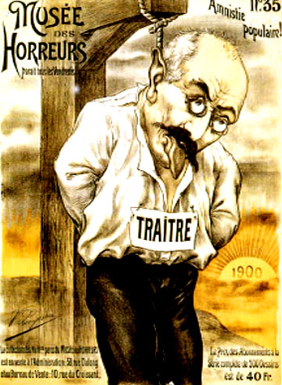
Dreyfus, the Traitor!

Slide 28
3. The Dreyfus Affair
Dreyfus finally got a new trial in 1899.
He was brought back from Devil’s Island white-haired and broken.
Results:
  Found guilty again, BUT with extenuating circumstances.
  Was given a presidential pardon.
  Exonerated completely in 1906.
  Served honorably in World War I.
  Died in 1935.

Slide 29
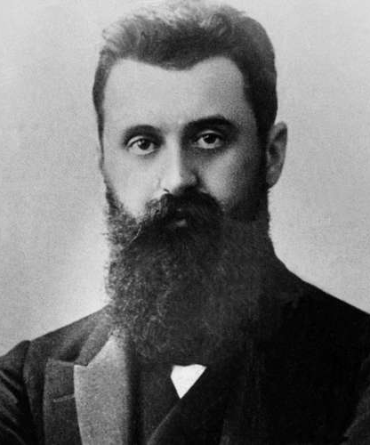
The Zionist Movement
Was motivated by the Dreyfus trial to write the book, Der Judenstaat, or
The Jewish State in 1896.
Creates the First Zionist Congress in Basel, Switzerland.
“Father of Modern Zionism.”
Theodore Herzl
[1860-1904]

Slide 30
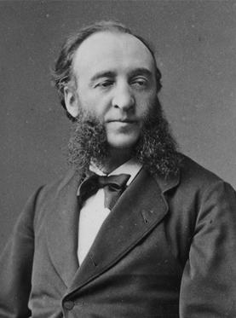
New Wave of Anti-Catholicism
The anti-clerical, republican left took power in the National Assembly in 1879.
  This anti-Catholicism was a remnant of the French Revolution.
  They stayed in power until 1914.
Ferry Laws [1879-1885]:
  Named after Jules
  Ferry, one of the
  ablest politicians of
  the 3rd Republic.
  Were the first major
  attempt at educational
  reform.

Slide 31
Ferry Laws
Only the State could grant degrees.
Free education in public primary schools.
Religious instruction was excluded from the State school curriculum.
Unauthorized religious orders [Marists, Dominicans, and Jesuits, who were eventually expelled from France] were forbidden to teach.
Authorized Catholic orders could NOT teach in French public schools.
State improved training of teachers.
They created a deep division between Church and State

Slide 32
The
Third
French
Republic:
Foreign Policy

Slide 33
Aims of French Foreign Policy
To regain the provinces of Alsace & Lorraine lost to Germany in 1871.
To end her isolation in international affairs after the Franco-Prussian War.
To expand her colonial empire and regain some of her prestige lost after the Franco-Prussian War.

Slide 34
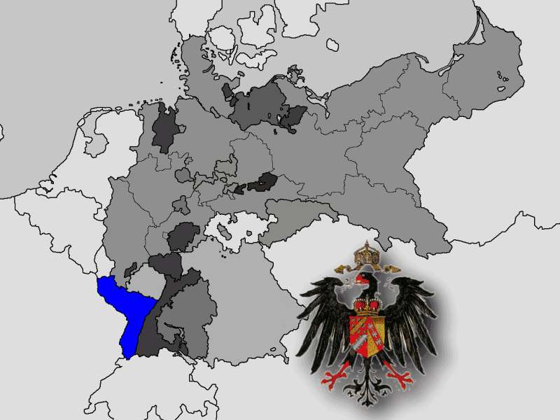
A National Trauma: France’s Loss of Alsace-Lorraine

Slide 35
French Colonial Empire
The empire set up under the 3rd Republic was the greatest France had ever possessed.
Jules Ferry played a huge role in French empire building.
Ironically, two-thirds of the missionary priests outside Europe were French
By 1914, France was the second largest colonial power in the world and the largest in Africa.

Slide 36
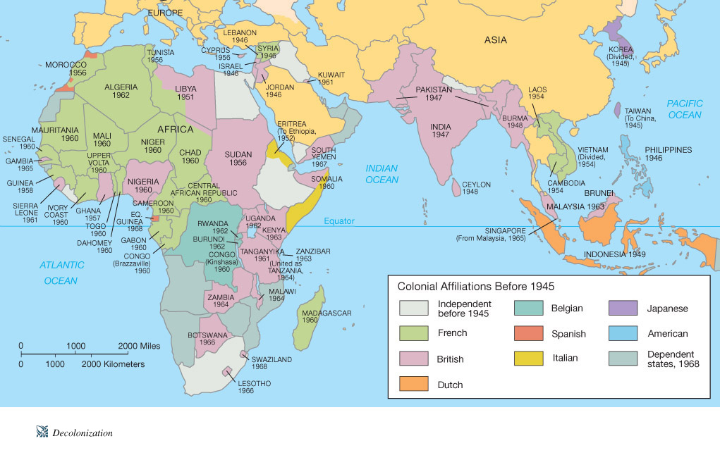
France’s Colonial Empire

Slide 37
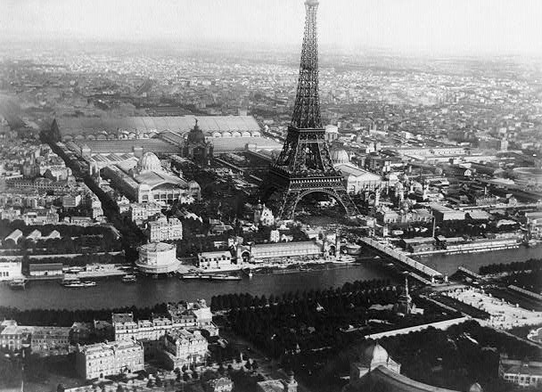
1889 Paris Exposition
World’s Fair held in honor of the French Revolution Centennial.
The Eiffel Tower, completed in 1889, served as the entrance to the Fair.

Slide 38
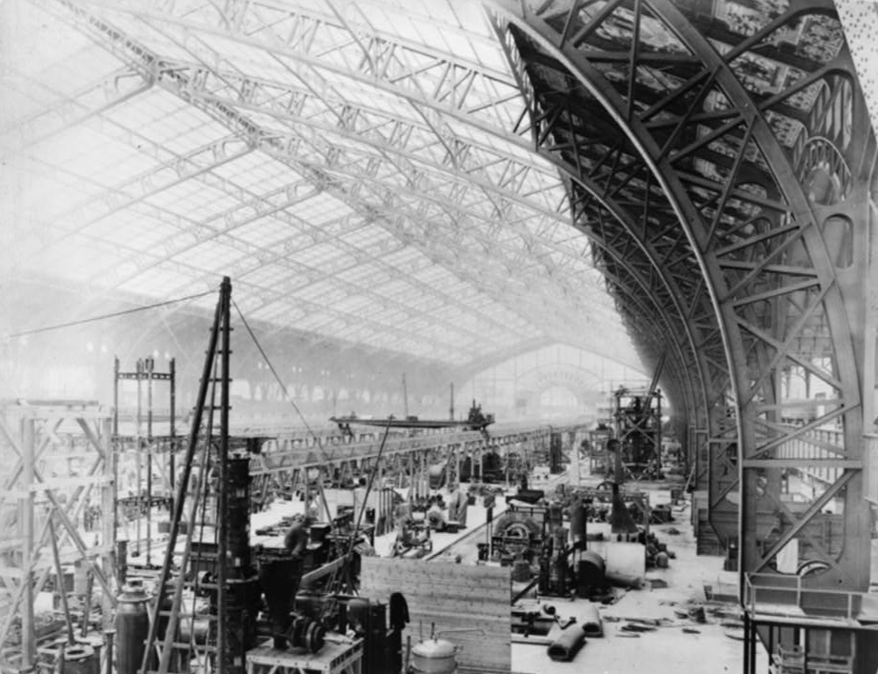
1889 Paris Exposition:
Gallery of Machinery

