Slide 1
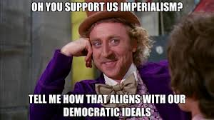
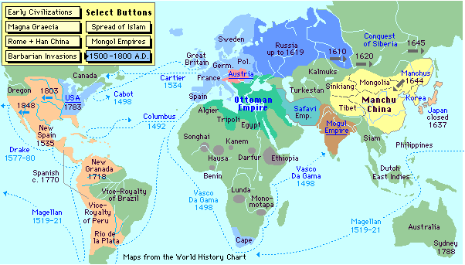
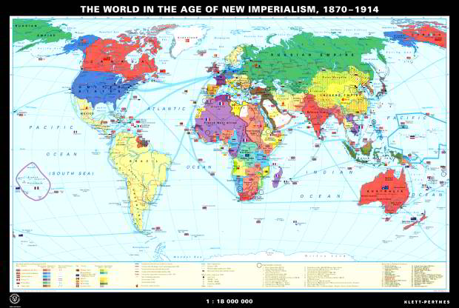
OLD IMPERIALISM VS. NEW IMPERIALISM Evaluating continuity and change

Slide 4
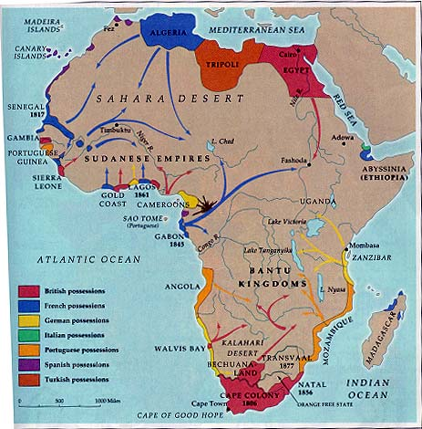
AFRICA
1850

Slide 5
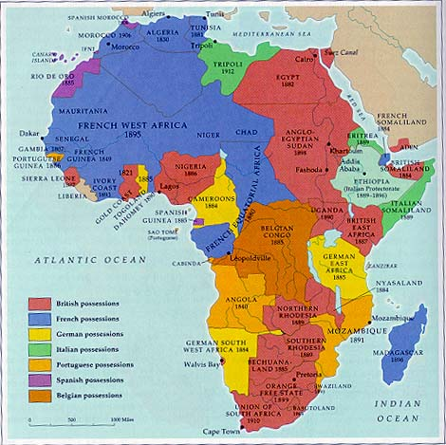
AFRICA
1900

Slide 6
Definition of Imperialism:
The domination by one country of the political (government & laws), economic (wealth, trade, resources), or cultural (language, religion, education) life of another country or region.

Slide 7
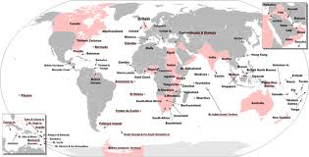
Old Imperialism
Under “Old Imperialism”, European powers did not usually acquire territory (except for Spain in Americas and Portugal in Brazil) but rather built a series of trading stations(why?) “ A primitive accumulation of wealth”
Respected and frequently cooperated with local rulers in India, China, Japan, Indonesia, and other areas where trade flourished between locals and European coastal trading centers.
the “new imperialism” tended to favor direct conquest and formal empire (technology, tools, ideology)
Africa and Asia had seen limited Euro. intrusion and most contacts had been coastal in nature…entire continents now came under Euro. influence

Slide 8
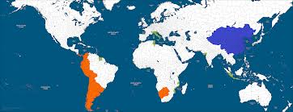
OLD IMPERIALISM
1500s-early 1800s…
Why? God-Gold-Glory-Trading Contacts-Catching “up to others”
Empires based on… Divine Right, some private joint stock with aid of monarchs
Which countries? France, England, Spain, Portugal, Dutch (SPEFN)
What were the goods sought? Spices, Gold, Markets , Slaves, Sugar, Silver
Type of economic system driving it?

Slide 9
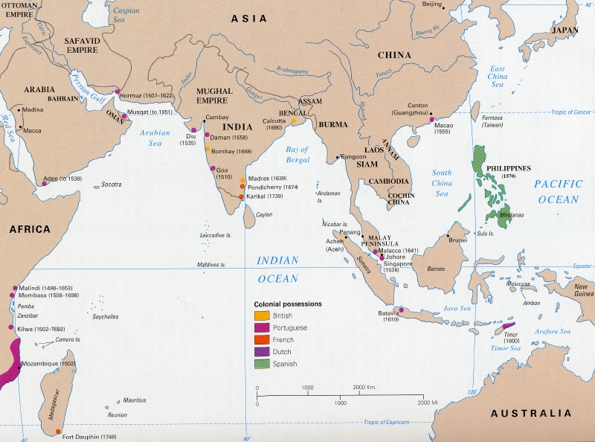
Trading post Empires

Slide 10
NEW IMPERIALISM
Mid 1800s-1914
Territorial conquest
Use of economic and technological means to make regions economically dependent as suppliers of raw materials and consumers
Conquest and colonial administration

Slide 11
84% of the world was colonized

Slide 12
Imperialism Motives What led industrialized nations to colonize other parts of the world?

Slide 13
Motives for Imperialism
ECONOMIC | Desire to make $ Control trade Access to new markets Acquire raw materials Cheap labor Export goods
POLITICAL | National power Compete w/ other European countries Expand territory & use military force Boost national pride = NATIONALISM

Slide 14
RELIGIOUS | desire to spread Christianity Spread European values and moral beliefs; educate in Euro ideas End slave trade
EXPLORATORY | Desire to explore the “unknown” Scientific research Adventure Medical- causes/cures for disease
IDEOLOGICAL | belief in superiority of Euro/American/Japanese people Other cultures “barbarians,” or “primitive” and should be “civilized” Great nations should have empires; strong nations over the weak

Slide 15
The Civilizing Mission
Jules Ferry – “On French Colonial Expansion”
Duty to civilize
Spanish didn’t “civilize” natives, but the French will
Bring French culture to natives
Prince Konoe- “On Japanese Education in China
Instructing Chinese students
Japanese language; dorms
Patriotism for Japan, not China
SIMILARITIES
Superiority; duty
“helping” and “teaching” by giving their culture/education

Slide 16
The Industrial Mission
What is “industry”?
What were industrialized nations trying to do?
What would they use natural resources for?

Slide 17
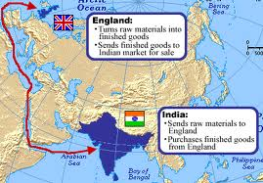
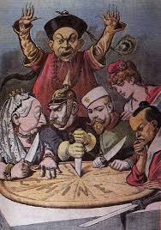
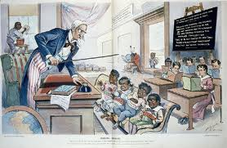
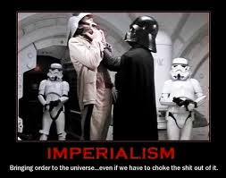
New Imperialism: Continuities
Guided by feeling of superiority
Exploitation of land labor and capital
Guided by civilizing or Christianizing mission(justify?)
Use of new technologies (better than natives?)
Spirit of capitalism (finite resources)
Markets exploited by dominant cultures (unfair treaties)
racism

Slide 18
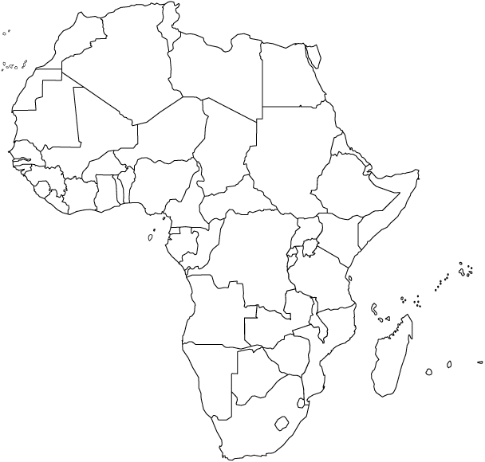
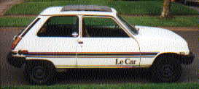
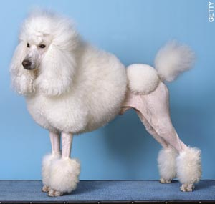
Our colonies, our prices!!!

Slide 19
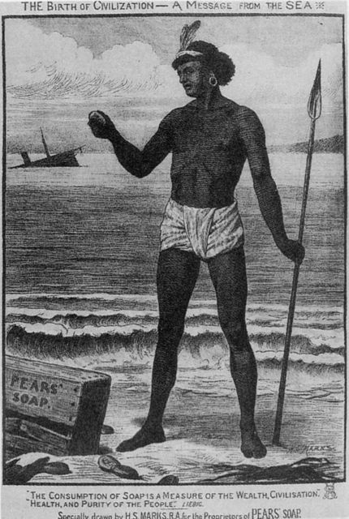

Slide 20
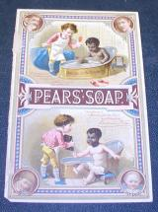

Slide 25
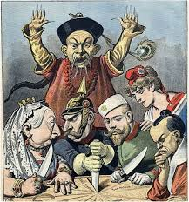
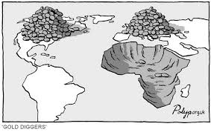
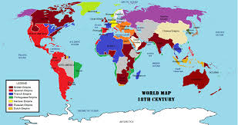
The Europeans maintained their exploitation of land labor and capital to support capitalist ideas of the accumulation of wealth through competition over territories for markets in Asia, the Americas and Africa

Slide 26
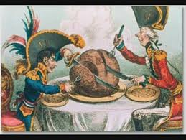
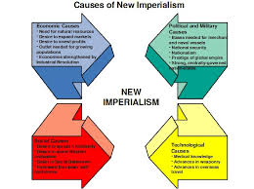
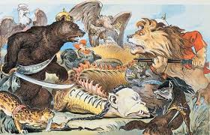
The Age of exploration inspired a European competitiveness for materials, markets and labor for the purpose of competitively dominating global trade and accumulating as much wealth for both public and private groups.

Slide 27
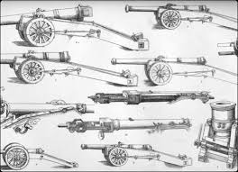
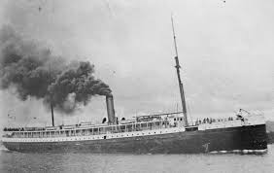
Technologies brought about by the Industrial and Scientific Revolution like the maxim gun quinine, and the steamship facilitated greater conquest of Asia and Africa

Slide 28
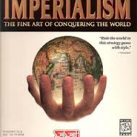
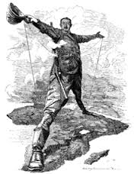
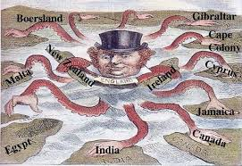
The guns, steel and horses of old imperialism may have facilitated conquest in the Americas but it was no match in the Eastern hemisphere until the introduction of the tools of industry which far outmatched the European’s newer territories as industrial was machines dominated their less advanced counterparts.

Slide 29
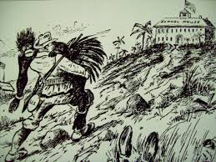
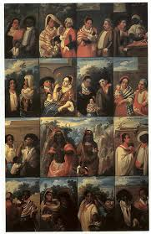
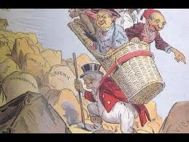
The racist/ethnocentric notion of Europeans being the dominant culture justified the conquest of territorial expansion in throughout the world.

Slide 30
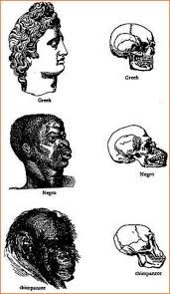
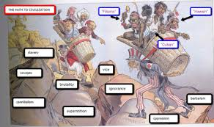
The ideas of social Darwinism and the “white man’s burden” were mere extensions of the racism which began as non-Europeans were looked at as uncivilized heathen and pagan justifying the conquest as an attempt to civilize and Christianize these “ignoble savages”.

Slide 31
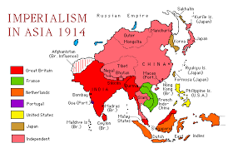
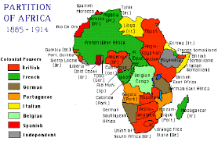
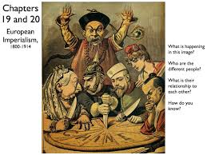
European imperialism in Asia and Africa was limited to trading posts and small coastal enclaves due to pre-existing empires and lack of ability to deal with tropical diseases whilst the military of industrialism coupled with medical advances facilitated global expansion

Slide 32
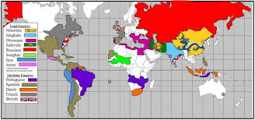
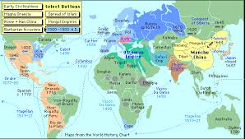
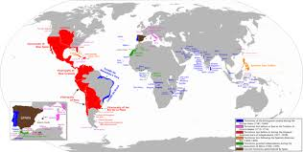
Empires like Kongo, Mughal and Qing were too dominant in the 16th centuries for Europeans to conquer as, too, were the tropical diseases of Yellow fever and Malaria until the advent of technologies (quinine, maxim gun, etc.) facilitated conquest in addition to fragmentation of these African and Asian Empires.

Slide 33
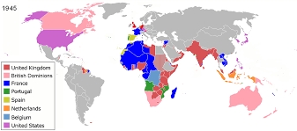
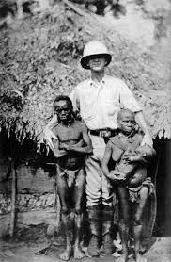
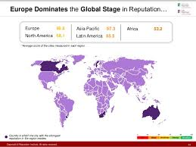
The traditional conquest of concentration on urban areas for the diffusion of European city culture maintained dominance as “European” cities continued to develop throughout Asia and Africa and Australia amongst others.

Slide 34
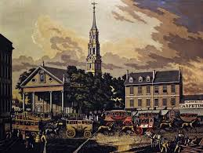
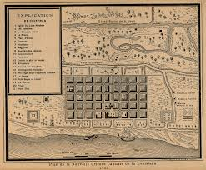
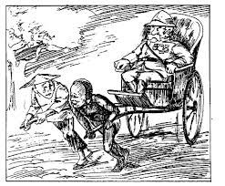
The cities of Bogota, Kingston and Lima were the first models of European colonial cities to be followed by Nairobi, Johannesburg, Hong Kong, Bombay and Rangoon became centers of commerce, university learning and areas where European colonists could settle

Slide 35
From 1450-1900 imperialism existed for the purpose of using military force to take territories for land. labor and capital, however, industrial production needed more territories like Africa and Asia and those who wielded technologies which were industrially produced were able to easily exploit those who wee not.
.The Europeans maintained their exploitation of land labor and capital to support capitalist ideas of the accumulation of wealth through competition over territories for markets in Asia, the Americas and Africa | Technologies brought about by the Industrial and Scientific Revolution like the maxim gun quinine, and the steamship facilitated greater conquest of Asia and Africa | European imperialism in Asia and Africa was limited to trading posts and small coastal enclaves due to pre-existing empires and lack of ability to deal with tropical diseases whilst the military of industrialism coupled with medical advances facilitated global expansion
The Age of exploration inspired a European competitiveness for materials, markets and labor for the purpose of competitively dominating global trade and accumulating as much wealth for both public and private groups | The guns, steel and horses of old imperialism may have facilitated conquest in the Americas but it was no match in the Eastern hemisphere until the introduction of the tools of industry which far outmatched the European’s newer territories as industrial was machines dominated their less advanced counterparts. | . Empires like Kongo, Mughal and Qing were too dominant in the 16th centuries for Europeans to conquer as, too, were the tropical diseases of Yellow fever and Malaria until the advent of technologies (quinine, maxim gun, etc.) facilitated conquest in addition to fragmentation of these African and Asian Empires

