Slide 1
© Morgan AP Teaching
Period 3: 1815 CE – 1914 CE
The New Conservatives

Slide 2
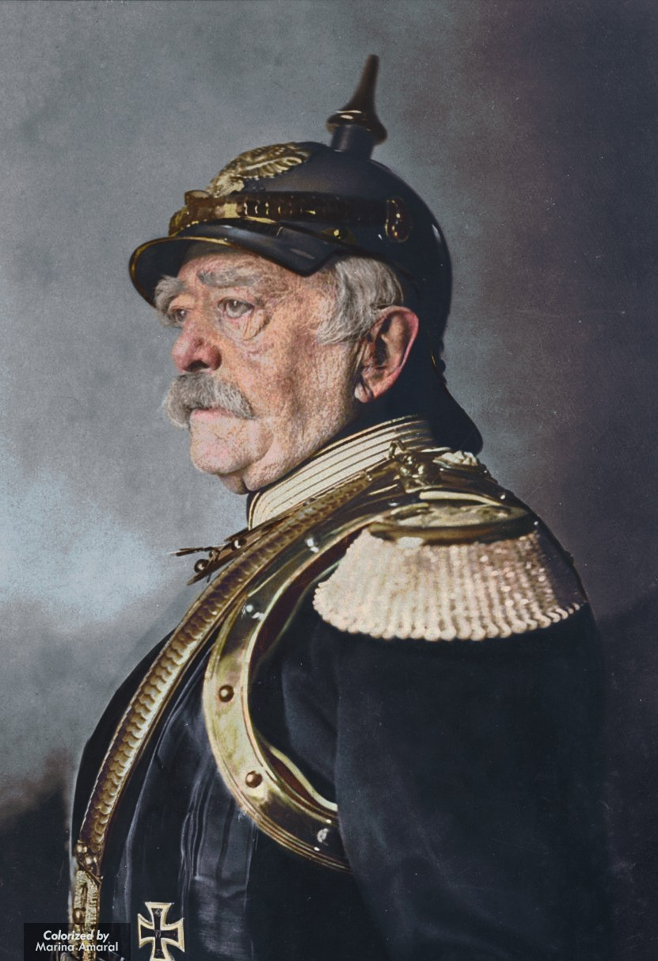
© Morgan AP Teaching
New Conservativism
The 19th century saw the rise of several new leaders emerged to unify,
develop, & maintain their states three series of nuanced political placations
In the 19th century, these leaders were each considered ‘conservative,’
meaning they favored state religion, traditional authority, and monarchy
However, these crafty leaders, having seen the multitude of revolutionary movements in the early 19th century, decided to embrace minimal necessary change to placate progressive groups such as nationalists, liberals, or socialists
Known as ‘New Conservatives,’ the leaders were still true to their conservative beliefs in traditional authority (i.e., the clergy are the monarchy), but placated progressive groups by issuing several forms in order to avoid instability or revolt

Slide 3
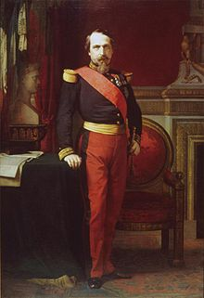
© Morgan AP Teaching
Napoleon III of France
Napoleon III was a leader who masterfully used the liberal and socialist agendas
to form a state centered around monarchal authority in mid-19th century France
Ways in which he was conservative:
While keeping almost all power in his hands as emperor, he also empowered
the old authority—the Church—by involving them in public schooling
Ways in which he acted to placate progressive reformers:
To keep liberals happy, he increased the powers of the National
Assembly (representative assembly headed by reg. people)
To keep socialists happy, he legalized strikes, unions, and began public works projects
To keep nationalists happy, he expanded France by helping Cavour,
and gaining Italian territory in exchange in Savoy and Nice

Slide 4
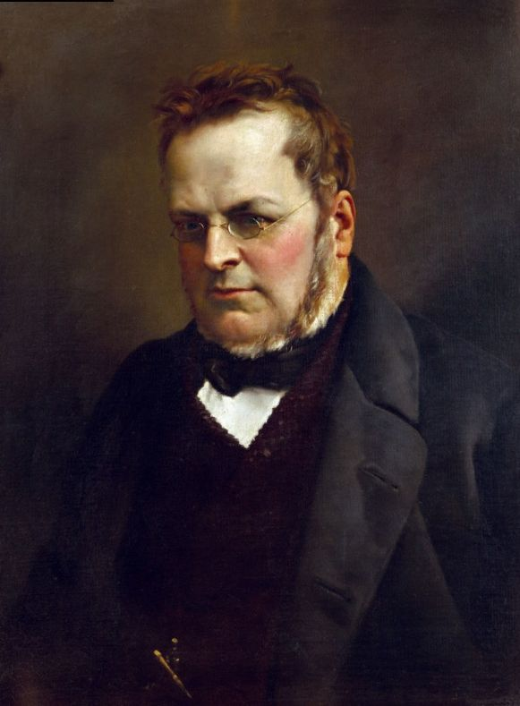
© Morgan AP Teaching
Count Cavour of Italy
Cavour, like his contemporaries Napoleon and Bismarck, used a very pragmatic political
approach to appease and work with powerful groups--whether or not he agreed with them
His intent was to keep a monarch as the head of Piedmont (and literally), but he had to
placate nationalists and liberals (those desiring natural rights and constitutionalism) in Italy
To placate liberals in Piedmont, he eliminated noble and clerical
privilege and protected natural rights with an ad-hoc constitution
To placate nationalists in Piedmont, and greater Italy, he moved to confiscate
Italian territory from Austria, and unify the Italian states as one, powerful kingdom
To maintain the monarchy, he admitted states to the union under
the agreement they would adhere to a constitutional monarchy
To maintain the existence of the Catholic Church, he negotiated with his political enemy—the radical liberal Garibaldi—in order to ensure Garibaldi’s forces did not dismantle it as he originally intended

Slide 5
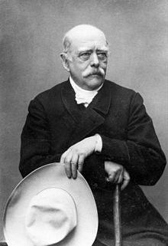
© Morgan AP Teaching
Otto von Bismarck of Prussia
Bismarck, like Cavour, use a diplomatic approach known as realpolitik–a pragmatic approach to politics in which one ignores the differences in personal beliefs to discuss and negotiate directly with opponents in the hopes of benefiting both parties
As a loyal prime minister who served his king (and later emperor) Wilhelm, Bismarck
placated nationalists, liberals, and later socialists to keep himself and the king in power
As Germany was in the early phases of development, Bismarck placated nationalists by driving Prussia to unite the German provinces, and also placated liberals by establishing a small representative assembly in the new government known as the Reichstag
In doing so, Bismarck ensured that he and the Kaiser (Emperor)
remained at the top of the state hierarchy, while satisfying liberals with
a representative assembly and nationalist with the unification movement

Slide 6
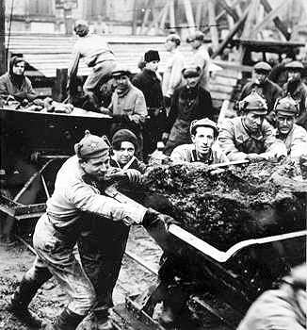
© Morgan AP Teaching
Otto von Bismarck of the German Empire
After Germany had formed, Bismarck quickly had to pass new laws and
policies to placate a growing new political group: working-class socialists
Prior to the mid-19th century, governments had embraced free market capitalism and free
trade, opposing attempts by workers to unify and collectively bargain against employers
However, with a growing, unified political movement, as well as the codified ideals
of Marxism following 1848, many leaders feared a violent workers revolution
Fearing the large group of workers organized in the German Social Democratic Party may eventually lead such a revolt, Bismarck shocked the world by using monarchal authority to make Germany the first nation to pass openly-socialist policies, in order to satisfy a disgruntled working class
In 1883, Bismarck pushed a bill through the Reichstag that required employers and employees contribute to health insurance (they later drew the funds from federal and state programs)
In 1884, he pushed a bill through that required employers to provide accident insurance
In 1889, he pushed a bill through that provided a state pension and worker disability insurance

