Slide 1
Neo-Classicism
By: Mrs. Braun
Pine View

Slide 2
Overview of Neo-Classicism
Art produced in Europe and North America from the mid-18c to the early 19c.
More than just an antique revival → a reaction against the surviving Baroque & Rococo styles.
Linked to contemporary political events:
Revolutions established republics in France and in America. [Neo-Classicism was adapted as the official art style].
Association with the democracy of Greece and the republicanism of Rome.
Napoleon → used the style for propaganda.

Slide 3
Origins of
Neo-Classical
Art

Slide 4
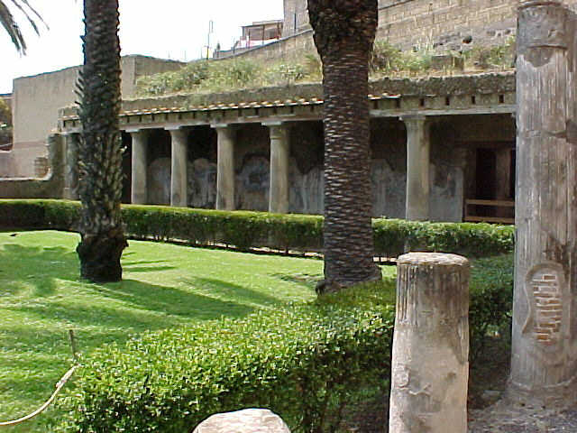
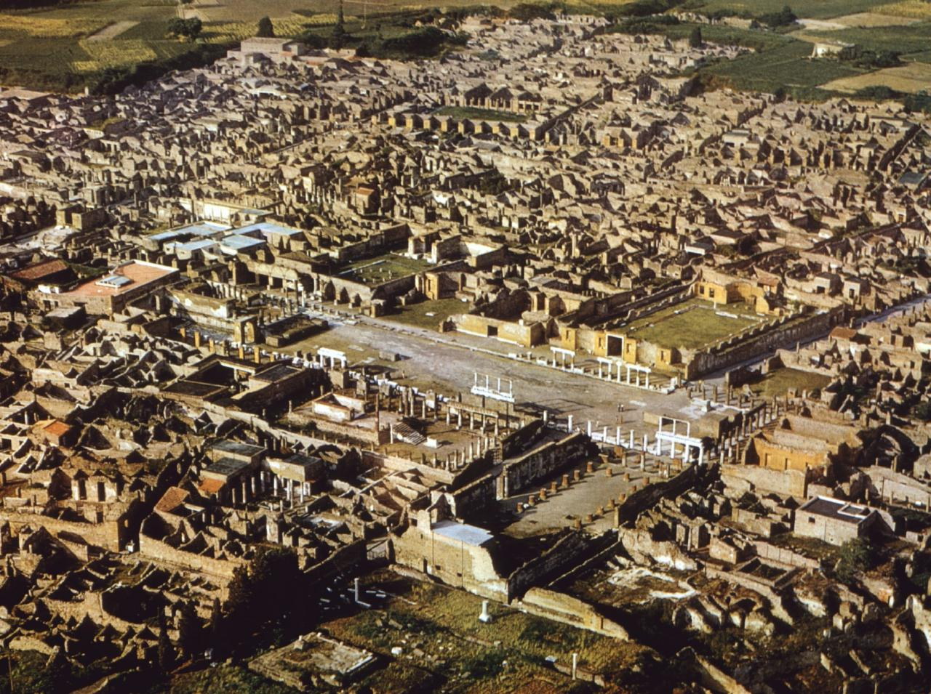
1. Excavations of the Ruins of Italian Cities
Pompeii in 1748.
Herculaneum in 1738.

Slide 5
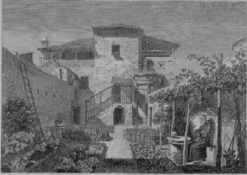
2. Publication of Books on Antiquity
James Stuart & Nicholas Revert Antiquities in Athens: 1762-1816.

Slide 6
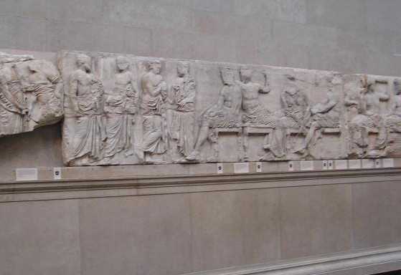
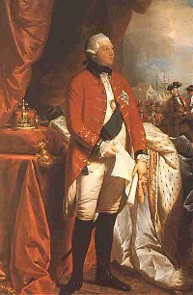
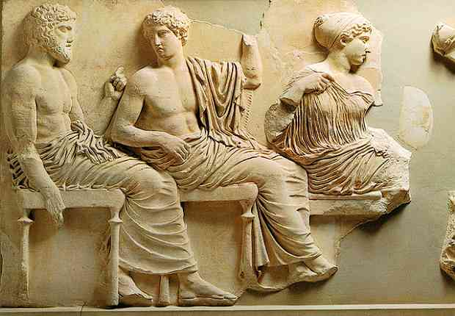
3. Arrival of the Elgin Marbles
Thomas Bruce, 7th Lord of Elgin British Museum, 1806
From the top façade of the Parthenon in Athens.

Slide 7
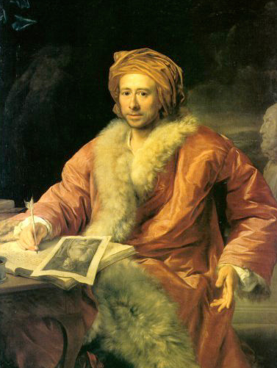
4. Johann Winckelmann’s Artists Circle
Artists should “imitate” the timeless, ideal forms of the classical world.
A circle of international artists gathered about him in the 1760s in Rome.
German art historian.

Slide 8
Characteristics of Neo-Classicism
Return to the perceived “purity” of the arts of Rome.
Model the “ideal” of the ancient Greek arts and, to a lesser, extent, 16c Renaissance classicism.
A conviction that there is a permanent, universal way things are (and should be), which obviously entails fundamental political and ethical commitments.
Sometimes considered anti-modern or even reactionary.

Slide 9
Neo-Classical
Architecture

Slide 10
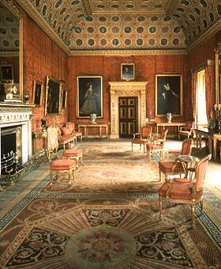
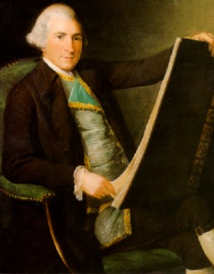
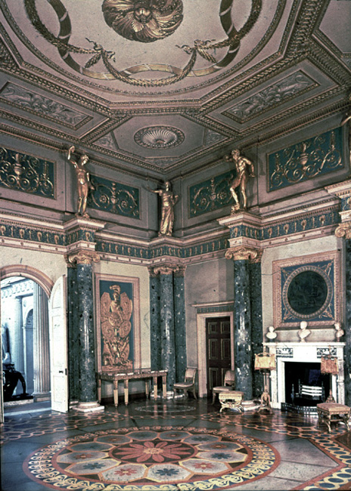
Robert Adam
Syon House The Red Salon
Scottish architect & designer
Syon House 1760s

Slide 11
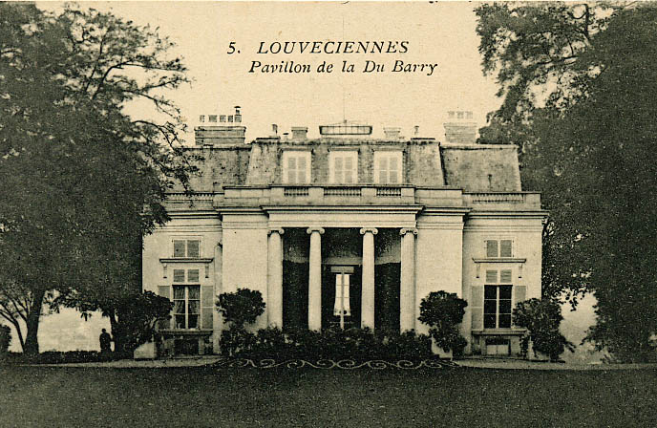
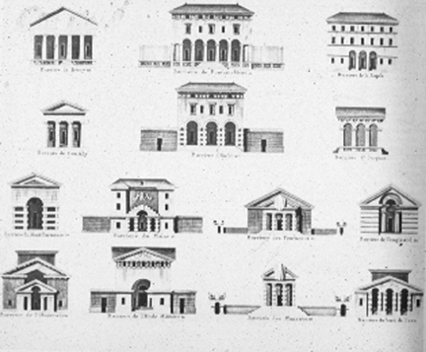
Claude Nicholas Ledoux
Designed a pavilion in 1771 for the Comtesse du Barry at Louveciennes.
Designed a series of city gates for Paris (1785-1789).

Slide 12
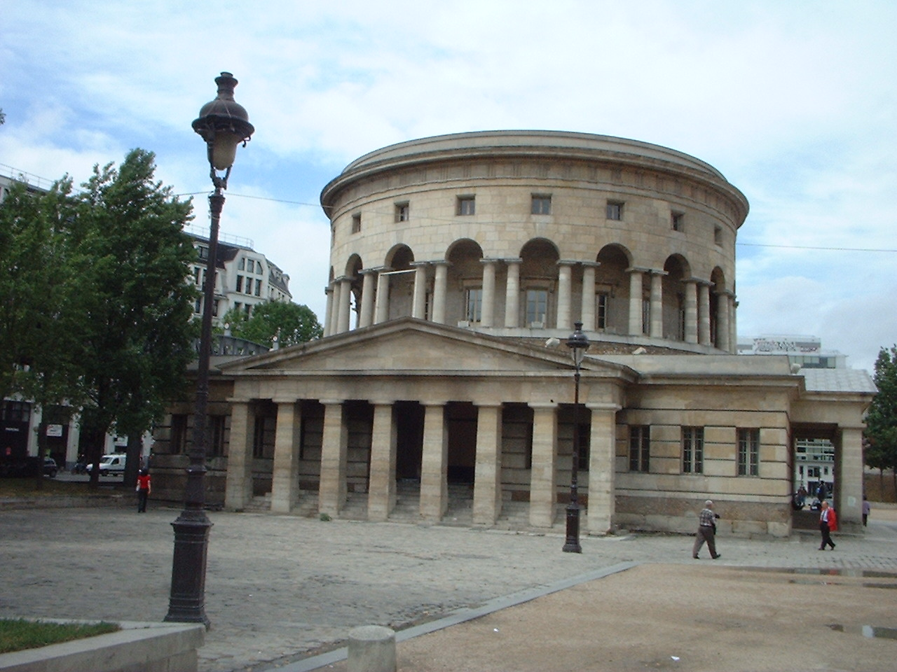
Claude Nicholas Ledoux
Rotunde de la Villette, Paris

Slide 13
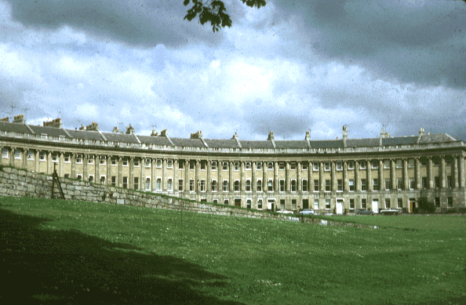
John Wood
“The Royal Crescent [Circus]” at Bath, England (1754).

Slide 14
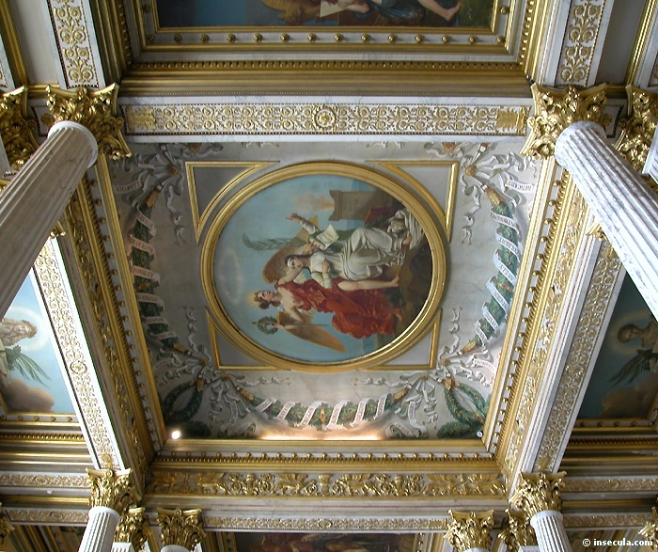
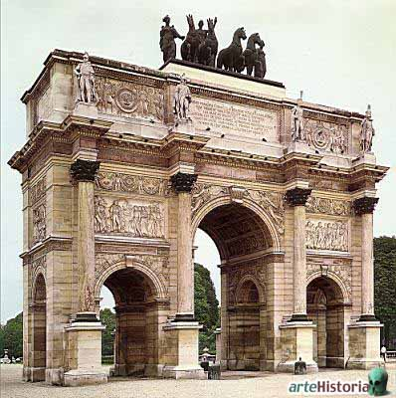
The “Empire Style”: Charles Percier & Pierre François Léonard Fontaine
Napoleon’s official architects.
They remade Paris in the intimidating opulence of Roman imperial architectural style.

Slide 15
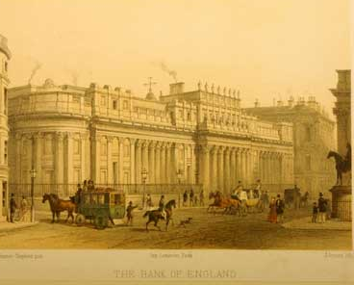
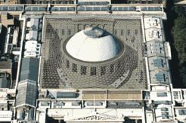
Greek-Inspired Architecture
Bank of England Rotunda Sir John Soane, 1796
British Museum Portico Sir Robert Smirke, 1823-1847

Slide 16
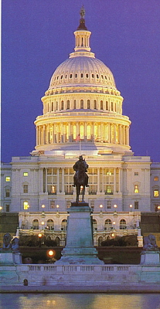
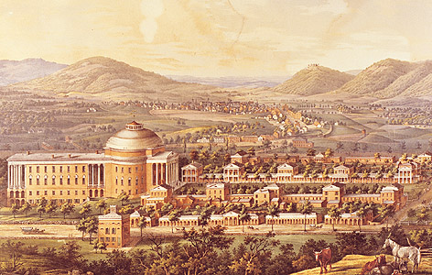
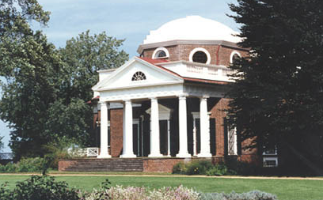
The “Federal Style” in America
1780 – 1820.
Thomas Jefferson’s influence.
University of VA
Monticello, VA
U. S. Capitol

Slide 17
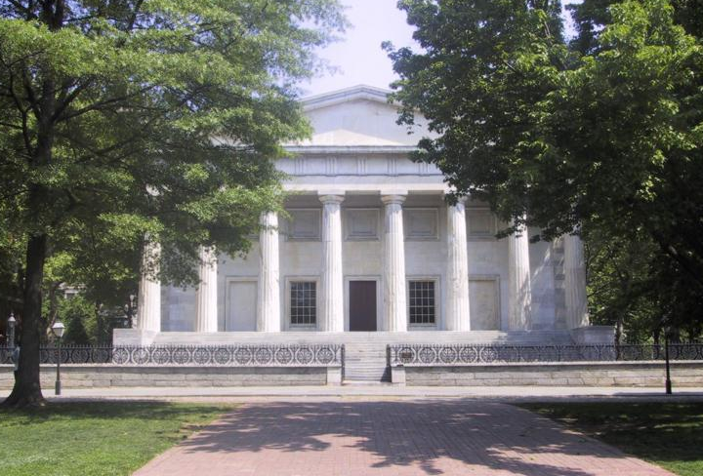
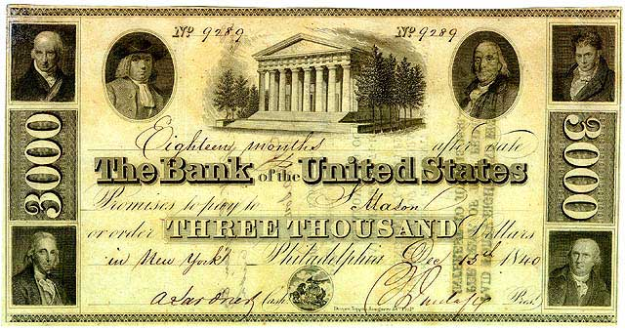
The “Greek Revival Style” in America
Second Bank of the US Philadelphia, 1824

Slide 18
Neo-Classical
Painting

Slide 19
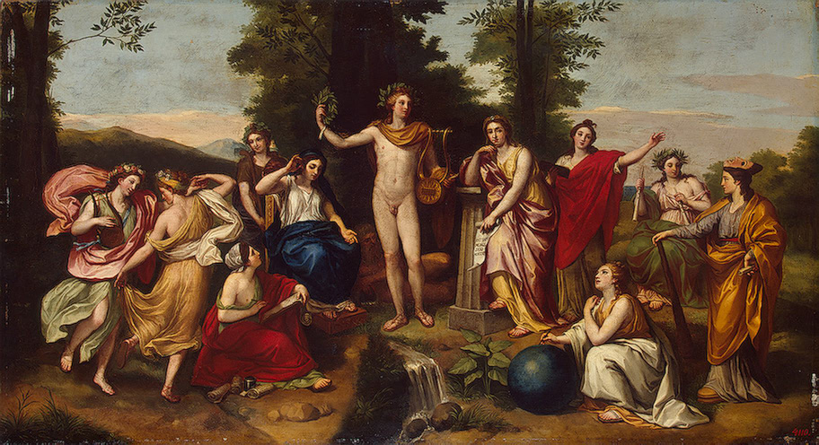
“Parnassus” Anton Raphael Mengs, 1761
Mengs was the leading artist of early Neo-Classicism.

Slide 20
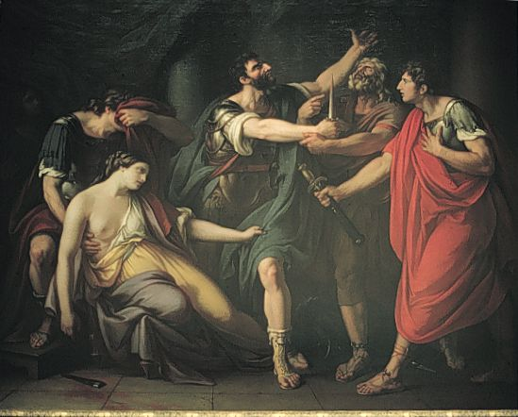
“The Oath of Brutus” Gavin Hamilton, 1767
The oath was sworn as a promise of individual revenge against a corrupt monarchy.

Slide 21
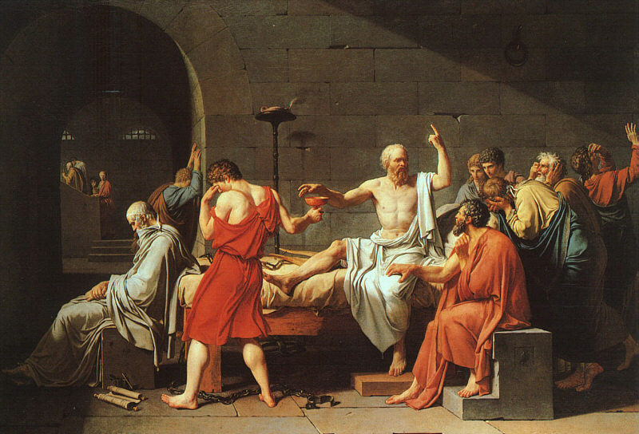
“The Death of Socrates” Jacques-Louis David, 1787
The death of Socrates was a symbol of republican virtue.

Slide 22
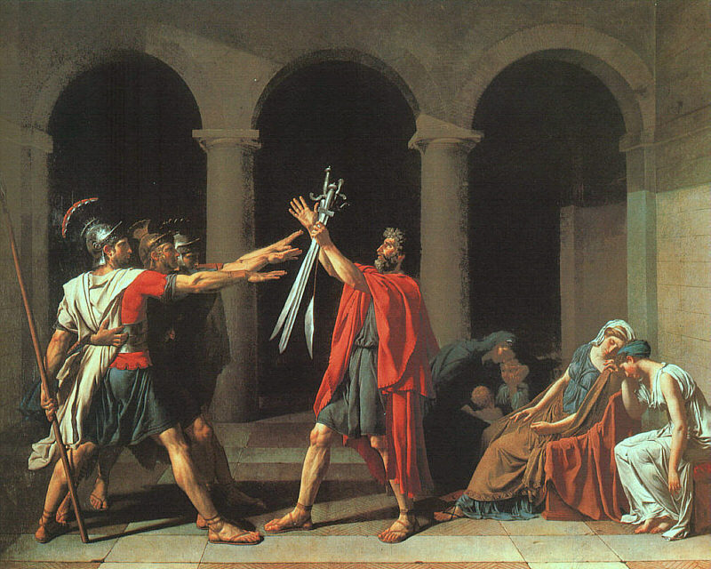
“The Oath of the Horatii” Jacques-Louis David, 1784
A depiction of dutiful patriotism.

Slide 23
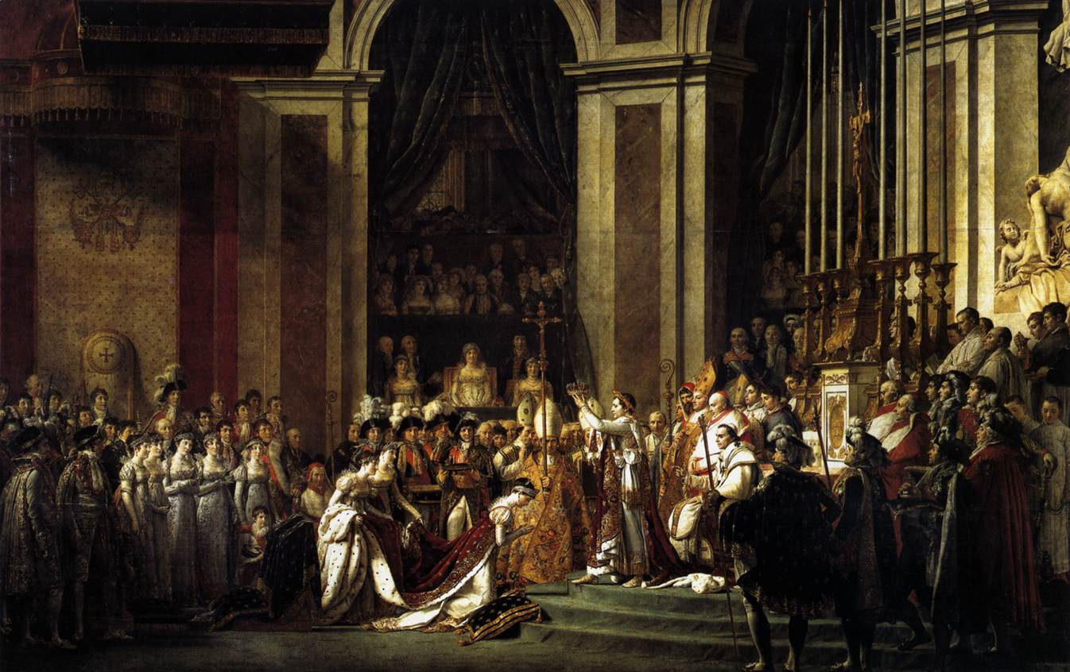
“The Consecration of Napoleon & Josephine” Jacques-Louis David, 1805-1807
A very different theme: The celebration of worldly splendor and power.

Slide 24
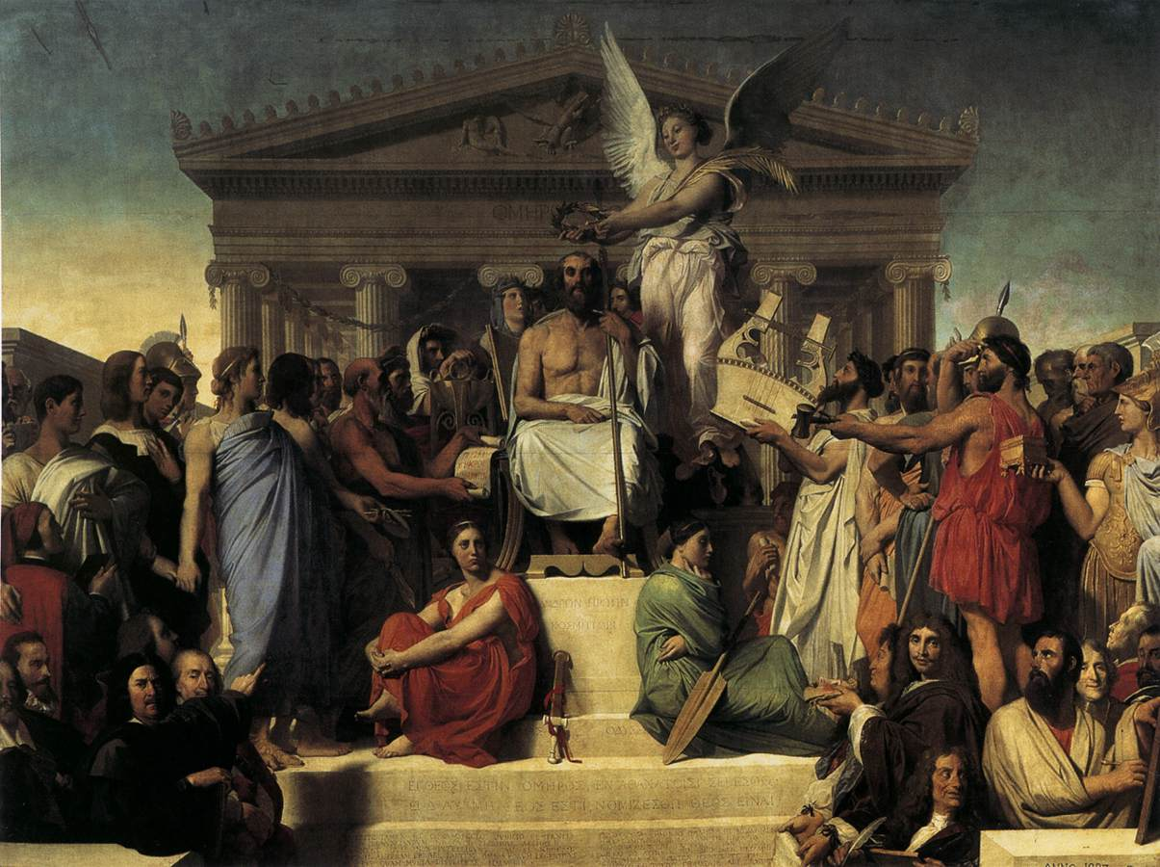
“The Apotheosis of Homer” Jean-Auguste-Dominique Ingres, 1827
This assembly of great artists and writers of all ages gathered to honor the ancient Greek poet before a classical temple.

Slide 25
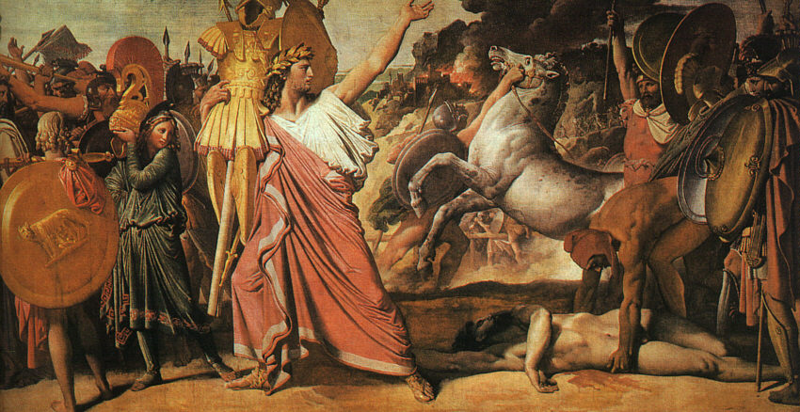
“Romulus—Victory over Acron” Jean-Auguste-Dominique Ingres, 1812
Painted for Napoleon’s palace in Rome.

Slide 26
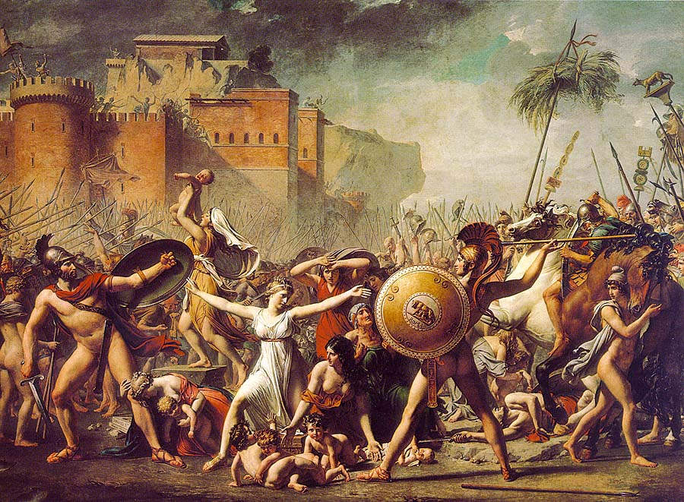
“The Sabine Women” Jean Auguste Ingres, 1799

Slide 27
Neo-Classical
Sculpture

Slide 28
Neo-Classical Sculpture
Profoundly influenced by ancient art since the Renaissance.
Neo-Classical sculptors avoided the dramatic twisting poses and colored marble surfaces characteristic of late Baroque and Rococo sculpture.
They preferred:
Crisp contours.
A noble stillness.
Idealized white marble forms.

Slide 29
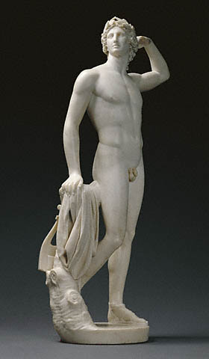
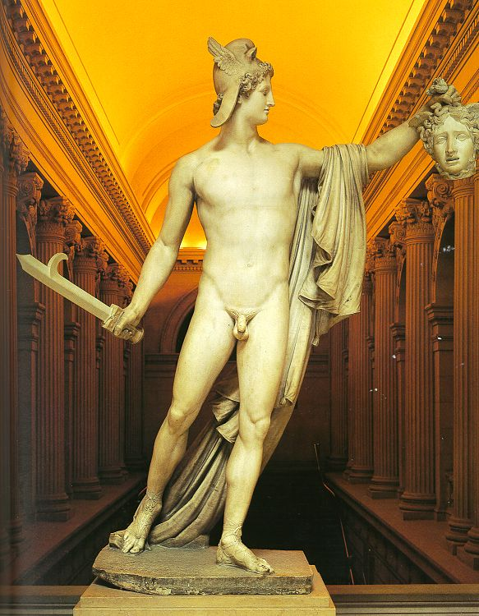
Antonio Canova
“Apollo Crowning Himself,” 1781
“Perseus with the Head of Medusa,” 1804-1806

Slide 30
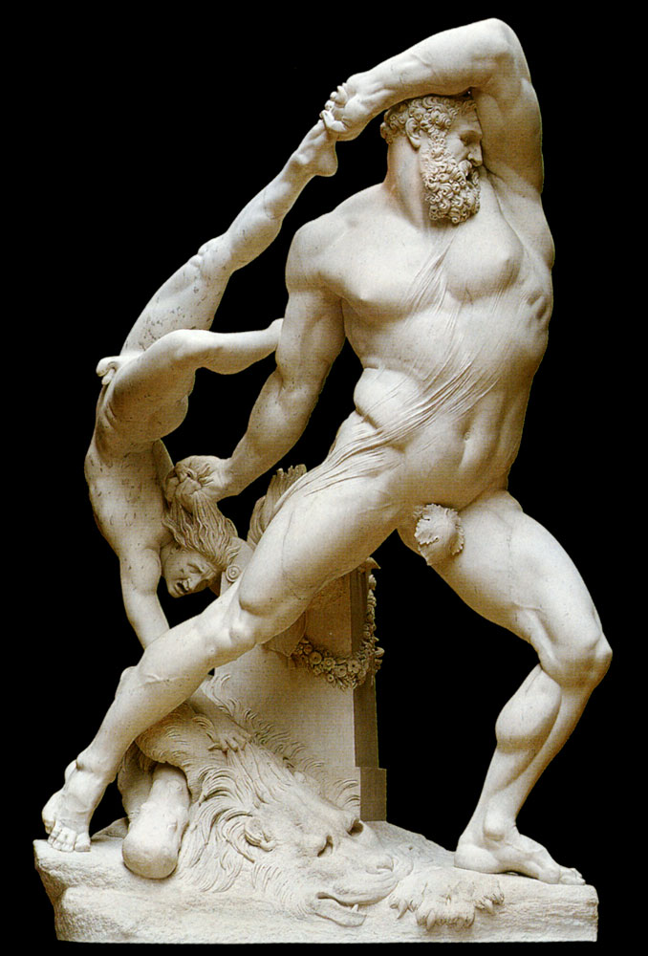
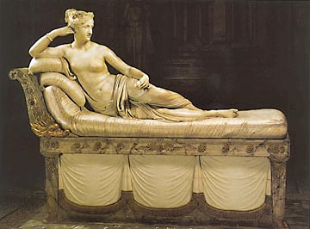
Antonio Canova
“Paulina Bonaparte,” 1808
“Hercules”

Slide 31
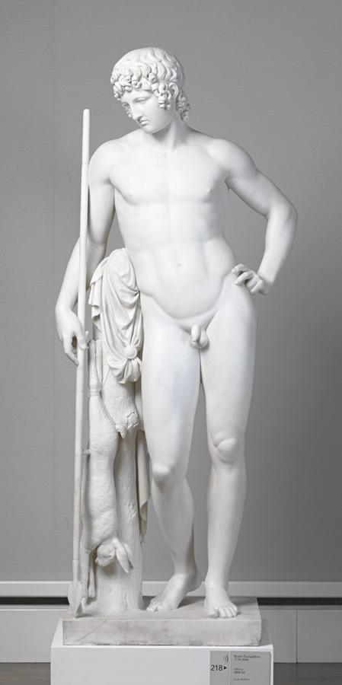
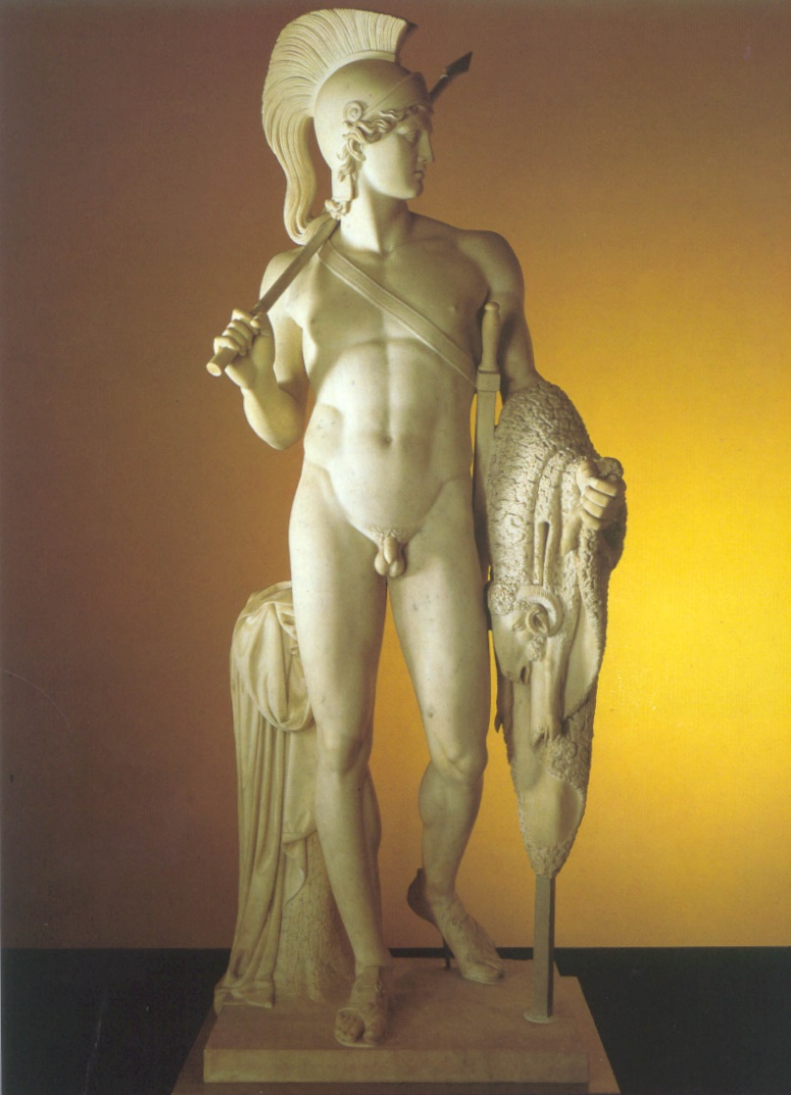
Bertel Thorvaldsen
“Jason,” 1803-1823
“Adonis,” 1808-1832

Slide 32
Neo-Classical
Decorative Arts

Slide 33
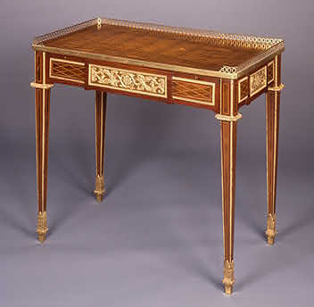
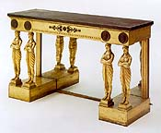
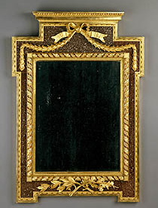
Furniture
The furniture designs used Greco-Roman motifs.
Became known as style étrusque [“Etruscan style”] in France.
Were favored by the court of Louis XV and later by Napoleon I.

Slide 34
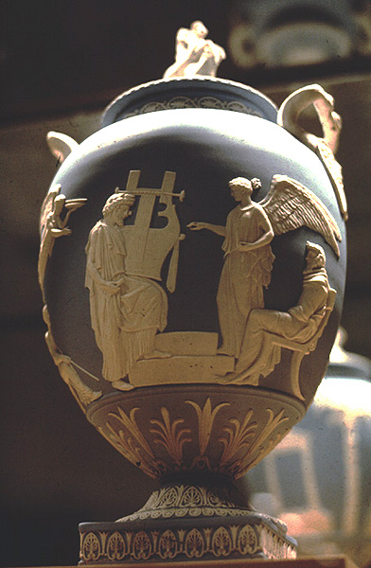
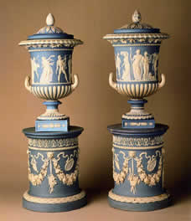
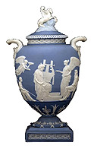
Josiah Wedgwood
Greek vases found in excavations became models for this new type of ceramics.

Slide 35
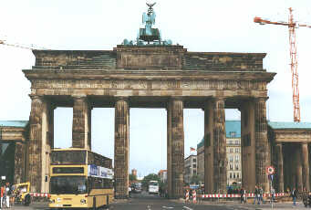
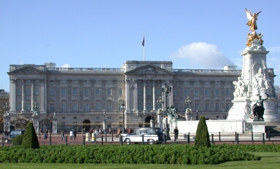
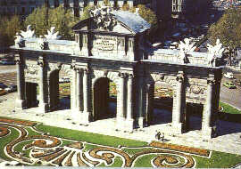
Neo-Classicism Continued Into the 19c and Beyond….
Brandenburg Gate, Berlin
Buckingham Palace, London
The Gate of Alcala, Madrid
By the mid-19s, several European cities were transformed into veritable museums of Neo-Classical architecture.

Slide 36
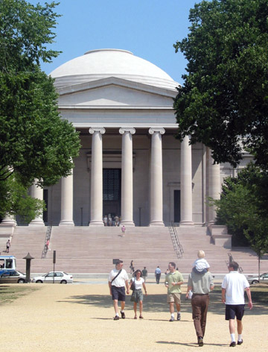
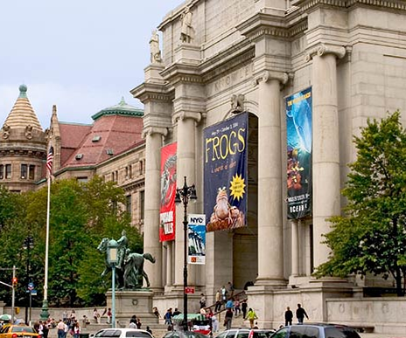
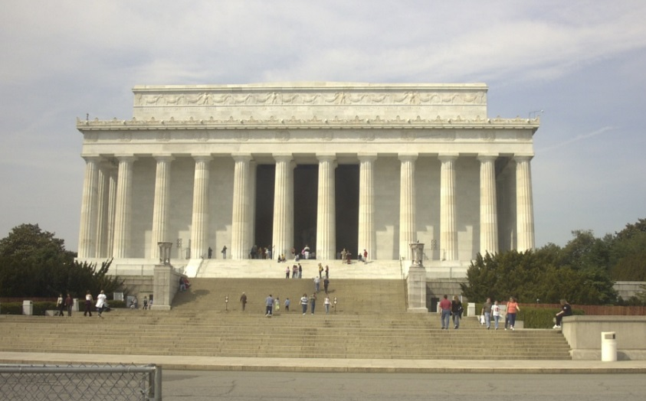
American Renaissance” Movement
American Museum of Natural History
National Gallery of Art
Lincoln Memorial
A Neo-Classical expression in Beaux-Arts architecture.

Slide 37
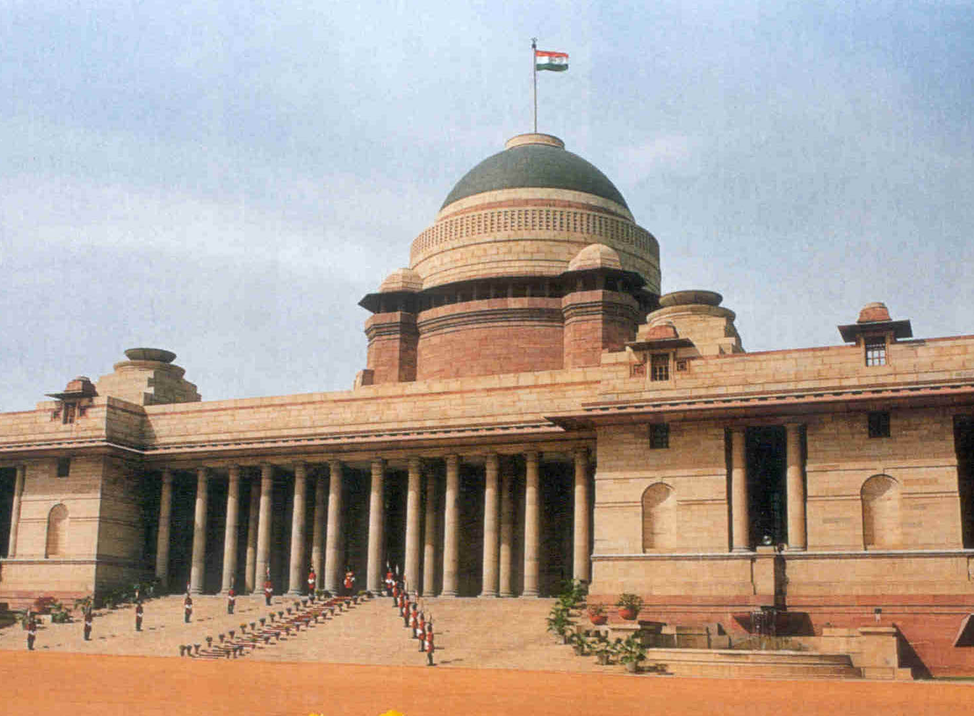
The “Sunset” of Neo-Classicism
Sir Edwin Lutyan → a monumental city plan for New Delhi during the British Raj.
Rashtrapati Bhavan [President’s House]
India Gate Monument

