Slide 1
Period 3: 1815 CE – 1914 CE
National Movements
and Unifications
© Morgan AP Teaching

Slide 2
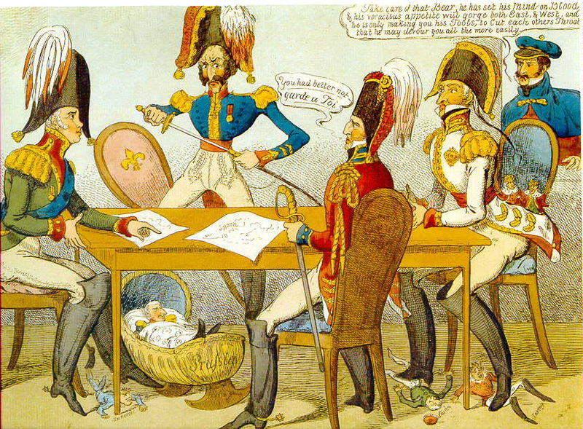
© Morgan AP Teaching
Crimean War - 1853
Until 1853, European power had more or less coordinated to maintain the Concert
of Europe, until the British and French became concerned with a growing Russia
Despite European efforts to chase the Ottoman Empire out of Europe
in the 17th century, Western Europeans now favored keeping the
Ottoman Empire in tact to prevent Austrian and Russia expansion
Despite aided during 1848, the Russians received no aid from Austria or
Prussia when the British & French allied with the Turks against Russia in 1853
Despite easily overwhelming the Ottoman Empire, Russian forces
were no match for the industrialized Anglo-French armies
The Crimean War not only ended the cooperative Concert, but it also
exposed Russia’s lack of development, and would force further reforms

Slide 3
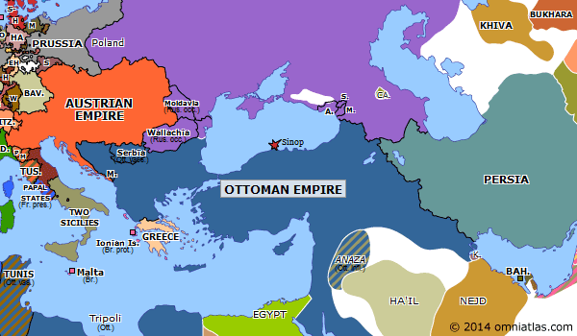
Eastern European Empires - 1850

Slide 4
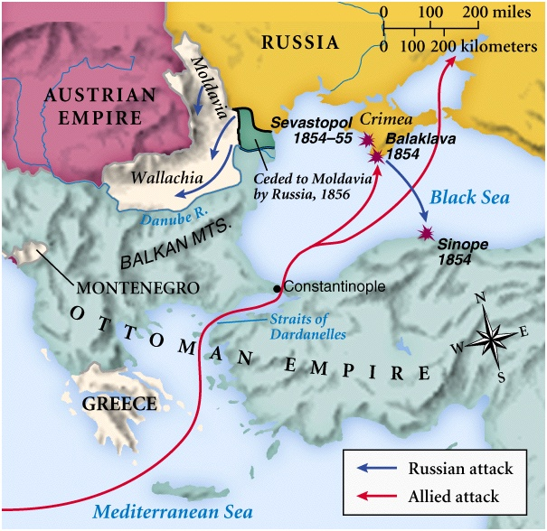
Crimean Conflict

Slide 5
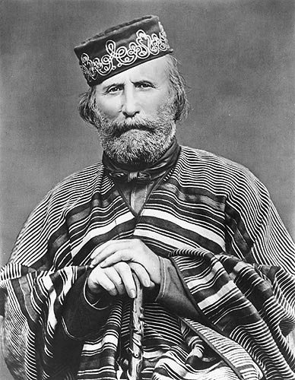
© Morgan AP Teaching
Unification of Italy (1858-1871)
With the Crimean War essentially ending the Concert of Europe, the door was opened for nationalist movements without fear of foreign intervention
Count Cavour of Italy would be one of the first to move for a complete re-unification of the long-separated Italian states
To do this, however, the separate govs. in Italy would have to be convincedor conquered, Austria driven out, and the Italian nation unified by force
With the support of Italian citizens and the French, Cavour used the state of Piedmont to united and fight for unification vs. Austria-Hungary in the North
In the south Giuseppe Garibaldi, swept through the south with a small army,
and the two met in the middle to shake hands and unify Italy in 1860
While the pebble states would hold out against unification
until 1871, the vast majority of Italy would be united by 1860

Slide 6
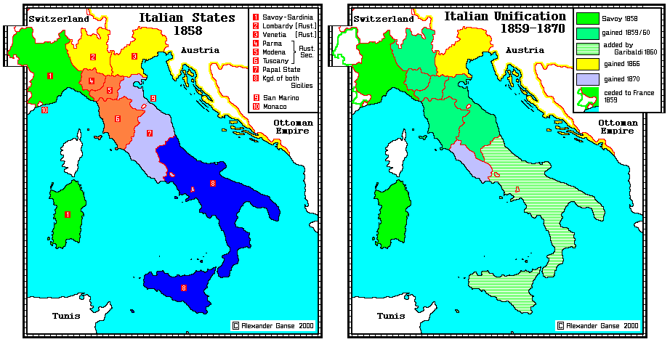
Italian States in 1858 and 1870

Slide 7
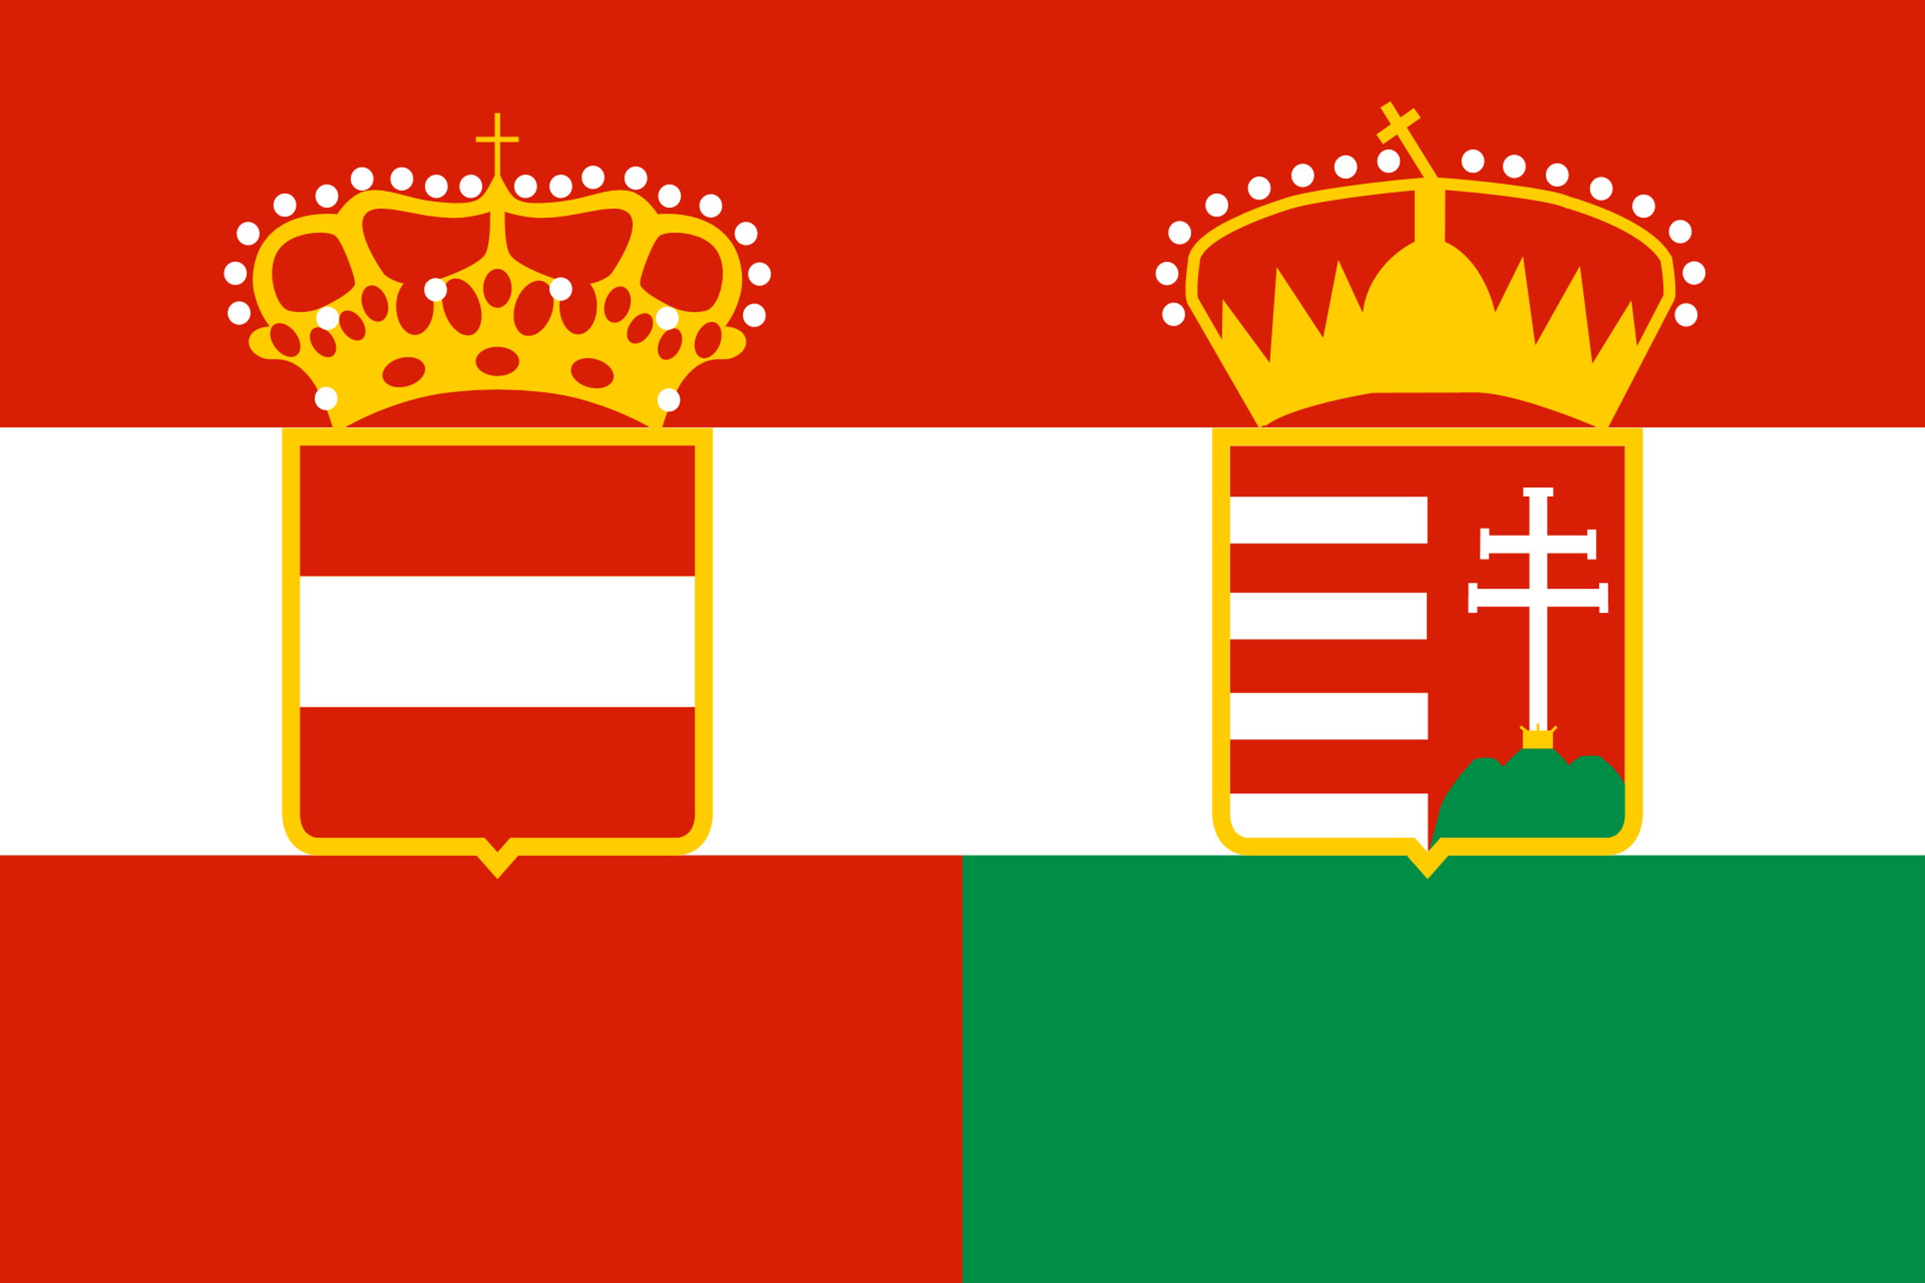
© Morgan AP Teaching
Dual Monarchy in Austria
After the Concert ended, Austria was left on its own to fight the separatist
will of the Hungarians (ethnic Magyars) and Slavs within its empire
With conflicts and revolts growing too frequent in the 1850s
& 1860s, the Austrian royal government made a compromise
Known as the dual monarchy, the Austrian Empire now shared its name with the
Kingdom of Hungary and treated as equals and shared the name Austria-Hungary
The Hungarians functioned autonomously as their own kingdom, and the
area known as Croatia-Slovenia was also considered an autonomous region
However, both the Hungarians and Slavs agreed to still cooperate with the Austrians in terms of war and foreign policy
Things would never remain internally peaceful, however, for Austria-Hungary, as the German populations of Austria in
the Magyar populations of Hungary both attempted to Germanize and Magyarize Slavic and Romanian inhabitants
Driven by their own nationalist fervor, Slavic and Romanian populations resisted attempts
to wash over their language and culture by replacing it with German or Magyar

Slide 8
Austrian & Ottoman Empires 1850

Slide 9
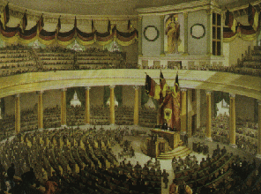
© Morgan AP Teaching
German Unification Attempts
In the mid 19th century, Germans had also attempted to unify common, German states
Germany however was a bit more divided than the Italians—most Germans
in the North were Protestant, while Southern Germans tended to be Catholic
In 1850, leaders of the German states had already attempted to unify with a constitutional mon. at the Frankfurt Parliament (just a meeting at Frankfurt)
Along with disagreements b/w North and Southern Germans, the crown of emperor of Germany, the leader of Prussia dismissed the offer as an offer for the ‘Emperor of Dirt’
While there was no official union, the Northern Protestant German states
did semi-unify under the Northern German Confederation in 1866

Slide 10
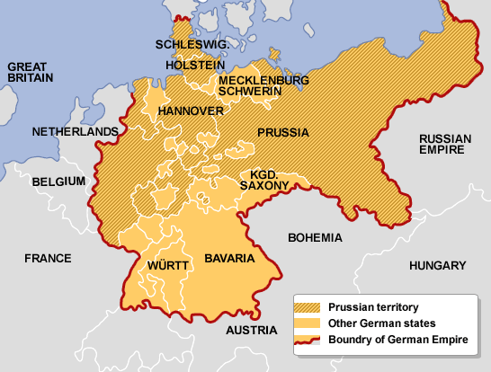
German Areas - 1870

Slide 11
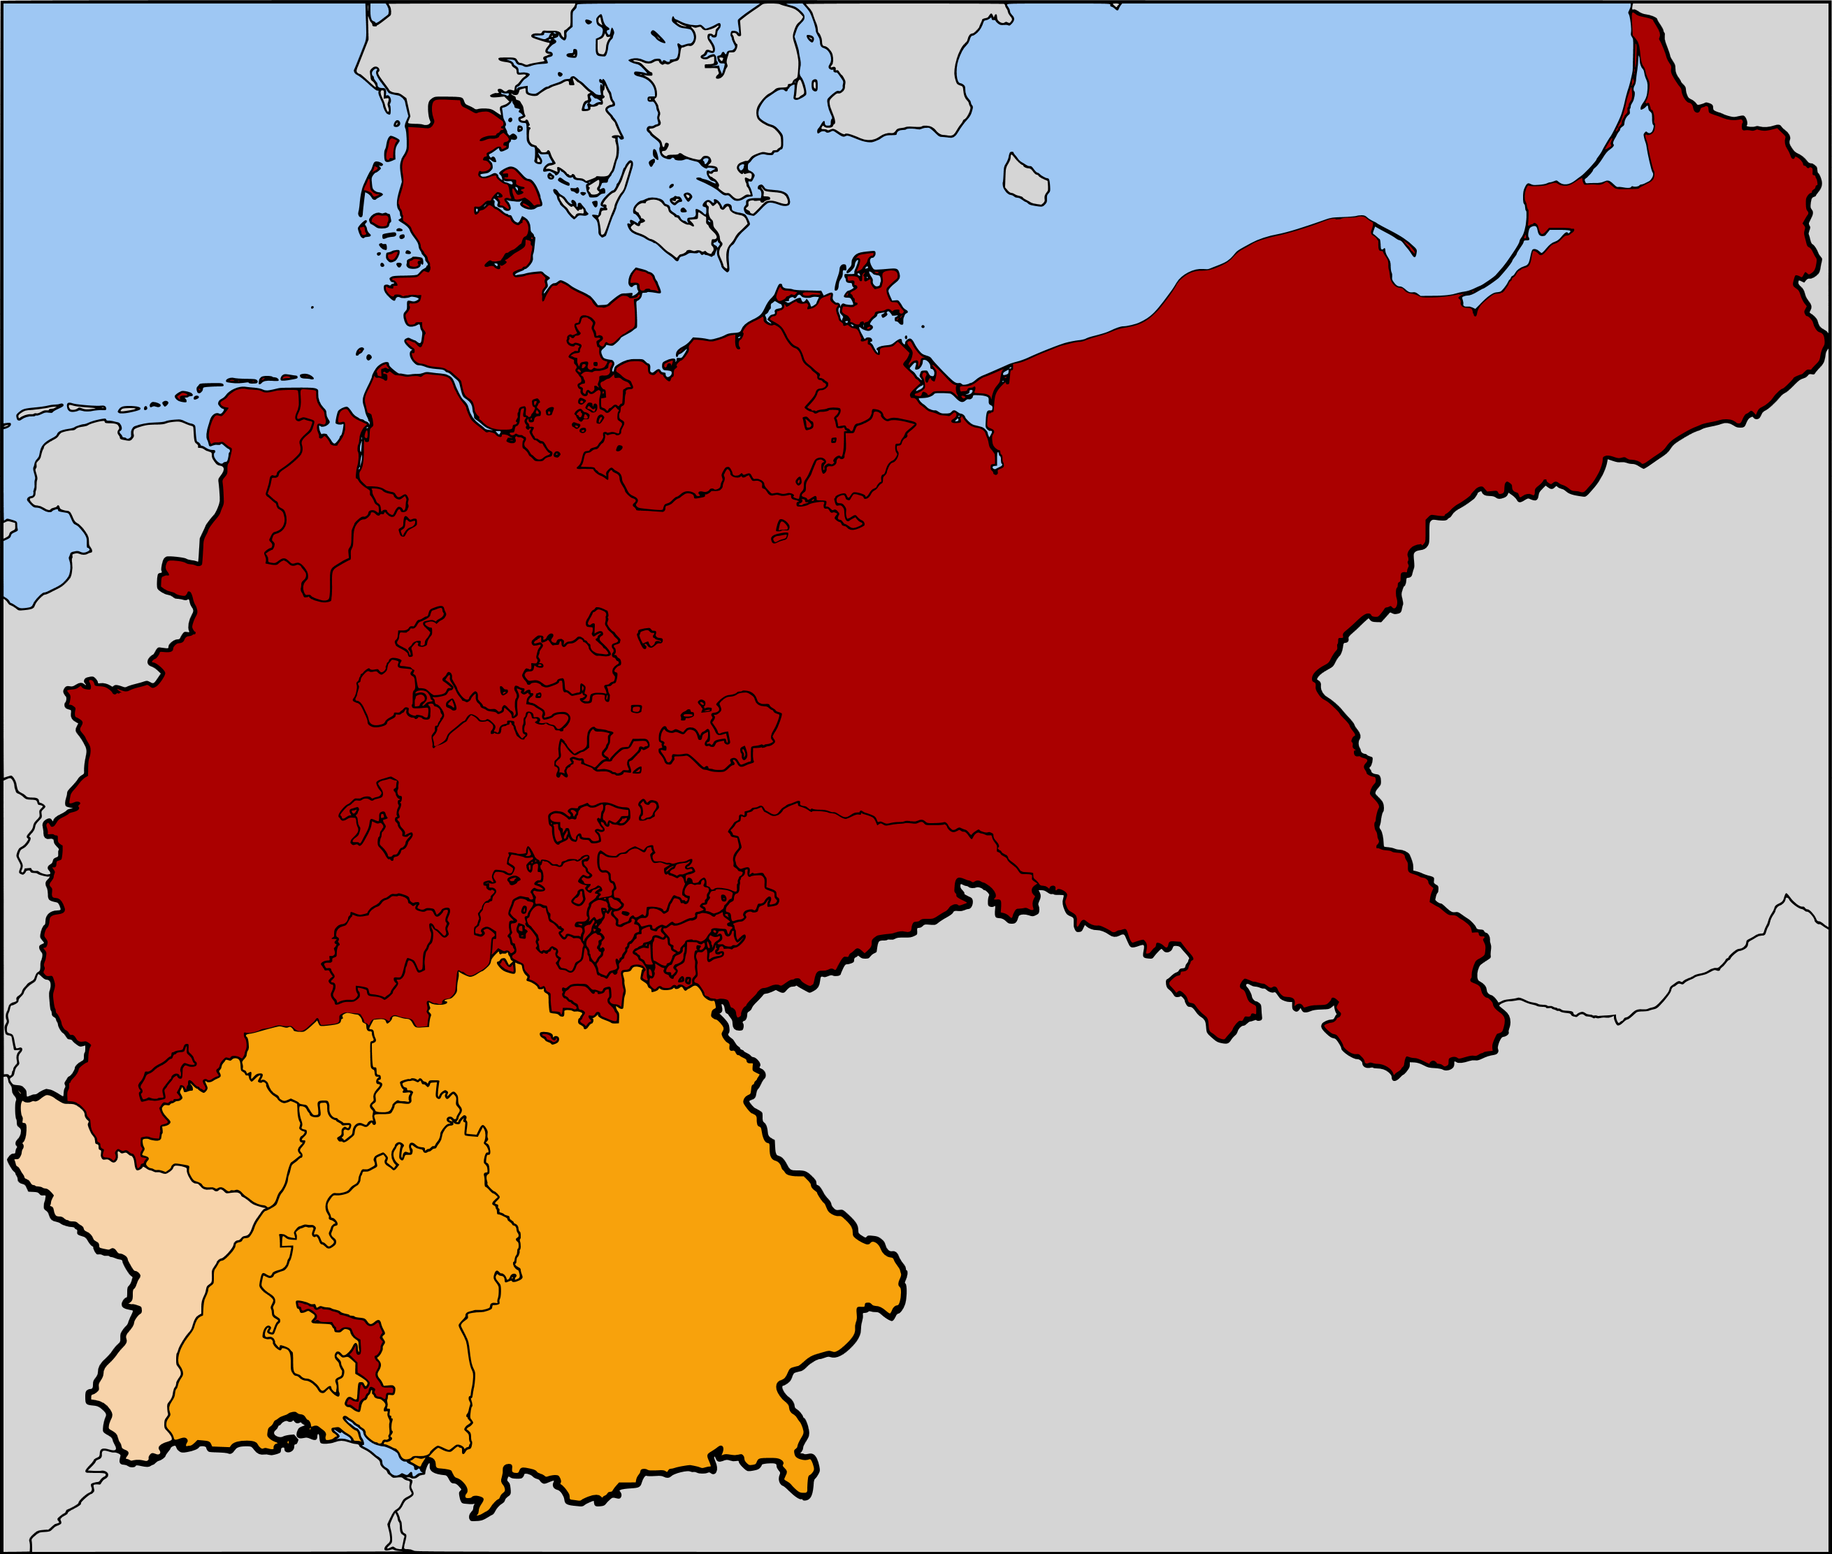
Northern German Confederation (red) in 1870 and the southern German states (yellow)

Slide 12
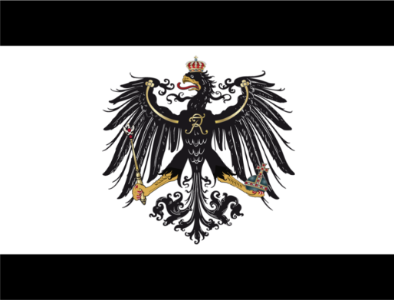
© Morgan AP Teaching
German Unification
While the Northern German Confederation was already operating close to a unified
country, it would take the threat of another Napoleon (III) to unify all the German states
This unification would come under the leadership of the strongest Germany
state Prussia, when disputes over territory would result in war with France
Fearing another French conquest of German lands under Napoleon III, the southern German states were convinced to join Prussia and the Northern German Confederation
Within 5 months, French armies were overrun, humiliated and defeated by superior German forces and coordination (and largely aided by the railroad system and economic cooperation of the previously-established Zollverein), and Paris occupied by the Prussians
Known as the Franco-Prussian War, hostilities between France and Germany were soundly established at the German annexation of Alsace-Lorraine in eastern France
Following their success, the German Empire officially announced its formal beginning from Paris in 1871 with Prussian statesmen at the helm, and the King of Prussia as Emperor

Slide 13
