Slide 1
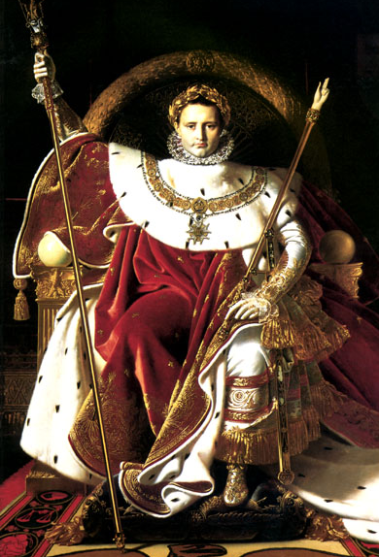
“Napoleon on His Imperial Throne”
1806
By Jean Auguste Dominique Ingres

Slide 2
Napoleon’s Downfall
The Continental System
The Peninsula War
Invasion of Russia

Slide 3
The Continental System
Berlin Decrees (1806)
British ships were not allowed in European ports.
“Order in Council” (1806)
Britain proclaimed any ship stopping in Britain would be seized when it entered the Continent.
Milan Decree (1807)
Napoleon proclaimed any ship stopping in Britain would be seized when it entered the Continent.
WAR OF 1812

Slide 4
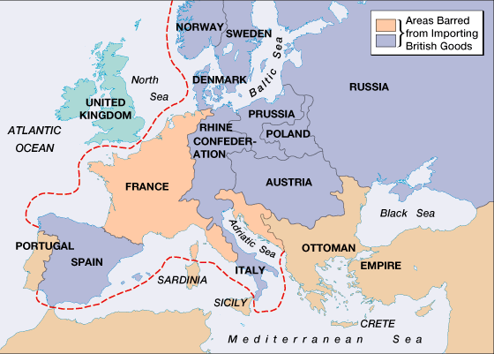
The Continental System

Slide 5
British Cartoon

Slide 6
Napoleon’s Divorce Statement (1807)
Far from ever finding cause for complaint, I can to the contrary only congratulate myself on the devotion and tenderness of my beloved wife. She has adorned thirteen years of my life; the memory will always remain engraved on my heart.

Slide 7
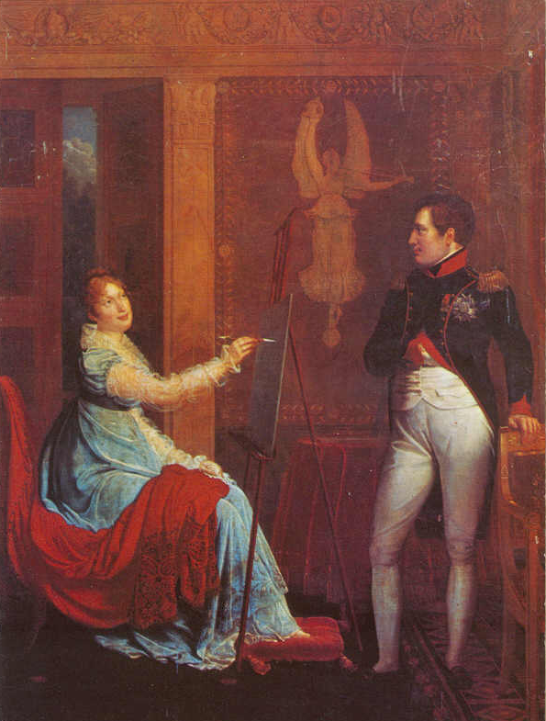
Marie Louise (of Austria) married Napoleon on March 12, 1810 in Vienna

Slide 8
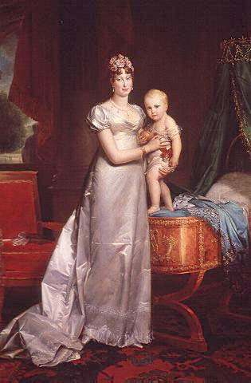
Marie Louise (of Austria) with Napoleon’s Son
(Napoleon Francis Joseph Charles: 1811-1832)

Slide 9
Peninsular War: 1807-1810
Continental System
1806:
France
Spain Portugal
Portugal did not comply with the Continental System.
France wanted Spain’s support to invade Portugal.
Spain refused, so Napoleon invaded Spain as well

Slide 10
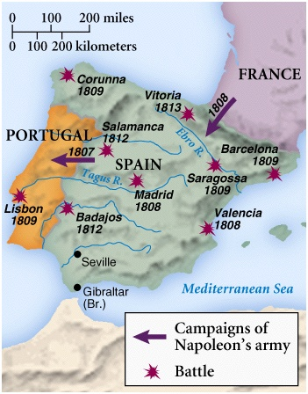
“The Spanish Ulcer”
Napoleon tricked the Spanish king and prince to come to France, where he imprisoned them.
He proclaimed his brother, Joseph, to be the new king of Spain.
He stationed over 100,000 Fr troops in Madrid.
On May 2, 1808 [Dos de Mayo] the Spanish rose up in rebellion.
Fr troops fired on the crowd in Madrid the next day [Tres de Mayo].

Slide 11
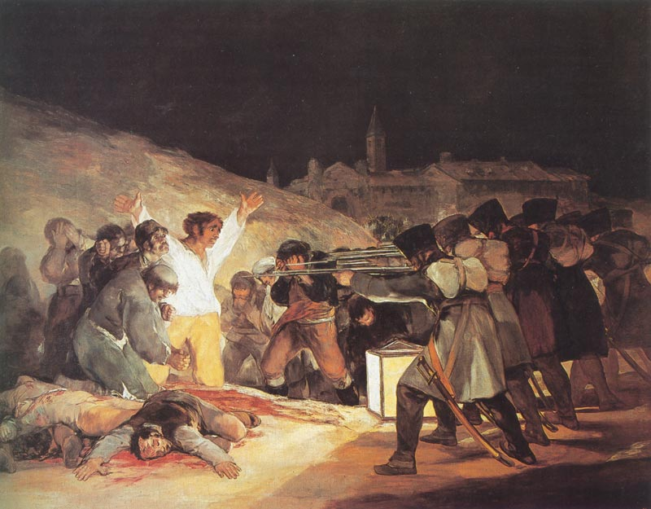
“Third of May, 1808” by Goya (1810)

Slide 12
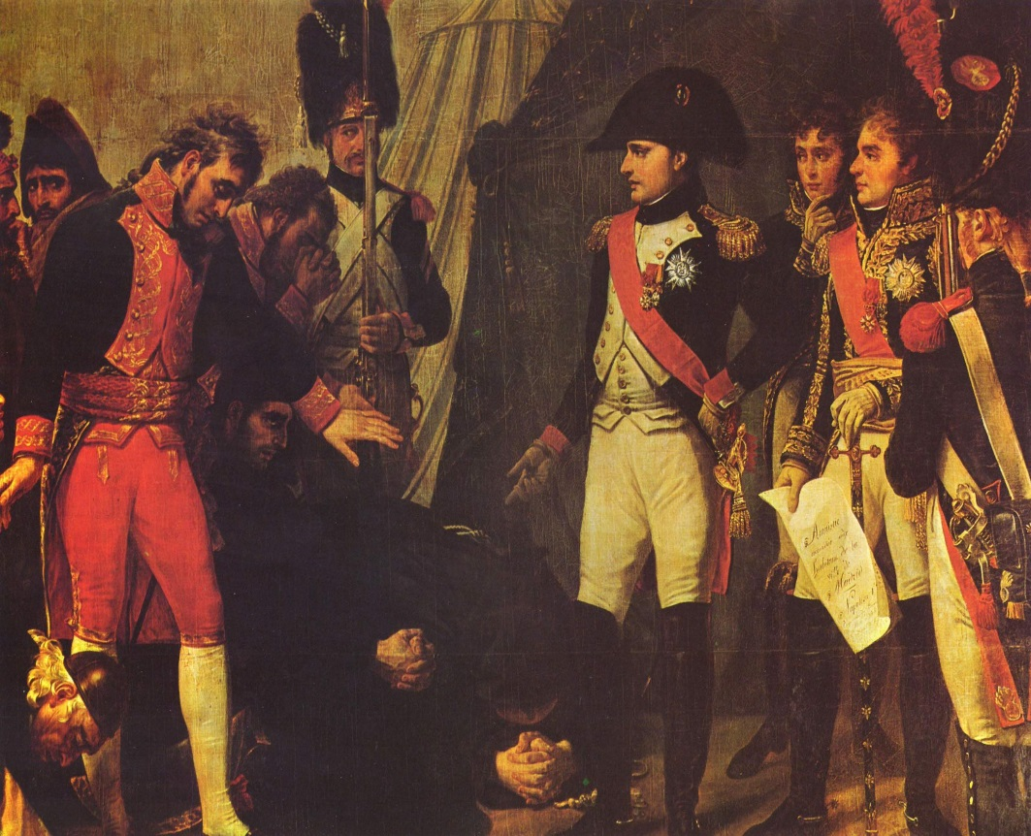
“The Spanish Ulcer”
500,000 troops
Guerrilla War
The British intervention by Arthur Wellesley
The Surrender of Madrid May, 1809 by Goya

Slide 13
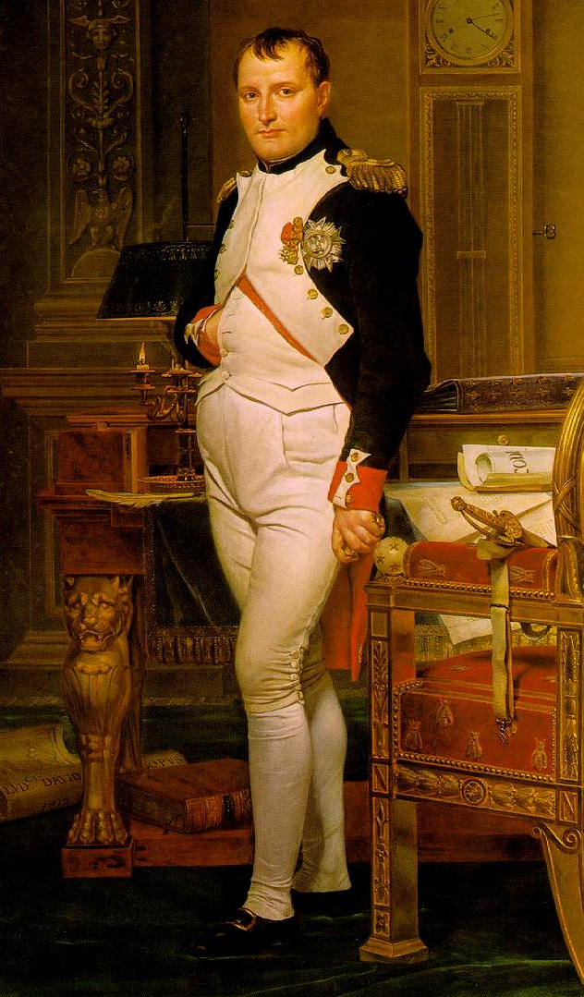
“Napoleon in His Study”
1812
by David

Slide 14
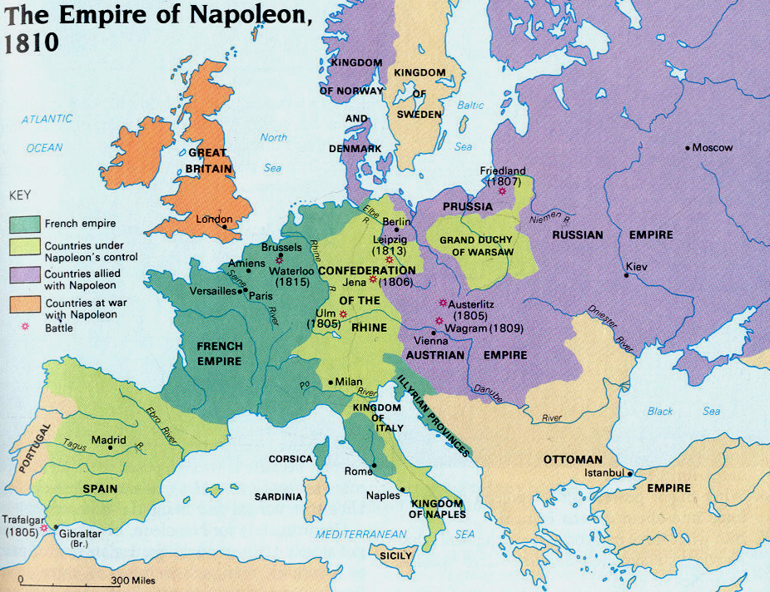
Napoleon’s Empire in 1810

Slide 15
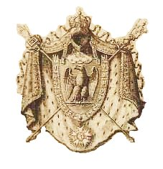
Napoleon’s Family Rules!
Jerome Bonaparte → King of Westphalia.
Joseph Bonaparte → King of Spain
Louise Bonaparte → King of Holland
Pauline Bonaparte → Princess of Italy
Napoleon Francis Joseph Charles (son)→ King of Rome
Elisa Bonaparte → Grand Duchess of Tuscany
Caroline Bonaparte → Queen of Naples

Slide 16
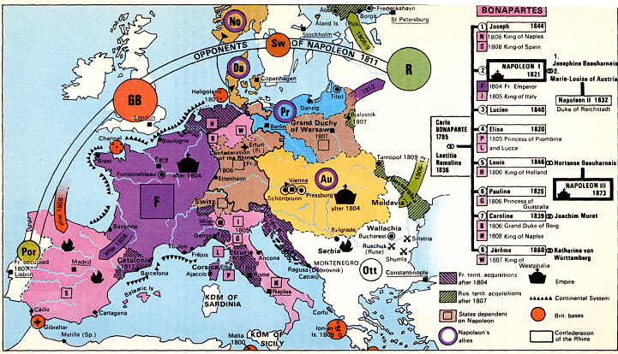
Napoleon’s Family & Friends/Allies

Slide 17
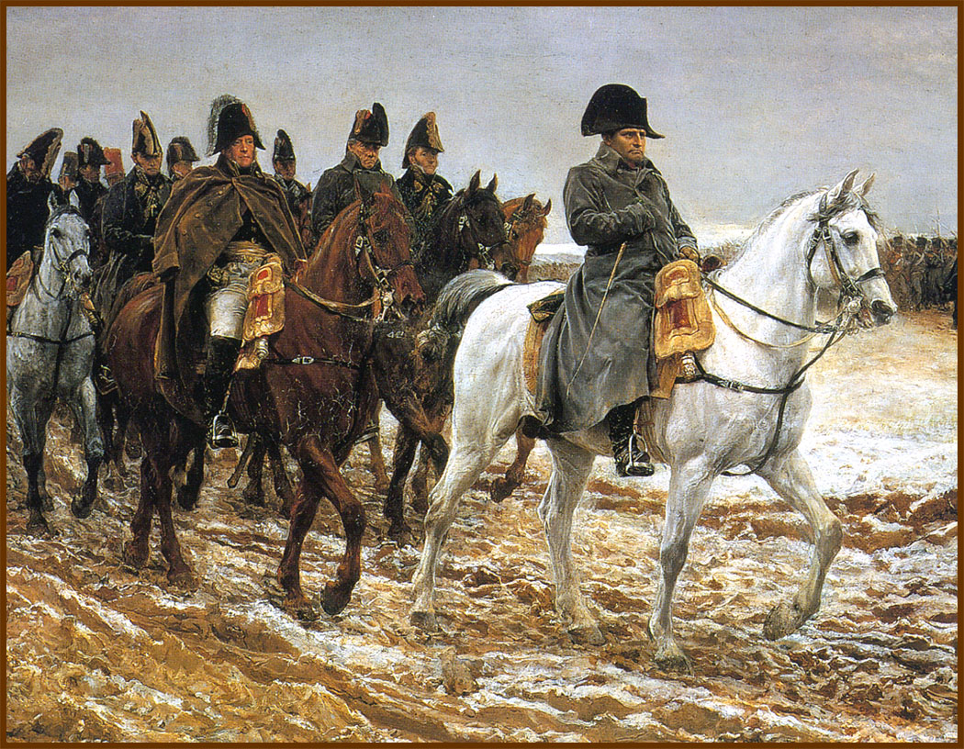
The “Big Blunder” -- Russia
In July, 1812 Napoleon led his Grand Armee of 614,000 men eastward across central Europe and into Russia.
Scorched Earth
Battle of Borodino

Slide 18
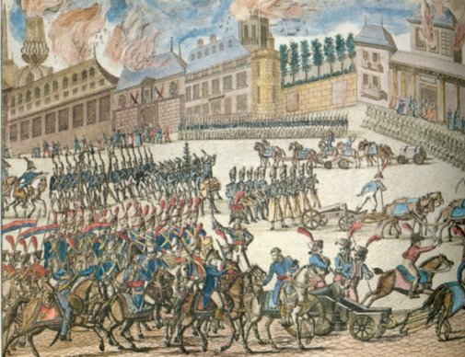
Napoleon’s Troops at the Gates of Moscow
September 14, 1812

Slide 19
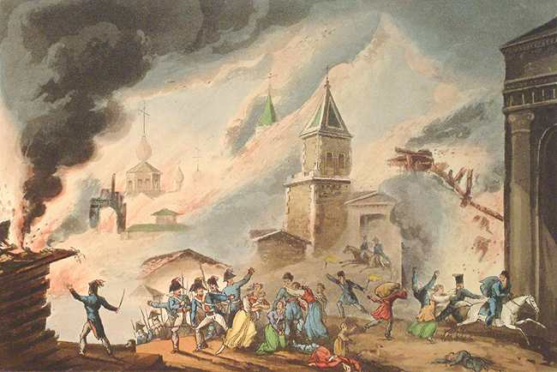
Moscow Is On Fire

Slide 20
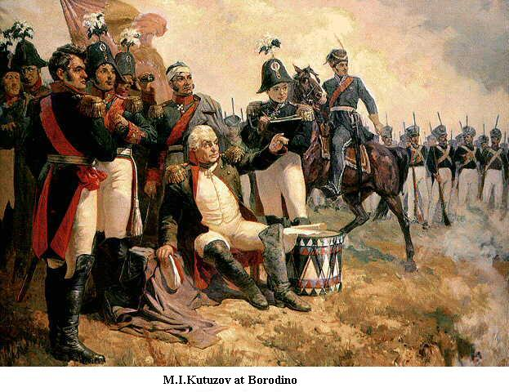
Russian General Kutuzov
Borodino

Slide 21
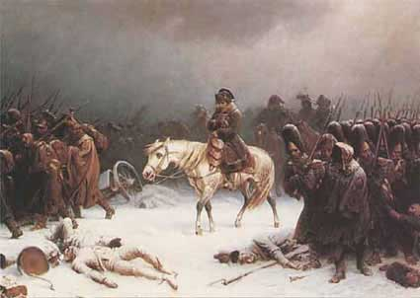
Napoleon’s Retreat from Moscow (Early 1813)

Slide 22
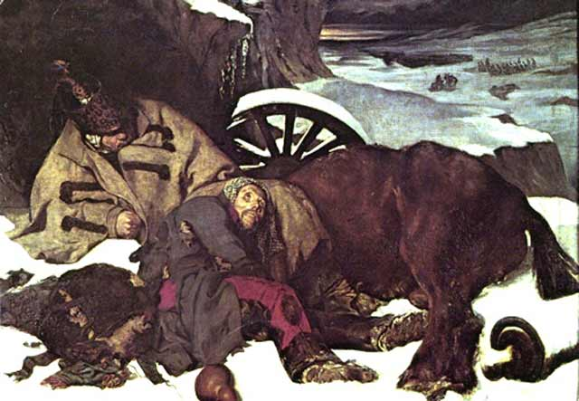
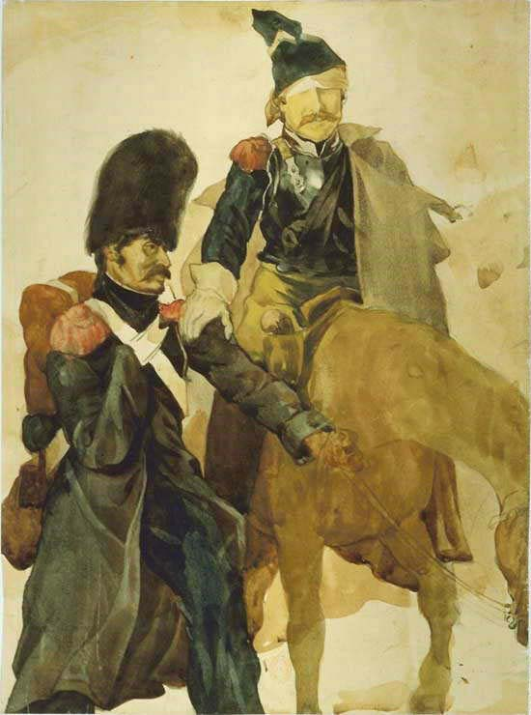
The 6th Coalition
Napoleon's Defeat
1813-1814:
France
Britain, Russia. Spain, Portugal, Prussia, Austria, Sweden, smaller German states

Slide 23
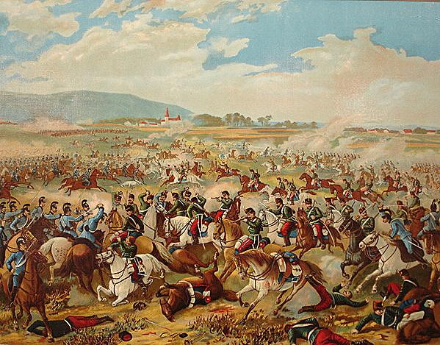
Battle of Dresden (Aug., 26-27, 1813)
Coalition: Russians, Prussians, Austrians.
Napoleon's forces regrouped with Polish reinforcements.
100,000 coalition casualties; 30,000 French casualties.
French victory.

Slide 24
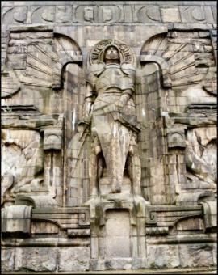
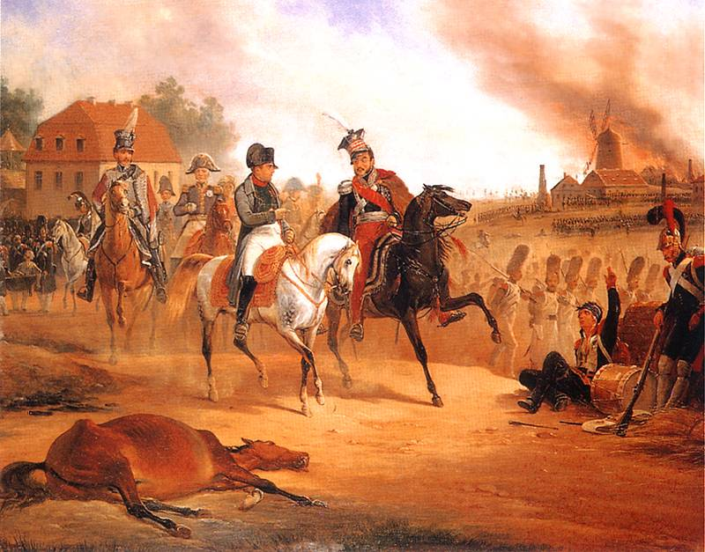
Napoleon’s Defeat at Leipzig (October 16-17, 1813)
“Battle of the Nations” Memorial

Slide 25
Napoleon Abdicates
Allied forces occupied Paris on March 31, 1814.
Napoleon abdicated on April 6 in favor of his son, but the Allies insisted on unconditional surrender.
Napoleon abdicated again on April 11.
Treaty of Fontainebleau exiles Napoleon to Elba with an annual income of 2,000,000 francs.
The Congress of Vienna restored Louis XVIII to the throne.

Slide 26
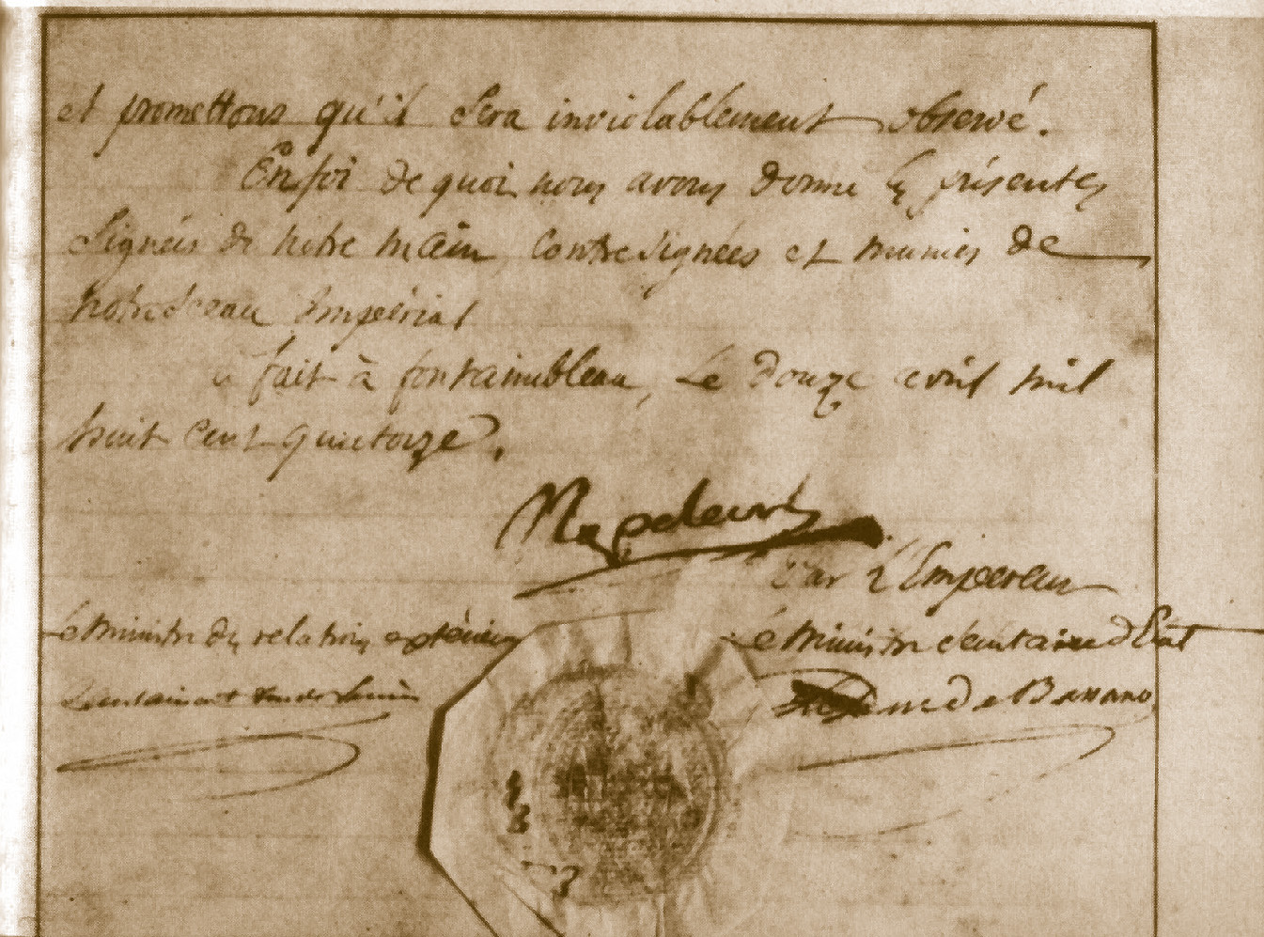
Napoleon’s Abdication

Slide 27
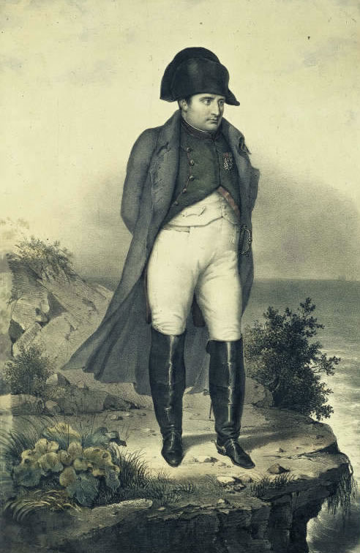
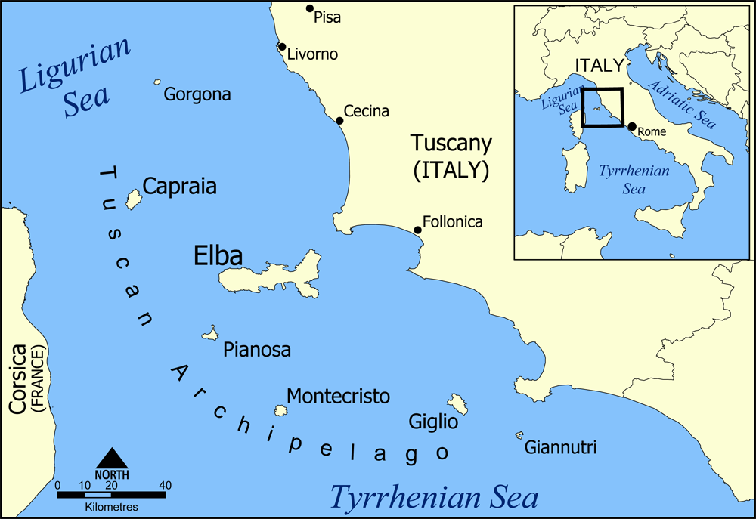
Napoleon in Exile on Elba

Slide 28
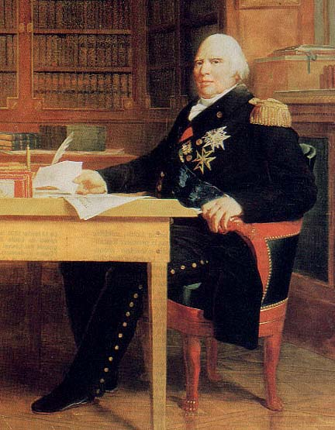
Louis XVIII (r. 1814-1824)

Slide 29
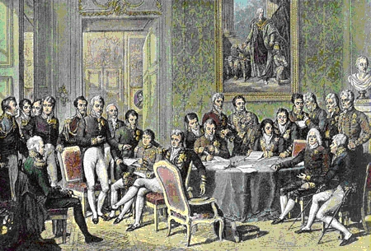
The Congress Of Vienna

Slide 30
The Hundred Days
March 20-June 22 1815

Slide 31
“The War of the 7th Coalition”
Napoleon’s “100 Days”
1815:
France
Britain, Russia. Prussia, Austria, Sweden, smaller German states
Napoleon escaped Elba and landed in France on March 1, 1815 the beginning of his 100 Days.
Marie Louise & his son were in the hands of the Austrians.
Klemens Von Metternich

Slide 32
Klemens Von Metternich

Slide 33
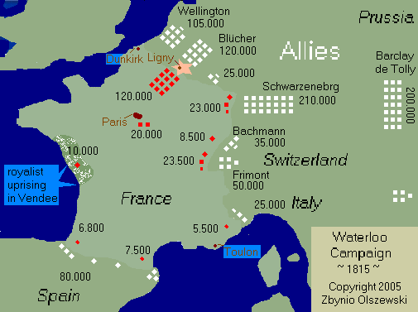
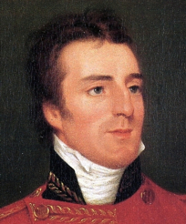
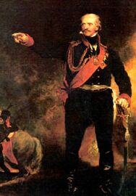
Napoleon’s Defeat at Waterloo (June 18, 1815)
Duke of Wellington
Prussian General Blücher

Slide 34
The Battle of Waterloo

Slide 35
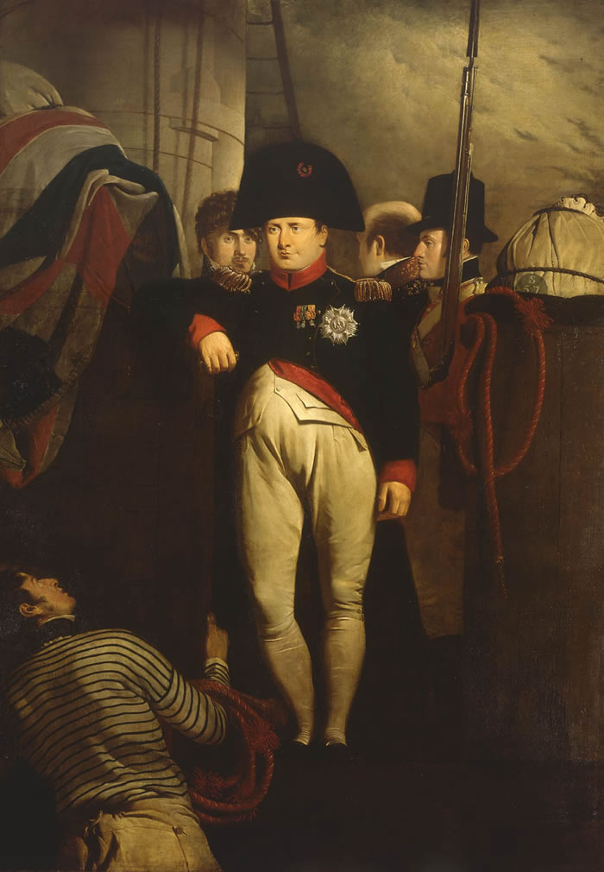
Napoleon on His Way to His Final Exile on St. Helena

Slide 36
St. Helena

Slide 37
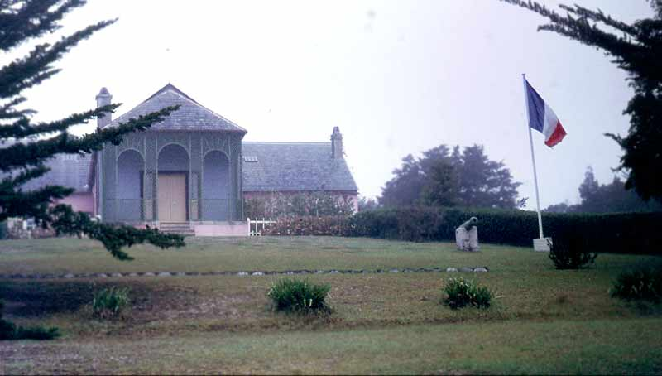
Napoleon’s Residence on St. Helena

Slide 38
Napoleon in Exile

Slide 39
The Death of Napoleon

Slide 40
Death Mask

Slide 41
Napoleon’s Tomb

Slide 42
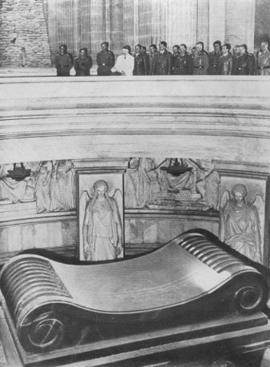
Hitler Visits Napoleon’s Tomb
June 28, 1940

Slide 43
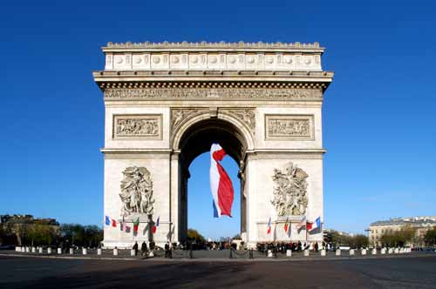
The Arc de Triumph

Slide 44
What is Napoleon’s Legacy?

