Slide 1
The
Northern
Renaissance

Slide 3
Renaissance Art in Northern Europe
Should not be considered an appendage to Italian art.
But, Italian influence was strong.
Painting in OIL, developed in Flanders, was widely adopted in Italy.
The differences between the two cultures:
Italy → change was inspired by humanism with its emphasis on the revival of the values of classical antiquity.
No. Europe → change was driven by religious reform, the return to Christian values, and the revolt against the authority of the Church.
More princes & kings were patrons of artists.

Slide 4
Characteristics of Northern Renaissance Art
The continuation of late medieval attention to details.
Tendency toward realism & naturalism [less emphasis on the “classical ideal”].
Intensely religious scenes & messages
Interest in landscapes.
More emphasis on middle-class and peasant life.
Details of domestic interiors.
Great skill in portraiture.

Slide 5
The Most
Exemplary
Work

Slide 6
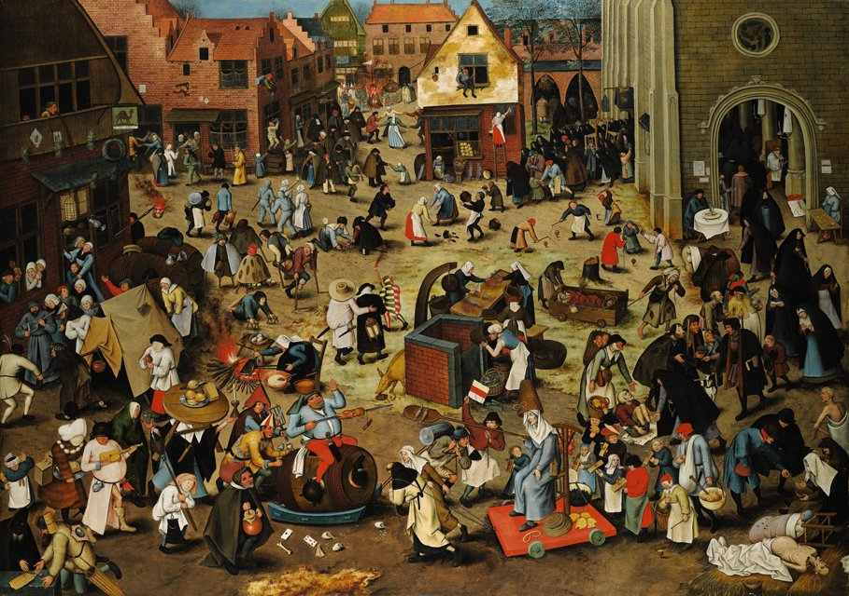
Pieter Bruegel’s, The Battle between Carnival and Lent, 1559

Slide 7
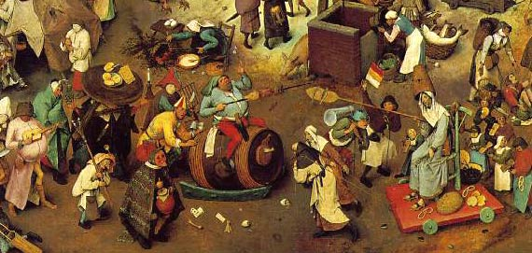
Pieter Bruegel’s, The Battle between Carnival and Lent, 1559 –detail

Slide 8
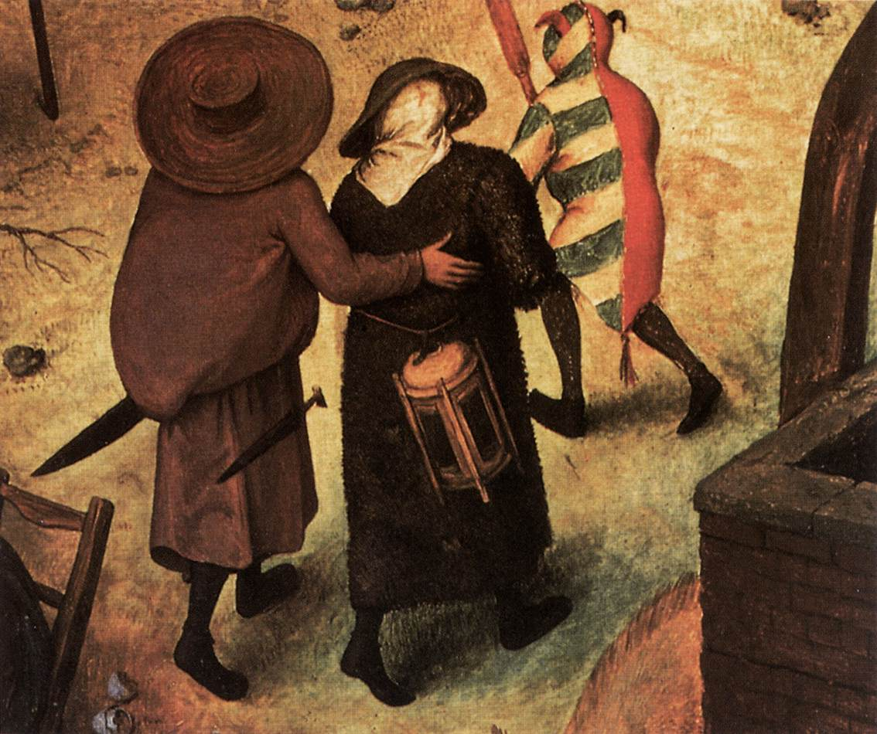
Pieter Bruegel’s, The Battle between Carnival and Lent, 1559 –detail

Slide 9
Honorable
Mention

Slide 10
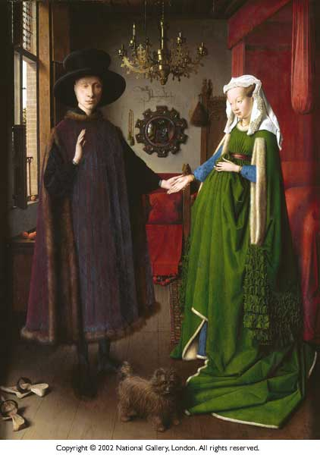
Giovanni Arnolfini and His Wife (Wedding Portrait) Jan Van Eyck 1434

Slide 11
Jan van Eyck - Giovanni Arnolfini & His Wife (details)

Slide 12
Albrecht Dürer Four Horsemen of the Apocalypse woodcut, 1498

Slide 13
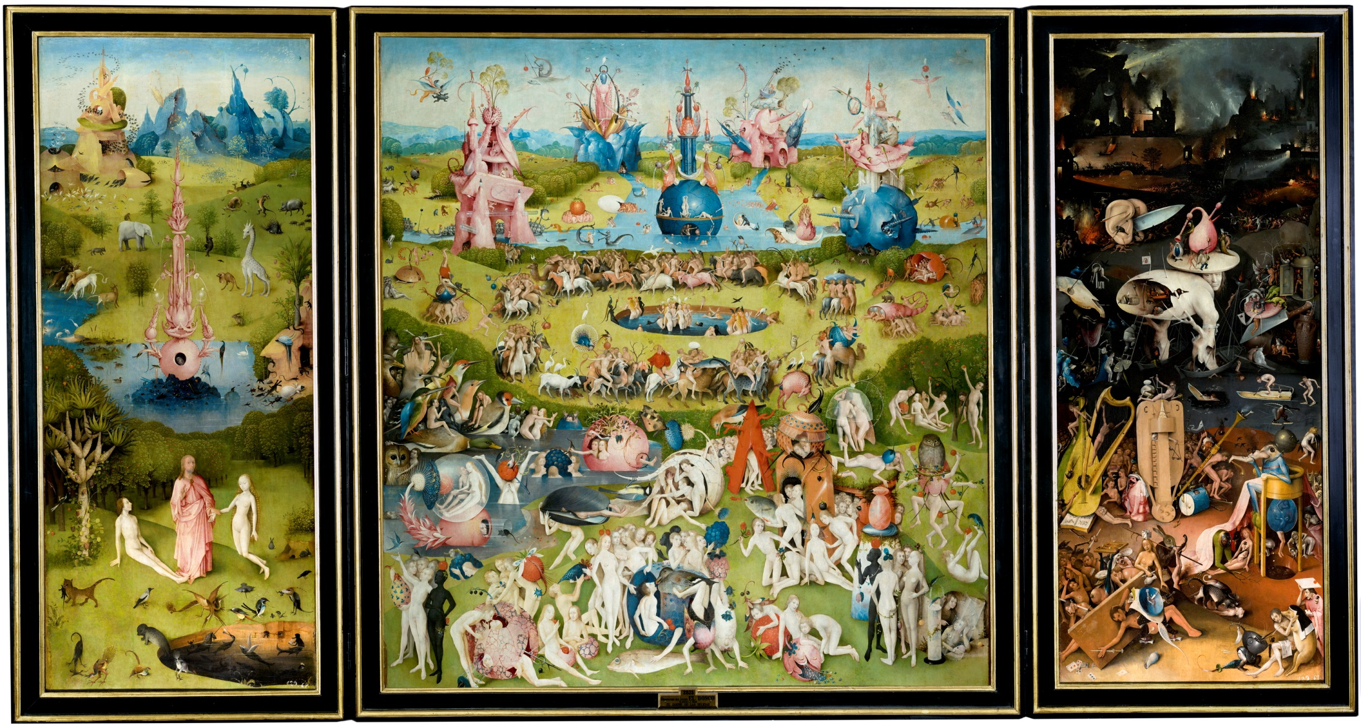
Hieronymus Bosch, The Garden of Earthy Delights, 1500

Slide 14
Hieronymus Bosch The Garden of Earthy Delights (details) 1500

Slide 15
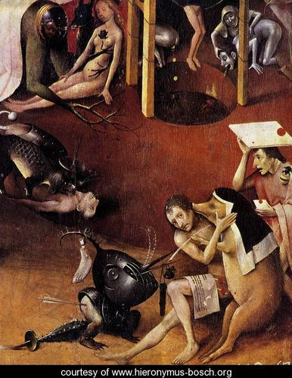
Hieronymus Bosch The Garden of Earthy Delights (details) 1500

Slide 16
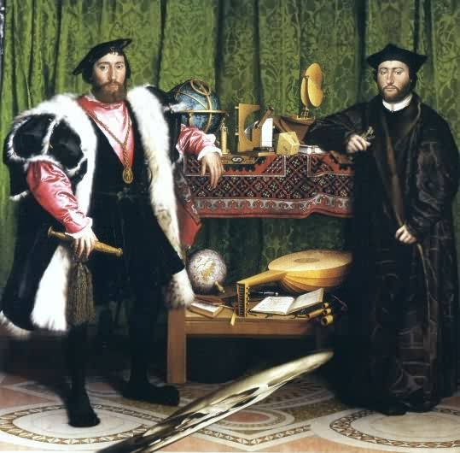
Holbein’s, The Ambassadors, 1533
A Skull

Slide 17
Multiple Perspectives

Slide 18
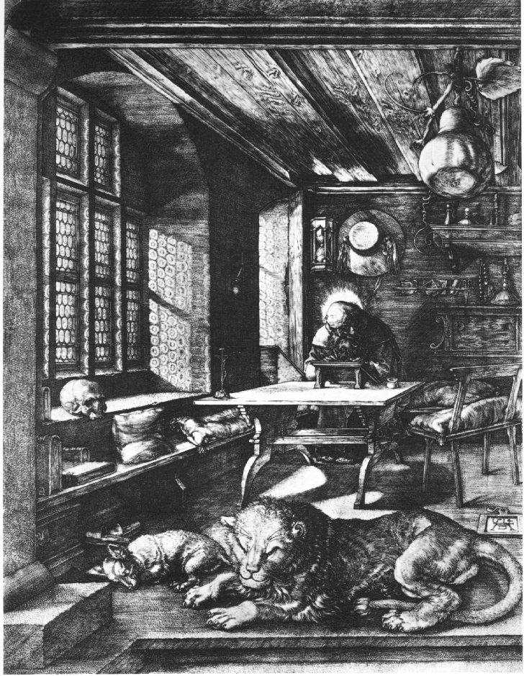
Dürer St. Jerome engraving, 1514

