Slide 1
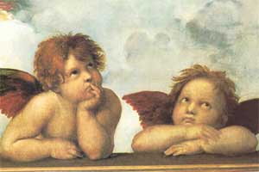
Mannerism
(1520-1600)

Slide 2
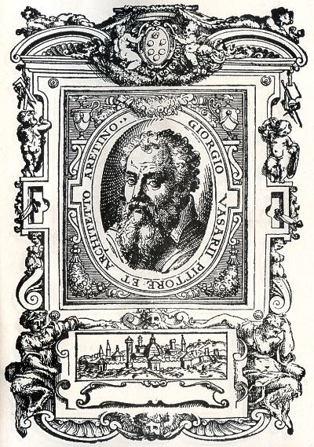
The Changing Role of the Artist
Giorgio Vasari’s Lives of the Artists, 1568.
He believed that the artist was no longer just a member of a crafts guild.
The artist was an equal in the courts of Europe with scholars, poets, and humanists.
Therefore, the artist should be recognized and rewarded for his unique artistic technique [maneria].

Slide 3
Background
Late Renaissance [Pre-Baroque].
Art was at an impasse after the perfection and harmony of the Renaissance.
Antithetical to the principles of the High Renaissance.
From the Italian de maneria.
A work of art done in the artist’s characteristic “touch” or recognizable “manner.”
First used by the German art historian, Heinrich Wölfflin in the early 20c.
Influenced by Michelangelo’s later works.

Slide 4
Michelangelo’s “Last Judgment” (Sistine Chapel)

Slide 5
Michelangelo’s “Last Judgment” (Sistine Chapel – left side)

Slide 6
Michelangelo’s “Last Judgment” (Sistine Chapel – right side)

Slide 7
Features
of
Mannerism

Slide 8
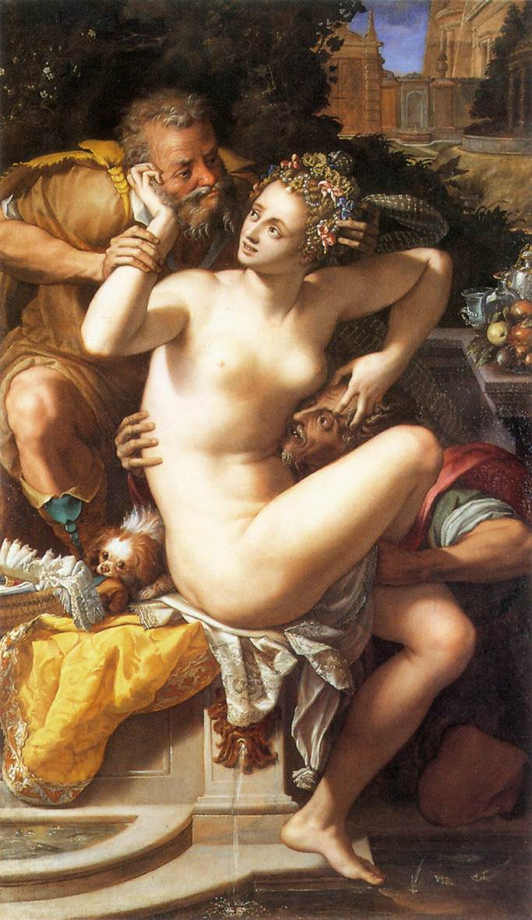
1. Replace Harmony With Dissonance & Discord
“Susanna & the Elders”
Alessandro Allori
Twisted bodies or “weight shift” [contrapposto]

Slide 9
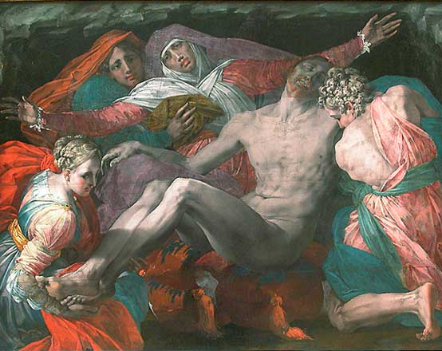
2. Replace Reason with Emotion
“Pietà” by Rosso Fiorentino
1530-1540

Slide 10
“Pietà” by El Greco
1587-1597

Slide 11
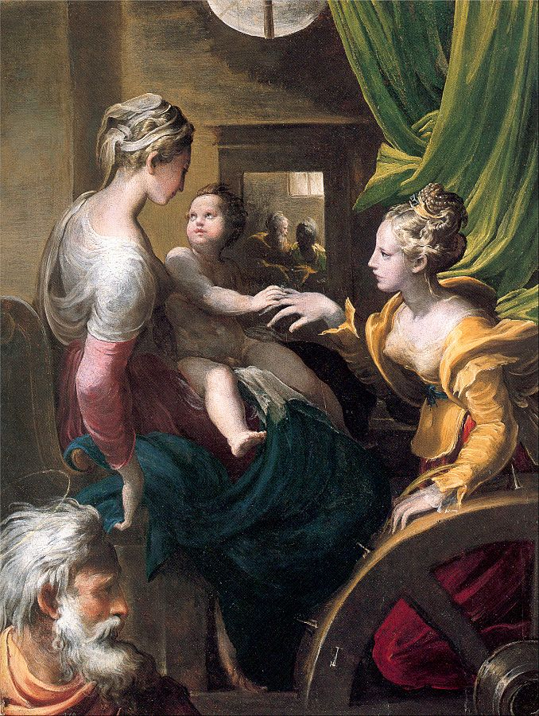
3. Replace Reality with Imagination
“The Mystic Marriage of St. Catherine”
Parmigianino
1525-1527

Slide 12
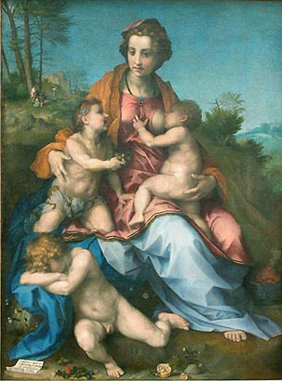
“Charity”
Andrea del Sarto
1518
An allegory of the French royal family.

Slide 13
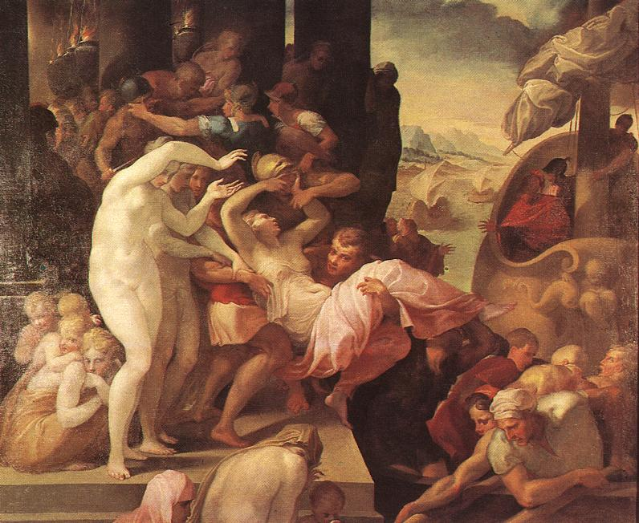
4. Create Instability Instead of Equilibrium
“The Rape of Helene”
Francesco Primaticcio
1530-1539

Slide 14
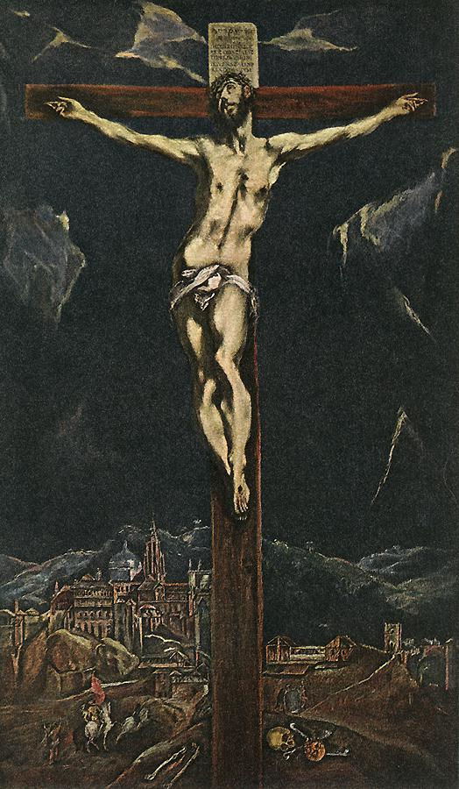
5. Bodies Are Distorted
“Christ in Agony on the Cross”
El Greco
1600s.
An attempt to express the religious tensions of the times.

Slide 15
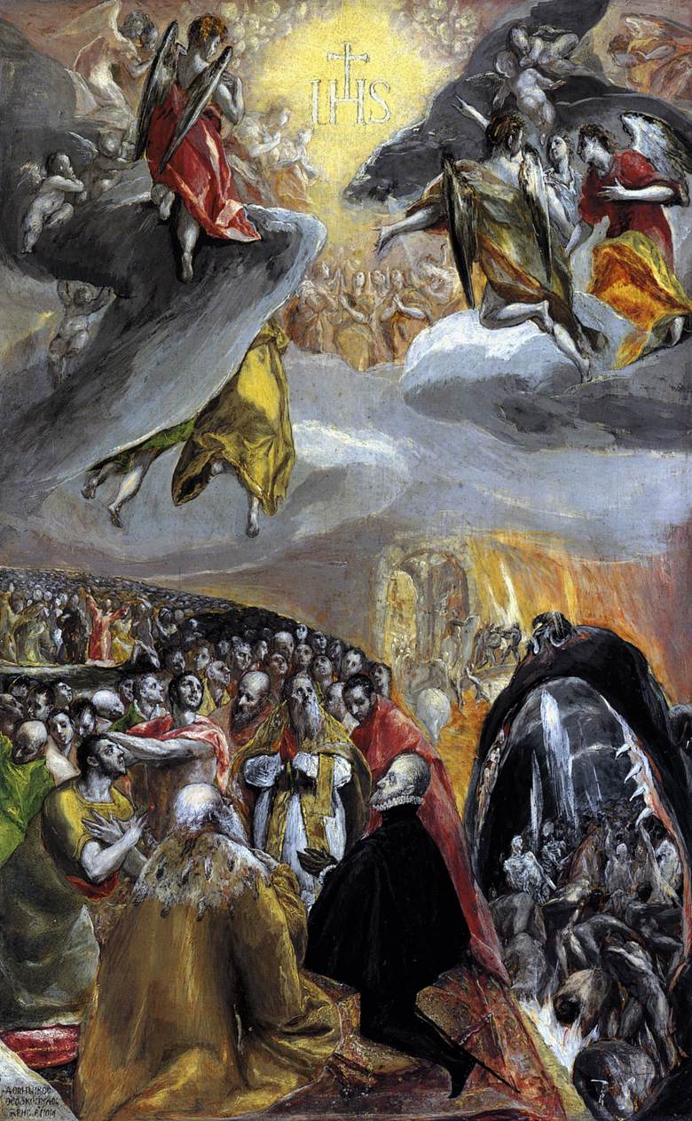
“Adoration of the Name of Jesus”
El Greco
1578-1580.

Slide 16
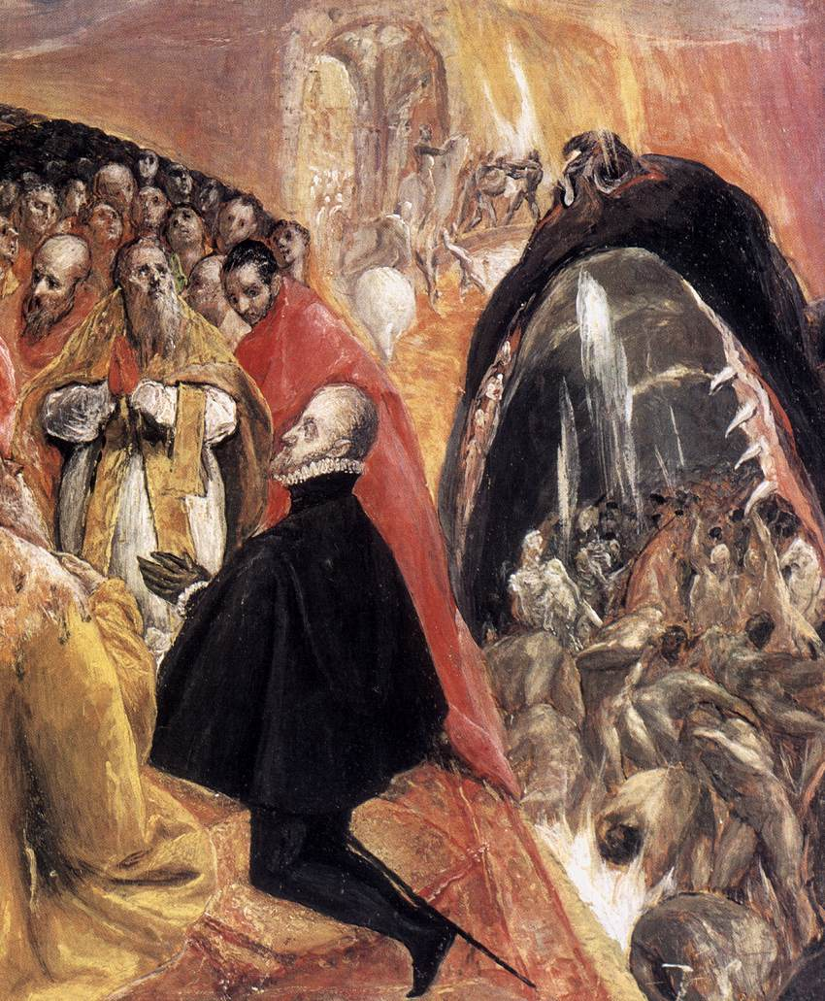
“Adoration of the Name of Jesus” (details)
Philip II of Spain
El Greco
1578-1580

Slide 17
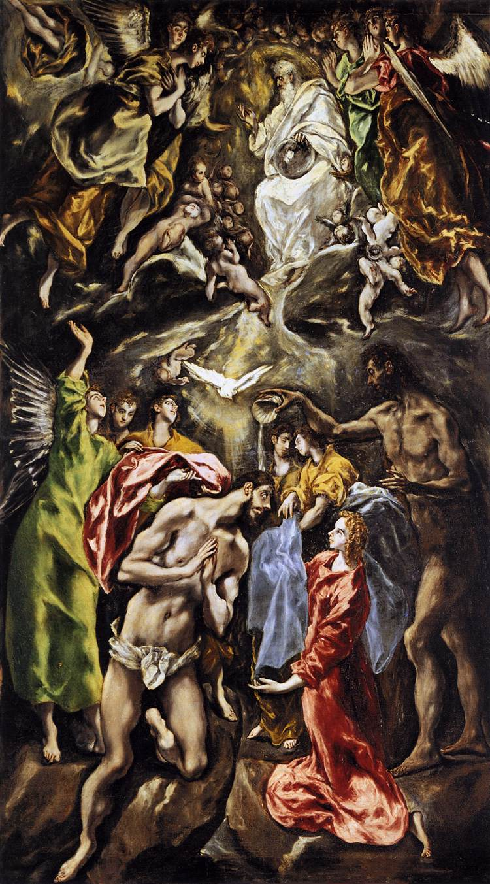
“The Baptism of Christ”
El Greco
1608-1628.

Slide 18
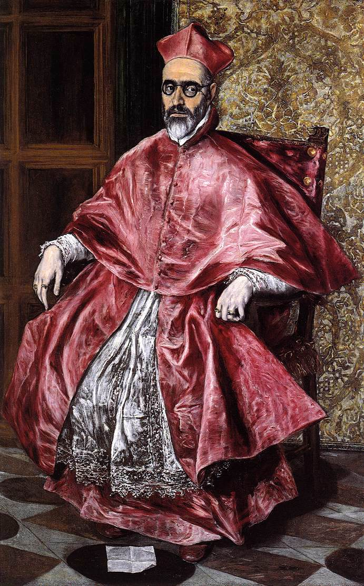
“Portrait of a Cardinal”
El Greco
1600

Slide 19
“St. Jerome” by El Greco
1587-1597

Slide 20
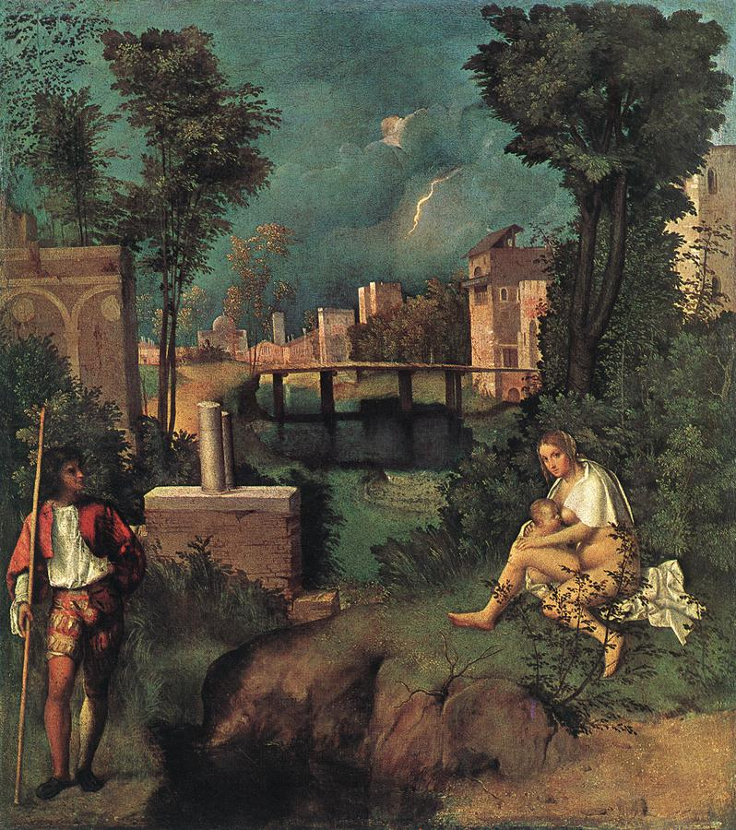
6. Colors are Lurid
“The Tempest”
Giorgione
1510

Slide 21
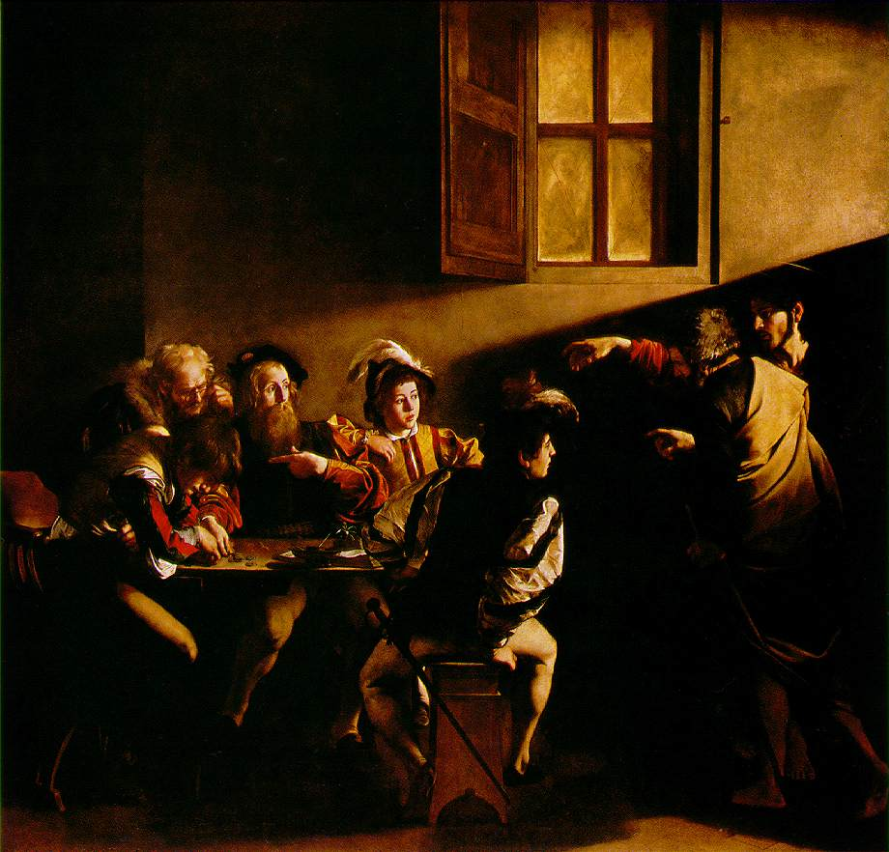
“The Calling of St. Matthew”
Caravaggio

Slide 22
“The View from Toledo”
El Greco
1597

Slide 23
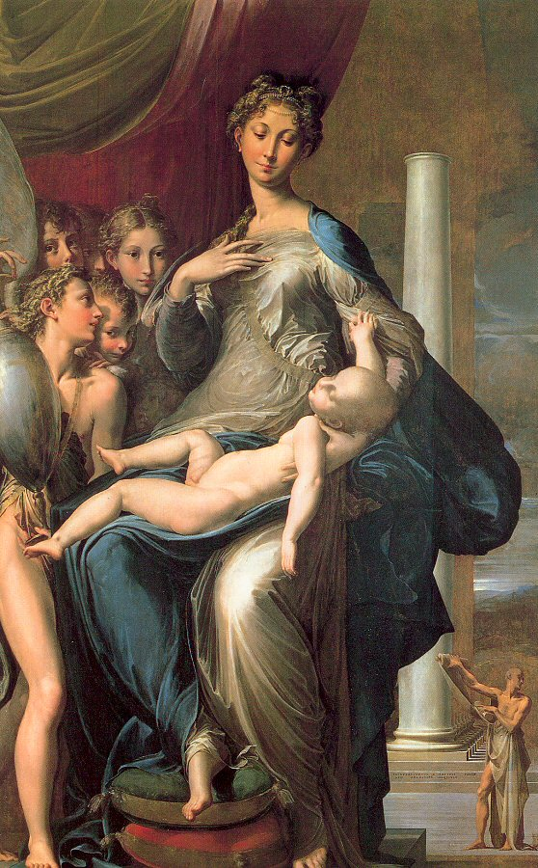
7. Pictoral Space is Crowded
“Madonna with the Long Neck”
Parmagianino
1534-1540

Slide 24
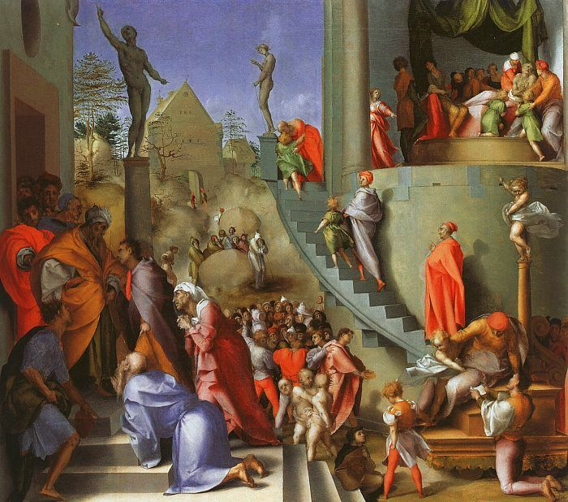
“Joseph in Egypt”
Jacomo Pontormo

Slide 25
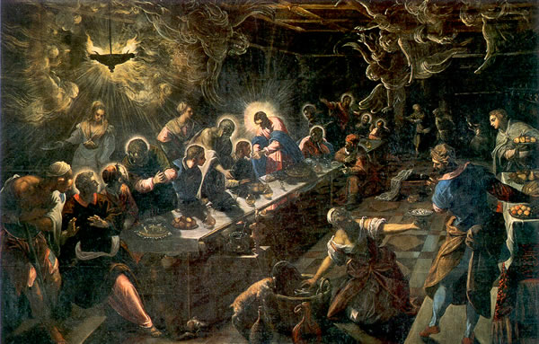
“The Last Supper”
Tintoretto
1594

Slide 26
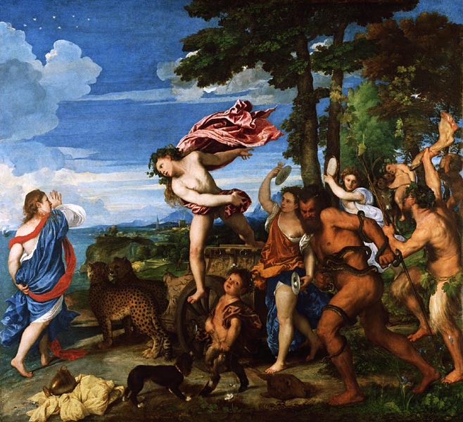
8. A Void in the Center
“Bacchus & Ariadne”
Titian
1522-1523
?

Slide 27
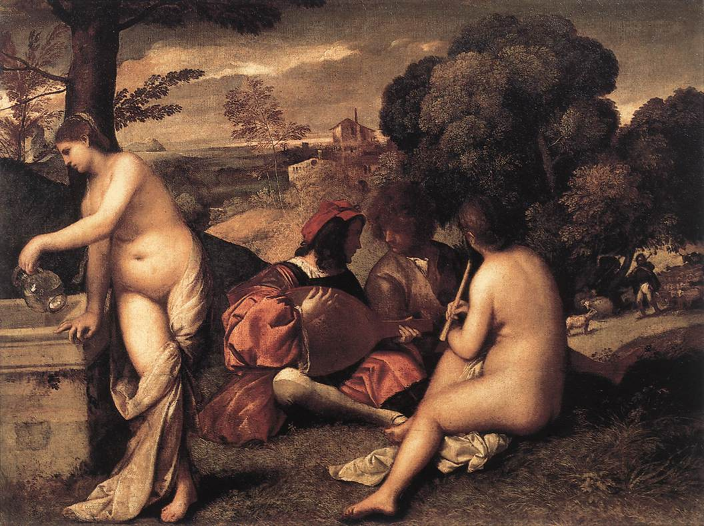
“Pastoral Concert”
Giorgione
1508-1510
?

Slide 28
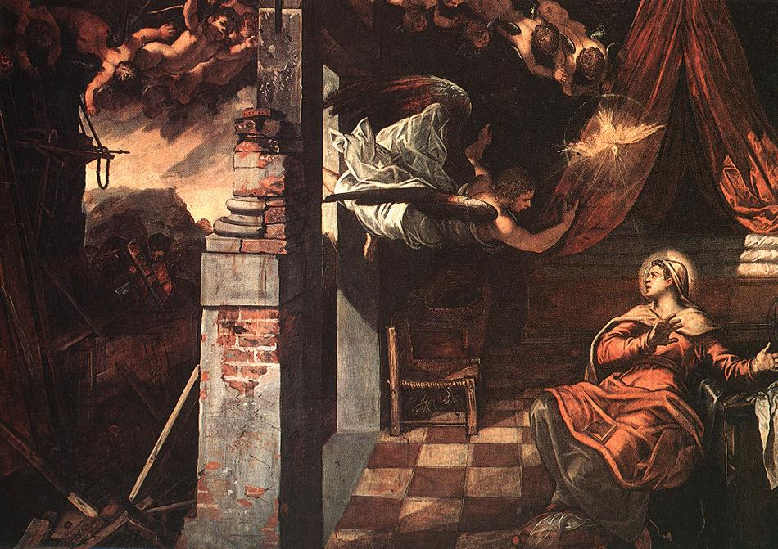
9. Hanging Figures
“The Annunciation”
Jacopo Tintoretto
1583-1587

Slide 29
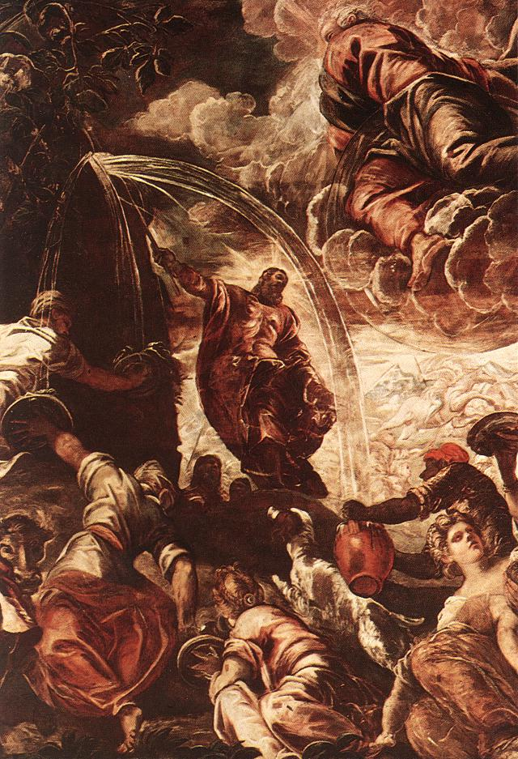
“Moses Drawing Water form the Rock”
Jacopo Tintoretto
1577

Slide 30
Manneristic
Architecture

Slide 31
Characteristics of Mannerist Architecture
Stylishness in design could be applied to a building as well as to a painting.
Showed extensive knowledge of Roman architectural style.
Complex, out of step style → taking “liberties” with classical architecture.
Architecture, sculpture, and walled gardens were seen as a complex, but not necessary unified whole.

Slide 32
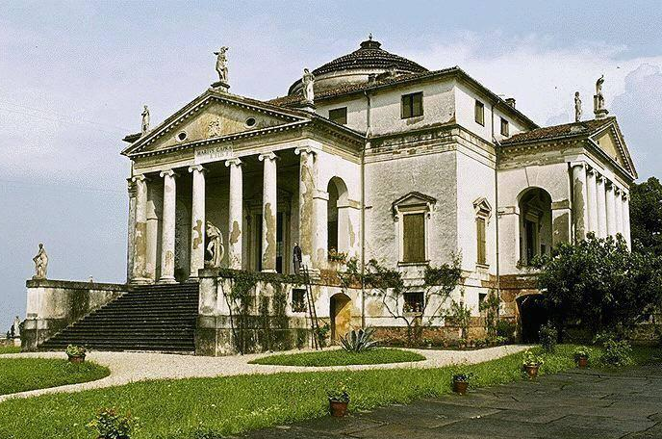
Villa Capra [or Villa Rotunda]
By Andrea Palladio
1566-1571
“Palladian” architectural style [popular in England]

Slide 33
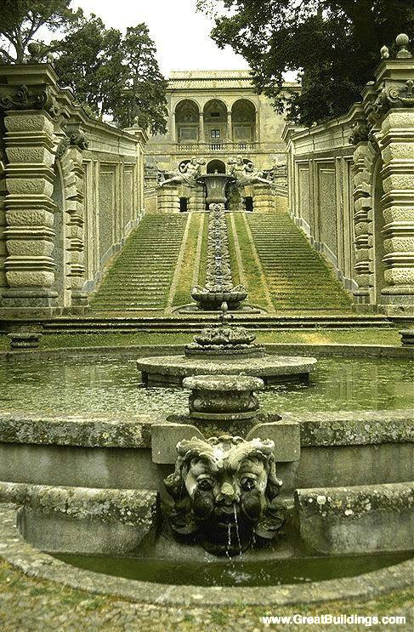
Entrance to the Villa Farnese at Caprarola
By Giacomo Vignola
1560

Slide 34
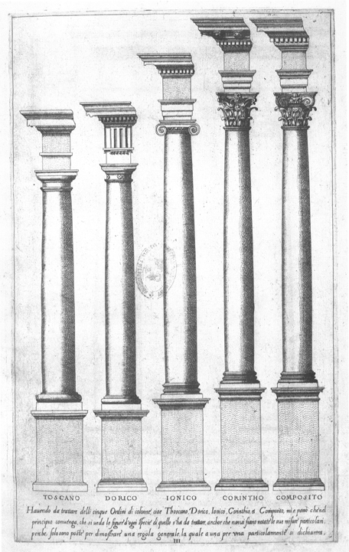
Giacomo da Vignola
Wrote The Rule of the Five Orders of Architecture
1563
Became a key reference work for architects.

Slide 35
The Fontainebleau School
French Mannerism → flourished from 1531 to the early 17c.
Characteristics:
Extensive use of stucco in moldings & picture frames.
Frescoes.
An elaborate [often mysterious] system of allegories and mythical iconography.
Centered around the Royal Chateau of Fontainebleau.

Slide 36
The Royal Chateau at Fontainebleau
Gallery [right] by Rosso Fiorentino & Francesco Primaticcio
1528-1537

Slide 37
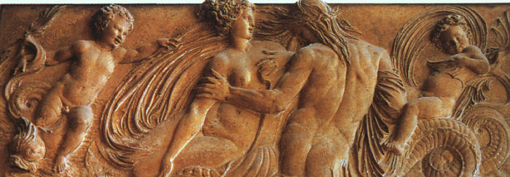
Jean Goujon
“Nymph & Putto,”
1547-1549
“Nymph,”
1548-1549

Slide 38
Germain Pilon
“Caryatids”
1550s

