Slide 1
Life In the 18th Century

Slide 2
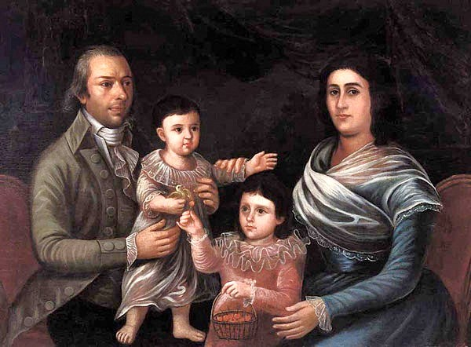
Family Structure
The Family prior to 1750
The nuclear family was the most common in pre- industrial Europe.
Young married European couples established their homes apart from their parents.
3-generation households usually entailed a parent moving in with a married child.

Slide 3
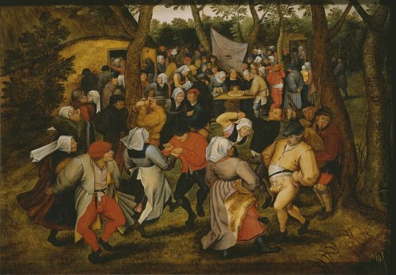
Marriage Norms
On average, the age at marriage was higher prior to 1750, especially for the lower classes
Late 20s or older for both men and women
Couples could not marry until they could support themselves economically.
Peasant sons often had to wait until their father's death to gain land (through inheritance).
Peasant daughters and family had to accumulate a small dowry to help her future husband to buy land or build a house.

Slide 4
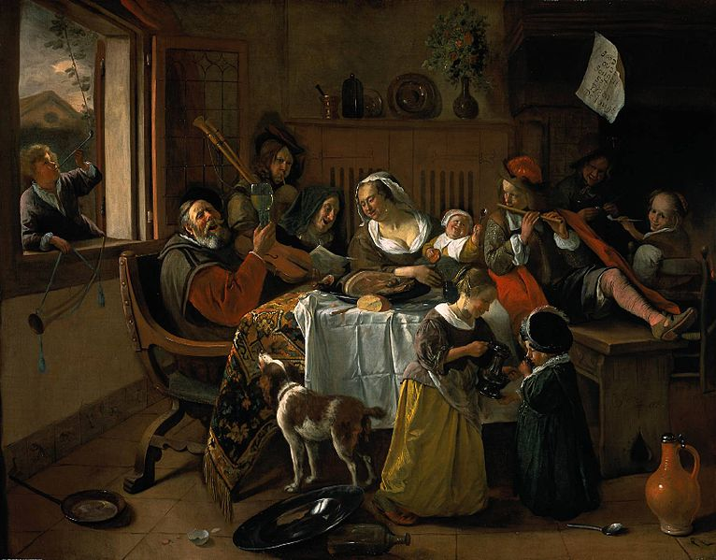
Class Approval
Some areas required legal permission or approval of local lord or landowner for marriage.
Austria and Germany had legal restrictions on marriage well into 19th century.
Local governments believed that without regulating marriages, lower classes would create more paupers, abandoned children and more gov't money would need to be expended on welfare.
This pattern helped maintain some balance between population and resources.
Many men and women never married.
Approximately 40 to 60% of women between 15 & 44 were unmarried at any given time.

Slide 5
Children
Rate of births out of wedlock was fairly low
Reflected powerful social controls of traditional villages, especially the open-field villages
Parents, village elders, priests, and landlords pressured young couples to marry if a pregnancy occurred.
Premarital sex was generally limited to couples who were already thinking about marriage.

Slide 6
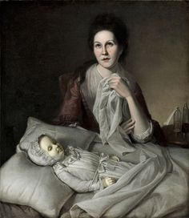
Childhood Mortality
Numbers of children per family
If wife & husband lived to age 45, odds about 50% of giving birth to 6 or more children.
Infant mortality was high.
20% in economically viable areas.
33% in poorer areas.
50% survival rate into adulthood was considered good.

Slide 7
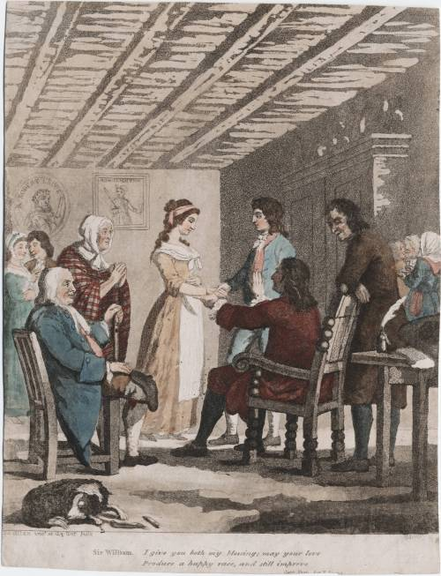
Changes After 1750
The growth of the cottage industry with its increased income resulted in higher rates of people marrying for love instead of just purely economic reasons.
Young people did not have to wait as long to become financially independent.
Arranged marriages for economic reasons declined
Laws and regulations on marriage, especially in Germany, were often ignored.
Factory workers after 1780 followed marriage pattern of cottage workers.

Slide 8
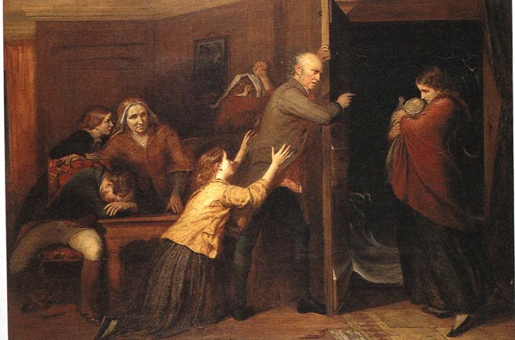
Illegitimate Births
The explosion of births was caused by increasing illegitimacy: 1750-1850.
Illegitimacy rates as high as 33% in certain areas.
Fewer girls abstaining from premarital sex and fewer boys married girls they impregnated.
Mobility encouraged new sexual and marital relationships which were less subject to parental pressure and village tradition.
In Germany, illegitimate births were a result of open rebellion against class laws limiting marriage among the poor.
Illegitimacy declined when marriage restrictions were rescinded.

Slide 9
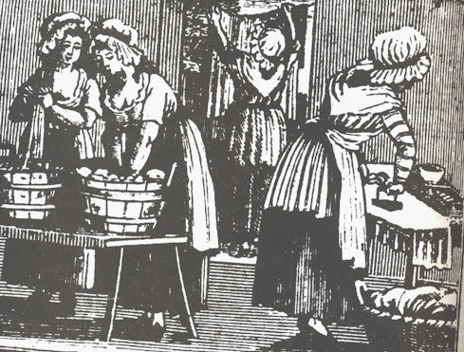
Womens’ Lib?
Women in cities and factories had limited economic independence.
Young women were not motivated by visions of emancipation and sexual liberation.
Most city women probably looked to marriage and family life as an escape from hard lifestyle.
Many intended marriages did not take place as poor economic and social conditions scared men away from the commitment.

Slide 10
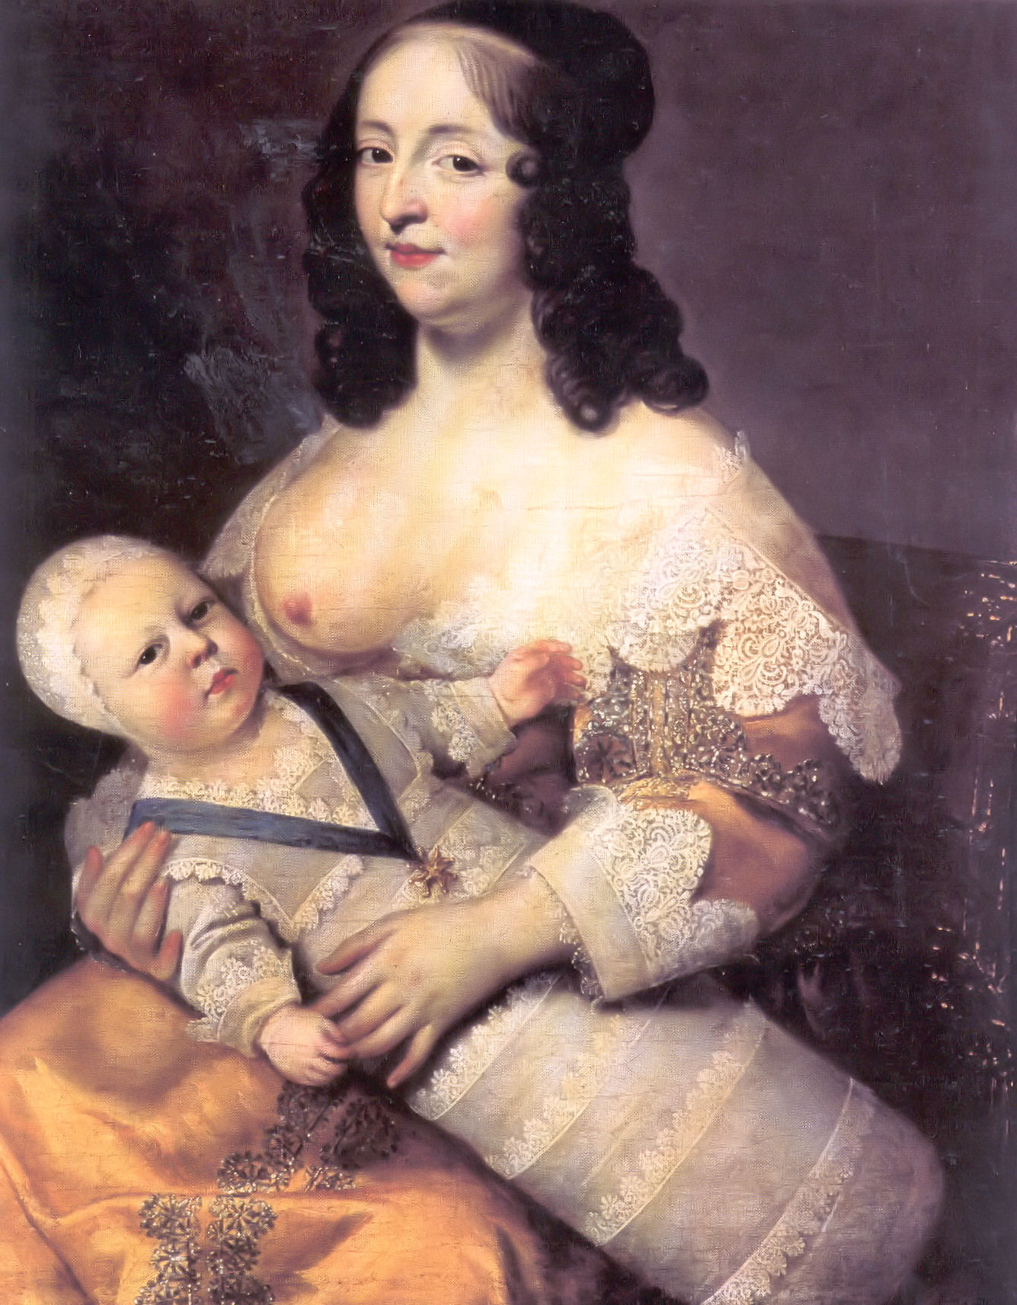
Child Care – Lower Classes
Child care and nursing
Poorer women generally breast-fed their infants for much longer periods than in the 20th century.
Resulted in spacing births of children from 2 to 3 years apart due to decreased fertility.
Infants more likely to survive on mother's milk than on artificial foods.

Slide 11
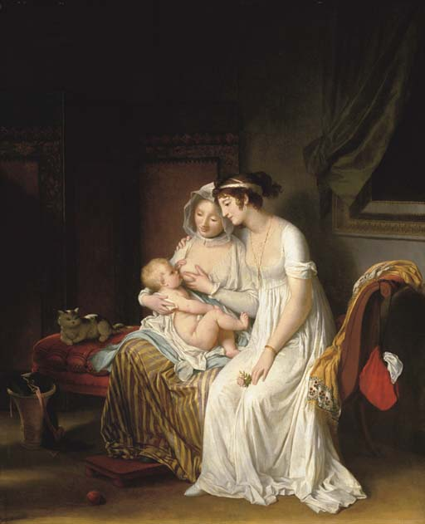
Child Care – Upper Classes
Women of aristocracy and upper-middle class seldom breast-fed
This was also true of wives of artisans who lived comfortably
Believed it was crude, common and beneath their dignity.
Wet-nurses hired to breast-feed their children.
Many babies sent to countryside
Wet-nursing took two to three years.
"Killing nurses" were negligent, resulting in the death of many or most babies in their custody.

Slide 12
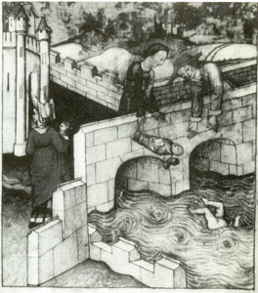
Infanticide
Early medieval church denounced infanticide; viewed each human life as sacred.
Yet, infanticide was rampant due to severe poverty.
"Overlaying" occurred in many cases with a parent rolling over and suffocating a child in bed.
Half of all babies died within a year anyway; at worst, 90% died.

Slide 13
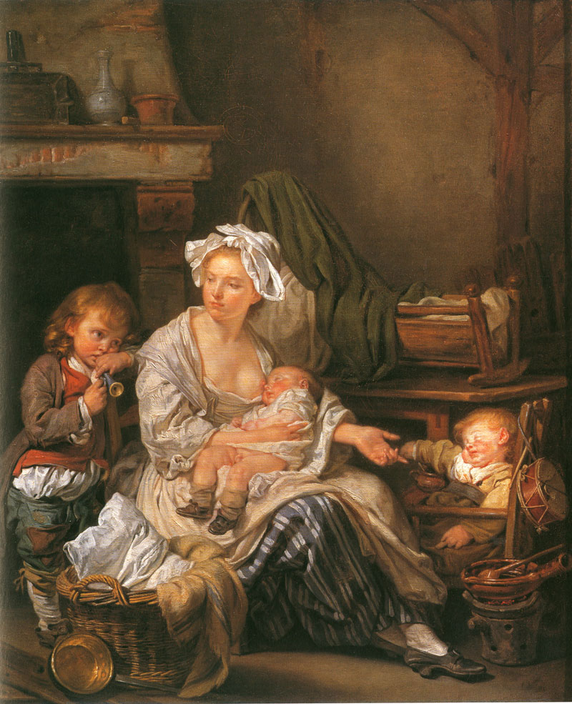
Foundling Homes
Foundling hospitals emerged, first in Paris then throughout Europe
Many poor women left babies on the doorstep of churches.
By 1770, 1/3 of all babies born in Paris were immediately abandoned to the foundling home; 1/3 of those came from married couples.
Foundling home in St. Petersburg cared for 25,000 babies in the early 19th century; receiving 5,000 new babies a year.
Some social critics claimed that foundling hospitals promoted "legalized infanticide."

Slide 14
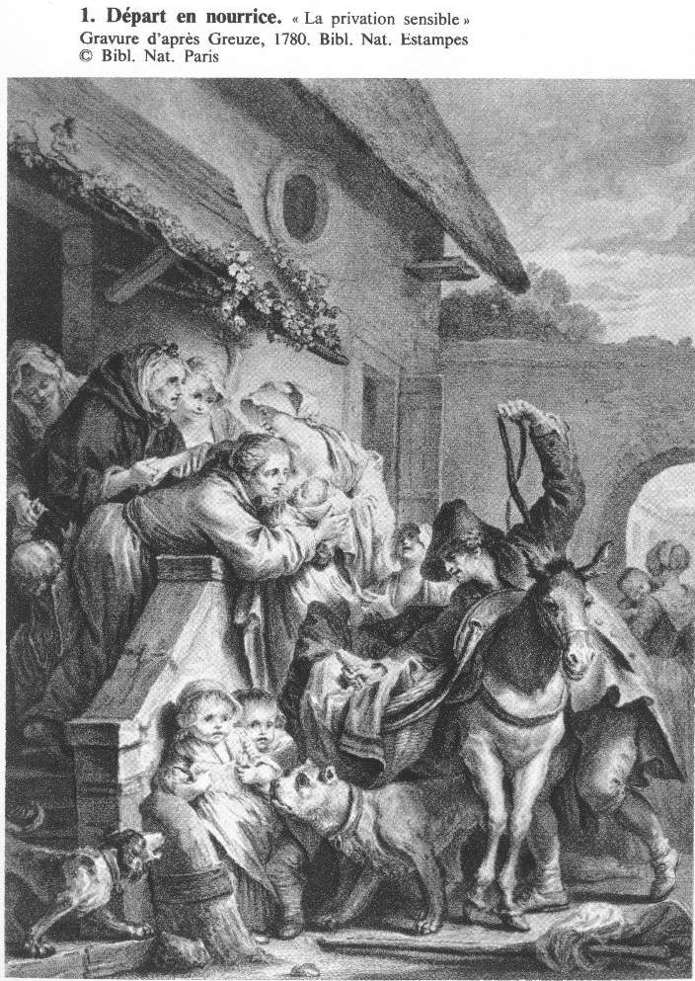
Child-rearing
Children were often treated indifferently and with strict physical discipline.
The use of wet-nurses is a good example.
Because of such high mortality rates, parents were reluctant to become too emotionally attached to their children.
Doctors often declined to care for sick children believing there was little that could be done.

Slide 15
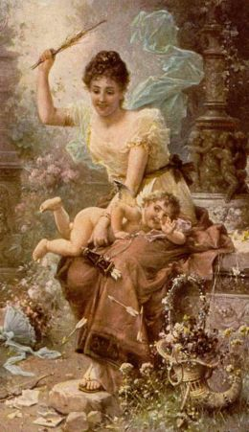
Discipline
"Spare the rod and spoil the child" - term coined by novelist Daniel Defoe
Many children worked in factories at a young age and were severely disciplined.
Many believed the task of parents was to break their will to make them obedient.

Slide 16
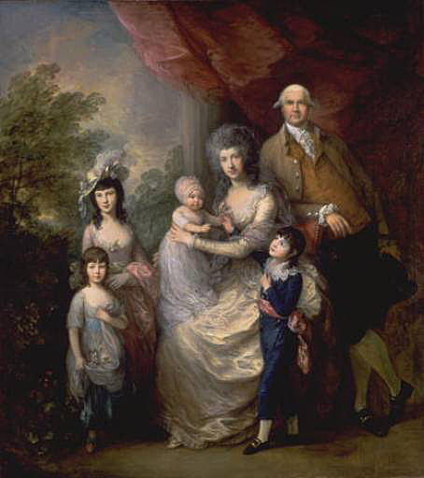
Enlightened Child-rearing
Humanitarianism and Enlightenment optimism regarding human progress emphasized better treatment of children.
Rousseau encouraged greater love and understanding toward children.
Increasingly, parents grew closer to their children.

Slide 17
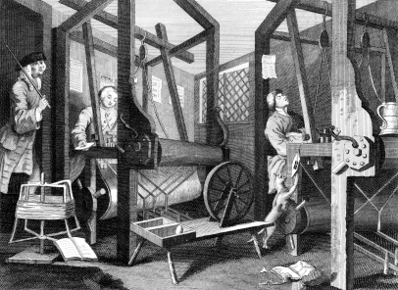
Work for the Young
Many young people worked within their families until they could start their own households.
Boys typically ploughed and wove (as part of the cottage industry).
Girls spun thread and tended to the animals.

Slide 18
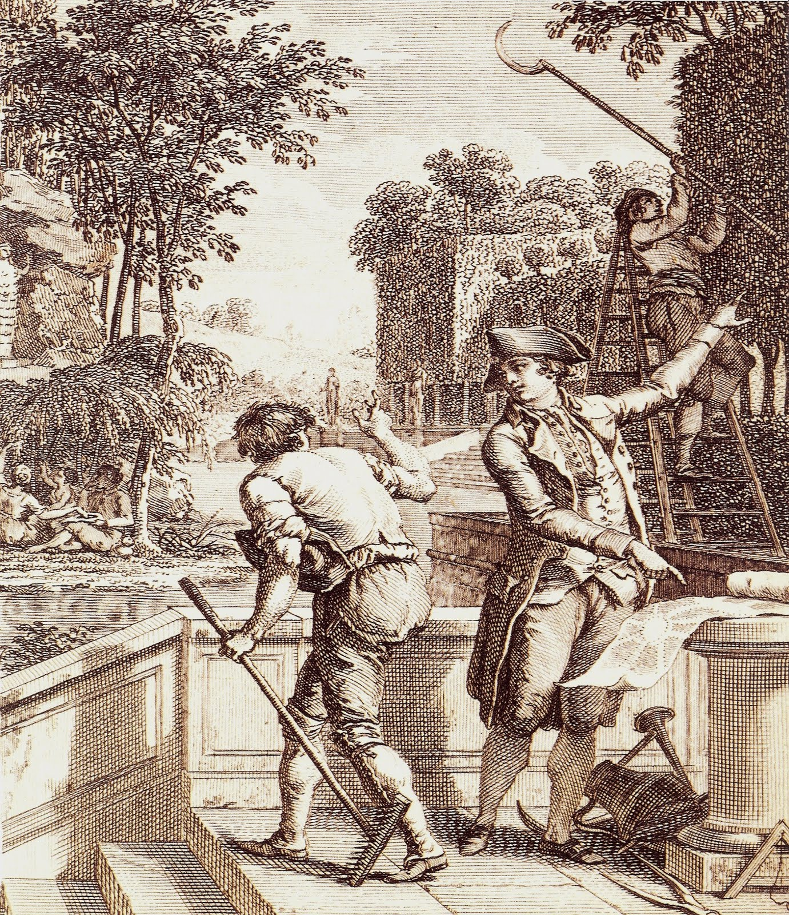
Work for Boys
Increasingly, many boys worked away from home
Boys in towns might be apprenticed to a craftsman for 7 or 14 years to learn a trade and perhaps be admitted to a guild.
Not allowed to marry during this period.
More often, young men would drift from one tough job to another

Slide 19
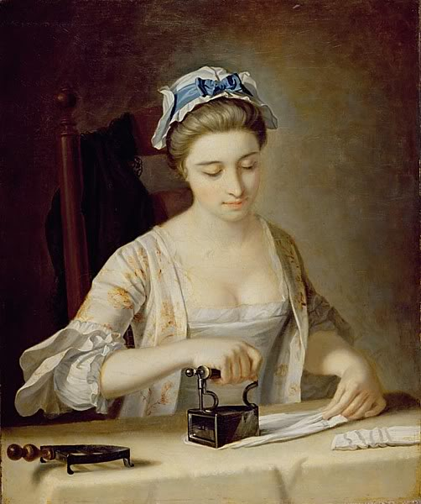
Work for Girls
Large numbers of girls also worked away from home at an early age.
Opportunities more limited than for men.
Domestic service in another family's household was most common job.
Most hoped to save money for their parents and for marriage.
Working away from home benefited parents who had one less mouth to feed.

Slide 20
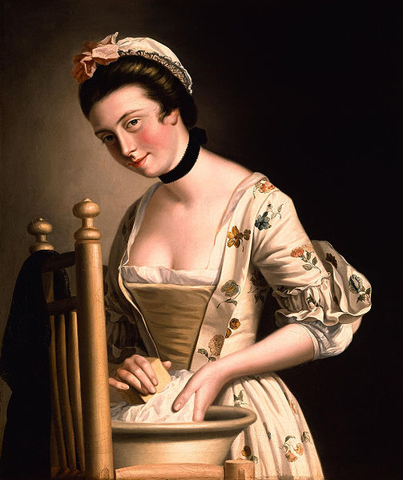
Servant Girls
Servant girls had little real independence
Girls were vulnerable to physical mistreatment by their mistresses.
Often became sexual victims
Upper classes commonly exploited servants sexually
If girl became pregnant she was quickly fired.
Prostitution and petty thievery often became only alternatives.

Slide 21
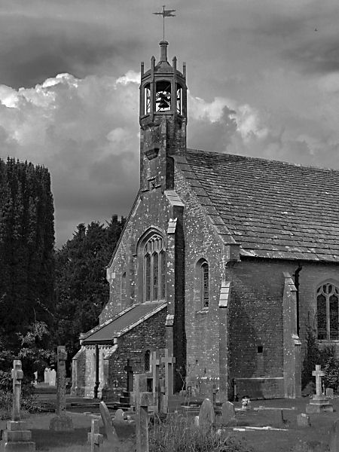
Education
The beginnings of formal education for the masses took root; largely inspired by Protestantism.
Aristocracy and the rich had a two-century head start beginning in the 16th century with special colleges, often run by Jesuits.

Slide 22
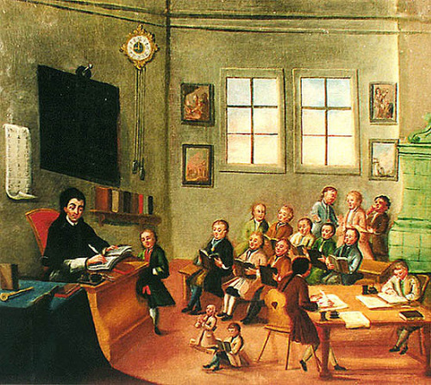
Educating the Poor
"Little schools" of elementary education began to appear in 17th century
Boys and girls from age 7 to 12 were instructed in basic literacy and religion.
The Church of England and "dissenting groups" such as the Puritans founded "charity schools" to instruct poor children.
Scotland created a network of parish schools for all citizens to teach reading of the Scriptures.

Slide 23
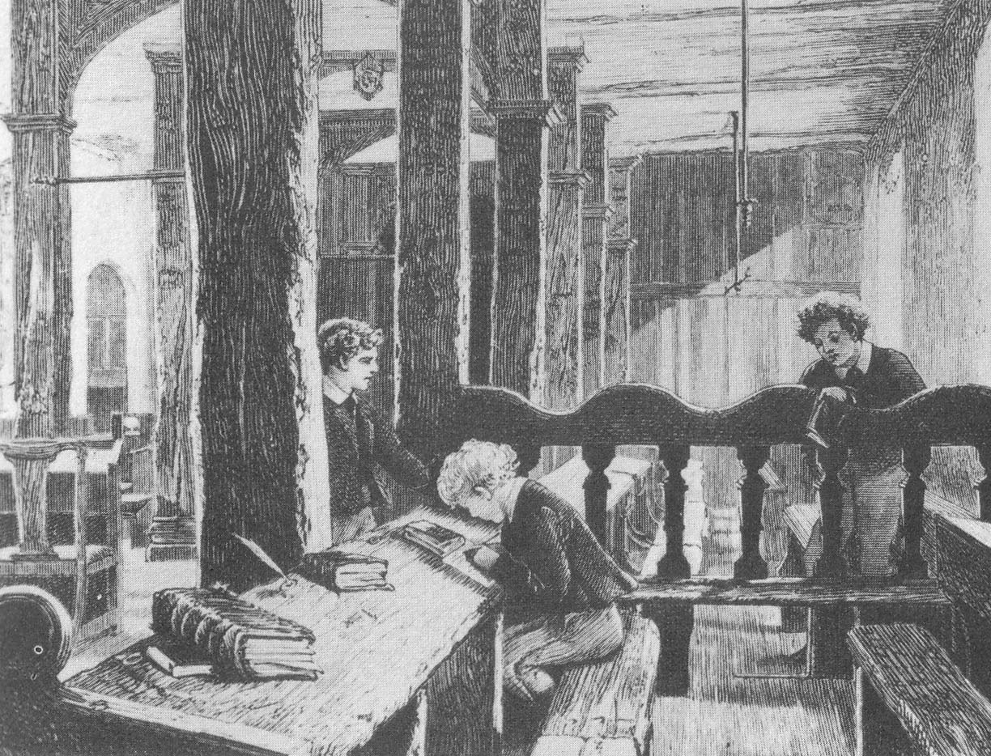
Educating the Poor (cont.)
France established Christian schools starting in 1682 which taught religion as well as reading and writing.
Starting in 1717, Prussia led the way with universal compulsory education.
Inspired by old Protestant idea that every Christian should be able to read the Bible

Slide 24
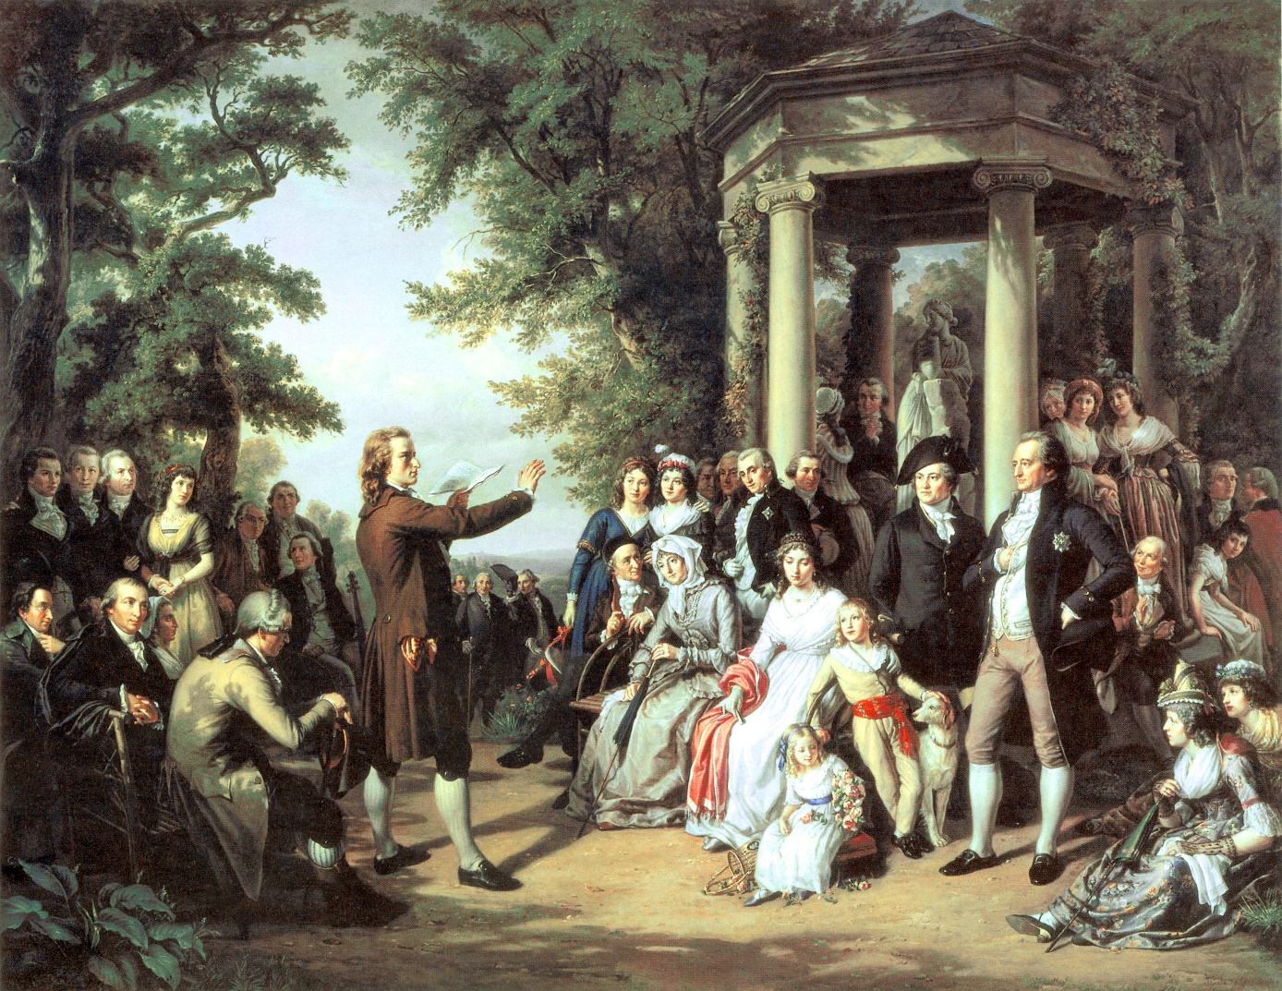
Why Educate the Poor?
Education also seen as way to make the population effectively serve the state.
Enlightenment commitment to greater knowledge through critical thinking reinforced interest in education during 18th century.

Slide 25
Literacy Rates
Literacy by 1800:
Almost 90% of Scottish male population; only 1 in 6 in 1600.
2 out of 3 males in France; in Normandy, 90%; only 1 in 6 in 1600.
Over 50% of male Brits; only 25% in 1600.
Women were increasingly literate but lagged behind men in general.

Slide 26
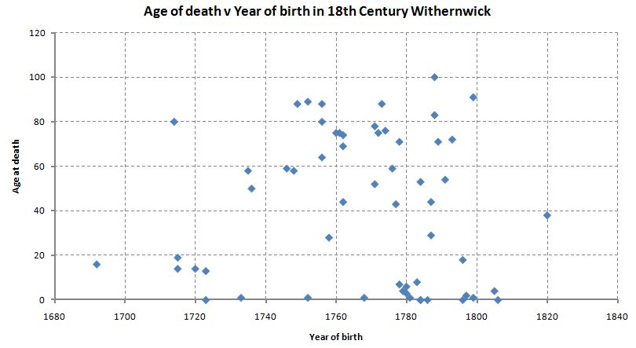
Life Expectancy
Increased life expectancy
The life spans of Europeans increased from 25 to 35 years in the 18th century.
Largely the result of the disappearance of the plague and starvation.
More time spent by children on education and preparation for adulthood – because they were more likely to have a future

Slide 27
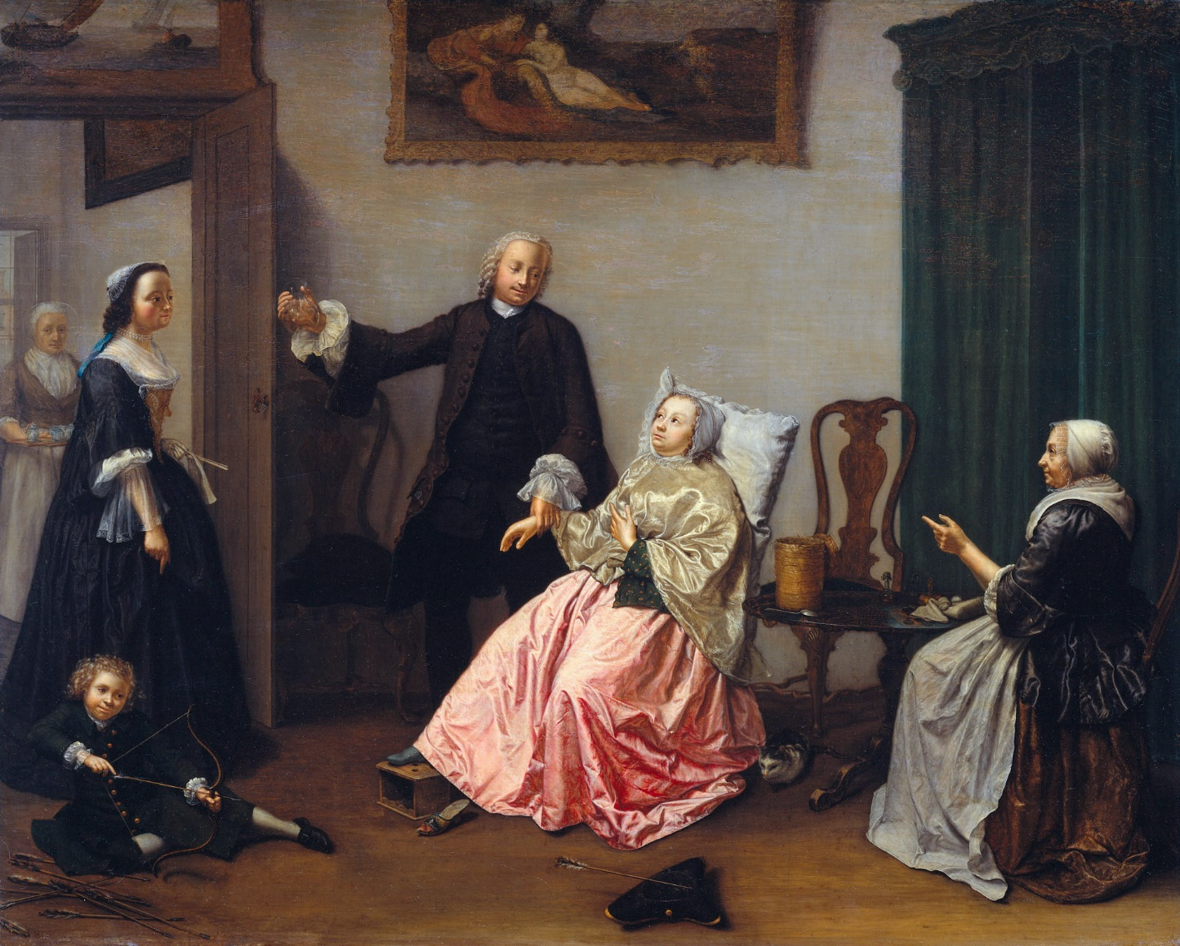
Health
Development of public health techniques were an important breakthrough of 2nd half of 18th century.
Improved practices in sanitation.
Mass vaccinations
Better clothing (due to proto-industrialization)
Improvements in developing warm dry housing.
Adequate food (due to the agricultural revolution)

Slide 28
Diet & Nutrition
The diet of ordinary people improved.
Poor people's diets usually consisted of grains and vegetables.
The potato improved the diet of the poor with vitamins A and C.
Most Irish lived almost exclusively on the potato; lived in abject poverty
Average male ate 8 to 10 lbs a day!
The crop produced more food per acre
By end of 18th century, potato an important food in much of Europe.

Slide 29
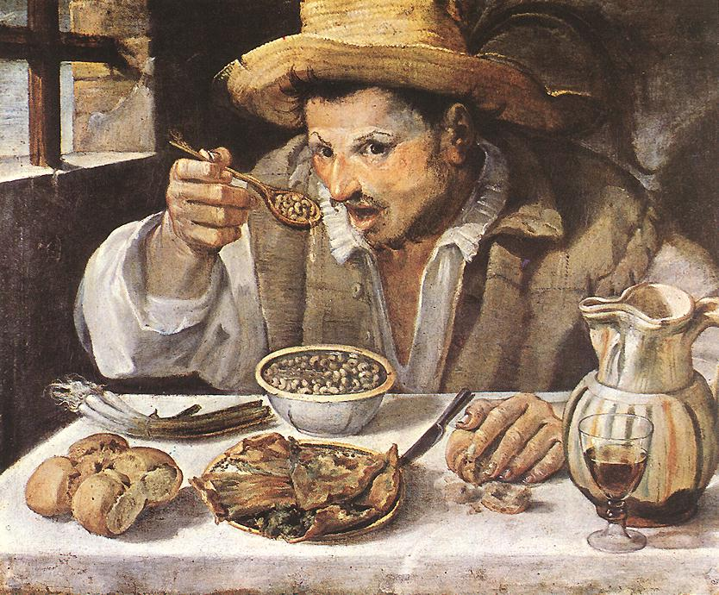
Diet & Nutrition (cont.)
Greater variety of vegetables existed in towns and cities
Upper classes consumed much meat and fish and alcohol.
Few fruits and vegetables eaten.
Greater affluence meant that some people indulged in less nutritious food (e.g. sugar).
Northern, Atlantic Europe ate better than southern, Mediterranean Europe.
The English ate the best of all.

Slide 30
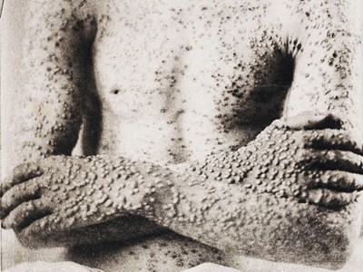
Medical Improvements
The conquest of smallpox was the greatest medical triumph of the 18th century
17th century: 25% of deaths in Great Britain caused by small pox
Small pox killed perhaps 60 million people in the 18th century
80% of Europeans contracted it; many scarred for life

Slide 31
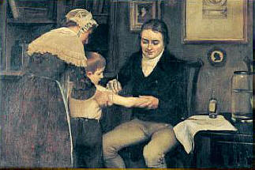
Smallpox Vaccine
Edward Jenner (1749-1823)
1778, created the foundation for the science of immunology with his vaccine for smallpox.
Discovered inoculating patients with cowpox would control onset of small pox.

Slide 32
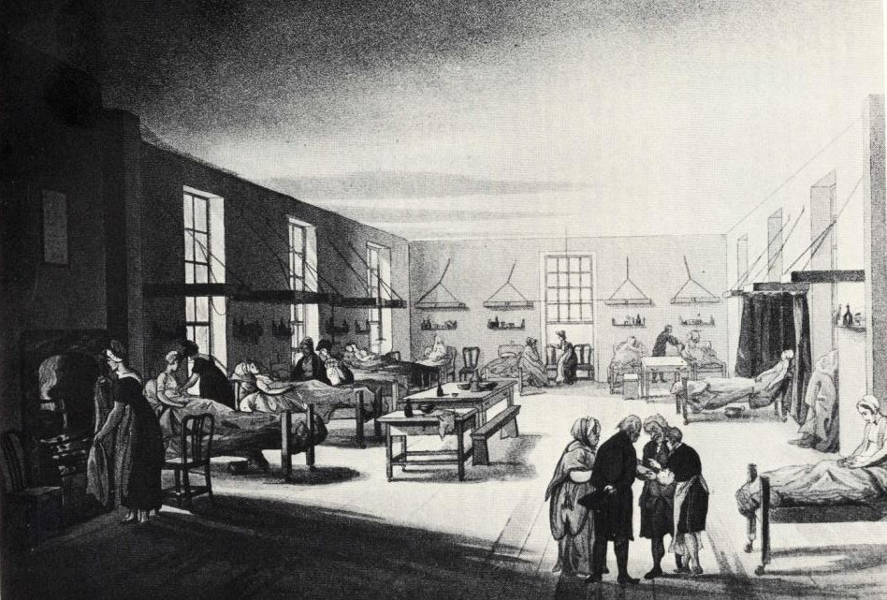
Hospitals
Humanitarianism of late 18th century led to hospital reform
Ventilation improved and filth eliminated as disease believed to be caused by bad air.
Spread of infection was reduced
First humane mental hospital founded in England in 1790

Slide 33
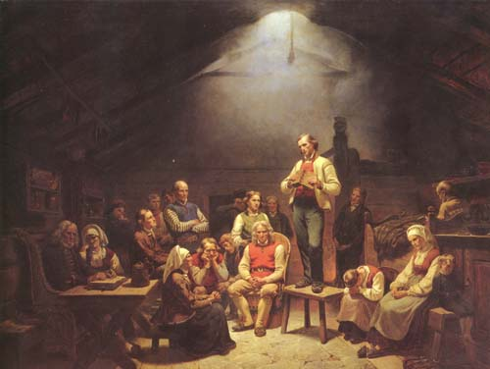
Pietism
"Pietism" in Germany caused its Protestant revival.
The emotional content of Christian faith was emphasized; enthusiasm in prayer, worship, preaching, and life itself, was the key concept.
Reasserted earlier radical stress on "priesthood of all believers."

Slide 34
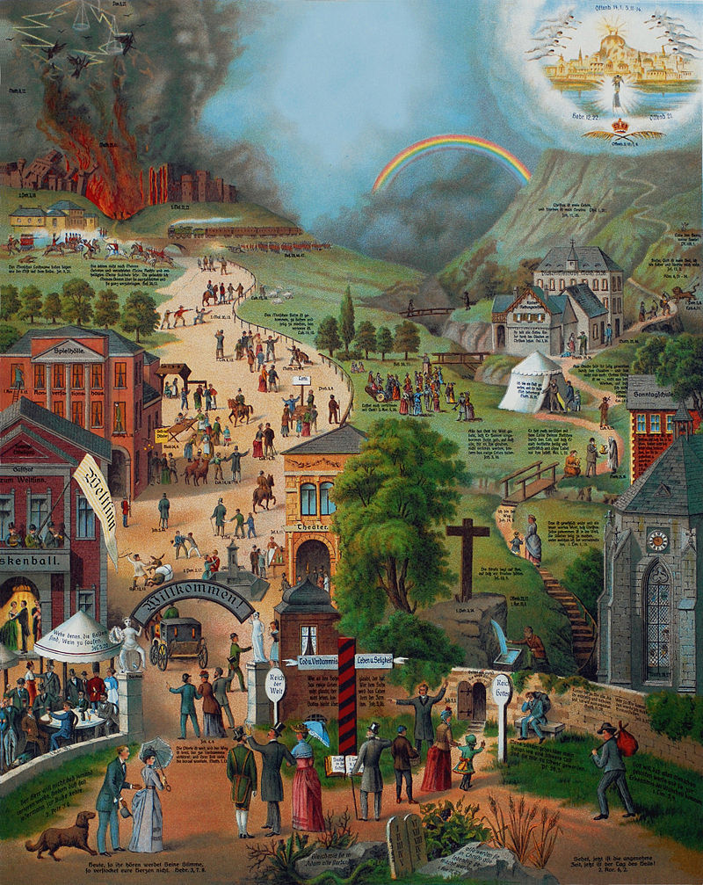
Pietism (cont.)
Attempted to reduce chasm between official clergy and Lutheran laity that had existed since the Reformation.
Bible reading and study extended to all classes, thus spurring public education.
Pietists believed in practical power of Christian rebirth in everyday affairs.
Reborn Christians expected to lead good, moral lives and come from all sectors of society.

Slide 35
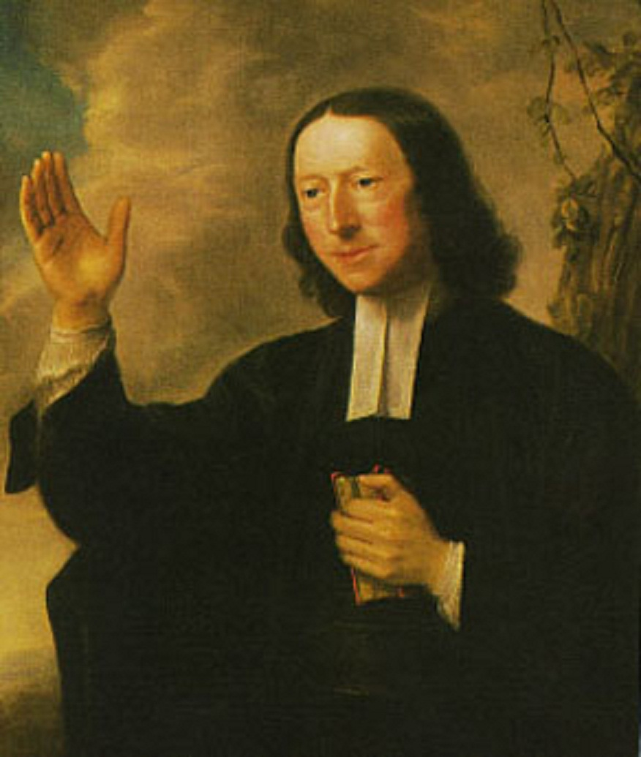
Methodism
John Wesley (1703-1791) founded Methodism
Influenced by Pietism in Germany
Wesley concerned about complacency of religion in England (also the skepticism of the Enlightenment and deism)
Wesley often preached in open fields to large numbers of people
Particularly popular among the lower classes
Rejected Calvinist idea of predestination
Believed all men and women who earnestly sought salvation might be saved.
Message of hope and joy, of free will and universal salvation.
Methodism eventually developed into a new denomination.

