Slide 1
Period 3: 1815 CE – 1914 CE
Late 19th-Century
Social Developments
© Morgan AP Teaching

Slide 2
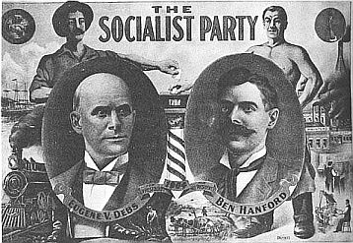
© Morgan AP Teaching
Working Class Identity
Set in motion by 19th century classical liberals with the Chartist movement,
the formation of mass political parties that developed uniform agendas
During the late 19th century, these political parties began to include larger
amounts of working-class citizens that advocated intervention by the gov.
Exposed to the corruption of crony capitalism (collusion between big business and politicians),
as well as the price gouging practices of 19th-century monopolies, it was clear free market
capitalism was not alone capable of achieving positive social change for the poor and working-class
Crony capitalists and powerful monopolies had both worked—independently and together
—to legally, and sometimes violently, prevent collective-bargaining and worker unionization
In an effort to stop these corrupt practices, new, large political parties began to form in
support of the expansion of the government in the economy to protect worker rights

Slide 3
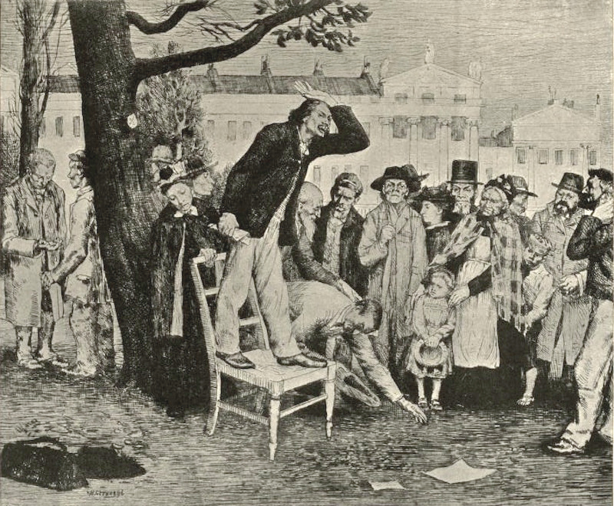
© Morgan AP Teaching
Continued
Reviled by opponents as ‘socialists,’ many liberals who supported free trade and laissez-
faire capitalism (even John Stuart Mill himself) began to branch off in late 19th century
These leaders formed massive political parties comprised of working class constituents; parties
like the German Social Democratic Party and British Labour Party emerged in late 19th century
with the mission to protect the rights, well-being, and safety of the industrial working class
Fearing such political parties and movements may result in a working class revolution
(as was detailed in Marxist Communist manifesto), many governments were forced to
pass laws and changes in the face of large, coordinated working-class political parties
In Germany, Otto von Bismarck push through social legislation in the 1880s to
require companies or the state to provide accident insurance and worker pensions
In Great Britain, the efforts of the British Labour Party were responsible for
responsible for state pensions (1908) and unemployment insurance (1911)

Slide 4
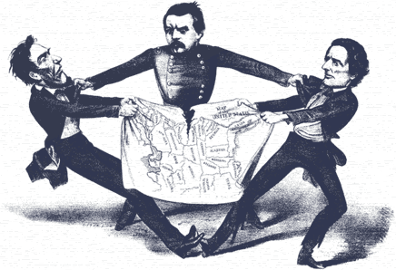
© Morgan AP Teaching
New Liberal Protectionism
While free trade was universally supported by liberals in the early-19th century, the connection
of European economies through free trade likely facilitated the spread of economic hardship
When the Austrian stock market and banking system experienced a crash and recession in 1873,
the resulting cross investment and commercial activity with Germany, France, Britain, and other
European states, resulted in the hastened spread of economic recession
Known as the Panic of 1873, Europe experienced a multi-year economic recession, and many of
the economist the time faulted the interconnectivity of free trade for the Panic’s scale
Additionally, cheap agriculture and goods from the US and Russia threatened European
agriculture, and resulted in many European farmers experiencing hardship in bankruptcy
As a result, many late 19th century liberals began to abandon their free trade positions in favor of protectionism (especially in agriculture) after 1873 to both protect domestic industry and prevent their economies from the blunders and recessions of other states
Modeled after Friedrich List’s National System, Germany began the onslaught of European tariffs by pushing through the Tariff Act of 1879, designed to protect grain farmers in eastern Prussia; once one country had begun setting tariffs, others followed suit to protect their own

Slide 5
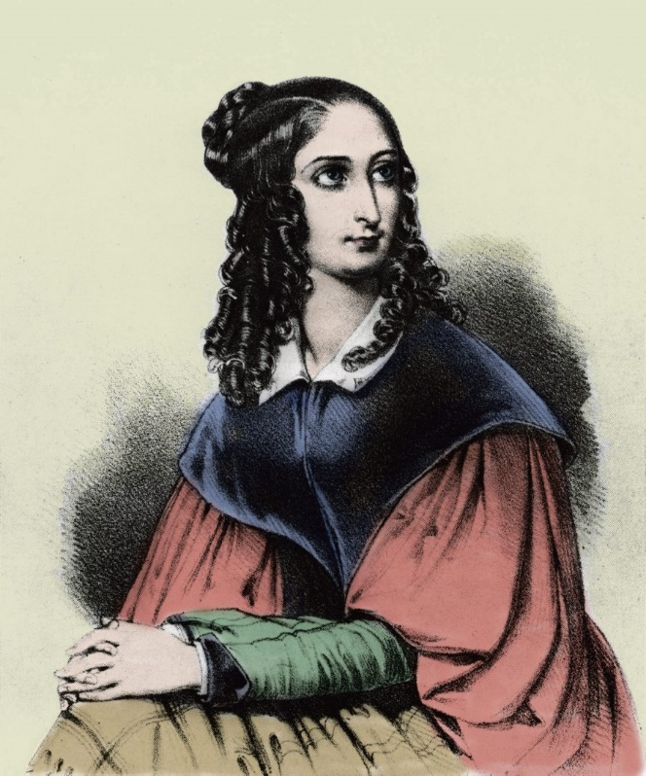
© Morgan AP Teaching
19th-Century Feminism
In the early 19th century, the desire of liberal chartists and socialists
to bring equality and expanded suffrage also spurred The First-Wave
Feminist Movement (the movement for female suffrage)
Early 19th century feminists, such as Flora Tristan, looked to the
unions and emerging political parties of the working class as a model
Tristan admired the organization and solidarity of working-class unions
and parties in striving for expanded worker rights and social reforms
She also admired the ‘united we stand, divided we fall’ attitude and
encourage and adopt its application in early feminist organizations
As such, beginning in 1830s, women began an organized call for expanded
women’s rights–most for which call for peaceful legislative reform
However, some radical groups, such as the British Women’s Social and Political Union (headed
by the Pankhurst Family) choose a more direct and belligerent approach by practicing civil
disobedience, harassing politicians, and intentionally getting arrested to raise awareness

Slide 6
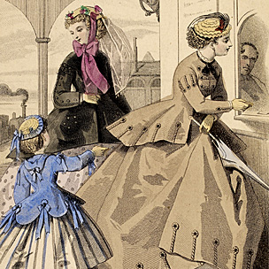
© Morgan AP Teaching
New Liberal Reform Policy
Further expanding the goals of late 19th century liberals (particularly middle-class women), it became
fashionable to hold a charitable view on the urban poor and young suffered from industrialization
The middle class began to pity and aid the ‘deserving’ poor: the women, children, elderly, and young prostitutes
Private charities, such as the Salvation Army, were formed for to provide aid to
these groups, and, prior to the advent of state education, the Sunday School
Movement worked to provide education to poor and working-class children
They also began to support ‘mutual aid societies’ in which workers would pool
money together to help one another during unemployment, sickness, or injury
They also advocated for the legalization of unions and strikes, to enable
workers to fight for their own protections and benefits against employers

Slide 7
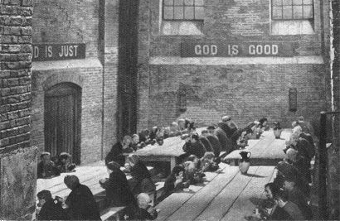
19th-Century Soup Kitchen

Slide 8
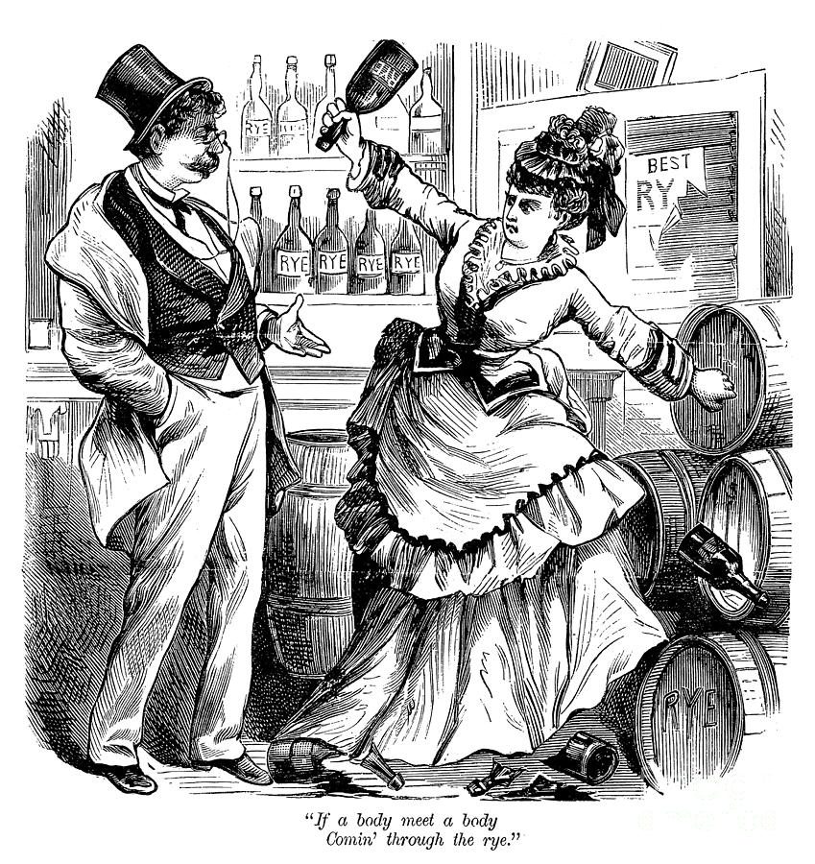
© Morgan AP Teaching
The Temperance Movement
New liberals of late 19th century also advocated state intervention to combat alcohol
To the eyes of the middle class, working class men had a very bad reputation
as being uneducated and poor, as well as highly dependent on alcohol
Today, we know they were using this is a mechanism to ‘escape reality’
and cope with their awful conditions, however, it had many adverse affects
Domestic violence in working class families tended to be high, and new liberals believed low working-class wages were being squandered on alcohol
Consequentially, beginning in the 1890s, many Christian and female middle class liberals
began to formulate political opposition to call in the form of the Temperance Movement
They believed that the lower classes were to ‘lazy’ or ‘unintelligent’ to stop themselves from squandering wages on the overconsumption of alcohol, and so moved to ban the substance
These groups were influential in eliminating alcohol sales on Sundays, the formation
of ‘dry counties’, and, in the US, officially banned alcohol (18th Amendment)

