Slide 1
The Art
of the
Italian Renaissance

Slide 2
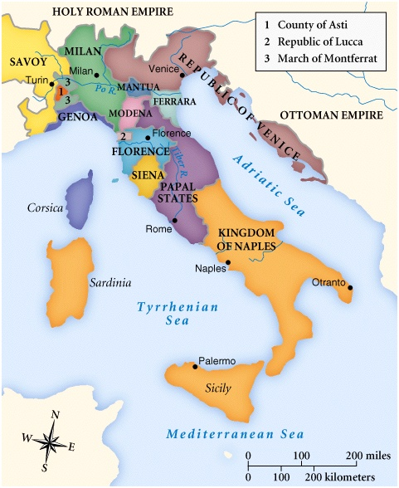
Periodization
Early Renaissance, c.1400-1490
“The Quattrocento”
High Renaissance, c.1490-c.1520
Late Renaissance, c.1520-c.1600
Mannerism

Slide 3
The 5 Key Ideas of the Italian Renaissance
Humanism
Individualism
Secularism
Virtù
Historical Consciousness
GOAL: To reproduce the forms of nature realistically through the scientific study of the body and natural world, and the rediscovery of classical art and literature.

Slide 4
Key Characteristics
Fresco, Tempera, & Oil Paintings
Realism & Expression
Linear Perspective
Classical Themes & Poses
Emphasis on the Individual
Idealized figures (heroic male nudes)
Geometrical Arrangement of Figures
Light & Shadowing/Softening Edges
Religious & Mythological Scenes

Slide 5
Most
Exemplary
Work

Slide 6
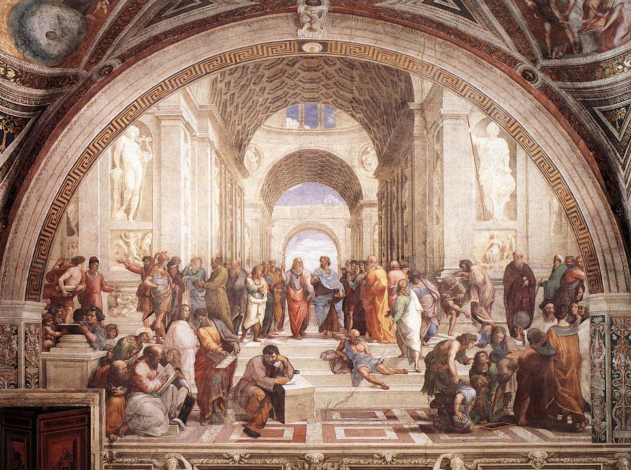
The School of Athens – Raphael, 1509 -11

Slide 7
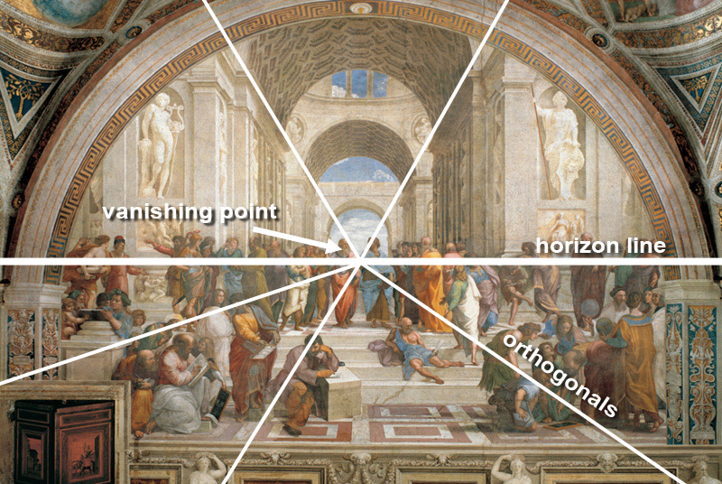
The School of Athens – Raphael, 1509 -11

Slide 8
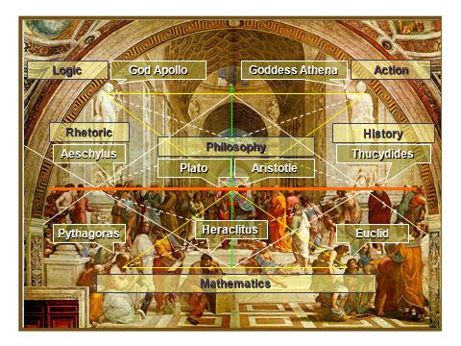
The School of Athens – Raphael, 1509 -11

Slide 9
The School of Athens – Raphael, 1509 -11
Da Vinci
Raphael
Michelangelo

Slide 10
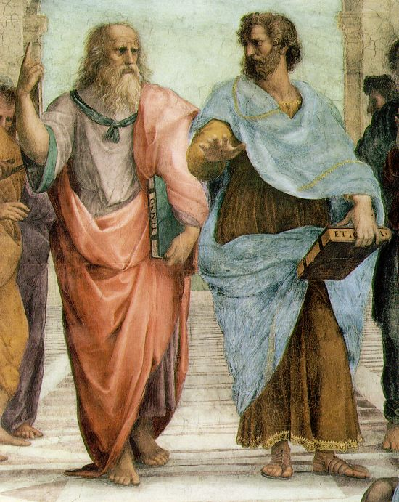
The School of Athens – Raphael, details
Plato: looks to the heavens [or the IDEAL realm].
Aristotle: looks to this earth [the here and now].

Slide 11
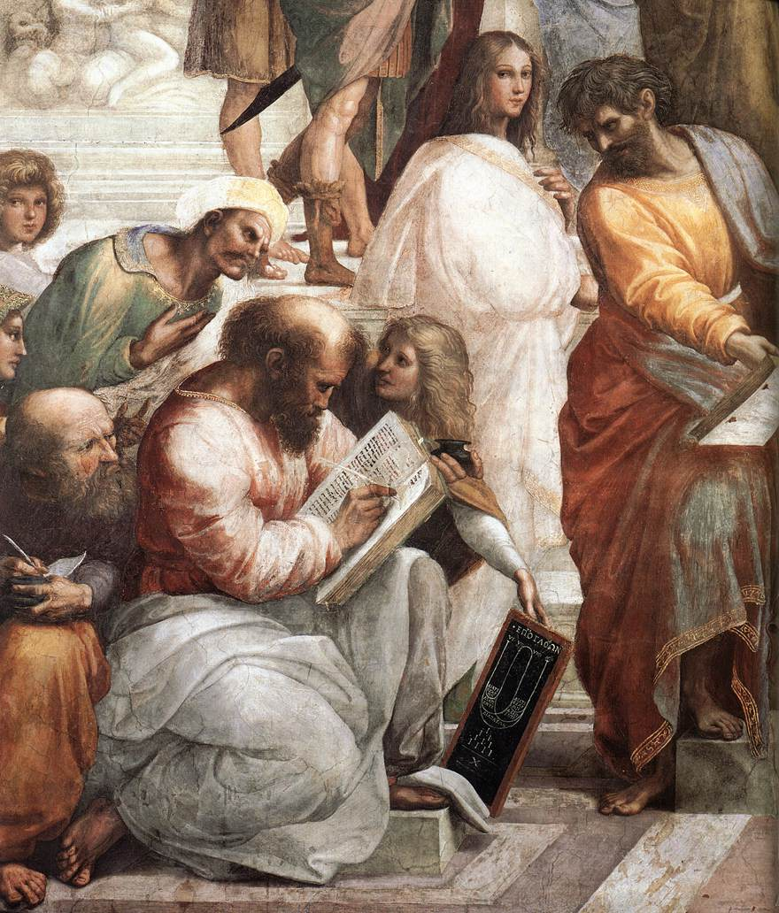
Averroes
Hypatia
Pythagoras

Slide 12
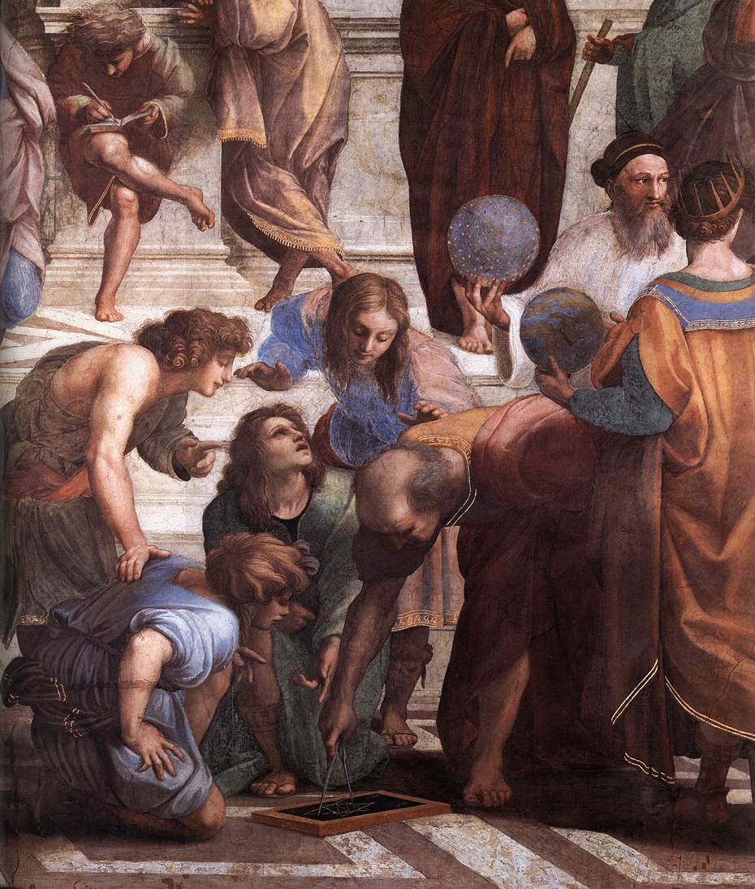
Zoroaster
Ptolemy
Euclid

Slide 13
Honorable
Mention

Slide 14
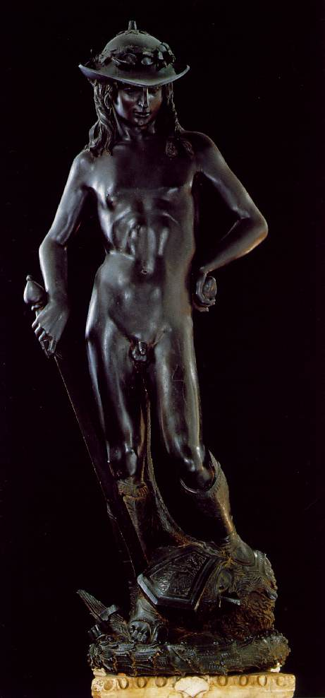
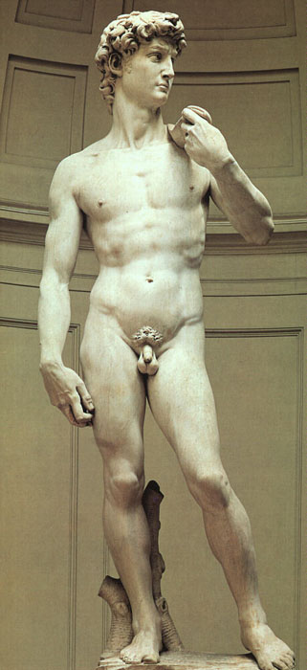
The Liberation of Sculpture – Two Davids
← 15c
What a difference a century makes!
16c →

Slide 15
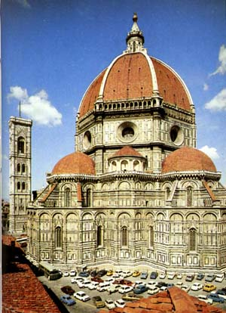
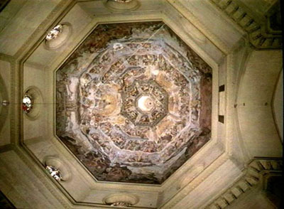
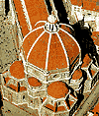
Il Duomo di Firenze (1436)
Filippo Brunelleschi 1377 - 1436
Architect
Cuppolo of St. Maria del Fiore

Slide 16
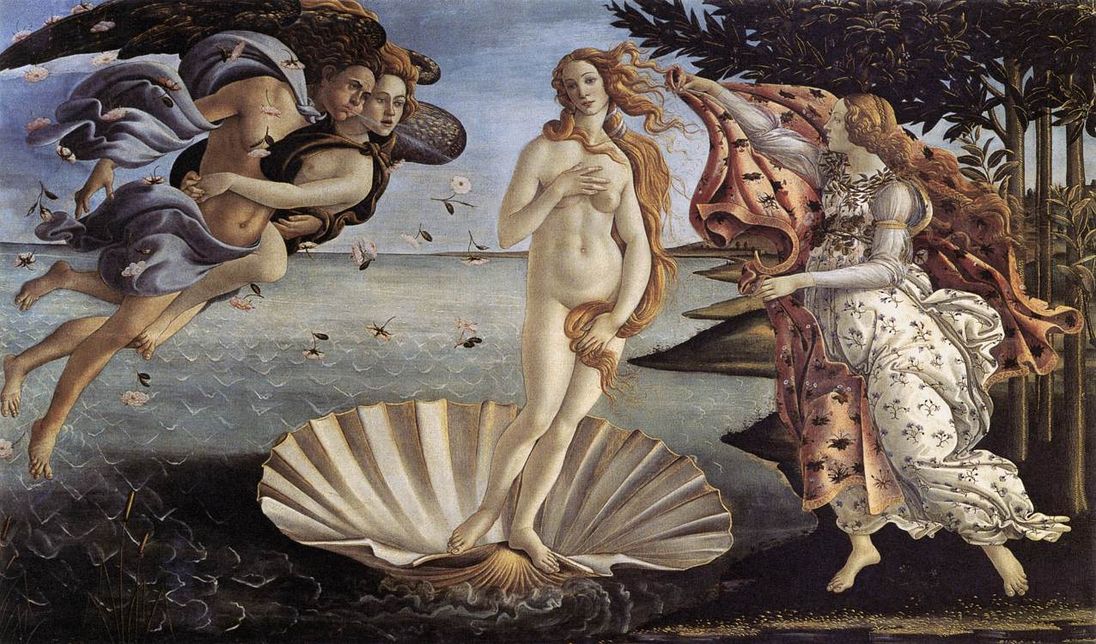
Birth of Venus – Botticelli, c.1485
An attempt to depict perfect beauty.

Slide 17
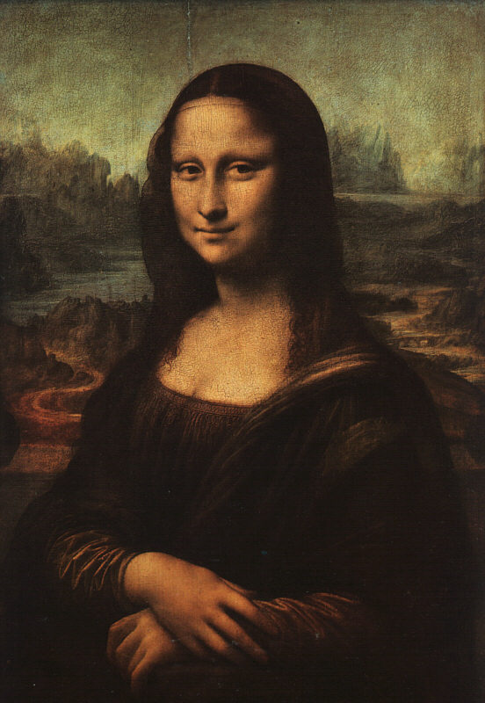
Mona Lisa – da Vinci, 1503-6
?

Slide 18
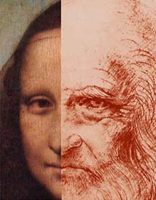
Mona Lisa OR da Vinci??

