Slide 1
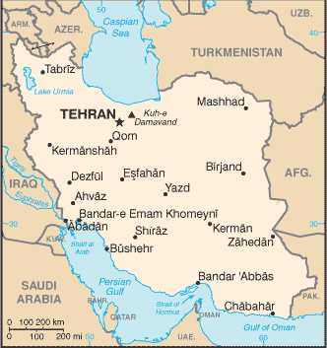
A Case Study Focusing on the 1979 Revolution
Iran:

Slide 2
Colonial Legacy
Although the nation of Iran, with its Persian roots, was not a western colonial creation and remained, in name, independent during the colonial era, it still was greatly influenced by the colonial powers in the area who intervened to protect their political and economic interests.
The U.S. restoration of the Pahlavi family to power in 1953, for example, can be seen as an example of a reassertion of colonialism.

Slide 3
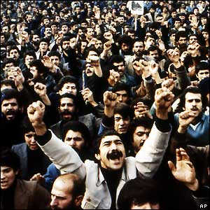
The Revolution
Began as a popular democracy movement
Ended with the establishment of the world's first Islamic state

Slide 4
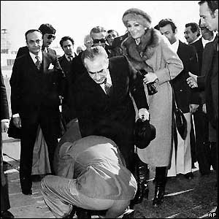
The Shah
Shah Reza Pahlavi and a circle of his relatives and friends ruled Iran.
Gap between rich and poor increased in 1970s
Dissent arose in response to economic problems and to Shah’s autocratic style

Slide 5
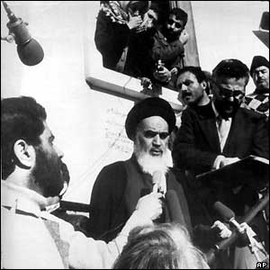
Opposition to the Shah
Ayatollah Ruhollah Khomeini—shia cleric in exile in Paris
Long the bravest and most outspoken opposition voice to the Shah
The Ayatollah promised economic reform and a return to traditional religious values
Appealed to many in Iran

Slide 6
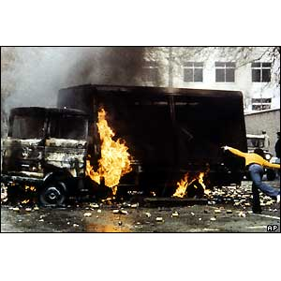
Unrest
In the late 1970s, numerous large and violent protests occurred
General strikes added to the instability

Slide 7
The Departure of the Shah
January 1979-Shah leaves Tehran for an “extended vacation,” never to return.
Khomeini supporters tear down his statues throughout Iran

Slide 8
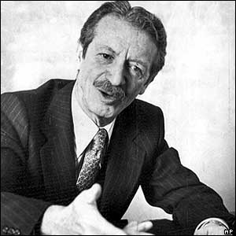
The Shah’s Regent
Prime Minister Shahpur Bakhtiar appointed by shah to run the country
Bakhtiar tries to resist growing opposition and refuses to allow Ayatollah Khomeini to form a new government

Slide 9
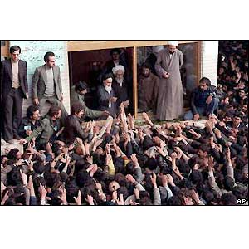
Khomeini Returns From Exile
Ayatollah Khomeini returns on Feb. 1, 1979
Instability increases
Street battles break out between Khomeini demonstrators, police, security forces, and the Shah’s supporters

Slide 10
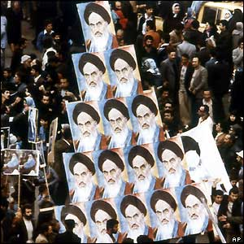
The Revolution
Feb. 11, 1979, tanks move through Tehran
Rumors of a military coup flew, but army did not make its move.
Revolutionaries broke into the leading radio station of Tehran and broadcast “This is the voice of the revolution of the Iranian people!”

Slide 11
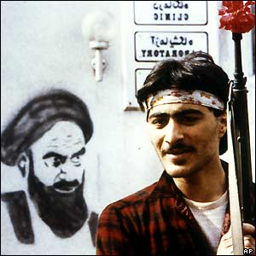
Revolutionary Era Begins
Bakhtiar resigns.
Ayatollah Khomeini wins national referendum by a landslide
Khomeini declares Iran an Islamic republic
Khomeini appointed Iran’s political and religious leader for life

Slide 12
Conclusion: Islam and Nationalism
The Iranian Revolution provides an excellent example of the tensions between secular nationalism and the ideals of political Islam.
The Shah had numerous opponents: clerics, democracy activists, the poor, and traditionalists who resented his secular reforms.
The Shah’s close ties with and support by the U.S. allowed the clerics to articulate opposition to him as an anticolonial jihad.

