Slide 1
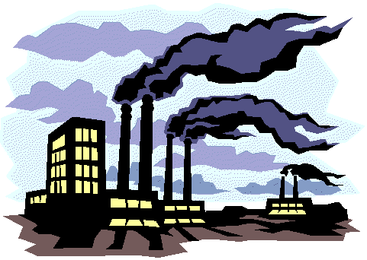
Why the Industrial Revolution Started in Great Britain
1760 AD – 1840 AD in England
1800s-1900s in France and Germany
1840s -1920s in United States

Slide 2
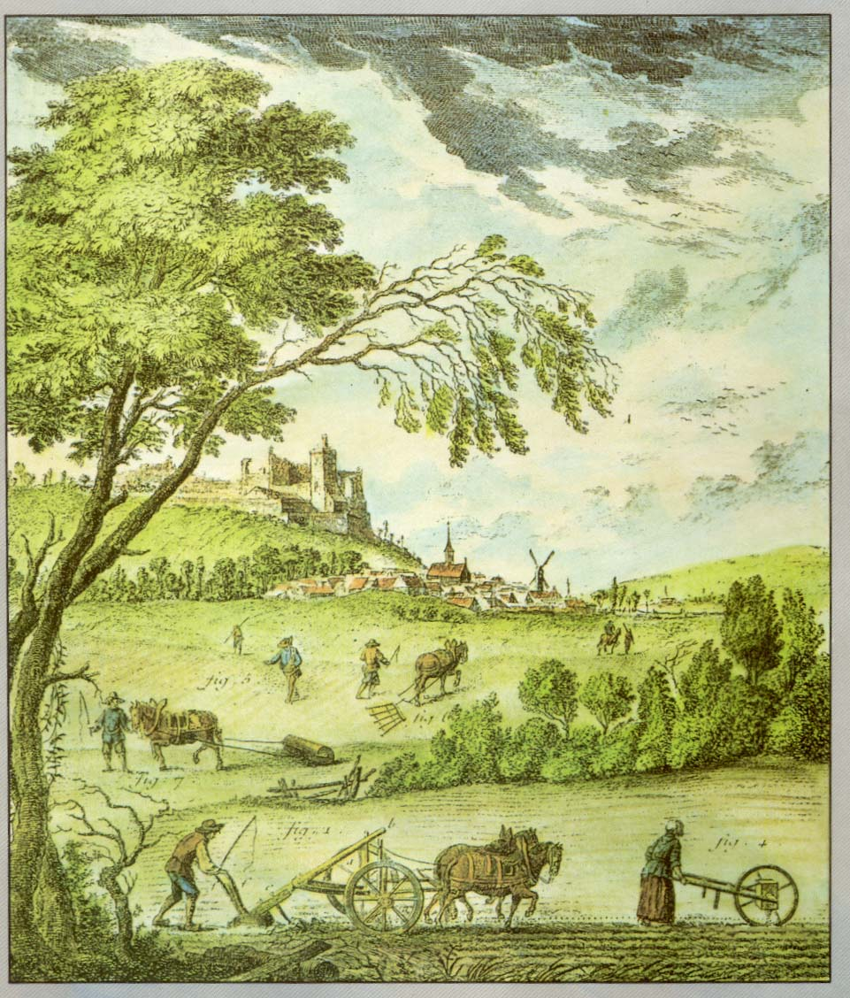

Slide 3
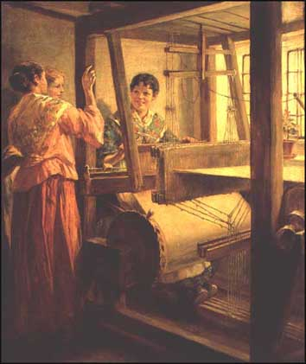
Life in England Before the Industrial Revolution?
8 out of 10 worked in countryside
Subsistence farming
Cottage industries - factories rarely employed more than 50 people
Handmade – buttons, needles, cloth, bricks, pottery, bread etc.
Developing towns – Liverpool,
Birmingham, Glasgow
Welsh spinsters

Slide 4
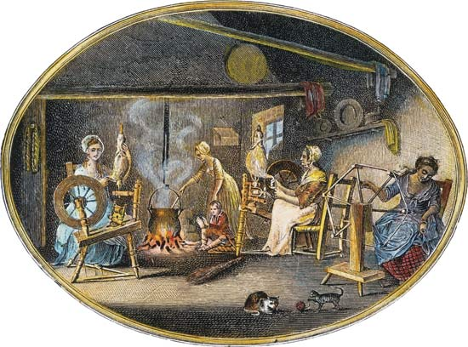
Before the Industrial Revolution: Cottage Industry

Slide 5
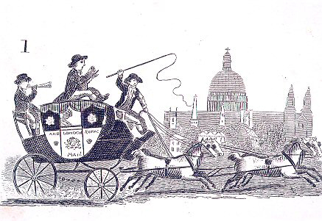
How did people get around before the Industrial Revolution?
‘We set out at six in the morning and didn’t get out of the carriages (except when we overturned or got stuck in the mud) for 14 hours. We had nothing to eat and passed through some of the worst roads I ever saw in my life’
This is a description of a journey by Queen Anne in 1704 from Windsor to Petworth – a journey of 40 miles. What does it tell us about transport at the time?

Slide 6
Definitions of Industrial Revolution and Industrialization
Industrial Revolution: a period of increased output of goods made by machines and new inventions; a series of dramatic changes in the way work was done
Industrialization: the process of developing machine production of goods that led to a better quality of life for people and also caused immense suffering

Slide 7
Two great economic “revolutions” occurred in human development
The Industrial Revolution, started in the eighteenth century, is still taking place today
  Involves a series of inventions leading to the use of machines and inanimate power in the manufacturing process
  Suddenly whole societies could engage in seemingly limitless multiplication of goods and services
  Rapid bursts of human inventiveness followed
  Gigantic population increases

Slide 8
Industrial Revolution
Began around 1750 in Great Britain
New machines led to the Industrial Revolution.
They replaced hand labor and helped workers produce more things faster.
Moving water power in rivers replaced worker’s muscle.
One water wheel could turn hundreds of machines.

Slide 9
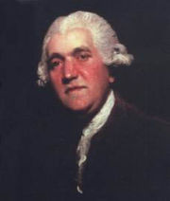

A technological revolution
A series of inventions that built on principles of mass production, mechanization and interchangeable parts
Josiah Wedgwood developed a mold for pottery that replaced the potters wheel, making mass production possible

Slide 10
Industrial Revolution
Machines also started the factory system.
The new machines were too large and costly to be put into a person’s home.
Large buildings called factories were built to hold many of the machines.
The workers in one factory manufactured more in a day than one person working in his or her home could manufacture in a lifetime.

Slide 11
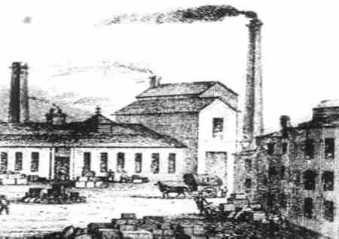

Slide 12
Industrial Revolution
Steam engines began to appear in the 1700s.
This important invention used wood or coal as fuel to heat water in a boiler.
Steam from the hot water powered the engine, which ran the machines.
Since a steam engine could be placed anywhere, factories no longer had to be built along rivers.
They could be built near fuel, raw materials, or labor.

Slide 13
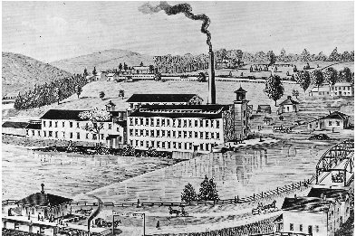

Slide 14
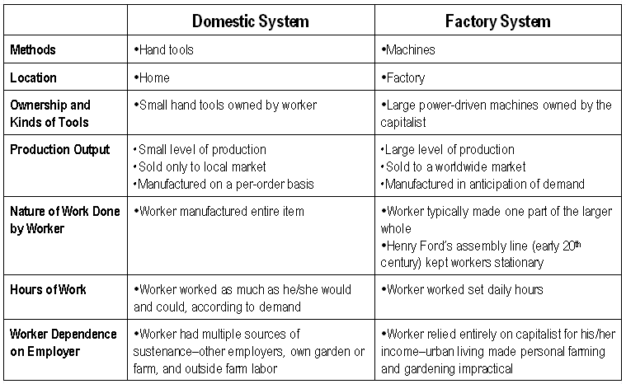

Slide 15
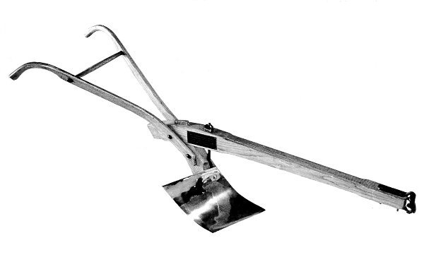
Origins---Why England?
Agricultural Revolution
  Horse and steel plow
  Fertilizer use
  Yields improved 300% 1700-1850
Growth of foreign trade for manufactured goods
  Foreign colonies
  Increase in ships and size
Successful wars and foreign conquest

Slide 16
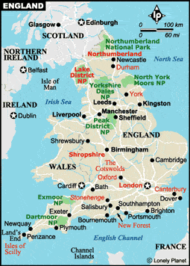
Origins – Why England?
Factors in England
  No civil strife
  Government favored trade
  Laissez-faire capitalism
  Large middle class
  Island geography
  Mobile population
  Everyone lived within 20 miles of navigable river
  Tradition of experimental science
  Weak guilds

Slide 17


The Agricultural Revolution
During the early 1700's, a great change in farming called the Agricultural Revolution began in Great Britain.
The revolution resulted from a series of discoveries and inventions that made farming much more productive than ever before.
By the mid-1800's, the Agricultural Revolution had spread throughout much of Europe and North America.
One of the revolution's chief effects was the rapid growth of towns and cities in Europe and the United States during the 1800's.
Because fewer people were needed to produce food, farm families by the thousands moved to the towns and cities.

Slide 18
Agricultural Revolution
More food was available.
Food production increased over 60% during the 1700s; twice the rate between the 1500s and 1700s.
Introduction of new crops, Columbian Exchange, from the New World.
English farmers began to raise potatoes which proved cheap and nourishing.
Other new crops indirectly benefitted humans as they improved animal feed: corn, buckwheat, carrots and cabbage.
This new animal feed produced larger quantities of better tasting meat and milk.

Slide 19
Agricultural Revolution
Enclosure Movement---allowed landowners to fence off land through the use of hedges and resulted in the loss of common lands used by many small farmers
Development of More Effective Farming Methods
a)Townshend---crop rotation
b)Bakewell---animal breeding
c)Tull---seed drill
*These advances displaced smaller farmers who now needed new employment
*Provided large land-owning farmers with more money to invest

Slide 20
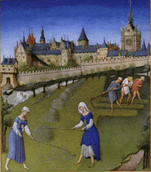
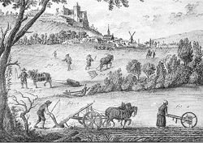

Agricultural Revolution
15th and 18th
Century Farming
Notes:
- 1st Picture: Peasants ranking and cutting hay in the 15th Century
2nd Picture: Farming Methods in Early 18th Century
Very little change
Common land still unenclosed and outside the village in the 18th century
Economy of Europe was agrarian
Used the three-field system: 1/3 of the land left idle to restore fertility

Slide 21
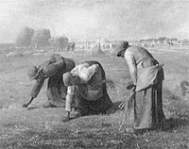
The Open-field System
Cooperative plowing
Conserved the quality of land
Balanced distribution of good land
Farmers were part of a “team”
Gleaning
Notes:
The Open-field System:
- England was divided into a number of fields which surrounded a village
- 1/3 left fallow
- further divided into rectangular sections called furlongs
-Furlongs were divided into narrow 1 acre strips
- Certain pasture and forest were set aside as common land

Slide 22
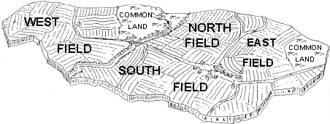
OPEN FIELD SYSTEM---Old System
ADVANTAGES
All villagers worked together
All the land was shared out
Everyone helped each other
Everyone had land to grow food
For centuries enough food had been grown

Slide 23
OPEN FIELD SYSTEM---Old System
Strips in different fields
Fallow land
Waste of time
Waste of land
Common land
DISADVANTAGES

Slide 24
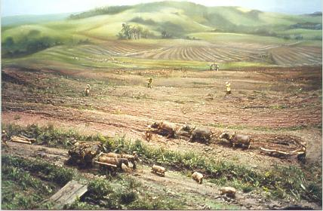
Disadvantages of the Open Field System
People have to walk over your strips to reach theirs
Field left fallow
Difficult to take advantage of new farming techniques
No hedges or fences
No proper drainage
Because land in different fields takes time to get to each field
Animals can trample crops and spread disease
Notes:
Show picture first and ask for ideas about what the problem might be. Introduce and explain – encourage note taking at this stage in brief bullet points

Slide 25

Why did the Open Field System change?
What was
happening to population?

Slide 26
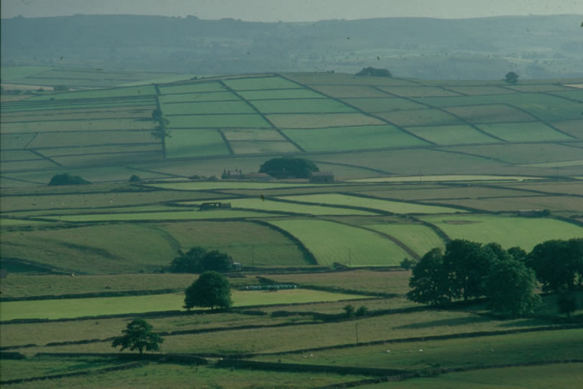
Causes of the Industrial Revolution
  A. Farming Changes: During the 1700’s, farmers were able to reclaim more land to plant, made better use of land, and used fertilizer to improve the soil.
  B. Enclosure Movement: In the 1700’s, rich landowners and the English Parliament began taking away land from peasants and were able to harvest more which made farming profitable.

Slide 27
Enclosures?
This meant enclosing the land with fences or hedges.
The open fields were divided up and everyone who could prove they owned some land would get a share.
Dividing the open land into small fields and putting hedges and fences around them.
Everyone had their own fields and could use them how they wished.
Open land and common land would also be enclosed and divided up.
Notes:
Encourage own research of the enclosures, what it meant both good and bad.

Slide 28
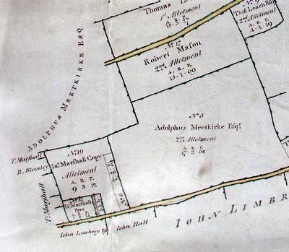
Common lands are enclosed; larger farms are created

Slide 29
Enclosure Movement
By the late eighteenth century enclosures were becoming very common in Great Britain.
Enclosure simply meant joining the strips of the open fields to make larger compact units of land.
These units were then fenced or hedged off from the next person’s land.
This meant that a farmer had his land together in one farm rather than in scattered strips.
The farmer now had a greater amount of independence.
This was not a new idea
Enclosures had been around since Tudor times, but increased dramatically in the 1700s because they made it easier for farmers to try out new ideas.

Slide 30
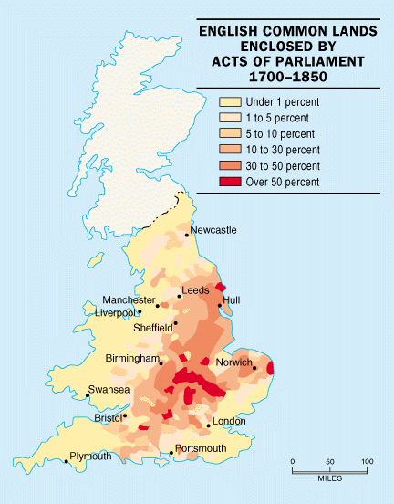
The Enclosure Movement

Slide 31
Methods of Enclosure
During the later 1770s, the number of enclosures in Britain increased because they made it easier for farmers to try out new farming techniques.
Farmers could now invest in new machinery for use on their land, work in one area and not waste time walking between strips of land.
The enclosed land was also useful for farmers wanting to experiment with selective breeding and new crops from abroad.
There were two ways for villages to enclose land.
One was by getting the whole village to agree among themselves, which was more common during the early 18th century.
The second was by an Act of Parliament. By 1770, landowners were forcing enclosure on their local village by using an Act of Parliament.

Slide 32
“Enclosed” Lands Today

Slide 33
Ways to Enclose
There were two ways to enclose a field.
Before 1740 most villages were enclosed by agreement.
This was when all of the major landowners in the village made a private agreement to join their strips together.
This possibly meant buying out smaller farmers.
When a small number or farmers did not want to sell their land an Act of Parliament had to be obtained.
This became seen as perfectly acceptable after 1750 because it had a number of really good points:
1. Each piece of enclosed land had legal documentation.
2. It provided a forum for opposition to be heard.
3. It allowed the whole village to be enclosed at the same time.

Slide 34
Role of Parliament with Enclosure Movement
So how did Parliamentary enclosures take place?
A village meeting was held and the owners of three quarters of the village's land had to agree to enclosure. In many cases, the Lord of the Manor and his friends owned three quarters of the land.
A petition was drawn up by landowners asking Parliament to pass an act enclosing local land.
A notice about the petition was placed on the village church door.
Parliament considered the petition and then passed an Enclosure Act and sent three commissioners to supervise the enclosure and decide who had the right to land in the village.
The commissioners then drew up a new map of the enclosed fields.

Slide 35
So did people want to enclose their land?
Well, some did and some didn’t. If they did not agree it was hard luck.
If the owners of four-fifths of the land agreed, they could force an Act of Parliament-
There was a great increase in the number of these in the eighteenth century, from 30 a year to 60, then from 1801 to 1810 there were 906, nearly 3 million hectares were enclosed.

Slide 36
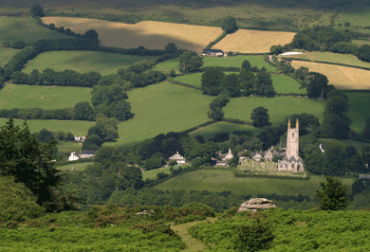

Slide 37
Benefits to the Enclosure Movement
Some agricultural improvers enclosed their land so as to reduce wastage.
It also meant it was easier for them to make decisions about changing the use of the land.
Because enclosure brought a farmer’s lands together, it was worth investing in machinery, lime, manure or seed from one strip to another.
Enclosures would also help farmers interested in selective breeding.
It also made it worthwhile to dig drainage ditches around their fields.
Historians generally agree that farmers enclosed land in order to produce a greater tonnage, thereby earning bigger profits.
In addition, where land was enclosed, landlords could charge tenants higher rents.

Slide 38
So what’s wrong with that?
Nothing - if you could
prove you owned the land,
if you had the money for
fences and hedges and if you
could afford to pay the
commissioners to come
and map the land,
not to mention the cost of an Act
of Parliament.

Slide 39
Groups That Supported The Enclosure Movement
Landowners: They made large profits from the enclosures because the new fields were more efficient, and they could charge their tenants higher rents.
Tenant Farmers: They did not mind the higher rents, because they were making so much profit that they could afford new machinery and the best fertilizer.
Labourers: They were given more work digging ditches, planting hedges, and building roads. Many of them even gained new homes on their master’s estates.

Slide 40
Groups That Were Against The Enclosure Movement
Smallholders: Many villagers lost land and were forced to become labourers, either because they could not prove their right to the enclosed land or because they could not afford to enclose the land.
Landless Labourers: People like squatters really suffered, because the common land was turned into enclose land. Many of them were left hungry.

Slide 41
Were there winners and losers?
Yes, the better off farmers and landowners gained the most - the rich got richer and the poor got poorer.
People who had no written proof of ownership lost their land altogether.
Some couldn’t afford to pay for fences and had to sell their land.
These people either became labourers on other peoples land or headed for the towns to try and get a job.
One farm labourer said: ‘All I know is that I had a cow and an Act of Parliament has taken it from me.’
There were riots in some villages.
Notes:
Look at the research already done and ask if they could understand what the farm labourer meant.

Slide 42
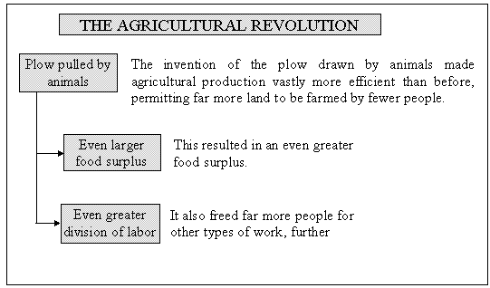
Invention of the Plow

Slide 43
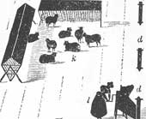
Better food production methods are developed. Nitrogen was recognized as an important fertilizer. Turnips and clover replaced lost nutrients. Science and Agriculture merged.

Slide 44
The appliance of organic chemistry solved the old problem of keeping soil fertile.
A scientist, Justus von Leibig, discovered that chemicals known as nitrates and phosphates were the most important nutrients needed by plants and crops.
The best source for this was crushed animal bones which could be spread on the fields.
Organic Chemistry

Slide 45
Selective Breeding?
Some farmers such as Robert Bakewell and the Culley brothers
This meant only allowing the fittest and strongest of their
cattle, sheep, pigs and horses to mate.
You can tell how successful they were:
In 1710 the average weight for cattle was
168 Kg by 1795 - it was 363 Kg
Notes:
Find pictures of the animals they bred – do they look healthy by today’s standards, what does it tell us about how they thought of their achievements that they had portraits painted.

Slide 46
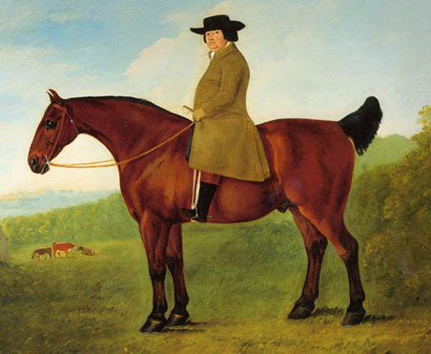
Robert Bakewell

Slide 47
Selective Breeding
Robert Bakewell
He was a pioneering selective breeder. His new methods were simple:
He only chose the best farm animals and bred from them. His most successful animals were the New Leicester Sheep and the Dishley Longhorn cattle.
They were bigger animals, but they did not have better meat.
Bakewell kept detailed records about his livestock, made sure they were very healthy and their stables and pens were always clean.
He was so successful that other farmers often hired his animals to breed from.
Bakewell also wrote articles and pamphlets describing his new breeding techniques and their advantages.

Slide 48
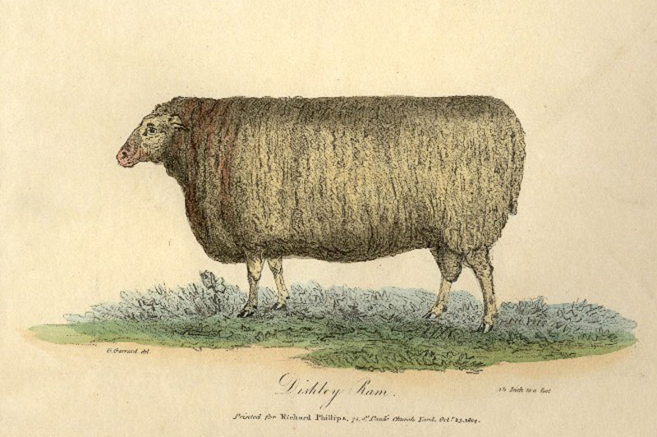
Robert Bakewell and Selective Breeding of Sheep

Slide 49
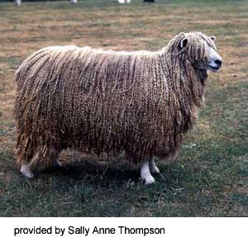
Development of the Breed by Bakewell in 1700s
Bakewell was the first to utilize modern animal breeding techniques in the selection of livestock.
His selection techniques changed a coarsely boned, slow growing Leicester into an animal that put on weight more rapidly and produced less waste when slaughtered.
Robert Bakewell deserves recognition for his work with these sheep because it changed livestock farming forever and because it influenced the work of people such as Charles Darwin and Gregor Mendel.

Slide 50
The Colling or Culley Brothers
They were also selective breeders, but not as well known as Robert Bakewell.
They improved on Robert Bakewell's methods and their main success was breeding the Durham Shorthorn cattle, which were able to produce large amounts of milk and high quality lean meat for sale at market.

Slide 51
Charles Townshend-Crop Rotation
Charles 'Turnip' Townshend
He popularised new techniques and proved that they were more profitable.
He introduced the Norfolk Four-Course Crop Rotation (wheat, turnips, barley, clover) to Britain.
Turnips were used as a cleansing crop to allow the land to be hoed to kill the weeds, and clover was grown to replace the nutrients in the soil that the crops had depleted.
This rotation prevented land from lying fallow and both turnips and clover were fodder crops, which could be fed to animals to allow more of them to survive cold winters.
Used a method called marling, which mixed rich subsoil with a poorer sandy soil to produce better quality crops and increasingly more profit.
Gave his tenant farmers longer leases to encourage them to invest more money to experiment with new ideas and improving their land.

Slide 52
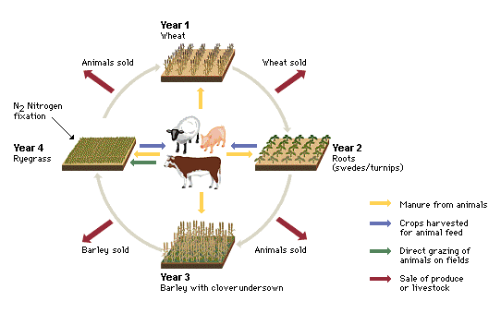

Slide 53
Norfolk Crop Rotations
This system meant that no land had to remain fallow. The system worked like this:
Each area of land would be split into four sections.
The crop that was grown on each field would be rotated so that different nutrients would be taken from the land.
In the first year turnips or another root crop would be grown;
In the second year barley was grown in the field (barley could be sold at a profit);
In the third year clover or a grass crop was grown and in the fourth year wheat was grown in the field (wheat could also be sold for a profit).

Slide 54
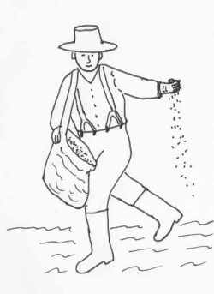
Planting Crops Before The Seed Drill

Slide 55
Tull and Seed Drill
Up until this period, farmers planted the seeds for cereal crops by carrying the seeds in a bag and walking up and down the field throwing or broadcasting the seed.
They broadcast the seed by hand on to the ploughed and harrowed ground.
The problem with this method was that it did not give a very even distribution.
It was not, therefore, an efficient use of the seed and much of it was wasted.
Jethro Tull invented a Seed Drill which could be pulled behind a horse.
It consisted of a wheeled vehicle containing a box filled with grain.
There was a wheel-driven ratchet that sprayed the seed out evenly as the Seed Drill was pulled across the field.

Slide 56
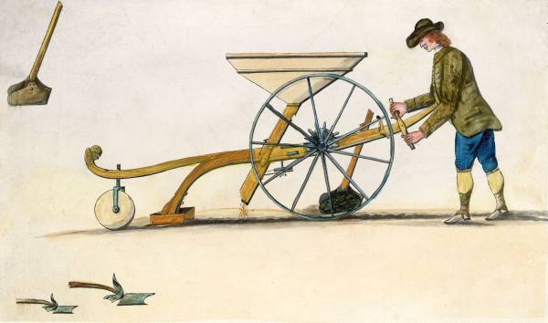
The First Seed Drill
1900s

Slide 57
Jethro Tull
He is important because he introduced ideas that others went on to develop.
In 1701, he invented a horse-powered seed drill that planted seeds at the same depth in straight lines.
This wasted less seeds and allowed farmers to manage their crops more easily.
In 1714, he invented a horse-drawn hoe that made it easier for farmers to weed between their seed rows.
In 1731, he wrote a book called "Horse Hoeing Husbandry", which promoted new farming ideas.

Slide 58
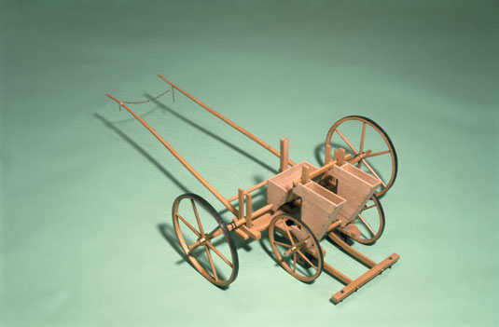
Tull’s Seed Drill

Slide 59
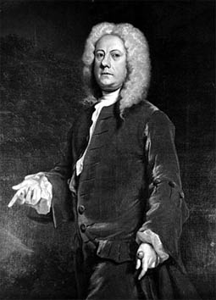
Jethro Tull and the Seed Drill
Since earliest times seeds had always been sown by hand
People who worked on the land would walk over the fields randomly scattering handfuls of grain
.Jethro Tull invented a machine which greatly helped to increase the harvest yield by planting seeds in straight lines.
Tull was far more interested in the farming methods employed on his land, which he called Prosperous Farm.
Tull travelled throughout Europe to study new farming techniques.
On his return to Prosperous Farm in 1701, he developed a horse-drawn mechanical Seed Drill.
The Seed Drill not only planted seeds at regular intervals but also planted them at the right depth and covered them with earth.
Because the seed drill planted seeds in straight lines, a mechanical horse-drawn hoe, which Tull also invented, could be used to remove weeds from between the lines of crop plants.

Slide 60
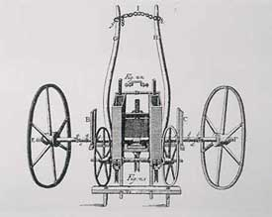
Tull’s Seed Drill

Slide 61
Jethro Tull
Tull advocated the importance of pulverising (crumbling) the soil so that air and moisture could reach the roots of the crop plants. His horse-drawn hoe was able to do this.
He also emphasised the importance of manure and of tilling the soil during the growing season.
At the time, Tull's ideas came under attack, mainly because they were new.
His Seed Drill was not immediately popular in England, although it was quickly adopted by the New England colonists across the Atlantic.
In 1731, Tull wrote a book called "Horse-houghing (hoeing) Husbandry" which he revised in 1733.
Although his Seed Drill was improved in 1782 by adding gears to the distribution mechanism, the rotary mechanism of the drill provided the foundation for all future sowing technology.

Slide 62
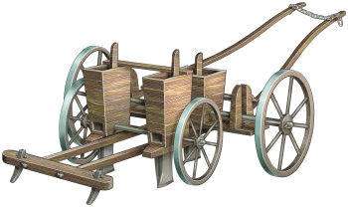
Seed Drill

Slide 63
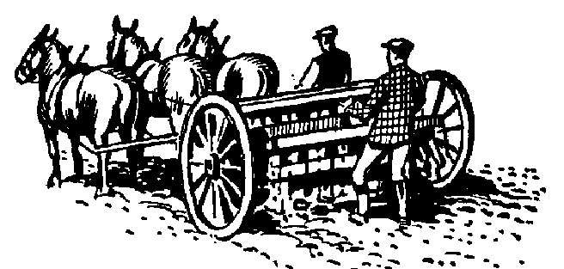

Slide 64
A New Agricultural Revolution
Improved Methods of Farming | Enclosure Movement | Population Explosion
Dikes for land reclamation Fertilizer Seed Drill – Jethro Tull Crop rotation | Rich landowners fenced in land formerly shared by peasant farmers. Output rose with fewer workers Tenants displaced Moved to cities | Britain’s population rose from 5 million in 1700 to 9 million in 1800. Declining death rates Reduced risk of famine.

Slide 65
Publicity to Encourage the Agricultural Revolution?!
Yeah, books were written on farming, there were model farms set up - George III set up one at Windsor.
The Board of Agriculture was set up and Arthur Young, the new secretary, went round the country recording the progress of the revolution and others could read his report to find out more.
Agricultural shows with competitions were held and people could exchange ideas and see the latest things.

Slide 66
Adam Smith, The Wealth of Nations, 1776
“The food produced by a field of potatoes is not inferior in quantity to that produced by a field of rice, and much superior to what is produced by a field of wheat. Twelve thousand weight of potatoes from an acre of land is not a greater produce than two thousand weight of wheat. The food or solid nourishment, indeed, which can be drawn from each of those two plants, is not altogether in proportion to their weight, on account of the watery nature of potatoes. Allowing, however, half the weight of this root to go to water, a very large allowance, such an acre of potatoes will still produce six thousand weight of solid nourishment, three times the quantity produced by the acre of wheat. An acre of potatoes is cultivated with less expense than an acre of wheat; the fallow, which generally precedes the sowing of wheat, more than compensating the hoeing and other extraordinary culture which is always given to potatoes. Should this root ever become in any part of Europe, like rice in some rice countries, the common and favorite vegetable food of the people, so as to occupy the same proportion of the lands in tillage which wheat and other sorts of grain for human food do at present, the same quantity of cultivated land would maintain a much greater number of people, and the laborers being generally fed with potatoes, a greater surplus would remain after replacing all the stock and maintaining all the labor employed in cultivation. A greater share of this surplus, too, would belong to the landlord. Population would increase, and rents would rise much beyond what they are at present.”

Slide 67
But it wasn’t all good news
New machines meant less people were needed to work the land - so there was unemployment, enclosure meant people lost land - this meant losing their homes as they had nowhere to grow food and there was little work- so they moved to towns.
In addition there were change in the
way the land looked from
open fields to a sort of patchwork quilt.
Changes in the shape of a village
as people could build on their own land

Slide 68
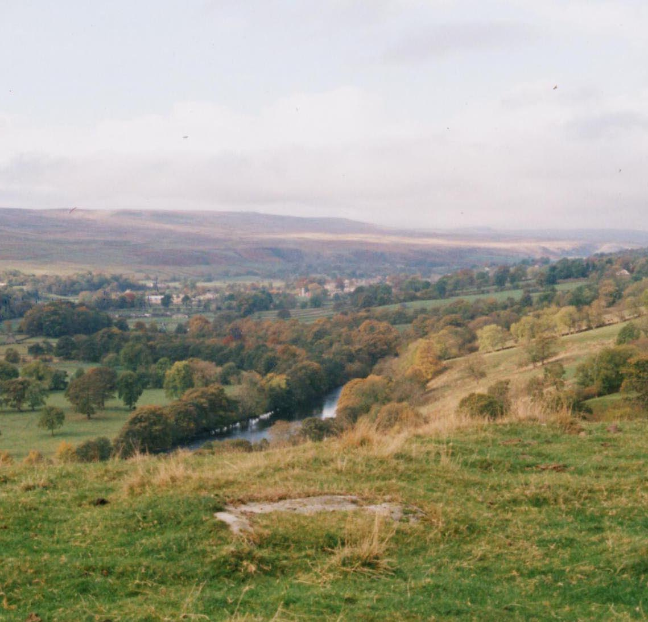
Effects in the Countryside
The only successful farmers were those with large landholdings who could afford agricultural innovations.
Most peasants:
  Didn’t have enough land to support themselves
  Were devastated by poor harvests (e.g., the Irish Potato Famine of 1845-47)
  Were forced to move to the cities to find work in the factories.

Slide 69
England’s Resources: Geography
England is the political center of Great Britain, an island
Great Britain (as the entire island was called beginning in 1707) did not suffer fighting on its land during the wars of the 18th century
Island has excellent harbors and ports
Damp climate benefited the textile industry (thread did not dry out)

Slide 70
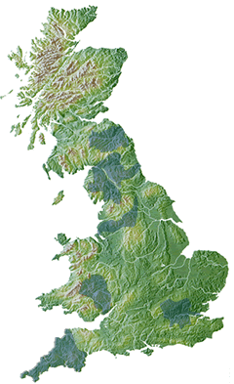
A country with many rivers and streams…so water power can be harnessed.

Slide 71
Natural Resources/Geography
Rich in natural resources
Large number of harbors and rivers that could be used year-round for shipping
Water also could be used as a power source
Huge supplies of iron and coal---raw materials for the building of machines and fueling the new machines
The damp climate was good for textile production, because it helped to keep the fibers in the material soft and easy to work with.
Separated from the continent, Britain was able to remain apart from the wars plaguing Europe during the 1600 and 1700s and thus conserve their resources.

Slide 72
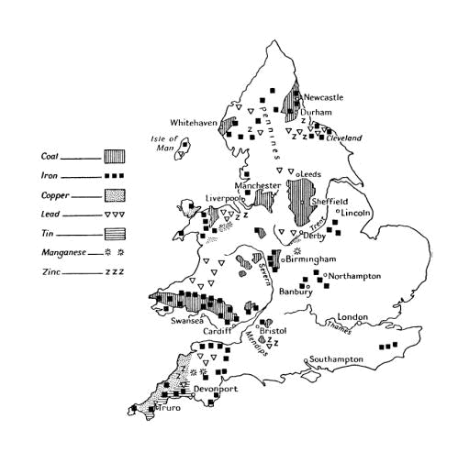

Slide 73
Natural Resources/Geography
England substituted coal for charcoal in the manufacturing of iron because by the 1700s, most of the forests were gone.
In 1708, the Darby family of Coalbrookdale started smelting iron using coke that was processed from coal. It made the highest quality of iron.
Since England had a large supply of coal, it was able to dominate the iron industry.

Slide 74
Coal Mining in Britain:
1800-1914
1800 | 1 ton of coal | 50, 000 miners
1850 | 30 tons | 200, 000 miners
1880 | 300 million tons | 500, 000 miners
1914 | 250 million tons | 1, 200, 000 miners

Slide 75
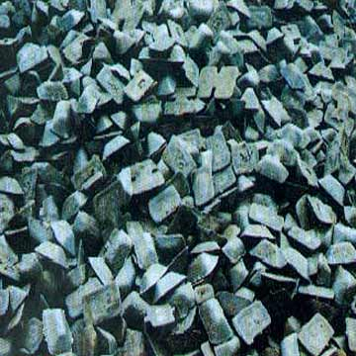
Output of Pig Iron - Selected Countries, Annual Averages
(in thousand metric tons)
 | UK | France | Germany | Austria | Belgium | Russia
1781-90 | 69 | 141 | - | - | - | -
1825-29 | 669 | 212 | 90 | 85 | - | 164
1855-59 | 3,583 | 900 | 422 | 306 | 312 | 254
1875-79 | 6,484 | 1,462 | 1,770 | 418 | 484 | 424
1900-14 | 8,778 | 2,665 | 7,925 | 1,425 | 1,070 | 2,773

Slide 76
Large Labor Supply
Growing population of workers due to the improvements in farming---more food available leads to better diet and longer life expectancy
1700---less than 7 million, 1800---11 million
Rapid population growth increased demand for goods
Displaced farmers due to the enclosure movement took over jobs in factories and mining
Birth rates rose in the 1700s, while death rates dropped.
In 1700 in London, there was a half-million more deaths than births.
By 1800 in London, the deaths only outnumbered births by 20,000.

Slide 77
Large Labor Supply
The death rate dropped because more babies were surviving childbirth due to the better training of midwives and formation of maternity hospitals.
Both children and adults were dying less from disease.
The major health epidemics like the Bubonic Plague had vanished in Britain after 1660 and the Great Fire of London.
Other major diseases followed a similar pattern like Syphilis which stopped being an epidemic in the 1700s.
Inoculations started in 1760 with Jenner’s Smallpox vaccine.
Other reasons for the reduction of the epidemics are unknown.

Slide 78
Social Factors
Most people moved to the cities instead of living in rural areas.
This was only seen in Britain and Germany.
By the mid 1800s, 70% to 80% of Britain’s population lived in urban areas.

Slide 79
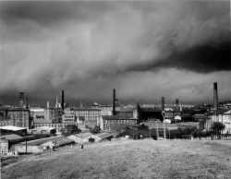
Society During the Industrial Revolution
  Urbanization-The movement of people from the country to the city.
  Social Classes during the Industrial Revolution
    Upper class elite, 5%
    (owned most of the country’s wealth)
    Middle classes, 15% (women worked at home raising kids)
    Lower classes, 80% (lived mostly in tenement housing-tightly packed apartment like housing)

Slide 80
Openness to New Ideas
Due to the increase in wealth and the middle class due to exploration and colonization of the New World, the middle class was willing to invest in the new industries.
By the end of the 1700s, the investments earned them 50% returns.

Slide 81
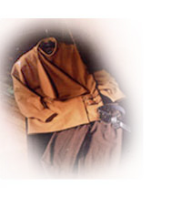
The first inventions are in the textile industry. With the increased population, the demand for cloth was great.

Slide 82
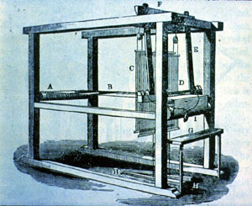
Flying Shuttle
John Kay
1733
Hand-operated machine which increased the speed of weaving

Slide 83
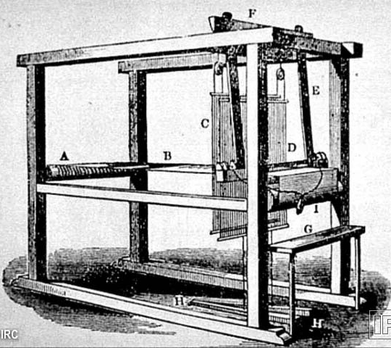
John Kay’s “Flying Shuttle”

Slide 84
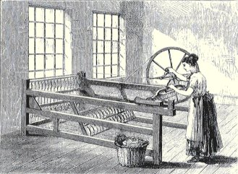
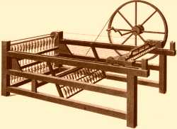
Spinning Jenny
James Hargreaves---1765
Home-based machine that spun thread 8 times faster than when spun by hand

Slide 85
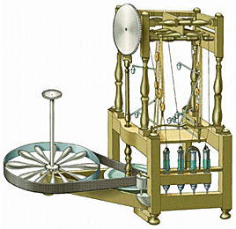
Water Frame
Richard Arkwright
1769
Water-powered spinning machine that was too large for use in a home – led to the creation of factories

Slide 86
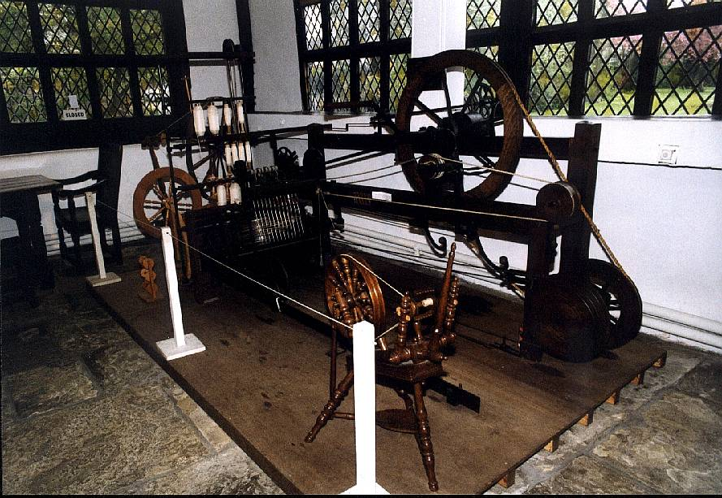
Spinning Mule
Samuel Crompton
1779
Combined the spinning jenny and the water frame into a single device, increasing the production of fine thread

Slide 87
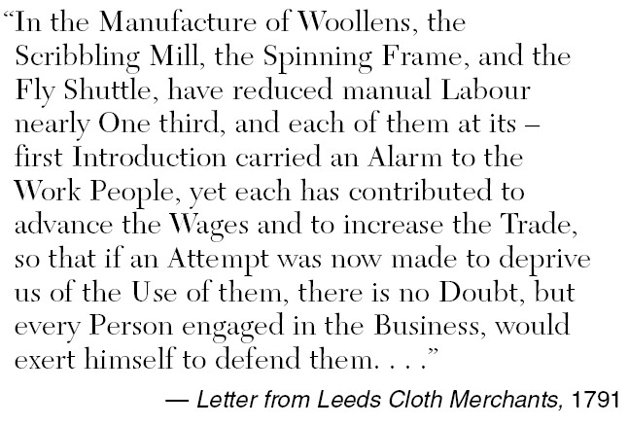

Slide 88
Edmund Cartwright---Power Loom
1785
Water-powered device that automatically and quickly wove thread into cloth

Slide 89
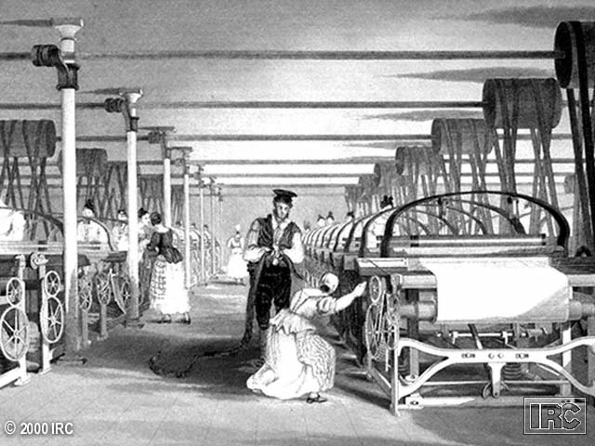
The Power Loom

Slide 90
James Watt (1736-1819) and Steam Engine
Improved Atmospheric Engine of Savery and Newcomen by adding separate condenser for steam.
Perfected flywheel
Made double reciprocating engine: steam drives piston in both directions
1000 steam engines in England in 1800

Slide 91
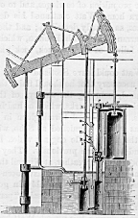
Watt’s Steam Engine

Slide 92
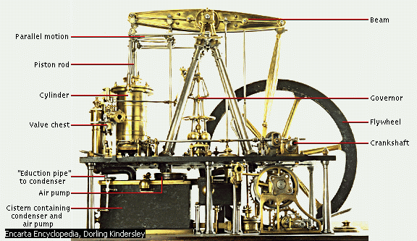
Openness to New Ideas: Inventions
Steam Engine-
  Provided a new source of power in factories.
  Eventually redesigned by James Watt
  Led to all factories being run by steam and not water.
    The location of factories was now unlimited

Slide 93
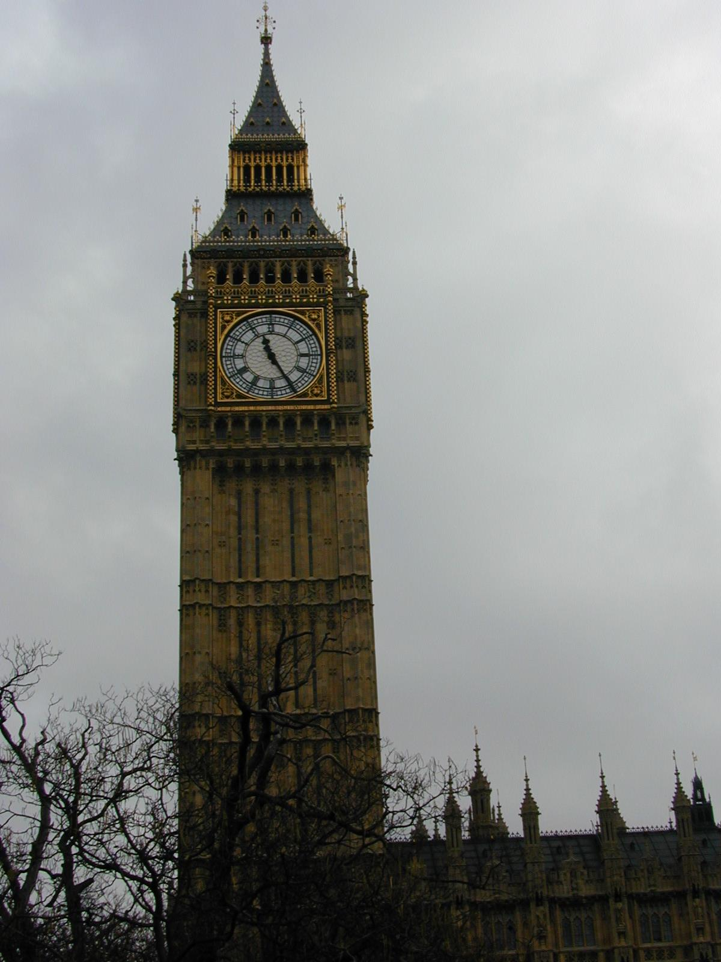
Government: Parliament
Parliament helped by providing a favorable business climate
  Provided a stable government
  Passed laws to protect private property
  Very few restrictions on private enterprises

Slide 94
British Government Supporting The Growth
From 1760 – 1774, Parliament passed over 500 laws related to building more and better roads
Between 1790 and 1794, the British Parliament passed 89 laws concerning the building of new canals.
The government pursued Laissez-Faire Capitalism and did not regulate working hours, pay, conditions, child labor, environmental issues, etc…that allowed for fast and cheap growth.

Slide 95
Colonial Empire
Britain’s colonial empire encouraged industrialization.
Because Britain had a lot of control over its colonies, it created and enforced the economic system of Mercantilism.
Britain purchased and imported raw materials from her colonies.
From these raw materials, British companies produced manufactured goods which they sold back to the colonies and to Europe.
British controlled colonies provided a ready-made, steady market for British goods.
The war ravaged European continent also imported British goods which increased the demand on British industries and pushed the industries to produce more.

Slide 96


How ‘Great’ was Britain?
British empire growing – Canada, West Indies, Africa, India & America
Imported goods from plantations, e.g. cotton, tobacco & sugar
Exported – cloth, pottery, metal goods

Slide 97
The Industrial Revolution
Benefits of Industrialization
  Better clothes, better heat, better food
  Increased goods
  More jobs
  More opportunities

Slide 98
Advantages of Industrializing First
Growth of early British factories was impressive.
As early as 1820, only 30% of the British labor remained in agriculture, while 80 to 100% of the continental labor was still devoted to agriculture.
Britain was able to specialize in industry and import agricultural products from the continental Europe.
Due to the effects of the French Revolution and the Napoleonic Wars, the Industrial Revolution was delayed in continental Europe. It would not arrive until 1830.
The French only began industrializing in the period 1830 – 1871, and only with a focus on luxury items and small-scale manufacturing.
German industrialization happened even later in the 1870s and 1880s after the German unification process.

Slide 99
England vs. Continental Europe
Produced 20% of industrial goods
Gross national product rose 4x
Population increase
Inventors took inventions abroad
Belgium’s coal and iron resources
Germany iron and wool factories
France slow to industrialize

Slide 100
The Industrial Revolution
Effects--- Working Conditions
  Men, women, and children worked 12-16 hours a day
  Working conditions were very dangerous & made little money

Slide 101
Social Implications
Urbanization
New demands on city services
Separation of work from home—home becomes a place to produce children, not goods.
Clock/calendar regimented life styles
Child labor

Slide 102


