Slide 1
The Philosophy of Hegel
AP European History

Slide 2
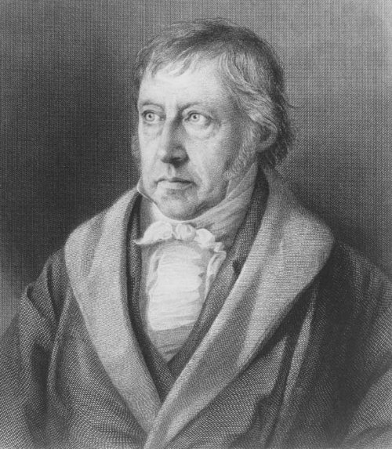
Who was Hegel?
Georg Wilhelm Friedrich Hegel was born in Stuttgart, Germany, in 1770.
Hegel worked as a professor in various German universities, where he became well acquainted with Romanticism, to which his ‘Hegelianism’ would largely be a response.
Notes:
While Hegel was at the various universities, he worked alongside minds such as Schelling, and got a thorough background in theology and philosophy. He was especially influenced by Kant, whose attempt at reconciling the two schools of thought on the nature of reality left an impression on Hegel. Hegel’s most important work as a professor was The Phenomenology of Spirit, which we’ll talk about later.

Slide 3
Who was Hegel?
Along with J. G. Fichte and F. W. J. von Schelling, Hegel (1770–1831) belongs to the period of “German idealism” in the decades following Kant. The most systematic of the post-Kantian idealists, Hegel attempted, throughout his published writings as well as in his lectures, to elaborate a comprehensive and systematic ontology from a “logical” starting point. He is perhaps most well-known for his teleological account of history, an account which was later taken over by Marx and “inverted” into a materialist theory of an historical development culminating in communism. For most of the twentieth century, the “logical” side of Hegel's thought had been largely forgotten, but his political and social philosophy continued to find interest and support. However, since the 1970s, a degree of more general philosophical interest in Hegel's systematic thought has also been revived.
Hegel’s work is normally categorized as German idealism, and he is considered specifically to be an absolute idealist.
Hegel was influenced by Immanuel Kant, and Hegel’s work in the philosophy of history would influence Karl Marx.
Like the earlier philosophers, Hegel tried to keep his philosophy systematic, with a logical “starting point” (the way Descartes did with cogito, ergo sum).
Hegel’s Influence
Descartes, Kant, Romanticism
Hegel
Marx, Nietzsche, Sartre
Notes:
While Hegel’s work is considered part of German idealism, a philosophical movement that included the important German thinkers of the time, he is really the creator of absolute idealism, which basically states that all of existence is united in one identity. That’s complicated, but we’ll get to it later. Hegel’s work synthesized most of the thinking of his time, and went on to influence mostly social and political philosophers and existentialists.

Slide 4
Absolute Idealism
Hegel is considered the creator of the school of thought called absolute idealism.
Some background: Kant’s transcendental idealism and Berkeley’s subjective idealism state that reality is essentially based on perception. Hegel disagreed, and published this alternate theory.
Absolute idealism describes how being is an all-inclusive whole.
This means that since the subject (a thinking being) can know an object (the world), there must be some sort of identity that connects the two, or else there would be no certain way of knowing anything.
Notes:
Absolute idealism means that for me to know you, there has to be some sort of identity that connects us. That identity is called the “world spirit,” which we’ll get to in a minute. Hegel made clear that thinking and being were not the same, however, and so he came up with an entirely new system to describe this absolute idealism. This new system is called the dialectic process.

Slide 5
The “World Spirit”
To the Romantics, the “world spirit” was the term they used for the deepest meaning of life.
In Hegel’s work, the “world spirit” (Weltgeist) is reason itself.
Hegel believed that the “world spirit” is continuously expanding toward knowledge of itself.
The “world spirit” comes to know itself in three stages: the subjective spirit (the individual), the objective spirit (the family, society, and state), and the absolute spirit (art, religion, and philosophy).
Notes:
When Hegel defines the world spirit as reason, he also defines reason as the sum of all human utterances. What does that mean? It means reason is the sum of all human thought, culture, and art. That equals the “world spirit” because only man has a spirit. This also means that he believed all knowledge was human knowledge, which means that there is not any absolute truth beyond human reason. That’s very different from previous beliefs about truth.

Slide 6
The Dialectic Process
First, someone puts forth a claim: this is called a thesis.
Then, someone else puts forth a contradictory claim: an antithesis.
A third party forms a synthesis, which accommodates the best of both points of view.
Hegel’s favorite example was that the thesis of being and the antithesis of non-being, or nothing, was resolved in the synthesis of becoming.
Notes:
The dialectic process is the name Hegel gives to the historical chain of reflections that makes up the development of the awareness of the “world spirit.”

Slide 7
The Dialectic Process
Not Dialectic
Synthesis: Blue
Antithesis: Yellow
Synthesis: Green
Dialectic
Synthesis: Blue -> Baby Blue
Antithesis: Yellow -> Pale Yellow
Synthesis: Mint Green
To Hegel, the dialectic process is an observed historical phenomenon – not a “prediction” – in which the best of two opposing points of view are “sublated,” or combined.

Slide 8
Hegel’s Philosophy of History
His philosophy was mostly a method for understanding history.
He believed that philosophers, and all thinkers, could not be considered outside their historical context.
The reason he stressed this is because his belief on truth was that since the basis of human understanding changes from one generation to the next, there is no eternal truth, but rather right and wrong relate to a certain historical context.
In fact, to Hegel, “truth” was that same process of history – in a sense.
Notes:
So recap on Hegel and history: he believed history was the story of the “world spirit” – human reason, consciousness – coming to knowledge of itself, and that this was done through the dialectic process. He emphasized that all truth is of the moment, that things are right and wrong in a particular historical context, but not necessarily forever. This is somewhere in between subjective truth – the truth is up to the individual – and objective truth – there is one eternal truth. Hegel doesn’t focus on truth, but on reason, which manifests itself in history. That is why Hegel equates truth and history: to him, they are two ways of describing the same thing, reason, the ultimate reality.

Slide 9
“Truth” in Hegel
“Truth” is not an objective entity.
“Truth” is also not subjective in the sense that it is “up to” the individual.
Truth is an evolving reality that develops in the same way that the “world spirit” does, but toward full truth rather than toward full knowledge of itself.
So “truth” isn’t really a thing of the moment; rather it’s a sort of living, growing being that develops alongside history and humanity.

Slide 10
Hegel, Summarized
Absolute idealism states that being is an all-inclusive whole, making it possible for a subject to know an object.
The “world spirit”, or human reason, is in the process of coming to know itself, which is history.
This process is called the dialectic process, which consists of a thesis, an antithesis, and a synthesis.
Since actions can be right or wrong in a given historical context, there is no eternal truth, but rather truth develops alongside the historical process.

