Slide 1
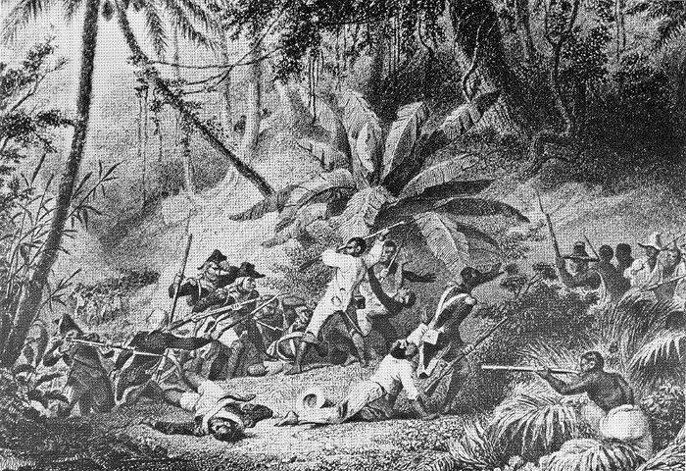
The Haitian Revolution 1791-1804

Slide 2
The Haitian Revolution 1791-1804
Most successful slave revolt in history!
2nd independent nation in the New World!
Proved that enlightenment ideals applied to all people!

Slide 3
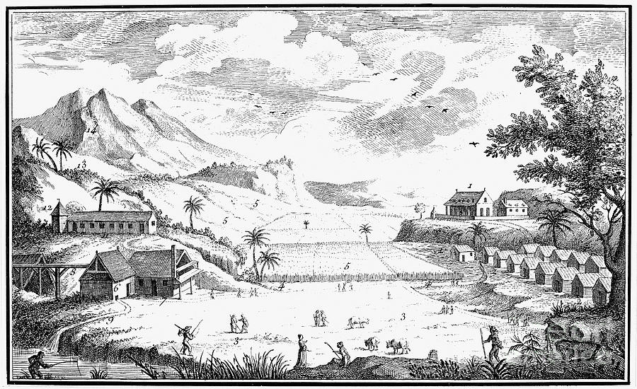
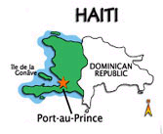
Known as Saint Dominique, Haiti was a French colony and the world's leading sugar producer. It had over 800 sugar plantations and made more profit than all 13 American colonies combined.

Slide 4
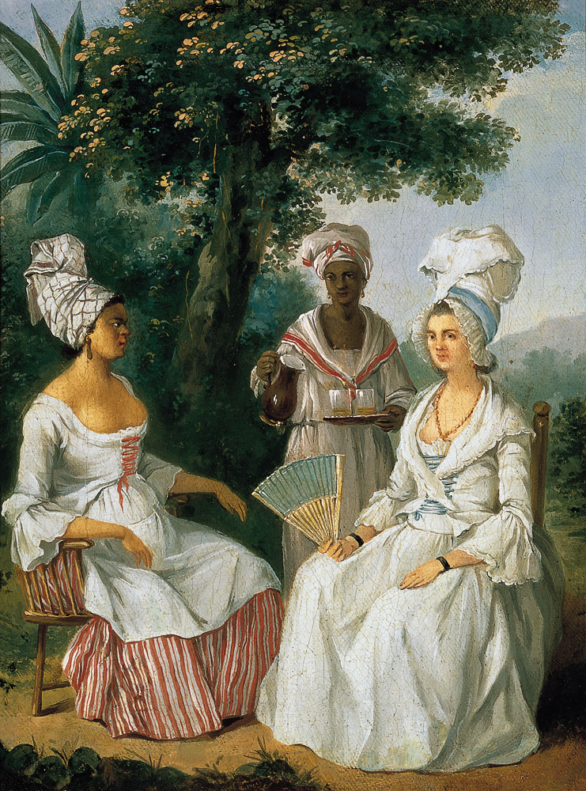
Haitian Population
A few French families made huge profits from sugar, while most Haitians, nearly 500,000 were African slaves
White
6%
Free People of
4% Color
Enslaved Africans
90%

Slide 5
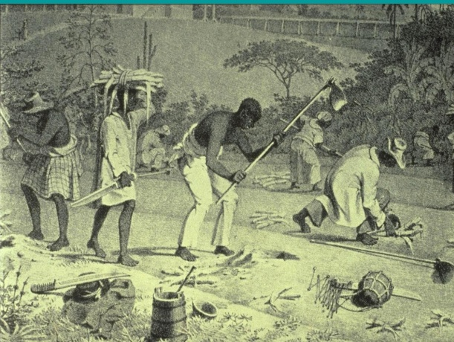
Most slaves worked on plantations and they outnumbered their masters dramatically. White masters thus used brutal methods to terrorize slaves and keep them powerless.

Slide 6
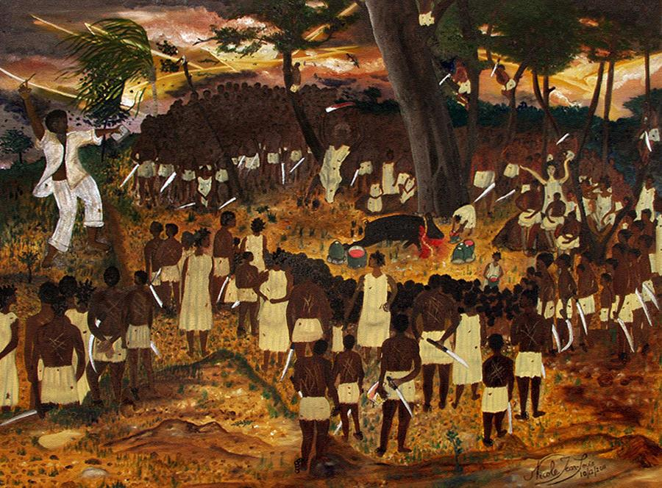
When the French Revolution began, white settlers on Haiti called for independence.
Boukman Dutty, a Haitian slave called on the slaves to have their own revolution!

Slide 7
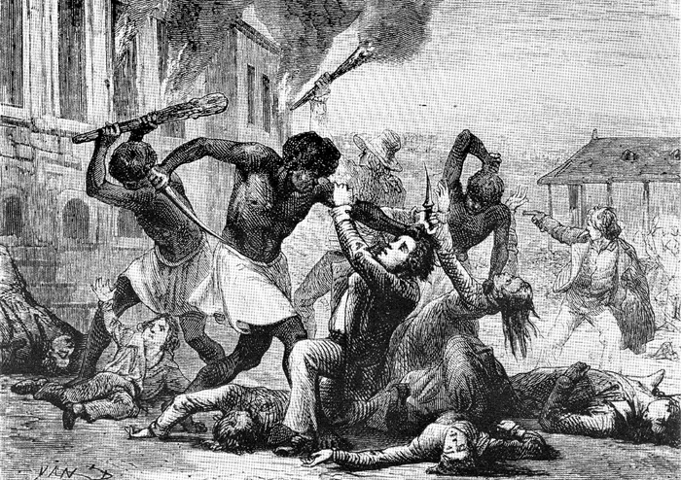
In 1791, about 100,000 slaves rose in revolt. They burned the sugar cane in the fields and killed hundreds of slave owners. The uprising touched off 13 years of civil war in which both sides suffered massacres.

Slide 8
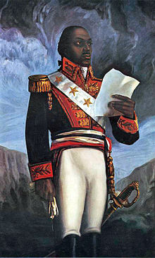
Toussaint L’Ouverture
Wanted to end slavery and gain Independence for Haiti!
He was an educated former slave!
* Rallied slaves to revolt in 1791 – Led armies against French, Spanish and British.
By 1801, he took control of the territory, freed the slaves and created a constitution.
Led first successful slave revolt in New World – Total independence for Haiti in 1804

Slide 9
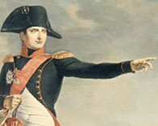
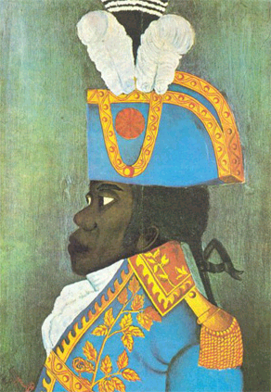
When Napoleon Bonaparte took power in France, he decided to reclaim the rich sugar plantations of Saint Dominique. In January 1802, 16,000 French troops landed in Saint Dominique to get rid of Toussaint.
I want St. Dominique back!
We will stop fighting if you agree to end slavery forever on St. Dominique!
Yes, of course we agree.. Why don’t you come to Paris to discuss this further.
L'Ouverture urged Haitians to fight to the death against the invaders.
However, in May, Toussaint agreed to halt the revolution if the French would end slavery.

Slide 10
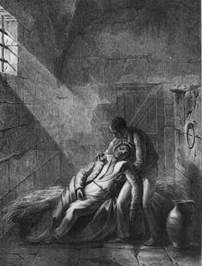
Despite the agreement, the French soon accused him of planning another uprising.
The French sent Toussaint to an icy prison in the French Alps. Ten months later, in 1803, the Haitian leader died.
“In overthrowing me, you have done no more than cut down the trunk of the tree of the black liberty in St.Domingue- it will spring back from the roots, for they are numerous and deep.”
- Toussaint L’Ouverture
In your own words, explain this quote by Toussaint L’Ouverture.
Touissant was captured and died in French Prison.

Slide 11
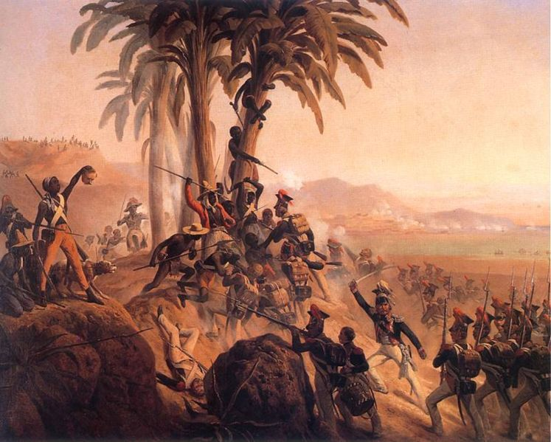
After Toussaint’s death, Haiti was restored to French domination and slavery was re-implemented. However, The taste of freedom that Toussaint had enabled the Haitians to feel was not in vain. They continued to fight the French in a brutal revolution.
Who do you think will win this war? Why?

Slide 12
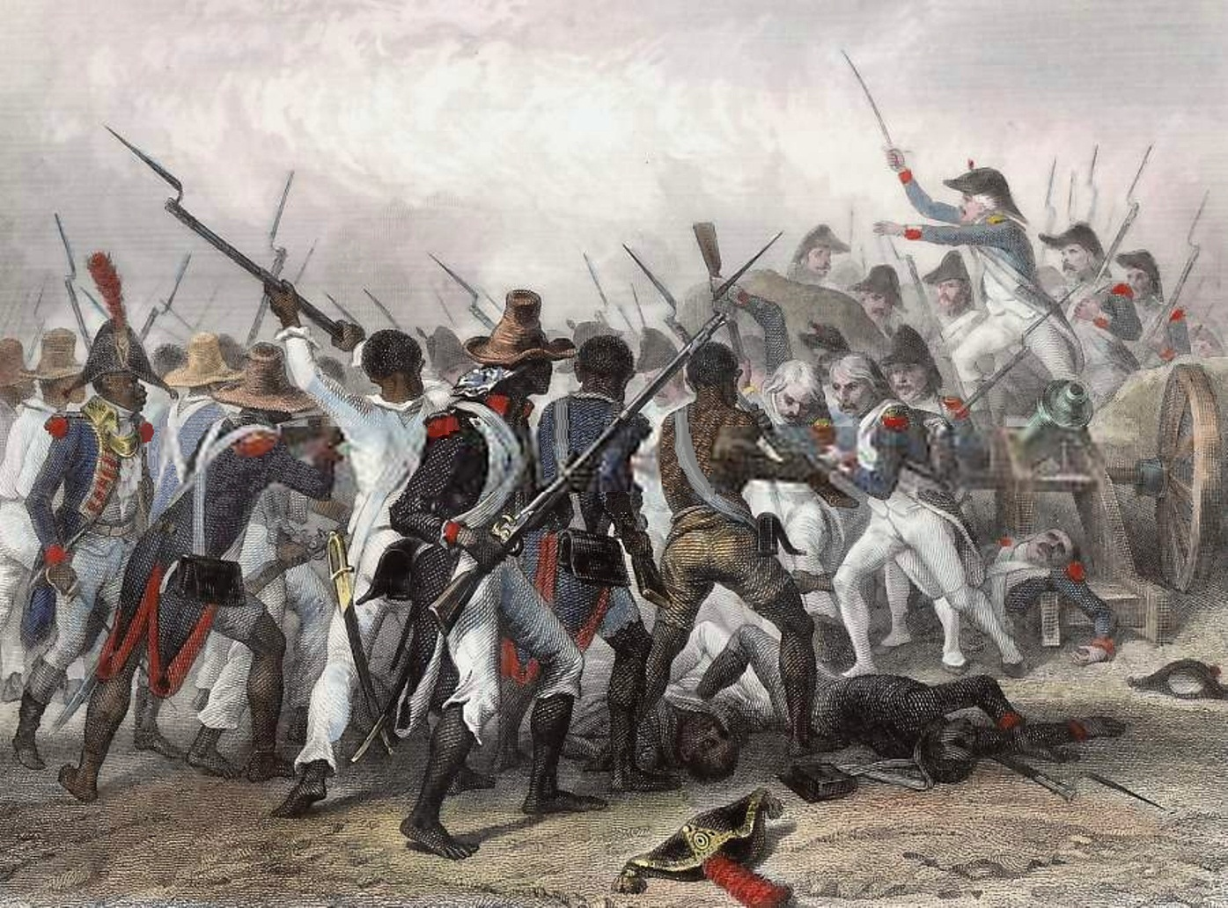
Independence At Last
Led by General Dessalines, the Haitian army fought a brutal war against the French army.
50,000 French soldiers, officers, doctors, and sailors may have died from yellow fever.
Napoleon abandoned Haiti and sold the French territory in North America to the United States (the Louisiana purchase).
First black colony to free itself from European control.

Slide 13
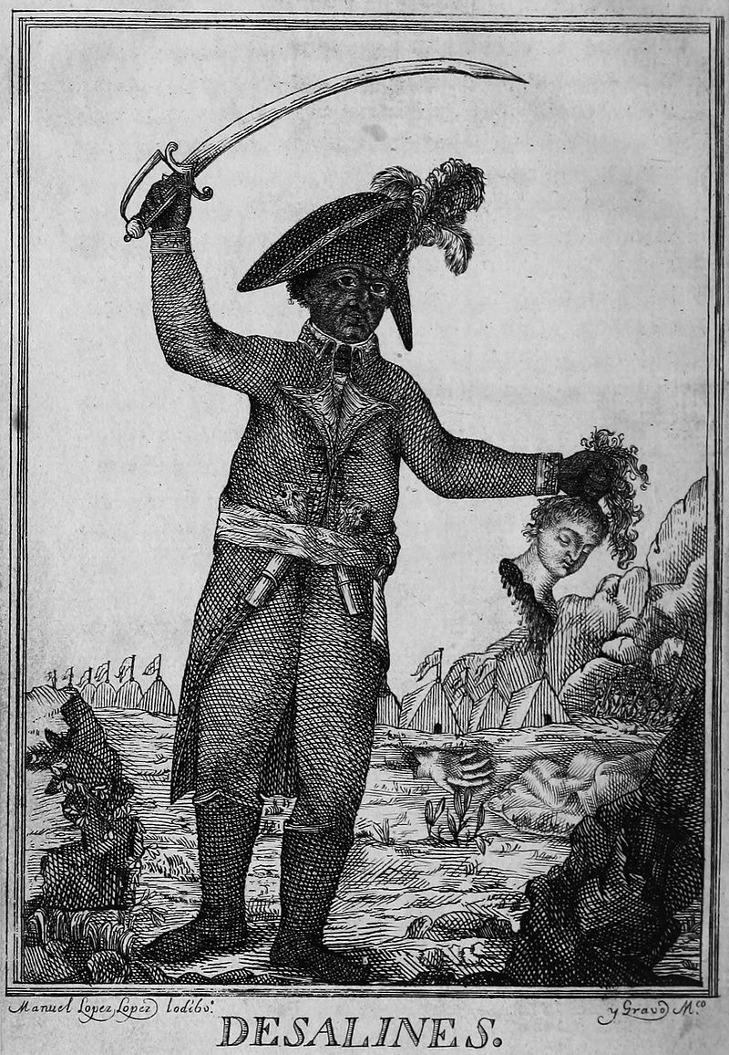
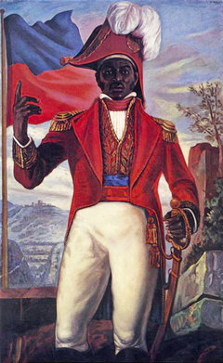
Jean-Jacques Dessalines
Proclaimed himself Emperor of Haiti
1804: After the French surrendered,
Dessalines ordered the mass killings of the remaining white population in Haiti. 3,000-5,000 people were killed
Later assassinated in a revolt.
1820: Haiti became an independent republic

