Slide 1
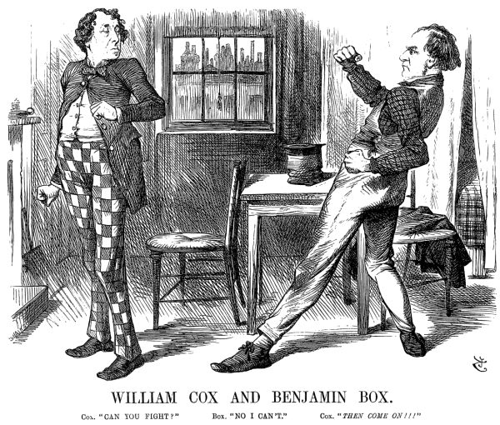
Punch Cartoon on Gladstone

Slide 2
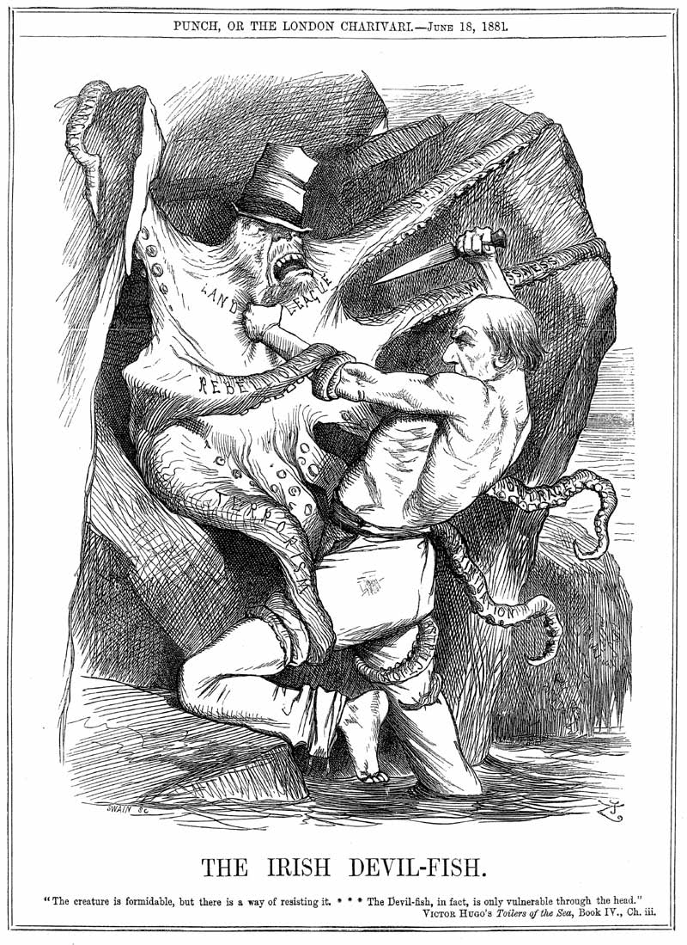
Punch cartoon: Gladstone wrestles with the Irish question

Slide 3
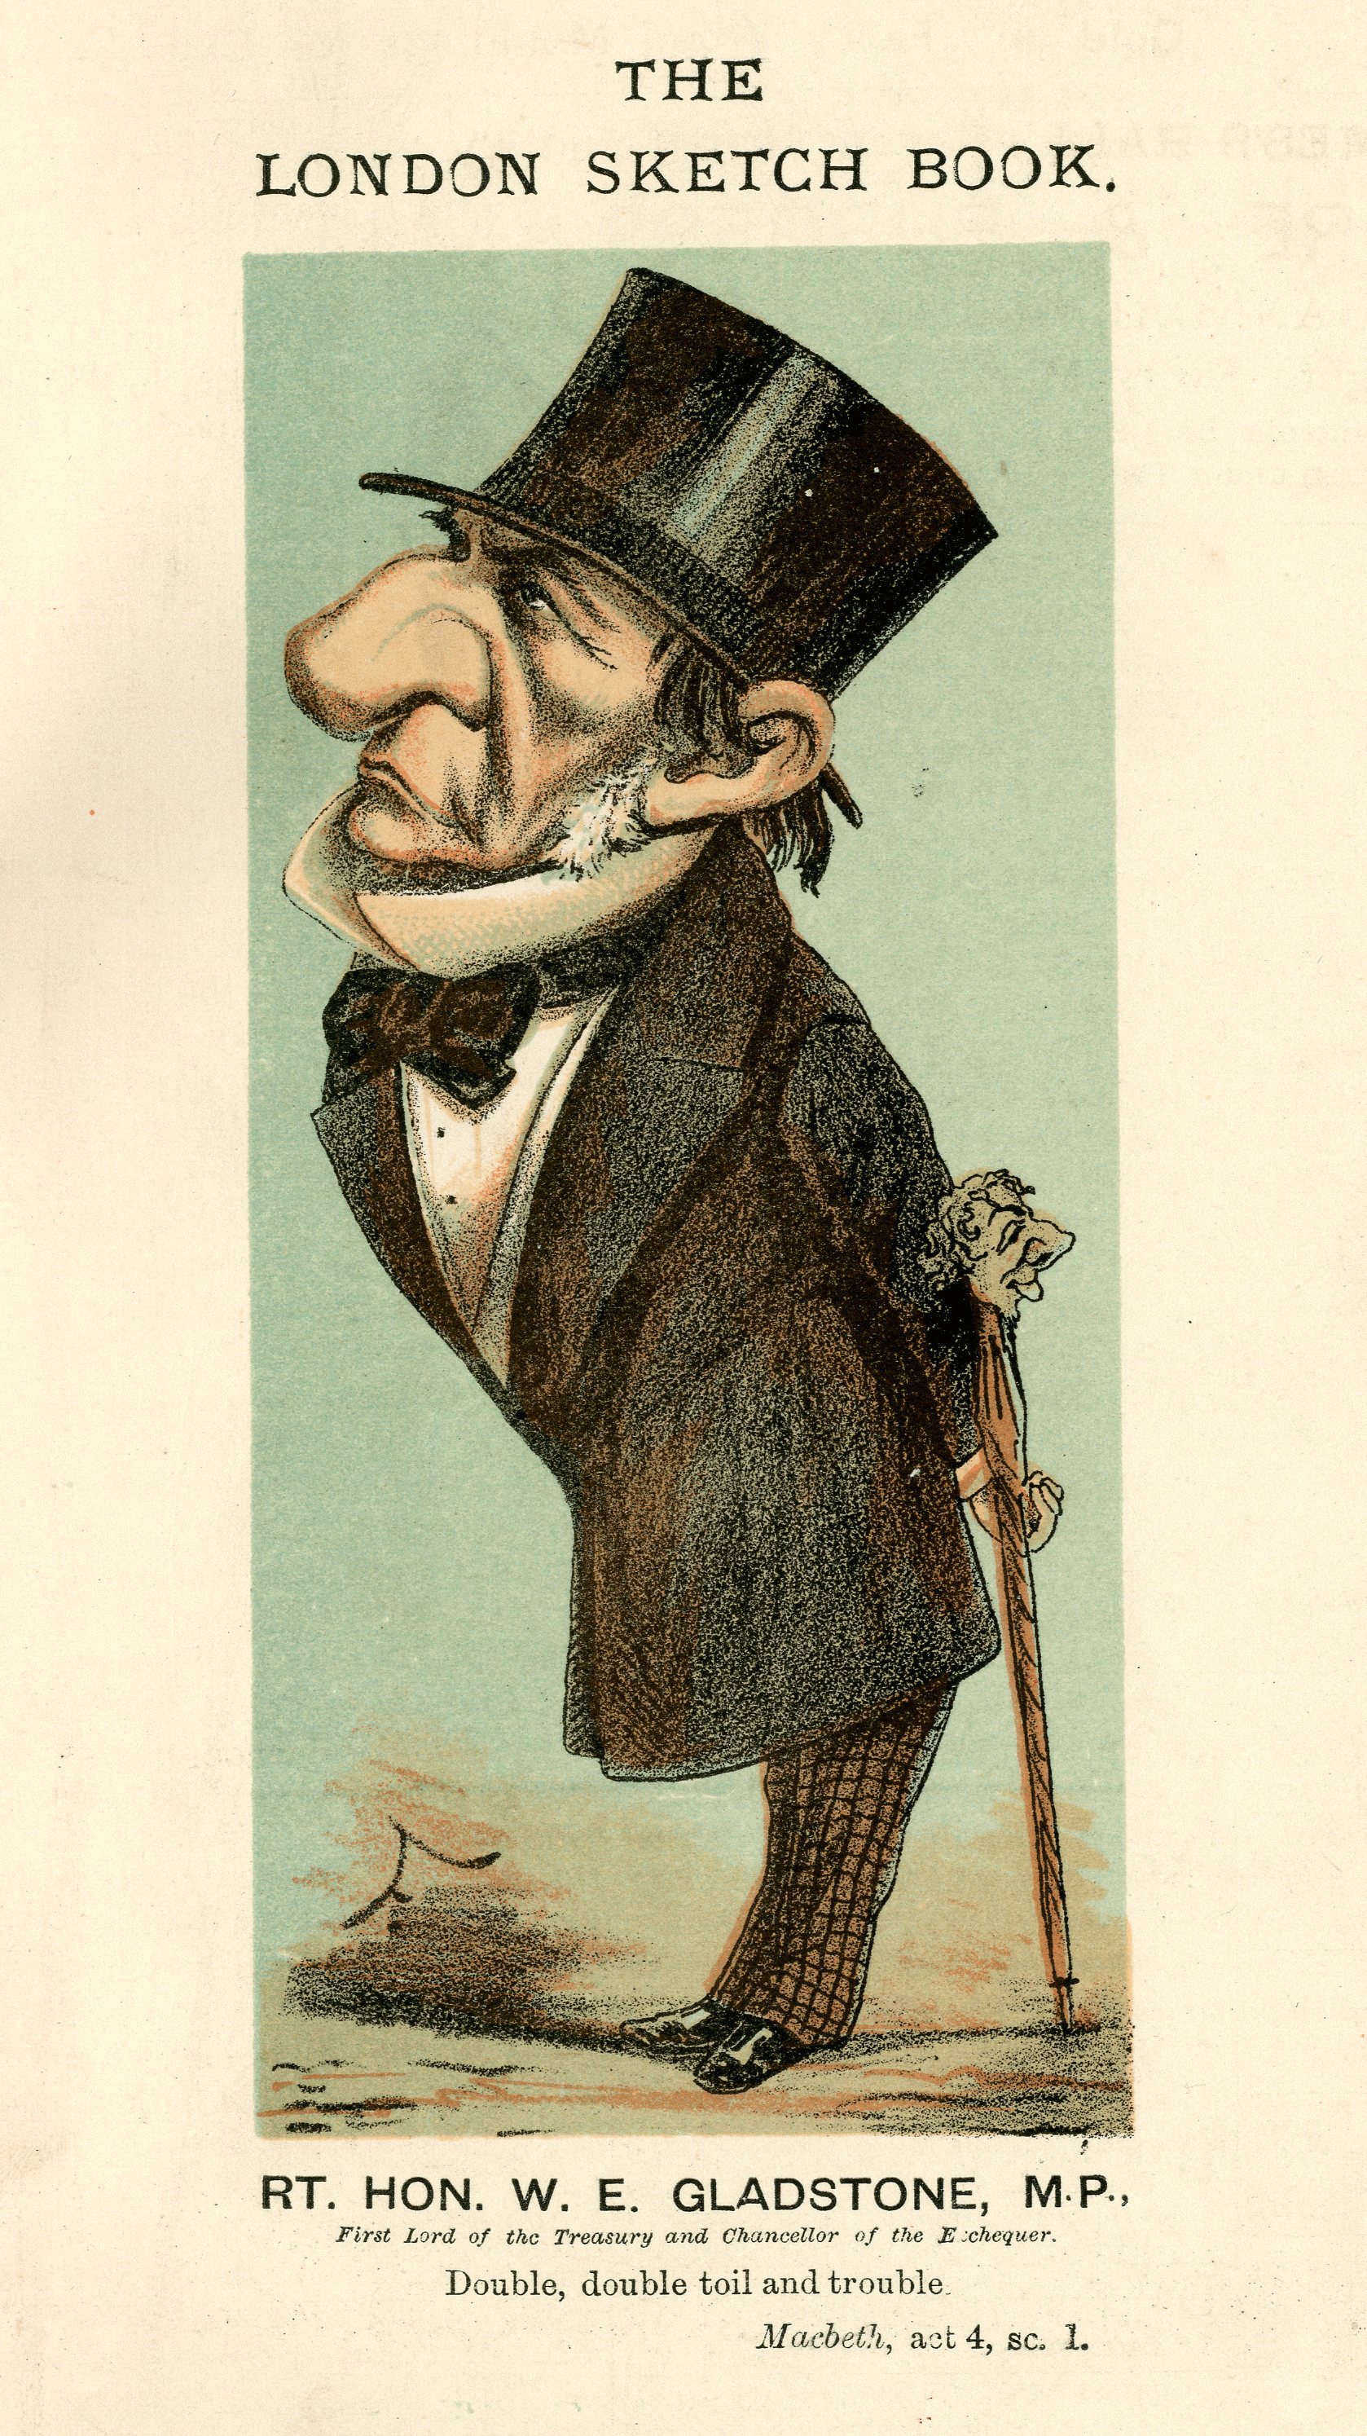
London Sketch Book caricature of Gladstone

Slide 4
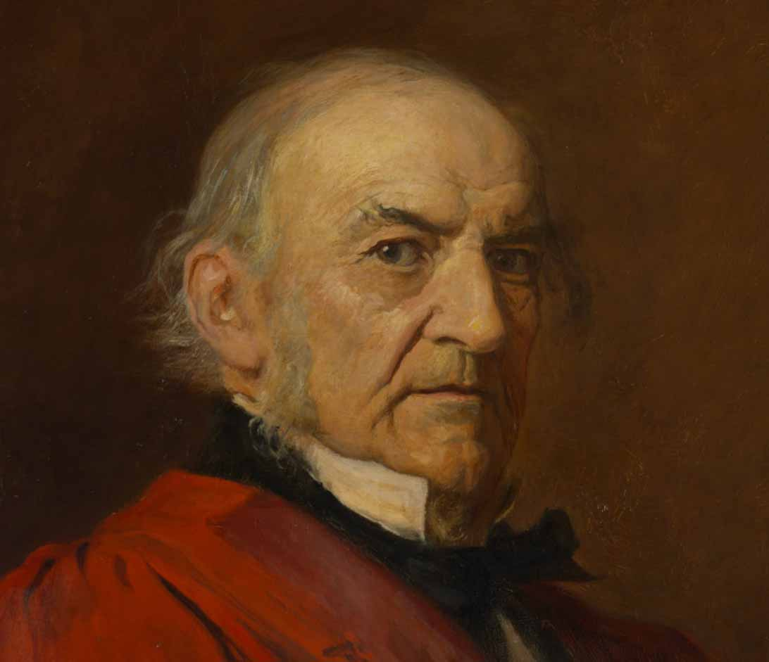
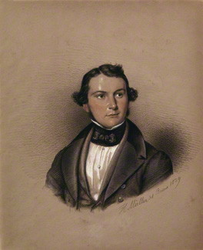
Portraits, young and old

Slide 5
The Gladstone ‘pissing pot’

Slide 6
Gladstone addressing a crowd at Blackheath, 1876

Slide 7
Gladstone the Orator
‘Without an effort … the great orator held his audience for nearly two hours. I stood so far off that the features were indistinct, but I was spellbound by the music and magnetism of the wonderful voice … I was only conscious of the presence of a great human personality, under whose spell I was and from whom I could in no way escape. … I felt lifted into a holy region of politics, where Tories cannot corrupt or Jingoes break through and yell’.

Slide 8
