Slide 1
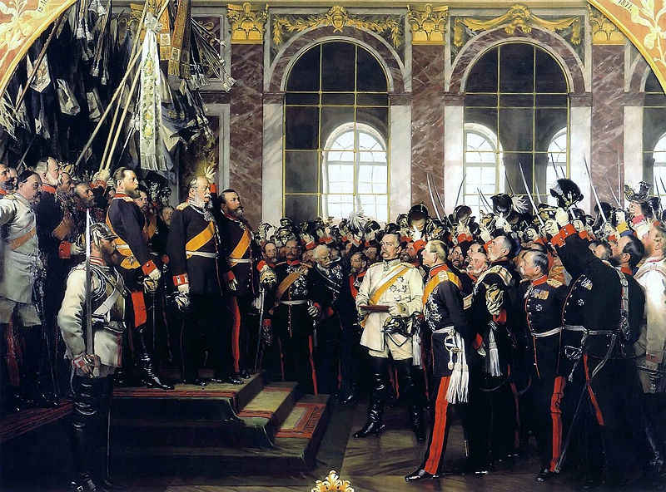
German
Unification

Slide 2
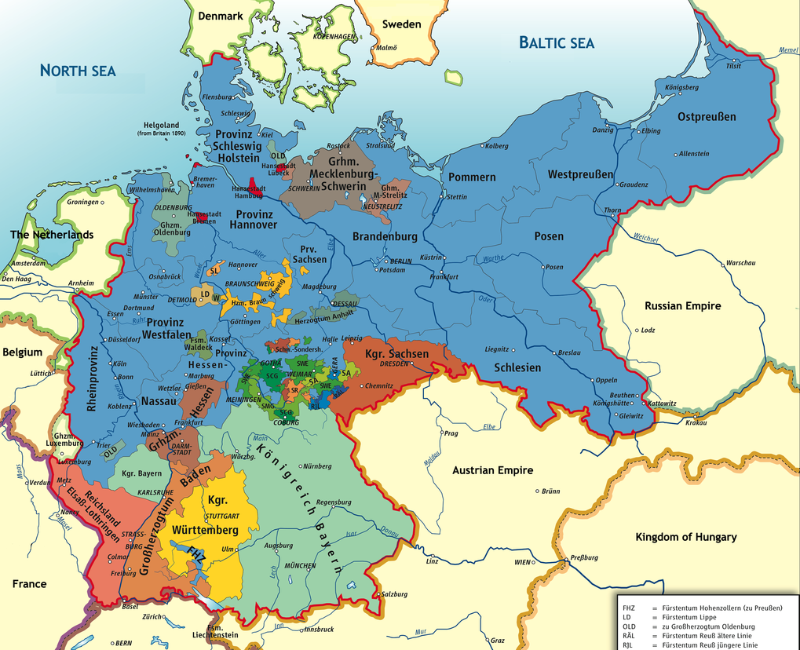
The single most important political development
in Europe between 1848 and 1914
Map Credit: kgberger

Slide 3
A HISTORY
OF DIVISON

Slide 4
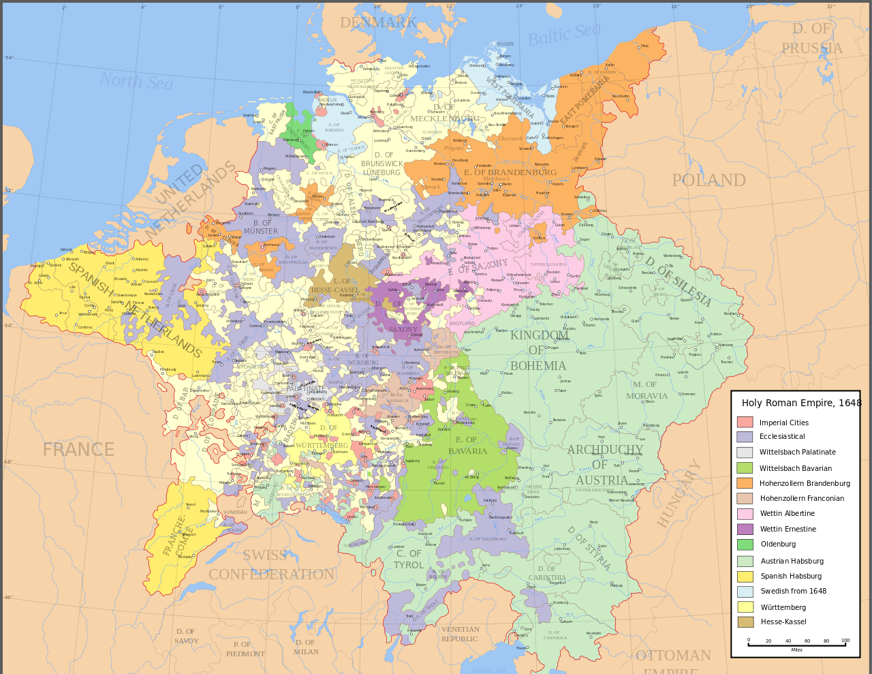
The Holy Roman Empire
962-1806
Several States
Frequent Wars
Map by Astrokey44 (Wikipedia)

Slide 5
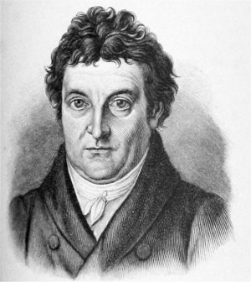
GERMAN NATIONALISM
“The first, original, and truly natural boundaries of states are beyond doubt their internal boundaries. Those who speak the same language are joined to each other by a multitude of invisible bonds by nature herself, long before any human art begins; they understand each other... they belong together and are by nature one and an inseparable whole.”
-- Johann Gottlieb Fichte

Slide 6
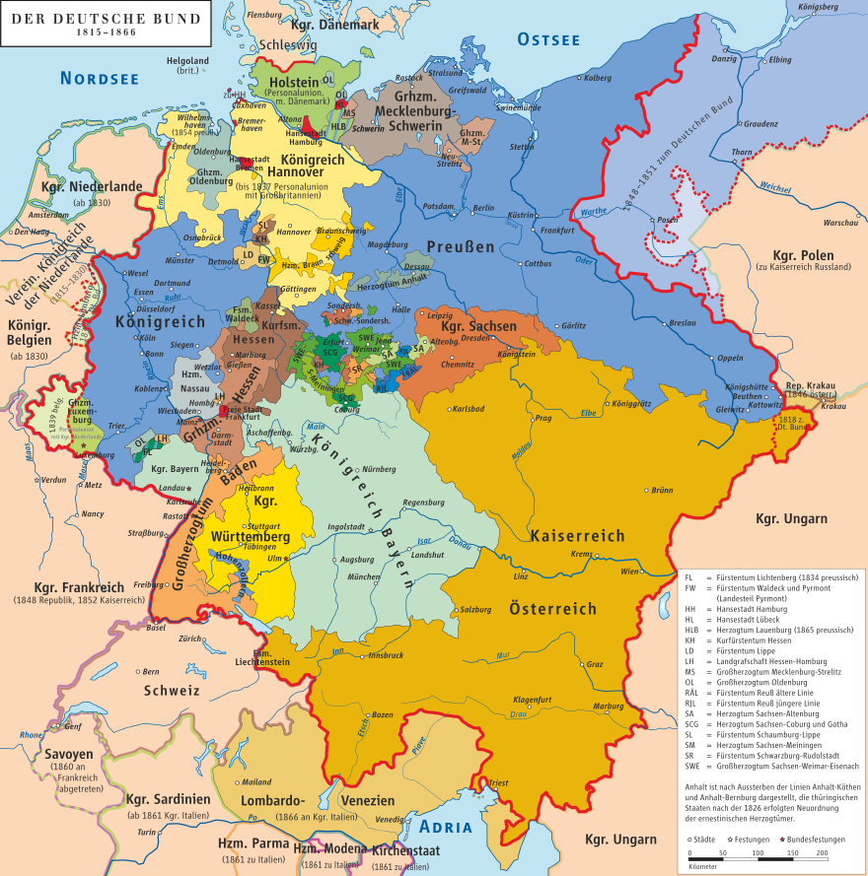
The German Confederation
Association of
39
German States
Map by kgberger

Slide 7
PRUSSIA
Austria
WHO WILL DOMINATE?
Map by kgberger

Slide 8
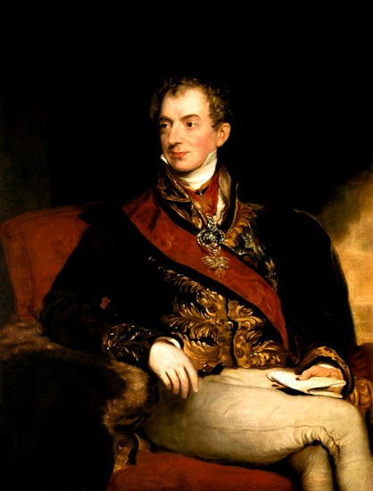
Austrian
Dominance
The Congress of Vienna established Austria
as the dominant German state.

Slide 9

PRUSSIAN
ASCENDANCE
Modern Industrialized Military
State
Some Rights Reserved by David Liuzzo

Slide 10
PRUSSIA
Austria
How to unify?
Map by kgberger

Slide 11
TWO MODELS
FOR UNIFICATION
BIG GERMANY (GROSSDEUTSCHLAND) | Small Germany (Kleindeutschland)
INCLUDES Austria | EXCLUDES Austria

Slide 12
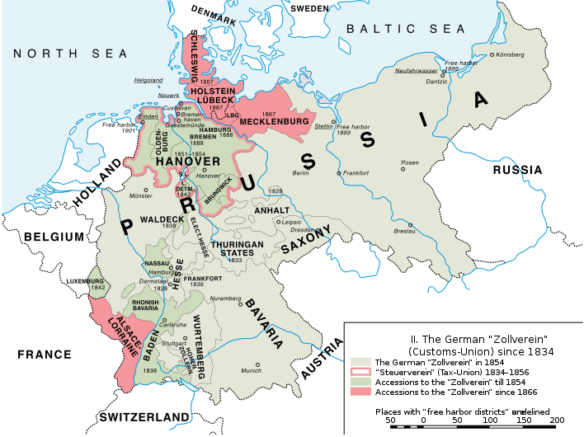
Zollverein
German
Free Trade
Agreement

Slide 14
Economic Union
Political Union
The Zollverein was the first agreement of its kind in Europe.

Slide 15
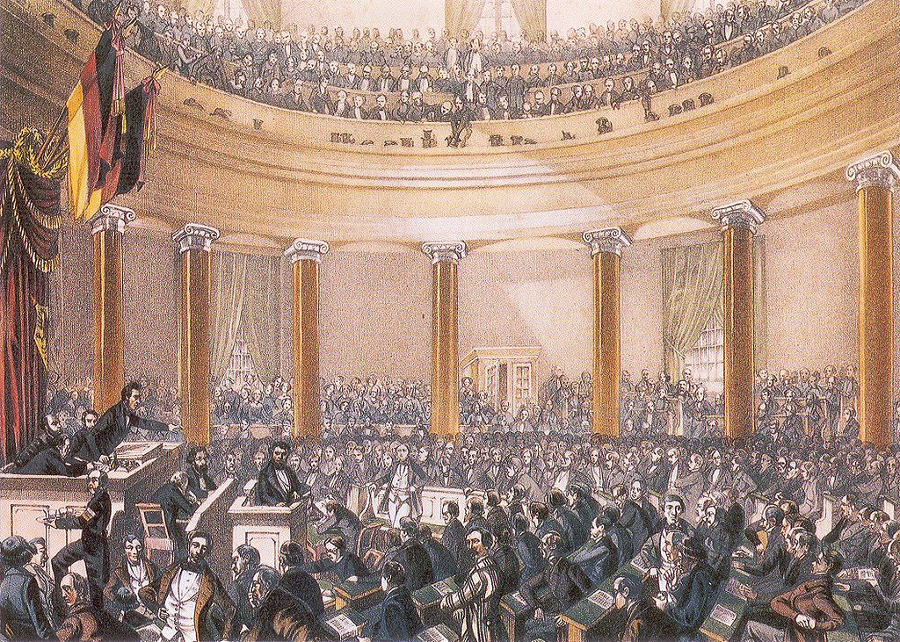
Frankfurt
Parliament
(1848)

Slide 16
PAN-GERMAN PARLIAMENT

Slide 17
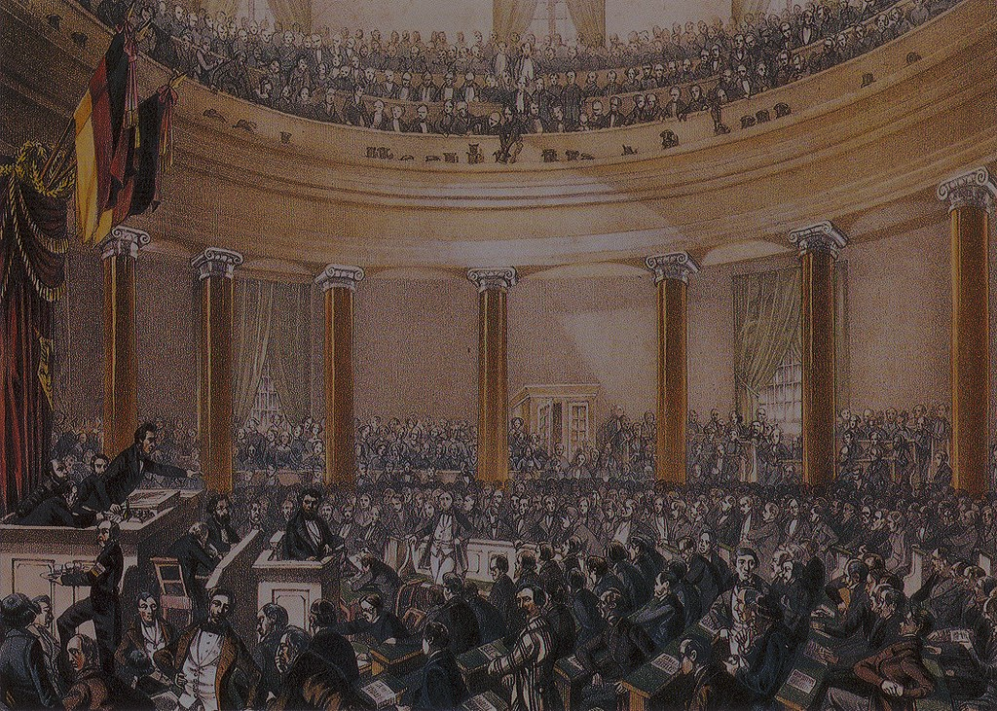
The Frankfurt Parliament drafted a
Constitution
for a unified Germany.

Slide 18
Constitutional
Monarch
Staatenhaus
Volkshaus

Slide 19
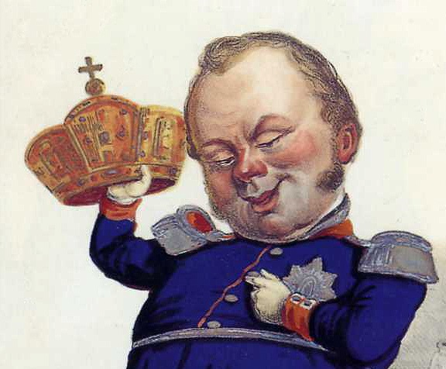
Should I?
Frederick William IV
of Prussia

Slide 20
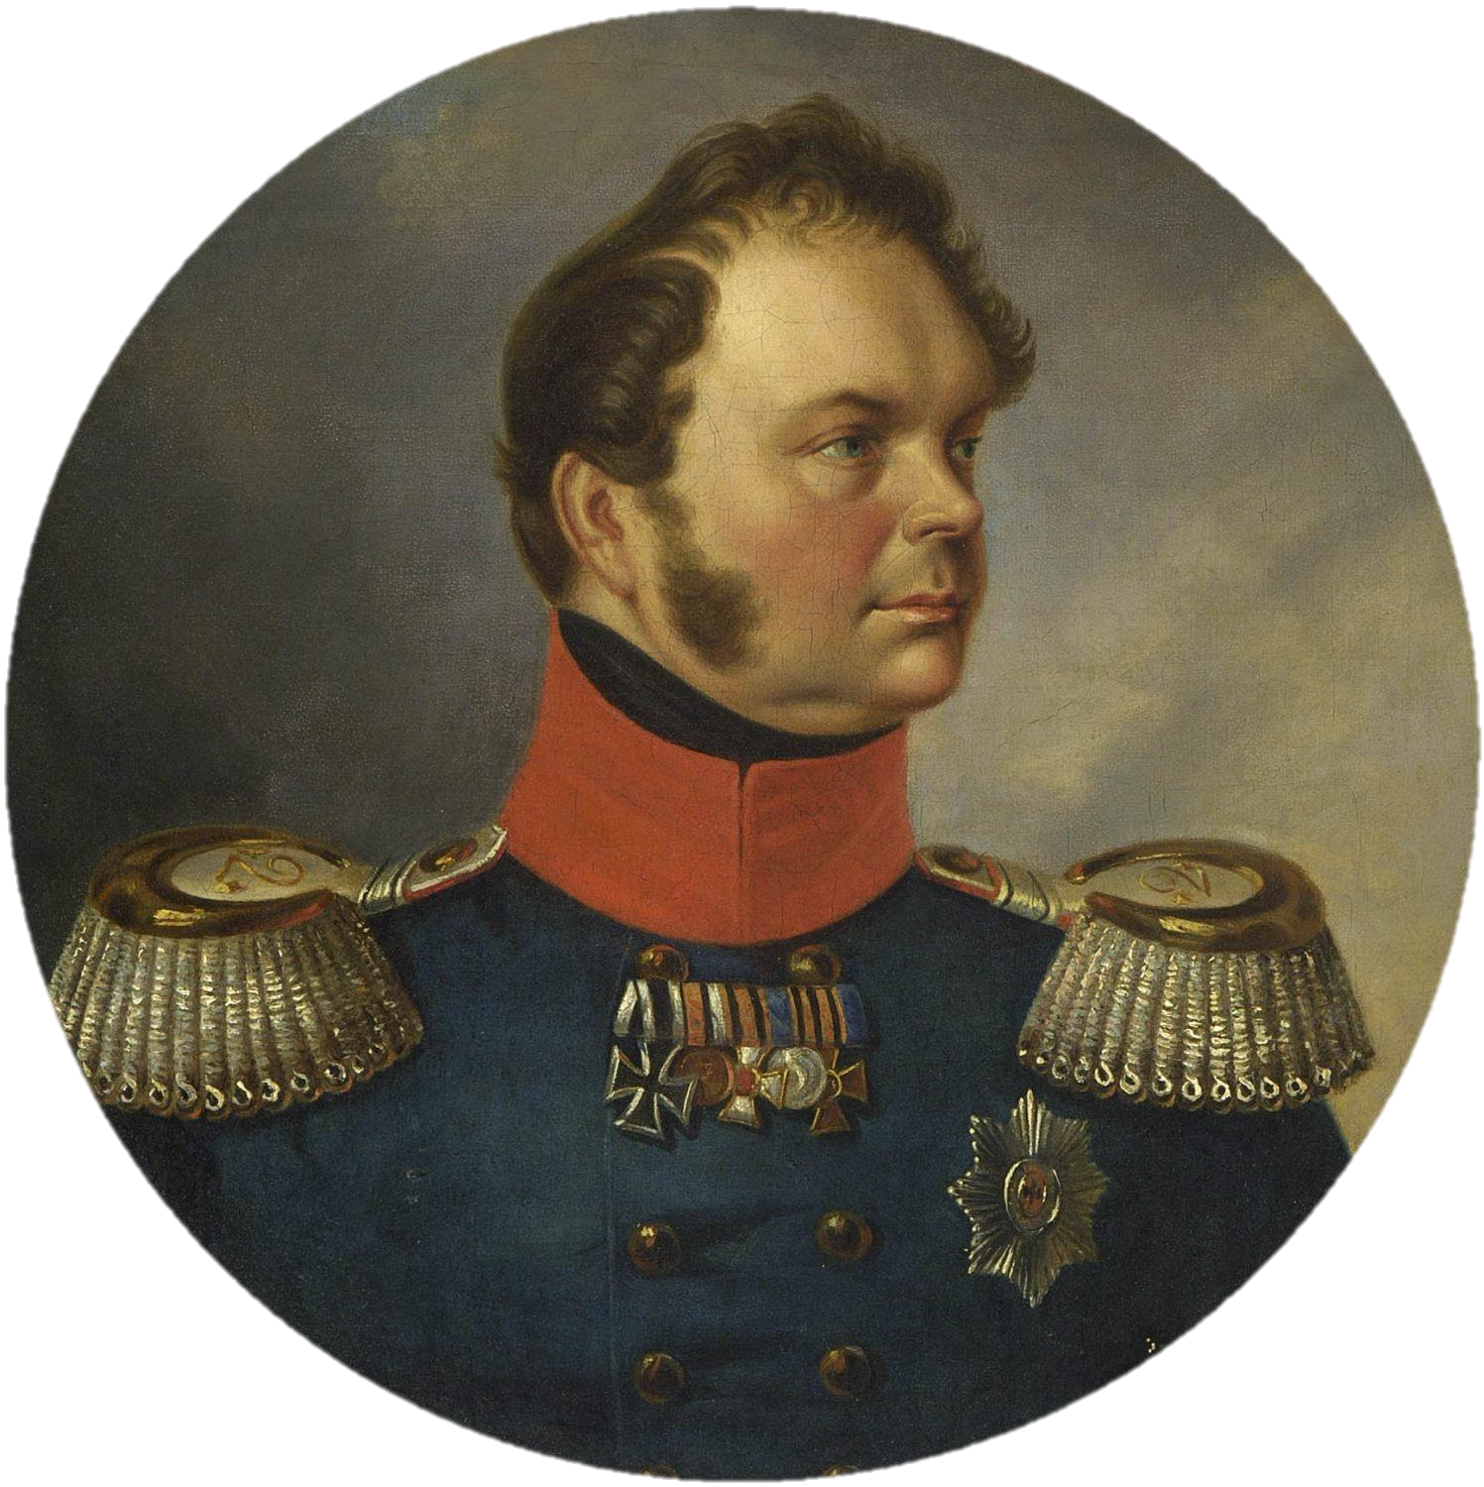
NO THANKS

Slide 21
FAIL

Slide 22
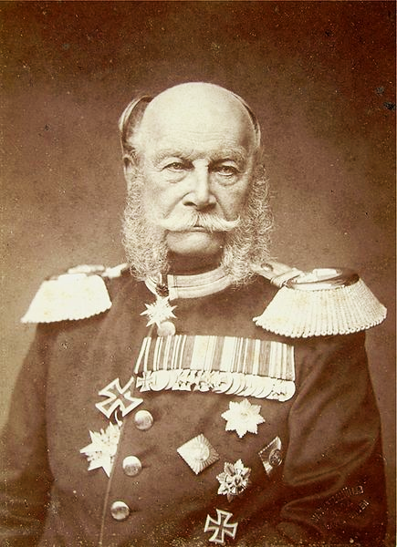
Kaiser
William I
Appointed Otto von Bismarck as Prime Minister

Slide 23
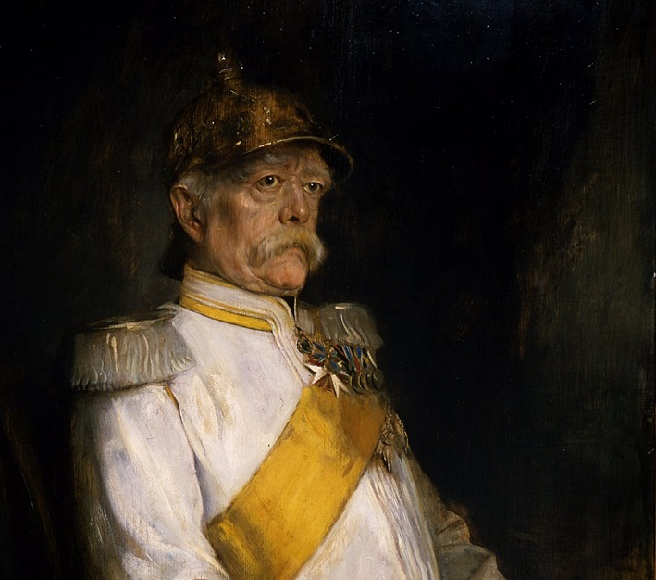

Otto von Bismarck
Ministerpräsident
of Prussia
1862-1873

Slide 24


GOAL:
A strong, unified German State under Prussian dominance

Slide 25

CONSERVATIVE
Photo by le vent le cri (cc 2.0)

Slide 26

Realpolitik
Photo by *Light Painting* (cc 2.0)

Slide 27
POLITICS BASED ON
power
rather than ideals.

Slide 28
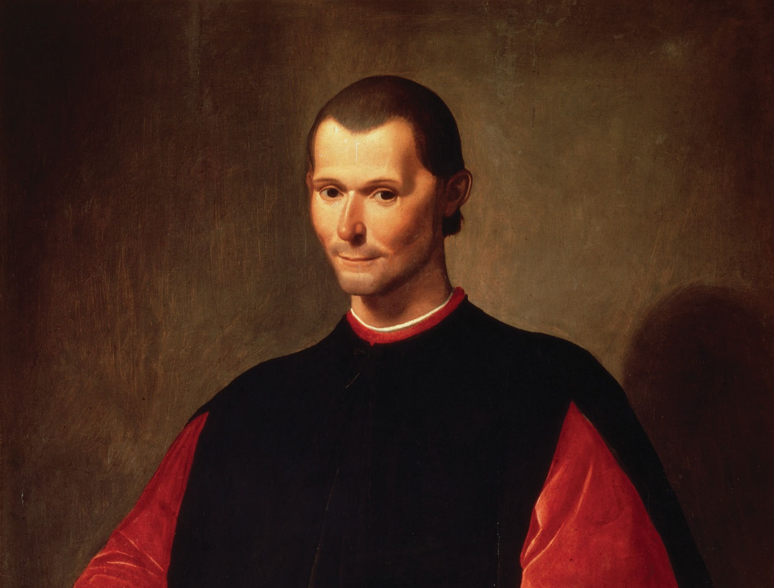
I can dig it.

Slide 29
ISMS

Slide 30
Idealistic
=
Unrealistic

Slide 31
DOMESTIC policy

Slide 32
Socialism is a Threat

Slide 33
realpolitik
“State Socialism”
BAN Social Democratic Party & Socialist Political Propaganda

Slide 34
realpolitik
“State Socialism”
BAN Social Democratic Party & Socialist Political Propaganda | Sponsor Europe’s First Social Welfare Programs

Slide 35

Old Age Pensions

Slide 36

ACCIDENT INSURANCE

Slide 37

Health Insurance

Slide 38
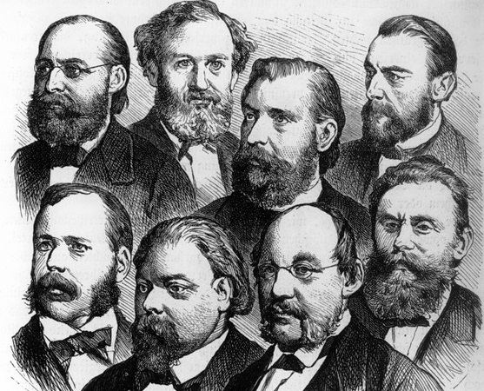
LIBERALS

Slide 39
I got this

Slide 40
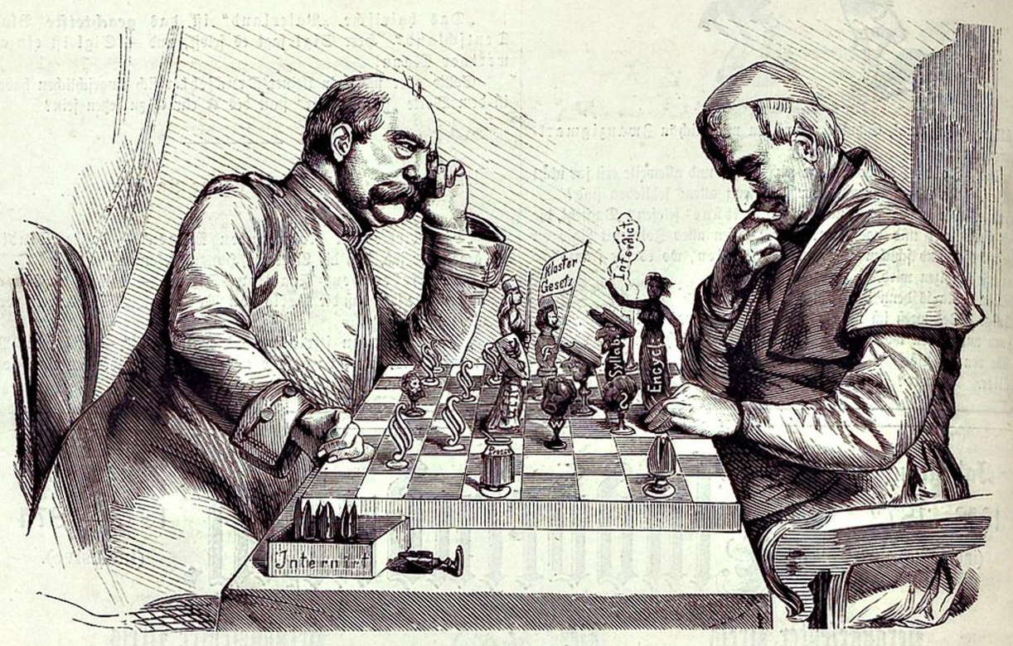
Kulturkampf

Slide 41
Bismarck’s anti-Catholic policies appealed to anticlerical liberals who were otherwise turned off by his authoritarian conservatism.

Slide 42

Industrialization
Liberals were also placated by Bismarck’s support of industrialization.

Slide 43
FOREIGN policy

Slide 44

BLOOD & IRON
Photo © Andrea Pun Used with Permission

Slide 45
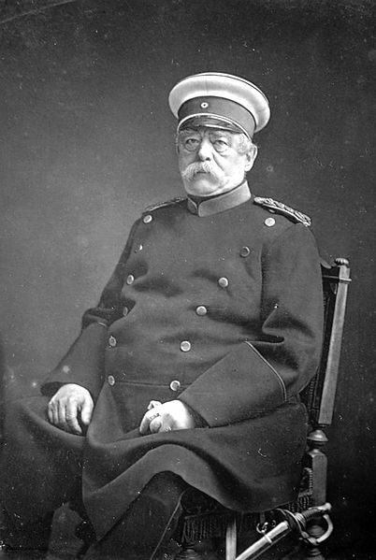
BLOOD & IRON
"The position of Prussia in Germany will not be determined by its liberalism but by its power... Prussia must concentrate its strength and hold it for the favorable moment... Not through speeches and majority decisions will the great questions of the day be decided...

Slide 46
BLOOD & IRON
“but by iron and blood.”
-- Otto von Bismarck (1862)

Slide 47

WARS OF GERMAN UNIFICATION
Schleswig Wars | Established German dominance over German-speaking territories
Austro-Prussian War | Established Prussia as dominant German state
Franco-Prussian War | United Northern and Southern Germany

Slide 48
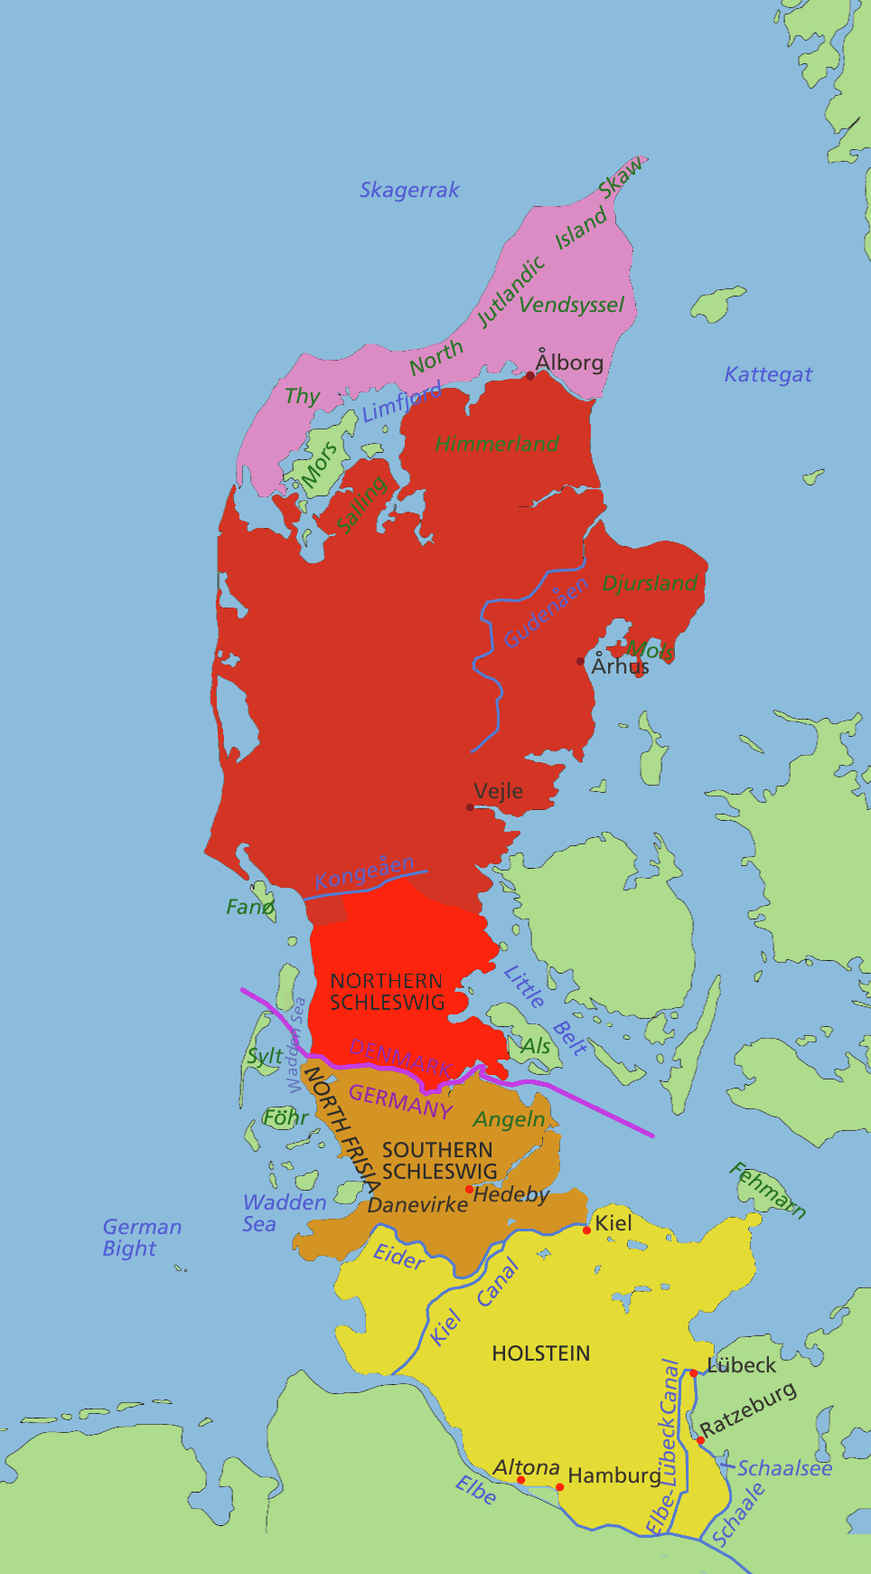
Schleswig Wars
Prussia & Austria vs.
Denmark

Slide 49
Schleswig Wars
Fought on the pretense
of liberating pockets of ethnic Germans under Danish control

Slide 50
Schleswig
Administered by Prussia
HOLSTEIN
Administered by Austria

Slide 51
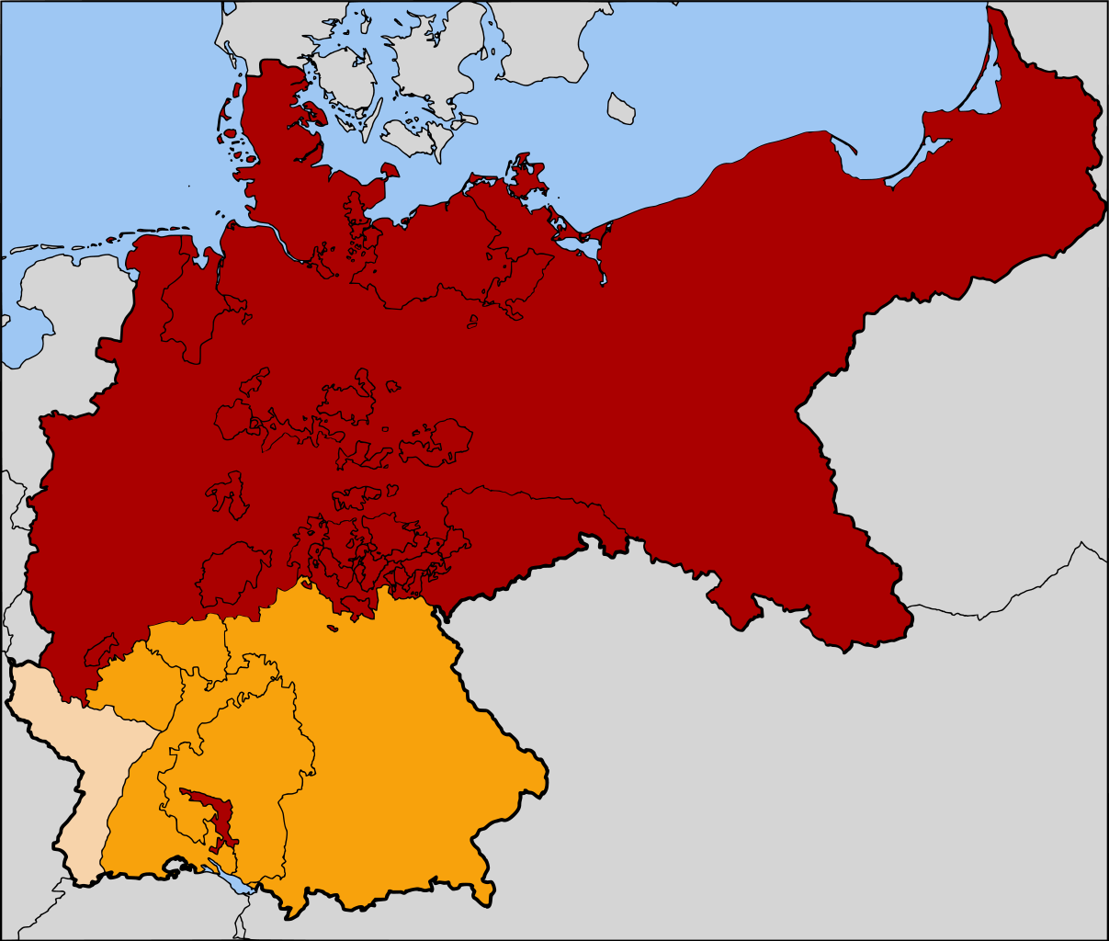
North German Confederation
Map Credit: 52 Pickup (Wikipedia)

Slide 52
Prussia annexed several smaller German states.
South German states resisted Prussian dominance.
Map Credit: 52 Pickup (Wikipedia)

Slide 53
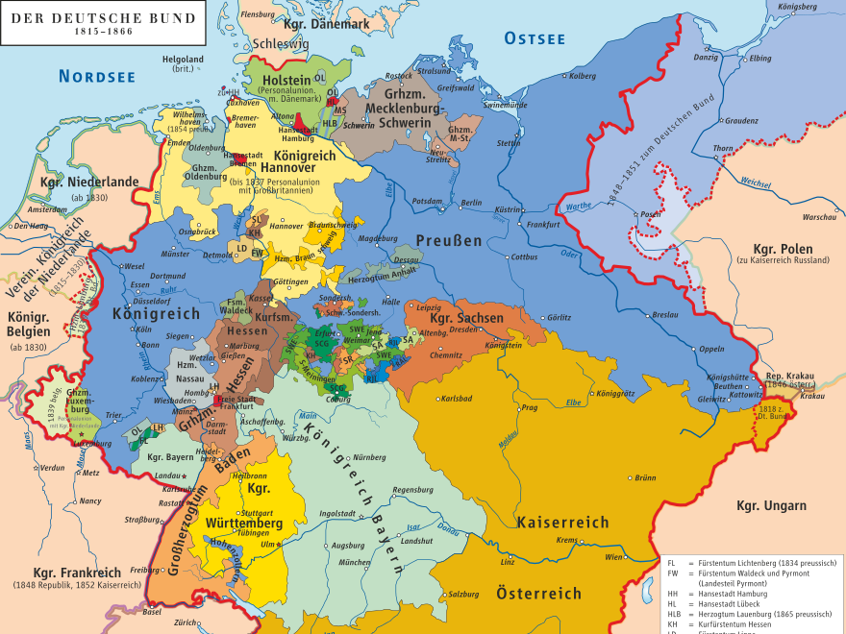
AND THEN THERE WERE TWO
Map by
kgberger

Slide 54

PRUSSIA
Austria
Map by
kgberger

Slide 55
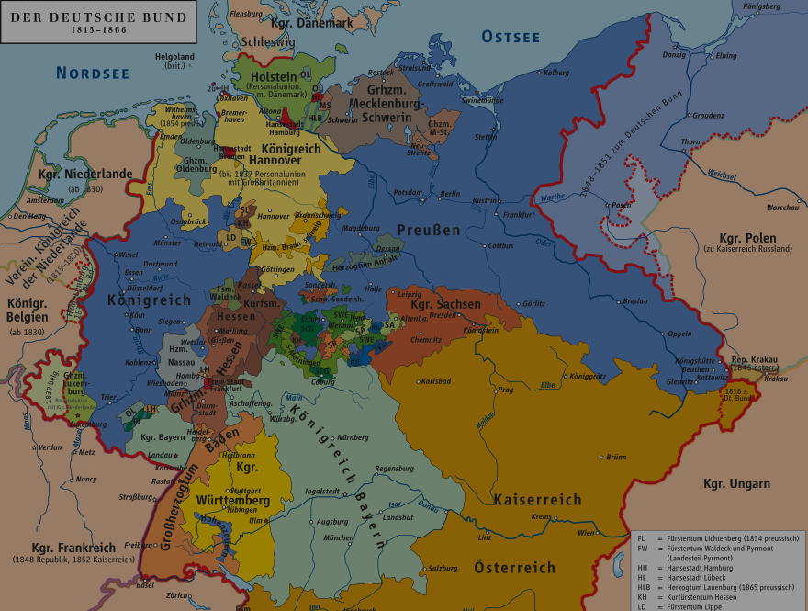
PRUSSIA
WHO WILL DOMINATE?
Austria
Map by
kgberger

Slide 56
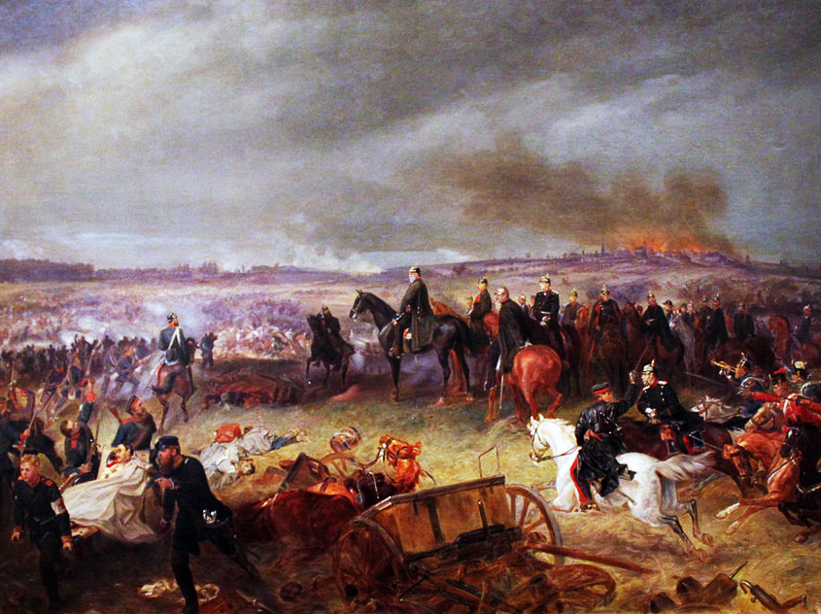
Austro-Prussian War
1866
Georg Bleibtreu, Battle of Königgrätz (1869)

Slide 57
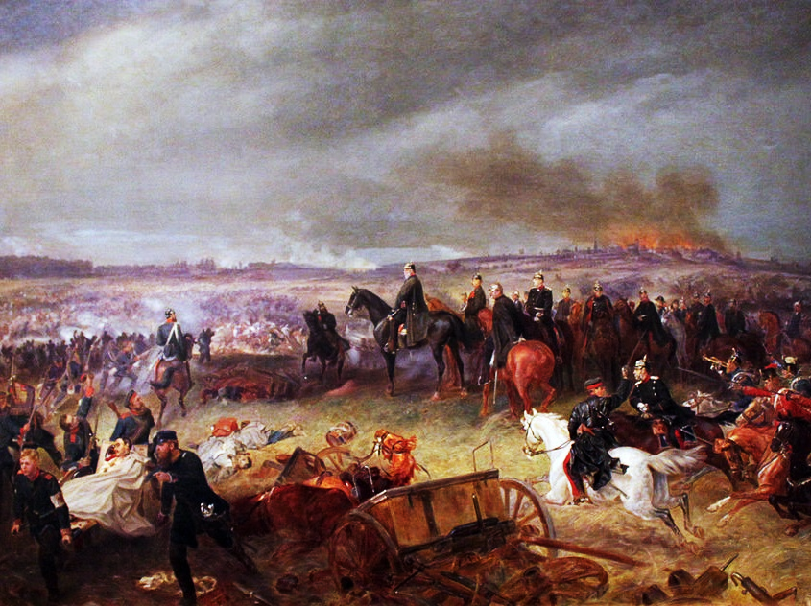
7 weeks
Georg Bleibtreu, Battle of Königgrätz (1869)

Slide 58
#winning

Slide 59
Kleindeutschland

Slide 60
Map by
kgberger

Slide 61
losers
Map Credit: 52 Pickup (Wikipedia)

Slide 62
Predominantly Catholic Southern German states had sided with Austria.
Map Credit: 52 Pickup (Wikipedia)

Slide 63
HOW will Germany be unified?

Slide 64
BLOOD & IRON
Photo © Andrea Pun Used with Permission

Slide 65
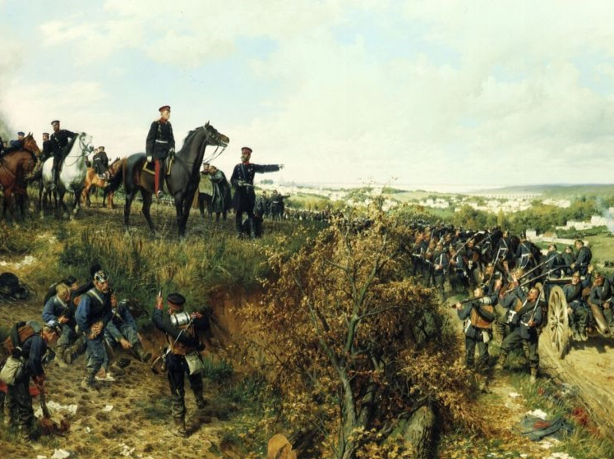
Franco-Prussian War
1870-1871
Anton von Werner - Moltke and his staff near Paris

Slide 66
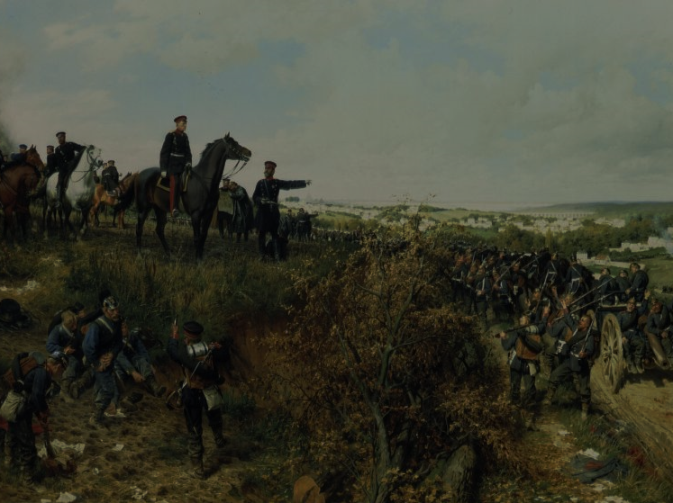
A war to unite
Germany

Slide 67
BLOOD & IRON
"I always considered that a war with France would naturally follow a war against Austria... I was convinced that the gulf which was created over time between the north and the south of Germany could not be better overcome than by a national war... I did not doubt that it was necessary to make a French-German war before the general reorganization of Germany could be realized.”
-- Otto von Bismarck (Memoirs)

Slide 68
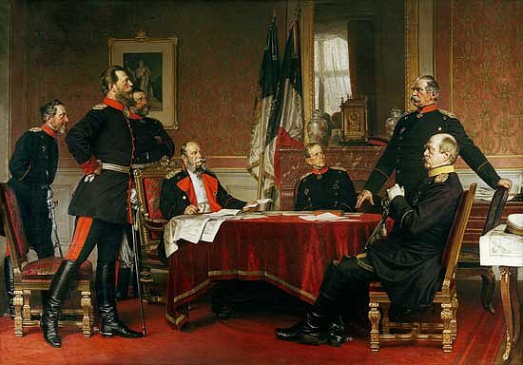
SUPERIOR Technology and ORGANIZATION
The Prussian army, with its efficient General Staff, employed railroads and artillery more effectively than the French.
Bismarck and the Prussian General Staff

Slide 69
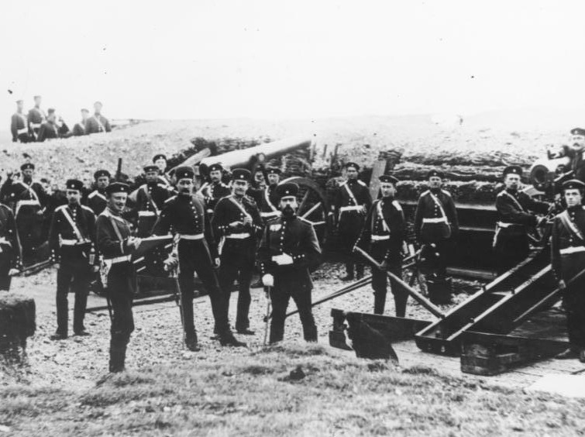
Prussian Artillerymen
German Federal Archive

Slide 70
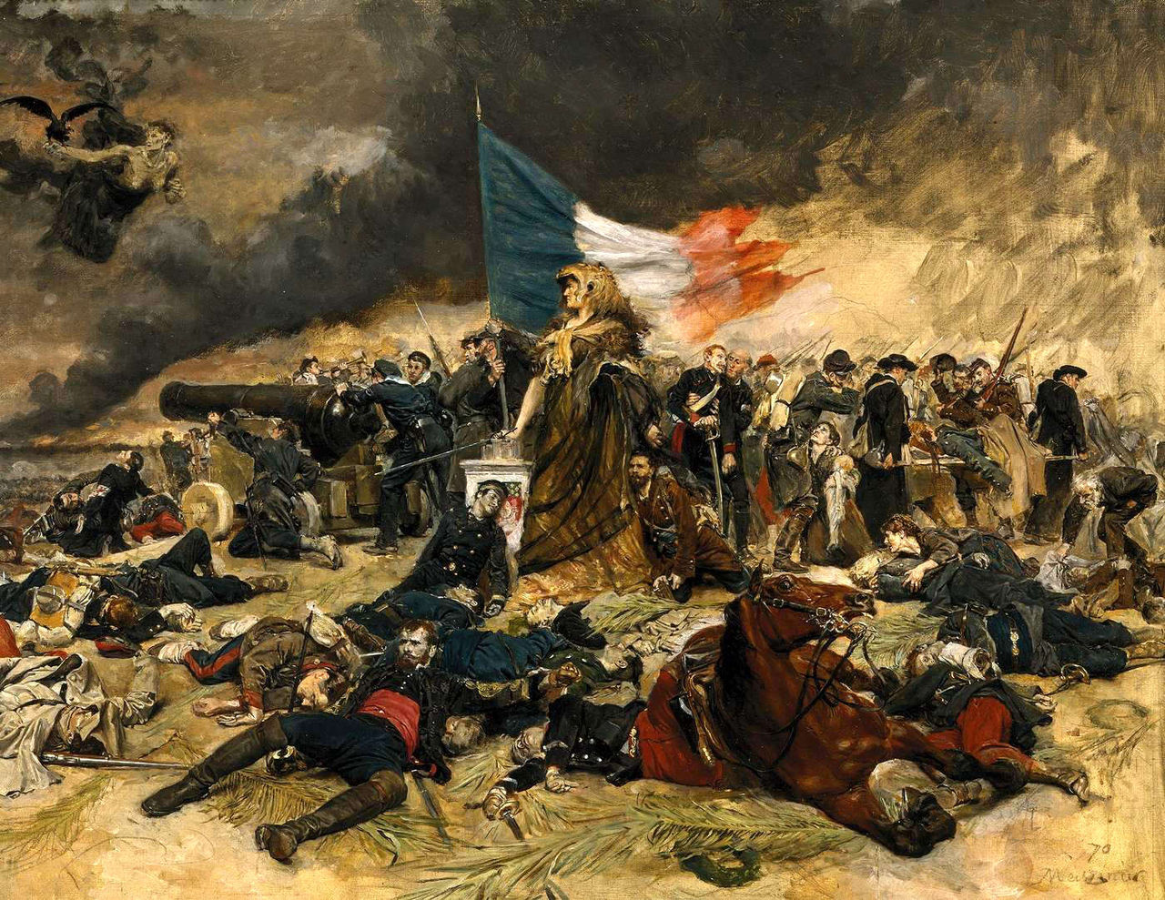
Siege of Paris
Sep. 1870 –
Jan. 1871

Slide 71
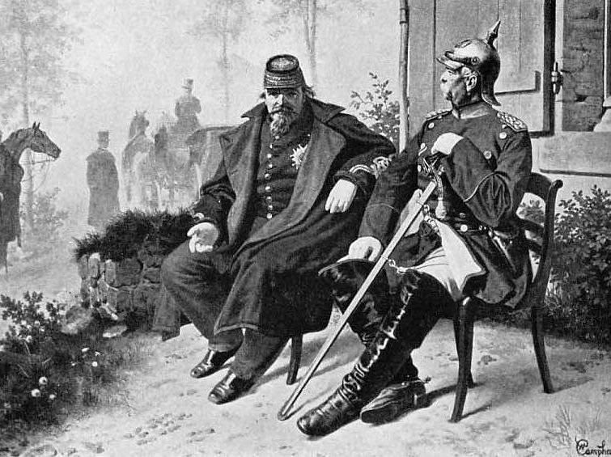
PRUSSIA WINS
Bismarck with POW Napoleon III

Slide 72
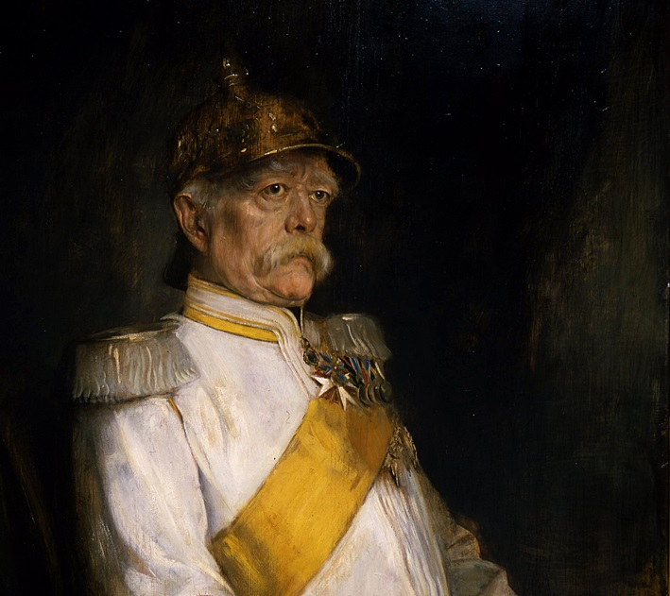

CHANCELLOR of Germany

Slide 73
Proclamation of the German Empire
Hall of Mirrors (Versailles)

Slide 74
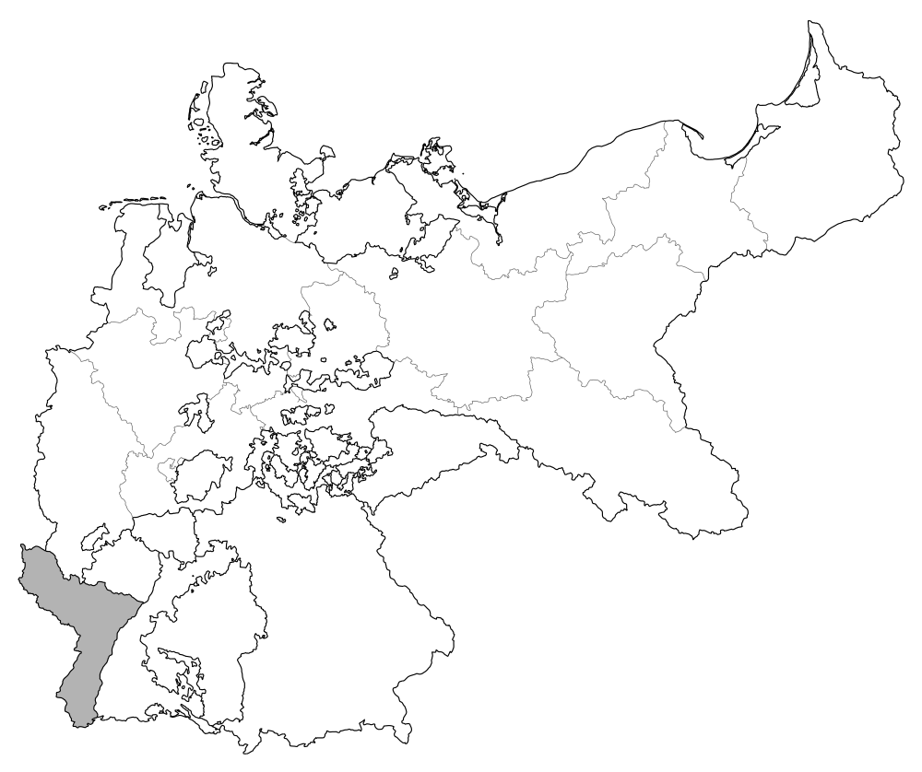
Annexation of Alsace-Lorraine
Map Credit: David Liuzzo

Slide 75
Alsace-Lorraine included many French speakers, and many German speakers -resented annexation into the Empire.
Map Credit: David Liuzzo

Slide 76

reparations
5,000,000,000 ₣
Photo by Marcel Grieder (cc 2.0)

Slide 77
Timeline
of German Unification
1815 | German Confederation Created
1848 | Frankfurt Parliament
1864 | Second Schleswig War
1866 | Austro-Prussian War
1870 | Franco-Prussian War
1871 | German Empire Proclaimed

