Slide 1
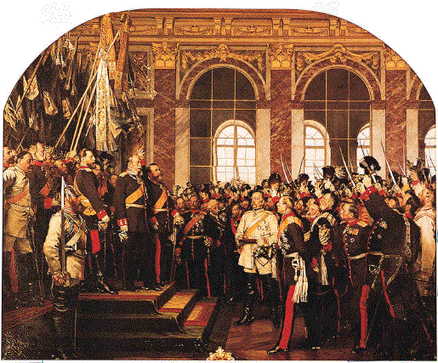
Deutschland
German unification: It seemed like a good idea at the time.

Slide 2
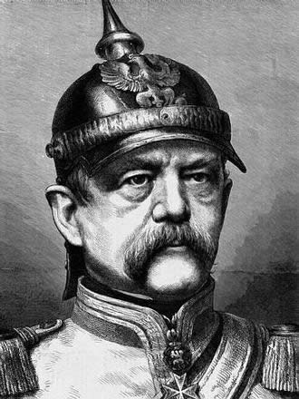
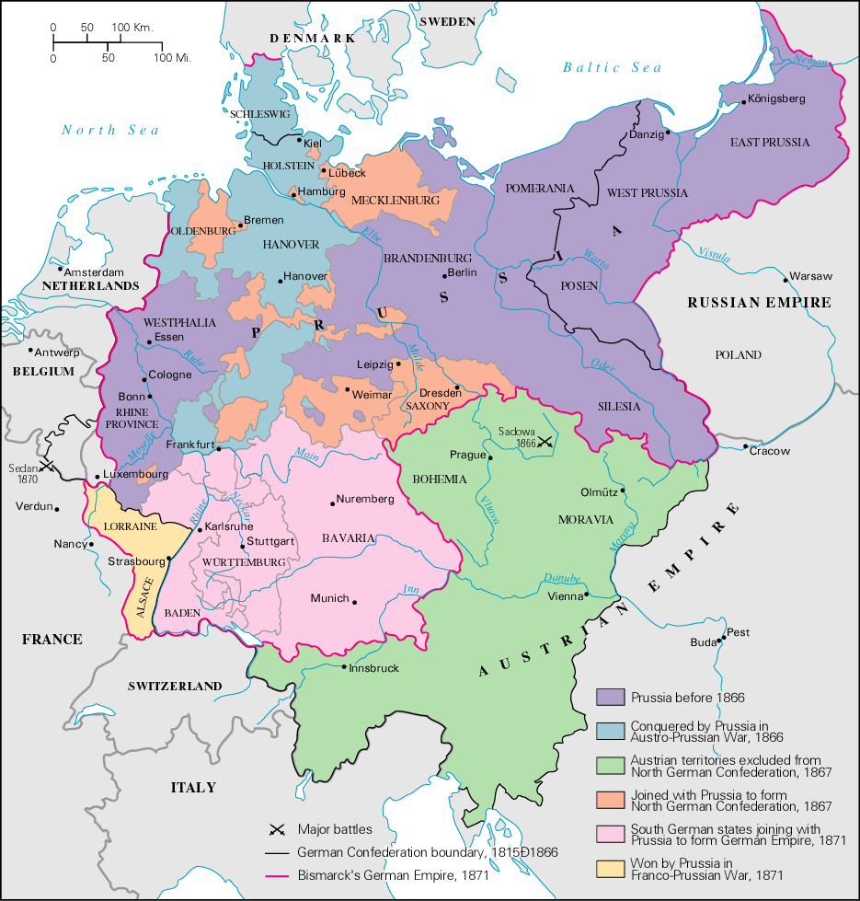
The German Confederation

Slide 3
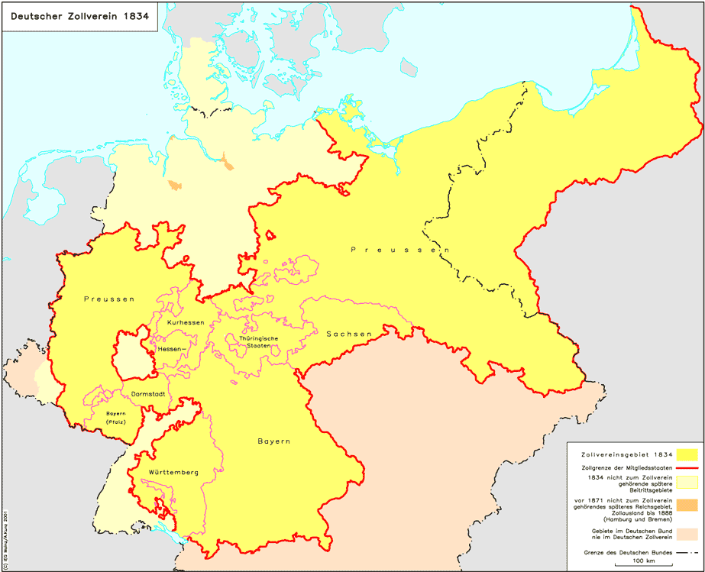
Zollverein, 1834

Slide 4

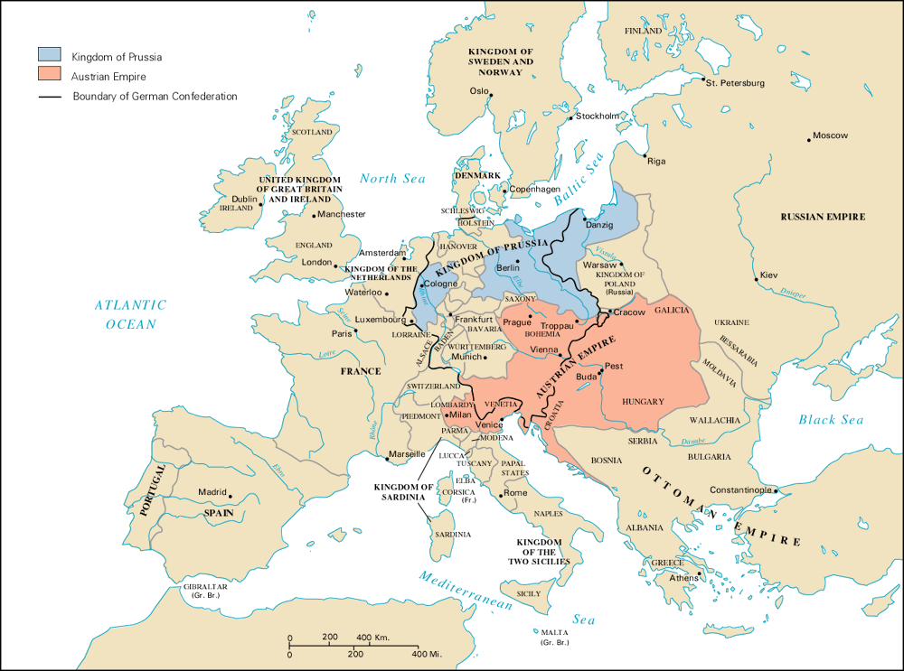
Prussia/Austria Rivalry

Slide 5
Key Players
Notes:
5

Slide 6
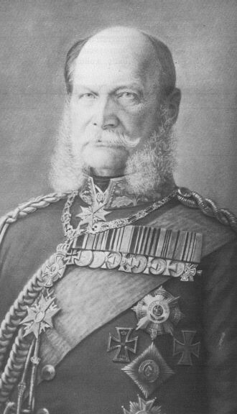
Wilhelm I
Notes:
6

Slide 7
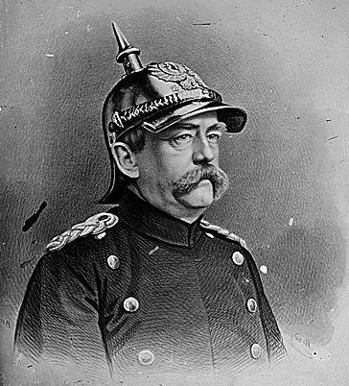
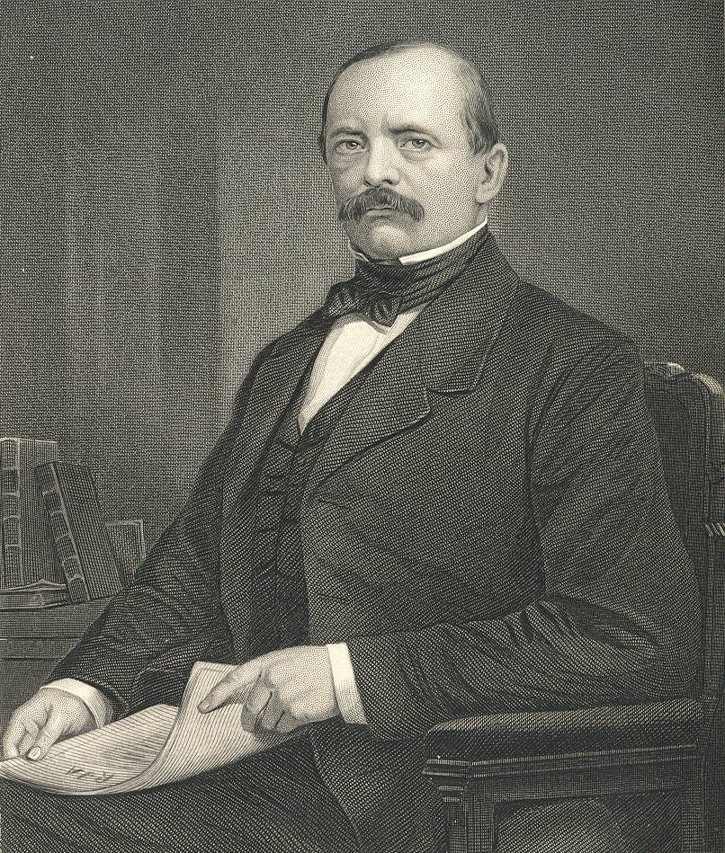
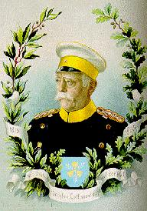
Otto Von Bismarck
The “Iron
Chancellor”
Realpolitik
Blood
&
Iron”
Notes:
7

Slide 8
Bismarck
The less people know about how sausages and laws are made, the better they’ll sleep at night.
Never believe in anything until it has been officially denied.
The great questions of the day will not be settled by speeches and majority decisions—that was the mistake of 1848-1849—but by blood and iron.
Notes:
8

Slide 9
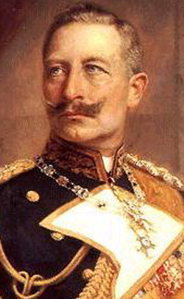
A generation that has taken a beating is always followed by a generation that deals one.
Some damned foolish thing in the Balkans will provoke the next war.

Slide 10
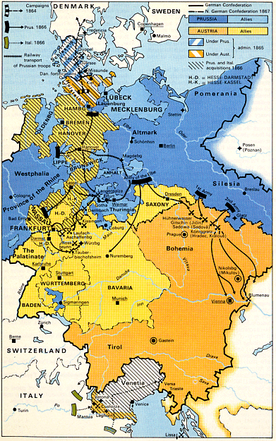
Step 1
The Danish War 1864
Notes:
10

Slide 11
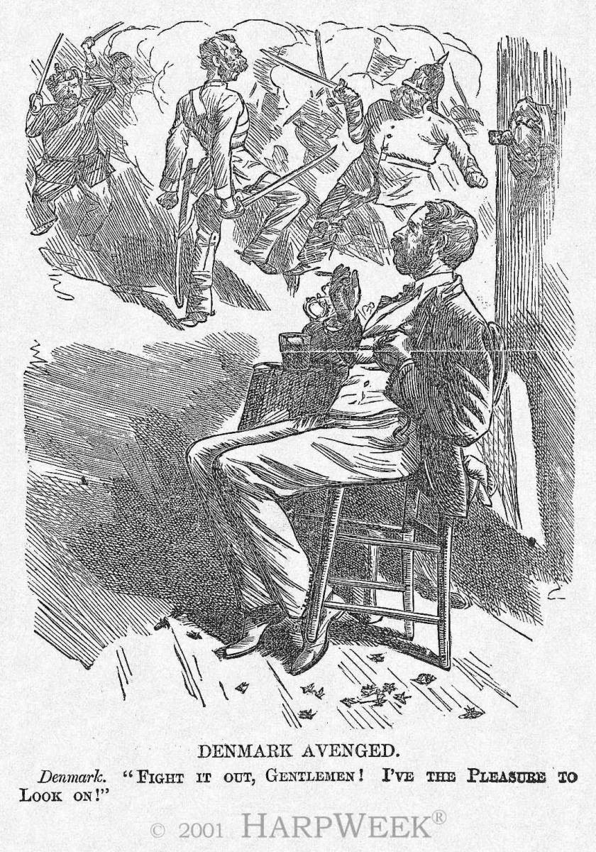
Step 2 Austria-Prussia War: 7 Weeks War
Notes:
11

Slide 12
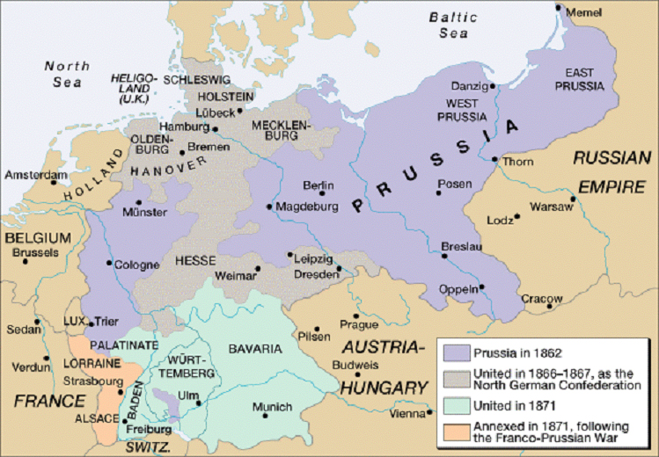

Slide 13
Step 3
Shortly following the victory of Prussia, Bismarck eliminated the Austrian led German Confederation.
        He then established a new North German Confederation which Prussia could control → Peace of Prague
Notes:
13

Slide 14
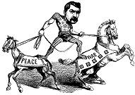
Bismarck
Notes:
14

Slide 15
Step 4 “ The Your Momma Strategy”
-1868 revolt in Spain.
-Bourbon or Hohenzollern?
- The Telegram
Notes:
15

Slide 16
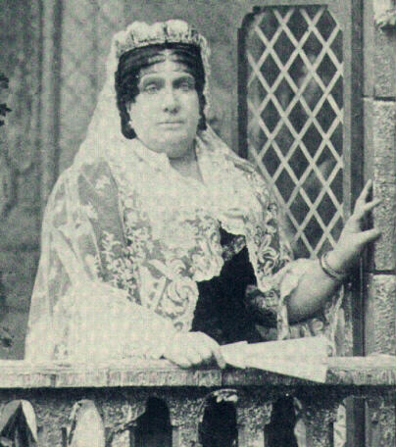
Step 4 “The Your Momma Strategy”
Notes:
16

Slide 17
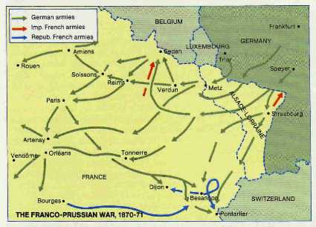
Step 5 The Franco-Prussian War 1870-1871
Notes:
17

Slide 18
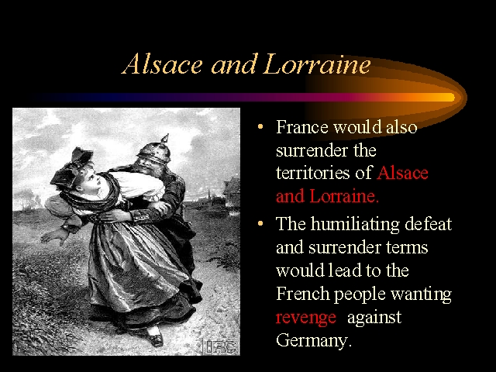
German Solider abusing a French woman
Notes:
18

Slide 19
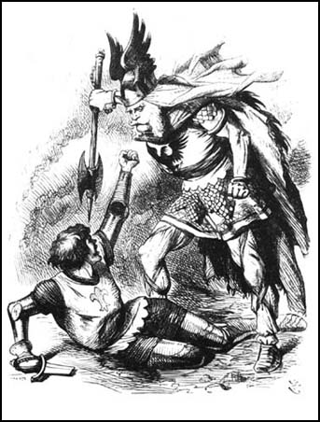
Franco-Prussian War
Notes:
19

Slide 20
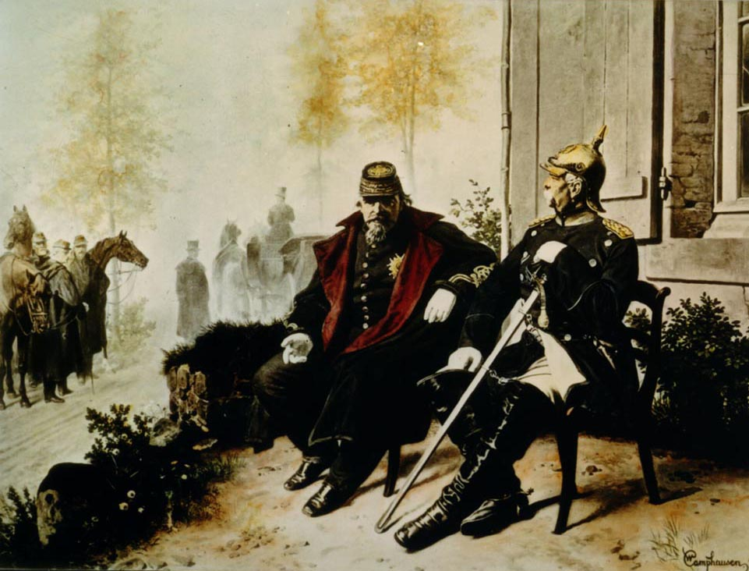
Napoleon III and Bismarck
Notes:
20

Slide 21
Treaty of Frankfurt 1871
The Second French Empire collapsed and was replaced by the Third French Empire.
The Italians took Rome and made it their capital.
Russia put warships in the Black Sea [in defiance of the 1856 Treaty of Paris that ended the Crimean War].
France paid a huge indemnity and was occupied by German troops until it was paid.
France ceded Alsace-Lorraine to Germany [a region rich in iron deposits with a flourishing textile industry].
Notes:
21

Slide 22
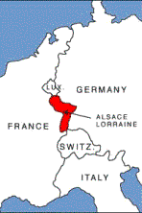
Notes:
22

Slide 23
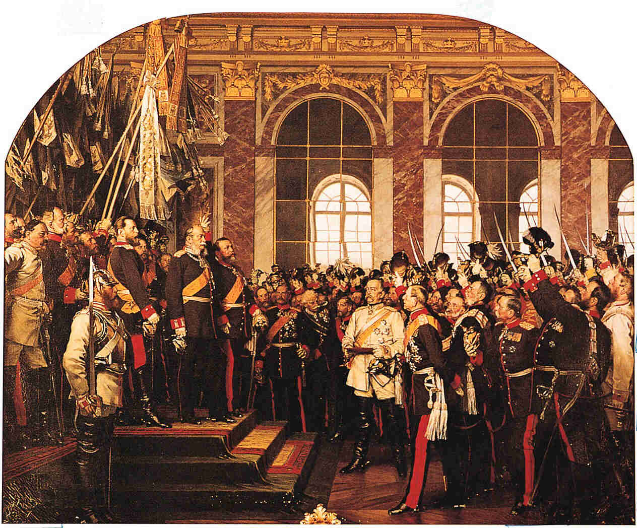
Step 4 “The Your Momma Strategy”
Coronation of Kaiser Wilhelm I
[r. 1871–1888]
Notes:
23

Slide 24
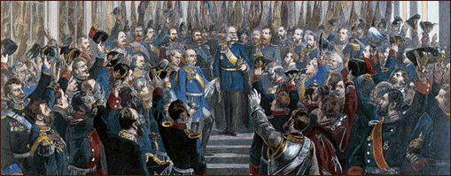
Junkers swear allegiance to the Kaiser
Notes:
24

Slide 25

Step 4 “The Your Momma Strategy”
Notes:
25

Slide 26
Bismarck’s Nightmare
France with allies!!!
Dual Alliance
1882 Triple Alliance
Russian Accords
Britain
Notes:
26

Slide 27
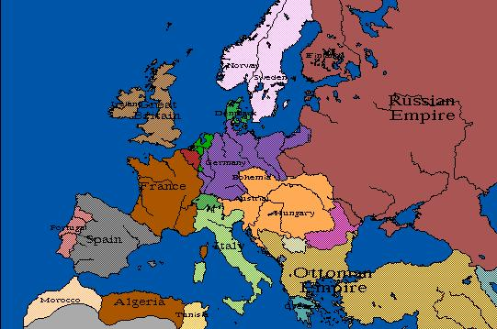

Slide 28
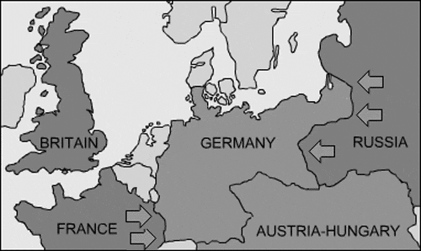

Slide 29
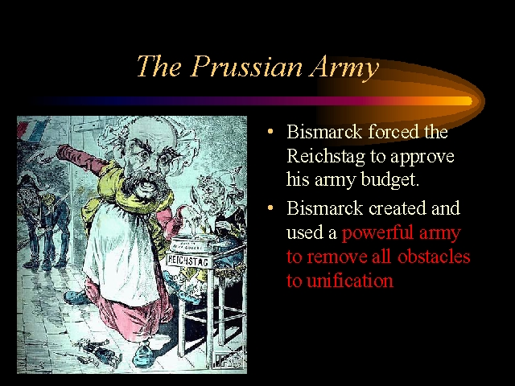
Bismarck and the Reichstag
Notes:
29

Slide 30
Bismarck’s Kulturkampf:
Anti-Catholic Program
Take education and marriage out of the hands of the clergy → civil marriages only recognized.
The Jesuits are expelled from Germany.
The education of Catholic priests would be under the supervision of the German government.
Notes:
30

Slide 31
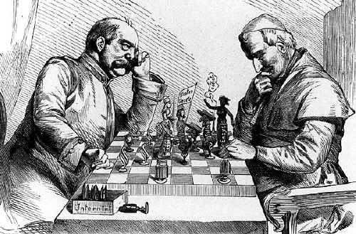
Bismarck’s rapprochement of the Church
Bismarck & Pope Leo XIII
Notes:
31

Slide 32
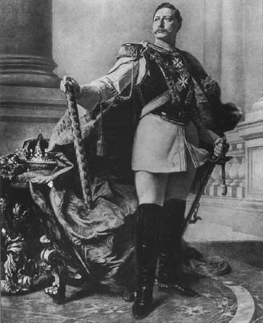
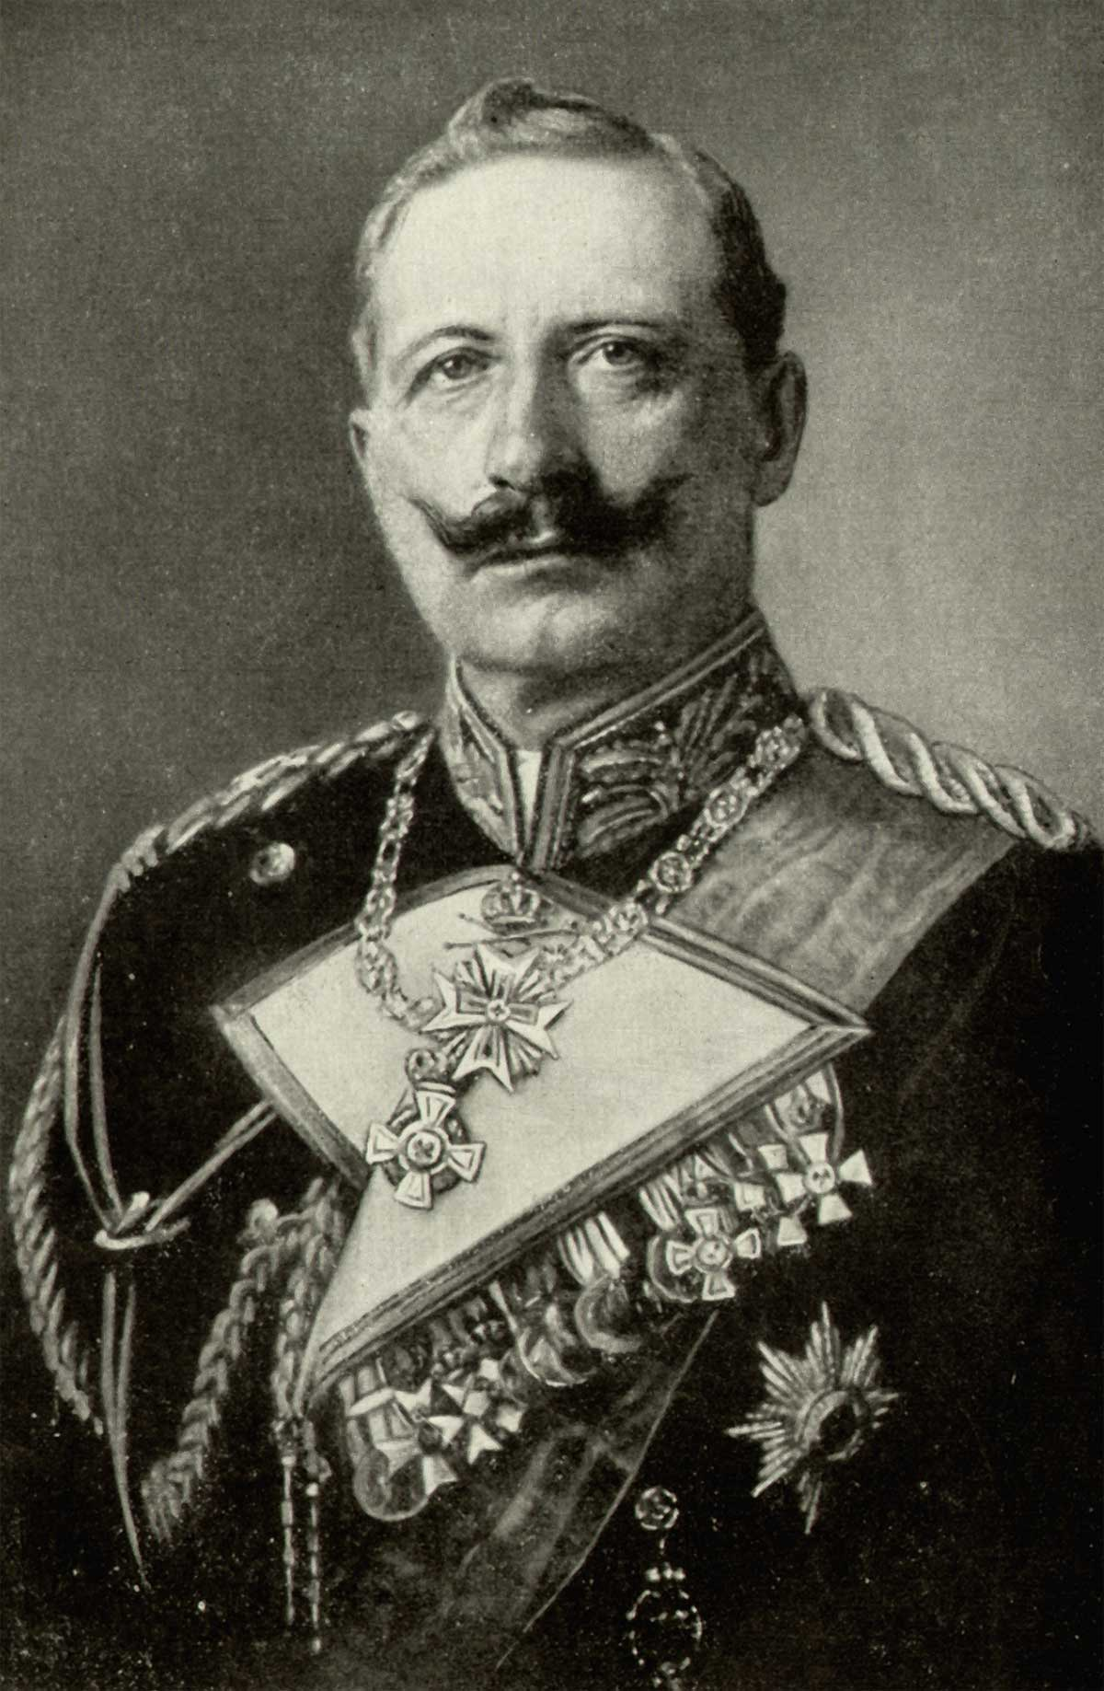
Kaiser Wilhelm II
Notes:
32

Slide 33
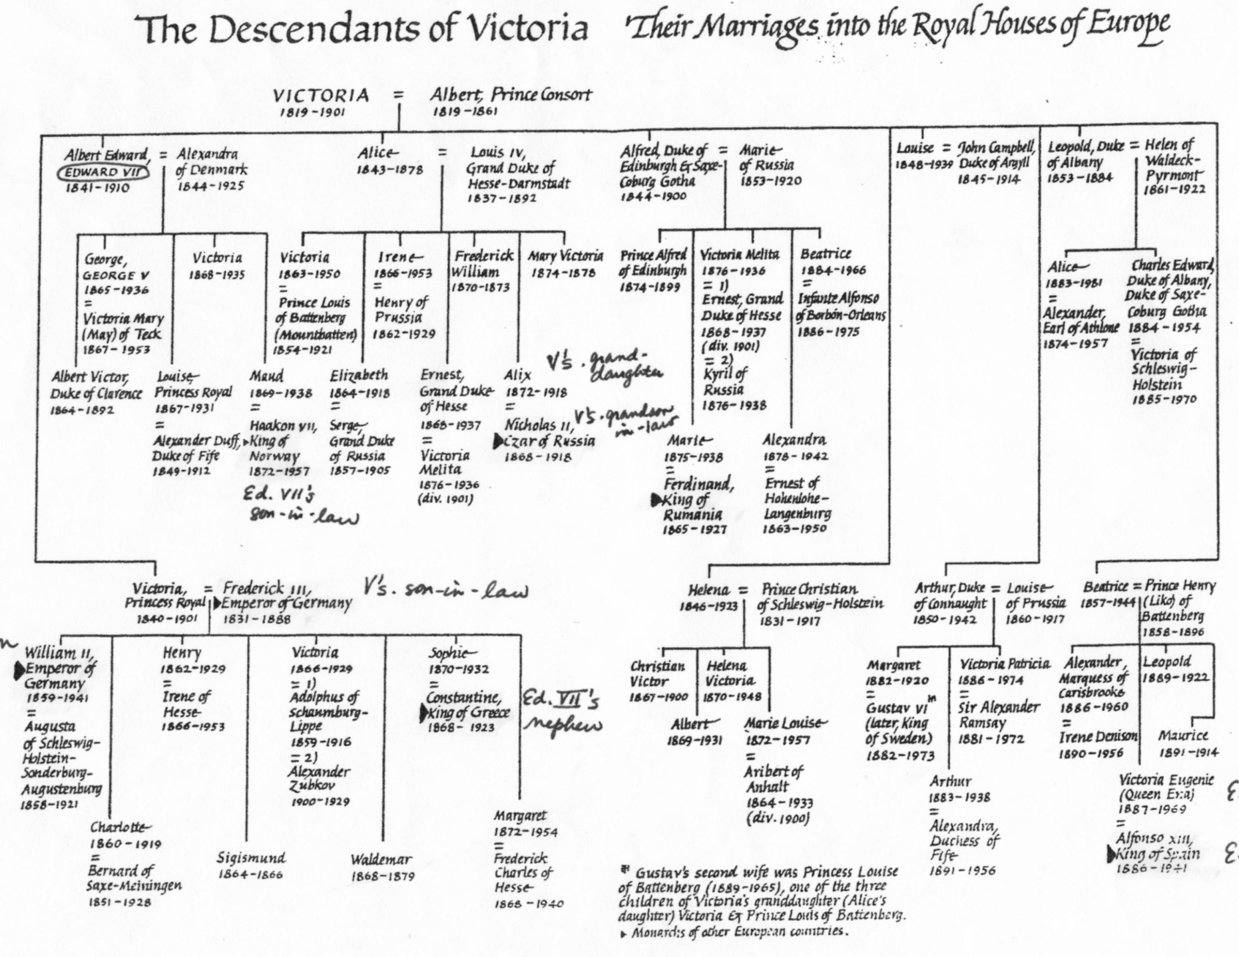
Step 4 “The Your Momma Strategy”
Queen Victoria’s Grandchildren
Notes:
33

Slide 34
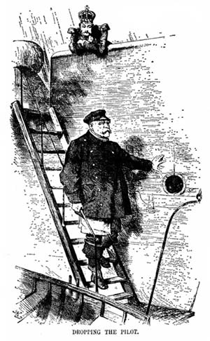
Step 4 “The Your Momma Strategy”
The Firing
Of
Bismarck
1890
Notes:
34

Slide 35
Step 4 “The Your Momma Strategy”
Germany would begin to become the new dominate European Power challenging Britain.
France demanded Revenge
Notes:
35

