Slide 1
Decolonization
Vietnam, etc…

Slide 2
France and Algeria
voting structure had given the French more power than the native Muslim people of Algeria
violent clashes between the Muslims and the French directly after World War II spur on even more Algerian nationalism
civil war breaks out in 1954 between Algerian nationalists led by the National Liberation Front and the French – the war divides French opinion and does not end till 1962
under General Charles de Gaulle, France eventually grants Algeria independence in 1962
many Muslims who supported France either flee Algeria for France or are massacred

Slide 3
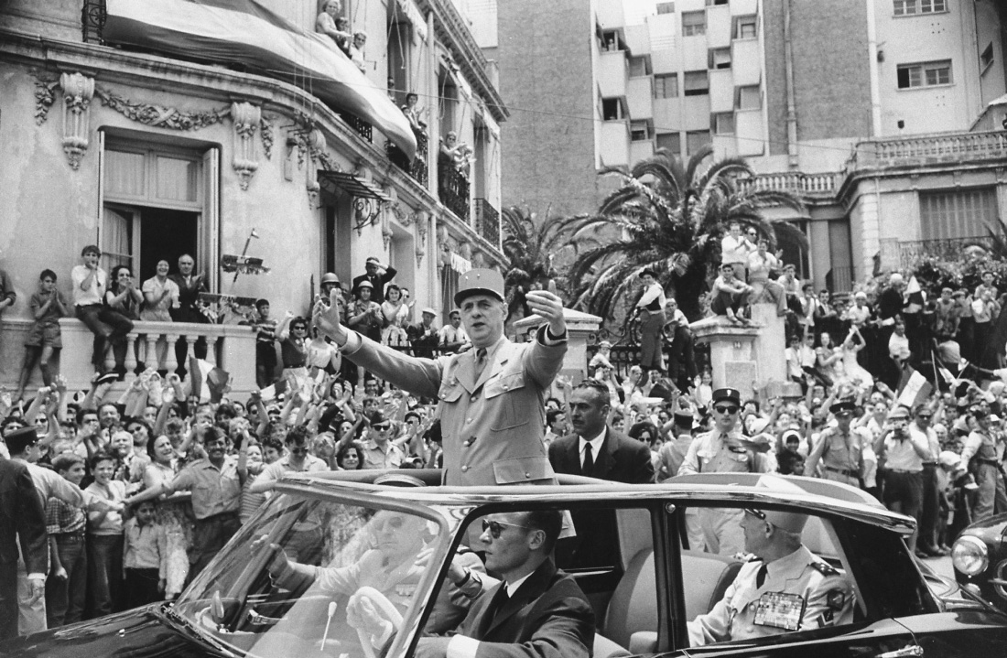
In 1959, Charles De Gaulle as President of the French Republic visited Algiers to great acclaim from its European inhabitants, known as colons. By 1962, however, he had sponsored a referendum that led to Algerian independence and the flight of most of those people.
Loomis Dean/Getty Images, Inc.

Slide 4
France and Vietnam
communist, anti-colonial, and nationalistic Vietnam leader Ho Chi Minh declares Vietnam’s independence from France in 1945
civil war breaks out in 1947
the French are crushed at Dien Bien Phu
peace accord in 1954 splits Vietnam in two
North Vietnam – Ho Chi Minh and the communists
South Vietnam – French controlled

Slide 5
Vietnam and the Cold War
the United States believing that North Vietnam was a puppet of the Soviet Union and the People’s Republic of China form the Southeast Asia Treaty Organization to combat the communists
France withdraws from South Vietnam in 1955 leaving Vietnamese political groups to fight for its power
United States supports Ngo Dinh Diem, a strong anti-communist nationalist (but certainly not for democracy)
the National Liberation Front with its military wing the Viet Cong make it a goal to overthrow Diem
Diem becomes more repressive
in 1963, Diem is assassinated by an army coup, supported by the United States
the United States, hoping for popular support in South Vietnam support Nguyen Van Thieu to be in charge

Slide 6
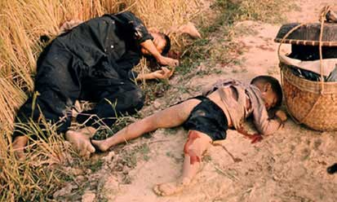
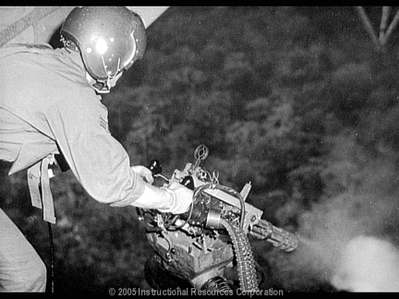
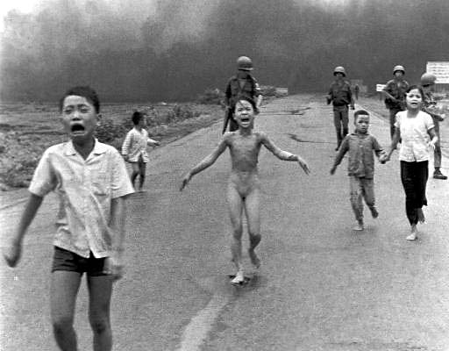
The Vietnam War
Kennedy is assassinated and his successor Lyndon Johnson steps up the commitment to South Vietnam especially after the an attack on an American ship in the Gulf of Tonkin
Hundreds of thousands of soldiers invade Vietnam and conduct a destructive and deadly war

Slide 7
Results of the Vietnam War
peace negotiations start in 1968, but no treaty till 1973
1975 – South Vietnamese troops evacuate country, but are routed by the North Vietnamese turning all of Vietnam over to the communists / South Vietnam capital renamed Ho Chi Minh City
Vietnam’s results in the U.S.
war hurt American prestige,
many European nations felt the United States neglected them to fight an aggressive colonial war
produced enormous divisions and debates in the United States

Slide 8
The Vietnam War
1965-1973 – major bombing attacks of Vietnam
at war’s peak – 500,000 American troops are stationed in Vietnam – 58,000 Americans killed
1969 – Vietnamization – President Nixon’s policy to gradually withdraw troops from Vietnam

Slide 9
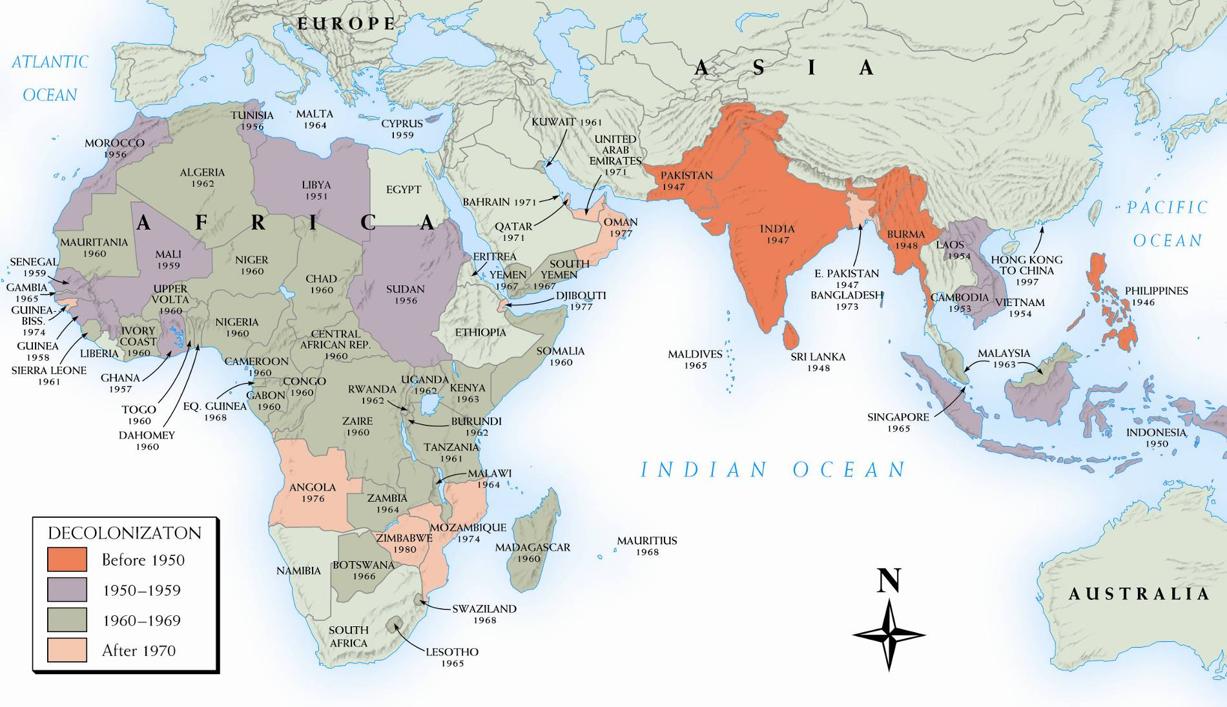
Map 29–6 DECOLONIZATION SINCE WORLD WAR II The Western powers’ rapid retreat from imperialism after World War II is graphically shown on this outline map covering half the globe—from West Africa to the southwest Pacific.

