Slide 1
“Fear not for the future, weep not for the past.” - Percy Bysshe Shelley The three best known western names in China are: Jesus Christ, Richard Nixon, and Elvis Presley

Slide 3
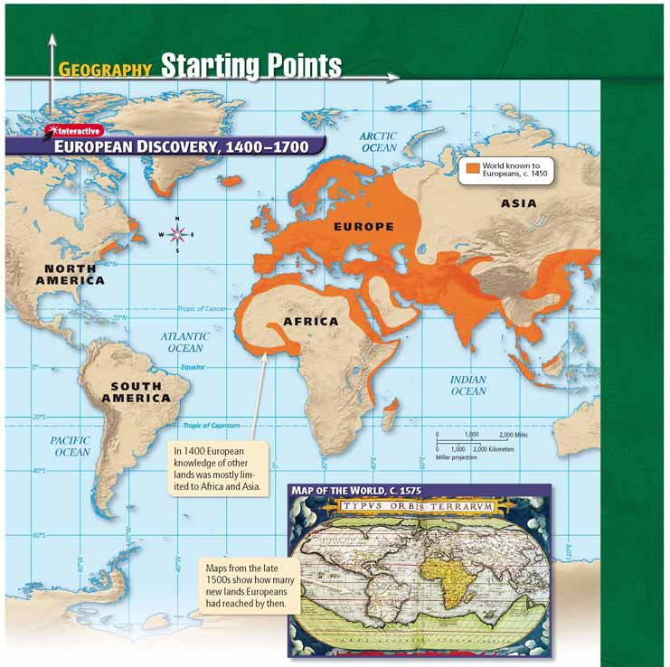

Slide 4
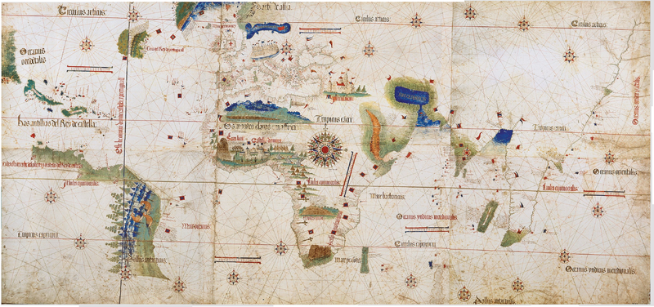

Slide 5
Voyages of Discovery
Main Idea
During the 1400s and 1500s European explorers—inspired by greed, curiosity, and the desire for glory, and aided by new technologies — sailed to many previously unknown lands.

Slide 6
Foundations of Exploration
Renaissance spirit of discovery and innovation in Europe
Spirit led Europeans to set sail on voyages of discovery
Period is sometimes called the Age of Exploration
Drive to Explore
New Routes
Faith, Curiosity
Search for wealth
Europeans desired expensive luxury goods
Flow of goods controlled by Italian merchants – also blocked by Ottoman Empire
Charged high prices for these rare goods
Hoped to find new, faster routes to Asia to gain trade foothold
Wealth not only goal - some set out to find fame, glory
Hoped making great discoveries would bring honor to their names
Other explorers hoped to spread their faith into new lands
Another motive—simple curiosity
Writings like Marco Polo’s very popular in Europe, intrigued many with tales of exotic lands, peoples

Slide 7
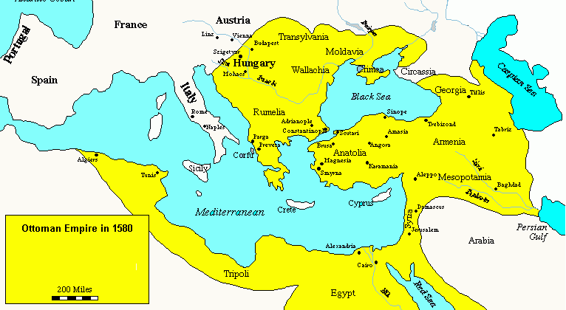

Slide 8
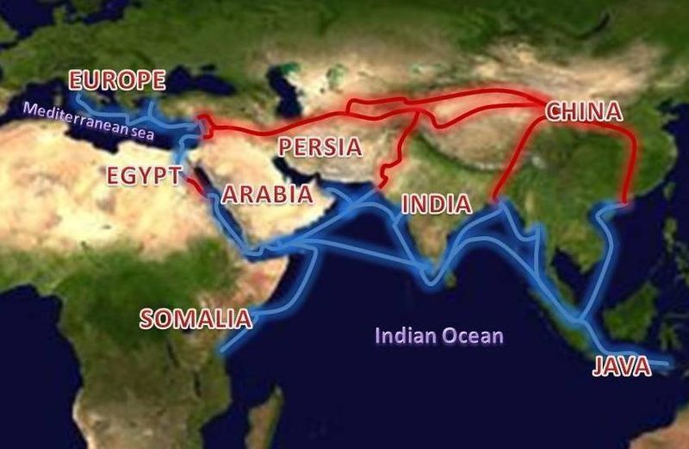
Red: Silk Road; Blue: Eastern Spice Trade

Slide 9
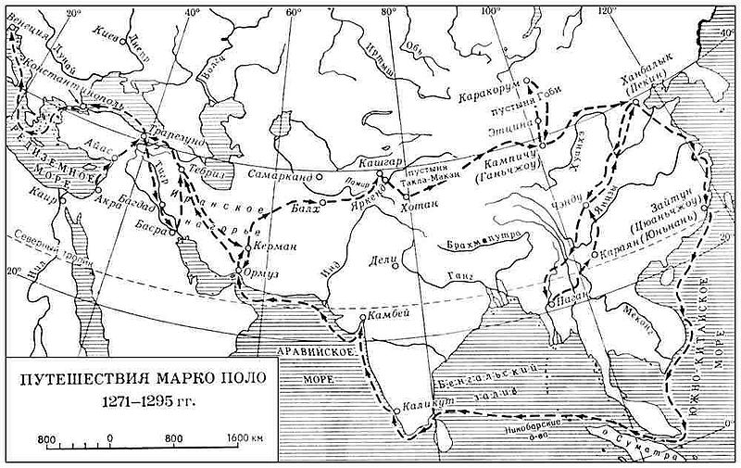

Slide 10
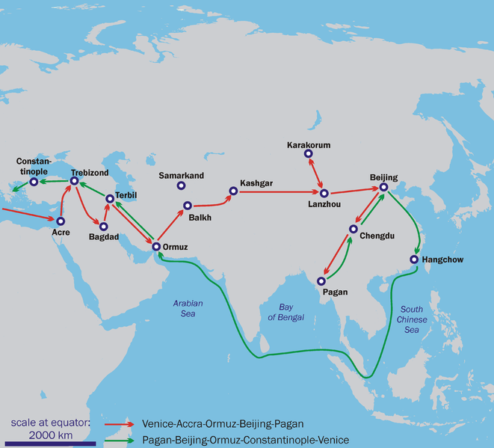

Slide 11
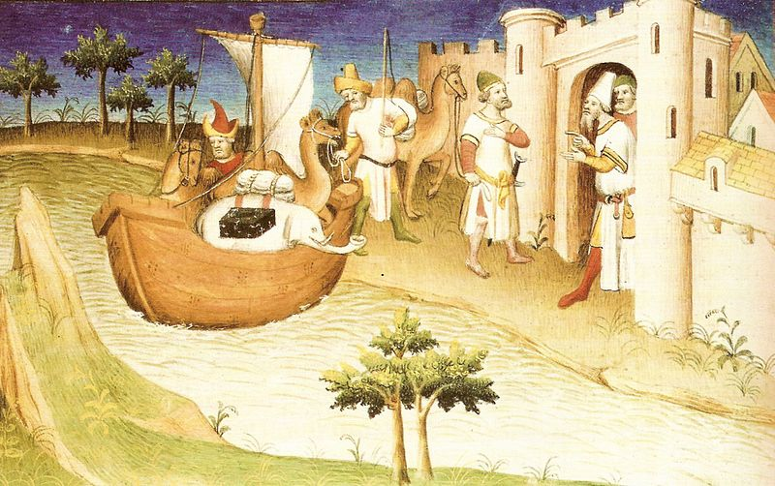

Slide 12
Advances in Technology: Navigation
Sailors needed precise means to calculate location
Compass brought to Europe from China, let know sailors know which direction was north at any time
Europeans learned to use astrolabe from Muslims
Navigators could chart location based on sun, stars in relation to horizon
Advances in Technology: Shipbuilding
Deep-draft ships could withstand heavier waves – rode lower in water and had larger cargo holds
Caravel, light, fast sailing ship; two features made it highly maneuverable: rudder and triangular sails – lateen; equipped with weapons
Maneuverability, defensive ability made caravel most popular for exploring

Slide 13
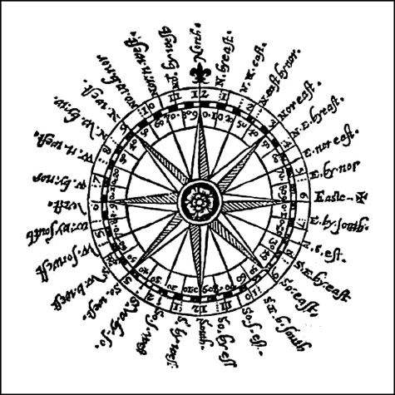
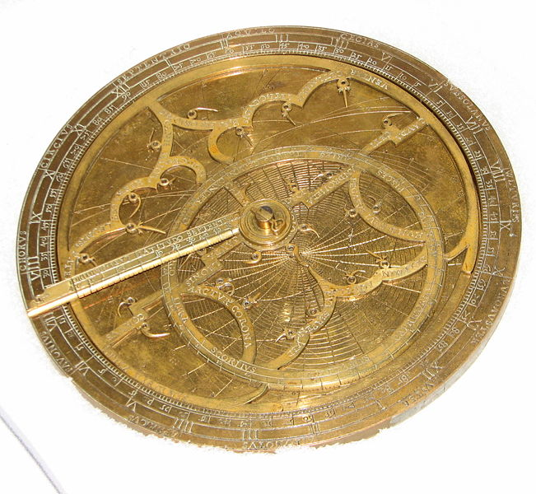

Slide 14
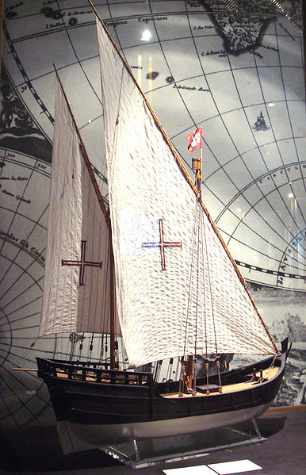
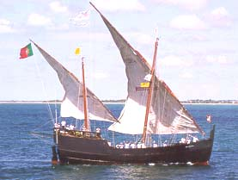
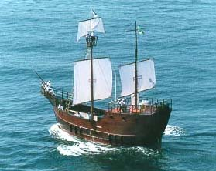

Slide 15
Question:
How did advances in technology spur exploration?
Answer(s): new ships faster and more maneuverable, could better handle sea voyages; navigational instruments allowed for voyages of exploration

Slide 16
Explorers from Portugal and Spain
The Portuguese
The Spanish
First country to launch large-scale voyages of exploration
Prince Henry the Navigator - patron, supporter of those who wished to explore
Early 1400s: established Navigation Court - ultimate goal—find water route around Africa to India - Vasco da Gama (1497–1499)
1488, Bartolomeu Dias became first to sail around southern tip of Africa
Portugal established trading centers; became rich, powerful European nation
1492, Christopher Columbus; 1493, returned to Spain - Spanish believed Columbus found new route to Asia, hailed him as hero
1502 Explorer Amerigo Vespucci sailed coast of South America - not Asia
1513, Núñez de Balboa - Pacific Ocean - Spanish realized they needed to cross another ocean to reach Asia
1519, Ferdinand Magellan set out for Spain with five ships, 250 men
1522, 18 survivors of original fleet arrived back in Spain, first to circum-navigate world

Slide 17
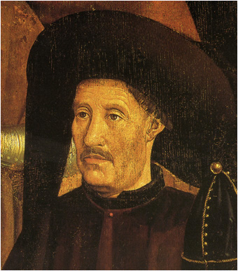
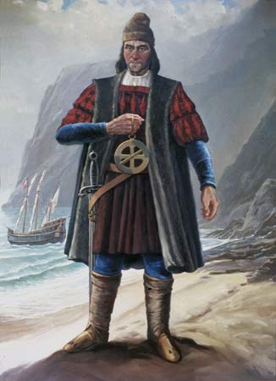
Henry the Navigator and Bartolomeu Dias

Slide 18
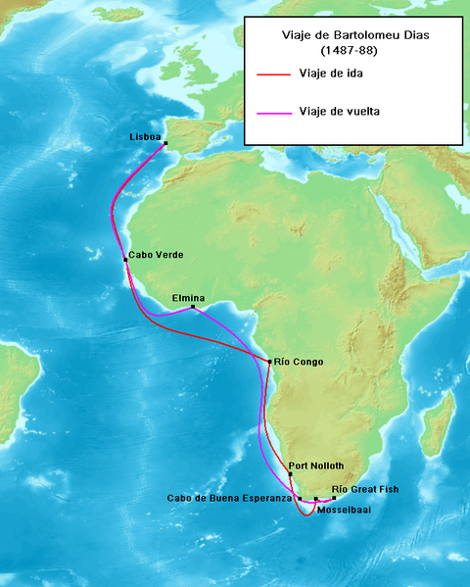

Slide 19
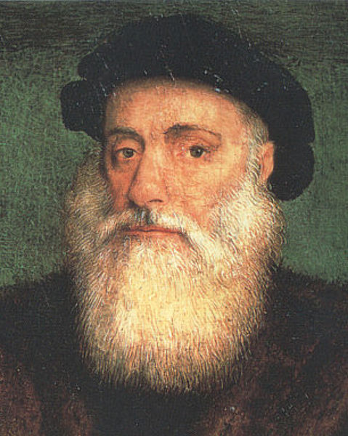
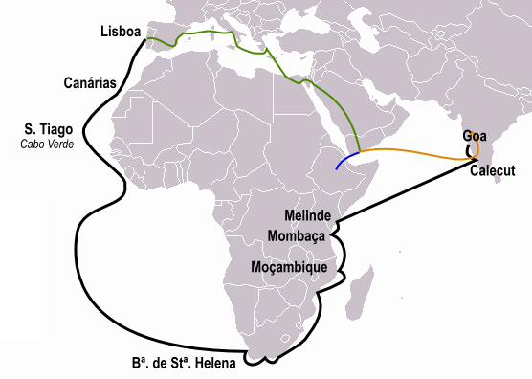
Vasco da Gama

Slide 20
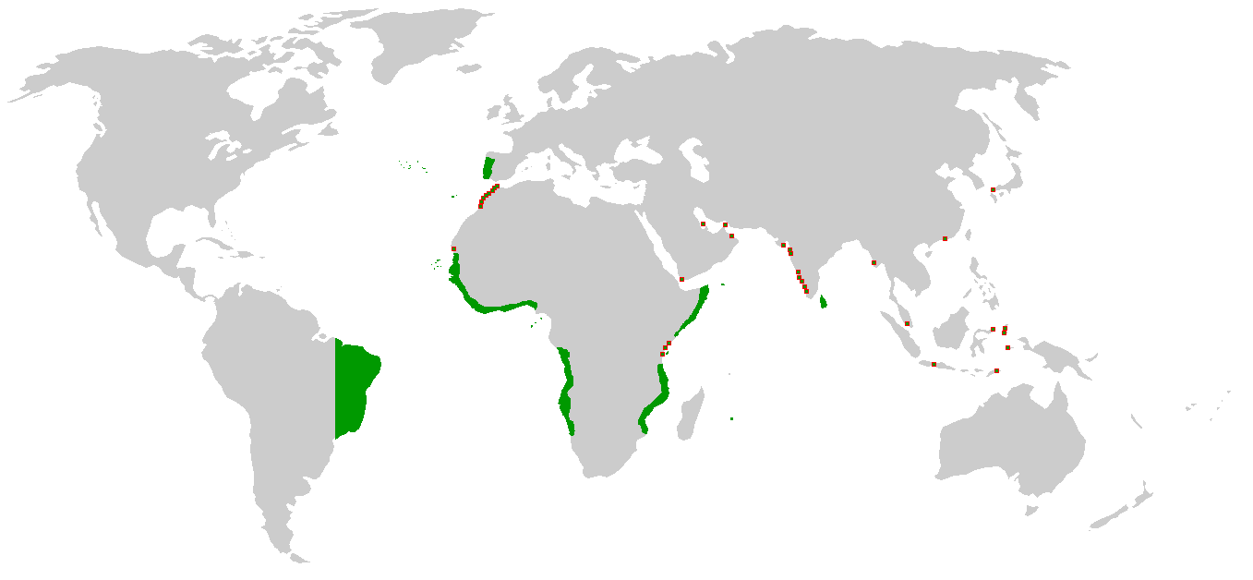
Portuguese Empire

Slide 21
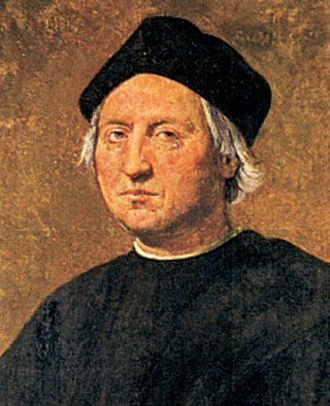
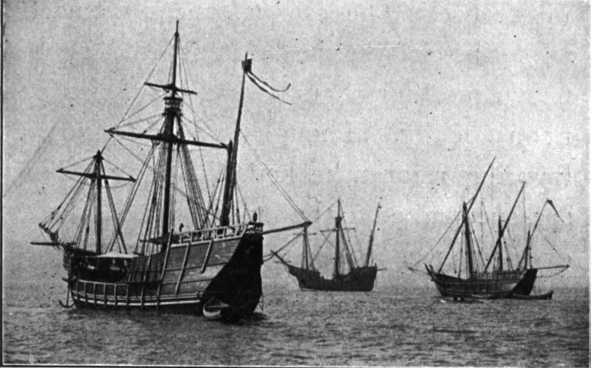
Christopher Columbus
Replicas of Niña, Pinta and Santa Maria

Slide 22
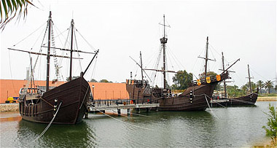

Slide 23
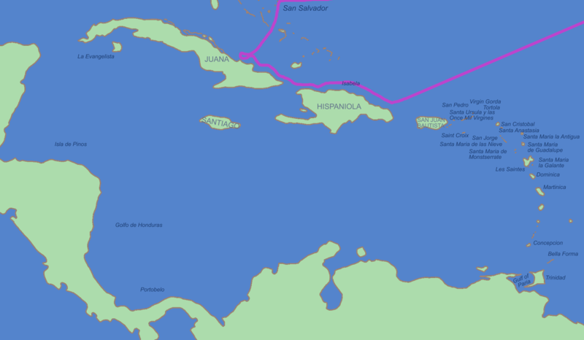
First Voyage

Slide 24
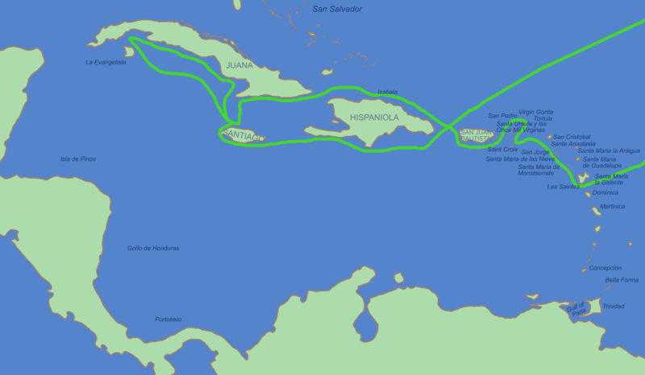
Second Voyage

Slide 25
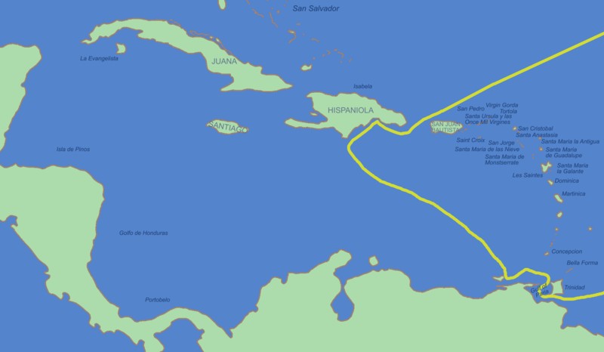
Third Voyage

Slide 26
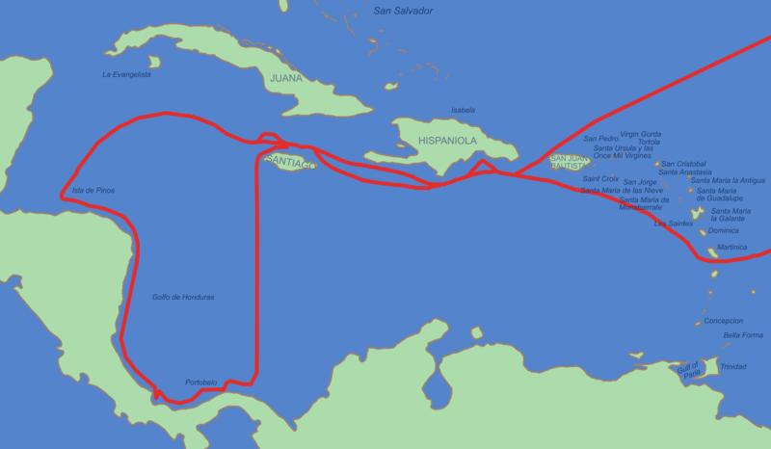
Fourth Voyage

Slide 27
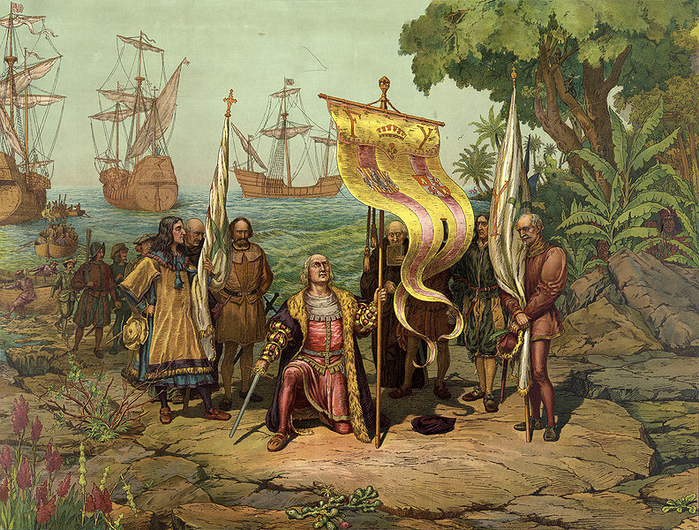

Slide 28
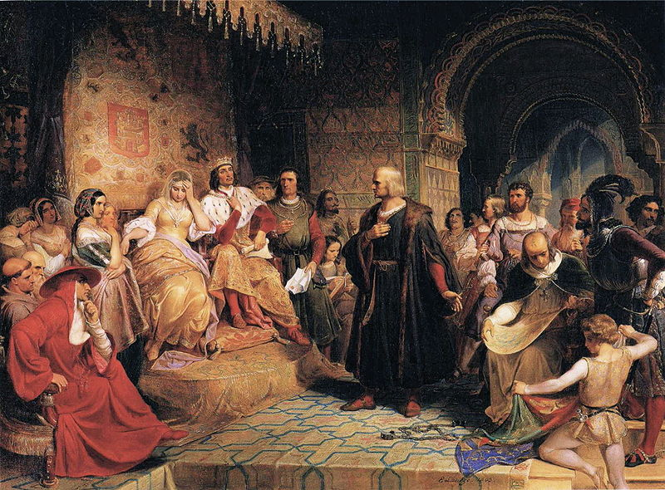

Slide 29
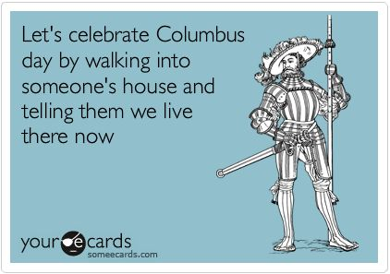

Slide 30
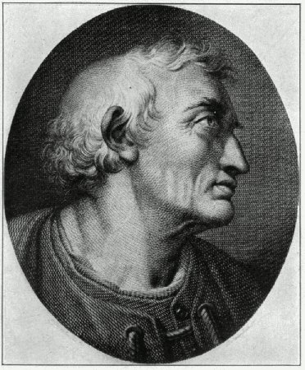
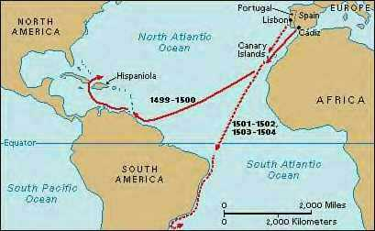
Amerigo Vespucci

Slide 31
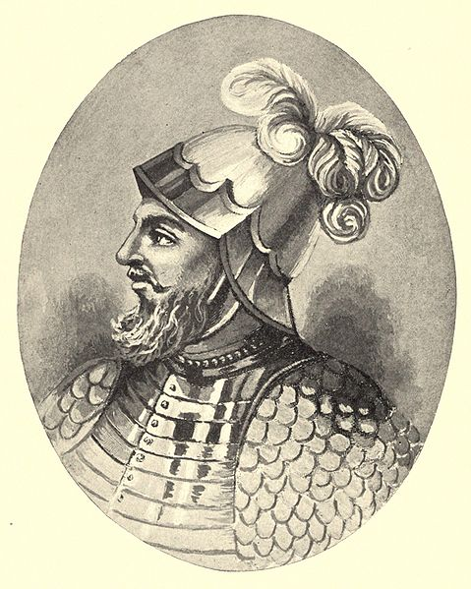
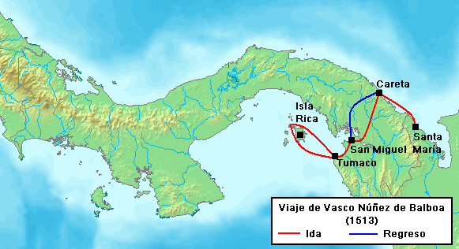
Núñez de Balboa

Slide 32
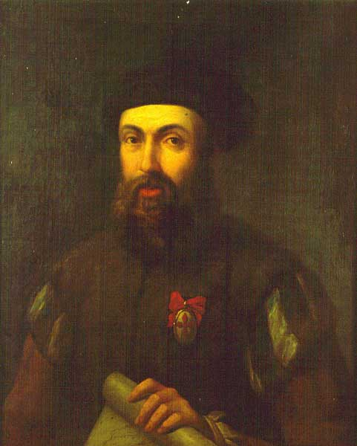
Ferdinand Magellan

Slide 33
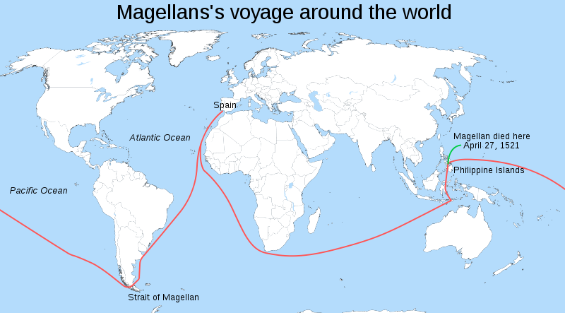

Slide 34
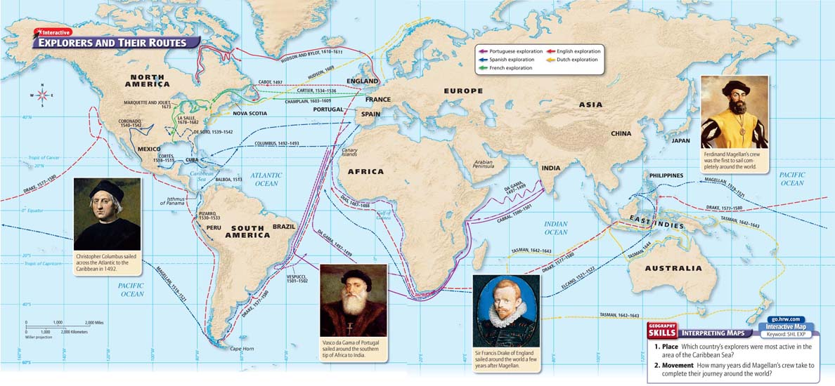
Explorers and their Routes
Chapter 16, section 1, pages 472-473

Slide 35
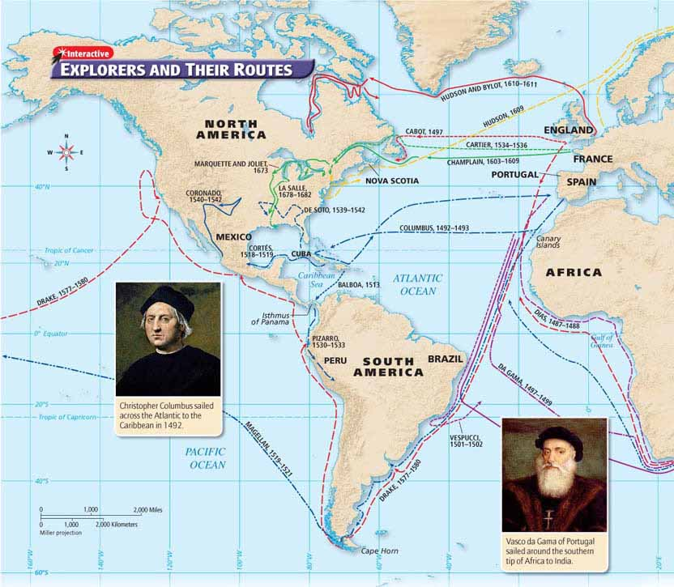

Slide 36
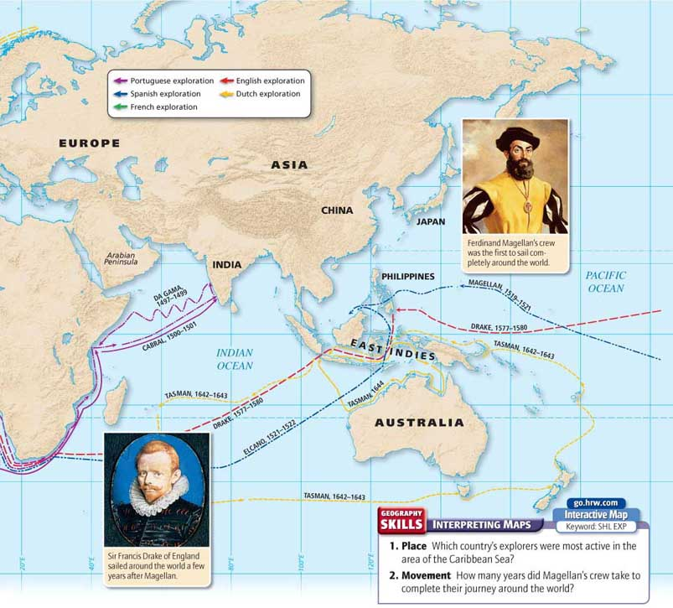

Slide 37
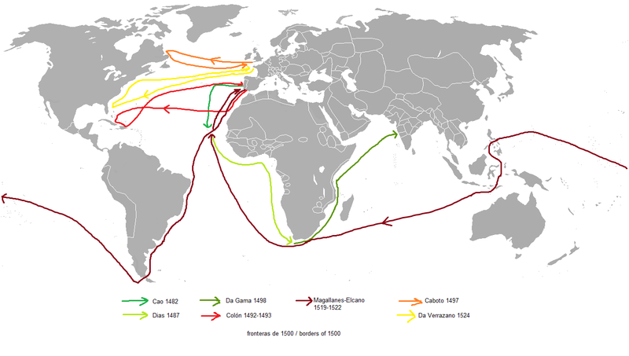

Slide 38
Question:
What did da Gama, Columbus, and Magellan accomplish?
Answer(s): da Gama—reached India via sea; Columbus—landed in the Americas; Magellan—circumnavigated the earth

Slide 39
Explorers from the Rest of Europe
By early 1500s the English and French were exploring northern parts of the Americas; Dutch later joined in explorations.
The English
The French
1497, first major English voyage of discovery launched
John Cabot sailed to Atlantic coast of what is now Canada
1577, Sir Francis Drake – sailed north to seek route around North America
Weather too cold, headed west around the world to get back to England - second man to circumnavigate the globe
1607, Henry Hudson and Northwest Passage
Sent explorers to look for Northwest Passage
1534, Jacques Cartier sailed past Newfoundland into St. Lawrence River, claimed land as province of New France, now Canada
The Dutch
By 1600s Netherlands powerful trading nation, hoped to find new products, trading partners

Slide 40
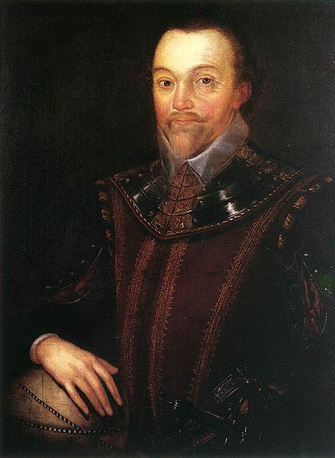
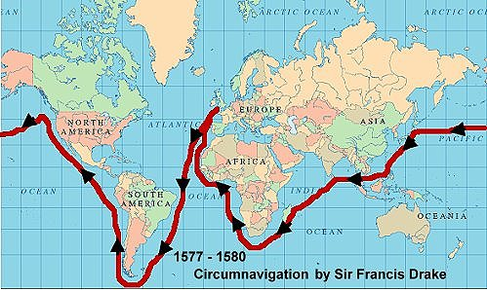
Sir Francis Drake

Slide 41
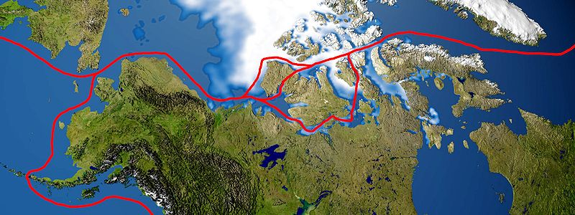
Northwest Passage

Slide 42
Question:
What did English, French, and Dutch explorers hope to find?
Answer(s): a shorter route to Asia

Slide 43
Conquest and Colonies
Main Idea
The countries of Europe established colonies in the lands they had discovered but, in some cases, only after violently conquering the native people who lived there.

Slide 44
Spain Builds an Empire
Scramble to establish colonies and empires in new lands
Spain first to successfully settle in the Americas
Spain in Caribbean
Encomienda
The Conquest of Mexico and Peru
First areas settled by Spanish, Caribbean islands, Hispaniola, Cuba
Columbus hoped to find gold, did not
Spanish introduced encomienda system
Colonist given land and Native Americans to work the land
Required to teach native workers about Christianity
Mistreatment, overwork, and diseases took toll on population
1519, Hernán Cortés , led expedition to Mexico, ended with conquest of Aztecs
10 years after conquest of Aztecs, Francisco Pizarro led expedition to Peru and conquered the Incan Empire

Slide 45
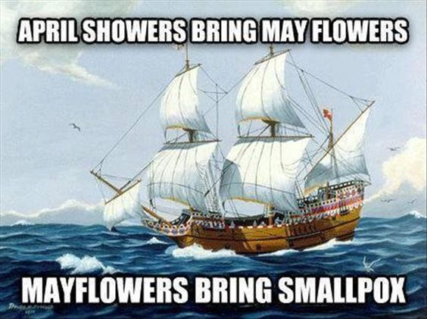

Slide 46
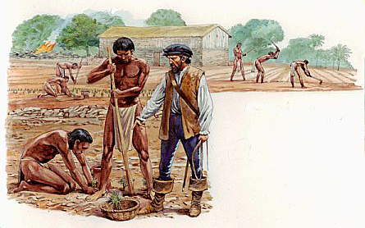
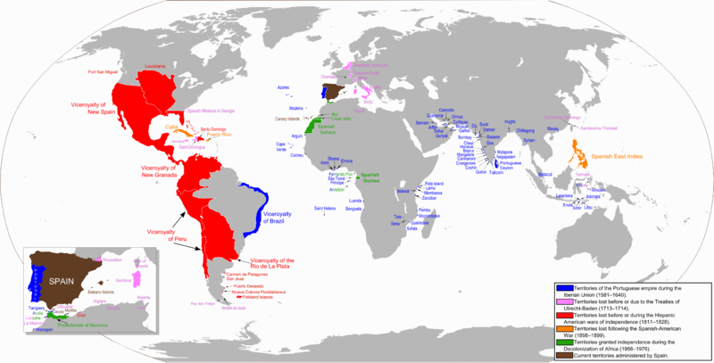

Slide 47
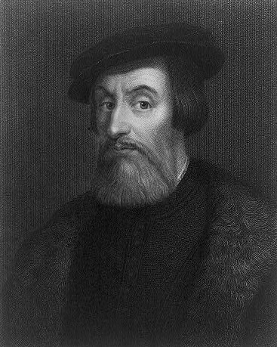
Hernán Cortés

Slide 48
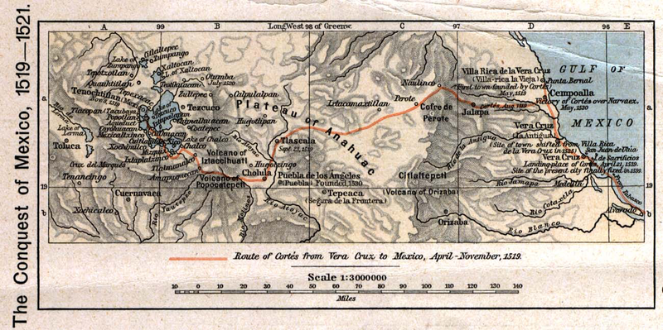

Slide 49
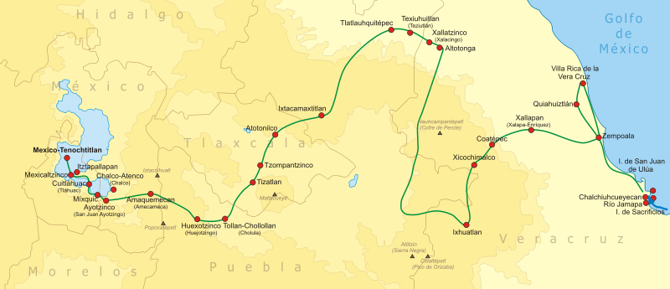

Slide 50
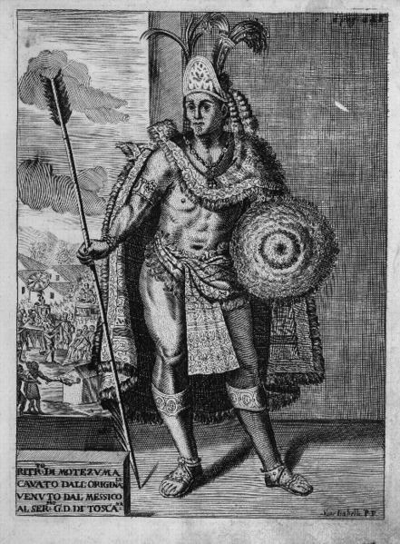
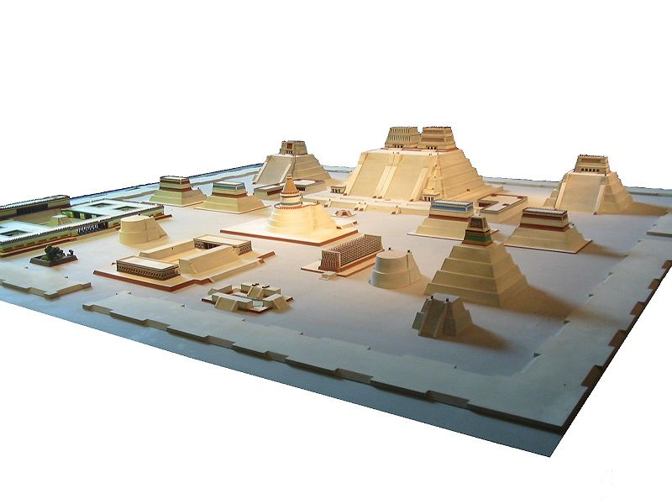

Slide 51
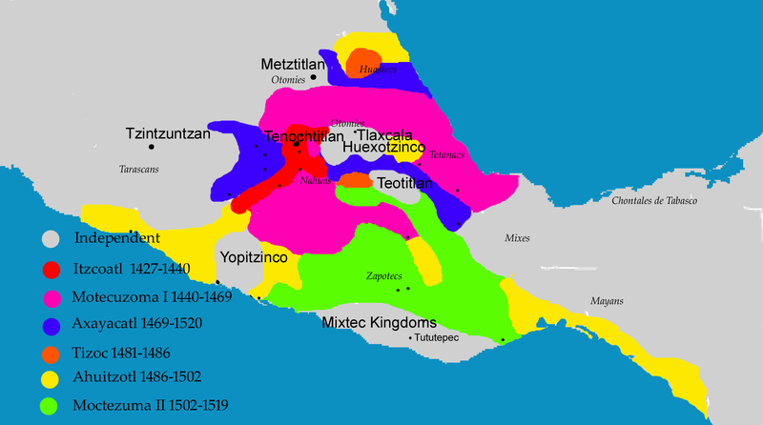

Slide 53
Francisco Pizarro

Slide 56
Spanish Empire

Slide 57
Portuguese Empire

Slide 58
Question:
How did the Spanish create an empire in the Americas?
Answer(s): conquered Aztec and Inca empires

Slide 59
French, Dutch, and English Colonies in the Americas
Silver and gold from American colonies began to circulate in Europe. Leaders in France, England, and the Netherlands decided that they needed to establish colonies in the Americas.
New France
Dutch and New Netherland
French explorers established colonies in New France (Canada)
Hoped this would be a rich source for gold, silver – found fish, furs
Little colonization – traders
1608, Samuel de Champlain founded city of Quebec
1682, René-Robert La Salle Mississippi and Louisiana
New Netherland did not grow - focused on developing colonies in other parts of world
Other colonies more profitable - Caribbean sugar, Asian spices more valuable

Slide 61
The English Colonies
1607, first English colony established at Jamestown - Settlers hoped to find gold, silver, river route to Pacific
Instead found marshy ground, impure water
80% of settlers died during first winter in America - Colony still endured
Pilgrims
British-French Conflict
1620, Pilgrims sailed from England - persecuted for religious beliefs
Established colony at Plymouth, Massachusetts
Colony self-sufficient within 5 years
Jamestown, Plymouth colonies received aid from local peoples – despite aid, Native American viewed with distrust
Mid-1700s, English colonists attempted to settle in French territory, upper Ohio River valley; 1754 – French and Indian War
French eventually surrendered, yielded Canada, all French territory east of Mississippi
War costly for British – king tried to tax colonists – led to American Revolution

Slide 64
“Our life’s a stage, a comedy: either learn to play and take it lightly, or bear its troubles patiently.” - Palladas There are twice as many kangaroos in Australia as there are people. The kangaroo population is estimated at about 40 million.

Slide 65
New Patterns of Trade
Main Idea
The creation of colonies in the Americas and elsewhere led to the exchange of new types of goods, the establishment of new patterns of trade, and new economic systems in Europe.

Slide 66
The Columbian Exchange
Voyages launched large-scale contact between Europe and Americas.
Contact between the two groups led to the widespread exchange of plants, animals, and disease—the Columbian Exchange.

Slide 67
Effects of the Columbian Exchange
Different Foods
Exchange of foods, animals had dramatic impact on later societies
Over time crops native to Americas became staples in diets of Europeans
New foods provided substantial nutrition, helped people live longer
Texas cattle ranching, Brazilian coffee, and by late 1600s, tomatoes (poisonous?) in Italian cookbooks
Effects Widespread
China: Arrival of easy-to-grow, nutritious corn helped population grow tremendously; main consumer of silver mined in Americas
Africa: Two native crops of Americas—corn, peanuts
Scholars estimate 1/3 of all food crops grown in world are of American origin
Introduction of new diseases in the Americans: Smallpox, measles, influenza, malaria killed millions – no natural resistances, devastated native population

Slide 69
New World native plants. Clockwise, from top left: 1. Maize 2. Tomato 3. Potato 4. Vanilla 5. Pará rubber tree 6. Cacao 7. Tobacco

Slide 70
Old World native plants. Clockwise, from top left: 1. Citrus 2. Apple 3. Banana 4. Mango 5. Onion 6. Coffee 7. Wheat 8. Rice

Slide 71
Question:
What were two lasting effects of the Columbian Exchange?
Answer(s): possible answers—changes in cuisine, changes in crops grown around the world, epidemics

Slide 72
Mercantilism
New Economic Policy
Balance of Trade
1500s, Europeans developed new economic policy, mercantilism
Nation’s strength depended on its wealth - wealthy nation had power for military and expanded influence
Wealth measured by amount of gold, silver possessed by nation
Mercantilists believed there was fixed amount of wealth in world
Mercantilism led to intense competition between nations
Mercantilists built wealth two ways—extract gold, silver from mines at home, colonies; sell more goods than it bought from foreign countries = favorable balance of trade
Favorable balance of trade - country received more gold, silver from other nations than it paid to them - increased its power; weakened foreign competitors
Tariffs on imports; encouraged exports that could sell for higher prices than raw materials; controlled sources
Building colonial empires essential to mercantilist system – control of resources

Slide 75
Question:
What were the main principles of mercantilism?
Answer(s): nation's strength depended upon its wealth; needed a favorable balance of trade

Slide 76
The Rise of Capitalism
Increasing trade between Europe and colonies created new business and trade practices during the 1500s and 1600s. These practices would have a great impact on the economies of European nations.
Capitalism Emerges
Rising Prices
Money Supply
During this time, capitalism expanded: economic activity carried on by private individuals, organizations in order to seek profit
Overseas trade made many merchants rich – investment in more business/business activity increased greatly
Investors took risks of investing in overseas trade because of inflation
Demand for goods increased due to growing population, scarcity of goods; rising demand drove prices higher
Increase of money supply another factor in higher prices
Gold, silver from Americas made into new coins
Over time, increase of money in circulation pushed prices for goods still higher

Slide 77
A New Business Organization
New Ventures
Overseas business ventures often too expensive for individual investors
Investors began pooling money in joint-stock companies
Joint-Stock Companies
Investors bought shares of stock in company
If company made profit, each shareholder received portion
Shares
Profit, loss based on number of shares owned
If company failed, investors lost only amount invested
Financing Colonies
British East India Company, one of first joint-stock companies
1600, imported spices from Asia
Others formed to bear cost of establishing colonies

Slide 79
Question:
Why did new business practices develop in Europe?
Answer(s): because of increasing trade between Europe and its colonies

Slide 80
The Atlantic Slave Trade
Main Idea
Between the 1500s and the 1800s millions of Africans were captured, shipped across the Atlantic Ocean, and sold as slaves in the Americas.

Slide 81
Origins of the Slave Trade and Trade Network
Shortage of labor in Americas led to beginning of Atlantic slave trade – laborers needed for plantations
Planters first used Native Americans; European diseases killed millions
1600s, used indentured servants – expensive
Eventually, slaves taken from coast of west Africa - some exchanged for firearms, goods; others kidnapped on raids by traders
Captured Africans became part of network called the triangular trade
First leg of triangle, ships carrying European goods to Africa to be exchanged for slaves
Second leg, Middle Passage, brought Africans to Americas to be sold
Third leg carried American products to Europe
Some slave traders from Americas sailed directly to Africa, not following triangular route

Slide 87
Slavery in the Colonies
Spanish—Caribbean sugar plantations; Portuguese—Brazil; English—West Indies but also to colonies in North America.
England dominated the slave trade by end of 1600s
Most worked on plantations; some in mines, towns, or countryside; women given domestic duties; skilled craft workers continued crafts in Americas
Laws in Americas considered enslaved Africans to be property - slaves had no rights, freedoms
Resistance
Slaves coped with inhumane conditions many different ways
Tried to keep cultural traditions alive, others turned to religion, slow work, destroyed equipment, revolted, and flee - est. communities of runaways
As result of slave trade, people of African descent and their culture spread throughout Americas, Western Europe - African Diaspora

Slide 88
Question:
Why did many slaves fight back against their owners?
Answer(s): to cope with inhumane conditions

