Slide 1
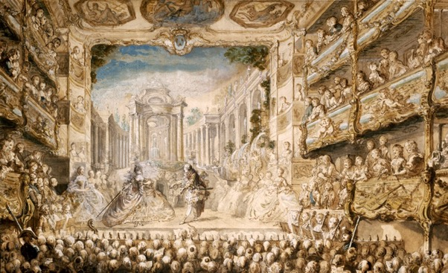
Period 2: 1648 CE – 1815 CE
European Society

Slide 2
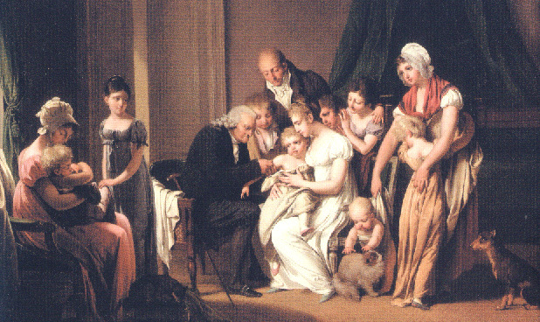
Population Changes
By the 1700s, the plague had disappeared as a major
epidemic and smallpox inoculations meant far more
children survived till adulthood
De-emphasis on religion increased premarital sex and
illegitimate births, however, Romanticism changed
marriage patterns as arranged marriages decreased
Marrying for love actually delayed most marriages, resulting
in having kids later in life and usually less of them
Additionally, early birth control began to be used more frequently with increased sexual activity (infanticide, killing nurses, abortions)

Slide 3
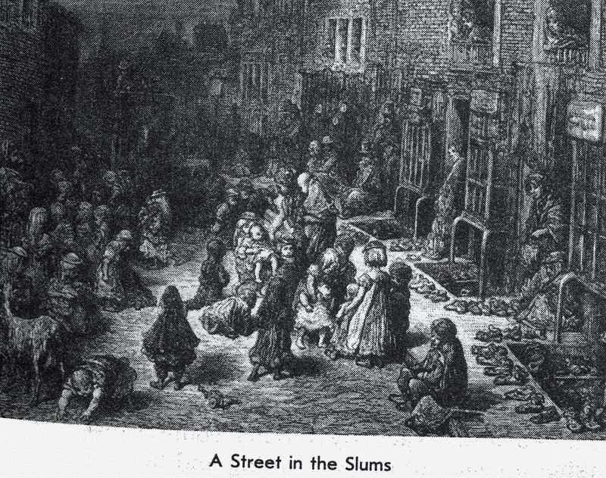
Urban Issues
The growth of cities eroded traditional communal values, and city governments
strained to provide protection and a healthy environment
Additionally, the close sense of community and closeness of rural
peasants disappeared in a more impersonal and alienating urban setting
This created the need for a city and county police forces as crime & population grew too fast for most cities to handle
The concentration of poor in cities led to a greater awareness of poverty, and prostitution as social
problems, and new laws were passed in response to rapidly growing urban poverty, crime, and prostitution
The New Poor Law in 1834 formed Poor Law Unions and the building of workhouses in each union
for the giving of poor relief that was paid for by a ‘poor rate’ tax on the property-owning middle classes
The Contagious Diseases Acts were passed in 1864 which allowed police officers to arrest women suspected of being prostitutes in certain ports and army towns; the women were then subjected to compulsory checks for venereal disease
If a woman was declared to be infected, she would be confined in what was known as a lock hospital (hospital
dedicated to treating sexually-transmitted diseases) until she recovered or her sentence finished

Slide 4
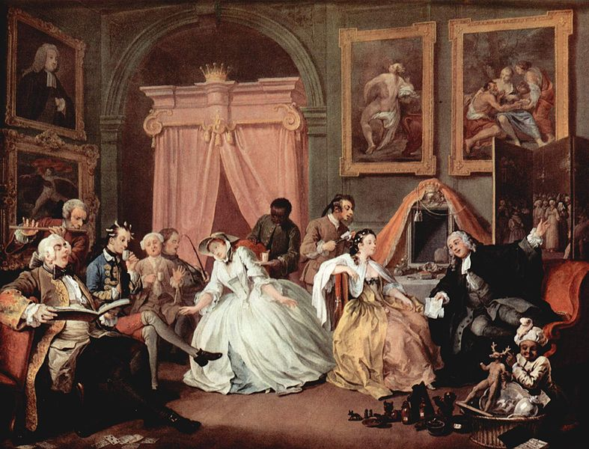
Modern Era Society
As commercial wealth increased, families dedicated more space
and resources to children (tutors), child-rearing and private comforts
The upper class would frequent coffeehouses, theaters and
opera houses (during the day)
Homes became new venues for leisure activities, such as novel
reading and private emotion and reflection
Make-up, mirrors, wigs, and cosmetics became popular, and symbols of wealth and power in the 18th century
Culturally, despite the Scientific Revolution, some old ideas persisted, such as the field of alchemy. While figures such as Paracelsus—the father of modern toxicology—had established the field in the Early Modern Era, key figures such as Isaac Newton still looked to the potions and mixtures of alchemy for answers
While not upheld as a field across time, alchemy played a foundational
role in human understanding of toxicology and many natural chemicals

Slide 5
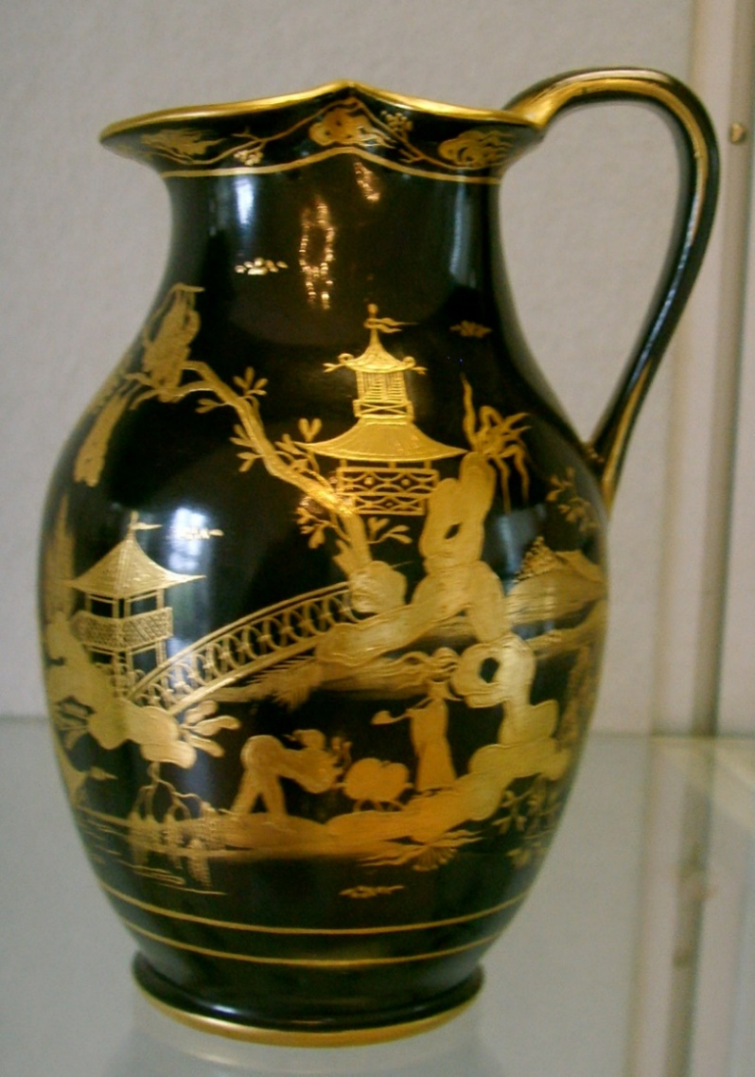
Exposure to Other Cultures
During the late 18th century, the Enlightenment quest for natural scientists to categorize all knowledge expanded beyond Europe itself
Carl Linnaeus began to categorize various species of plants, and later animals, with his taxonomic system
This resulted in many natural scientists exploring and recording discoveries across the world, which made their way back to a fascinated Europe
Additionally, scientists and explorers began to log and track various people and cultures outside of Europe, that equally fascinated Europeans
It became popular for the wealthy to purchase art and decorations inspired by Chinese style (chinoiserie), along with greater demand for tea and silk

