Slide 1
Enlightenment Thinkers Locke, Hobbes, and Rousseau
Mrs. Braun
Unit 4

Slide 2
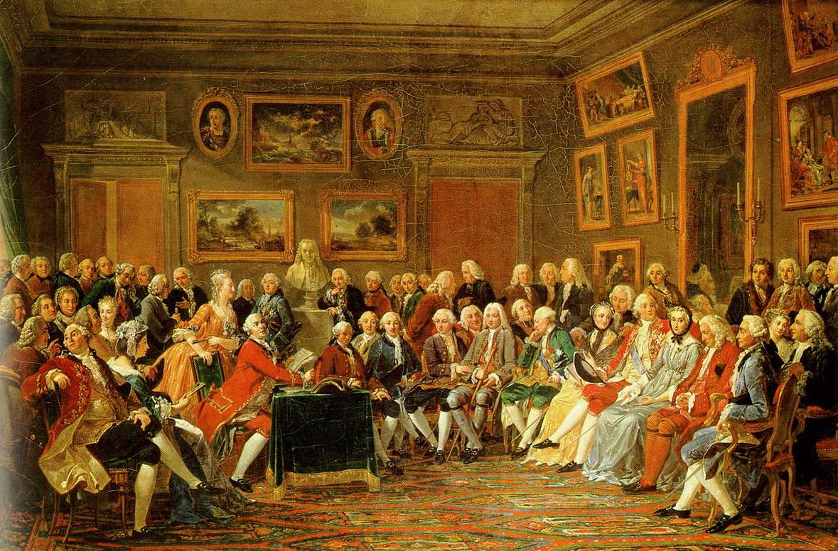
The Beginning of the Enlightenment
Early 1700’s
Every social, political and economic problem could be solved through the use of reason

Slide 3
Major Enlightenment Ideas
Governments are created to secure an orderly society
Separation of powers
All men are created “free and equal”
A free market

Slide 4
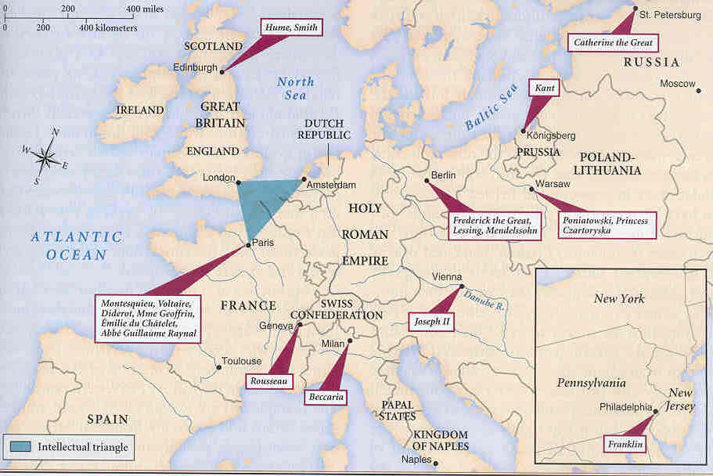
The Spread of the Enlightenment

Slide 5
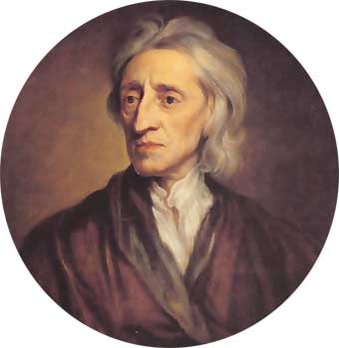
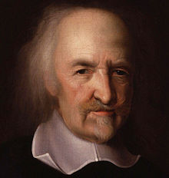
Enlightenment Thinkers
John Locke
Thomas Hobbes

Slide 6
Social Contract
Thomas Hobbes
John Locke
Humans are naturally cruel, greedy and selfish.
To escape this “brutish” life people entered into a social contract.
Only a powerful government could ensure an orderly society.
Believed only an absolute monarchy could keep a society completely orderly.
Religious Tolerance
Humans are naturally reasonable, moral and good
Humans have natural rights: life liberty and property
People form governments to protect natural rights
Best government was one with limited power
If a government violates people’s natural rights, people have the right to overthrow government
Religious tolerance of Christians

Slide 7
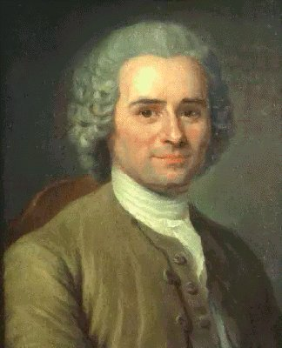
Jean Jacques Rousseau
believed politics and morality are not separate
he is considered an opponent of the Enlightenments emphasis on reason
rely more on instinct and emotion
government is a contract between the ruler and citizens
wrote The Social Contract

Slide 8
Enlightenment and the Economy
Physiocrats were Enlightenment
thinkers who focused on economic reforms
Laissez-Faire: allowing business to operate with little or no government interference

