Slide 1
The Enlightenment Spreads
Chapter 6, Section 3

Slide 2
Baroque Music
Representative Composers
Antonio Vivaldi
Johann Sebastian Bach
George Friedrich Handel

Slide 3
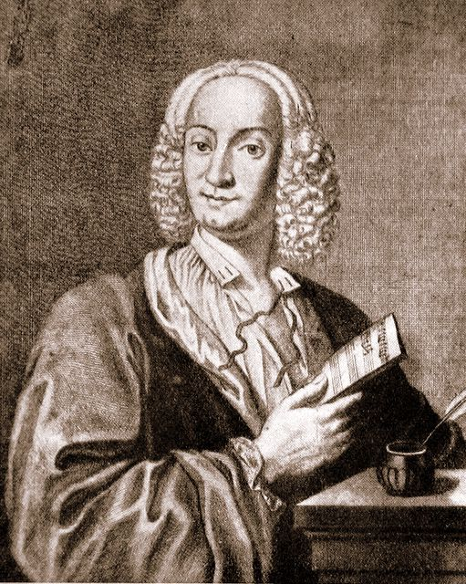
Antonio Vivaldi (1678-1741)
Representative Works
Most famous work Le quattro stagioni (The Four Seasons) written in 1723.
46 operas
76 sonatas
Chamber music
Sacred music

Slide 4
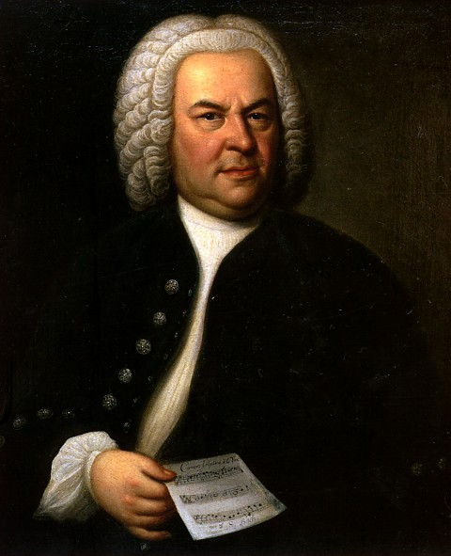
Johann Sebastian Bach (1685-1750)
Representative Works
cantatas
chorales
organ works
lute music
chamber music
canons and fugues
Famous piece: “Jesu Joy of Man’s Desiring”

Slide 5
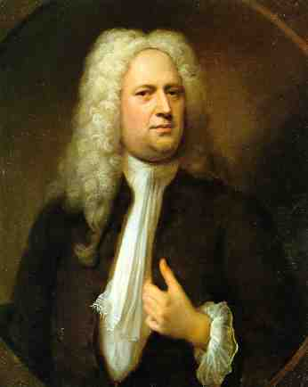
George Frederick Handel (1685-1759)
Representative Works
42 operas
29 oratorios
120 cantatas, trios, duets
numerous arias
chamber music
Most famous work: Messiah oratorio traditionally performed during the Christmas season, including “Hallelujah Chorus”.

Slide 6
Classical Music
Representative Composers
Joseph Haydn
Wolfgang Amadeus Mozart
Ludwig van Beethoven

Slide 7
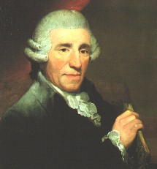
Joseph Haydn (1732-1809)
Known as “Father of the Symphony” and “Father of the String Quartet”
Representative Works
104 Symphonies
numerous concertos for various instruments
15 operas
other music

Slide 8
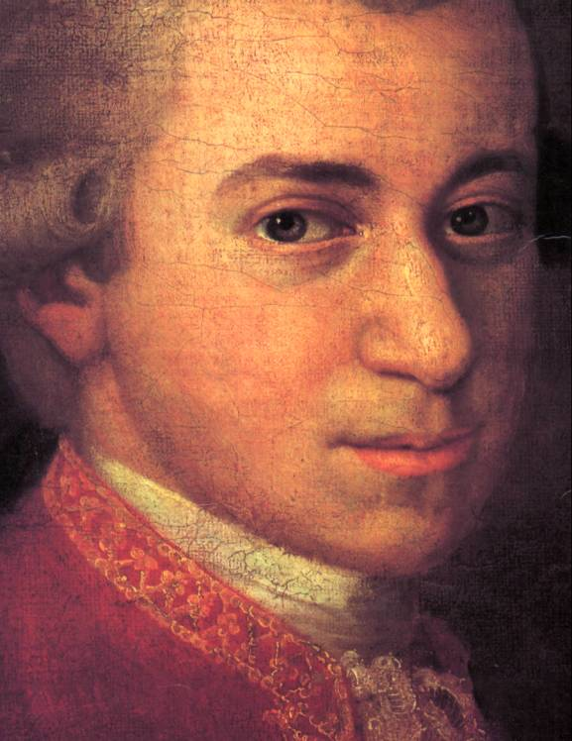
Wolfgang Amadeus Mozart (1756-1791)
Representative works
23 operas
numerous symphonies
“Toy Symphony”
concertos
“Flute concerto no. 2 in D Major, K 314”
piano music
chamber music
sacred music
masses

Slide 9
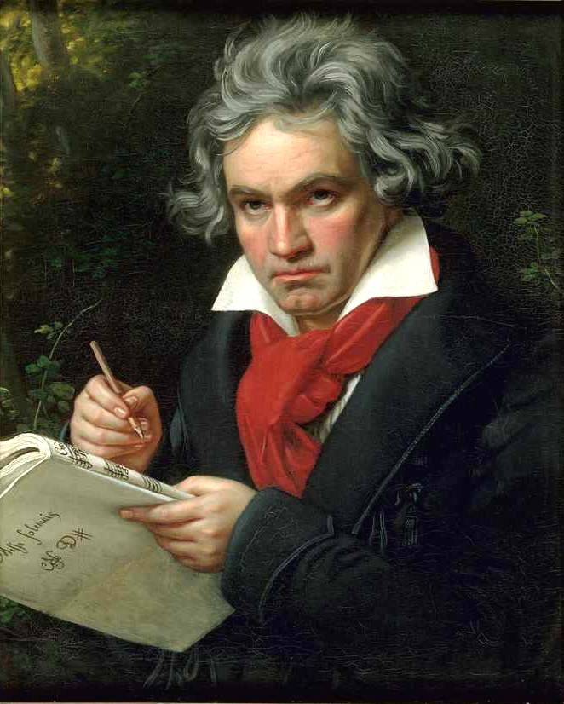
Ludwig van Beethoven
Representative Works
Symphonies (5th and 9th probably the most famous)
Piano music
“Fur Elise”
Vocal music
Operas
Choral music

Slide 10
Enlightened Despots
Frederick II (the Great) of Prussia
Joseph II of Austria
Catherine II (the Great) of Russia

Slide 11
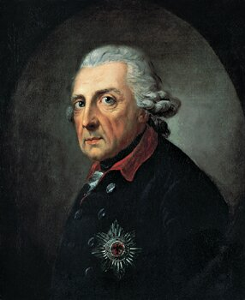
Frederick II (the Great) of Prussia
Ruled Prussia from 1740 to 1786; granted religious freedoms, reduced censorship, improved education

Slide 12
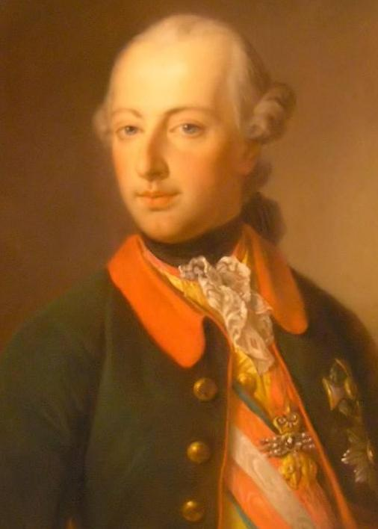
Joseph II of Austria
Religion
Joseph II had the most progressive policy of religion toleration in all of Europe. He granted toleration toward Jews as well as Protestants. His anti-clerical and liberal innovations provoked a visit from the Pope Pius VI in 1782. Joseph showed himself a good Catholic, but was not persuaded to change his liberal positions on religion.
The Arts
He was known as the “musical king.” He was a huge patron of composers. He is featured prominently in the movie Amadeus, the fictionalized biography of Mozart.

Slide 13
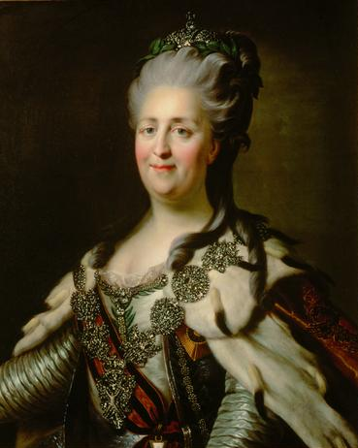
Catherine II (the Great) of Russia
Ruled Russia from 1762 to 1796; put in place limited reforms; vastly enlarged the Russian empire

Slide 14
Diderot’s Encyclopedia
Diderot began to publish a series of books in 1751 that were compilations of articles from leading scholars. Even though the French government and the Catholic Church censored the Encyclopedia, it was responsible for spreading Enlightenment ideas all over Europe.

Slide 15
Neoclassical Style
Neoclassical art began to replace baroque art during the late 1700s. Neoclassical art followed a simple and elegant style that drew on ideas from classical Greece and Rome.

Slide 16
Changes in music during the Enlightenment
Classical music, with a new, lighter style, emerged during the Enlightenment. Haydn, Mozart, and Beethoven were three classical composers from Austria.

Slide 17
Changes in literature during the Enlightenment
Eighteenth century writers began writing novels, lengthy works of prose fiction. Pamela, by Samuel Richardson, is often considered the first English novel.

Slide 18
Enlightened despots
Enlightened despots supported the ideas of the philosophes and made enlightenment reforms. Europe’s most important enlightened despots included Frederick II of Prussia, Joseph II of Austria, and Catherine the Great of Russia.

Slide 19
Frederick II
Ruled Prussia from 1740 to 1786; granted religious freedoms, reduced censorship, improved education

Slide 20
Catherine the Great
Ruled Russia from 1762 to 1796; put in place limited reforms; vastly enlarged the Russian empire

